Slide 1
Special Considerations in Caring for Adolescents, Young Adults, and Women
Sarah M. Bagley, MD, MSc
Assistant Professor of Medicine and Pediatrics
Medical Director, CATALYST Program
Grayken Center for Addiction
Boston University School of Medicine/Boston Medical Center
May 11, 2021

Slide 2
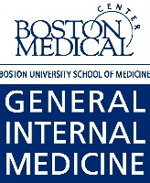
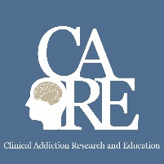
Disclosure Information
Sarah M. Bagley, M.D., MSc.
Nothing to disclose

Slide 3
Why are we talking about this?
Addiction is a disease of pediatric onset
What happens in childhood/adolescence affects how our adult patients present in adult care
Pregnancy and parenthood present unique opportunities and barriers to care

Slide 4
Learning Objectives
Describe the current trends in adolescent and young adult substance use and treatment
Identify 2 opportunities and 2 barriers to provide evidence-based addiction care for adolescents and young adults
Discuss the epidemiology of alcohol and other drug use in pregnancy

Slide 5
#1 Describe the current trends in adolescent and young adult substance use and treatment

Slide 6
Early Onset Matters!
Long term risk: development of substance use disorders
AND
Youth who use alcohol and other drugs engage in other risky behaviors

Slide 7
Prevalence and kinds of drug use different
Teens (12 -- 17 y/o)
Monitoring the Future, 2019

Slide 8
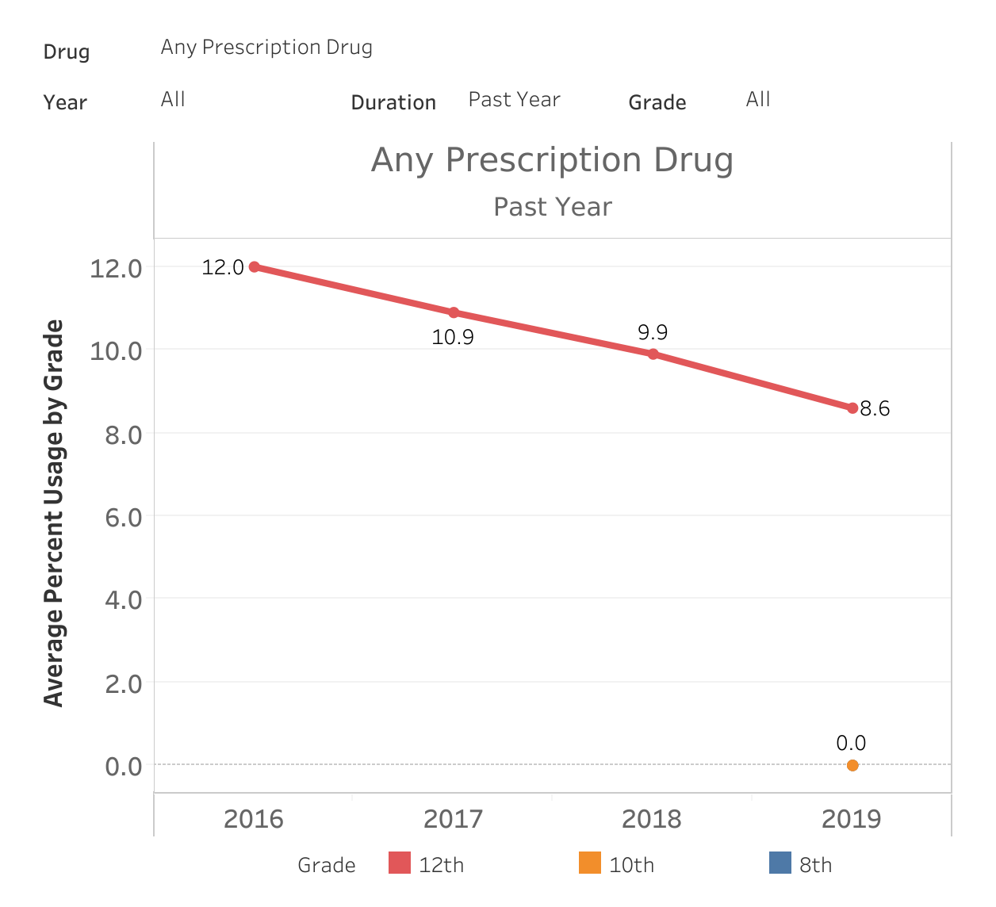
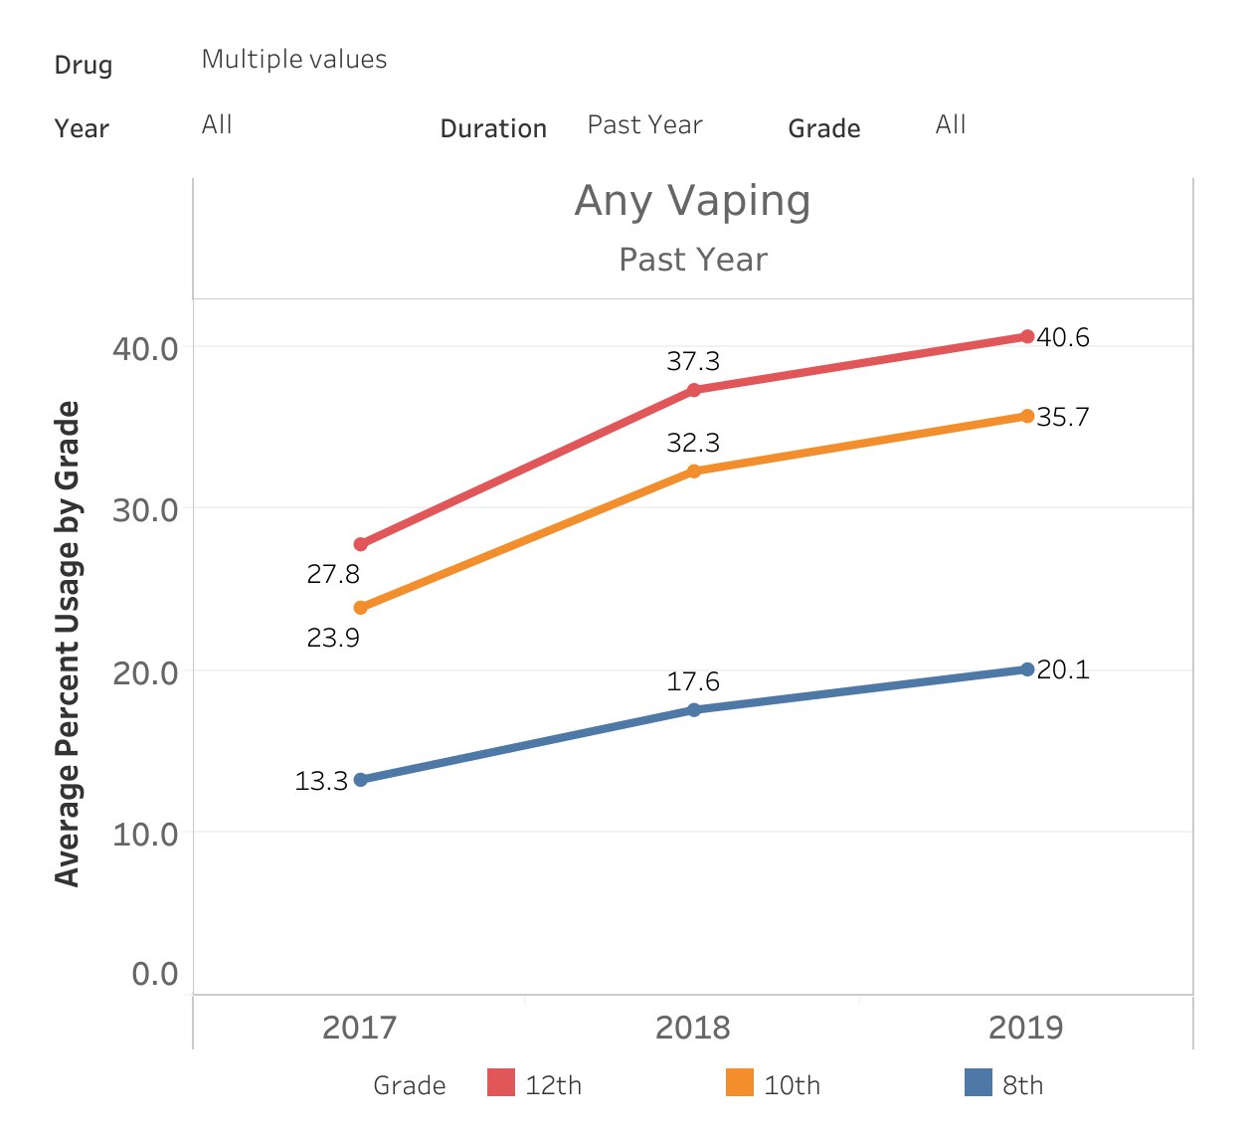
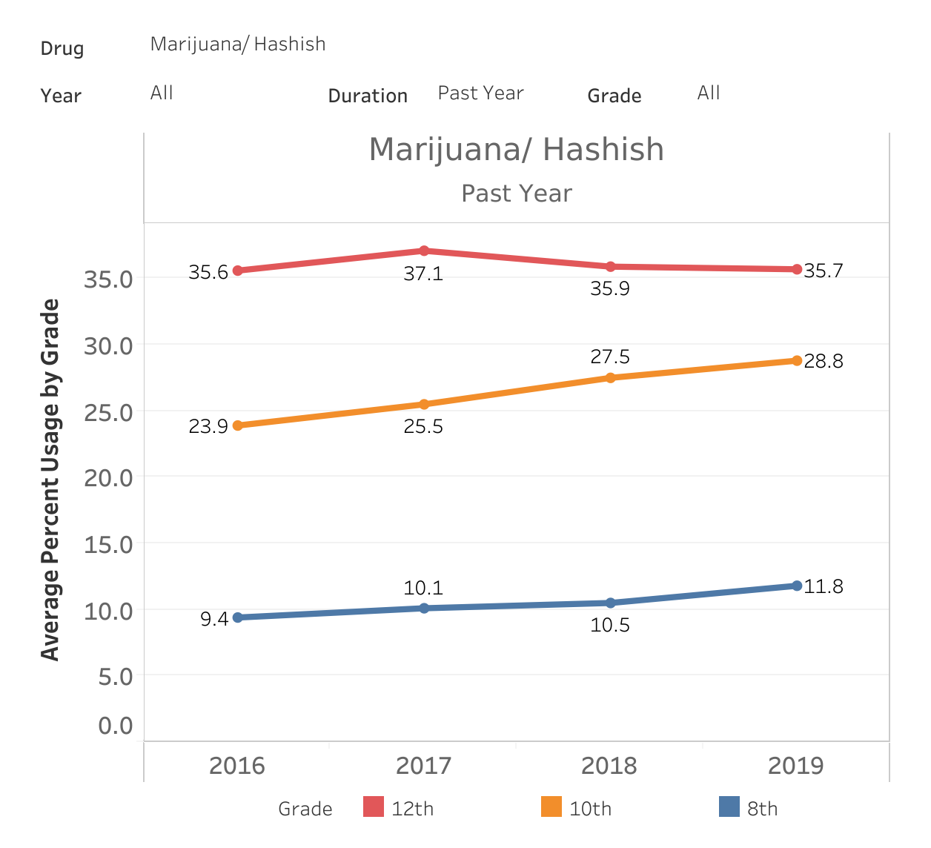
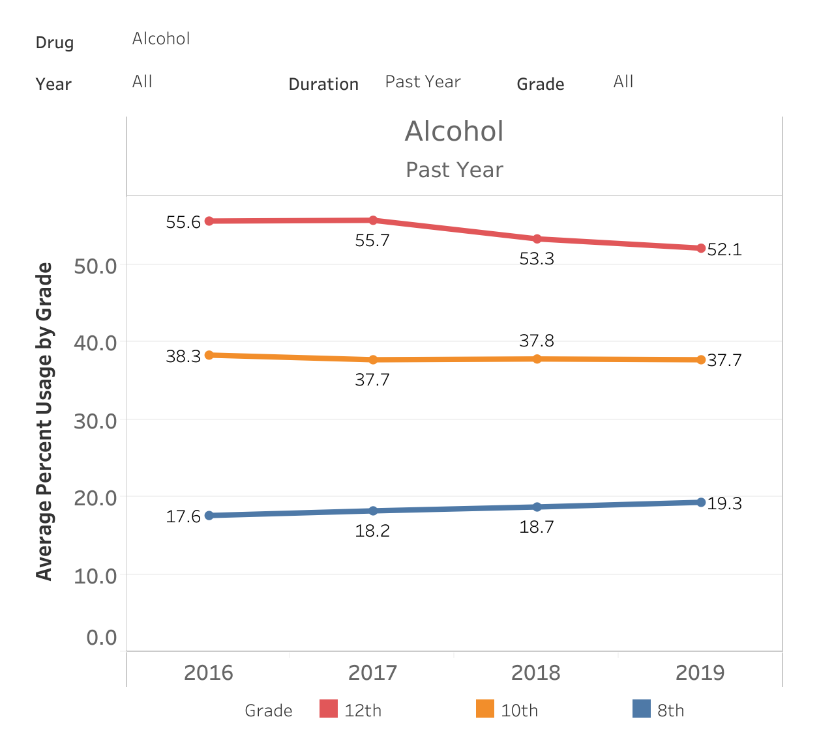
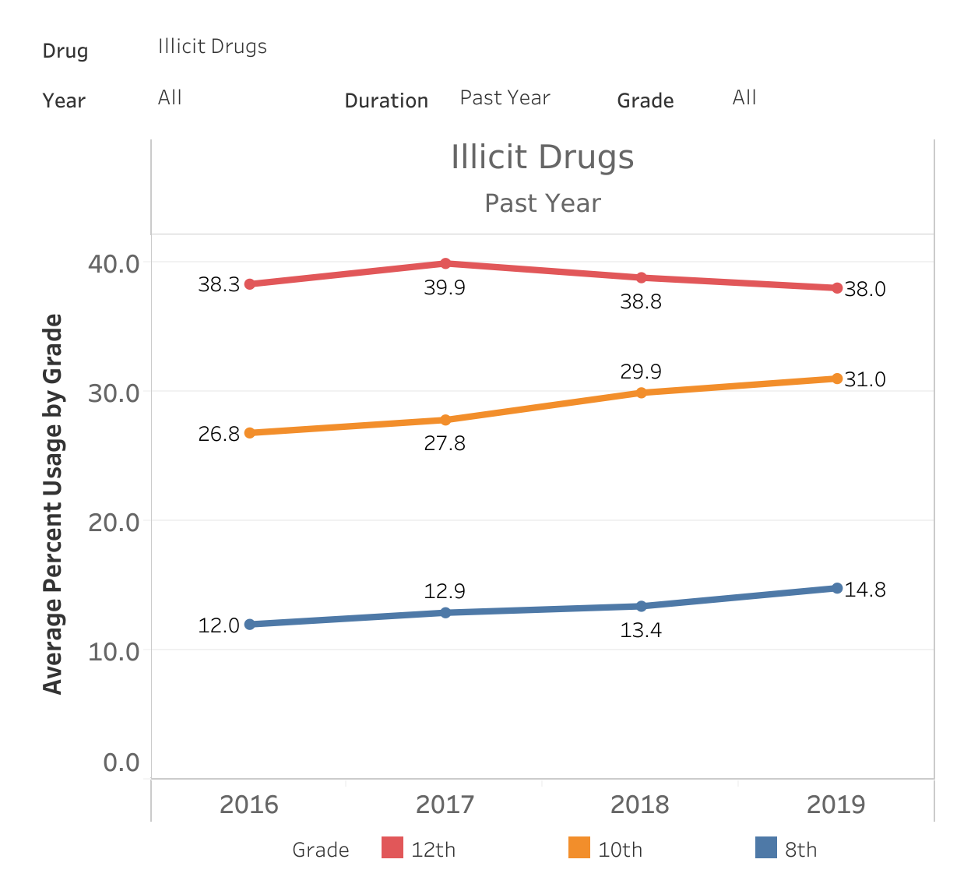
Prevalence and kinds of drug use different
Teens (12 -- 17 y/o)
MTF (2019)

Slide 9
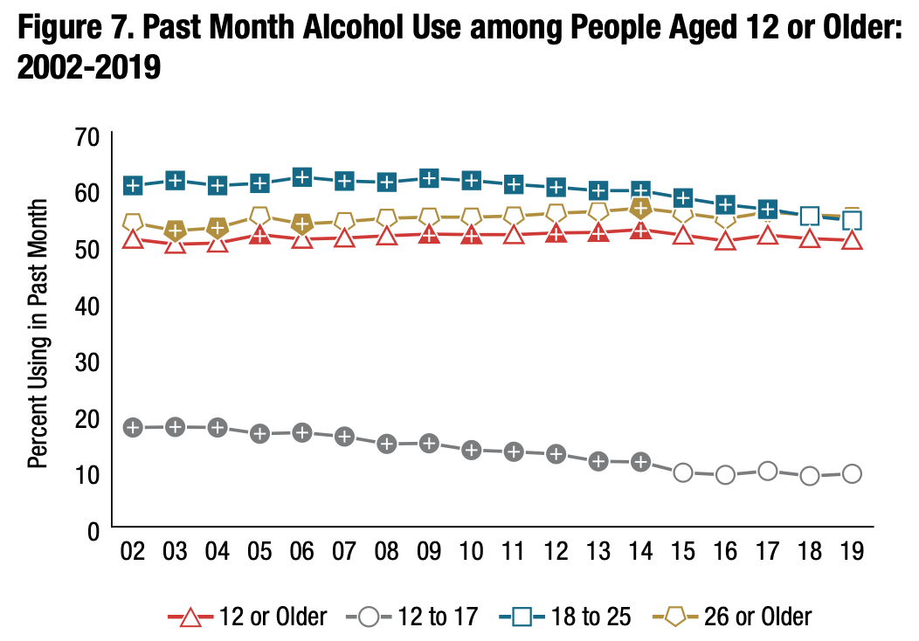
Prevalence and kinds of drug use different
Young adults (18-25 y/o)
NSDUH, 2019

Slide 10
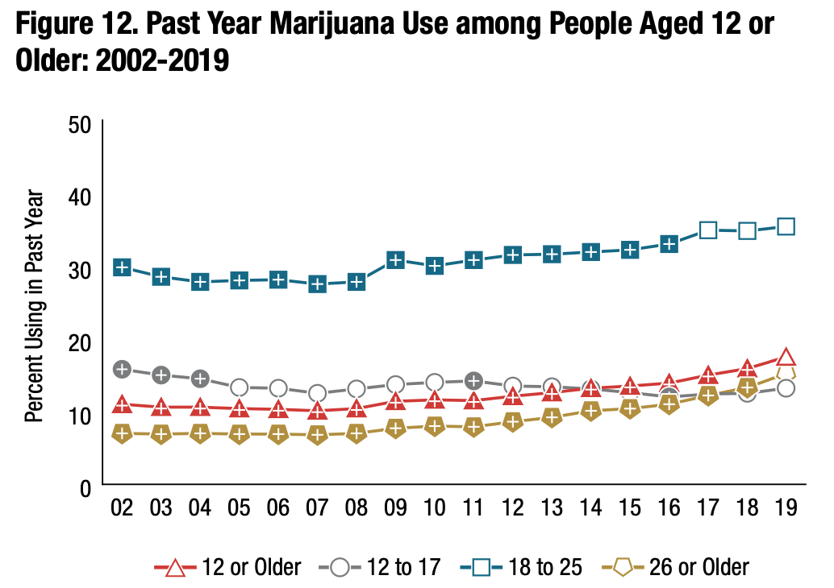
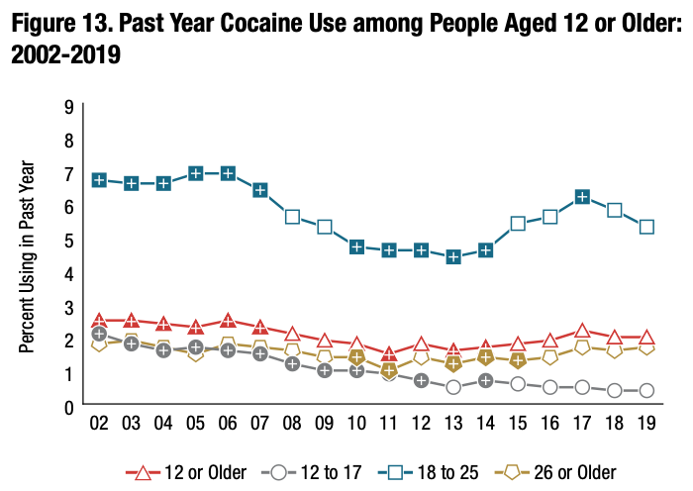
Prevalence and kinds of drug use different
Young adults (18-25 y/o)
NSDUH, 2019

Slide 11
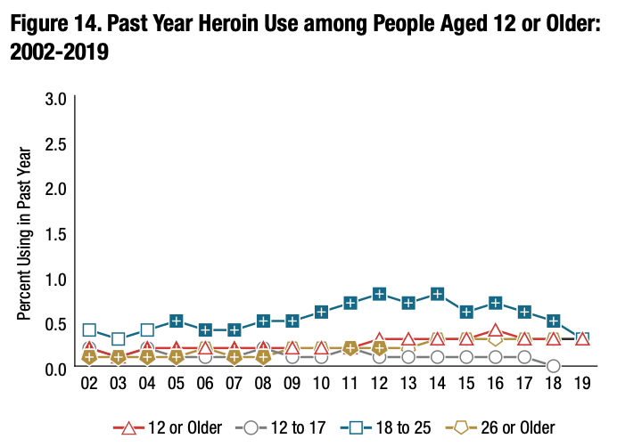
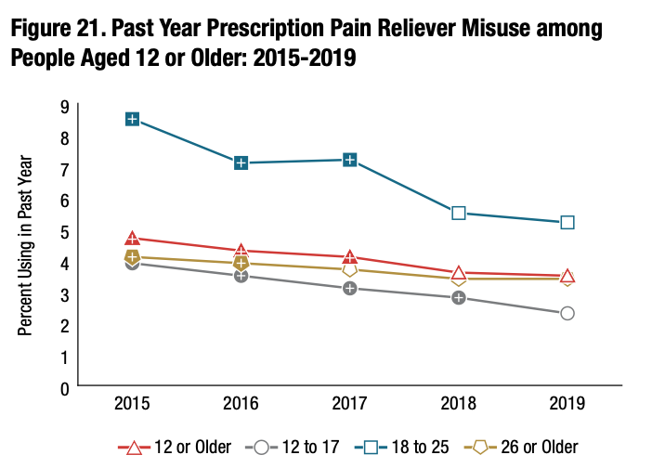
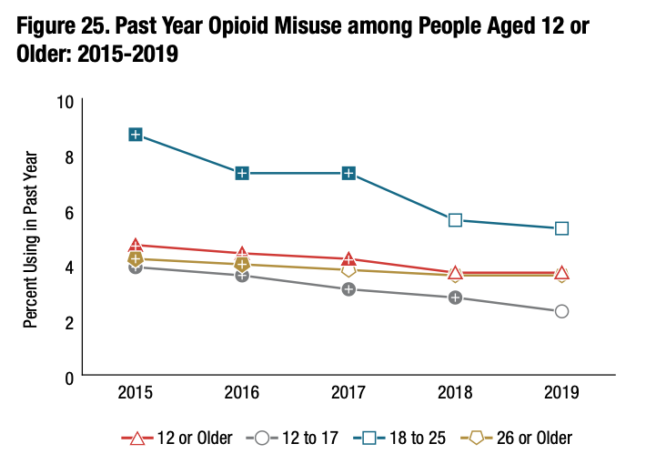
Prevalence and kinds of drug use different
Young adults (18-25 y/o)
NSDUH, 2019

Slide 12
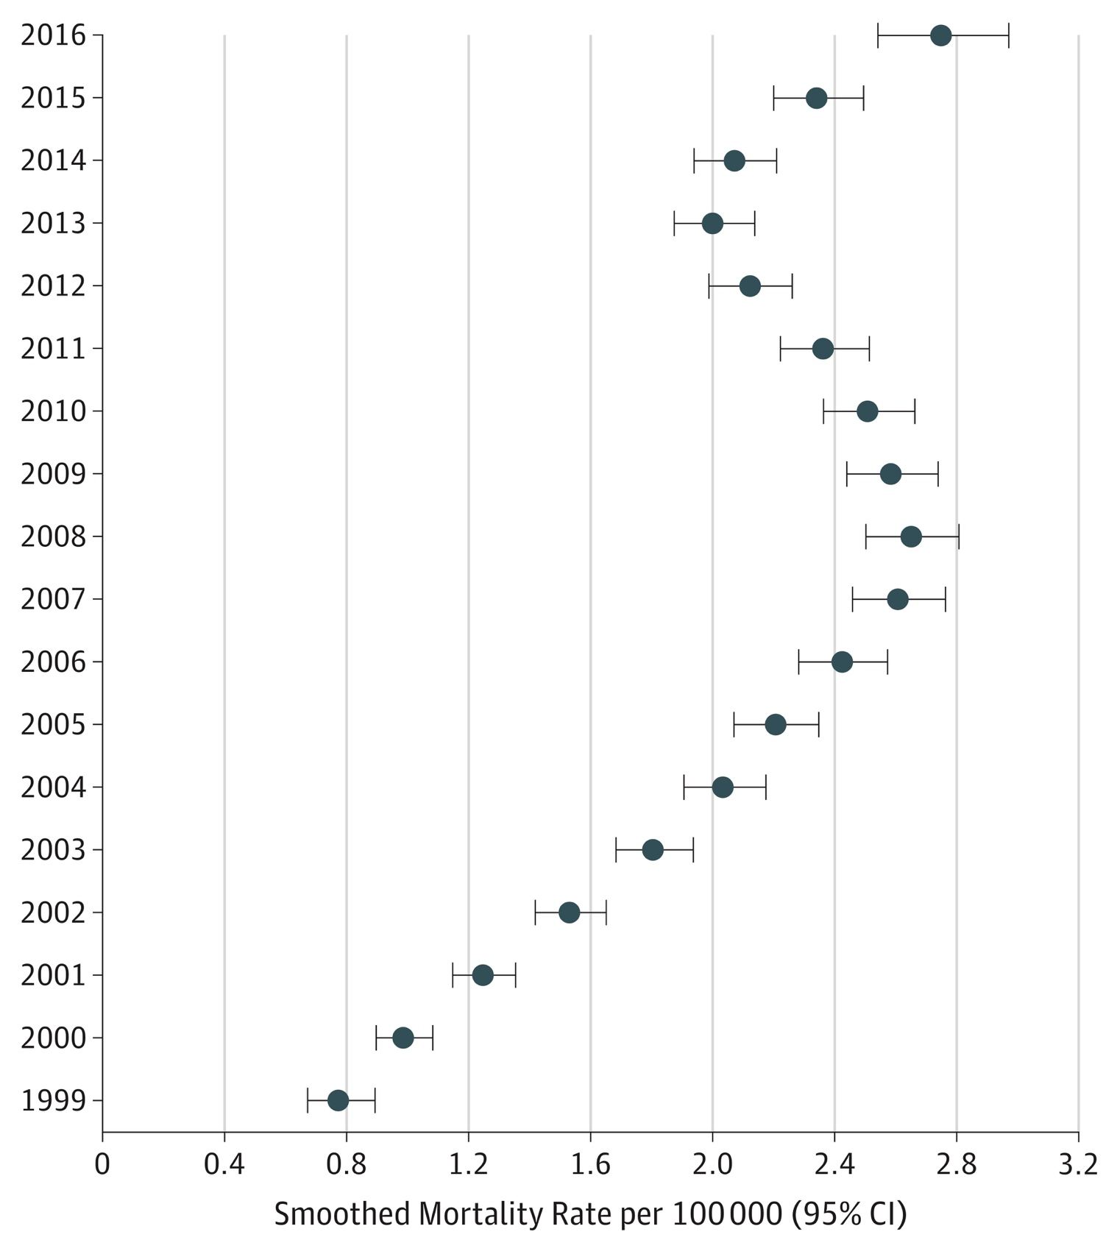
Opioid deaths
US National Trends in Pediatric Deaths From Prescription and Illicit Opioids, 1999-2016
Between 1999 and 2016, overdose deaths rose among 15- to 19-year-olds:
95% for prescription opioids
405% for heroin
2925% for synthetic opioids (i.e., fentanyl)
Gaither JR, et al. JAMA Netw Open. 2018;1(8):e186558.
Notes:
So I have now told you that overall opioid use has been decreasing but that hospitalization for opioid poisoning might be increasing- until really last week there was question about what was happening with overdose deaths in this age group- but then this data brief was released by the CDC and the NCHS- showing that there has been an increase in the last couple of years in overdose deaths (from any substance)

Slide 13
Overdose deaths involving opioids
Drug Overdose Death Rates for 15-24 year olds by type of opioid drug involved: United States, 1999-2017
Data Source: Centers for Disease Control and Prevention, National Center for Health Statistics. Multiple Cause of Death 1999-2017 on CDC WONDER Online Database, released December, 2018

Slide 14
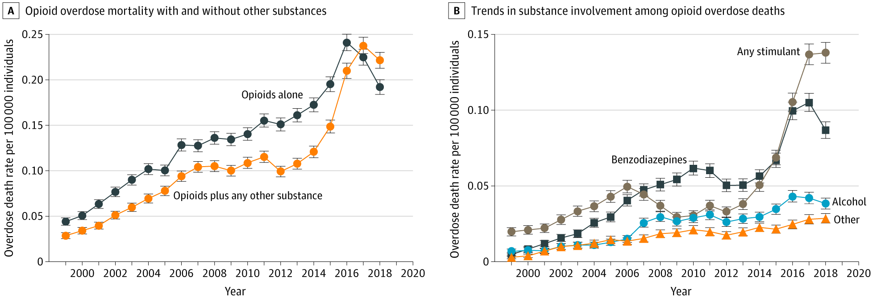
Stimulant-involved deaths increasing among youth
Lim et al., 2020 JAMA Pediatr.

Slide 15
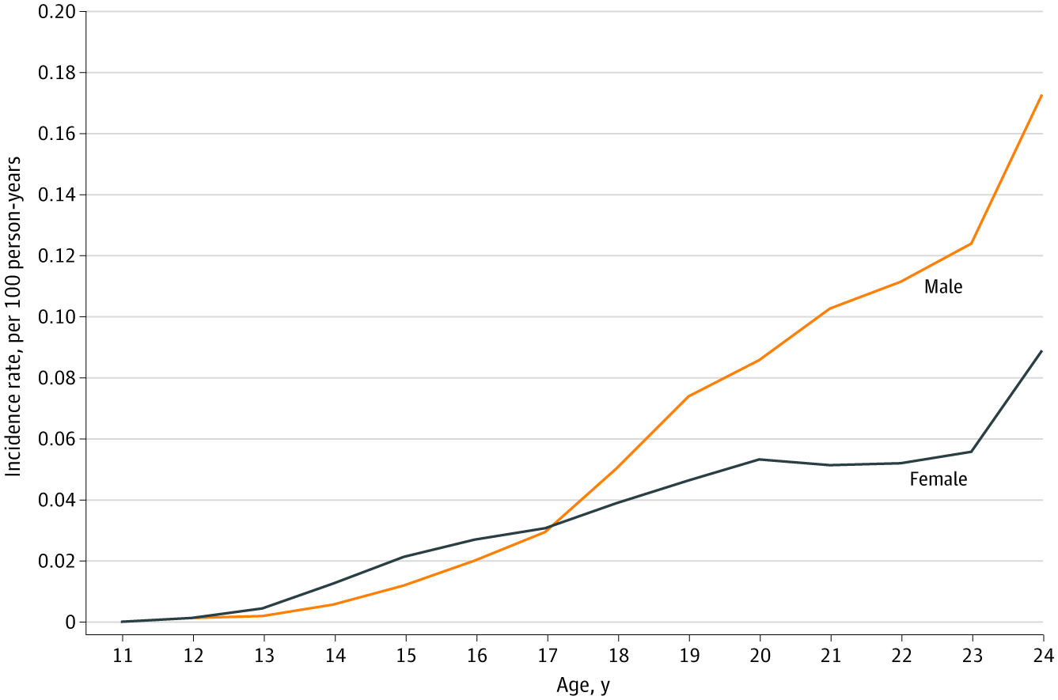
Sex-based differences in nonfatal opioid overdose rates
Figure 2: Incidence Rate of First Nonfatal Opioid Overdose by Age and Gender from 2006 to 2016
Bagley et al. (2020) JAMA Netw Open

Slide 16
#2 Identify 2 opportunities and 2 barriers to provide evidence-based addiction care for adolescents and young adults

Slide 17
Case 2
20 year-old female referred to us from the adolescent/emerging adult crisis stabilization program
Has had multiple admissions related to opioid use and never offered medication treatment until this last admission
Started on buprenorphine at program and we then see her for regular follow-up
Despite relapse, she explicitly says that medication treatment has made a huge impact on recovery

Slide 18
What does treatment look like for youth?

Slide 19
Addiction treatment facilities primarily serve adults
In a cross-sectional study of addiction treatment facilities, only 26% offered adolescent programs
Programs that offered treatment for adolescents were half as likely to offer medications for opioid use disorder
Alinsky et al. J Adol Health, 2020

Slide 20
What’s the evidence?
Improved retention in care (clinical trials and observational data)
Decreased opioid positive urine drug tests (clinical trials)
Improved mortality (observational data)
BUT TAY have poorer retention!
Woody et al., (2008) JAMA; Marsch et al. (2016) Addiction; Fishman et al. (2010) Addiction; Matson et al., (2014) J Addict Med

Slide 21
Low timely receipt of MOUD among youth
Only 1 in 4 youths received treatment within 3 months of OUD diagnosis
Hadland et al. (2018) JAMA Pediatr.
https://www.eurekalert.org/pub_releases/2018-09/bmc-bsa091018.php

Slide 22
Access to timely addiction treatment lacking
<1/3 received timely addiction treatment after overdose
Only 1 in 54 received MOUD
Youths who experienced a heroin overdose were significantly less likely than those who overdosed on other opioids to receive any treatment
Alinsky et al. (2020) JAMA Pediatrics.

Slide 23
Widening treatment gap 15-24 yo
Olfson et al. (2020) JAMA.

Slide 24
Inequities to receipt of MOUD
Black youth 42% less likely to receive medication
Hispanic youth 17% less likely to receive medication
Hadland SE, et al. (2017) JAMA Pediatr
Notes:
Scott- here I think that you can add that there are data highlighting that black youth are less likely to use MJ than white youth but more likely to be justice involved/arrested for their use: https://www.ncbi.nlm.nih.gov/pmc/articles/PMC3477985/
Long history of racism built into addressing SU that likely contributes to mistrust of health care and treatment

Slide 25
Barriers and Opportunities: families, language, stigma, and harm reduction

Slide 26
Barriers and opportunities for care
Stigma: significant misinformation about what medication treatment is and it’s benefits
Lack of training: only 1% of waivered providers identify as pediatricians
Coordination of care: these cases are complicated - involve state agencies, families, children→ can be hard to ensure that a consistent plan is being offered and implemented

Slide 27
Engagement is Key

Slide 28
“The opposite of addiction is not sobriety, it is human connection.” Johann Hari

Slide 29
Engagement is key
This might mean not getting all the history in the first visit (but getting the necessary info so you can offer a treatment plan)
Holding judgments
Offering any and all opportunities for youth to make decisions and maintain their autonomy

Slide 30
Addiction is a Family Disease
Addiction is a chronic illness
Families can be invited to be part of treatment planning
Their involvement can vary
Few family-based strategies that have been specifically tested among the TAY population

Slide 31
Strategies Focused on the Family
Many strategies exist that focus on supporting families affected by addiction whose loved ones may not be in treatment yet.
The following is not an exhaustive list but provides information on well-known approaches.
Community Reinforcement Approach and Family Training (CRAFT)
Overdose Education and Naloxone Rescue Kits
Al-Anon or other mutual support groups

Slide 32
Language Matters
“Recovery” language may not resonate
Figure out the youth’s goals and align language
Chronic disease model may be limited

Slide 33
Language Matters
As Eitan (non-binary, 23) reflected:
“They don't want their life to continue to be defined by their substance use, including if that means being defined by not using substances…Because having your identity be centered around being in recovery is also not, like your life is still being centered around substance using and that works for some people, that's great. But, I don't think that's what most people want… I think the conversation isn't just about …people won't die … It's like people will be present for their lives again.”
Landon (male, 29) commented, “I don’t believe it’s a disease. I believe it’s just a choice... I never knew it was a disease until I went to detox. I knew what I was doing every time I did it. I knew I was being sneaky, I knew I was lying. I knew I was stealing from people I loved. I just decided to do it. And when you go to detox and all these programs, they drill it in your head that it’s a disease and it’s all right to keep relapsing... It’s not… I don’t know, maybe it is a disease. In my head I really don’t feel like it’s a disease… And when they tell us the disease, we tend to use that as an excuse… we start thinking it’s okay. It’s just my disease. Everything, you blame it on the disease. Oh it was just my disease. I stole my wife’s wedding ring, it was the disease.”
Unpublished data, under review

Slide 34
Language Matters: “hard to reach”
“defines the problem as one within the group itself, not within your approach to them” (Smith 2006)
it makes it sound like the fault of the non service-user - "you are hard to reach" - like they are sat up on a shelf and we have got to lure them down with biscuits, or something.... actually if you just got a ladder and sat next to them that would be fine.”
I am not "hard to reach", generally people don't know how to reach me
Freimuth & Mettger 1990 Public Heealth Rep.
Flanagan & Hancock 2010 BMC Health Serv Res.

Slide 35
Harm Reduction and Youth
HIV prevention and PrEP
Access to clean syringes and supplies for injecting drugs (for 18 years and older)
Educating parents about harm reduction
If desired, pregnancy prevention

Slide 36
Recommended components to improve engagement
Youth empowerment through participation in program development
Parental relationships
Technology
Engagement through the medical or mental health clinic (convenience, welcoming staff, age-appropriate spaces)
School
Social marketing
Dunne et al. (2017) Journal of Adolescent Health

Slide 37
#3 Discuss the epidemiology of alcohol and other drug use in pregnancy and postpartum

Slide 38
Case
27 year old pregnant woman is admitted for titration of methadone
What should you be thinking about as you prepare to interview her?

Slide 39
Context: Why we do we care about gender in addiction?
Gender differences exist in the:
Origins
Development
Course and treatment of SUD
Historically men used alcohol/drugs more > women
Addiction services, research, and polices have been either tailored to men or designed using a gender-neutral approach
Gender-neutral approaches tend to benefit men > over women
They fail to consider the specific needs of women
Meyer JP, et al. Drug Alcohol Depend. 2019
Keyes KM, et al. Drug Alcohol Depend. 2008

Slide 40
Gender impact on substance use disorder
Women who use start using drugs/alcohol have higher rates of psychiatric comorbidities & trauma
Women develop substance use disorders and health-related problems in less time (telescoping)
Women develop more severe SUDs
Women experience higher rates of harms from drug use
Injection related infections
HIV
HCV
McHugh RK, et al. Clin Psychol Rev.
Pinkham S, et al. Reprod Health Matters. 2008
El-Bassel N, et al. J Acquir Immune Defic Syndr. 2015

Slide 41
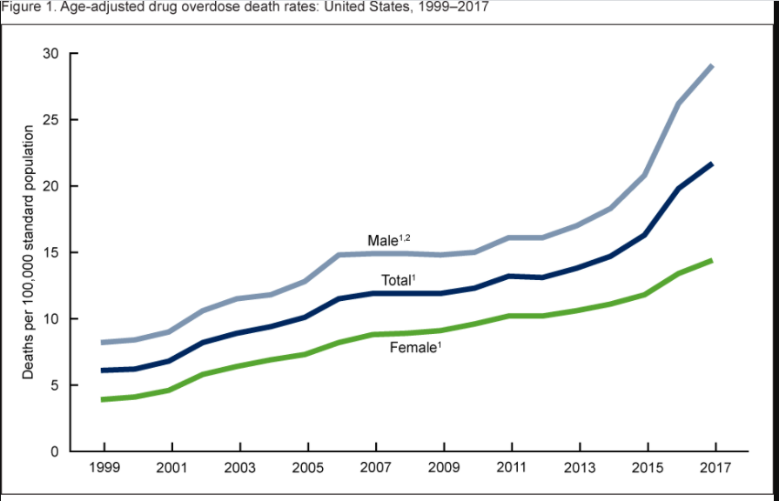
Epidemiology of SUD: Focusing on women is important
While substance use more prevalent among men women are the fastest-growing segment of substance users in the United States
Overdose death rate among women increased by 270% from 1999-2017

Slide 42
Epidemiology of OUD
Globally, the number opioid-related deaths in women increased 92% in the past 10 years, compared to a 63% increase in men
>Five-fold increase in maternal opioid use and NOWS from 2004-2014
UN. World Drug Report 2020. 2021.
Honein MA, et al. Pediatrics 2019

Slide 43
Drug use and pregnancy
https://www.tennessean.com/opinion/

Slide 44
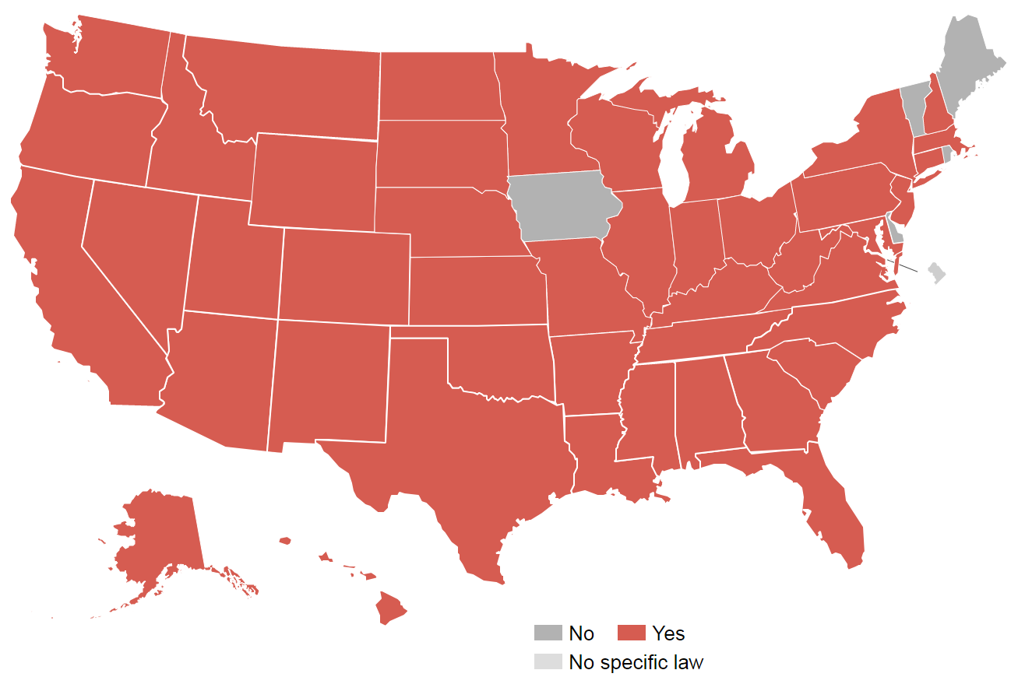
Criminalization of pregnancy and drug use
States where women have been prosecuted for drug use during pregnancy
Projects.propublica.org

Slide 45
Screening for Drug Use during Pregnancy
American College of Obstetricians and Gynecologist recommends universal screening at first prenatal visit using validated tool (4Ps, NIDA quick screen, and CRAFFT)
Urine drug testing can be done if there is a positive test but MUST be done with the patient’s permission

Slide 46
OUD during pregnancy has quadrupled
Haight SC, MMWR, 2018

Slide 47
Inequities in receipt of treatment
Among 5247 women with an opioid use disorder in Massachusetts, Black non-Hispanic and Hispanic women had lower odds of receiving medication treatment
Black non-Hispanic and Hispanic women were also less likely to receive buprenorphine
Schiff DM et al. JAMA Open Network, 2020

Slide 48
Overdose risk dependent on treatment status
Schiff DA et al, Obstet Gynecol, 2018

Slide 49
Breastfeeding
Breastfeeding rates among women with OUD vary widely
Breastfeeding is an important aspect of the postpartum period
Specific advantages of breastfeeding for substance-exposed mother-infant dyads
Reduces severity of neonatal-opioid withdrawal syndrome
Decreases need for pharmacologic treatment
Welle-Strand GK, et a.l. Acta Paediatr Oslo Nor. 2013

Slide 50
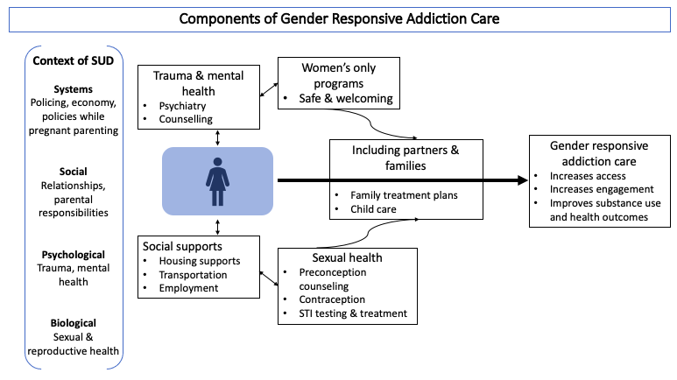
Notes:
Trauma and mental health: As discussed earlier, co-occurring mental health disorders and trauma is high among women with substance use disorders. Programs should offer trauma informed integrated treatment for co-occurring mental health disorders, including considering single-gender group therapy, which some women report offers a safer environment.⁶⁶
Sexual health: If available, programs should offer comprehensive reproductive and sexual health care. In addition to routine screening for sexually transmitted infections, age-appropriate cervical cancer screening, assessing pregnancy timing goals, and providing appropriate counseling for contraception or preconception should be offered. Addressing the sexual and reproductive health needs of women increases engagement with addiction treatment.⁹³
Social needs: Different clinical programs will have varying capacity to respond to social needs affecting women. However, having the capacity to refer to clinical and community supports such as housing services, life skills programs, and recovery management are necessary. Where possible providing child care, transportation and cell phones for those who need them can concretely increase access to care for women.⁹⁴
Women’s only programs: Women’s only treatment offers a safe environment that women may be more comfortable accessing. Programs unable to offer women’s only spaces all of the time could alternatively offer select women’s only groups, days, or times for treatment or harm reduction services.⁹⁵
Including partners and families: Data demonstrate the importance of including families and partners in treatment.⁹⁶ Families can provide critical support for women outside of the clinical setting at home and in the community. When possible, this includes providing childcare services for parenting women.

Slide 51
Thank you
Sarah.bagley@bmc.org
@smbagley

Slide 52
Are there limitations of the chronic disease model for youth?

Slide 53
How we think about addiction has shifted
McLellan AT. (2000) JAMA.
Lewis M (2018) NEJM.
Caruso Brown AE (2020) JAMA.
Notes:
Starting at least 18 years ago, there has been a shift in how we think about substance use disorder- this paper from 2000 illustrated the important similiarites between addiction and other chronic illnesses such as COPD or asthma, chronic, relapsing nature, responsive to medication and behavioral treatment, changes in brain form and function that occur as a result of use.
This shift in how we think about addiction has been really helpful- it has allowed us to not think about addiction as a moral failing but rather as a disease that can be treated. We see that in our public policy where the majority of the discussion is on prevention and treatment instead of punishment.
Although there is no doubt that patients and families still encounter significant stigma and discrimination related to addiction, things are definitely moving in the right direction.

Slide 54
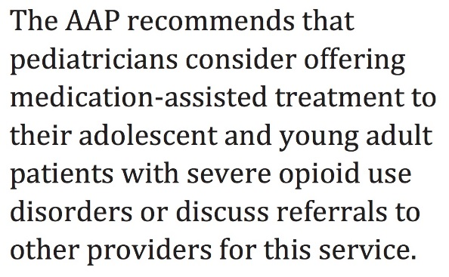
Should Youth Receive Meds…?
AAP Committee on Substance Use and Prevention, August 2016

Slide 55
Adolescents and young adults have poor access to addiction care
Received Specialty Substance Use Treatment in the Past Year among People Aged 12 or Older Who Needed Substance Use Treatment in the Past Year, by Age Group: 2017
NSDUH, 2017

Slide 56
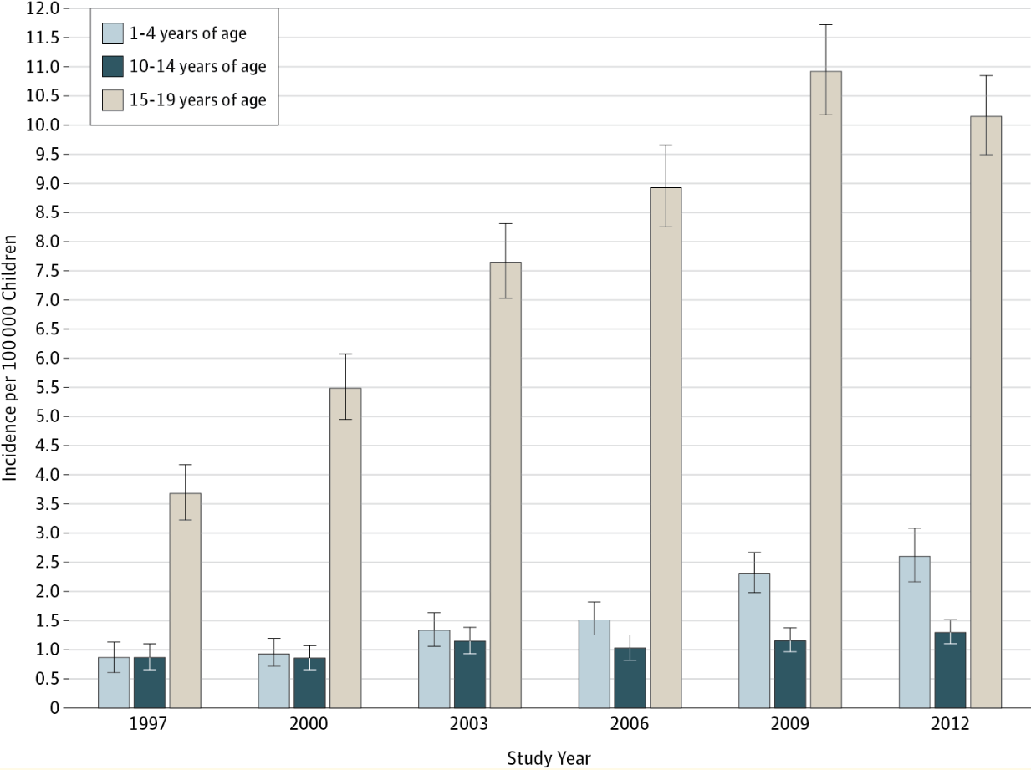
Opioid poisonings
Hospitalizations for Prescription Opioid Poisonings Stratified by Age Category
Pediatric hospitalizations for opioid poisonings increased nearly 2-fold from 1997 to 2012
Gaither (2016) JAMA Pediatr. 2016;170(12):1195-1201

Slide 57
Disparities in Access Based on Age
Availability of services for adolescents is limited: fewer than 1 in 3 specialty drug treatment programs in the United States offers care to adolescents
From 2000 to 2014 only 1 in 4 youth diagnosed with OUD received medication (buprenorphine or naltrexone) within 6 months of diagnosis
Hadland SE, et al. JAMA Pediatr, 2017;171(8):747-755.

Slide 58
Models of care for pregnant women
https://safehealthcareforeverywoman.org/
https://store.samhsa.gov/system/files/sma16-4978.pdf
https://www.addictionpolicy.org/blog/coordinating-care-for-pregnant-and-postpartum-oud-patients

