Slide 1



Unhealthy Alcohol and Other Drug Use
Screening, Assessment and Brief Intervention
CRIT/FIT/JFIT 2021
Jeffrey H. Samet, MD, MA, MPH
John Noble Professor of Medicine and Professor of Public Health
Daniel P. Alford, MD, MPH
Professor of Medicine and Director, Clinical Addiction Research and Education (CARE) Unit

Slide 2
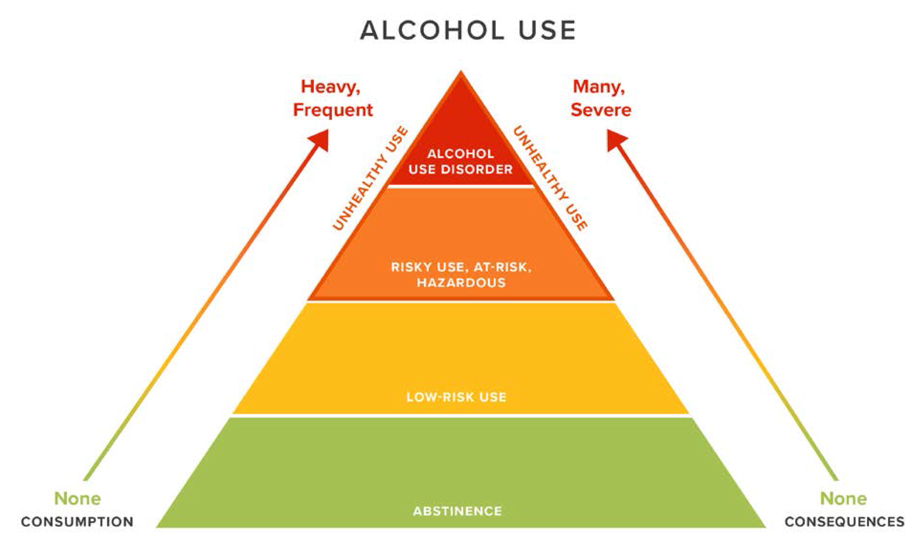
Unhealthy Substance Use
Adapted with permission from Saitz R. New Engl J Med 2005

Slide 3
Case
A 29 year old resident enjoys 2-3 beers 2-3 times a week after work.
Is the residents alcohol use risky?

Slide 4

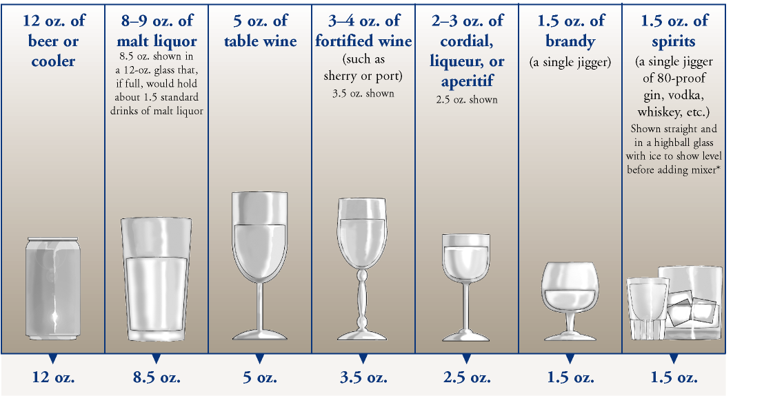
Standard Drink

Slide 5
Risky Amounts
Risky* alcohol use (quantity, frequency)
Men ≤65
  >14 drinks per week, >4 per occasion (5+)
Women (and men >65)
  >7 drinks per week, >3 per occasion (4+)
USDA, US Dietary Guidelines Advisory Committee Report:
≤ 1 drink/d (Dietary Guidelines Advisory Committee, 2020)
*>1/day increase in mortality, stroke, heart failure and other CVD (except non-fatal MI (nadir for MI 5/wk))
Carcinogen
Millwood et al. Lancet . 2019
Wood et al. Lancet. 2018
Risky drug use
Any?
Notes:
43
21
Treatment Need
Injection, use of heroin once, marijuana daily, other drug weekly, or use with prior treatment history

Slide 6
Screening and Assessment
To identify and initiate behavior change or treatment discussion
To assist with differential diagnosis
To let patients know this is part of healthcare

Slide 7
‘Single’ Item Screening Questions
  Alcohol
  “Do you sometimes drink beer wine or other alcoholic beverages?”
  “How many times in the past year have you had 5 (4 for women) or more drinks in a day?”
    Positive = greater than “never”
      82% sensitive, 79% specific for unhealthy use
  Drug
  “How many times in the past year have you used an illegal drug or used a prescription medication for non-medical reasons?”
    Positive = greater than “never”
      93% sensitive, 94% specific for current drug use
      100% sensitive, 74% specific for current drug use disorder
NIAAA. Clinicians Guide to Helping Patients Who Drink Too Much, 2007.
Smith PC, Saitz R. J Gen Intern Med 2009
Smith PC, Saitz R. JAMA Intern Med 2010
Saitz R et al. J Studies Alcohol Drugs. 2014
McNeely J et al. Validation for self-administration. J Gen Intern Med. 2015

Slide 8
Alcohol Use Disorder Identification Test (AUDIT)
  10 questions (score: 0 - 40)
  Most widely validated instrument
  8+ is unhealthy alcohol use (90% sensitivity, 80% specificity)
  20+ suggests AUD
Saitz R. www.uptodate updated: Aug 06, 2020

Slide 9
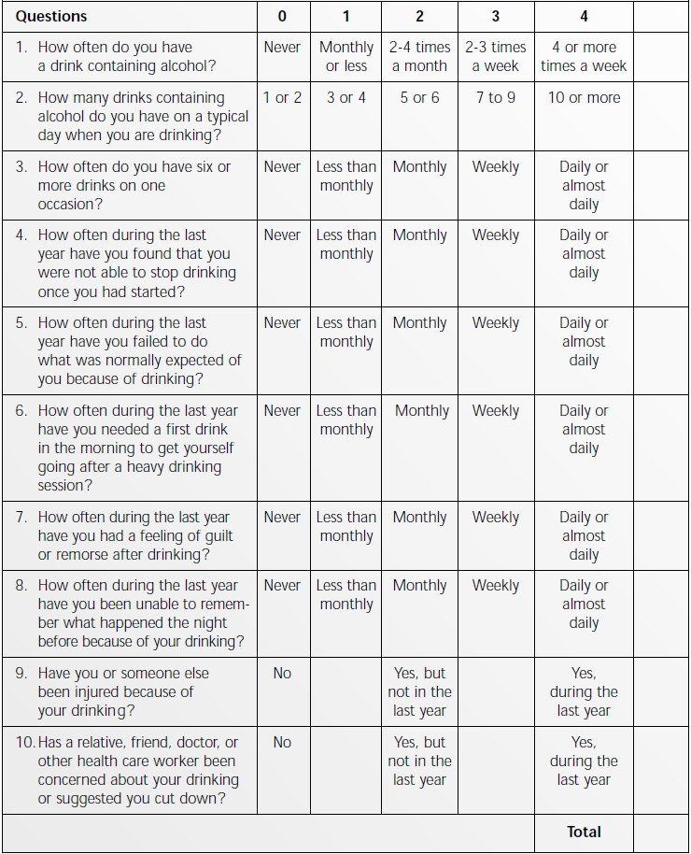
Full AUDIT Screen
Alcohol Intake
Related Harms
Loss of Control, Physical Dependence
The AUDIT was developed by the World Health Organization
Notes:
Lee
Alcohol Use Disorders Identification Test
10 questions on alcohol
Most questions have 5 response choices
Scoring: add point values of responses
Validated in for many countries and cultures

Slide 10
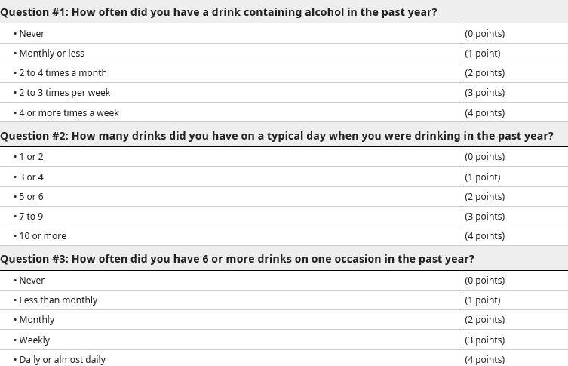
Alcohol Use Disorders Identification Test
Consumption items (AUDIT-C)
Requires scoring
>3 women, >4 men
  73-86% sensitivity
  89-91% specificity
>7 to 10 suggests moderate to severe disorder
Bradley KA, et al. AUDIT-C as a brief screen for alcohol misuse in primary care. Alcohol. Clin. Exp. Res. 2007
Saitz R. Screening for unhealthy use of alcohol and other drugs. UpToDate 2021

Slide 11
DSM-5 Substance Use Disorders (SUD)
1.
Tolerance*
2.
Withdrawal*
3.
Larger amounts and/or longer periods
4.
Inability to cut down on or control use
5.
Increased time spent obtaining, using or recovering
Physiologic
Loss of Control
6.
Craving/
Compulsion
7.
Role failure: work, home, school
8.
Social, interpersonal problems
9.
Reducing social, work, recreational activity
10.
Physical hazards
11.
Physical or psychological harm
Continued Use Despite Negative Consequences
Mild SUD: 2-3 Criteria
Moderate SUD: 4-5 Criteria
Severe SUD: >6 Criteria
*This criterion is not considered to be met if taking opioids under appropriate medical supervision
APA. (2013). Diagnostic and Statistical Manual of Mental Disorders (5th ed.)
Notes:
DSM-5 Opioid Use Disorders
In terms of diagnosing an opioid use disorder, the DSM-V criteria are an agreed upon set of criteria that allow you to assess your patients. So these evaluate tolerance and withdrawal, though it’s important to note that these first two criteria may be seen in patients on prescribed opioids and do not necessarily by themselves constitute a use disorder, and the 11 criteria go on to assess for loss of control and for continued use despite negative consequences. And patients can be stratified into a mild, moderate or severe opioid use disorder based on how many criteria out of these 11 that they meet.

Slide 12
‘Single’ Item Screening Questions – Personal Preference
  Alcohol
  “Do you sometimes drink beer wine or other alcoholic beverages?”
  “How many times in the past year have you had 5 (4 for women) or more drinks in a day?”
    Positive = greater than “never”
  Drug
  “How many times in the past year have you used an illegal drug or used a prescription medication for non-medical reasons?”
    Positive = greater than “never”
Smith PC, Saitz R. J Gen Intern Med 2009
Smith PC, Saitz R. JAMA Intern Med 2010

Slide 13
CAGE CAGE-AID*
Assessment
Have you ever felt you should Cut down on your drinking?
Have people Annoyed you by criticizing your drinking?
Have you ever felt bad or Guilty about your drinking?
Have you ever taken a drink first thing in the morning (Eye-opener) to steady your nerves or get rid of a hangover?
Or drug use?
Or drug use?
Or drug use?
Or used drugs?
Mayfield D et al. Am J Psych 1974
Brown RL & Rounds LA. Wisconsin Med J 1995* "Adapted to Include Drugs”
Notes:
7
Here are the CAGE questions, first published in 1974 by Mayfield.
I’d like to mention just 2 additional issues with the CAGE questionnaire. First, the questions ask if the patient has ever cut down, been annoyed, felt guilty or had an eye-opener, allowing us to identify patients in remission as well as those with acute problems. Second, we translated the CAGE into Spanish, backtranslated it, checked it for accuracy and validated it here in the primary care clinics and found that at least in Carribean Latinos, the test had sensitivity and specificity at least as good as that found for English speakers.
4 items, yes/no
brief, memorizable
detects lifetime problems\
usual cutoff >1 or 2
may miss some hazardous drinkers
Doesn’t ask quantity
CAGE AID validated in 63 elders. 63 elderly (>age 60) persons with drug abuse/dep, 838 controls
>1: 92% sensitive, 48% specific
AGE-AID: 82% sensitive, 69% specific
>2: 81% sensitive, 72% specific
AGE-AID: 77% sensitive, 89% specific
Hinkin 2001

Slide 14
Screening Results in Primary Care
10-20% unhealthy alcohol use
  Of those, 1/5 alcohol use disorder (AUD)
3% unhealthy drug use
  Of those, 1/3 substance use disorder (SUD)
Notes:
Mertens, ACER 2005, HMO, in a pop had 3.2% drug, 7.5% alc, 10% had at least one of the 2

Slide 15
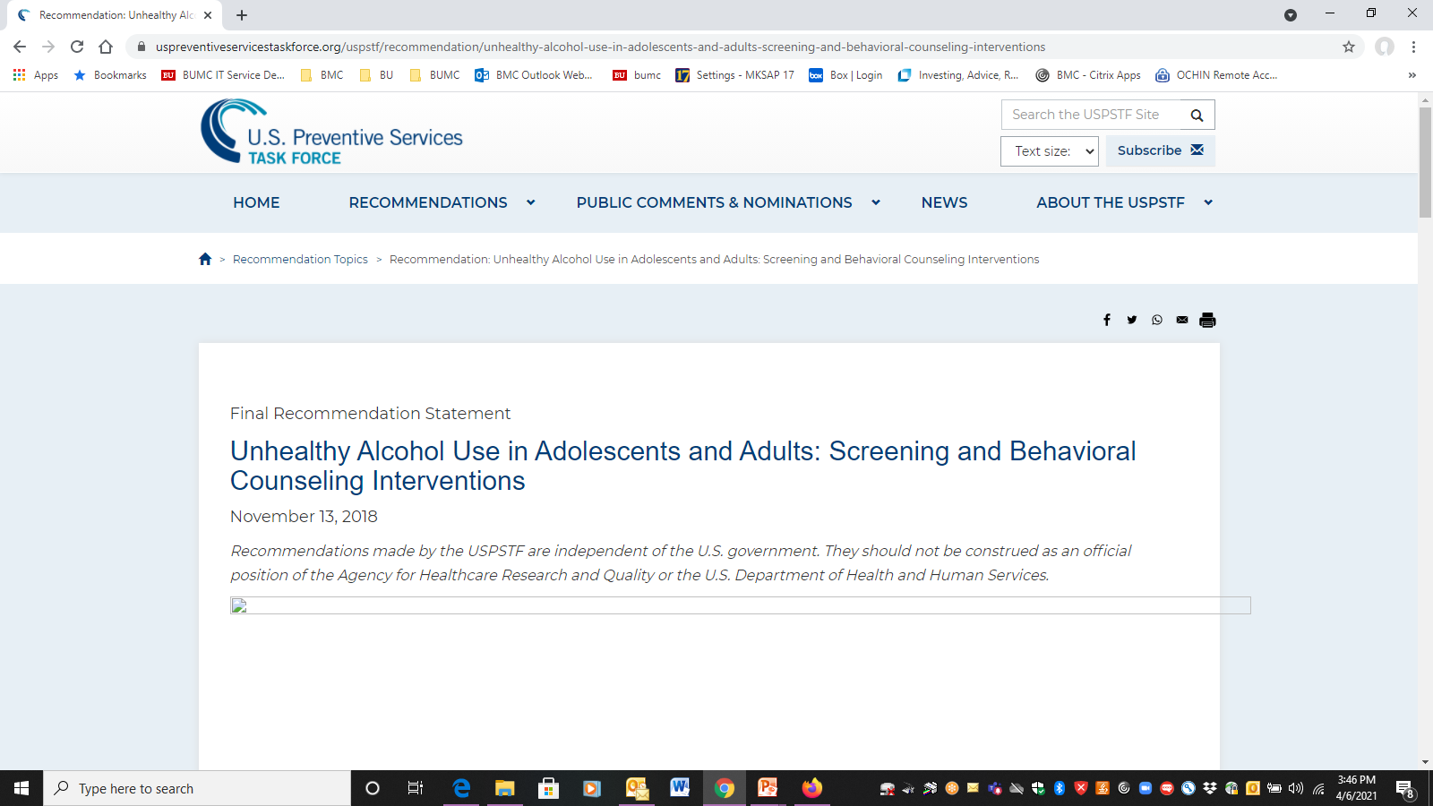
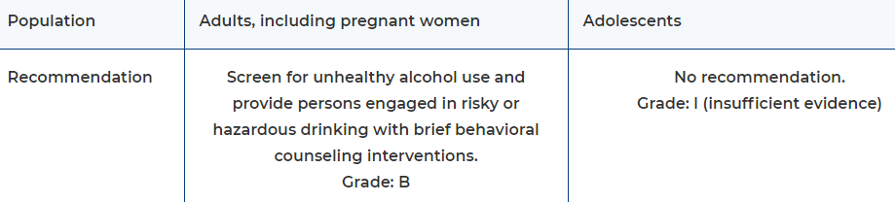
Curry SJ, et al. JAMA. 2018
Notes:
Based on primary care setting

Slide 16
Brief Intervention
50 years of ALCOHOL brief intervention trials
Modest efficacy for reducing self-reported consumption
  3-4 drinks/week, 10-12% less unhealthy use (e.g. 57% vs 69% at 1 year)
  No consistent effects on anything else
No evidence it prevents disorder
No effect on ‘dependence,’ very heavy use, or getting people identified by screening to treatment
No effect on referral
BUT, repeat, and be available when patients are ready, connect and counsel long-term
USPSTF. JAMA. 2018;320(18):1899-1909.
Jonas DE et al. Ann Intern Med 2012;157:645-54.
Kaner et al. Drug and Alcohol Review 2009;28:301–23
Beich et al. BMJ 2003;327:536
Bertholet et al. Arch Intern Med. 2005;165:986
Kristenson H, et al. Alcohol Clin Exp Res 1983;7:203 (mortality, 3-16 yrs)
Fleming MF et al. Alcohol Clin Exp Res. 2002;26(1):36-43 (cost)
Cuijpers et al. Addiction 2004;99: 839–845 (mortality)

Slide 17
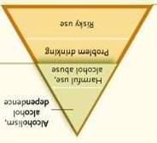

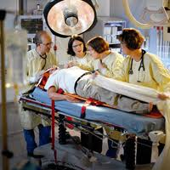


Setting Matters
Evidence is mixed for emergency and hospital
Most people identified by screening in hospitals have a mod/severe disorder
Different expectations and goals
Belen Martinez et al INEBRIA 2007
Saitz et al. Ann Intern Med 2007;146:167-76
Freyer-Adam J et al. Drug Alcohol Depend 2008
Bischoff G et al. Drug Alcohol Depend 2008
Bischof et al. Int J Pub Health 2010
Saitz et al. Int J Pub Health 2010
McQueen J. Cochrane review 2011
D’Onofrio RCTs; Schmidt CS. Et al. Addiction, 2016;111: 783–794 Very small effect (meta-analysis).
Gentilello et al 1999 and subsequent studies

Slide 18
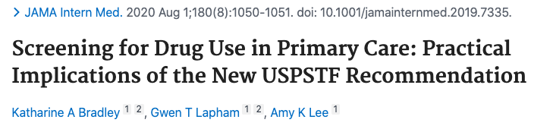
SBI for Drugs: Adults (largely ineffective)
USPSTF recommended one practical approach
Harder to change (behavior despite negative sanctions) Severity
Screen and treat (D’Onofrio JAMA 2015)
-more engagement, less use (in ED)
DeMicheli D et al. Rev Assoc Med Bras 2004; 50(3): 305-13
Bernstein E et al. Acad Emerg Med 2009; 16: 1174-85
Walton MA (Blow) et al. Drug Alcohol Dependence 2013;132;646-53.
Walton MA (Blow) et al. Addiction 2013;109:786-97.
Notes:
Zahradnik A, et al. Addiction. 2009;104(1):109–117
Otto C, et al. Drug Alcohol Depend 2009;105:221-6
Bernstein et al. Drug Alcohol Depend 2005;77:49
Woodruff SI et al. Addict Sci Clin Pract (2014) 9:8.doi:10.1186/1940-0640-9-8
Blow FC et al. Poster, and Abstract book p.14
CPDD 77th Annual Meeting • Arizona Biltmore, Phoenix, Arizona
Bogenschutz JAMA Internal Med 2014;174:1736-45
Gelberg L, et al. Addiction. 2015;110:1777–1790
JAMA. 2014;312(5):502-513. doi:10.1001/jama.2014.7862.
JAMA. 2014;312(5):492-501. doi:10.1001/jama.2014.7860

Slide 19
Screening Workflow
Screen
Screen negative
for unhealthy substance use
Screen positive
for unhealthy substance use
Assess: Level of Risk and SUD
SUD unlikely
SUD likely
REACT:
Reinforce, Educate, Anticipate Challenges of Tomorrow
Brief Negotiated Interview
Monitor
Brief Negotiated Interview
Treat +/- Refer
Notes:
.auditctool
.auditcscoring

Slide 20
Brief Negotiated Interview (BNI)
Six Steps, after asking permission:
“Is it okay if we talk about your use of [X]?”
Explore Pros and Cons
Review Health Risks
Summarize and Ask Key Question
Explore Readiness
Negotiate Goals
Explore Confidence
Bernstein E, et al. Ann Emerg Med 1997

Slide 21
Step 1: Explore Pros and Cons
Ask PROS
Ask CONS
What do you enjoy/like about [X]? What else?
What do you enjoy less (or regret) about your [X] use? What else?
Explore problems mentioned in screening, if done. You mentioned … Can you tell me more about that situation?”
Notes:
Highlight:
Why do we ask about pros- why are they important- why do we ask them first? Be sure to keep it short.

Slide 22
Step 2: Review Health Risks
1. Elicit: patient knowledge of risks
2. Provide information
3. Elicit response
What do you know about the health effects and/or risks of [X]?
Would it be okay if I shared some additional information* with you? ….Provide the information
What do you think about that?
* Link any medical problems with [X] use
* For alcohol, review lower risk drinking levels
Notes:
Assessing student’s own knowledge
Explain info you have so that it is tangible- avoid medical terminology, avoid lingo
Make sure to break it up
Be aware of pushback, tune out

Slide 23

Step 3: Summarize & Key Questions
1. Summarize what the patient’s said so far
2. Use a key question to elicit response (change talk) from the patient
So to summarize, on the one hand, you said [pros], AND on the other hand you said [cons] and we discussed [risks]…
Did I get that right?
Where does that leave you with your [X] use?

Slide 24
Step 4: Explore Readiness
1. Readiness ruler
2. Ask about lower number
To help me understand how you feel about making a change in your [X] use…
On a scale of 0-10, how ready are you to change your [X] use?... “0 is not ready”, “10 completely ready”
Why did you choose a [X] and not a lower number like a 1 or 2?
If they choose “a zero” - What would need to happen in your life to consider making a change?

Slide 25
Step 5: Negotiate Goals
You mentioned some reasons to change. What type of changes might you make?
Is it OK if I share some suggestions that might be helpful?
Cut back to lower risk amounts if:
  Risky drinking amounts without reported negative consequences
    "You may want to cut back on your drinking in order to avoid risks"
Abstain if:
  Negative consequences from [X] use
  Known medications or medical conditions that are risky with [X] use
  Pregnant or trying to conceive
    "You should stop drinking if you are pregnant or trying to get pregnant"
What are your thoughts about that?

Slide 26
Step 6: Explore Confidence
On a scale of 0 – 10, how confident are you to change your use of [X]?
What are some challenges to reaching your goal(s)?
How can you overcome those challenges?
Can I suggest other strategies that have helped other patient? *Recommend 1-2 strategies that may help
Thanks for being so open with me today!
1. Explore confidence
2. Explore challenges
3. Suggest other strategies

Slide 27
Brief Negotiated Interview (BNI)
Six Steps, after asking permission:
“Is it okay if we talk about your use of [X]?”
Explore Pros and Cons
Review Health Risks
Summarize and Ask Key Question
Explore Readiness
Negotiate Goals
Explore Confidence
Bernstein E, et al. Ann Emerg Med 1997
Notes:
Same as slide 19, do we want both?

Slide 28
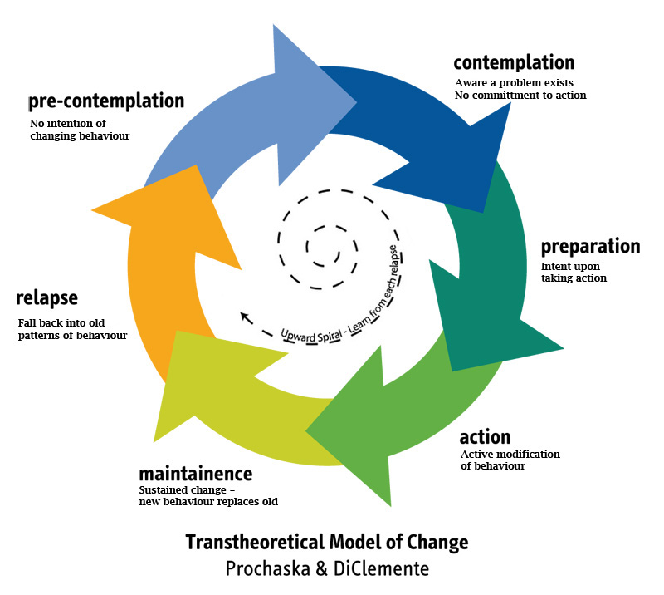
Addressing Different Stages of Change

Slide 29
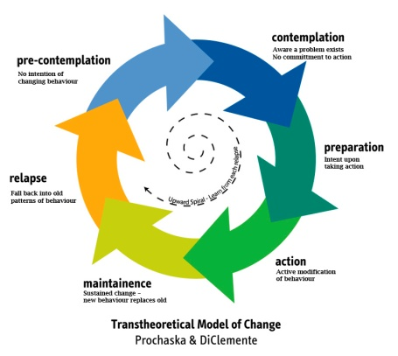
Precontemplation
Goal is to raise doubt, increase perception/ consciousness of problem
  express concern
  state the problem non-judgmentally
  agree to disagree
  advise a trial of abstinence or cutting down
  importance of follow-up (even if using)
  less intensity is better
Samet, JH, Rollnick S, Barnes H. Arch Intern Med. 1996;156:2287-2293.

Slide 30
Contemplation
Goal is to tip the balance
  elicit positive and negative aspects of drinking
  elicit positive and negative aspects of not drinking
  summarize (patient could write these down)
  demonstrate discrepancies between values and actions
  advise a trial of abstinence or cutting down

Slide 31
Preparation
Goal is to help determine the best course of action
  working on motivation is not helpful
  supporting self-efficacy is (remind of strengths--i.e. period of sobriety, coming to doctor)
  help decide on achievable goals
  caution re: difficult road ahead
  relapse won’t disrupt relationship

Slide 32
Action
Goal is to help patient take steps to change
  support and encouragement
  acknowledge discomfort (losses, withdrawal)
  reinforce importance of recovery

Slide 33
Maintenance
Goal is to help prevent relapse
  anticipate difficult situations (triggers)
  recognize the ongoing struggle
  support the patient’s resolve
  reiterate that relapse won’t disrupt your relationship

Slide 34
Relapse/Return to Use
Goal is to renew the process of contemplation
  explore what can be learned
  express concern
  emphasize the positive aspects of prior abstinence and of current efforts to seek care
  support self-efficacy

Slide 35
Summary
Screen to identify the spectrum of unhealthy alcohol and other drug use
  Includes (risky) use, use disorder
Validated questions best
Incorporate into health history, ask “matter of fact”
Assess after a positive screening test
  To confirm unhealthy use
  To identify use disorder
Use brief negotiated interview to address unhealthy substance use to help motivate patients to change cognizant of their stage of change

