Slide 1
Opioids
Immersion Training in Addiction Medicine Program 2021
May 2021
Daniel P. Alford, MD, MPH
Professor of Medicine
Associate Dean, Continuing Medical Education
Director, Clinical Addiction Research and Education (CARE) Unit

Slide 2
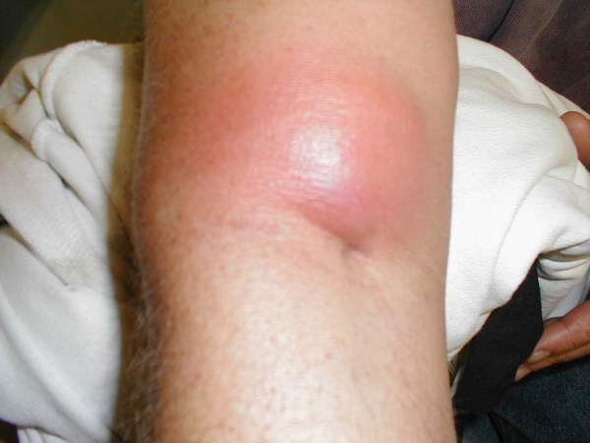
Case
32 yo male brought in after “opioid overdose”
Brisk response to naloxone
Re-sedation after 1 hr requiring repeat naloxone
Antecubital abscess and cellulitis at injection site
Admitted for “drug overdose”, “persistent altered mental status” and “arm cellulitis”

Slide 3
Trends in Opioid Overdose Deaths
6/2019 - 6/2020
>83,000 OD deaths
Highest number in a 12-month period
21% increase compared to the previous year
National Vital Statistics System. 2021, www.cdc.gov/nchs/nvss/
Hedegaard H et al. National Center for Health Statistics. 2020

Slide 4
Natural History of Opioid Use Disorder
Euphoria
Normal
Withdrawal
Tolerance & Physical Dependence
Initial use
Chronic use
Alford DP. http://www.bumc.bu.edu/care/

Slide 5
Case continued
Substance use history
Daily heroin use
Intranasal use for 6 months then IV for 7 years
History of 2 overdoses
Had been in recovery for 2 years by going to NA but relapsed 3 months ago
History of 10 detox’s, no treatment with medications
No other drug, alcohol or tobacco use
HIV and hepatitis C negative
Unemployed electrician
Lives with wife (in recovery) and 2 young children
Now complaining of opioid withdrawal
How will you assess and treat him?
Notes:
2

Slide 6
Opioid Use Disorder Complex Provider/Patient Experience
Study conducted on the inpatient medical service of a public urban teaching hospital
Qualitative analysis on the interactions with illicit opioid-using patients and their medical teams identified 4 common themes
Merrill JO, et al. J Gen Intern Med. 2002

Slide 7
Provider Perspective
1. Physician Fear of Deception
Physicians question the “legitimacy” of need for opioid analgesics (“drug seeking” patient vs. legitimate need).
“All of us go through a little bit of a hitch every time we are requested to prescribe narcotics for our patients....Are they trying to get more out of me than they really should have? The last thing I want to do is over-dose them or reinforce this behavior (of) trying to coax more drugs out of you.”
-Senior Medical Resident
Merrill JO, et al. J Gen Intern Med. 2002

Slide 8
Patient Perspective
2. No Standard Approach
The evaluation and treatment of pain and withdrawal is extremely variable among physicians and from patient to patient. There is no common approach nor are there clearly articulated standards.
“The last time, they took me to the operating room, put me to sleep, gave me pain meds, and I was in and out in two days.. . .This crew was hard! It’s like the Civil War. ‘He’s a trooper, get out the saw’. . .’”
-Patient w/ Multiple Encounters
Merrill JO, et al. J Gen Intern Med. 2002

Slide 9
Patient Perspective
3. Avoidance
Physicians focused primarily on familiar acute medical problems and evaded more uncertain areas of assessing or intervening in the underlying addiction problem-particularly issues of pain and withdrawal.
Patient/Resident Dialog
Resident: “Good Morning”
Patient: “I’m in terrible pain.”
Resident: “This is Dr. Attending, who will take care of you.”
Patient: “I’m in terrible pain.”
Attending: “We’re going to look at your foot.”
Patient: “I’m in terrible pain.”
Resident: “Did his dressing get changed?”
Patient: “Please don’t hurt me.”
Merrill JO, et al. J Gen Intern Med. 2002

Slide 10
Patient Perspective
4. Patient Fear of Mistreatment
Patients are fearful they will be punished for their drug use by poor medical care.
“I mentioned that I would need methadone, and I heard one of them chuckle. . .in a negative, condescending way. You’re very sensitive because you expect problems getting adequate pain management because you have a history of drug abuse. . .He showed me that he was actually in the opposite corner, across the ring from me.”
-Patient
Merrill JO, et al. J Gen Intern Med. 2002

Slide 11
Opioid Withdrawal Assessment
Grade
Symptoms / Signs
0
Anxiety, Drug Craving
1
Yawning, Sweating, Runny nose, Tearing eyes, Restlessness Insomnia
2
Dilated pupils, Gooseflesh, Muscle twitching & shaking, Muscle & Joint aches, Loss of appetite
3
Nausea, extreme restlessness, elevated blood pressure, Heart rate > 100, Fever
4
Vomiting / dehydration, Diarrhea, Abdominal cramps, Curled-up body position
Clinical Opiate Withdrawal Scale (COWS): pulse, sweating, restlessness & anxiety, pupil size, aches, runny nose & tearing, GI sx, tremor, yawning, gooseflesh (score 5-12 mild, 13-24 mod, 25-36 mod severe, 36-48 severe)

Slide 12
Inpatient Goals
Prevent/treat acute opioid withdrawal
Inadequate treatment may prevent full treatment of medical/surgical condition
Don’t expect to cure OUD during hospitalization
Withholding opioids will not cure patient’s OUD
Giving opioids will not worsen patient’s OUD
Diagnose and treat medical illness
Initiate addiction treatment referral
Notes:
6

Slide 13
Inpatient Treatment of Opioid Withdrawal
Methadone
Start w/ 20 mg
Reassess q 2-3 h, give additional 5-10 mg until withdrawal signs abate
Don’t exceed 40 mg/24 hrs
Buprenorphine
Start with 4 mg
Reassess q 2-3 h, give additional 4 mg until withdrawal signs abate
Don’t exceed 16 mg/24 hrs
Monitor for CNS and respiratory depression
Give same dose each daily including day of discharge
Don’t give a methadone prescription
Can give a buprenorphine prescription if you are waivered
Boston Medical Center protocol updated 2019
Notes:
9

Slide 14
Case continued
Hospital course
Arm abscess I and D, cellulitis treated with IV Vancomycin
Opioid withdrawal management
Day 1 Methadone 20 mg
Day 2
Very anxious, demanded increase in methadone
Off the floor for 2+ hours
Repeat urine drug test was positive for “opiates”
Notes:
11

Slide 15
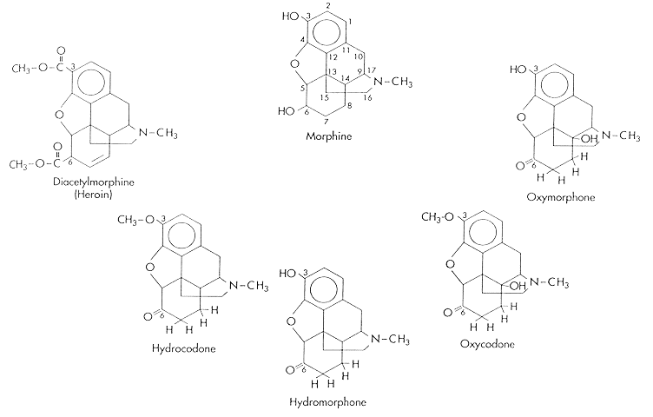
Opiates: Codeine and Morphine
Opioids
Natural (Opiates)
Diacetylmorphine (Heroin)
Oxymorphone
Semisynthetic
Hydrocodone
Oxycodone
Hydromorphone
Synthetic
Methadone
Meperidine
Fentanyl
Notes:
Opioids
So, let’s move on to opioid pharmacotherapy. And that really starts with opiates, the natural compounds codeine, and morphine. And you can take these natural compounds, and bring them to the lab, and alter them, and create semisynthetic opioids, like diacetylmorphine, which is heroin, or hydrocodone, hydromorphone, oxycodone. And the important thing to remember here is that these semisynthetic opioids came from codeine and morphine, and they can convert back to morphine and codeine in the body and show up in the urine as an opiate.
We’re going to talk more about urine drug testing later on, but it’s important to remember that when you send a urine in that says opiate positive, the person is either taking codeine or morphine, or they’re taking a semisynthetic opioid that converted back to an opiate. But that’s different than the synthetic opioids, like methadone, meperidine, and fentanyl. They never came from an opiate, and they will never turn your urine positive for an opiate.

Slide 16
Case continued
6 months later
He presents to your primary care clinic requesting referral to “detox” for his heroin addiction
He has been using heroin since the day he left the hospital

Slide 17
Opioid Detoxification Outcomes
Low rates of retention in treatment
High rates of relapse post-treatment
< 50% abstinent at 6 months
< 15% abstinent at 12 months
Increased rates of overdose due to decreased tolerance
O’Connor PG JAMA 2005
Mattick RP, Hall WD. Lancet 1996
Stimmel B et al. JAMA 1977

Slide 18
Reasons for Relapse
Protracted abstinence syndrome
Secondary to derangement of endogenous opioid receptor system
Symptoms
Generalized malaise, fatigue, insomnia
Poor tolerance to stress and pain
Opioid craving
Conditioned cues (triggers)
Priming with small dose of drug

Slide 19
Medications for OUD Treatment
Options
Naltrexone (full opioid antagonist)
Opioid Agonist Therapy (OAT)
Methadone (full opioid agonist)
Buprenorphine (partial opioid agonist)
Goals
Alleviate physical withdrawal (OAT)
Opioid blockade
Alleviate drug craving
Normalized brain changes

Slide 20
Naltrexone
Pure opioid antagonist
Patients physically dependent must be opioid free for a minimum of 7-10 days before treatment
Oral naltrexone (FDA approved 1984)
Well tolerated, safe, duration of action 24-48 hours
No statistically significant difference compared to placebo (Minozzi S et al. 2011)
Only 28% of people were retained in treatment in the included studies
More effective than placebo when patients legally mandated to take it
Injectable XR naltrexone (FDA approved 2010)
IM w/ customized needle/month

Slide 21
Injectable Naltrexone (XR-NTX)
Multicenter (13 sites in Russia) funded by Alkermes
DB RPCT, 24 wks, n=250 w/ opioid use disorder
All offered biweekly individual drug counseling
Results
Weeks of confirmed abstinence (90% vs 35%)
Craving (-10 vs +0.7)
Krupitsky E, et al. Lancet, 2011

Slide 22
XR-NTX Retention is Poor
Mean doses (max 6)
Heroin users 2.3
Non-heroin opioid users 2.5
Drop out risk factors
Homelessness
Opioid injection use (regardless of opioid-type)
Mental illness
N=171
Cousins SJ et al. J Sub Abuse Treat 2016
Notes:
171 participants. Three medication hubs were set up across LA County to provide XR-NTX to patients who were referred from SUD treatment centers. These medication hubs were residential SUD treatment centers that had the staffing and facilities to administer and store themedication.
3.1.2. XR-NTX retention rates
Of the 171 patients who received XR-NTX, the mean number of doses received was 2.4 (SD = 1.5); 40.9% (n = 70) received one dose only, 19.3% (n = 33) two doses, 14.6% (n = 25) three doses, 16.4% (n = 28) four doses, 4.1% (n = 7) five doses, 2.9% (n = 5) six doses, and 1.8% (n = 3) seven or more doses.
3.1.3. Heroin versus non-heroin opioid users
The mean number of XR-NTX injections received by heroin users was 2.3 (SD = 13), compared to 2.5 received by non-heroin opioid users (SD = 1.7, p = 0.25). Heroin users and non-heroin opioid users had similar dropout rates
Non-heroin opioid users and heroin userswere retained in XR-NTX treatment for comparable
periods of time. However, those who identified as homeless, injected opioids (regardless of opioid-type),
or were diagnosed with a mental illness were less likely to be retained in treatment with XR-NTX.

Slide 23
Opioid Agonist Treatment (OAT)
Euphoria
Normal
OAT
Withdrawal
Tolerance & Physical Dependence
Initial use
Chronic use
Alford DP. http://www.bumc.bu.edu/care/

Slide 24
Methadone Maintenance Treatment
Methadone
Full opioid agonist
PO onset of action 30-60 minutes
Duration of action 24-36 hours to treat OUD
Proper dosing for OUD
20-40 mg for acute withdrawal
> 80 mg for craving, “opioid blockade”
Opioid Treatment Program
Highly structured
Observed daily → “Take homes”

Slide 25
Extensive Research on Effectiveness
JAMA 1965
Increases treatment retention
Decreases illicit opioid use
Decreases hepatitis and HIV seroconversion
Decreases mortality
Decreases criminal activity
Increases employment
Improves birth outcomes

Slide 26
Methadone Maintenance Limitations
Highly regulated - Narcotic Addict Treatment Act 1974
Limited access
Inconvenient and highly punitive
Mixes stable and unstable patients
Lack of privacy
No ability to “graduate” from program
Stigma “Substituting one drug for another…I don’t believe in methadone”

Slide 27
Drug Addiction Treatment Act (DATA) 2000
Qualified physician (e.g., 8 h training “X waiver”) to prescribe scheduled III - V, narcotic FDA approved for OUD treatment (i.e., buprenorphine) with patient limits (30 →100 → 275)
Comprehensive Addiction and Recovery Act (CARA) 2016
Expands to qualified advanced practice providers (e.g., NPs, PAs)
Require 24 hours of training
Must be supervised by qualifying physician if required by state law

Slide 28
Practitioners (MD/DO, PAs, NPs, clinical nurse specialists, RN anesthetists, nurse midwives) licensed under state law w/ valid DEA registration, may be exempt from required training, counseling and other ancillary services
30 patient limit
Must obtain a waiver by submitting a Notice of Intent to SAMHSA
Practitioners who do not wish to practice under the exemption and its 30 patient limit may seek a waiver per established protocols

Slide 29
Buprenorphine
Semi-synthetic analogue of thebaine
FDA approved 2002 as schedule III – up to 5 refills
High receptor affinity
Slow receptor dissociation
Ceiling effect on CNS and respiratory depression
Mu-opioid receptor partial agonist
Kappa-opioid receptor antagonist (antidepressant and anxiolytic effects)

Slide 30
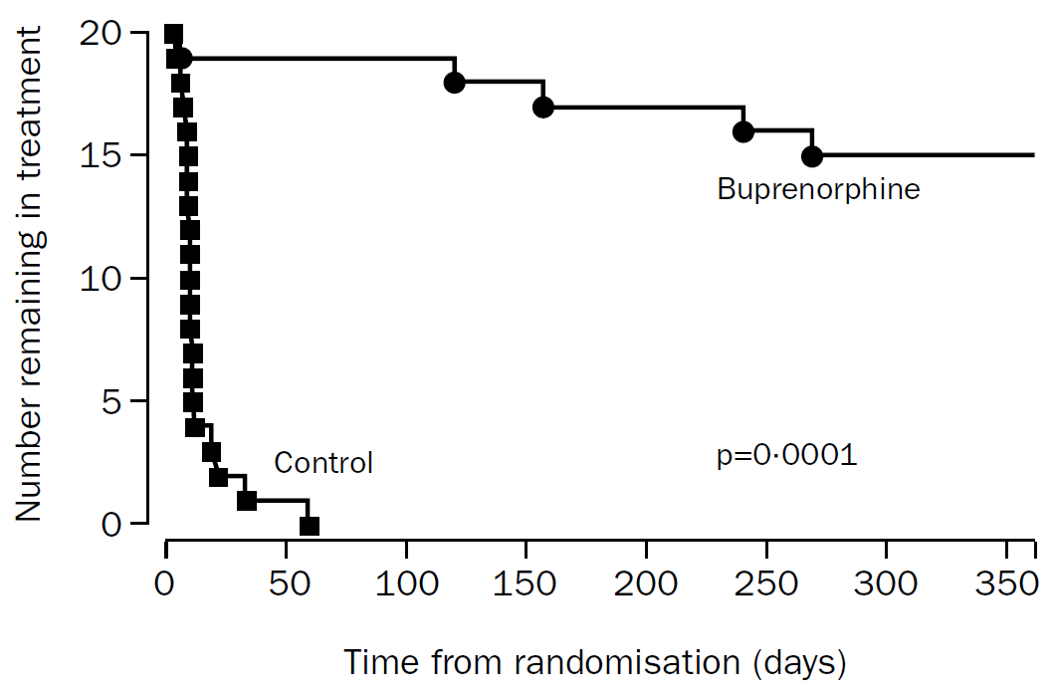
Buprenorphine Maintenance vs Taper
Completion 52 wk trial:
Taper 0%
Maintenance 75%
Mean % urine neg:
Maintenance 75%
Mortality
Taper 20%
Maintenance 0%
Kakko J et al. Lancet 2003

Slide 31
Buprenorphine Formulations
Drug |  | Formulations | Maintenance
Buprenorphine
 | generic | SL tabs | 16 mg/d
 | Probuphine | SD implant | 4 implants/6m
 | Sublocade | SQ injection | 100 mg/m
Buprenorphine/Naloxone
 | generic | SL tabs | 16/4 mg/d
 | Bunavail | buccal film | 8.4/1.4 mg/d
 | Suboxone | SL film | 16/4 mg/d
 | Zubsolv | SL tab | 11.4/2.8 mg/d
The Medical Letter 2/2018

Slide 32
Buprenorphine Efficacy Summary
Studies (RCT) show buprenorphine (16-24 mg) more effective than placebo and equally effective to moderate doses (80 mg) of methadone on primary outcomes of:
Retention in treatment
Abstinence from illicit opioid use
Decreased opioid craving
Decreased mortality
Improved occupational stability
Improved psychosocial outcomes
Johnson et al. NEJM 2000
Fudala PJ et al. NEJM 2003
Kakko J et al. Lancet 2003
Sordo L et al. BMJ 2017
Mattick RP et al. Conchrane Syst Rev 2014
Parran TV et al. Drug Alcohol Depend 2010

Slide 33
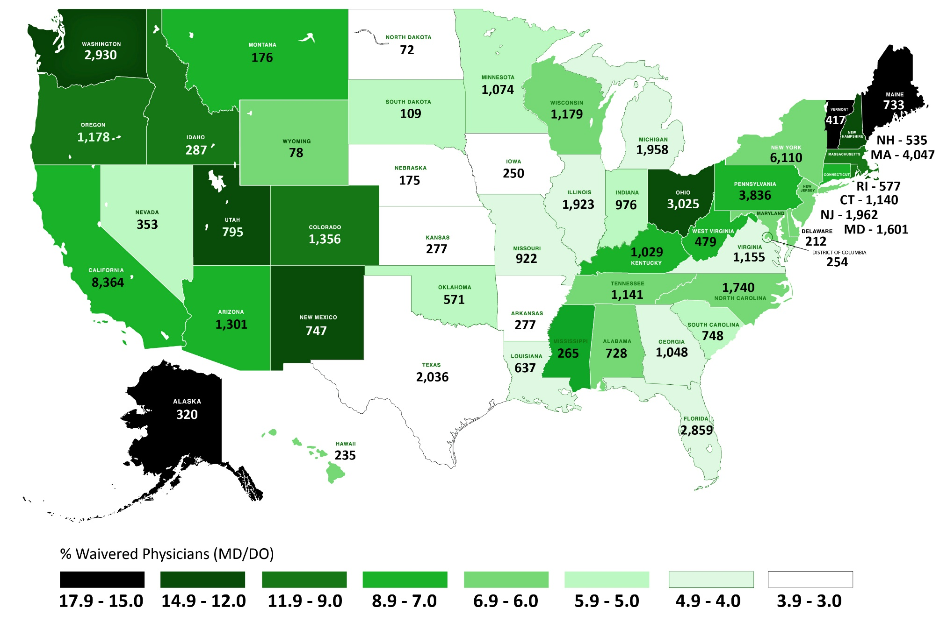
Percent Waivered Physicians by State
Waivered
All Physicians: 6.5% (66,197/1,022,006)
PCPs: 13.6% (66,197/486,405)
SAMHSA 2020 Image by Andrew Paraskevas, BUSM CME

Slide 34
Starting Medications for OUD Wherever Patients Present
Inpatient Service (Liebschutz JM et al. JAMA Intern Med. 2014)
Compared with an inpatient detoxification, initiation of and linkage to buprenorphine treatment is effective for engaging medically hospitalized patients who are not seeking addiction treatment and reduces illicit opioid use 6 months after hospitalization
Emergency Department (D’Onofrio G et al. JAMA. 2015)
ED-initiated buprenorphine treatment vs brief intervention and referral significantly increased engagement in addiction treatment, reduced self-reported illicit opioid use

Slide 35
Medication for OUD (MOUD) after Opioid Overdose
Data from multiple Massachusetts administrative systems (2011-2015)
Retrospective cohort of overdose survivors (N=17,568)
For the 12 months after the index overdose only 17% received buprenorphine, 11% received methadone, and 6% received naltrexone
Compared with no MOUD, receipt of buprenorphine or methadone was associated with a two-thirds reduction in death (all-cause and opioid-related mortality)
Larochelle MR , et al. Ann Intern Med. 2018

Slide 36
Major Barriers to Use of Medications for OUD
Delay between OUD onset and MOUD receipt 4-7 yr
Misunderstanding and stigma toward drug addiction, individuals with OUD, and the medications to treat it
Inadequate education of health professionals
Current regulations around methadone and buprenorphine, such as waiver policies, patient limits, restrictions on settings, and other policies that are not supported by evidence or employed for other medical disorders
National Academies of Sciences, Engineering, and Medicine. 2019. The National Academies Press.

Slide 37
Opioid Agonist Treatment (OAT) and Acute Pain Management
Patients with an OUD on OAT (i.e. methadone or buprenorphine) have less pain tolerance then matched controls
Patients who are physically dependent on opioids (i.e. methadone or buprenorphine) must be maintained on a daily equivalence before ANY analgesic effect is realized with opioids used for acute pain management
Opioid analgesic requirements are often higher due to increased pain sensitivity and opioid cross tolerance
Alford DP, Compton P, Samet JH. Ann Intern Med 2006
Alford DP. Handbook of Office-Based Buprenorphine Treatment of Opioid Dependence 2nd ed. American Psychiatric Publishing, Inc. (APPI) Arlington, VA. 2018

Slide 38
Thanks! Questions?

