Slide 1

Stimulants: Cocaine and Methamphetamine
CRIT/FIT/JFIT/AFIT program – October 2020
Alex Walley, MD, MSc

Slide 2
Learning objectives
At the end of this session, participants will be able to:
Understand how and why people use stimulants
Know the characteristics of stimulant intoxication and withdrawal syndromes
Understand the consequences of these drugs
Know the current options for treatment of stimulant dependence

Slide 3
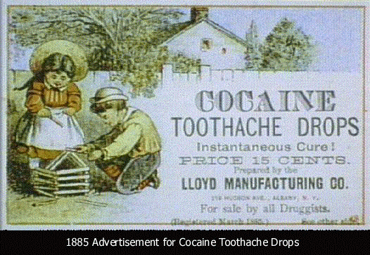
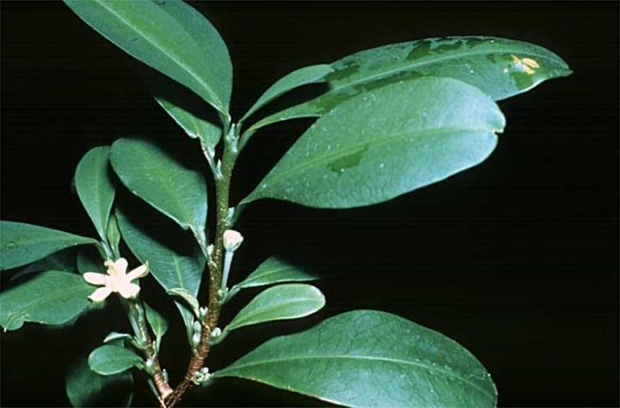
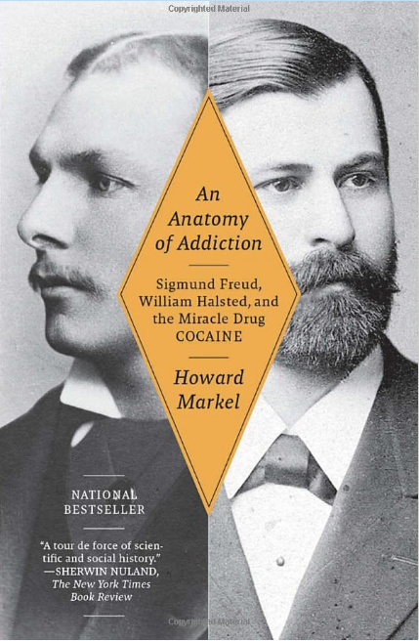
History: Cocaine
From erythroxylon coca leaves in Andes
Leaves chewed for thousands of years as stimulant
1884 Freud published, Uber Coca, describing cocaine’s effects on Freud and its potential to treat opiate addiction
1885 Halsted published study about anesthetic uses
1886 Halsted raided ship medicine cabinet for fix
Used in medicines and beverages until early 1900s
Street preparations 10-50% cocaine
  Hydrochloride powder is snorted or injected
  Alkaline rocks (aka crack) are smoked
  Crack, Rock, Base

Slide 4
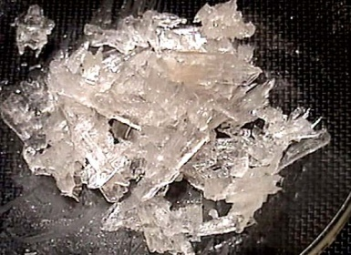
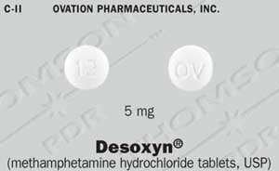
History: Methamphetamine
1893 methamphetamine first synthesized in
Japan as decongestant
Used by German, English, American, and Japanese military in WWII for performance enhancement.
First epidemic occurred in Japan when the military dumped large quantities into the civilian market
Popular among truckers and west coast bikers in 1970s
DESOXYN to treat ADHD and obesity
Speed, Crystal, Crank, Ice, Meth, Tina
Lineberry 2006

Slide 5
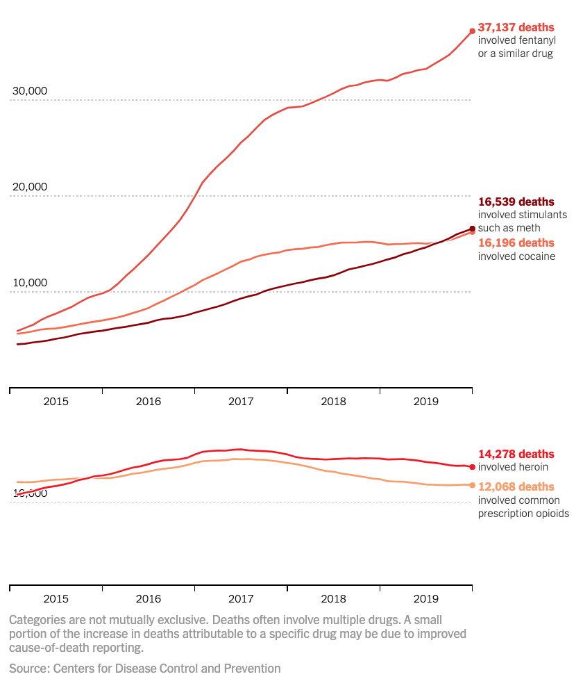
Stimulant-involved overdose deaths
surging with opioids
Katz, J. The First Count of Fentanyl Deaths in 2016: Up 540% in Three Years. NYT – The UpShot 9/2/2017.

Slide 6
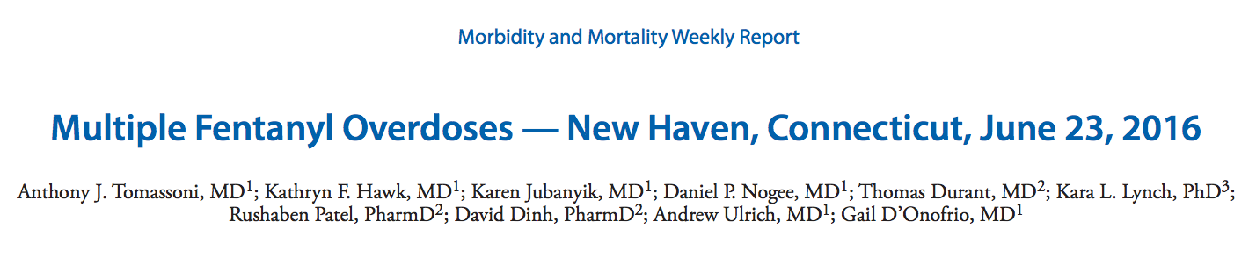
Over 8 hours at the ED of Yale Hospital, white powder advertised as cocaine resulted in 12 patients for signs of opioid overdose, presumed from snorting
9 admitted, 4 to ICU, 3 intubated, 1 on naloxone gtt, 3 died
High doses of naloxone required: 4mg and higher
Drug sample tested had 6.6% fentanyl by weight and trace amounts of cocaine + inert adulterant

Slide 7
Drug Abuse Warning Network 2011 Report: www.samhsa.gov/data/sites/default/files/DAWN127/DAWN127/sr127-DAWN-highlights.htm
Notes:
ED perspective

Slide 8
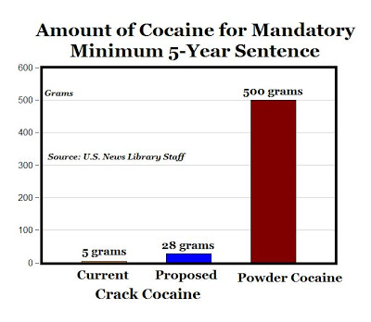
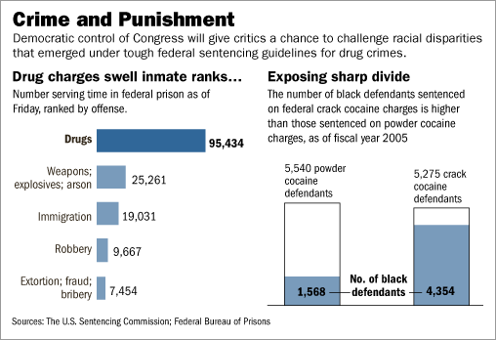
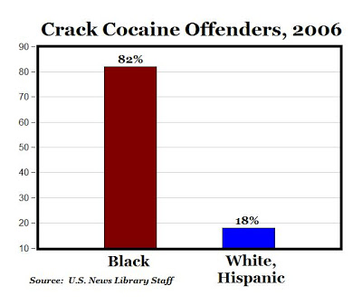
Despite harsher penalties for crack versus powder cocaine, crack use declined less than powder cocaine and even less than drugs not included in sentencing policies. These findings suggest that mandatory minimum sentencing may not be an effective method of deterring cocaine use.
Walker LS, Mezuk B. Mandatory minimum sentencing policies and cocaine use in the U.S., 1985-2013. BMC Int Health Hum Rights. 2018 Nov 29;18(1):43.
Racial minorities were at low risk for powder cocaine use and Hispanics were at low risk for crack use. Blacks were at increased risk for lifetime and recent crack use, but not when controlling for other socioeconomic variables.
Palamar JJ, Davies S, Ompad DC, Cleland CM, Weitzman M. Powder cocaine and crack use in the United States: an examination of risk for arrest and socioeconomic disparities in use. Drug Alcohol Depend. 2015 Apr 1;149:108-16.
Notes:
WSJ 12/26/2006 - https://www.wsj.com/articles/SB116709740054459343
https://www.aei.org/carpe-diem/from-100-1-to-18-1-improved-disparity-for-double-standard-racist-minimum-drug-sentencing/
Walker LS, Mezuk B. Mandatory minimum sentencing policies and cocaine use in the U.S., 1985-2013. BMC Int Health Hum Rights. 2018 Nov 29;18(1):43.

Slide 9
Stimulant Effects

Slide 10
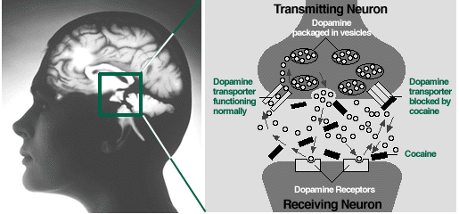
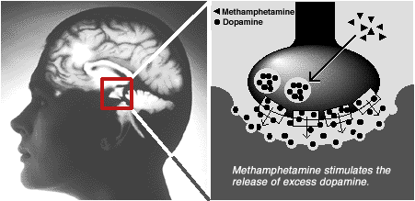
Cocaine
Methamphetamine

Slide 11
PK: Cocaine
 | IV | Smoked | Snorted
Time to effect | 10-60sec | 3-5sec | 1-5min
Peak concent. | 3-5min | 1-3min | 15-20min
Half-life | 20-60min | 5-15min | 60-90min
Lange, R. A. and L. D. Hillis (2001). "Cardiovascular complications of cocaine use." N Engl J Med 345(5): 351-8.
PK: Methamphetamine
 | IV | Smoked | Snorted | Ingested
Time to effect | 15-30 sec | Immediate | 3-5 min | 15-20 min
Peak concent. | 2-4 h | 2-4 h | 2-4 h | 2-4 h
Half-life | 10-12 h | 10-12 h | 10-12 h | 10-12 h
Lineberry 2006
Notes:
In effort to recapture initial rush, people use repetitively, despite mounting levels drug. Acute tolerance to this rush develops, leaving the binger in the “tweaking” state. Eventually use ceases, perhaps after days, ending in crash into nonrestful sleep.
The rush that users get from IV use and smoking is similar in both cocaine and MA. The rush is the most reenforcing part of using. Acute tolerance occurs to this rush occurs quickly and requires repeated administration to recapture this euphoria. HOWEVER, cocaine has a half-life of about 90 minutes compared to 10-12 hours for MA. Thus the buildup of MA levels during repetitive use (seen during binging) can be very high compared to cocaine. This buildup explains the “tweaker” state – restless anxiety, irritability, fatigue, and dysphoria.

Slide 12
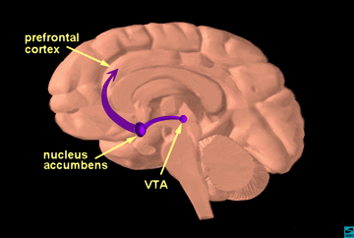
Why do people use stimulants?
Euphoria - Rush
  Onset and intensity depends on delivery method
Increased energy, alertness, libido
Diminished social inhibition
Decreased appetite
Notes:
MENTION DOPAMINE
So why do people use methamphetamine? Because it is highly re-enforcing, it feels good.

Slide 13






Notes:
Stimulant binge
Euphoria - Rush
Onset and intensity depends on delivery method
Increased energy, alertness, libido
Diminished social inhibition
Decreased appetite
For methamphetamine, there is acute tolerance to the euphoric/ rewarding effects, but the andrenergic effects persist and thus accumalte with repetitive use.

Slide 14
Acute Toxicity
Binges
2-3 day binges are typical, called runs
Regular re-dosing to maintain rush or high in setting of acute tolerance
Ends when drug or money runs out, or paranoia/ disorganized thinking sets in
Elevated BP and HR
Arrythmia
Vasoconstriction
Hyperthermia
Agitation
Rhabdomyolysis
Seizure
Acute psychosis → prolonged psychosis
  Paranoid delusions
  Visual, sensory, and auditory hallucinations
    ie formications

Slide 15
Stimulant Intoxication Treatment = De-escalation
Ten Domains of De-escalation:
1. Respect personal space
2. Do not be provocative
3. Establish verbal contact
4. Be concise
5. Identify wants and feelings
6. Listen actively; respond appropriately
7. Agree or agree to disagree
8. Lay down the law and set clear limits
9. Offer choices and optimism
10. Debrief the patient and staff.
Minimize sensory stimulation
Neuroleptics (ie haldol) for agitation
Benzos to control seizures
Treat hyperthermia (external cooling)
For increased BP+HR, use vasodilators and CCB or non-selective beta-blockers
Richmond JS, Berlin JS, Fishkind AB, et al. Verbal De-escalatio=n of the Agitated Patient: Consensus Statement of the American Association for Emergency Psychiatry Project BETA De-escalation Workgroup. West J Emerg Med. 2012;13(1):17-25. Available at: https://pubmed.ncbi.nlm.nih.gov/22461917/
Notes:
Supportive care

Slide 16
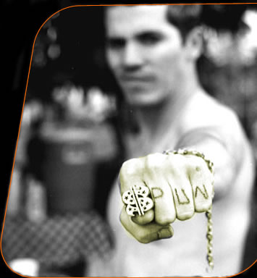
Dental
Darkened teeth
Caries
Periodontal disease
Neuro-psychiatric
Stroke
Seizure
Depression
Anxiety
Mania
Impulsivity
Paranoia
Auditory/ visual hallucinations + formications
Violence
Pulmonary
Acute pulmonary edema
Pulmonary HTN
Inhalation injury
Renal/Metabolic
Rhabdomyolisis
Dehydration
Acute Renal Failure
Acidosis
Hyperthermia
Cardiovascular
Hypertension
DCM
Arrythmia/ Tachycardia
Acute Coronary Syndrome
Aneurysm/ dissection
Erectile dysfunction
Infectious
HIV risk
HCV/ HBV
STDs
Skin
Cellulitis/ abscess
Excoriations
Chemical burns
Health Consequences

Slide 17
ETOH + Cocaine >> Cocaethylene
Psychoactive substrate from ETOH+cocaine
ETOH commonly used as “landing gear”
ETOH before cocaine inhibits cocaine metabolism, producing cocaethylene
60-90% of cocaine abusers abuse ETOH
Greater cardiac toxicity
Greater rates of seizures, hepatic damage
Notes:
Mention practice of buying alcohol with cocaine.
Is it to bring an endpoint or is itto potentiate the high?
Bottom line: Screen forETOH when you encounter cocaine user

Slide 18
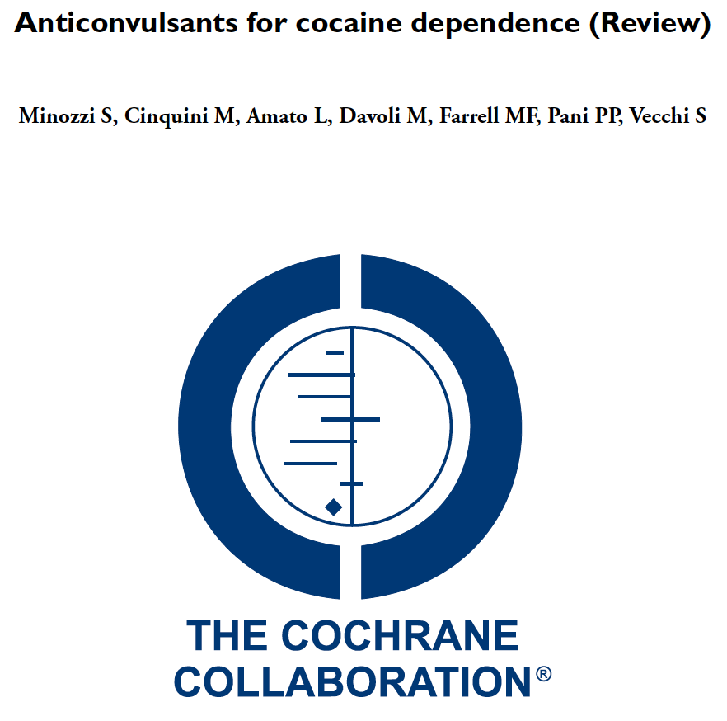
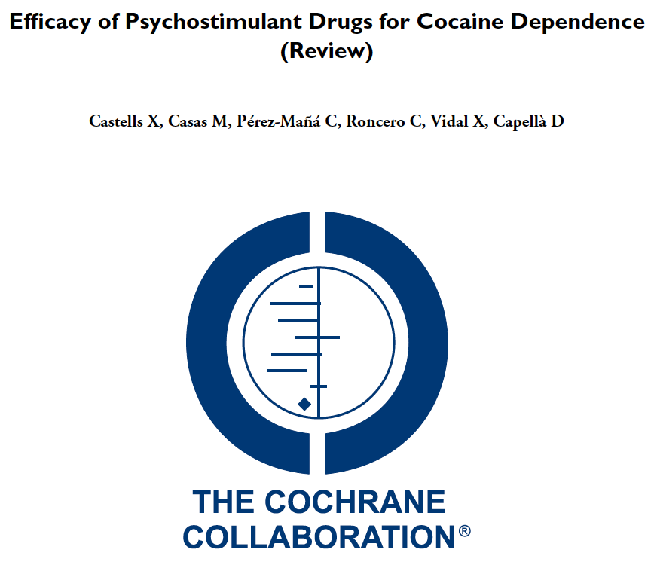
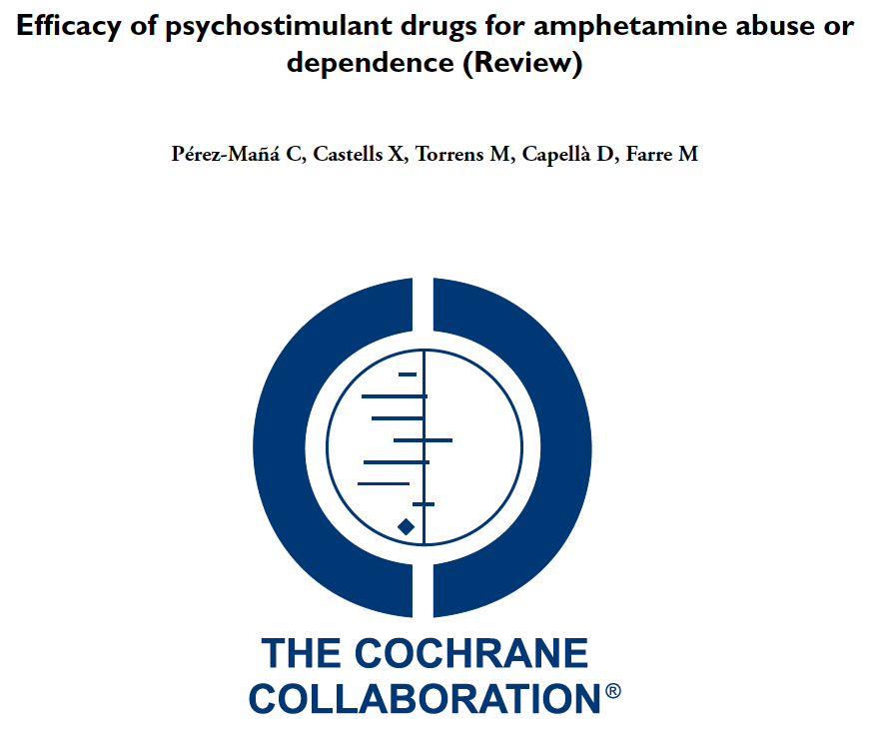
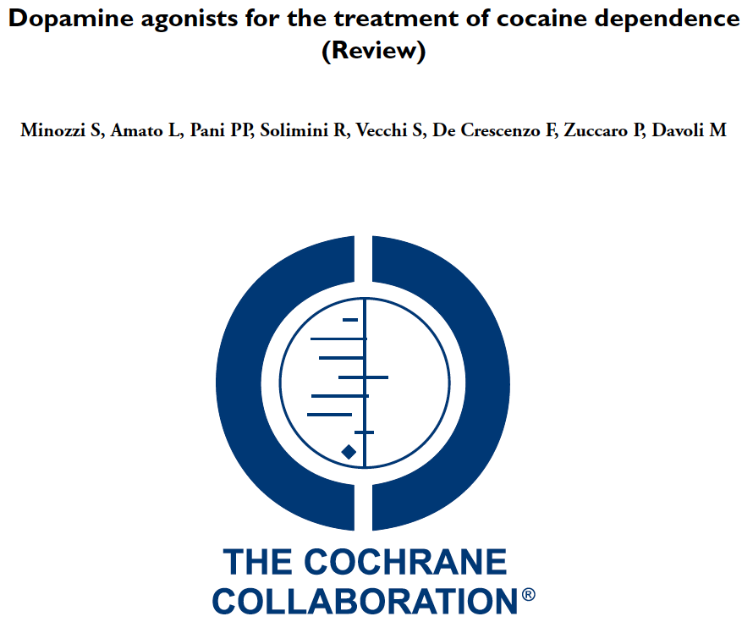
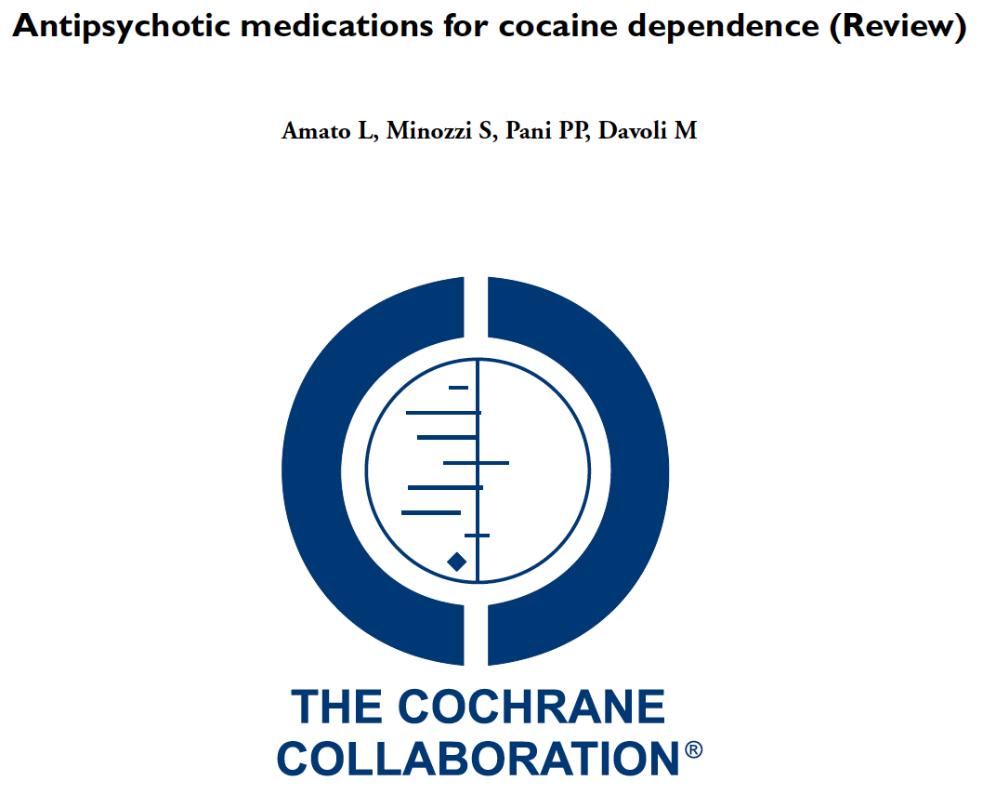
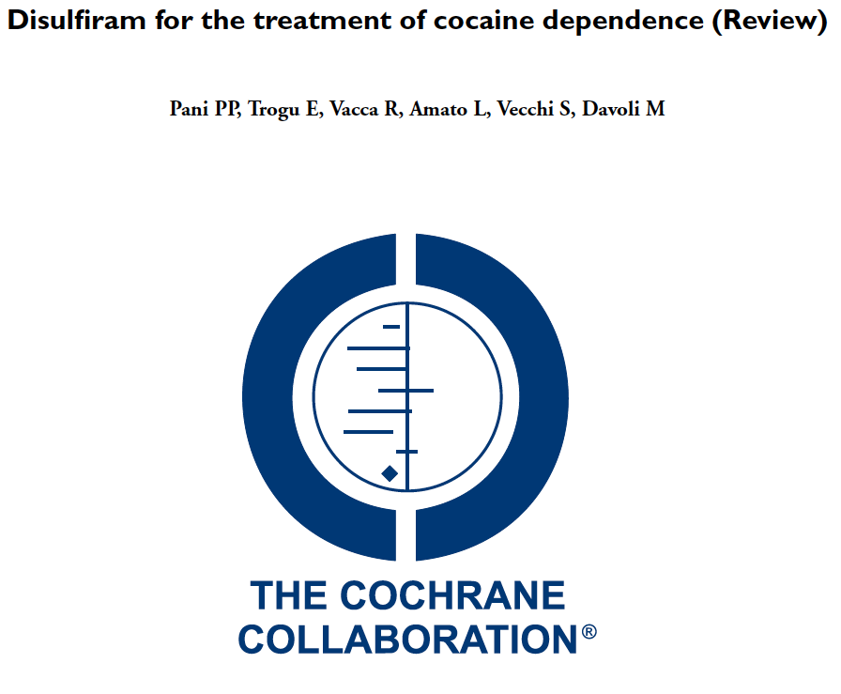
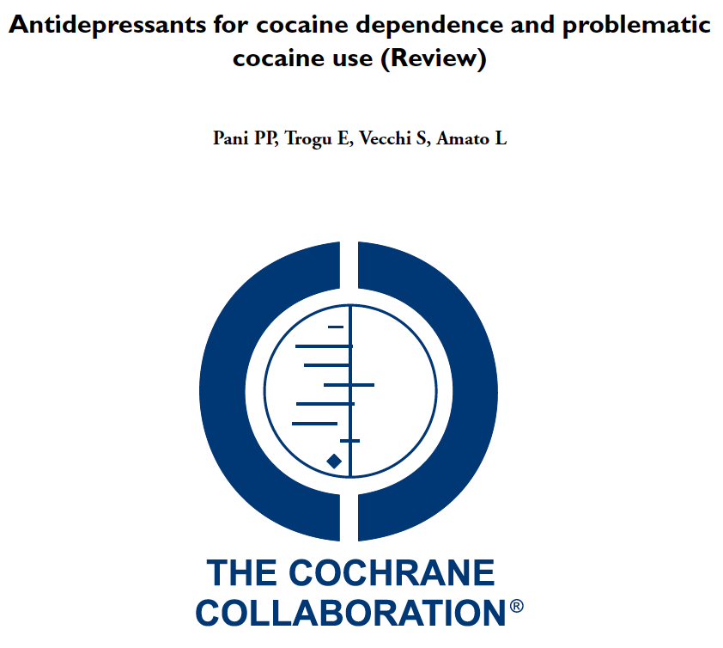
This review found mixed results. Psychostimulants improved cocaine abstinence compared to placebo in some analyses but did not improve treatment retention. Since treatment dropout was high, we cannot rule out the possibility that these results were influenced by attrition bias. Existing evidence does not clearly demonstrate the efficacy of any pharmacological treatment for cocaine dependence, but substitution treatment with psychostimulants appears promising and deserves further investigation.
Notes:
Castells X, Cunill R, Pérez‐Mañá C, Vidal X, Capellà D. Psychostimulant drugs for cocaine dependence. The Cochrane Library. 2016 Jan 1.
Pérez‐Mañá C, Castells X, Torrens M, Capellà D, Farre M. Efficacy of psychostimulant drugs for amphetamine abuse or dependence. Cochrane Database of Systematic Reviews. 2013(9).

Slide 19
Stimulant maintenance for people with concomitant ADHD or HUD
73 Dutch patients with cocaine UD on heroin+methadone maintenance
Dexamphetamine SR 60mg once daily observed vs. placebo
11% dropout
At 12 weeks
  45 versus 61 days of cocaine use
  21% versus 8% >= 1 cocaine-negative urine in last 4 weeks
  No differences in craving, use of other substances, or criminality
Nuijten M et al. Lancet. 2016; 387:2226-34.
126 US patients with adult-ADHD and cocaine UD
Mixed amphetamine salts SR 60 or 80mg once daily vs. placebo
Weekly CBT groups
26% dropped out
At 13 weeks
  Reduced ADHD symptoms: 60-75% vs 40%
  3-wk abstinence: 30-17% vs. 7%
Levin FR et al. JAMA Psychiatry. 2015 1;72:593-602.

Slide 20
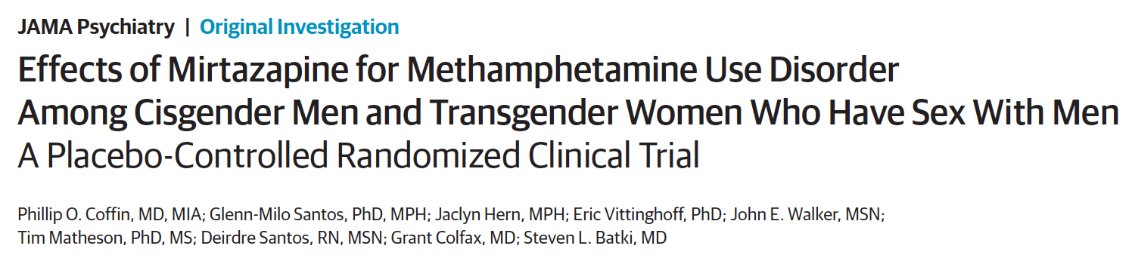
120 men who have sex with men who use methamphetamine
Randomized to mirtazapine 30mg or placebo once daily for 24 week + counseling
Medication adherence was almost 40%
Mirtazapine group had at 24 weeks
  RR of 0.75 for MA use
  RR <0.52 for multiple sex partners, condomless anal sex
  Improved depressive symptoms and insomnia severity

Slide 21
Single infusion of ketamine for cocaine use disorder
55 inpatients with CUD were randomized to a 40minute infusion of ketamine at 0.5mg/kg vs. midazolam. Both arms received 5-weeks of mindfulness based relapse prevention counseling, daily for 4 days, then weekly for 4 weeks
Ketamine 48% vs. midazolam 11% 2-week abstinence at 5weeks
Ketamine group 53% less likely to relapse
Ketamine group 58% lower craving scores
44% reported 6mo abstinence in ketamine group; 0 in the midazolam group
Dropout: 7 of 27 in ketamine; 16 of 28 inmidazolam
Dakwar E, Nunes EV, Hart CL, Foltin RW, Mathew SJ, Carpenter KM, Choi CJJ, Basaraba CN, Pavlicova M, Levin FR. A Single Ketamine Infusion Combined With Mindfulness-Based Behavioral Modification to Treat Cocaine Dependence: A Randomized Clinical Trial. Am J Psychiatry. 2019 Nov 1;176(11):923-930.
Notes:
Dakwar E, Nunes EV, Hart CL, Foltin RW, Mathew SJ, Carpenter KM, Choi CJJ, Basaraba CN, Pavlicova M, Levin FR. A Single Ketamine Infusion Combined With Mindfulness-Based Behavioral Modification to Treat Cocaine Dependence: A Randomized Clinical Trial. Am J Psychiatry. 2019 Nov 1;176(11):923-930.

Slide 22
Non-medical treatment for addiction
Physician advice and brief intervention
  Evidence is limited to non-dependent, risky alcohol use
  Except Bernstein et al. DAD 2005: 77; 49
Motivational enhancement therapy
Cognitive behavior therapy
Exercise-supported recovery
12-step facilitation
Contingency management
All treatments require adherence
Notes:
Wang D, Zhou C, Zhao M,Wu X, Chang YK.
Dose-response relationships between exercise
intensity, cravings, and inhibitory control in
methamphetamine dependence: an ERPs study.
Drug Alcohol Depend. 2016;161:331-339.

Slide 23
Evidence for Contingency Management for stimulants
Systematic Review – Schierenberg 2012 – 19 studies
CM in combination with other treatment
  Increases cocaine abstinence
  Improves treatment retention
  May act synergistically with medications
RCT in 6 community methadone programs of CM among stimulant users
Usual Care vs.
Intermittent, escalating re-enforcement
  1000 chips
    500 “Good job”
    250 “Small” - $1 value – i.e. toiletries
    209 “Large” - $20 value – i.e. kitchenware
    1 “Jumbo” – $80-100 value – tv, stereo
  # of draws = # of weeks with clean urine
Peirce et al. Arch Gen Psychiatry. 2006;63:201-208.
Notes:
With contingency management mention drug courts and appointment intervals

Slide 24
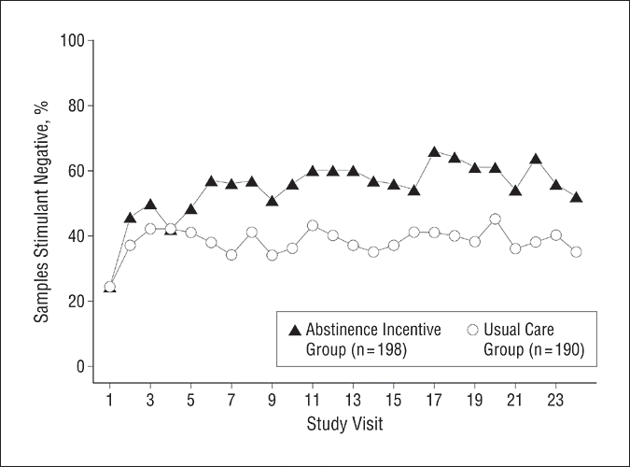
Contingency Management
  The mean percentage of submitted samples testing negative for target drugs (stimulants and alcohol) is shown for abstinence incentive and usual care participants at each of 24 study visits.
  Average cost = $1.46 per person/day
Peirce et al. Arch Gen Psychiatry. 2006;63:201-208
Notes:
With contingency management mention drug courts and appointment intervals

Slide 25
How can we help our stimulant-using patients?
Decriminalize substance use
Ask and educate about medical complications, overdose
Harm reduction – safer use techniques
Recommend psychosocial treatment, especially contingency management
Stimulants have shown some promise for cocaine, but no medications have shown consistent, convincing evidence for effectiveness
Advocate, research and develop novel strategies in the treatment of stimulant use disorders

Slide 26
Learning objectives
At the end of this session, participants will be able to:
Understand how and why people use stimulants
Know the characteristics of stimulant intoxication and withdrawal syndromes
Understand the consequences of these drugs
Know the current options for treatment of stimulant dependence

Slide 27
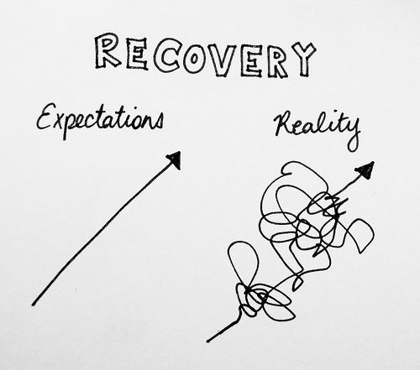

Realistic Expectations!
Addiction is a chronic relapsing condition
Over time treatment works
People get better, if the stay alive
Engage people before, at, and after health system touchpoints awalley@bu.edu

Slide 28
Dynamic Cycle of Stimulant Addiction
Cocaine
+
Cocaine Euphoria
Positive Reinforcement
Activated Reward Pathways
DA/Glutamate
Cocaine Administration
Drug-Seeking Behavior
Failed Impulse Suppression
Multiple Risks/Hazards
Reward Dysregulation
Cocaine Withdrawal
DA/Glutamate
Dynorphin/GABA
-
Cocaine Craving
Negative Reinforcement
DA/Glutamate
Loss of Control
Denial / Poor Decision-Making
Hypofrontality / Low D2
Reduced Gray Matter Density
Cocaine Cues
Limbic Activation
DA/Glutamate
Stress
Slide from Nadia Fairbairn

Slide 29
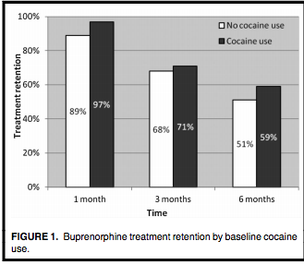
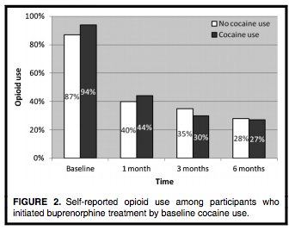
Cocaine use at beginning of buprenorphine treatment
Cunningham et al. Am Journal Addictions 2013: 22; 352-357.

Slide 30
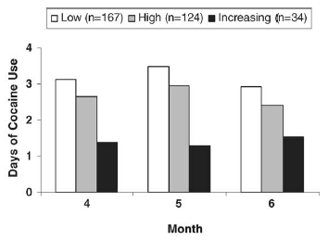
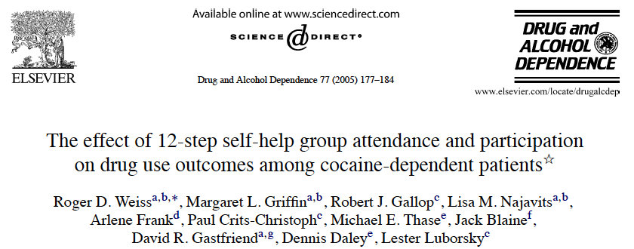
487 cocaine-dependent outpatients.
12-step active participation (i.e. speaking at meetings, working the steps, having a sponsor) predicted reduced cocaine use in the following month
12-step meeting attendance did not predict subsequent drug use

Slide 31
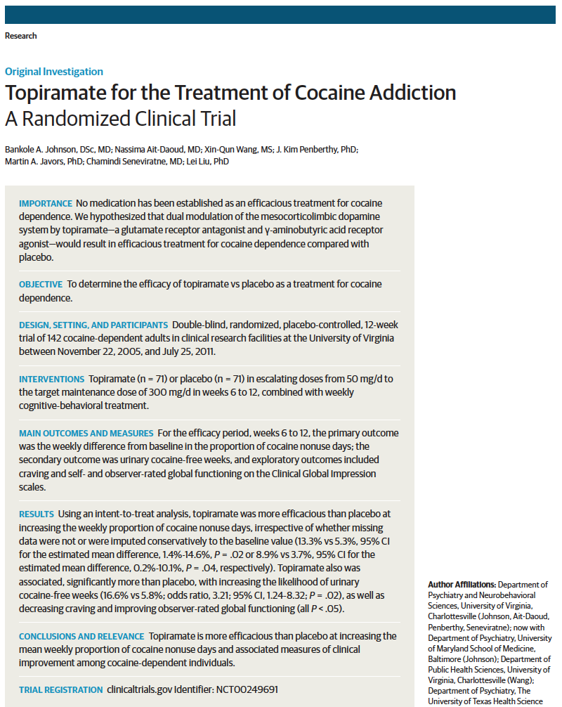

Slide 32
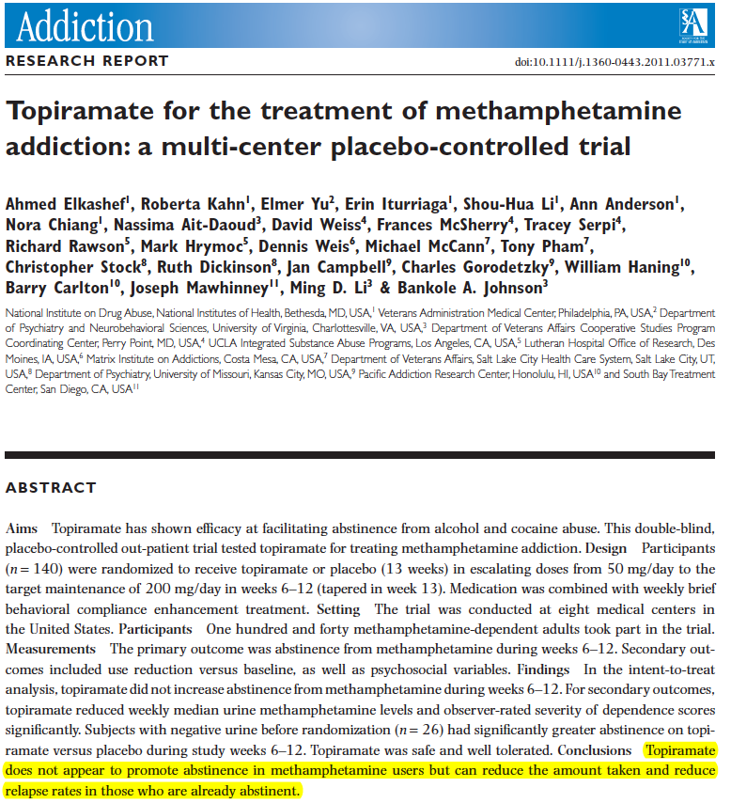

Slide 33
AHA 2011 Updated Scientific Statement on cocaine and methamphetamine unstable angina/NSTEMI
Class I: Benefit >>> Risk
  NTG and CCB for ST changes (Level C)
    Immediate cathif ST remain elevated after NTG and CCB (Level C)
      Fibrinolytics if cath not available
Class IIa: Benefit >> Risk
  NTG + CCB for normal ECGs or minimal ST changes (Level C)
  Cath for new persistent ST changes after NTG + CCB (Level C)
  Manage methamphetamine similarly to cocaine UA
Class IIb: Benefit ≥ Risk
  Non-selective beta-blockers for bp > 150/100 or HR > 100 after NTG or CCB
Class III: Risk ≥ Benefit
  Cath with no ST changes and negative stress test and troponins
Wright et al. JACC. 2011: 57; e215-367
All guidelines are Class 3 LIMITED evidence

Slide 34
Beta-Blockers in Cocaine Chest Pain
331 patients with chest pain and cocaine-positive urine test results admitted to San Francisco General Hospital between 2001-05
151 patients received a beta-blocker in ED
  85% received metoprolol
During the hospitalization
  SBP decreased more in ED beta-block group
  No differences in ECG results, troponin levels, intubation rates, vasopressor use, malignant ventricular arrhythmia rates, or death were found.
45 deaths over a median follow-up of 972 days
  Discharge on a beta-blocker regimen was associated with a lower risk of cardiovascular-specific death but not all-cause mortality
Rangel C, Shu RG, Lazar LD, et al. Beta-blockers for chest pain associated with recent cocaine use. Arch Intern Med. 2010;170(10):874–9.

Slide 35
Pharmacologic Treatment
Antipsychotics
  Amato. Cochr Database Syst Rev. 2007 Jul 18;(3):
Anticonvulsants - GABA modulators
  Carbamazepine, Phenytoin, Valproic Acid, Tigabine, Gabapentin, Lamotrigine – Alvarez. JSAT 2010: 38; 66-73.
  Baclofen – Heinzerling. Drug Alcohol Depend. 2006 Dec 1;85(3):177-84.
  Vigabatrin – Brodie. Am J Psychiatry. 2009;166:1269-77.
  Topiramate – Ekashef Addiction 2012: 107;1297-1306.
Stimulant replacement
  Modafinil – Shearer. Addiction. 2009 Feb;104(2):224-33.
  Dexamphetamine – Longo. Addiction 2009, 105, 146–154
Vaccine
  Martell. Arch Gen Psychiatry. 2009 Oct;66(10):1116-23.
Disulfiram – Pani. Cochr Database Syst Rev. 2010. Oliveto. Drug Alcohol Depend 2010
Notes:
Consider keeping this slide

Slide 36
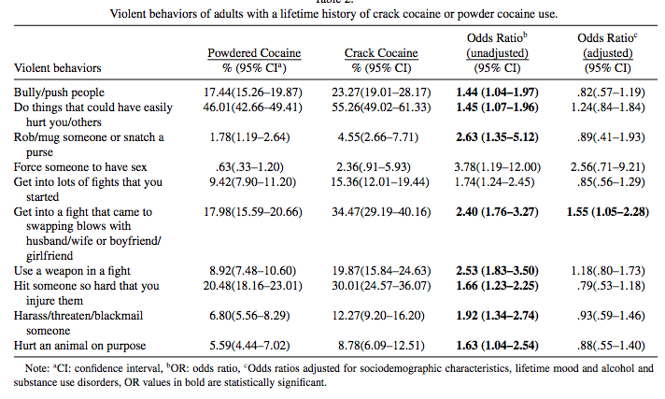
Does crack make people more violent than powder cocaine?
Vaughn et al. AM J Drug Alc Abuse 2010: 36; 181-186.

Slide 37
Contingency Management
Methadone Maintenance Patients With Specified Weeks of Continuous Stimulant/Alcohol-Negative Samples (n=388)
  Average cost = $1.46 per person/day
Pierce et al. Arch Gen Psychiatry. 2006;63:201-208.
Notes:
With contingency management mention drug courts and appointment intervals

Slide 38
Studies of the treatment for cocaine-related unstable angina with beta-blockers…
include randomized controlled trials that demonstrate that they save lives
include randomized controlled trials that demonstrate that they cause harm
include catheter studies in humans that show improved vasospasm with propranolol
include observational studies that show no increased adverse events among people receiving beta-blockers in the ED

Slide 39
Which statement is true about stimulants?
Methamphetamine is only used intravenously or smoked
Methamphetamine has a longer half-life than cocaine
Intravenous injection results in the fastest onset of action
Cocaine’s peak concentration occurs in about 1 hour

Slide 40
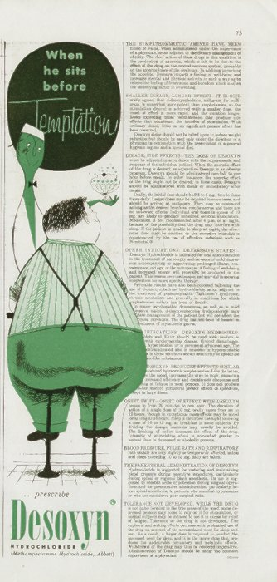
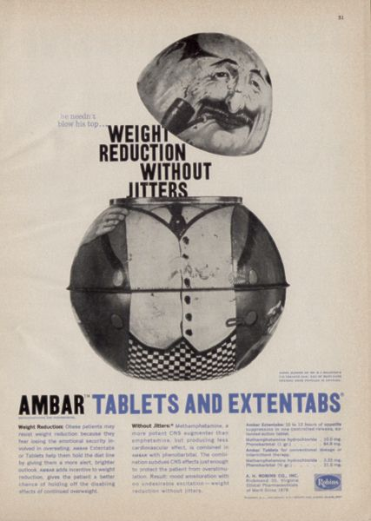
1957
1959
1964 - JAMA

Slide 41
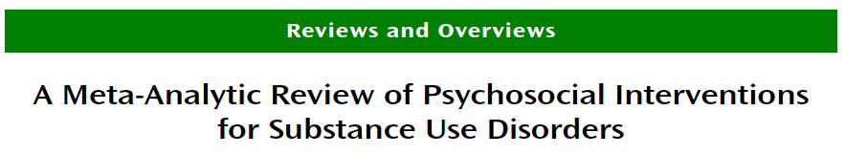
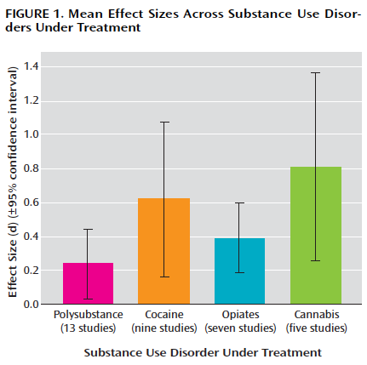
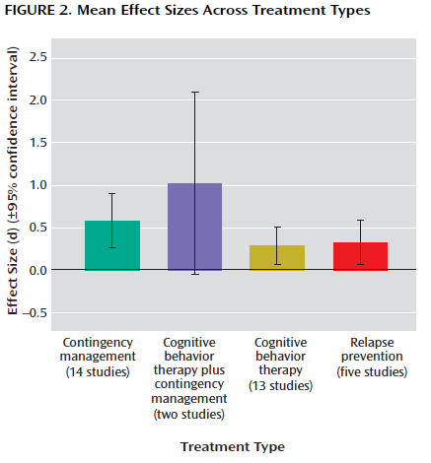
Dutra et al., Am J Psychiatry, 2008

Slide 42
Treatment

Slide 43
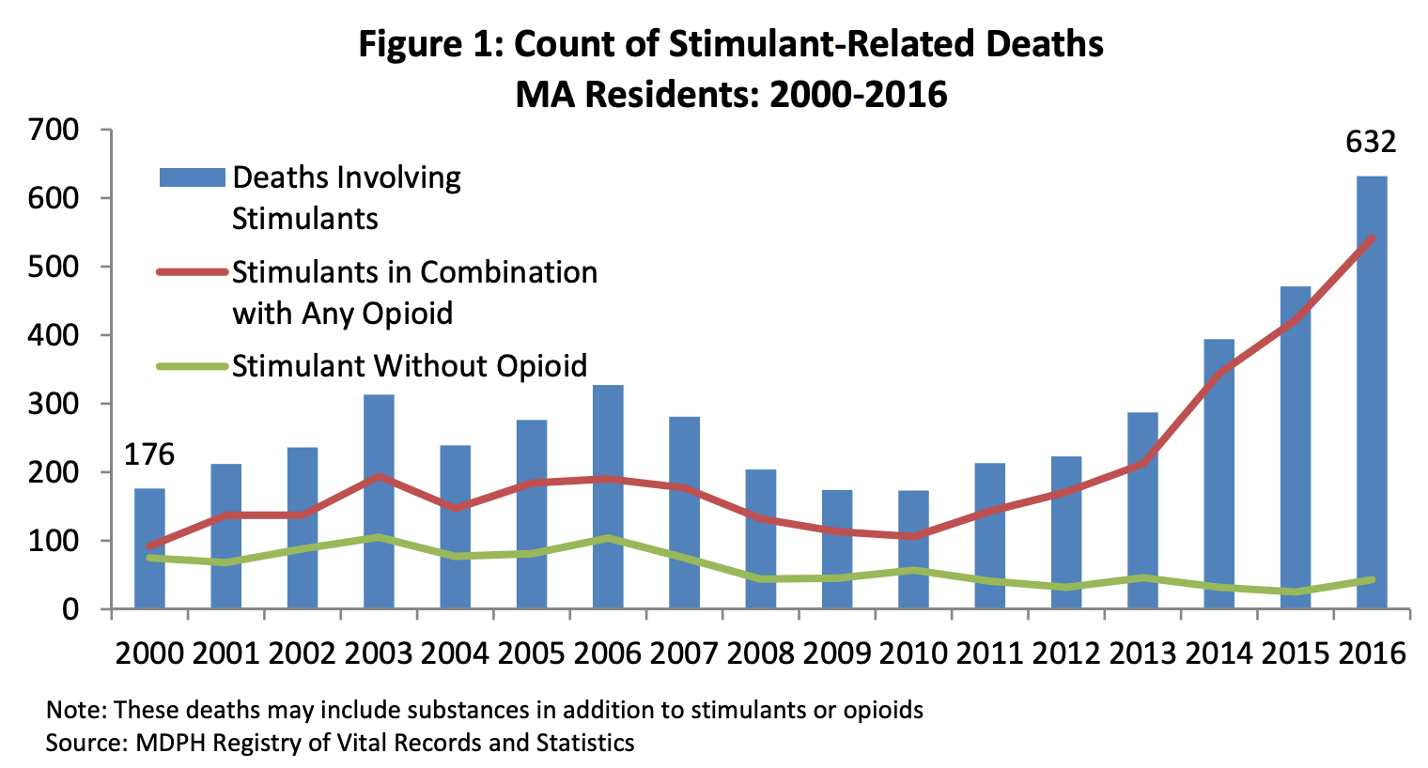
Stimulant-involved overdose deaths surging with opioids
https://www.mass.gov/files/documents/2019/03/13/PHD-1.0-Combined-Data-Brief.pdf

Slide 44
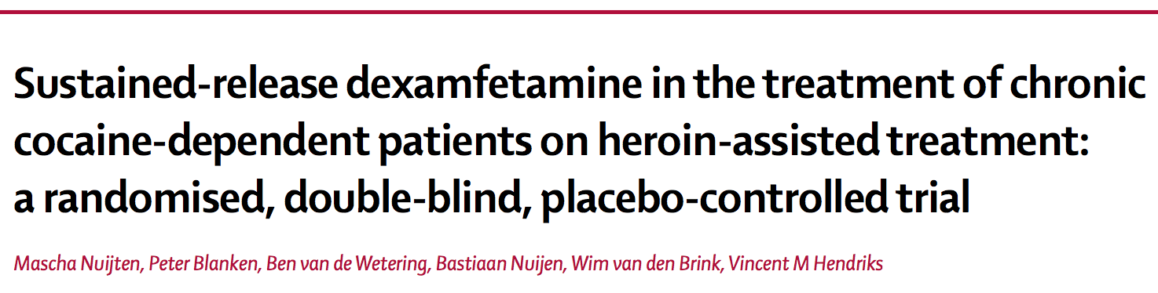
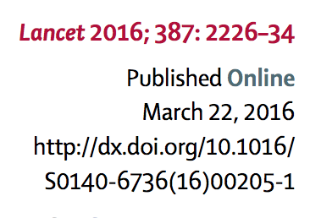
73 Dutch patients with co-occurring heroin and cocaine UD on heroin/methadone maintenance and unable to stop cocaine despite 2 efforts
Received dexamphetamine SR 60mg once daily observed vs. placebo
At 12 weeks
  45 versus 61 days self-reported days of cocaine use
  21% versus 8% with at least one cocaine-negative urine test in last 4 weeks
  No significant differences in craving, use of other substances, or criminality

Slide 45
5 things about stimulants
Easily available
Directly activate the mesolimbic pleasure center
Binge use often ends with dysphoria or lack of funds
Social and medical consequences
Treatment can work if you can find it

Slide 46
Is there stimulant withdrawal?
-Yes, per DSM 5
Dysphoric mood and two or more additional symptoms
  Fatigue
  Vivid, unpleasant dreams
  Hypersomnia, then insomnia
  Increased appetite
  Psychomotor agitation or retardation
>> All results of relative dopamine depletion

Slide 47
Dopamine release: nucleus accumbens

Slide 48
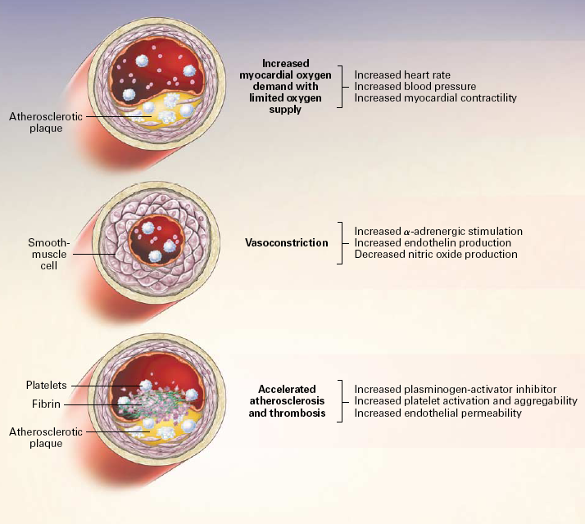
Lange, R. A. and L. D. Hillis (2001). "Cardiovascular complications of cocaine use." N Engl J Med 345(5): 351-8.

Slide 49
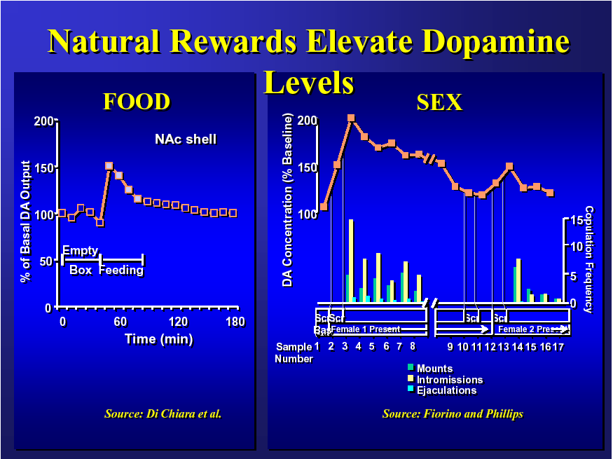
Slide from Richard Rawson
Notes:
This slide and the next slide are from difference studies, but Rawson uses them to illustrate a point saying in effect…. If you think a cheeseburger causes a 50% increase in basal dopamine in a rat, a rat sex is as good as two cheeseburgers, nicotine and heroin are as good as two cheeseburgers, cocaine is almost as good as 4 cheeseburgers and amphetamine (methamphetamines brother) is as good as 10 cheeseburgers.

Slide 50
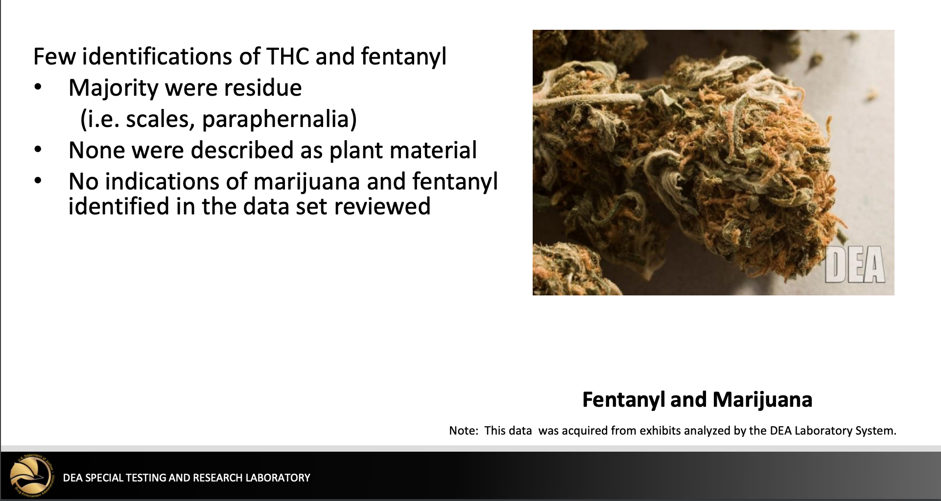
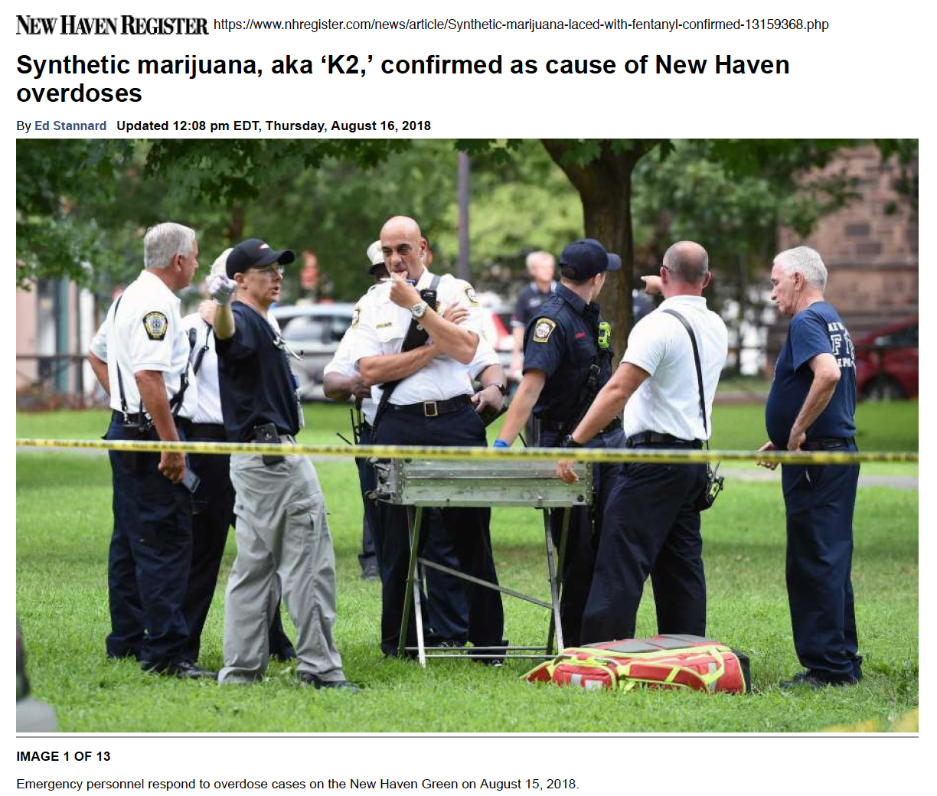
Jill Head, DEA - Drug Threats in the United States: 2019 Update. NDEWS Webinar March 13, 2019 - https://ndews.umd.edu/resources/drug-threats-united-states-2019-update

Slide 51
Effects of Drugs on Dopamine Release
1500
1000
500
0
METHAMPHETAMINE
COCAINE
Accumbens
400
Accumbens
300
DA
DOPAC
% Basal Release
% of Basal Release
HVA
200
100
0
1
2
3hr
0
Time After Methamphetamine
Time After Cocaine
250
NICOTINE
250
Accumbens
ETHANOL
200
Accumbens
200
Dose (g/kg ip)
Caudate
0.25
% of Basal Release
150
0.5
% of Basal Release
1
150
2.5
100
100
0
0
1
2
3 hr
0
0
1
2
3
4hr
Time After Nicotine
Time After Ethanol
Source: Shoblock and Sullivan; Di Chiara and Imperato
Slide from Richard Rawson

Slide 52
Pregnancy
More common in stimulant users:
  Mental illness, seizure, injury, hypertension
  Premature membrane rupture and labor, placenta previa, placental abruption, intrauterine death
1998-2004
  Cocaine-related hosp decreased: 0.74>>0.41 per 100
  MA-related hosp increased: 0.11>>0.22 per 100
Cocaine vs. MA related pregnancy
  More common for cocaine: mental illness, poor fetal growth, and premature delivery
  More common for MA: hypertension, placenta previa
Cox et al. Obstet Gynecol. 2008;111:341-7.
Notes:
Researchers from the Centers for Disease Control and Prevention queried the Healthcare Cost and Utilization Project National Inpatient Sample to determine trends in cocaine and ampetamine-related hospitalizations and complications during these hospitalizations among pregnant women between 1998 and 2004.

Slide 53
Cardiomyopathy and Methamphetamine
In a case-control study, researchers examined the association between methamphetamine use and cardiomyopathy (CM).
Subjects included patients aged 45 years or younger discharged from a tertiary care medical center in Honolulu.
Through medical record review, researchers identified…
  107 cases (had a discharge diagnosis of CM or congestive heart failure) and
  114 controls (ejection fraction >55% and no wall motion abnormalities).
Yeo K-K, et al. Am J Med. 2007;120(2):165–171.

Slide 54
Cardiomyopathy and Methamphetamine
42% of cases and 20% of controls had ever used methamphetamine.
Methamphetamine use was significantly more common in cases than in controls.
OR in analyses adjusted for age, body mass index, and renal failure, 3.7
Yeo K-K, et al. Am J Med. 2007;120(2):165–171.

Slide 55
“No lies here folks this recipe will manufacture methamphetamine this will get you into trouble if you do this BE CAREFUL!”
First of all let's talk about supplies:
4 Bottles Iodine Tincture 2%
2 Bottles of Hydrogen peroxide
3 20 0z Coke Bottles (Plastic type)(with Lids/caps)
1 Can Red Devils Lye
1 Pair of sharp scissors
4 Boxes Book Matches (try to get the ones with brown/red striker pads)
1 pyrodex baking dish
1 Box execto razor blades single sided
1 digital scale that reads grams
2 gallons distilled water
1 Roll Aluminum foil tape
1 Case Regular Pint size Mason Jars ( Used for canning)
2 Boxes Contact 12 hour time released tablets.
3 Bottles of Heet.
4 feet of surgical tubing.
1 Bottle of Rubbing Alcohol.
1 Gallon Muriatic Acid ( Used for cleaning concrete)
1 Gallon of Coleman's Fuel
1 Gallon of Aceton
1 Pack of Coffee Filters
1 Electric Skillet
“That's what you would have to go buy if you wanted to make meth.”
www.totse.com/en/drugs/speedy_drugs/howtomanufactu172921.html
Notes:
Results of google search.
Methamphetamine is cooked from a recipe rather than grown

Slide 56
Cocaine and HIV
Crack cocaine use is associated
  increased number of sex partners
  sex work
  HIV infection, independent of IVD use
IV cocaine leads to HIV through frequent injection Chaisson. JAMA. 1989 Jan 27;261(4):561-5.

Slide 57
MA and HIV
Increased libido, social disinhibition, increased energy >> riskier sex behaviors
PDE5 inhibitors (sildenafil) can be used to mitigate MA-induced erectile dysfunction
Notes:
Fact check Interactions

Slide 58
Methamphetamine and Trauma
To assess the prevalence and impact of metham-phetamine use (MU) in trauma patients, researchers surveyed the records of…
4932 patients who presented to
  San Diego trauma center between 2003–2005
  urine toxicology screening during their visit
Swanson SM, et al. J Trauma. 2007;63(3):531

Slide 59
Results
The rate of MU (defined as a positive urine screen), but not other illicit drug use, increased from 2003 to 2005 (from 9% to 15%).
In adjusted analyses, patients with MU were more likely to have…
  been injured in a violent way (OR, 2.0),
  attempted suicide (OR, 1.7),
  been a victim of domestic violence (OR, 2.5),
  required more medical care (e.g., ≥1 operations [OR, 1.5], mechanical ventilation [OR, 1.6]), and
  died from their injuries (OR, 2.3).
Swanson SM, et al. J Trauma. 2007;63(3):531

Slide 60
Cognitive Behavioral Therapy
16 week RCT of cocaine-dependent methadone patients of:
CBT vs. CM vs. CBT+CM vs. TAU
30 patients per group
Rawson et al. Arch Gen Psychiatry. 2002

Slide 61
Cognitive Behavioral Therapy
Rawson et al. Arch Gen Psychiatry. 2002

Slide 62
Cognitive Behavioral Therapy
Rawson et al. Arch Gen Psychiatry. 2002

Slide 63
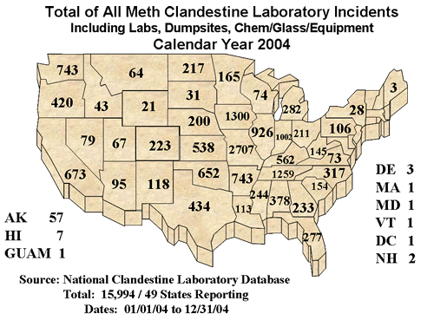
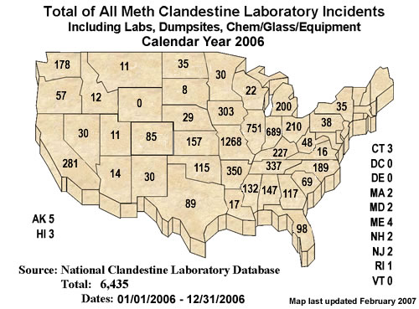
Clandestine lab incidents
www.dea.gov
Notes:
Law enforcement perspective
Karran: The epidemic family and environment and criminal justice system.

Slide 64
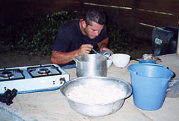
From where do these drugs come?
http://www.colombiajournal.org/cocainephotos.htm
Methamphetamine
  Super labs – Primarily Mexico
  Local clandestine labs - 1 pound of MA creates 6 pounds of toxic waste
      Holton WC. Unlawful lab leftovers. Environ Health Perspect. 2001;109:A576
Cocaine -
  75% grown in Colombia with
    75% via Mexico/ Central America
Notes:
2006 reauthorized Patriot Act required pseudo-ephedrine to be held behind the counter and purchasers to sign a log book and show ID.

Slide 65
Punding/Stereotypy
Compulsive rearrangement of furniture, fastidious, bathing, and distinctive and repetitive walking patterns - activities that users tend to do normally
Amphetamine (26%), cocaine (up to 38%), and Parkinson’s patient treatment with dopamine replacement
Find the behaviors pleasurable, not bothersome
Stimulant users can also develop tics, dyskinesias, and formications
Sanchez-Ramos, Juan. "Neurologic complications of psychomotor stimulant abuse." International review of neurobiology. Vol. 120. Academic Press, 2015. 131-160.
Notes:
Rusyniak, D. E. (2011). Neurologic manifestations of chronic methamphetamine abuse.
Neurologic Clinics, 29(3), 641–655. http://dx.doi.org/10.1016/j.ncl.2011.05.004.
Rusyniak, D. E. (2013). Neurologic manifestations of chronic methamphetamine abuse. The
Psychiatric Clinics of North America, 36(2), 261–275. http://dx.doi.org/10.1016/
j.psc.2013.02.005.
Rylander, G. (1972). Psychoses and the punding and choreiform syndromes in addiction to
central stimulant drugs. Psychiatria, Neurologia, Neurochirurgia, 75(3), 203–212.
Sanchez-Ramos, J. R. (1993). Psychostimulants. Neurologic Clinics, 11(3), 535–553.
Fasano, A., & Petrovic, I. (2010). Insights into pathophysiology of punding reveal possible
treatment strategies. Molecular Psychiatry, 15(6), 560–573. http://dx.doi.org/10.1038/
mp.2009.95.

