Slide 1
Clearing the Smoke on Cannabis
Jeanette M. Tetrault, MD FACP FASAM Professor of Medicine Program Director, Addiction Medicine Fellowship Associate Director for Education and Training, Program in Addiction Medicine Yale School of Medicine

Slide 2
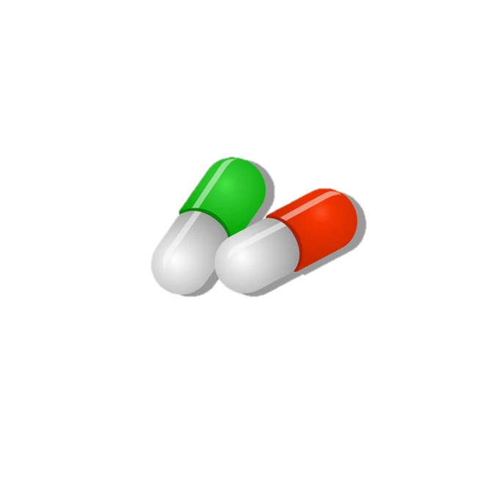
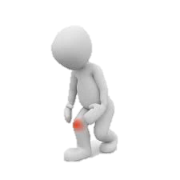
Clinical conundrum
Notes:
48 yo father of two living in CT with obesity and chronic OA of the knee presents for follow up
Initially followed by pain specialist, maintained on MS Contin 30 mg tid and one-two oxycodone 5mg tabs q6 hours for breakthrough pain, not to exceed 6 tabs/day
No longer seeing pain specialist after losing his insurance
In primary care, continued on regimen and followed treatment agreement
Became increasingly sedentary
Diagnosed with other chronic conditions including OSA, COPD and cardiac disease
BMI increased from 28-32 in two years; in a rut can’t exercise due to pain, can’t lose weight because can’t
exercise, weight gain has made the pain worse
History of binge drinking in college BUT NOW drinks 12 beers/week; has not drank more than 5 drinks per occasion in the last year; has not used an illicit substance in the past year.
After discussion with the patient, you both agree, his opioids are no longer optimizing his pain, he understands the risk profile and asks, “maybe you should just prescribe cannabis?”
States he tried it once in college but made him “giggly and a little paranoid” but has heard it has helped, including athletes, with pain. Asks if you will consider giving it to him since you are taking away his opioids

Slide 3
Learning objectives
Define the key components of cannabis and review relevant epidemiology and terminology
Analyze policy issues regarding cannabis legalization
Describe adverse health effects of cannabis use
Counsel patients about cannabis use based on scientific evidence

Slide 4
Learning objectives
Define the key components of cannabis and review relevant epidemiology and terminology
Analyze policy issues regarding cannabis legalization
Describe adverse health effects of cannabis use
Counsel patients about cannabis use based on scientific evidence

Slide 5
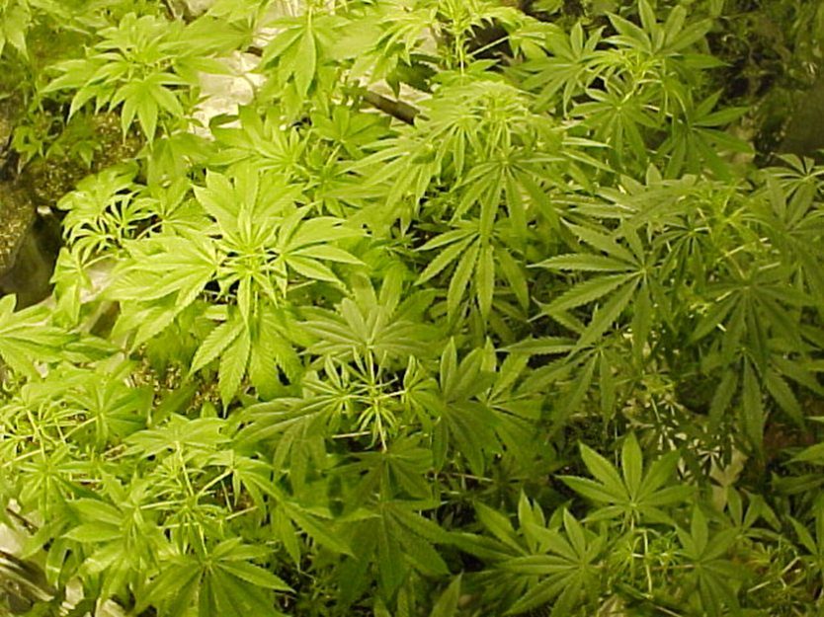
What is cannabis?
Dried flowers, leaves, stems and seeds of Cannabis sativa
Different species:
Sativa
Indica
Two main components:
Terpenes
Cannabinoids
Cannabidiol (CBD)
Δ9-tetrahydrocannabinol (THC)
Potency related to concentration of THC and route of administration

Slide 6
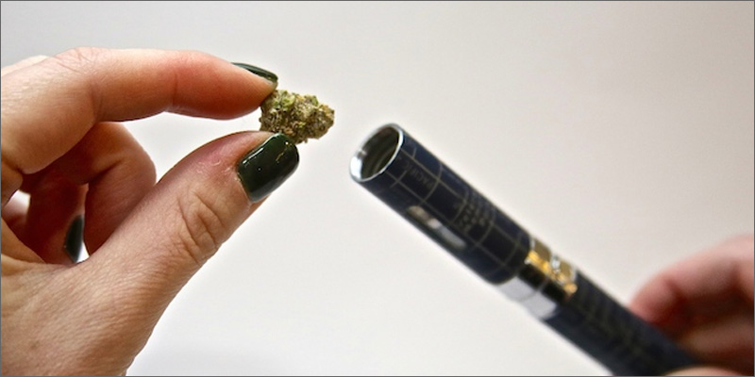
Routes of administration
Smoking
Edibles
Tinctures
Transdermal patch
Suppository
Topical cream
Beverage
Vaping – activating raw plant matter without combustion
~40% of individuals with medical cannabis user vape as a route of administration
Dabbing – inhale cannabis vapor from concentrates, oils or extracts through a “dab rig”
Delivers a high dose of THC in a short period of time

Slide 7
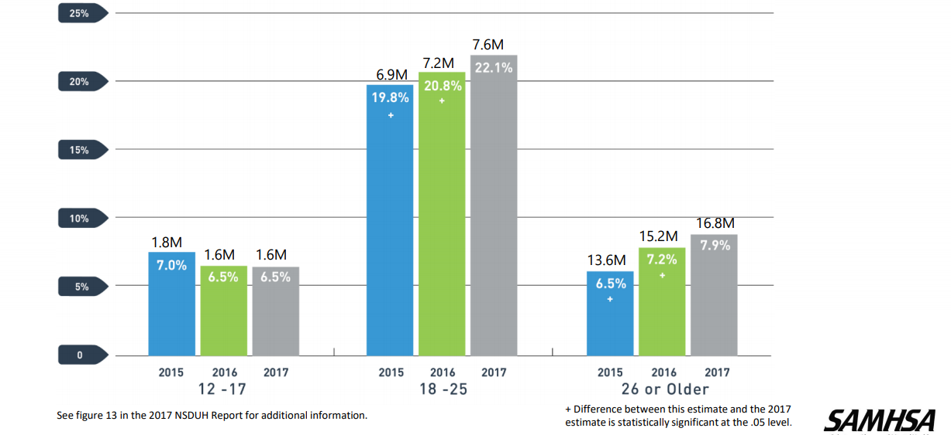
Past-month cannabis use 2015-2017
Notes:
In 2013, almost 6 million daily users of MJ which represents almost 17% of total users, 8 million monthly users representing almost 40% of total.

Slide 8
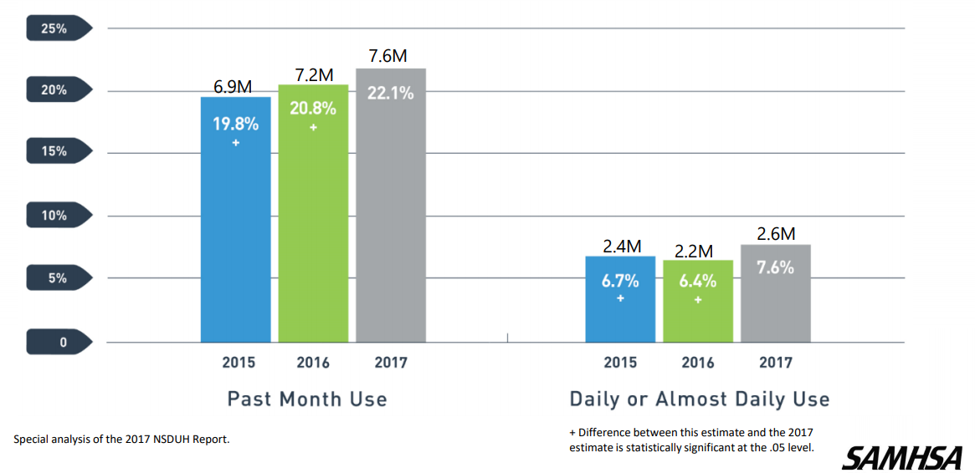
Cannabis use among young adults

Slide 9
Why the increase?
Daily Cannabis Use vs. Perceived Risk of Regular
Cannabis Use among 12th Graders, 1975-2013
Notes:
Additionally, we know that Education is key, because when risk awareness goes up drug use goes down. Data from the MTF study suggests that there is inverse relationship between perceived risk and marijuana use. As perceived risk goes up (red line), marijuana use (blue line) goes down and vice versa. In recent years perceived risk has been decreasing, while use has been ticking up—even daily use among 12th graders is at about 6% (not shown), which is the highest its been in the history of the Monitoring the Future survey .
As perceived risk decreases, epidemiology increases.

Slide 10
Cannabis Use Disorder DSM 5
A problematic pattern of cannabis use leading to clinically significant impairment or distress, as manifested by two or more of the following within a 12-month period:
Cannabis is often taken in larger amounts or over a longer period than was intended
There is a persistent desire or unsuccessful efforts to cut down or control cannabis use
A great deal of time is spent in activities necessary to obtain cannabis, use cannabis, or recover from its effects
Craving, or a strong desire or urge to use cannabis
Notes:
BEFORE WE GET INTO THE Policy implications and ADVERSE HEALTH EFFECTS, WE NEED TO GET ON THE SAME PAGE REGARDING TERMINOLOGY AND DSM5 DIAGNOSES
DSM 5 combines abuse and dependence into a single construct called substance use disorder with certain modifiers for mild, moderate or server.
Mild: Two to three symptoms
Moderate: Four to five symptoms
Severe: Six or more symptoms

Slide 11
Cannabis Use Disorder, Cont’d
Recurrent cannabis use resulting in a failure to fulfill major role obligations at work, school, or home
Continued cannabis use despite having persistent or recurrent social or interpersonal problems caused or exacerbated by the effects of cannabis
Important social, occupational, or recreational activities are given up or reduced because of cannabis use
Recurrent cannabis use in situations in which it is physically hazardous
Continued cannabis use despite knowledge of having a persistent or recurrent physical or psychological problem that is likely to have been caused or exacerbated by use
Tolerance
Withdrawal

Slide 12
Cannabis withdrawal: New to DSM 5
Cessation of cannabis use that has been heavy and prolonged
Three or more of the following signs and symptoms develop within approximately one week after the cannabis cessation:
Irritability, anger, or aggression
Nervousness or anxiety
Sleep difficulty (eg, insomnia, disturbing dreams)
Decreased appetite or weight loss
Restlessness
Depressed mood
At least one of the following physical symptoms causing significant discomfort: abdominal pain, shakiness/tremors, sweating, fever, chills, or headache
Cause distress or impairment
No other explanation for symptoms
Of note, symptoms generally resolve in 7-14 days but may persist for weeks
Notes:
TIMELY: Just added to DSM IV
NEED TO INCLUDE:
The signs or symptoms cause clinically significant distress or impairment in social, occupational, or other important areas of functioning
The signs or symptoms are not attributable to another medical condition and are not better explained by another mental disorder, including intoxication or withdrawal from another substance
Symptoms generally resolve in 7-14 days but may persist for weeks.

Slide 13
Learning objectives
Define the key components of cannabis and review relevant epidemiology and terminology
Analyze policy issues regarding cannabis legalization
Describe adverse health effects of cannabis use
Counsel patients about cannabis use based on scientific evidence

Slide 14
Policy timeline
1970: Controlled Substances Act passed by Congress, cannabis listed as schedule I drug
1996-2018: 11 states with recreational + medical, 36 states with medical only, 4 states illegal
2005: Supreme Court decision (Gonzales v. Raich)
Federal law enforcement has the authority to arrest and prosecute MDs or patients
2009, 2014: Department of Justice Memorandum
Federal resources should not be used to prosecute those who comply with states laws
2008-2010: IOM, ACP, AMA
Petitioned DEA/FDA to reschedule to schedule II …it remains schedule I to this day
Notes:
I think it is important to review the policy time line with regard to marijuana legislation in this country.
1970: Controlled Substances Act passed by Congress, marijuana listed as schedule I drug (i.e. no currently accepted medical use, high potential for abuse, and a lack of accepted safety even under medical supervision)
1985: dronabinol or Marinol (synthetic THC) approved in the US for treatment of intractable nausea
Between 1996-2017: 29 states legalize medical marijuana (AK, AZ, CA CO, CT, DE, HI, IL, ME, MD, MA, MI, MT, NV, NH, NJ, NM, NY, OR, RI, VT, WA) AND 4 states and DC legalized recreational use (AK, CO, OR, WA)
On the federal level:
In 2005: Supreme Court decision (Gonzales v. Raich)
Regardless of state laws, federal law enforcement has the authority under the CSA to arrest and prosecute physicians who prescribe or dispense marijuana and patients who possess or cultivate it.
In 2009: Department of Justice
Issued a memorandum to U.S. Attorneys stating that federal resources should not be used to prosecute providers and patients whose actions comply with their states’ laws permitting medical use of marijuana.
Between 2008-2010: several medical organizations including the IOM, ACP, AMA individually
Petitioned DEA/FDA to reschedule marijuana to schedule II …it remains schedule I to this day
Jan 2018: Sessions rescinds Obama era memorandum which in turn gives federal prosecutors around the country more discretion about enforcing federal law in marijuana cases, even in the states where it is legal.—this move has received deep criticism from both sides of the aisle.
Schumer's legislation would remove marijuana from the list of scheduled substances under a 1970 law that classifies marijuana as dangerous as heroin for legal and regulatory purposes.
It would establish funding for women- and minority-owned marijuana businesses, require more research on the drug's public health impact, and maintain federal authority to regulate commercial advertising, similar to existing regulations for tobacco and alcohol.

Slide 15
Racial disparities in enforcement of cannabis laws
Between 2001 and 2010 there were > 8 million arrests related to possession of cannabis in the US.
Cannabis use is roughly similar among Black and white individuals, however, Black individuals are 3.73 times more likely to be arrested for possession of cannabis.
Nearly 80% of people in federal prison and almost 60% of people in state prison for drug related charges are Black or Latinx.

Slide 16
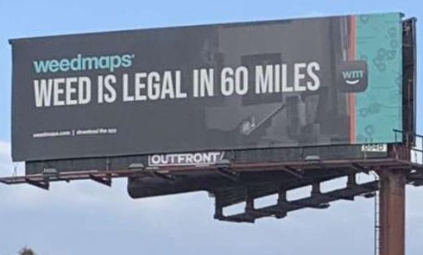
State-to-state variation

Slide 17
Learning objectives
Define the key components of cannabis and review relevant epidemiology and terminology
Analyze policy issues regarding cannabis legalization
Describe adverse health effects of cannabis use
Counsel patients about cannabis use based on scientific evidence

Slide 18
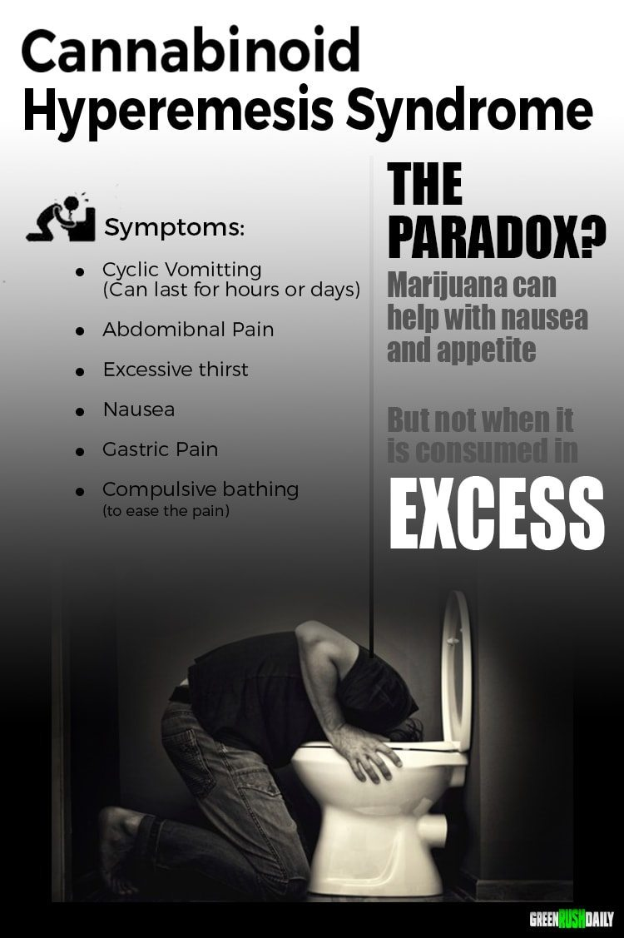
Acute adverse effects
Intoxication
agitation, psychosis, and anxiety
tachycardia and hypertension
Cannabinoid Hyperemesis Syndrome
Pediatric Exposures
Kim &Monte Annals of Em Med 2016
https://www.greenrushdaily.com/2016/08/17/cannabinoid-hyperemesis-syndrome-cannabis/
Notes:
We observed a doubling in ED visits for cyclic vomiting after the legalization of medical marijuana in Colorado in 2009 (41 per 113,262 visits prelegalization versus 87 per 129,095 visits postlegalization), although the absolute number of visits remained modest.¹⁸
Public service annoucement add about cannibis hyperemsis syndrome from https://www.greenrushdaily.com/Green Rush Daily is the voice of the cannabis revolution. Providing unbiased, uncensored marijuana news and information.

Slide 19
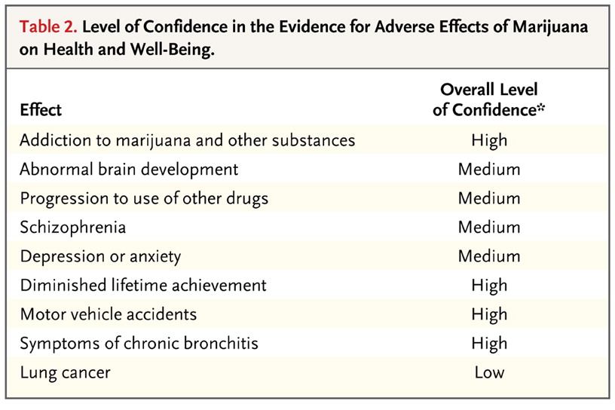
Adverse effects of chronic cannabis use
{
}
Volkow ND et al. NEJM 2014;370:2219-2227.
Notes:
As physicians, it is imperative that we weigh known risks against possible benefits with patients when discussing any therapeutic option with patients. But outlining risks is just as important when discussing substance use with patients.
A recent study published in the New England Journal of Medicine in 2014 by the head of the National Institute on Drug Abuse reviewed the health consequences of marijuana use and graded the overall level of confidence in the existing literature with regard to various health consequences.
I will highlight over the next few slides some of these adverse effects.
The indicated overall level of confidence in the association between marijuana
use and the listed effects represents an attempt to rank the strength of the
current evidence, especially with regard to heavy or long-term use and use
that starts in adolescence.

Slide 20
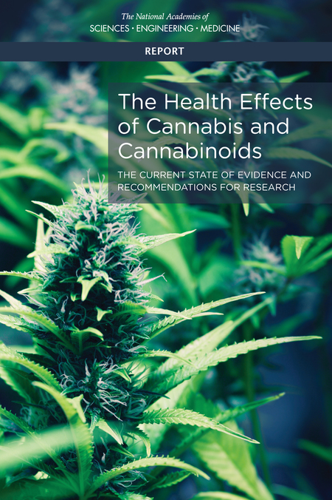
16 person committee reviewed > 10,000 abstracts published since 1999
Focused on recently published systematic reviews and high quality primary research for 11 groups of health effects including both harms and therapeutic effects
Report of National Academies of Science, Engineering and Medicine.
Health Effects of Cannabis and Cannabinoids. 2017

Slide 21
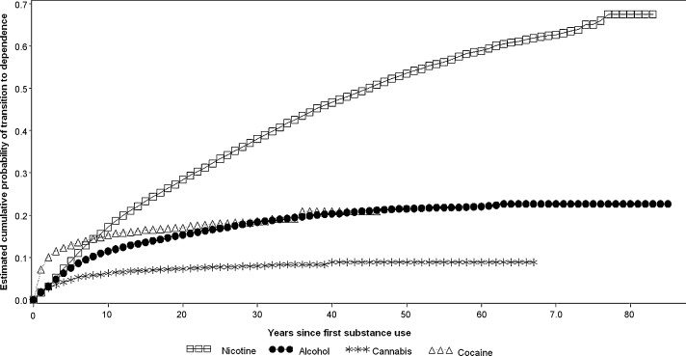
Cumulative Probability of Transitioning to Substance Use Disorder for Nicotine, Alcohol, Cannabis and Cocaine
Develop CUD:
9% of overall,
17% if begin during adolescence,
25-50% if daily use
Lopez-Quintero, C. et al. Drug & Alcohol Dependence 2011

Slide 22
Health effects of cannabis and cannabinoids: SUD
There is substantial evidence that:
Initiating cannabis use at an earlier age is a risk factor for the development of problem cannabis use
There is moderate evidence of a statistical association between cannabis use and:
The development of substance use disorder for substances, including alcohol, tobacco, and other illicit drugs
Report of National Academies of Science, Engineering and Medicine.
Health Effects of Cannabis and Cannabinoids. 2017

Slide 23
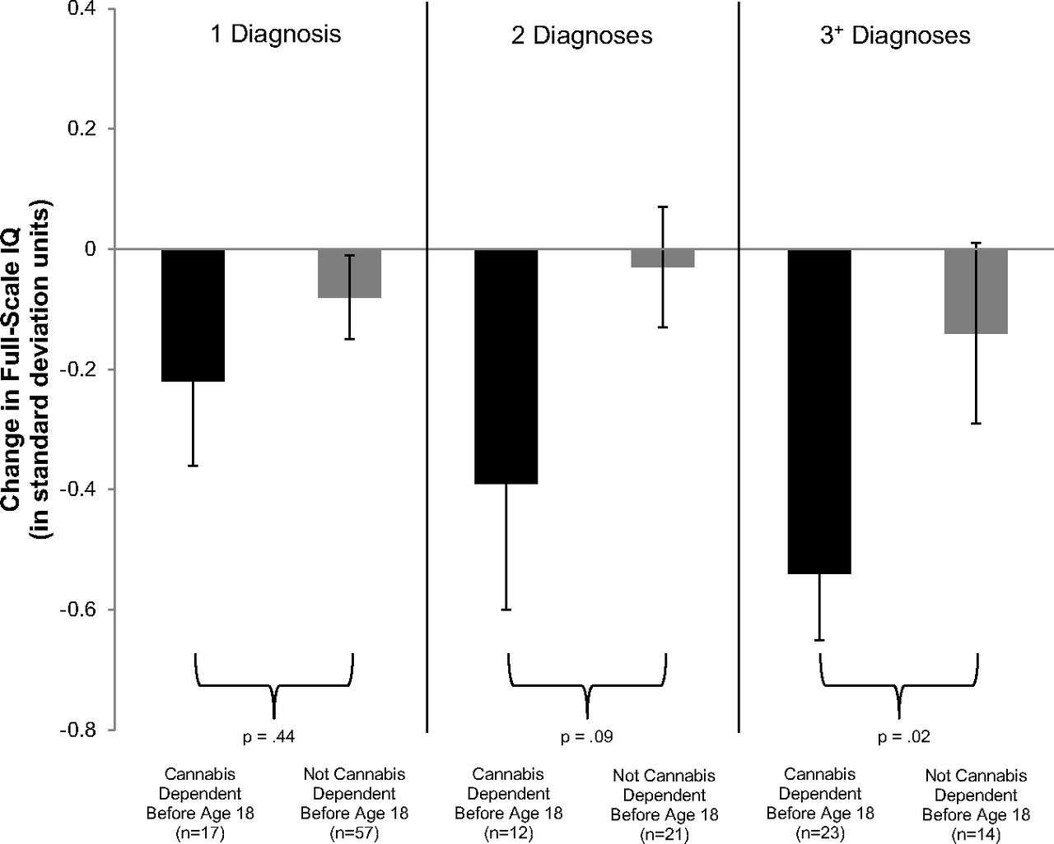
Adolescent vulnerability in IQ decline
Meier M H et al. PNAS 2012
Notes:
Though addiction is concerning especially among individuals who start using in adolescence, so too are concerns about brain development. Here we show data from a
Prospective birth cohort- which followed over 1000 individuals followed from birth to age 38, with multiple testing waves throughout this times period.
This Figure shows Adolescent vulnerability in IQ decline.. Individuals with adolescent-onset marijuana use disorder, shown in black bars, experienced greater IQ decline than individuals with adult-onset marijuana use disorder, shown in gray bars. The IQ decline of individuals with marijuana use beginning in adolescence and persisting into adulthood corresponds to a loss of roughly 8 IQ points.
Follow up data not shown here suggest that those who used marijuana heavily as teenagers and quit using as adults do not recover the lost IQ points. Although the numbers of individuals who met criteria for MJ use disorder were relatively small over multiple testing waves, this trend has been replicated in other studies.

Slide 24
Health effects of cannabis and cannabinoids: Psychosocial domains
There is moderate evidence of a statistical association between cannabis use and:
The impairment in the cognitive domains of learning, memory, and attention
Report of National Academies of Science, Engineering and Medicine.
Health Effects of Cannabis and Cannabinoids. 2017

Slide 25
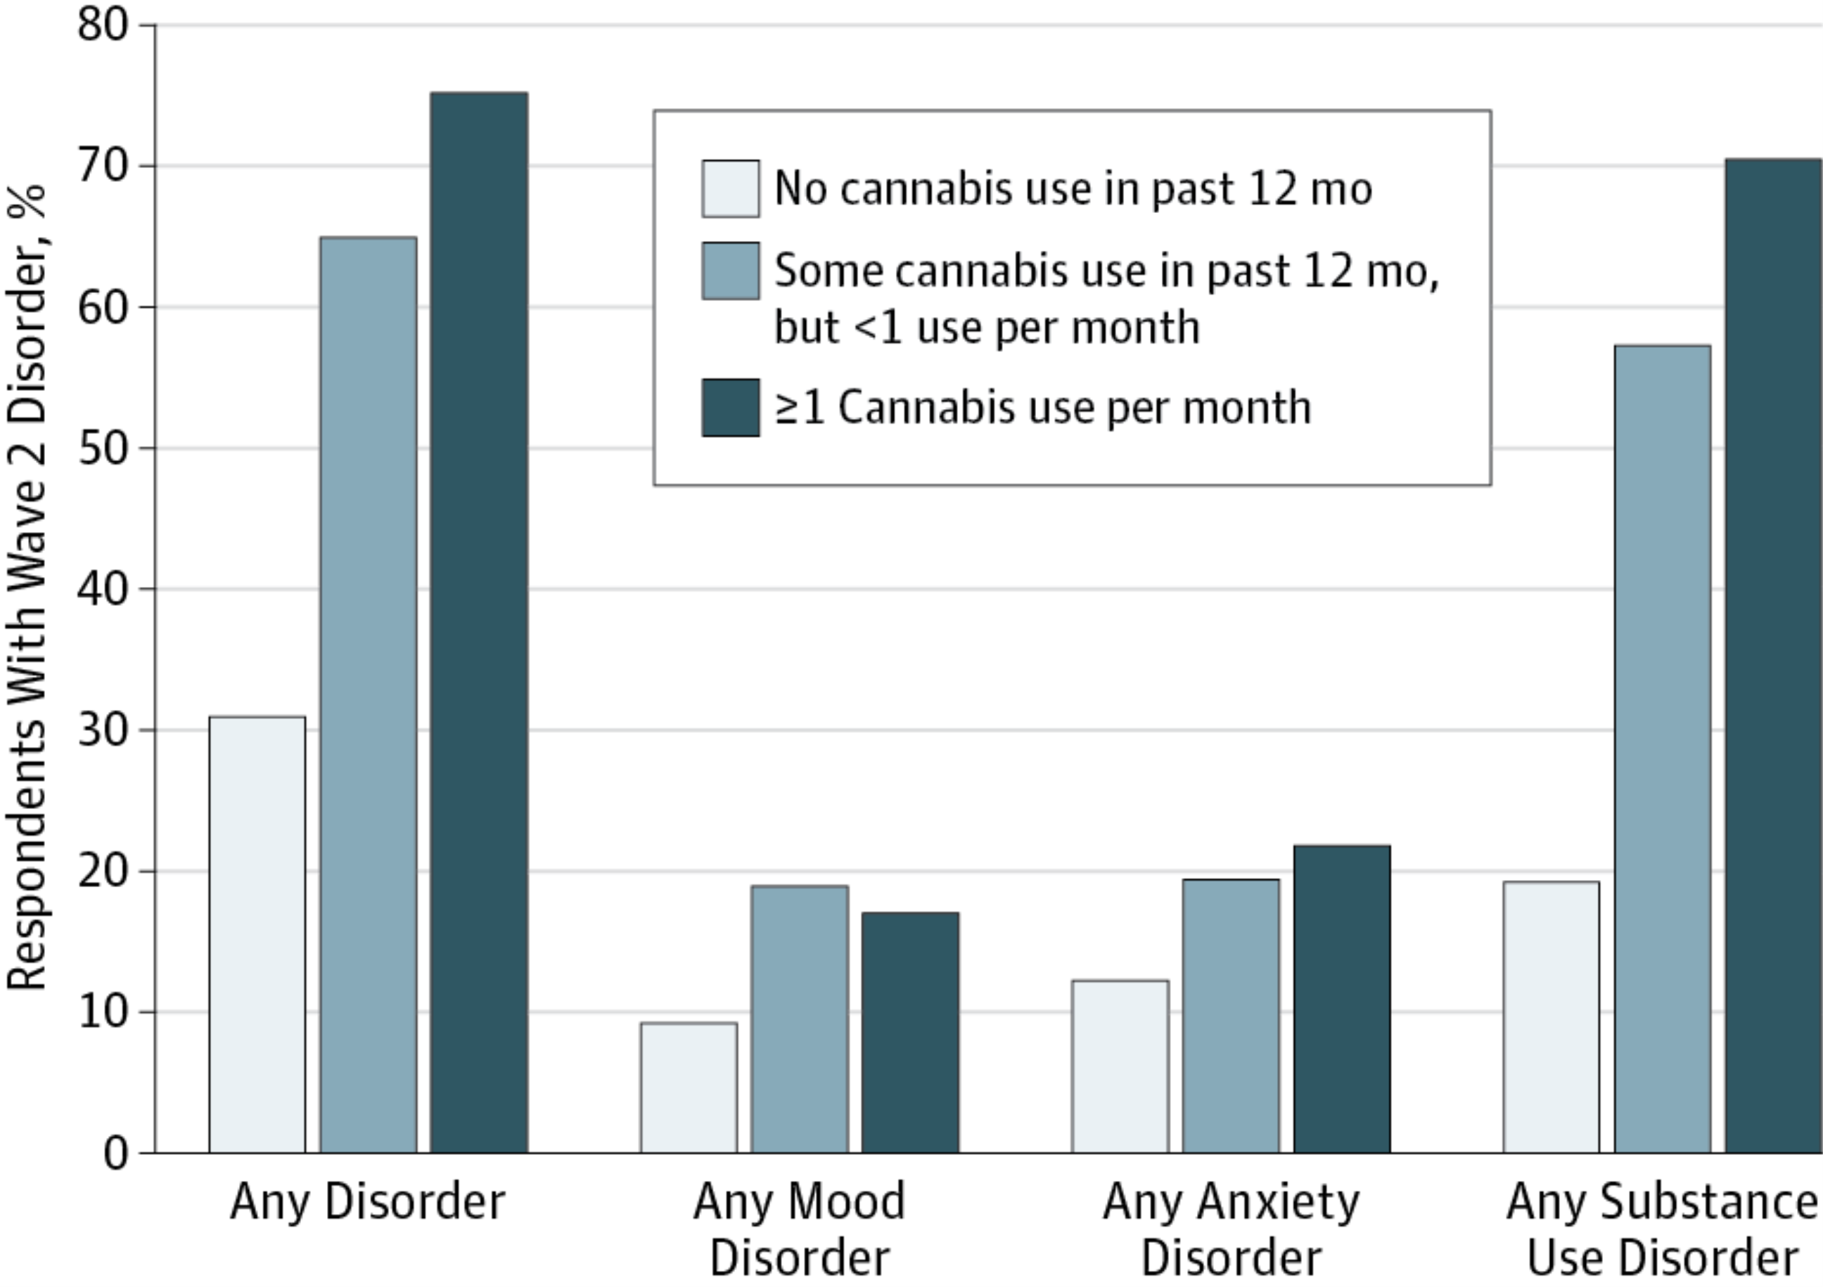
Association between mental health conditions and cannabis use
Blanco et al JAMA Psychiatry, 2016
Notes:
To examine prospective associations between cannabis use and risk of mental health and substance use disorders in the general adult population.
Within the general population, cannabis use is associated with an increased risk for several substance use disorders.
Carlos Blanco, Head of NIDA’s Division of Epidemiology, Services, and Prevention Research at NIH recently published a study using the NESARC data
Nationally representative sample of US adults aged 18 years or older was interviewed 3 years apart in the National Epidemiologic Survey on Alcohol and Related Conditions (wave 1, 2001-2002; wave 2, 2004-2005). In both analyses, the same set of wave 1 confounders was used, including sociodemographic characteristics, family history of substance use disorder, disturbed family environment, childhood parental loss, low self-esteem, social deviance, education, recent trauma, past and present psychiatric disorders, and respondent’s history of divorce.
Cannabis use in wave 1 (2001-2002) was significantly associated with substance use disorders in wave 2 (2004-2005) (any substance use disorder: odds ratio [OR], 6.2; 95% CI, 4.1-9.4; any alcohol use disorder: OR, 2.7; 95% CI, 1.9-3.8; any cannabis use disorder: OR, 9.5; 95% CI, 6.4-14.1; any other drug use disorder: OR, 2.6; 95% CI, 1.6-4.4; and nicotine dependence: OR, 1.7; 95% CI, 1.2-2.4),
but not any mood disorder (OR, 1.1; 95% CI, 0.8-1.4) or anxiety disorder (OR, 0.9; 95% CI, 0.7-1.1).
mood disorders (major depressive disorder, dysthymia, and bipolar disorder), and anxiety disorders (panic disorder, social anxiety disorder, specific phobia, and generalized anxiety disorder).
**WE DO KNOW ABOUT GENETIC PREDISPOSITIONS** MOVED SLIDE TO END BECAUSE WAS PART OF DAN’S OPENING PLENARY

Slide 26
Health effects of cannabis and cannabinoids: Mental Health
There is substantial evidence of a statistical association between cannabis use and:
The development of schizophrenia or other psychoses, with the highest risk among the most frequent users
There is moderate evidence of a statistical association between cannabis use and:
Increased symptoms of mania and hypomania in individuals with bipolar disorders
A small increased risk for the development of depressive disorders
Major depressive disorder is a risk factor for the development of problem cannabis use
Increased incidence of suicidal ideation, suicide attempts and suicide completion
Increased incidence of social anxiety disorder Major depressive disorder is a risk factor for the development of problem cannabis use
Report of National Academies of Science, Engineering and Medicine.
Health Effects of Cannabis and Cannabinoids. 2017

Slide 27
Treatment Options for cannabis use disorder
Pharmacotherapy
No currently approved medication
cannabinoid antagonist
oral THC for withdrawal, maintenance or short-term treatment?
cannabinoid agonist—Levin FR DAD 2011
N-Acetylcysteine
Behavioral
Substance use treatment setting
cognitive-behavioral therapy, contingency management, motivational enhancement, therapeutic living
General medical settings
Brief interventions
Notes:
Widespread screening for adolescent substance use is controversial, there is some emerging evidence for BI for mj use

Slide 28
Fundamental tension
Intoxication and withdrawal of cannabis are not fatal
Overdose is unlikely
Long-term, moderate use seems to be relatively frequent (compared to other drugs)
Risk of end-organ damage appears to be lower than several other legal and illegal substances
Ratio of medical benefit to harm may be equal or better than some controlled substances

Slide 29
Health effects of cannabis and cannabinoids: Therapeutic effects
There is conclusive or substantial evidence that cannabis or cannabinoids are effective:
For the treatment of chronic pain in adults (cannabis)
As antiemetics in the treatment of chemotherapy-induced nausea and vomiting (oral cannabinoids)
For improving patient-reported multiple sclerosis spasticity symptoms (oral cannabinoids)
Report of National Academies of Science, Engineering and Medicine.
Health Effects of Cannabis and Cannabinoids. 2017

Slide 30
Learning objectives
Define the key components of cannabis and review relevant epidemiology and terminology
Analyze policy issues regarding cannabis legalization
Describe adverse health effects of cannabis use
Counsel patients about cannabis use based on scientific evidence

Slide 31
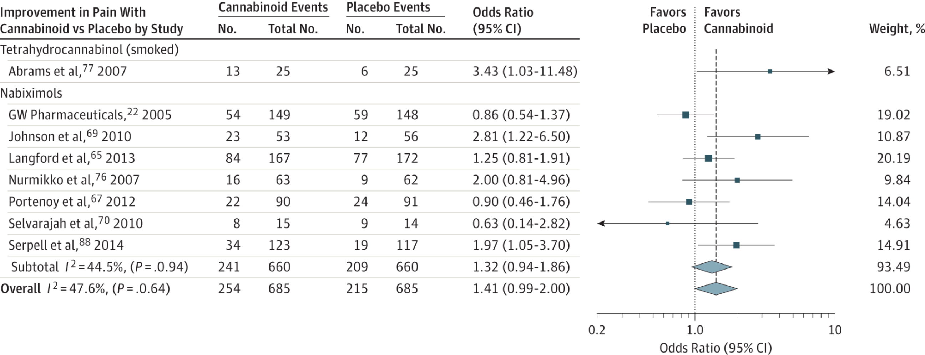
Cannbinoids for medical use: Pain
30% decrease in pain w cannabinoid vs placebo:
OR 1.41 (95% CI, 0.99-2.00)
Whiting PF et al. JAMA.2015;313(24):2456-2473
Notes:
ONE EXAMPLE
There was moderate-quality evidence to support the use of
cannabinoids for the treatment of chronic pain and spasticity. There was low-quality evidence
suggesting that cannabinoids were associated with improvements in nausea and vomiting
due to chemotherapy, weight gain in HIV infection, sleep disorders, and Tourette syndrome.
Cannabinoids were associated with an increased risk of short-term AEs.
Improvement in PainOdds indicate 30% or greater improvement in pain with cannabinoid compared with placebo, stratified according to cannabinoid. The square data markers indicate odds ratios (ORs) from primary studies, with sizes reflecting the statistical weight of the study using random-effects meta-analysis. The horizontal lines indicate 95% CIs. The blue diamond data markers represent the subtotal and overall OR and 95% CI. The vertical dashed line shows the summary effect estimate, the dotted shows the line of no effect (OR = 1).
Change in Ashworth Score for Cannabinoid Compared With Placebo, Stratified According to CannabinoidThe square data markers indicate mean differences from primary studies, with sizes reflecting the statistical weight of the study using random-effects meta-analysis. The horizontal line indicate, 95% CIs. The blue diamond data markers represent the subtotal and overall weighted mean difference and 95% CI. The vertical dashed line shows the summary effect estimate, the solid vertical line shows the line of no effect (mean difference = 0).
NOT Included in the spacticity was the following study:
The Cannabinoid Use in Progressive Inflammatory brain Disease (CUPID) trial: a randomised double-blind placebo-controlled parallel-group multicentre trial and economic evaluation of cannabinoids to slow progression in multiple sclerosis
Health Technology Assessment, No. 19.12; Feb 2015
Susan Ball, Jane Vickery, Jeremy Hobart, Dave Wright, Colin Green, James Shearer, Andrew Nunn, Mayam Gomez Cano, David MacManus, David Miller,Shahrukh Mallik, and John Zajicek.
Headline
The study found that oral dronabinol did not slow down the progression of progressive multiple sclerosis. No major safety concerns were identified in the use of dronabinol

Slide 32
Challenges in conducting research on adverse health effects or therapeutic effects of cannabis
Regulatory barriers, including the classification of cannabis as a Schedule I substance, impede the advancement of cannabis research
Difficult for researchers to gain access to the quantity, quality, and type of product necessary to address research questions on health effects
A diverse network of funders is needed to support cannabis research
To develop conclusive evidence for the effects of cannabis use on short- and long-term health outcomes, improvements and standardization in research methodology (including those used in controlled trials and observational studies) are needed
Report of National Academies of Science, Engineering and Medicine.
Health Effects of Cannabis and Cannabinoids. 2017

Slide 33
JAMA. 2019;321(7):639-640. doi:10.1001/jama.2019.0077

Slide 34
“For the opioid addiction crisis, clearly efficacious medications such as methadone and buprenorphine are under-prescribed. Without convincing evidence of efficacy of cannabis for this indication, it would be irresponsible for medicine to exacerbate this problem by encouraging patients with opioid addiction to stop taking these medications and to rely instead on unproven cannabis treatment.”
JAMA. 2019;321(7):639-640. doi:10.1001/jama.2019.0077

Slide 35
Reducing potential harm from cannabis use
Caution with edibles
Describe long onset of action/labelling concerns
Safe storage
Caution with high THC products
58 mg THC in a joint – don’t smoke the whole joint
Certain routes of administration i.e., dabbing carry particular risk
Consider use of products with lower THC, higher CBD
Cut back—employ brief intervention

Slide 36
Back to the case…What would you do?
Notes:
48 yo father of two living in CT with obesity and chronic OA of the knee presents for follow up
Initially followed by pain specialist, maintained on MS Contin 30 mg tid and one-two oxycodone 5mg tabs q6 hours for breakthrough pain, not to exceed 6 tabs/day
No longer seeing pain specialist after losing his insurance
In primary care, continued on regimen and followed treatment agreement
Became increasingly sedentary
Diagnosed with other chronic conditions including OSA, COPD and cardiac disease
BMI increased from 28-32 in two years; in a rut can’t exercise due to pain, can’t lose weight because can’t
exercise, weight gain has made the pain worse
History of binge drinking in college BUT NOW drinks 12 beers/week; has not drank more than 5 drinks per occasion in the last year; has not used an illicit substance in the past year.
After discussion with the patient, you both agree, his opioids are no longer optimizing his pain, he understands the risk profile and asks, “maybe you should just prescribe cannabis?”
States he tried it once in college but made him “giggly and a little paranoid” but has heard it has helped, including athletes, with pain. Asks if you will consider giving it to him since you are taking away his opioids

Slide 37
Interactive teaching scenario: Morning report/role play
Set up a “spicy,” public health debate regarding legalization of recreational cannabis using the following citation as a spring board for discussion:
Kilmer B. Recreational Cannabis — Minimizing the Health Risks
from Legalization. Perspective. NEJM. February 23, 2017
Assign report participants to one of two groups:
Recreational marijuana SHOULD be legalized in all states nationwide
Citing adverse effects of criminalization and potential for increasing state budgets through taxation, potential impact on opioid epidemic
Recreational marijuana SHOULD NOT be legalized in all states nationwide
Citing current research on adverse health effects and natural experiment data from states that have already legalized recreational marijuana
All arguments need to be evidence-based and factual

Slide 38
Thank you
Questions?
Acknowledgements: several slides adapted from Dr. William Becker (Yale), Dr. Devan Kansagara (OHSU)
Dr. Hilary Kunins (NY DPH), Dr. Jeffrety Hunt (Brown), Dr. Zoe Weinstein (BU)

Slide 39
Extra slides

Slide 40
Pulmonary effects of smoked cannabis
Acute → bronchodilation (FEV₁ increase ~ 0.15-0.25L)
Long-term → cough (OR 2.0, 95% CI 1.32-3.01), phlegm, wheeze
At low levels of exposure, FEV₁ increased by 13 mL/joint-year and FVC by 20 mL/joint-year, but at higher levels of exposure, airflow obstruction was observed
Tetrault JM et al. Archives IM 2007
Pletcher MJ et al. JAMA 2012
Notes:
Most data on the pulmonary effects of MJ show an acute bronchodilatory effect of smoked MJ.
In a systematic review, 34 studies included. Chronic mj smoking was clearly associated with increased likelihood of cough, sputum production and wheeze.
In a 20 year cohort study of MJ smoking

Slide 41
Health effects of cannabis and cannabinoids: Respiratory disease
There is substantial evidence of a statistical association between cannabis smoking and:
Worse respiratory symptoms and more frequent chronic bronchitis episodes
There is moderate evidence of a statistical association between cannabis smoking and:
Improved airway dynamics with acute use, but not with chronic use
Higher forced vital capacity (FVC)
Report of National Academies of Science, Engineering and Medicine.
Health Effects of Cannabis and Cannabinoids. 2017

Slide 42
Trends in fatal motor vehicle crashes before and after cannabis commercialization in CO
Salomonsen-Sautel, S. Drug & Alcohol Dependence, 2014
Notes:
Both immediate exposure and long-term exposure
to marijuana have been shown to impair driving ability; marijuana
is the illicit drug most frequently reported
in connection with impaired driving and accidents,
including fatal accidents and According to a recent meta-analysis, the overall
risk of involvement in an accident increases by a
factor of about 2 when a person drives soon after
using marijuana.
Here we show the trends in FATAL motor vehicle crashes before and after MJ commercialization in CO.
In Colorado, since mid-2009 when medical marijuana became commercially available and prevalent, the trend became positive in the proportion of drivers in a fatal motor vehicle crash who were marijuana-positive (change in trend, 2.16 (0.45), p<0.0001); in contrast, NO significant changes were seen in Non Medical Marijuana States. The data are not shown here but for both Colorado and NMMS, NO significant changes were seen in the proportion of drivers in a fatal motor vehicle crash who were alcohol-impaired

Slide 43
Health effects of cannabis and cannabinoids: Injury and death
There is substantial evidence of a statistical association between cannabis use and:
Increased risk of motor vehicle crashes
There is moderate evidence of a statistical association between cannabis use and:
Increased risk of overdose injuries, including respiratory distress, among pediatric populations in U.S. states where cannabis is legal
Report of National Academies of Science, Engineering and Medicine.
Health Effects of Cannabis and Cannabinoids. 2017

Slide 44
Synthetic cannabis: K2, Spice, etc.
General Information:
Marketed as safe legal alternative to cannabis
Effects:
Mild euphoria and relaxation
Increased sensitivity to external stimuli
Frank, vivid hallucinations
Adverse effects:
Dry mouth, palpitations, vomiting, agitation
Not detected in urine
May be adulterated with heavy metal residues or other fillers including rat poison

Slide 45
FDA-Approved Cannabinoids
Cannabinoid (Brand Name) | Indication (Year Approved)
Dronabinol (Marinol, Syndros) | Chemotherapy-induced nausea and vomiting (1985) Appetite stimulation in wasting conditions like HIV (1992)
Nabilone (Cesamet) | Chemotherapy-induced nausea and vomiting (1985)
Cannabidiol (Epidiolex) | Seizures associated with Dravet syndrome and Lennox-Gastaut syndrome (2018) Seizures associated with Tuberous Sclerosis Complex (2020)

