Slide 1
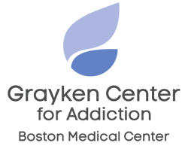
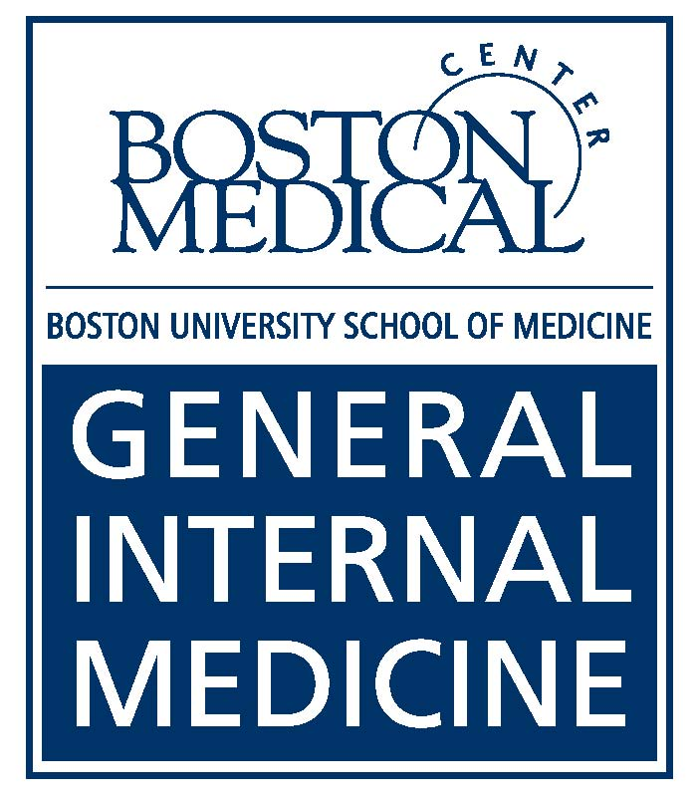
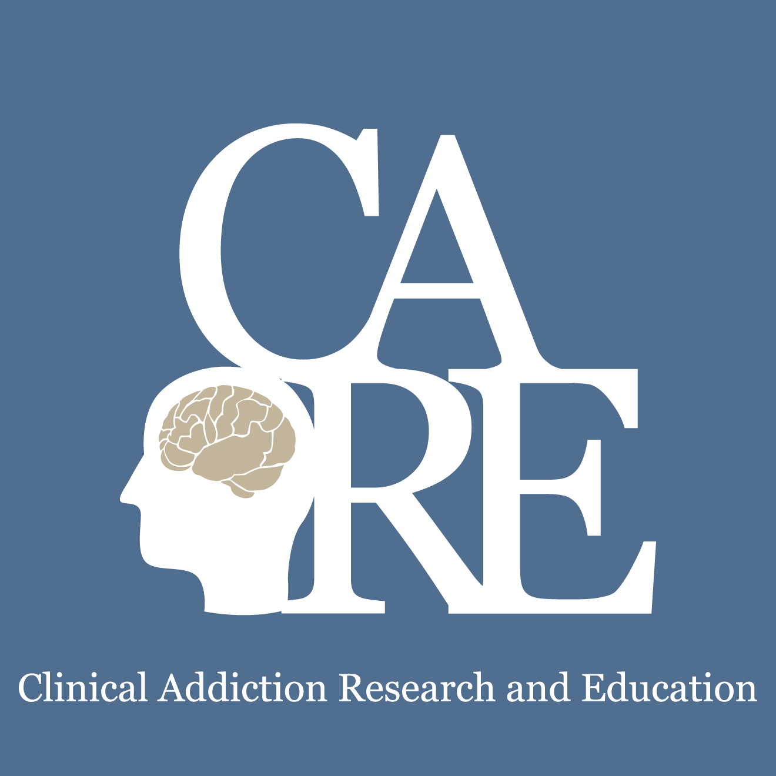
Unhealthy alcohol and other drug use: screening, assessment, brief intervention
Jeffrey H. Samet, MD, MA, MPH
Chief, General Internal Medicine
John Noble Professor in General Internal Medicine & Professor of Public Health
Boston University Schools of Medicine & Public Health
Boston Medical Center
*Slides thanks to Richard Saitz
School of Public Health

Slide 2
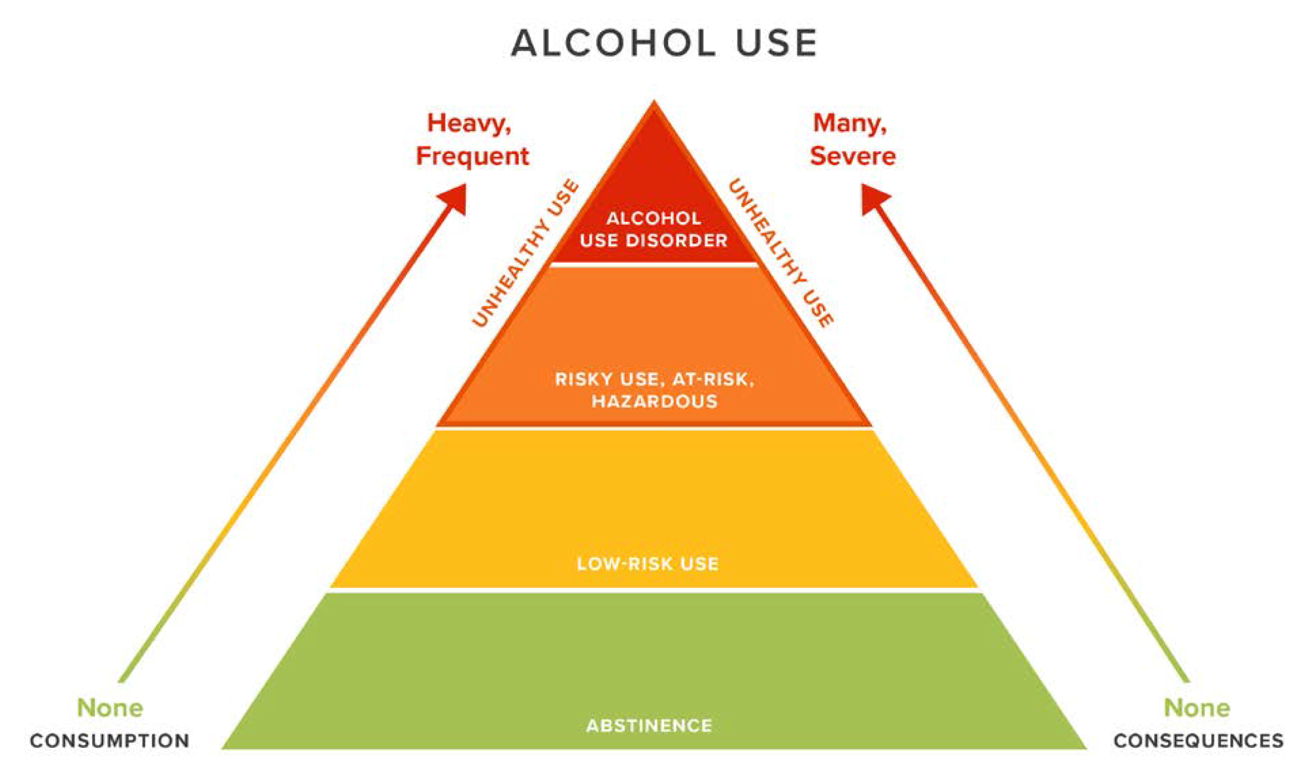
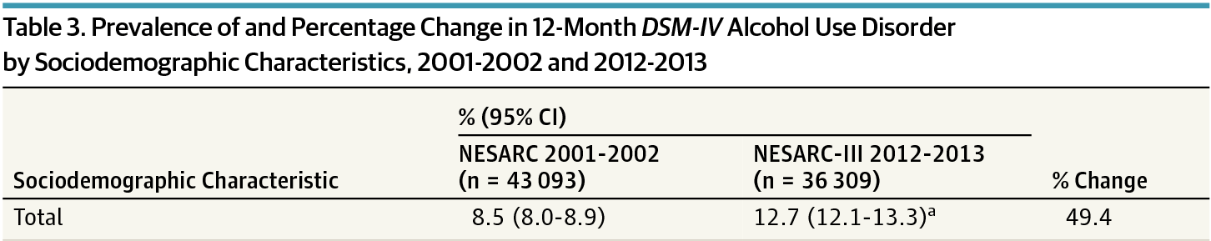
UNHEALTHY USE
Adapted with permission from Saitz R. New Engl J Med 2005;352:596 for Oot E, Saitz R. Alcohol and health. In Boulton M, Wallace R (eds). Maxcy-Rosenau-Last Public Health and Preventive Medicine. 16th edition, in press 2020.
Grant BF et al. JAMA Psychiatry. Sep 1 2017;74(9):911-923

Slide 3
Case
A 29 year old resident enjoys 2-3 beers 2-3 times a week after work

Slide 4


Slide 5
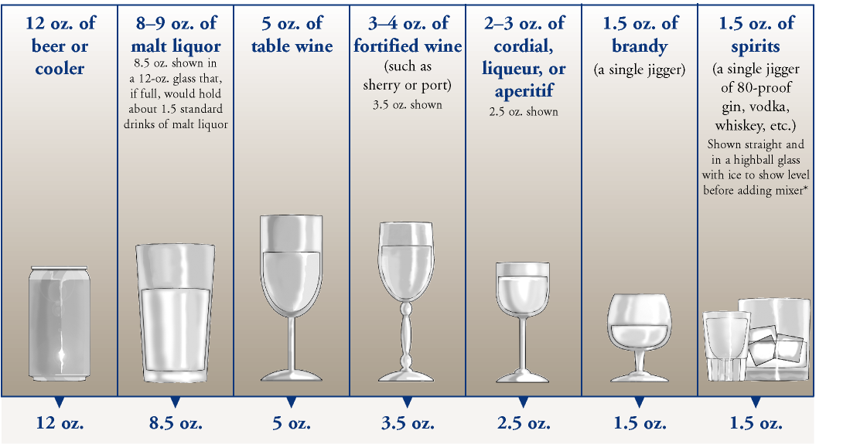
Risky Amounts
Men ≤65
  >14 drinks per week, >4 per occasion (5+)
Women (and men >65)
  >7 drinks per week, >3 per occasion (4+)
Drugs: Any?
*>1/day increase in mortality, stroke, heart failure and other CVD (except non-fatal MI (nadir for MI was about 5/wk))
Carcinogen
Not causal
Millwood et al. Lancet online April 2019
Wood et al. Lancet 2018;391:1513-23.
NIAAA, US Dietary Guidelines Advisory Committee Report
≤ 1/d (Naimi et al, 2020)
Notes:
43
21
Treatment Need
Injection, use of heroin once, marijuana daily, other drug weekly, or use with prior treatment history

Slide 6
screening
To identify and initiate behavior change or treatment discussion
To assist with differential diagnosis
To let patients know this is part of healthcare

Slide 7
‘Single’ Item
  Alcohol
  “Do you sometimes drink beer wine or other alcoholic beverages?”
  “How many times in the past year have you had 5 (4 for women) or more drinks in a day?”
    +answer:>0
    82% sensitive, 79% specific for unhealthy use
  Drug
  “How many times in the past year have you used an illegal drug or used a prescription medication for non-medical reasons?”
    a response of >1 is considered positive
NIAAA. Clinicians Guide to Helping Patients Who Drink Too Much, 2007.
Smith PC, Saitz R. J Gen Intern Med 2009 24:783-8. Saitz R et al. J Studies Alcohol Drugs. 2014;75(1):153-157.
McNeely J et al. Validation for self-administration. J Gen Intern Med. 2015 Dec;30(12):1757-64

Slide 8
Alcohol Use Disorders Identification Test
Consumption items (AUDIT-C)
Requires scoring
>3 women, >4 men
  73-86% sensitivity
  89-91% specificity
>7 to 10 suggests moderate to severe disorder
Replace six with four for women, in item 3
Saitz R. Screening for unhealthy use of alcohol and other drugs. UpToDate 2019.

Slide 9
screen results in primary care
10-20% unhealthy alcohol use
  Of those, 1/5 alcohol use disorder (AUD)
3% unhealthy drug use
  Of those, 1/3 substance use disorder (SUD)
Notes:
Mertens, ACER 2005, HMO, in a pop had 3.2% drug, 7.5% alc, 10% had at least one of the 2

Slide 10
Assessment

Slide 11
Substance use disorder (DSM 5)
2 or more in 12 mo
2-3=mild, 4-5=moderate, 6 or more=severe
Recurrent use resulting in a failure to fulfill major role obligations at work, school, or home
Recurrent use in situations in which it is physically hazardous
Continued use despite having persistent or recurrent social or interpersonal problems
Tolerance*
Withdrawal*
Use in larger amounts or over a longer period than intended
Persistent desire or unsuccessful efforts to cut down
A great deal of time is spent obtaining alcohol, using it, recovering from it
Important social, occupational, or recreational activities given up or reduced
Use despite knowledge of related physical or psychological problem
Craving

Slide 12
Interview, checklist or self-assessment
http://rethinkingdrinking.niaaa.nih.gov

Slide 13
CAGE CAGE-AID
FOR ASSESSEMENT
Have you ever felt you should Cut down on your drinking?
Have people Annoyed you by criticizing your drinking?
Have you ever felt bad or Guilty about your drinking?
Have you ever taken a drink first thing in the morning (Eye-opener) to steady your nerves or get rid of a hangover?
Or drug use?
Or drug use?
Or drug use?
Or used drugs?
Mayfield D et al. Am J Psych 1974;131:1121
Brown RL & Rounds LA. Wisconsin Med J 1995;94:135-40.
Notes:
7
Here are the CAGE questions, first published in 1974 by Mayfield.
I’d like to mention just 2 additional issues with the CAGE questionnaire. First, the questions ask if the patient has ever cut down, been annoyed, felt guilty or had an eye-opener, allowing us to identify patients in remission as well as those with acute problems. Second, we translated the CAGE into Spanish, backtranslated it, checked it for accuracy and validated it here in the primary care clinics and found that at least in Carribean Latinos, the test had sensitivity and specificity at least as good as that found for English speakers.
4 items, yes/no
brief, memorizable
detects lifetime problems\
usual cutoff >1 or 2
may miss some hazardous drinkers
Doesn’t ask quantity
CAGE AID validated in 63 elders. 63 elderly (>age 60) persons with drug abuse/dep, 838 controls
>1: 92% sensitive, 48% specific
AGE-AID: 82% sensitive, 69% specific
>2: 81% sensitive, 72% specific
AGE-AID: 77% sensitive, 89% specific
Hinkin 2001

Slide 14
Summary
Screen to identify the spectrum of unhealthy use
  Includes (risky) use, disorder
Validated questions best
Incorporate into health history, ask “matter of fact”
Assess after a positive screening test
  To confirm unhealthy use
  To identify disorder

Slide 15
Brief intervention

Slide 16
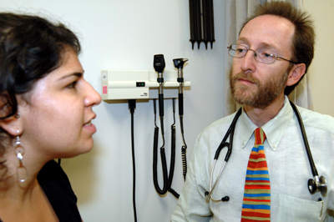
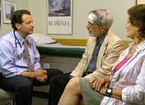
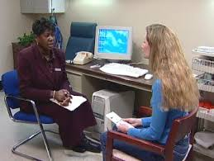
What is Brief Intervention?
“You are drinking more than is safe for your health.”
10-15”, empathic, non-confrontational, collaborative conversations
Feedback*
  Ask permission
  Ask what patient thinks of it
Advice (clear)
Goal setting
  Menu of options
  Support self-efficacy
Follow-up
“My best medical advice is that you cut down or quit.”
“What do you think? Are you willing to consider making changes?”
*drinking, screening results, GGT, risky behaviors, consequences
Saitz R. N Engl J Med 2005;352:596-607.

Slide 17
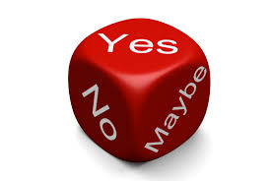


Slide 18
50 years of ALCOHOL brief intervention trials
Modest efficacy for reducing self-reported consumption
  3-4 drinks per week, 10-12% less unhealthy use (e.g. 57% vs 69% at 1 year)
  No consistent effects on anything else
No evidence it prevents disorder
No effect on ‘dependence,’ very heavy use, or getting people identified by screening to treatment
No effect on referral
BUT, repeat, and be available when patients are ready, connect and counsel long-term
USPSTF. JAMA. 2018;320(18):1899-1909.
Jonas DE et al. Ann Intern Med 2012;157:645-54.
Kaner et al. Drug and Alcohol Review 2009;28:301–23
Beich et al. BMJ 2003;327:536
Bertholet et al. Arch Intern Med. 2005;165:986
Kristenson H, et al. Alcohol Clin Exp Res 1983;7:203 (mortality, 3-16 yrs)
Fleming MF et al. Alcohol Clin Exp Res. 2002;26(1):36-43 (cost)
Cuijpers et al. Addiction 2004;99: 839–845 (mortality)
References available on request…

Slide 19
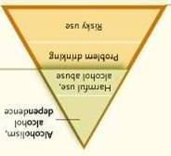

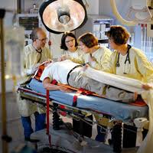

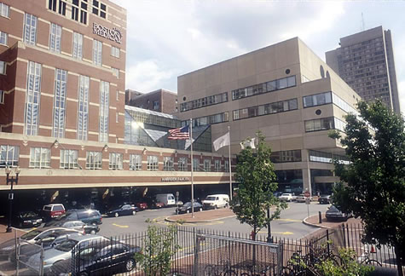
SETTING
Evidence is mixed for emergency and hospital
Most people identified by screening in hospitals have a mod/severe disorder
Different expectations and goals
Belen Martinez et al INEBRIA 2007
Saitz et al. Ann Intern Med 2007;146:167-76
Freyer-Adam J et al. Drug Alcohol Depend 2008
Bischoff G et al. Drug Alcohol Depend 2008
Bischof et al. Int J Pub Health 2010
Saitz et al. Int J Pub Health 2010
McQueen J. Cochrane review 2011
D’Onofrio RCTs; Schmidt CS. Et al. Addiction, 2016;111: 783–794 Very small effect (meta-analysis).
Gentilello et al 1999 and subsequent studies

Slide 20
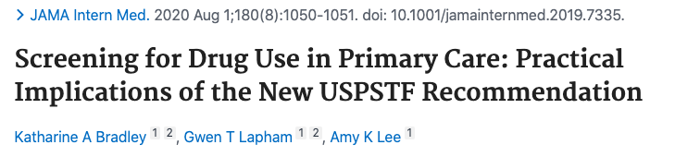
SBI for drugs: adults (Largely ineffective)
USPSTF recommended one practical approach
Harder to change (behavior despite negative sanctions) Severity
DeMicheli D et al. Rev Assoc Med Bras 2004; 50(3): 305-13
Bernstein E et al. Acad Emerg Med 2009; 16: 1174-85
Walton MA (Blow) et al. Drug Alcohol Dependence 2013;132;646-53.
Walton MA (Blow) et al. Addiction 2013;109:786-97.
Screen and treat (D’Onofrio JAMA 2015)
-more engagement, less use (in ED)å
Notes:
Zahradnik A, et al. Addiction. 2009;104(1):109–117
Otto C, et al. Drug Alcohol Depend 2009;105:221-6
Bernstein et al. Drug Alcohol Depend 2005;77:49
Woodruff SI et al. Addict Sci Clin Pract (2014) 9:8.doi:10.1186/1940-0640-9-8
Blow FC et al. Poster, and Abstract book p.14
CPDD 77th Annual Meeting • Arizona Biltmore, Phoenix, Arizona
Bogenschutz JAMA Internal Med 2014;174:1736-45
Gelberg L, et al. Addiction. 2015;110:1777–1790
JAMA. 2014;312(5):502-513. doi:10.1001/jama.2014.7862.
JAMA. 2014;312(5):492-501. doi:10.1001/jama.2014.7860

Slide 21
Summary/Implications
Feedback, advice and goal setting
Best evidence:
  may reduce alcohol among at-risk,
  largely ineffective for drug, disorders, referral (screen and treat), acute care settings, but can start the conversation
  may be more effective in those seeking help

Slide 22
“SBRIT” reframe for disorder
Identify
Discuss the diagnosis and treatments
Treat
Refer (for specialized care and for services)
An “SBIRT” re-frame.

Slide 23
How?
What advice?
Elements of brief intervention
How to address different stages of change

Slide 24
Best Advice
Abstinence
  Failed attempts at cutting down
  Moderate/severe disorder
  Pregnancy/preconception
  Contraindicated medical condition or medication
Cutting down
  Risky or problem use
https://alcoholtreatment.niaaa.nih.gov/

Slide 25
Feedback
Provide personalized feedback and state your concern.
  GGT
  Drinking/drug use data
  Risky behaviors
  Consequences
  Determine the patient’s perception of their use and feedback

Slide 26
Advice
  Make explicit recommendation for change in behavior
  Emphasis on personal RESPONSIBILITY for change
    “…it’s up to you to decide…”
  Give them a menu of options
  Use an EMPATHIC counseling style

Slide 27
Goal Setting
  Discuss patient’s reaction and negotiate plan.
    Enhancement of SELF-EFFICACY (confidence)
    Reinforce it, state your belief they can do it
    Give example of patient’s past success

Slide 28
Addressing different stages of change

Slide 29
Precontemplation
Goal is to raise doubt, increase perception/ consciousness of problem
  express concern
  state the problem non-judgmentally
  agree to disagree
  advise a trial of abstinence or cutting down
  importance of follow-up (even if using)
  less intensity is better
Samet, JH, Rollnick S, Barnes H. Arch Intern Med. 1996;156:2287-2293.

Slide 30
Contemplation
Goal is to tip the balance
  elicit positive and negative aspects of drinking
  elicit positive and negative aspects of not drinking
  summarize (patient could write these down)
  demonstrate discrepancies between values and actions
  advise a trial of abstinence or cutting down

Slide 31
Determination
Goal is to help determine the best course of action
  working on motivation is not helpful
  supporting self-efficacy is (remind of strengths--i.e. period of sobriety, coming to doctor)
  help decide on achievable goals
  caution re: difficult road ahead
  relapse won’t disrupt relationship

Slide 32
Action
Goal is to help patient take steps to change
  support and encouragement
  acknowledge discomfort (losses, withdrawal)
  reinforce importance of recovery

Slide 33
Maintenance
Goal is to help prevent relapse
  anticipate difficult situations (triggers)
  recognize the ongoing struggle
  support the patient’s resolve
  reiterate that relapse won’t disrupt your relationship

Slide 34
“Relapse”/return to use
Goal is to renew the process of contemplation
  explore what can be learned
  express concern
  emphasize the positive aspects of prior abstinence and of current efforts to seek care
  support self-efficacy

Slide 35
Summary
Assess severity to determine best advice
Brief counseling intervention
  Feedback, advice, goal setting
    Treat disorder or refer when needed
  Assess and tailor to stage of change

Slide 36
How do I teach this?
TEACHING POINTS
Accurate terms
Single-item screening, AUDIT-C
Engage with precontemplation (express concern, agree to disagree) and contemplation (pros and cons)
INTEGRATE
Demo in clinic, hospital; screening forms/record review
Journal club systematic reviews
Teach validity of diagnostic tests

