Slide 1
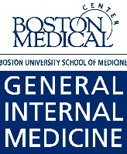
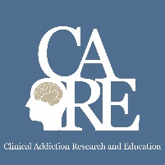
Adolescents, Young Adults, and Pregnancy
Sarah M. Bagley, MD, MSc
Assistant Professor of Medicine and Pediatrics
Medical Director, CATALYST Program
Grayken Center for Addiction
Boston University School of Medicine/Boston Medical Center
October 20, 2020

Slide 2
Disclosure Information
Nothing to disclose

Slide 3
Why are we talking about this?
Addiction is a disease of pediatric onset
What happens in childhood/adolescence affects how our adult patients present in adult care
I have been effective in lobbying these 2 points

Slide 4
Learning Objectives
Describe the current trends in adolescent and young adult substance use and treatment
Identify 2 barriers to evidence-based addiction care for adolescents and young adults
Discuss the epidemiology of alcohol and other drug use in pregnancy

Slide 5
Case 1
17 yo male with mother with history of HIV and substance use, referred from mother’s primary care provider
Referred to CATALYST program to prevent development of problematic substance use
Meets with social worker for therapy and adolescent provider primary care and prevention

Slide 6
Adolescence and young adulthood is a key developmental period
Ongoing brain development
Increasing autonomy
Identity exploration
Primed for new experiences

Slide 7
Early Onset Matters!
Long term risk: development of substance use disorders
AND
Youth who use alcohol and other drugs engage in other risky behaviors

Slide 8
Long term consequences
Early onset matters:
Likelihood of lifetime substance use disorder was reduced by 4% and 5% with each year drug use onset was delayed
Young adults who began drinking before age 14 exhibited a lifetime dependence prevalence of 47% compared to 9% of youth who began drinking at/after 21
Prior history of nonmedical use of prescription opioids strongly associated with heroin initiation
Grant, Dawson J Subst Abuse, 1998
Hingson, Heeren, Winter, 2006
Cerda, 2015

Slide 9
Short term consequences
Early onset matters:
Marijuana use associated with significantly increased crash risk in a dose and frequency dependent relationship
28% of MVC fatalities with individuals ≤20 years old involved alcohol
From 2008 to 2013 there was an increase in IE related to injection drug use from 28% to 42% (P <0.001)
Among 18-29 year olds, HCV increased by 400% from 2004-2014
Wurcel AG et al., 2016
Hadland et al. Pediatrics, 2017
Li et al. Epidemiol Rev, 2012

Slide 10
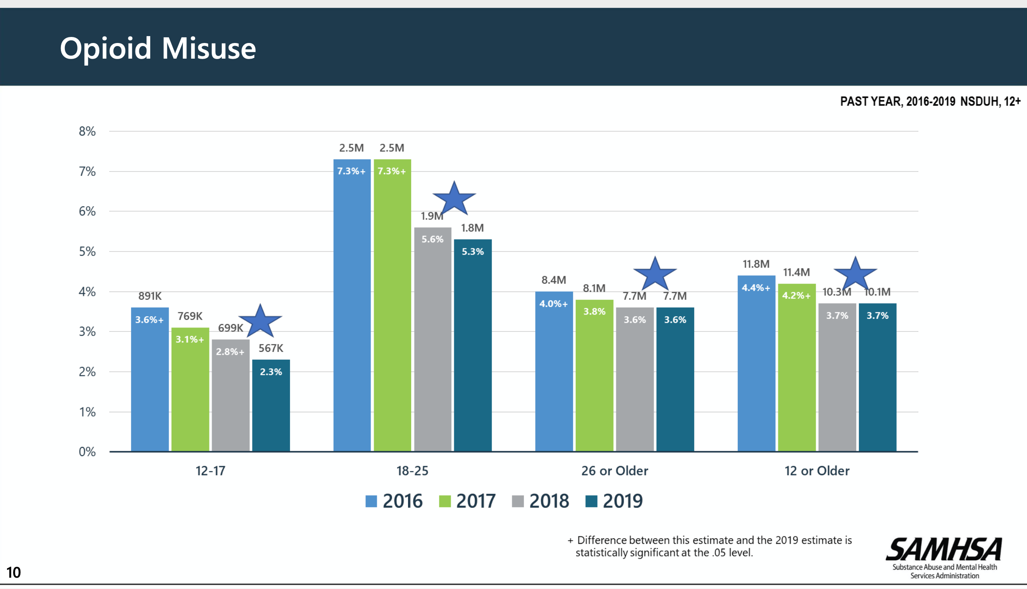
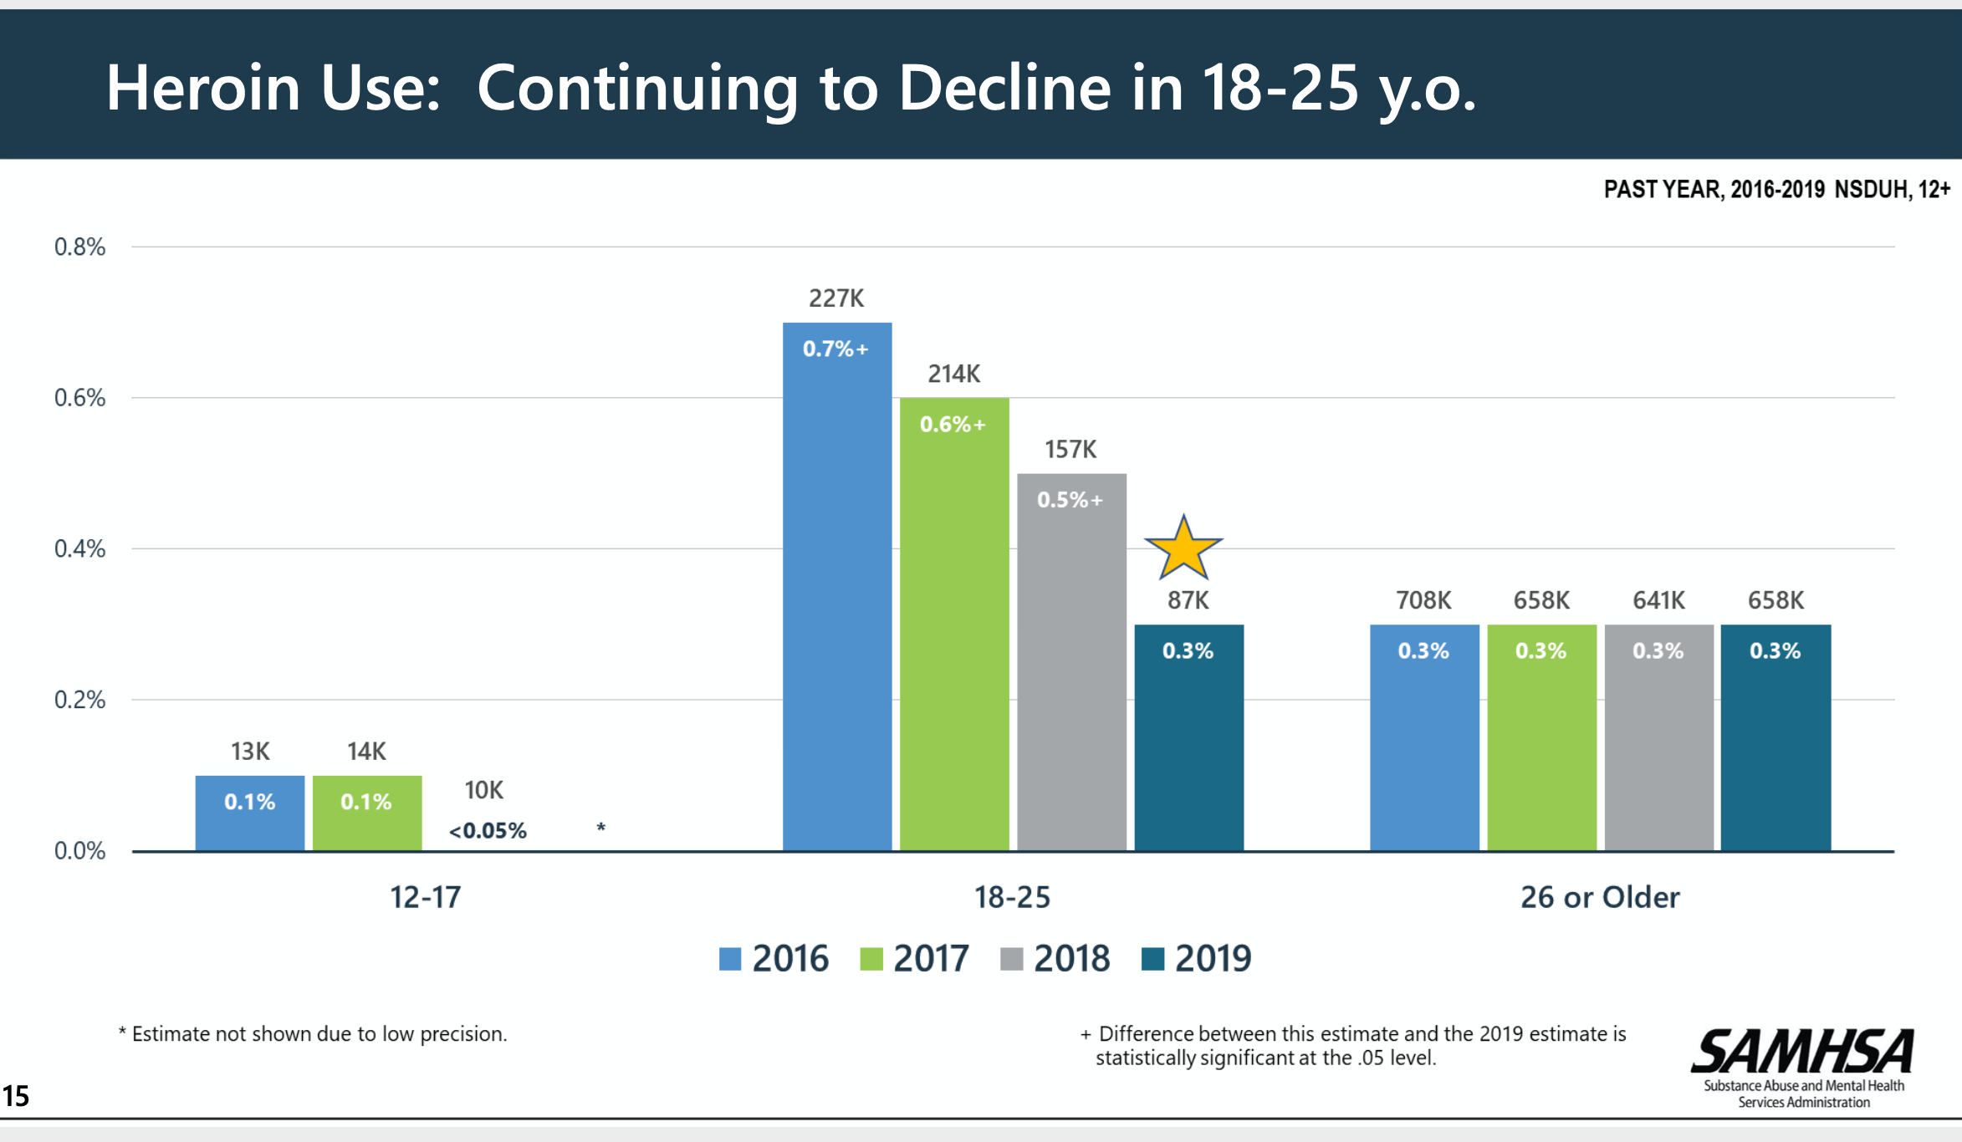
Opioid use – young adults
Slide courtesy of SAMHSA presentation of 2019 NSDUH data

Slide 11
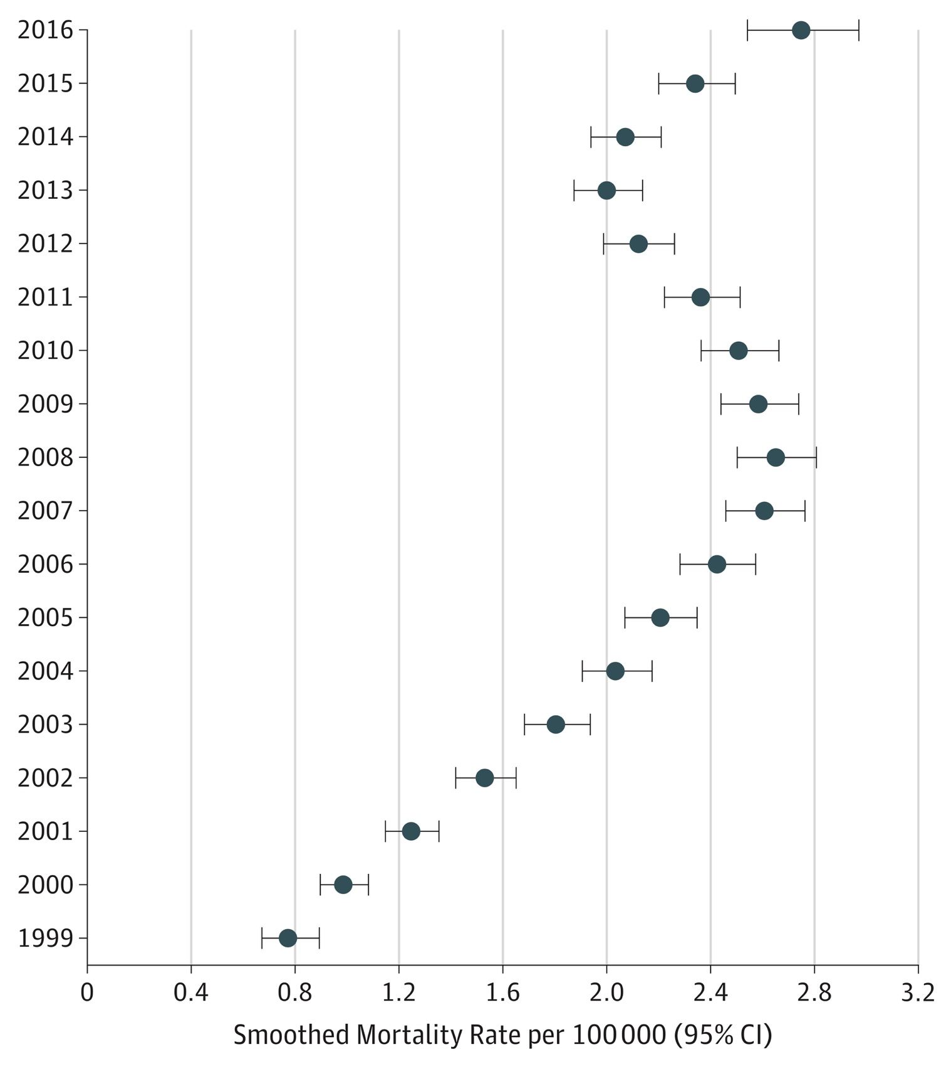
Opioid deaths
US National Trends in Pediatric Deaths From Prescription and Illicit Opioids, 1999-2016
Between 1999 and 2016, overdose deaths rose among 15- to 19-year-olds:
95% for prescription opioids
405% for heroin
2925% for synthetic opioids (i.e., fentanyl)
Gaither JR, et al. JAMA Netw Open. 2018;1(8):e186558.
Notes:
So I have now told you that overall opioid use has been decreasing but that hospitalization for opioid poisoning might be increasing- until really last week there was question about what was happening with overdose deaths in this age group- but then this data brief was released by the CDC and the NCHS- showing that there has been an increase in the last couple of years in overdose deaths (from any substance)

Slide 12
Overdose deaths involving opioids
Drug Overdose Death Rates for 15-24 year olds by type of opioid drug involved: United States, 1999-2017
Data Source: Centers for Disease Control and Prevention, National Center for Health Statistics. Multiple Cause of Death 1999-2017 on CDC WONDER Online Database, released December, 2018

Slide 13
Take home points
Adolescence and young adulthood is a unique and exciting time for development
Counseling should focus on the short and long term consequences
Overall teen drug use trends are encouraging and young adults continue to have the highest prevalence of use

Slide 14
Case 2
20 year old female referred to us from the adolescent/emerging adult crisis stabilization program
Has had multiple admissions related to opioid use and never offered medication treatment until this last admission
Started on buprenorphine at program and we then see her for regular follow-up
Despite relapse, she explicitly says that medication treatment has made a huge impact on recovery and wants to continue

Slide 15
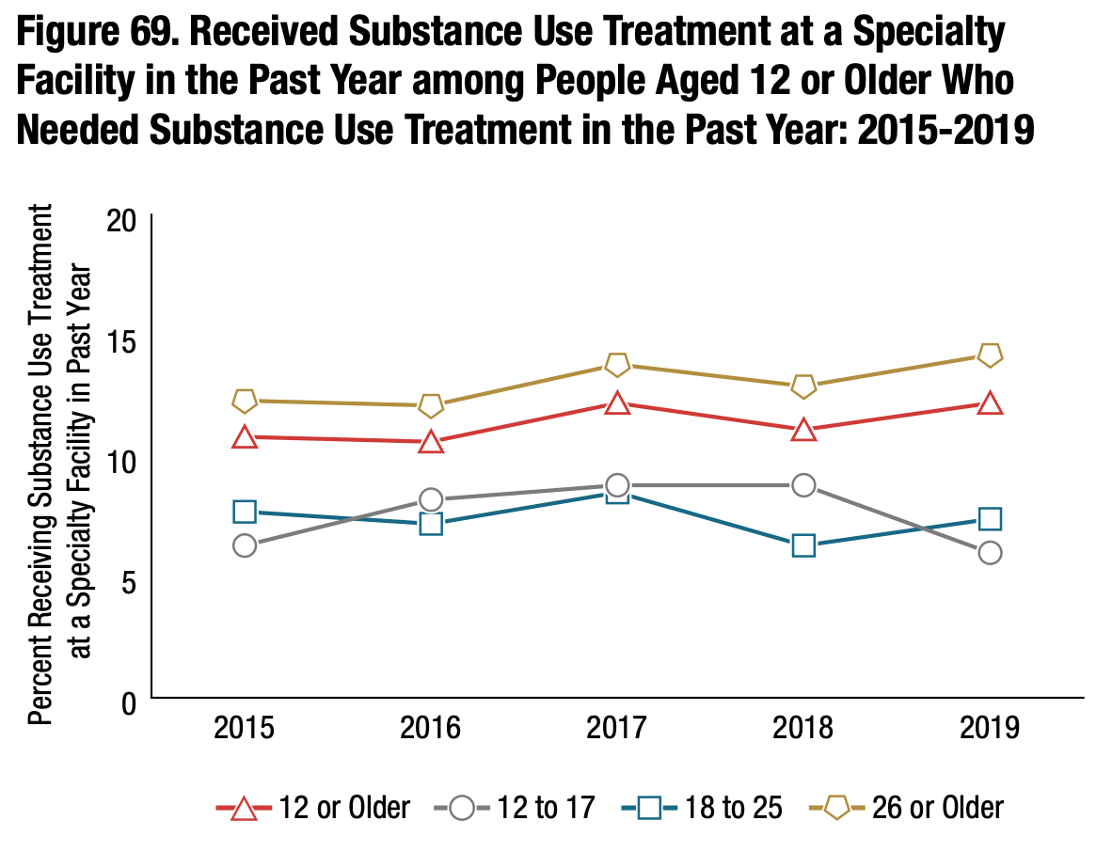
Adolescents and young adults have poor access to addiction care
NSDUH, 2019

Slide 16
Youth have poor access to care
Fewer than 1 in 3 specialty drug treatment programs in the United States offer care to adolescents
Youths who experienced a heroin overdose were significantly less likely than those who overdosed on other opioids to receive any treatment
Only 1 in 4 youths received treatment within 3 months of OUD diagnosis
<1/3 received timely addiction treatment after overdose
1 in 3 young adults received medication for opioid use disorder in the 12 months after surviving an overdose
Alinsky et al. (2020) JAMA Pediatrics
Hadland et al. (2018) JAMA Pediatrics
Bagley et al. (2019) Annals of Emergency Medicine
Mericle et al. (2015) J Child Adolesc Subst Abuse
Olfson et al. (2020) JAMA

Slide 17
Barriers and opportunities for care
Stigma: significant misinformation about what medication treatment is and it’s benefits
Lack of training: only 1% of waivered providers identify as pediatricians
Coordination of care: these cases are complicated - involve state agencies, families, children→ can be hard to ensure that a consistent plan is being offered and implemented

Slide 18
Take home points
Barriers to treatment are significant for youth
By adapting our models of care, we will be able to better suit needs of youth

Slide 19
Alcohol
Epidemiology: No known safe amount of alcohol to drink while pregnant
-11.5% of pregnant women reported current drinking
-3.9% reported binge drinking during the past 30 days
Risks: fetal alcohol spectrum disorders: abnormal facial features, attention difficulties, poor memory, learning disabilities, speech and language delays
-1.1%–5.0% prevalence of FASDs among first-grade students
Advice: provide alcohol screening and brief counseling, advise women on risks, refer to additional services if needed
Denny et al. MMWR Morb Mortal Wkly Rep, 2019

Slide 20
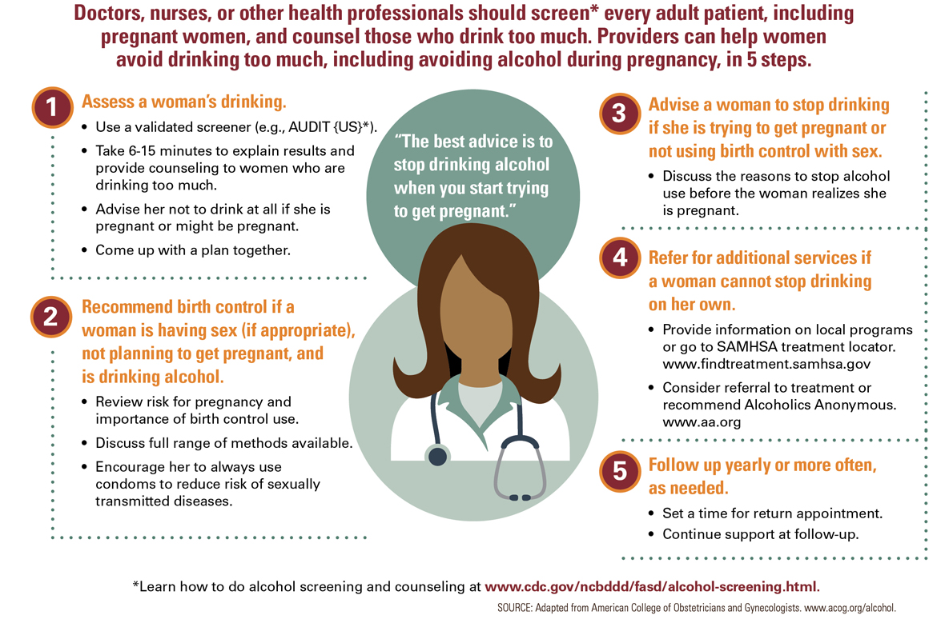
https://www.cdc.gov/vitalsigns/fasd/index.html

Slide 21
Marijuana
Epidemiology: No known safe amount during pregnancy
-5.4% of women report past month marijuana use, 1.7% report daily use
-Nearly 70% of Colorado cannabis dispensaries contacted recommended cannabis products to treat nausea in the first trimester
Risks: THC can enter the fetal brain from mother’s bloodstream, disrupts the endocannabinoid system, lower birth weight, interferes with brain development, hyperactivity, THC found in breast milk up to six days after last recorded use
Advice: brief screening, counseled about risks and consequences, encouraged to discontinue use, absence of data should encourage discontinuation
https://www.hhs.gov/surgeongeneral/reports-and-publications/addiction-and-substance-misuse/advisory-on-marijuana-use-and-developing-brain/index.html
ACOG: https://www.acog.org/clinical/clinical-guidance/committee-opinion/articles/2017/10/marijuana-use-during-pregnancy-and-lactation

Slide 22
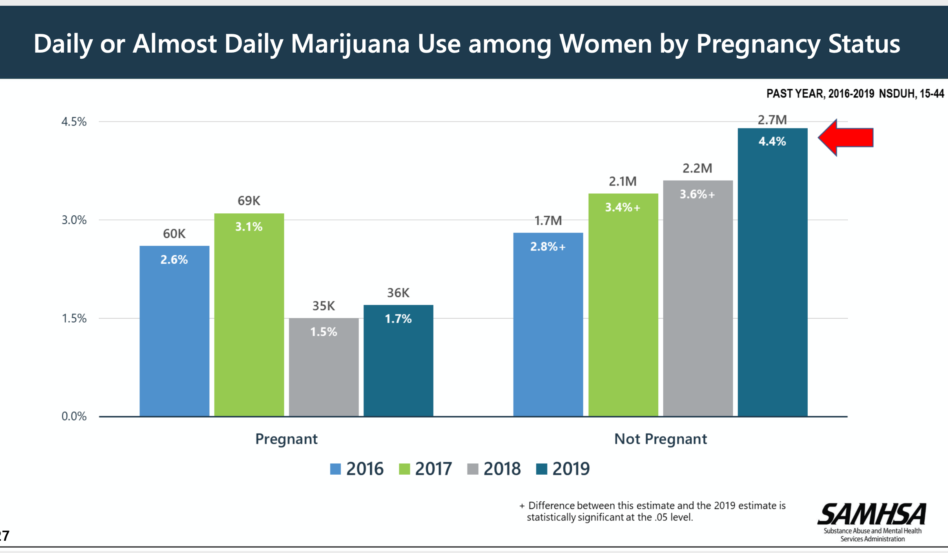
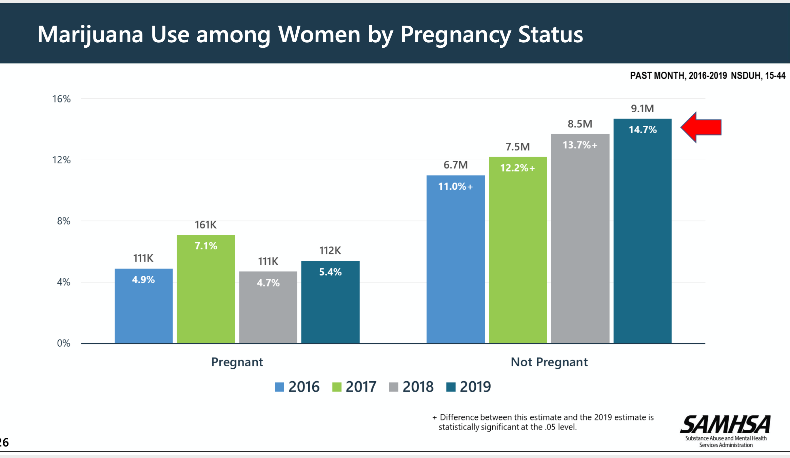
Slide courtesy of SAMHSA presentation of 2019 NSDUH data

Slide 23
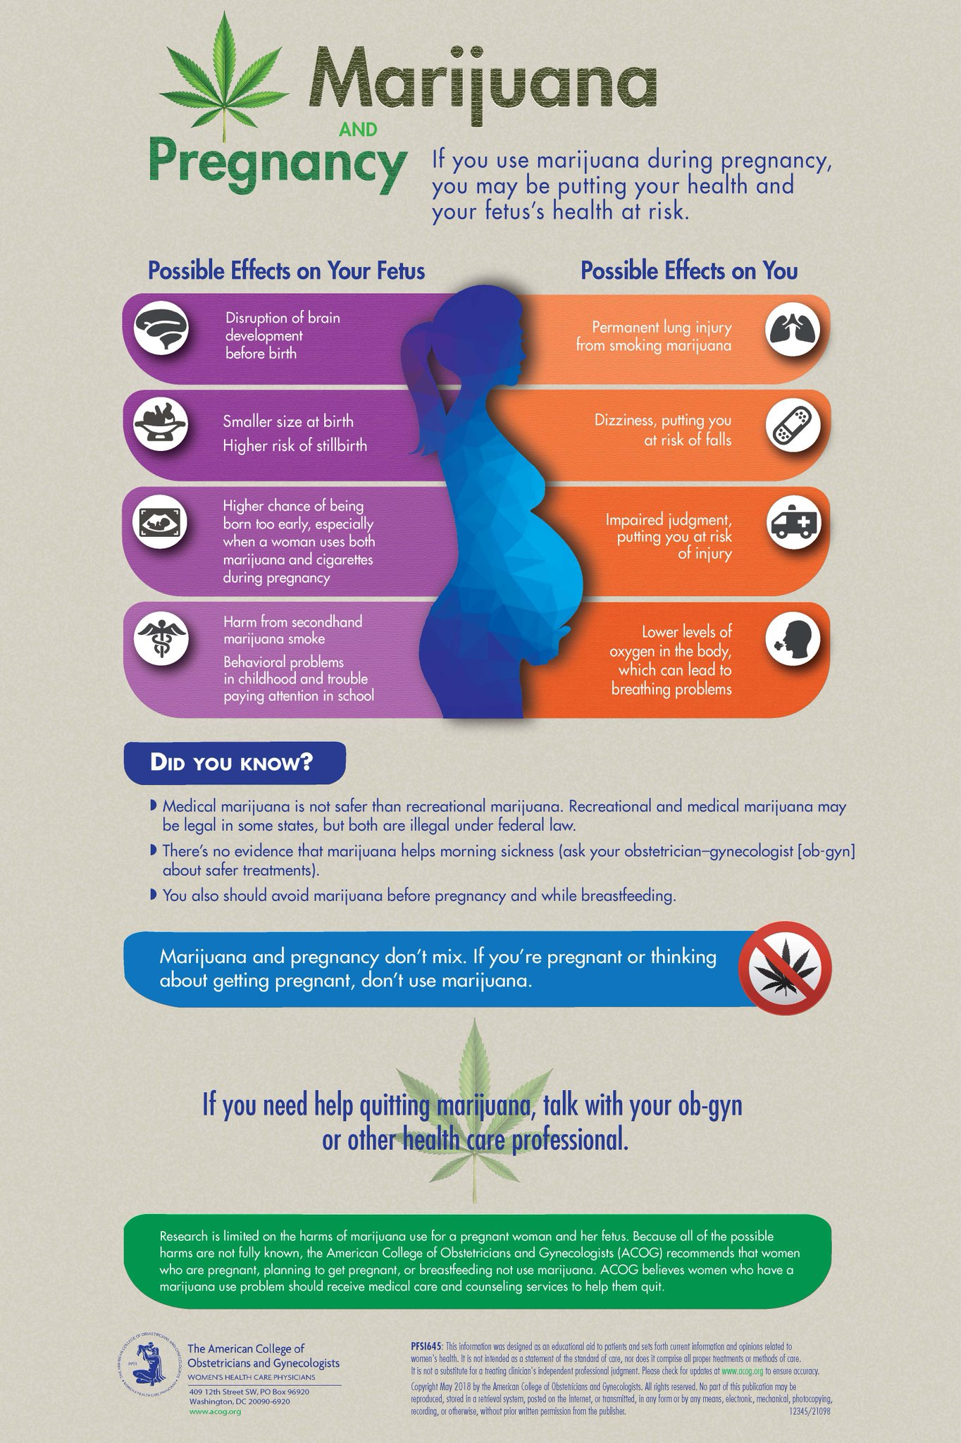
ACOG: https://www.acog.org/clinical/clinical-guidance/committee-opinion/articles/2017/10/marijuana-use-during-pregnancy-and-lactation

Slide 24
Opioids
Epidemiology: rate of infants experiencing opioid withdrawal after birth grew five-fold over past decade
Risks: neonatal abstinence syndrome (NAS): physiologic and neurobehavioral signs of withdrawal that may occur in a newborn exposed in utero, increase in birth defects, fetal death, preterm labor,
50-80% of opioid-exposed infants developed NAS
Advice: Early universal screening, brief intervention, referral to treatment, routine screening part of comprehensive obstetric care, alternative pain therapies for chronic pain, MOUDs recommended, monitoring post-birth
https://www.acog.org/clinical/clinical-guidance/committee-opinion/articles/2017/08/opioid-use-and-opioid-use-disorder-in-pregnancy
Patrick, Schiff, Committee on Substance Use and Prevention AAP, 2017

Slide 25
OUD during pregnancy has quadrupled
Haight SC, MMWR, 2018

Slide 26
Overdose risk dependent on treatment status
Schiff DA et al, Obstet Gynecol, 2018

Slide 27
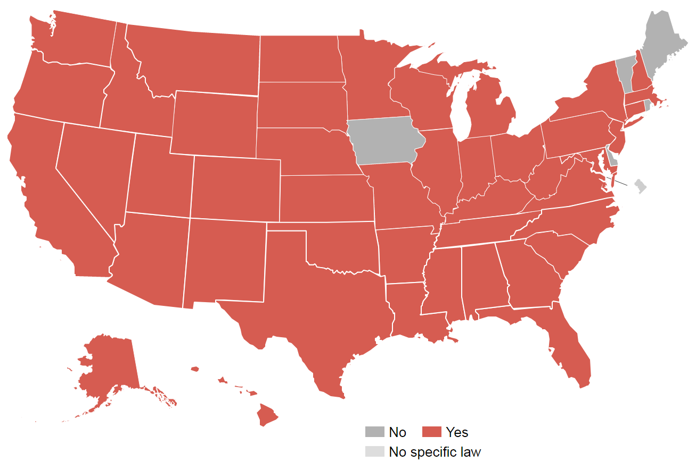
Criminalization of pregnancy and drug use
States where women have been prosecuted for drug use during pregnancy
Projects.propublica.org

Slide 28
Models of care for pregnant women
https://safehealthcareforeverywoman.org/
https://store.samhsa.gov/system/files/sma16-4978.pdf
https://www.addictionpolicy.org/blog/coordinating-care-for-pregnant-and-postpartum-oud-patients

Slide 29
Acknowledgments
Samanthan Schoenberger- my stellar RA
Scott Hadland

Slide 30
NAS incidence by payer
Tyler N.A. Winkelman et al. Pediatrics 2018

Slide 31
Treatment options for NAS
Disher T et al. JAMA Peds, 2019

Slide 32
What is toxic stress?
We often talk about how our patients development seems as though it was arrested
Can be two reasons for this- (1) substance use (2) effects of toxic stress that many of our patients have experienced
This has a direct impact on our interactions with our patients- even when caring for adults

Slide 33
Drug use – young adults
Slide courtesy of SAMHSA presentation of 2019 NSDUH data
NSDUH, 2017

Slide 34
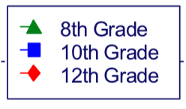
Drug use – adolescents
MTF, 2019

Slide 35
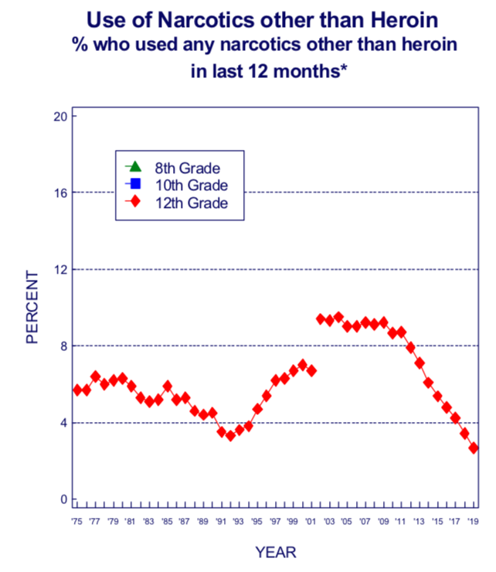
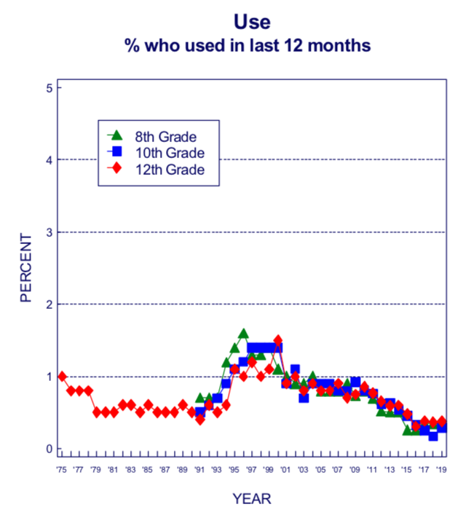
Opioid use– adolescents
Heroin Use
MTF, 2019

