Slide 1



The Science of Addiction
Immersion Training in Addiction Medicine Program 2020
October 2020
Daniel P. Alford, MD, MPH
Professor of Medicine
Associate Dean, Continuing Medical Education
Director, Clinical Addiction Research and Education (CARE) Unit

Slide 2
Substance Use Disorder
Substance Use Disorder a diagnostic term in DSM-5 recurrent use of alcohol or other drugs causing significant impairment, such as health problems, disability and failure to meet major responsibilities
It combines the DSM-IV categories of substance abuse and dependence into a single disorder measured on a continuum from mild, moderate, or severe
Each specific substance is addressed as a separate use disorder
American Psychiatric Association DSM-5 (2013)

Slide 3
Addiction
Addiction indicates the chronic stage of Substance Use Disorder (synonymous with “moderate to severe Substance Use Disorder”)
It is a primary, chronic disease of the brain reward, motivation, memory and related circuitry
Like other chronic diseases, addiction often involves cycles of relapse and remission. Without treatment, addiction is progressive and can result in disability or premature death
Volkow ND et al. N Engl J Med. 2016

Slide 4
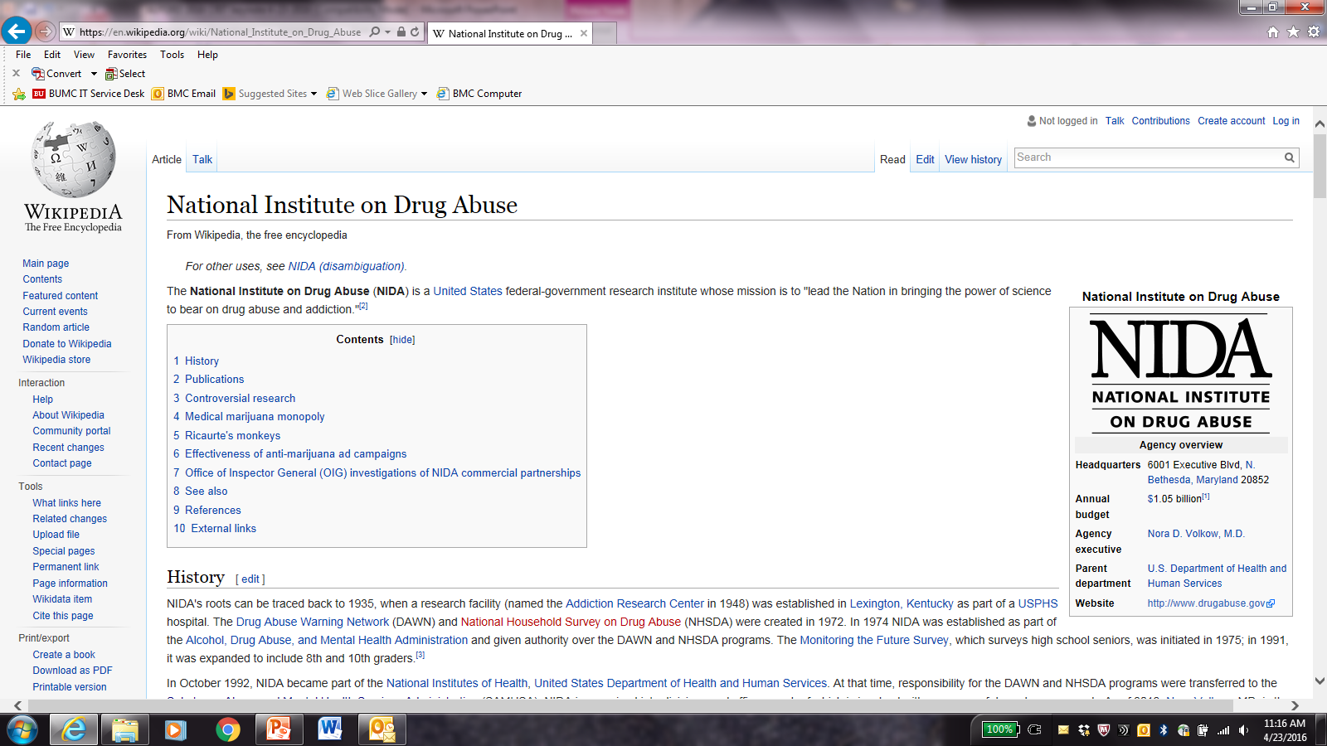
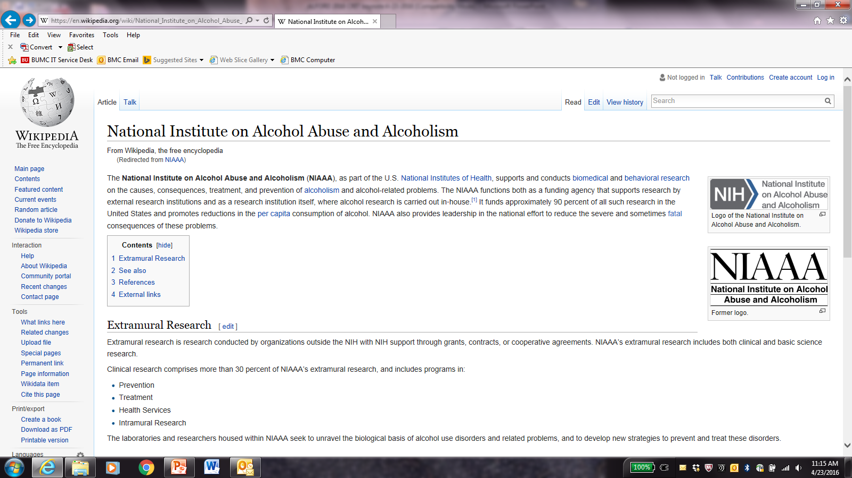
Some Important Organizations (Acronyms)
NIDA (National Institute on Drug Abuse)
  supports and conducts biomedical and behavioral research on the causes, consequences, treatment, and prevention research on drug use and addiction
NIAAA (National Institute on Alcohol Abuse and Alcoholism)
  supports and conducts biomedical and behavioral research on the causes, consequences, treatment, and prevention of alcoholism and alcohol-related problems

Slide 5
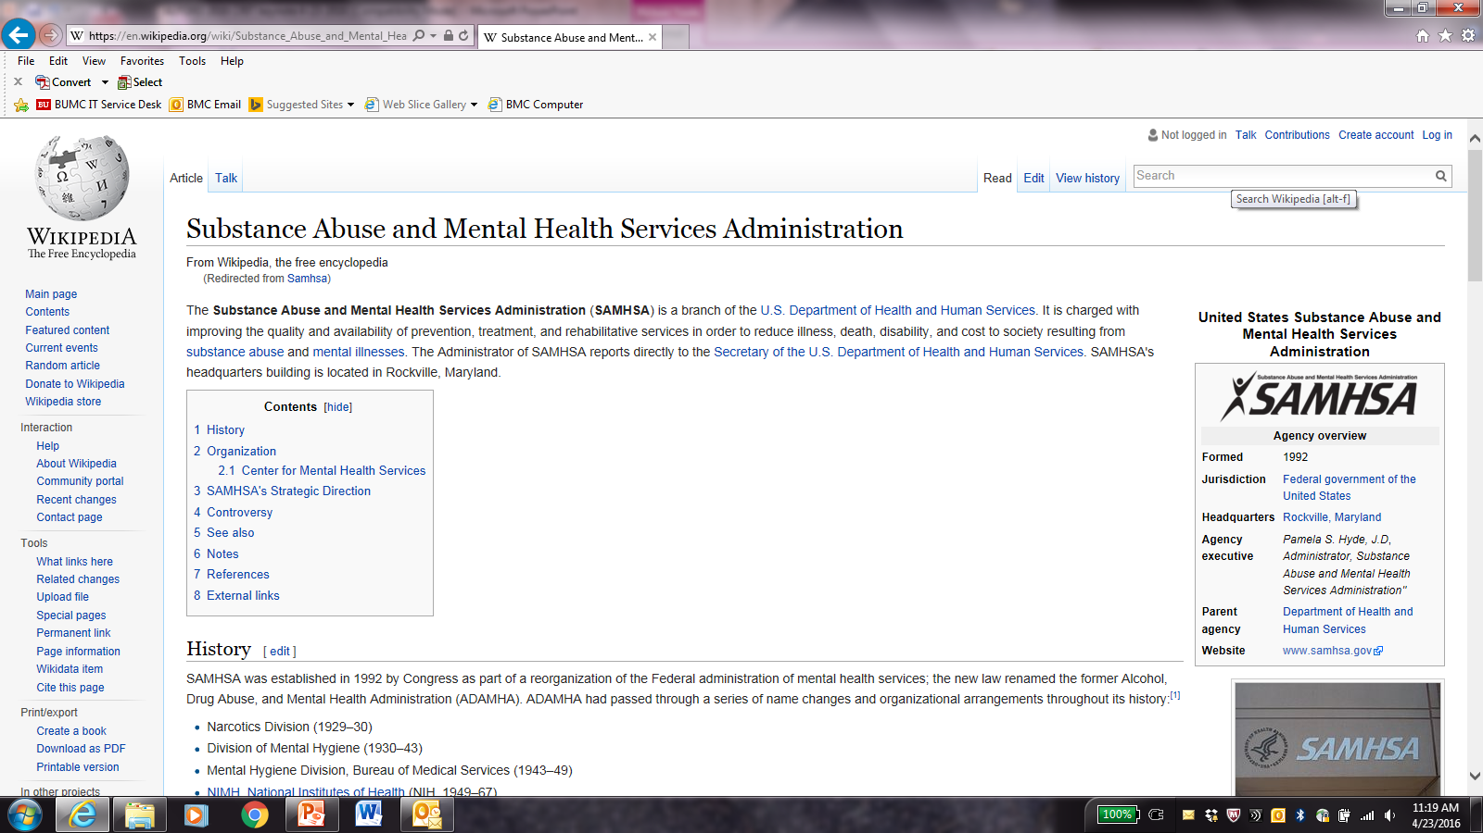
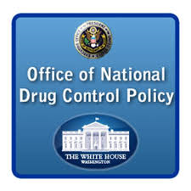
Some Important Organizations (Acronyms)
SAMHSA (Substance Abuse and Mental Health Services Administration)
  a branch of the U.S. Department of Health and Human Services charged with improving the quality and availability of prevention, treatment, and rehabilitative services for substance use and mental illnesses
ONDCP (Office of National Drug Control Policy)
  establishes policies, priorities, and objectives to eradicate illicit drug use, manufacturing, and trafficking, drug-related crime and violence, and drug-related health consequences

Slide 6


Trends: Sources of Data
National Survey on Drug Use and Health (NSDUH)
  annual since 1971, SAMHSA survey on use of illicit drugs, alcohol, and tobacco in the US civilian, noninstitutionalized population aged >12 years. Face-to-face interviews at their place of residence obtained from approximately 67,500 individuals
Monitoring the Future (MTF)
  annual since 1975, NIDA funded survey of 8th, 10th, and 12th graders measuring drug, alcohol, and cigarette use by the University of Michigan. About 44,000 students from 360 public and private schools are surveyed

Slide 7
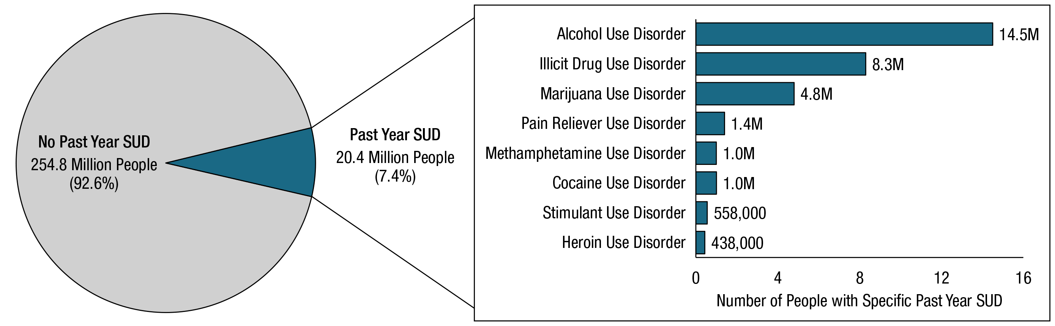
Past Year Substance Use Disorder
SAMHSA. (2020). 2019 National Survey on Drug Use and Health

Slide 8
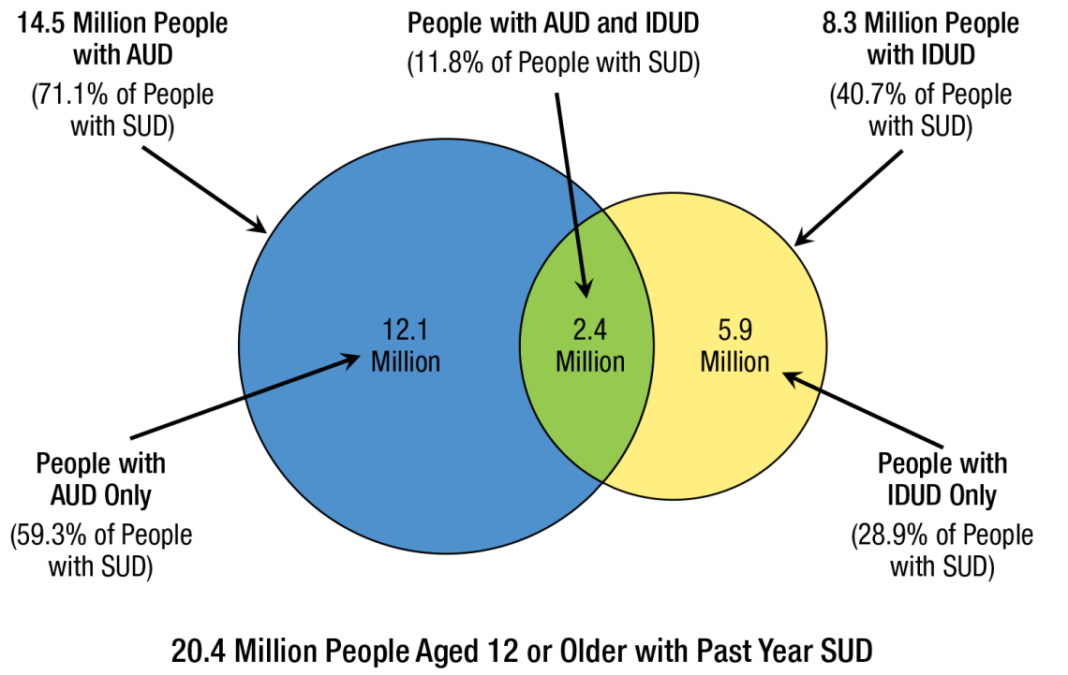
Past Year AUD and IDUD
SAMHSA. (2020). 2019 National Survey on Drug Use and Health

Slide 9
NSDUH 2018→2019 Trends
Alcohol
  Past year AUD remained stable in all age groups
Opioids
  Prescription opioid misuse and heroin initiation decreased significantly
  Opioid overdose deaths increased by approximately 4.6%
Cannabis
  Past month use and past year use significantly increased in adults
  Past year CUD increased significantly in adolescents
Stimulants
  No change in cocaine use in all age groups
  Upward trend in methamphetamine use
SAMHSA. (2020). 2019 National Survey on Drug Use and Health

Slide 10
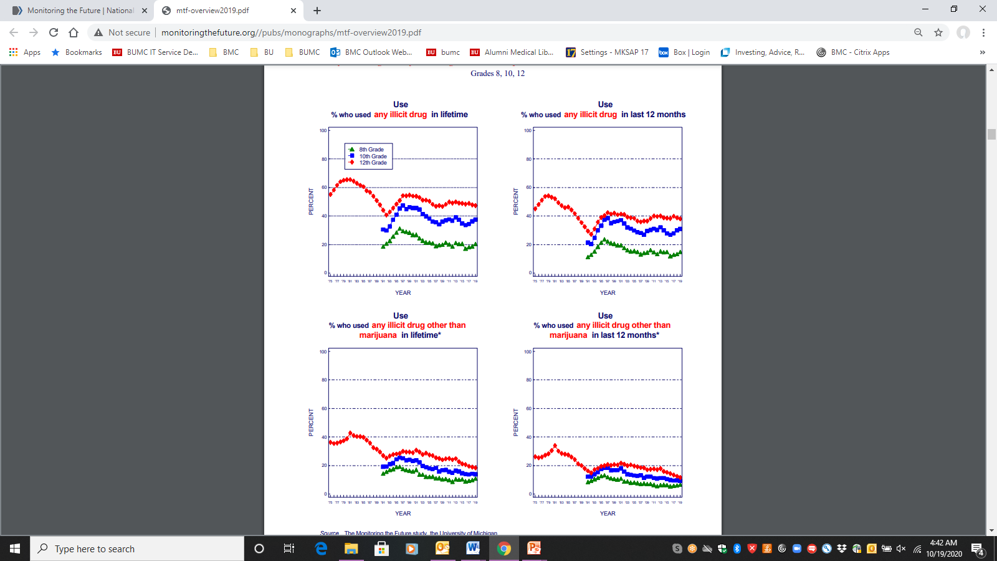
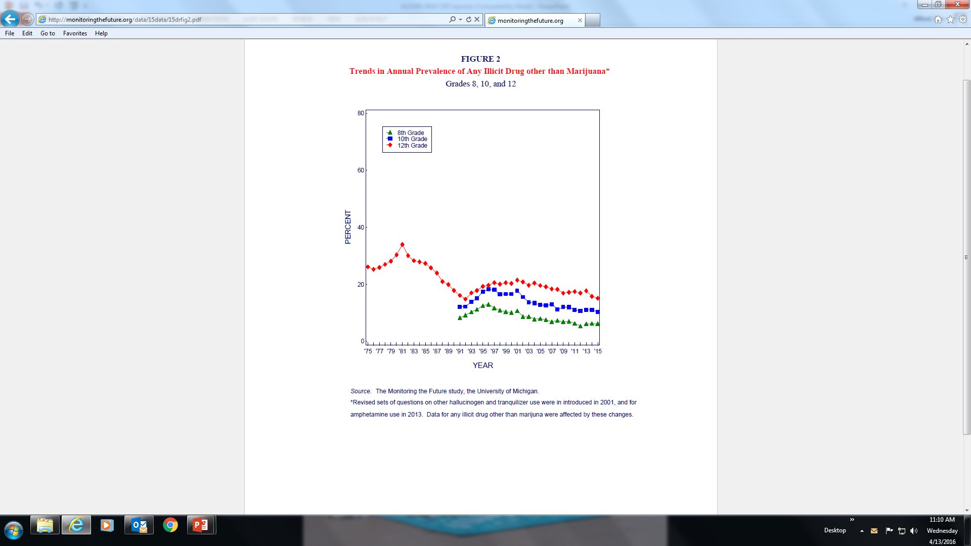
Past Year Illicit Drug Use by Teens
Illicit Drug Use
excluding Cannabis
Illicit Drug Use
In the last 5 years any illicit drug other than cannabis declined significantly for 10th and 12th grades, with no significant change for 8th grade
Johnston LD et al. (2020). 2019 Monitoring the Future Study

Slide 11
Addiction Is a Developmental Disease
1.8
Tobacco
Cannabis
Age at tobacco, alcohol and cannabis dependence, as per DSM IV
1.6
Alcohol
1.4
1.2
1.0
% in each age group to develop
first-time dependence
0.8
0.6
0.4
0.2
0.0
5
10
15
20
25
30
35
40
45
50
55
60
65
70
75
Age
National Epidemiologic Survey on Alcohol and Related Conditions (NESARC), 2003
Notes:
designed to assess the prevalence of alcohol use disorders (AUD) and their associated disabilities in the general population. The survey is the largest ever comorbidity study of multiple mental health disorders among U.S. adults, including alcohol and other substance use disorders, personality disorders, and anxiety and mood disorders. NESARC is designed to be a longitudinal survey with the first wave fielded in 2001–2002. The second wave of interviews was completed in 2004–2005 and used the same sample of respondents.
NESARC is a nationwide household survey with a probability sample representative of US adults. The final sample for Wave 1 was 43,093 respondents; Wave 2 was 34,653 of the Wave 1 respondents.
16% of alcoholics began drinking prior to turning 12 years old, while only 9% first touched alcohol between 15 and 17. This percentage is even lower, at 2.6%, for those who first started the habit after they were 21. These statistics clearly show that introducing a person to alcohol at a very young age can put them at severe risk of dependence or abuse later on in life. Like with alcohol, the earlier someone starts to use drugs, the higher the chance that they will grow to abuse or become dependent on them later on in life.
Most new cases of drug use disorders develop during adolescence. Perhaps there is something special (“sensitive”) about adolescence for developing addiction.
Addiction is also characterized as a developmental disorder characterized by increased risk for substance use disorder for tobacco MJ and alcohol
There are many factor that contribute to the increase in incidence including
-Social/ environmental factors
- Genetic and
Neurobiological factors (Sowell brain volume subtraction method between normal 12-16 year old adolescents and 23-30 year old young adults revealed parietal, temporal and occipital lobes showed little maturational change but, importantly, dorsal, medial and lateral regions of the frontal lobes (purple) those regions involved in executive function and inhibitory control were less developed.
Adolescents with risk haplotype on Chromosome 15 that start smoking before age 15 go on to become more dependent to tobacco as adults than those with other haplotypes
Universal Prevention intervention research is aimed at developing and testing programs that can reduce drug initiation and use during this vulnerable developmental period.

Slide 12

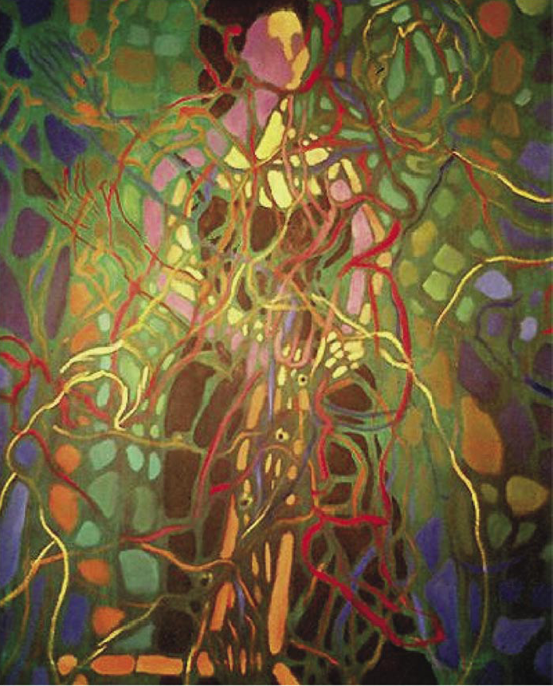
Why do people use substances?
To feel good
To have novel:
Feelings
Sensations
Experiences
AND
To share them
To feel better
To lessen:
Anxiety
Worries
Fears
Depression
Hopelessness
Withdrawal
Drawings courtesy of Vivian Felsen

Slide 13
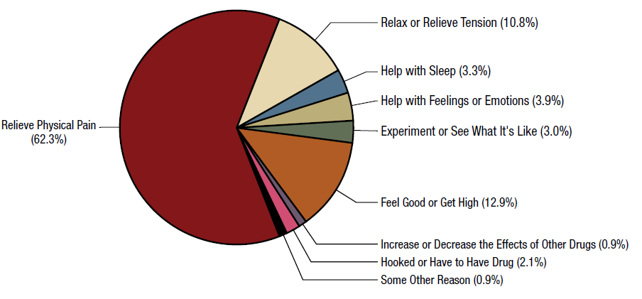
Reasons for Prescription Opioid Misuse
~20%
SAMHSA. (2017). 2018 NSDUH

Slide 14
What have we learned about vulnerability?
Why do some people become addicted while others do not?

Slide 15
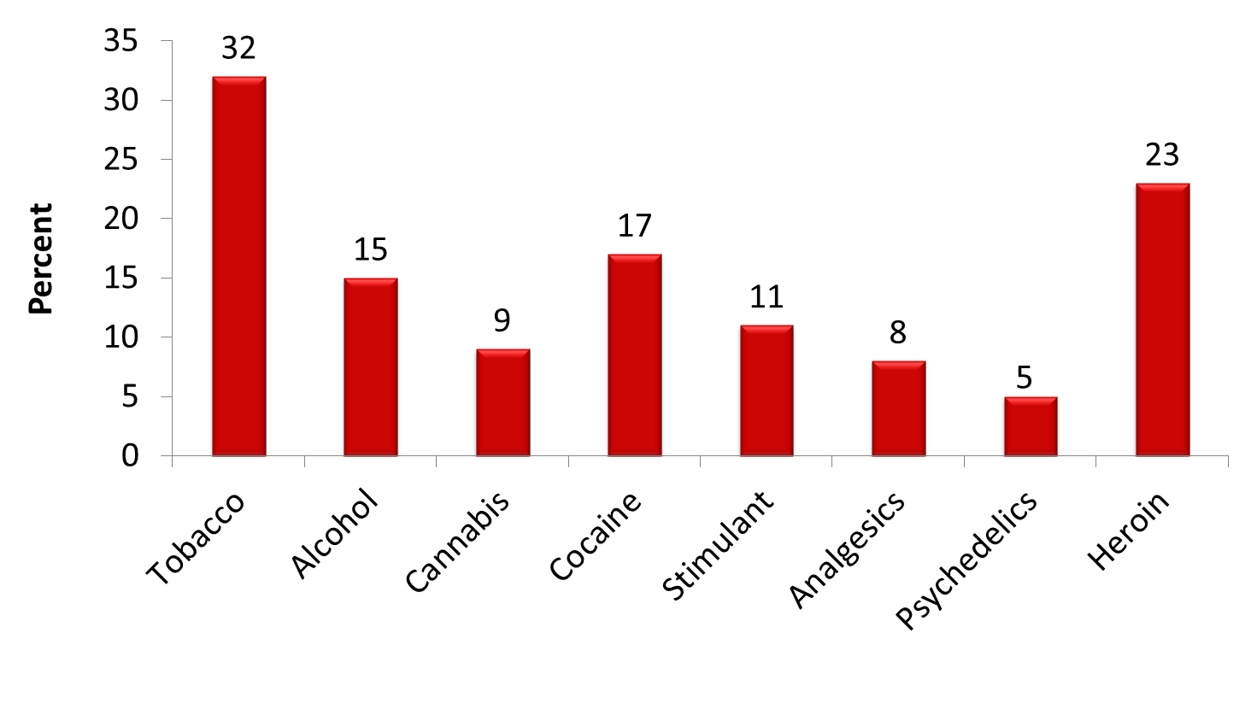
Addiction Prevalence Varies by Substance
National Comorbidity Survey (1990-1992) noninstitutionalized population aged 15-54 years old
Estimated Prevalence of Dependence (Use Disorder) among Users
(n=8,098)
Anthony JC et al., Exp Clin Psychopharm 1994

Slide 16
Development of Substance Use Disorders
Involves Multiple Factors
Biology
Genes/Development
Environment
DRUG/ALCOHOL USE
Brain Mechanisms
Substance Use Disorder

Slide 17
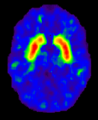
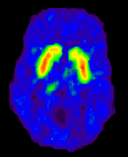
DA Receptor Levels and Response to MP
Striatal Dopamine D2 receptors (D2R) levels and reinforcing responses to the psychostimulant methylphenidate (MP) in nondrug-using subjects (n=7)
Subjects with low D2R levels in the striatum found MP pleasant while those with high D2R found MP unpleasant
Low D2R = “reward deficiency syndrome”
2.5
unpleasant response
0
Striatal D2R modulate reinforcing responses to stimulants and may underlie predisposition for drug use
pleasant response
D2R radioligand and PET imaging
Volkow ND et al. Synapse. 2002
Notes:
We had shown that striatal DA D2 receptors levels predicted the reinforcing responses to the psychostimulant drug methylphenidate in nondrug‐abusing subjects. Here, we assessed the replicability of this finding. We measured D2 receptors with PET and [¹¹C]raclopride (twice to determine stability) in seven nondrug‐abusing subjects to assess if they predicted the self‐reports of “drug‐liking” to intravenous methylphenidate (0.5 mg/kg). DA D2 measures were significantly correlated with “drug‐liking” in both evaluations (r = 0.82 and r = 0.78); subjects with the lowest levels reported the higher ratings of “drug‐liking” and vice versa. These results replicate our previous findings and provide further evidence that striatal DA D2 receptors modulate reinforcing responses to stimulants in humans and may underlie predisposition for drug self‐administration.

Slide 18


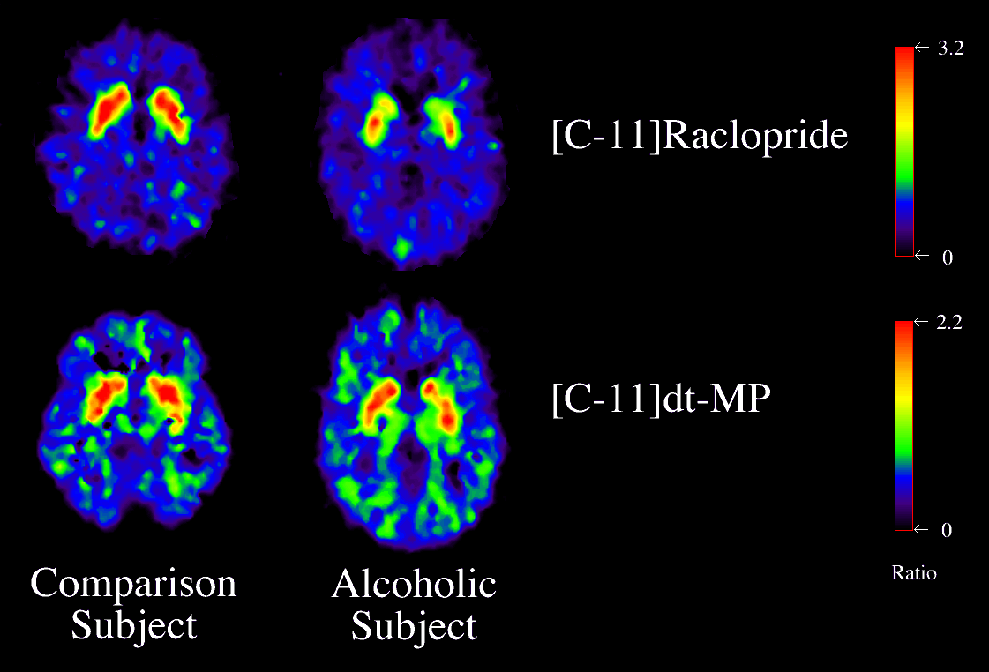
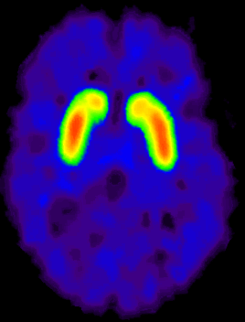
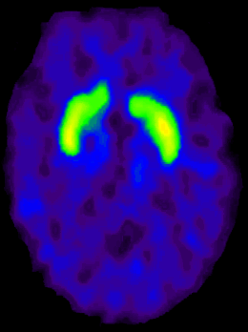
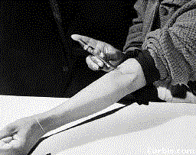
D2R Lower in Individuals with Addiction
“hypo-dopaminergic state”
Volkow et al., Neuro Learn Mem 2002
Cocaine
DA D2 Receptor Availability
Alcohol
Heroin
Control
Addicted
Notes:
PET studies measuring DA D2 receptors have consistently shown long-lasting decreases in DA D2 receptors in drug abusers when compared with controls (reviewed Volkow & Fowler, 2000) (Table 1) (Fig. 2). We have postulated that the decreases in DA D2 receptors coupled with the decreases in DA brain function in the drug abusers would result in a decreased sensitivity of reward circuits to stimulation by natural reinforcers

Slide 19
Genetics
Gene
Environment
Interaction
Environment
Notes:
From Linda 10/26/00 for New Orleans Neuroscience presentation

Slide 20
Environmental Factors
Drug availability
Peers who use drugs
Family problems
Early physical or sexual trauma
Stress
Notes:
Many environmental factors also contribute to a person’s propensity to take drugs of abuse. These include having a history of physical or sexual abuse, witnessing violence, or experiencing other kinds of stressors. Drug availability is, of course, a primary environmental factor in contributing to drug abuse and addiction.

Slide 21
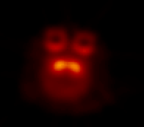
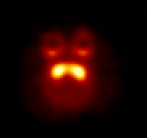
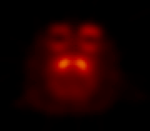
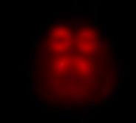
Social Stressors Change D2R Amount and Availability and Propensity to Administer Cocaine
N
Individually
Housed
Group
Housed
Dominant
50
Subordinate
Becomes Dominant
No longer stressed
40
>20% higher D2R
30
*
Reinforcers (per session)
*
20
Social Setting Can Change Neurobiology
10
0
Becomes Subordinate
Stress remains
S
.003
.01
.03
.1
Cocaine (mg/kg/injection)
N=20 monkeys
Morgan, D. et al. Nature Neuroscience, 2002
Notes:
Here we used positron emission tomography (PET) imaging to study brain dopaminergic function in individually housed and in socially housed cynomolgus macaques (n = 20). Whereas the monkeys did not differ during individual housing, social housing increased the amount or availability of dopamine D₂ receptors in dominant monkeys and produced no change in subordinate monkeys. These neurobiological changes had an important behavioral influence as demonstrated by the finding that cocaine functioned as a reinforcer in subordinate but not dominant monkeys. These data demonstrate that alterations in an organism's environment can produce profound biological changes that have important behavioral associations, including vulnerability to cocaine addiction.

Slide 22
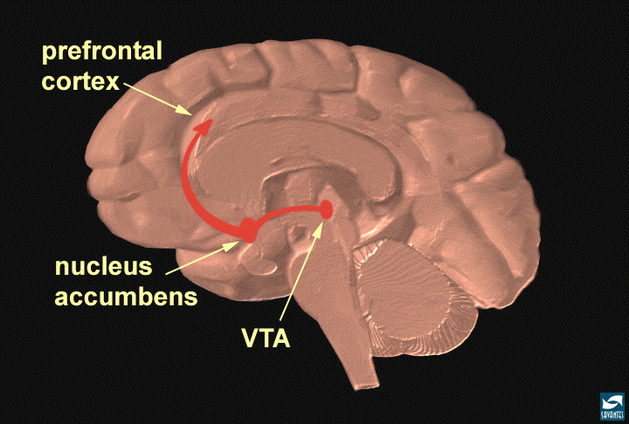
Neuronal Circuits Involved In Substance Use and Addiction
Executive Function
Inhibitory Control
PFC
ACG
OFC
Hipp
SCC
Reward
Motivation
Drive
NAcc
VP
Amyg
Memory
Learning
Notes:
FC – prefrontal cortex; ACG – anterior cingulate gyrus; OFC – orbitofrontal cortex; SCC – subcallosal cortex; NAc – nucleus accumbens; VP – ventral pallidum; Hipp – hippocampus; Amyg – amygdala.

Slide 23
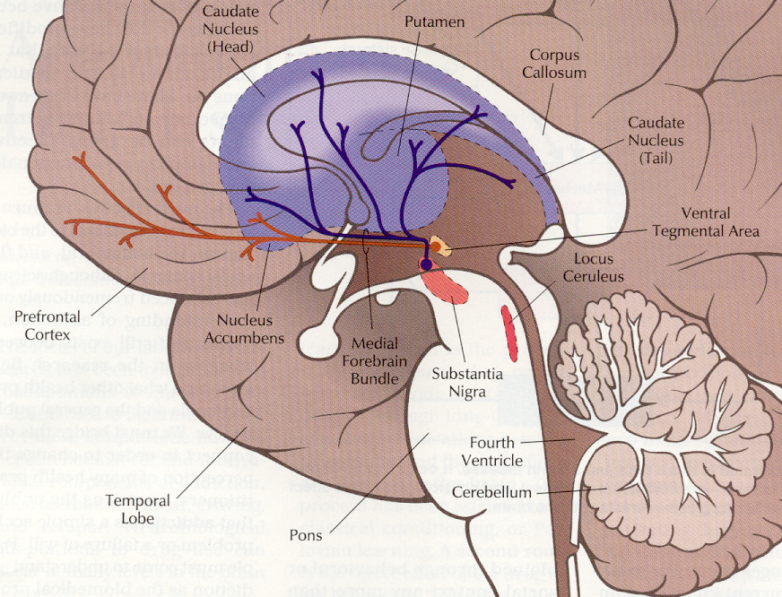
The Reward Pathway
Reward and reinforcement is in part controlled by mu-opioid receptors in the Reward Pathway:
Ventral Tegmental Area (VTA)
Nucleus Accumbens with projections to Prefrontal Cortex
Dopaminergic system
Leshner A. Hospital Practice. 1996

Slide 24
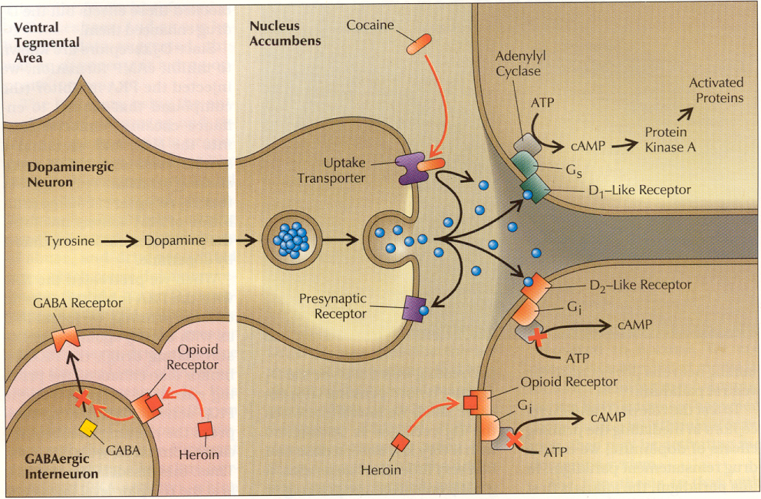
The Reward Pathway
Leshner A. Hospital Practice. 1996

Slide 25
Natural Rewards Elevate Dopamine Levels
R
Food
Sex
200
200
NAc shell
150
150
% of Basal DA Output
DA Concentration (% Baseline)
100
100
50
Empty
Box Feeding
Female Present
0
0
60
120
180
Sample
Number
1
2
3
4
5
6
7
8
Time (min)
Rat brain dialysis measuring extracellular synaptic dopamine concentration
Di Chiara et al., Neuroscience, 1999
Fiorino and Phillips, J. Neuroscience, 1997
Notes:
25
Natural rewards stimulate dopamine neurotransmission. Eating something that you enjoy or being stimulated sexually can cause dopamine levels to increase. In these graphs, dopamine is being measured inside the brains of animals. Its increase is shown in response to food or sex cues. This basic mechanism of controlled dopamine release and reuptake has been carefully shaped and calibrated by evolution to reward normal activities critical for our survival.

Slide 26
Drugs Elevate Dopamine More/Longer
1100
AMPHETAMINE
400
COCAINE
1000
900
800
300
700
% of Basal Release
600
% of Basal Release
500
200
400
300
200
100
100
0
0
0
1
2
3
4
5
0
1
2
3
4
5
Hrs. after amphetamine
Hrs. after cocaine
250
250
NICOTINE
MORPHINE
200
200
% of Basal Release
150
% of Basal Release
150
100
100
0
0
0
1
2
3
0
1
2
3
4
5
Hrs. after nicotine
Hrs. after morphine
Di Chiara G, Imperato A. Proc Natl Sci. 1988

Slide 27
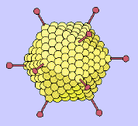
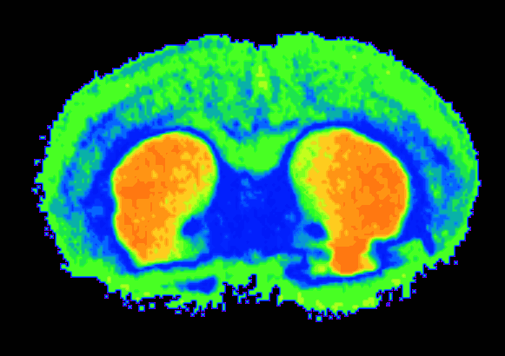
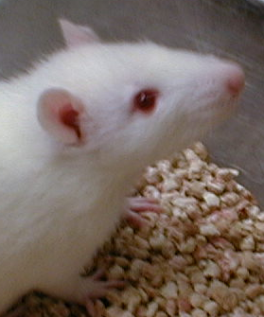
Effects of an Adenovirus Vector Carrying a D2R Gene into NAc
60
1st D2R Vector
p < 0.0005
2nd D2R Vector
50
Rats trained to self-administer alcohol
p < 0.0005
Overexpression of D2R reduces alcohol self-administration
40
p < 0.005
p < 0.005
30
Percent Change in D2R
20
p < 0.10
10
0
4
6
8
10
Null Vector
0
24
0
-20
DA
DA
-40
p < 0.01
DA
DA
% Change in Alcohol Intake
DA
p < 0.01
DA
-60
DA
p < 0.001
DA
-80
p < 0.001
p < 0.001
-100
0
4
6
8
10
24
Thanos, PK et al., J Neurochem, 2001.
Time (days)

Slide 28
2. Memory circuit
Hipp
Amyg
MEMORY/
LEARNING
“People, places and things…”

Slide 29
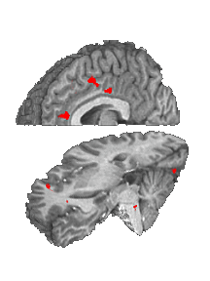

Cocaine Craving:
Population (Cocaine Users, Controls) x Film (cocaine )
Cingulate
Ant Cing
Signal Intensity (AU)
IFG
Controls (14) Cocaine Users (17)
Garavan et al A .J. Psych 2000
Cocaine Film

Slide 30
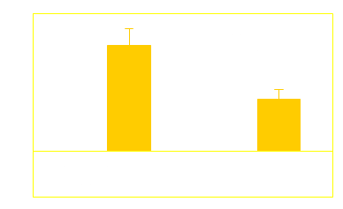
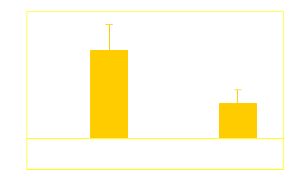
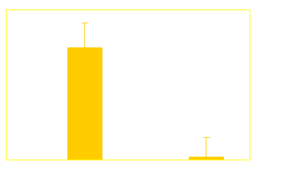
Cocaine Craving:
Population (Cocaine Users, Controls) x Film (cocaine, erotic)
Cingulate
Ant Cing
Signal Intensity (AU)
IFG
Controls (14) Cocaine Users (17)
Garavan et al A .J. Psych 2000

Slide 31
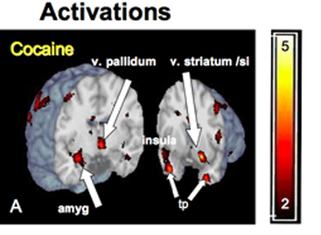
Even Unconscious Cues Can Elicit Brain Responses
Brain Regions Activated by 33 millisecond Cocaine Cues (too fast for conscious recognition)
Childress, et al., PLoS ONE 2008

Slide 32
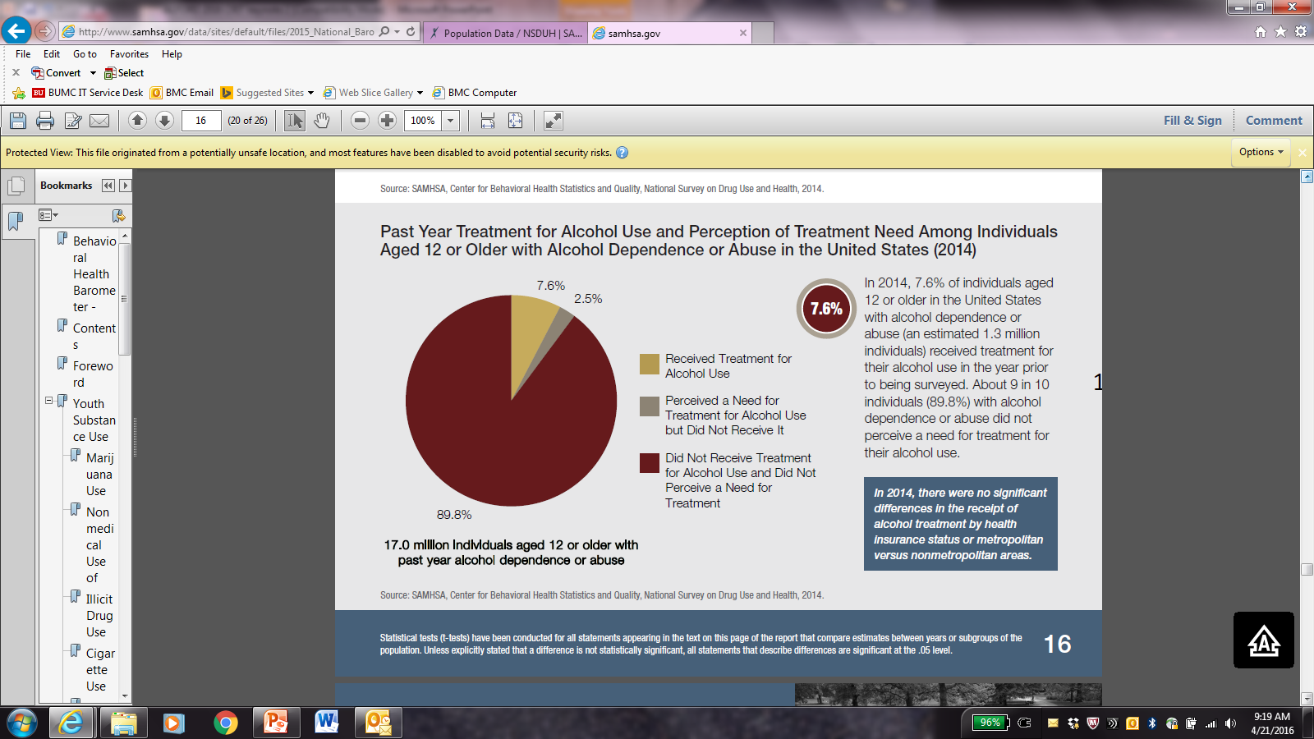
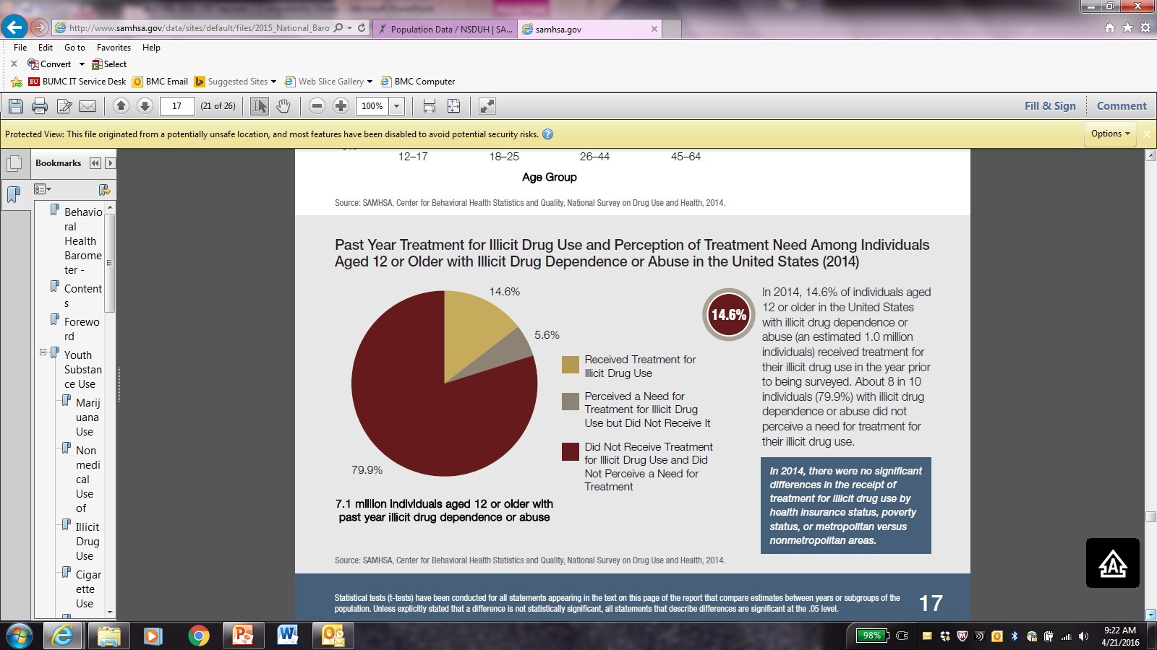
SUD Treatment
Past year AUD
Past year DUD
Received treatment
Perceived need but did not receive it
Did not receive treatment and did not perceive need
SAMHSA 2015 NSDUH

Slide 33
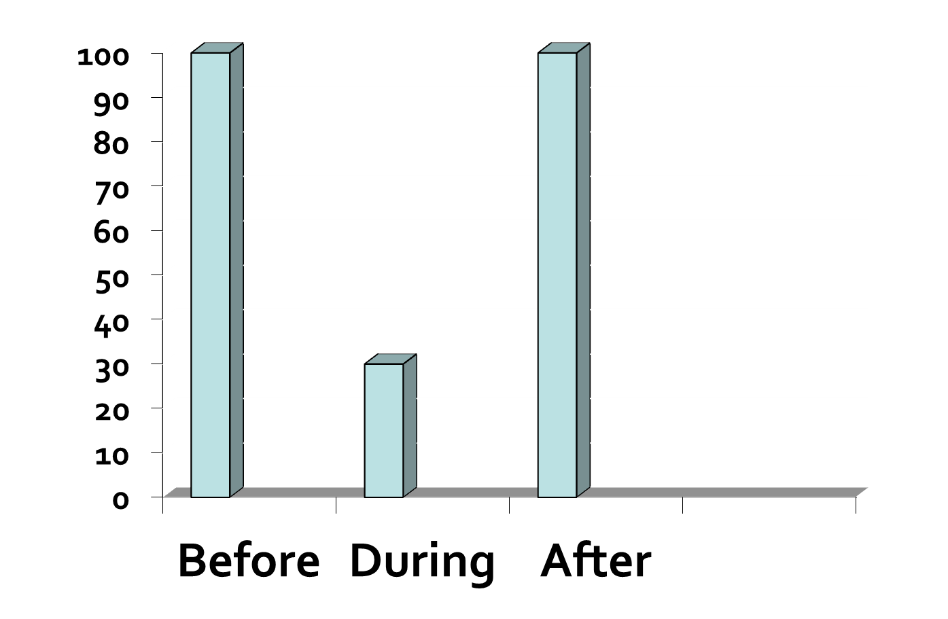
Evaluating Hypertension Treatment
It Works!
McLellan AT et al. JAMA 2000

Slide 34
Evaluating Addiction Treatment
It Doesn’t Work!?
McLellan AT et al. JAMA 2000

Slide 35
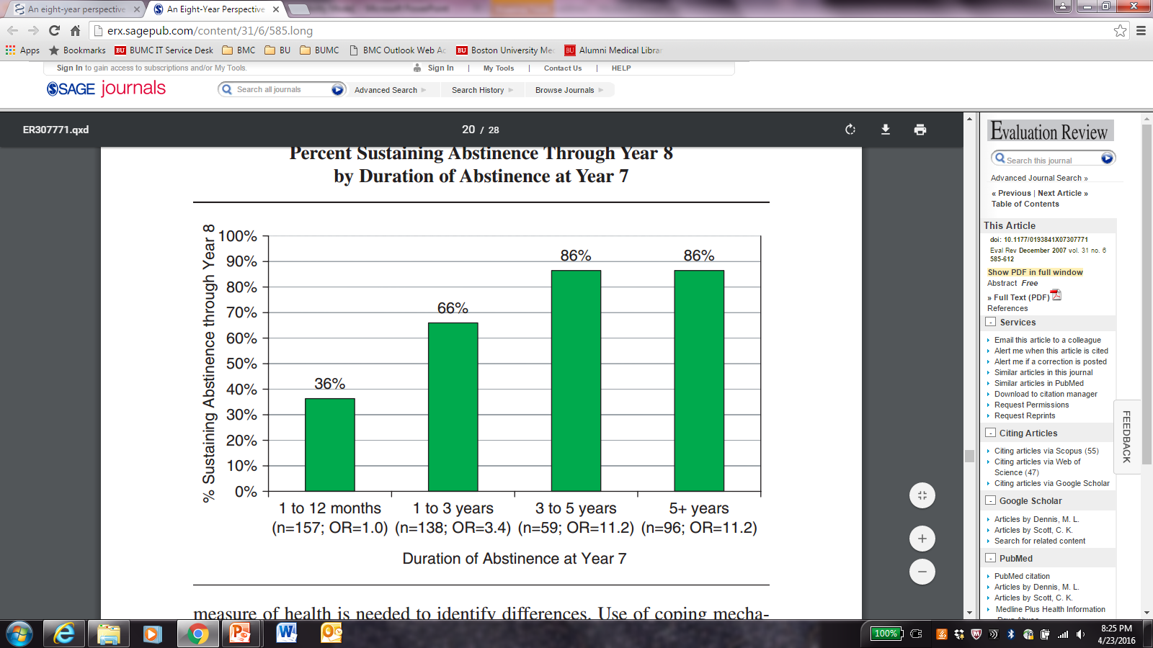
How Long is Treatment Needed?
After 3 years in recovery < 15% relapse
N=1,162
It takes a year of abstinence before <50% relapse
Dennis ML et al. Eval. Rev. 2007
Notes:
examines how the duration of abstinence at a given point is related to the odds of sustaining abstinence in the subsequent year.
This figure shows the odds of sustaining recovery to year 8 based on the duration of abstinence as of year 7.
Data are from the Pathways to Recovery sample of 1326 patients
Results show that extended abstinence is predictive of sustained recovery.
If abstinent for a year or less, only 36% were likely to still be abstinent the following year.
The odds of remaining abstinent rise above chance if patients had been abstinent 1 to 3 years. 66% percent were still abstinent the following year.
The most telling result is that beyond 3 years of abstinence recovery odds remain high and stable, as indicated by the results for both the 3-5 year group and the greater than 5-year group.
After 5 years of sobriety, their a appears to be a plateau of sustained recovery.

Slide 36
Thanks!

