Slide 1
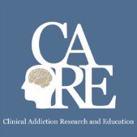


Pain, Opioids and
Addiction
Immersion Training in Addiction Medicine Programs 2020
October 2020
Daniel P. Alford, MD, MPH
Professor of Medicine
Associate Dean, Continuing Medical Education
Director, Clinical Addiction Research and Education (CARE) Unit

Slide 2
Chronic Pain is Complex
Acute Pain
Life sustaining symptom
Chronic Pain
Can be a disease in itself
  Maladaptive, pathologic, disorder of the somatosensory pain signaling pathways influenced by genetic and epigenetic factors
  Adaptive by eliciting motivation to minimize harm and allow healing
  Associated with higher risk of fatal and nonfatal suicide attempts*
*
Petrosky E, et al. Ann Intern Med. 2018
Ilgen MA, et al. JAMA Psychiatry. 2013
Tang NK et al. Psychol Med. 2006
Dzau VJ, Pizzo PA. JAMA. 2014
Walk D, Poliak-Tunis M. Med Clin N Am. 2016
Argoff CE, et al. Pain Med. 2009
Notes:
Acute versus Chronic Pain
Well, let’s start thinking about the difference between acute versus chronic pain. Acute pain is a life-sustaining symptom. It’s adaptive, and it really elicits motivation to minimize harm, or to allow for healing. But let’s move on to chronic pain, which is – which really can be a disease in itself. It’s maladaptive. It’s pathological. And it’s really a disorder of the somatosensory pain signaling pathway, influenced by genetic, and epigenetic factors.
We usually think about chronic pain as nociceptive, that is pain that’s somatic, or visceral, cause by some noxious stimuli, or neuropathic pain, which usually involves nerve injury, or nerve impairment. It’s also important to note that chronic pain has been associated with higher risks of fatal and non-fatal suicide attempts.

Slide 3
Chronic Pain in Perspective
Chronic pain is common
Pain is subjective to the patient and the clinician
Pain can’t always be visualized
Psychiatric co-morbidities are common
Significant barriers to adequate pain care
  Negative attitudes and disparities in pain care
  Lack of decision support for chronic pain management
  Financial misalignment favoring use of medications
  Poor support for team-based care and specialty clinics
  Many competing priorities in primary care
Institute of Medicine. 2011 Relieving Pain in America. Washington DC

Slide 4
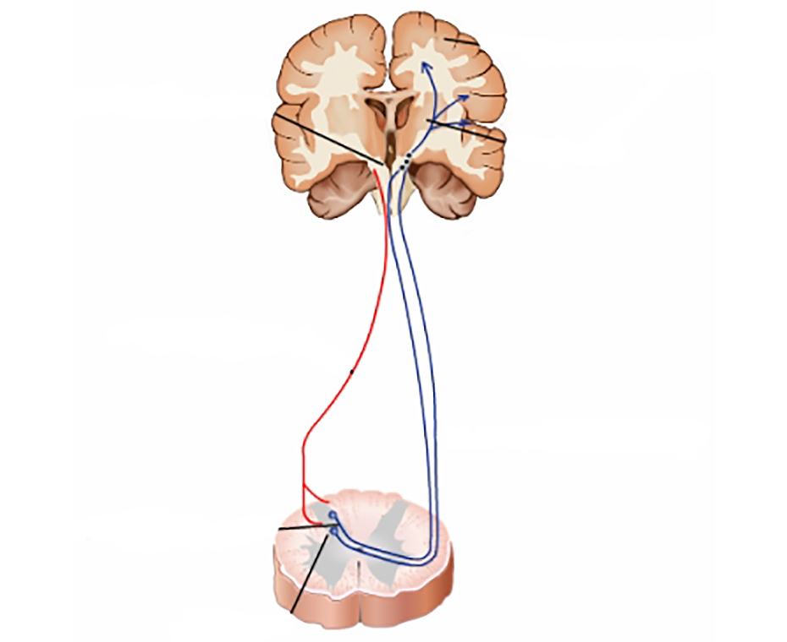
Opioid Analgesics
Analgesia
  Turn on descending inhibitory systems
  Prevent ascending transmission of pain signal
  Inhibit terminals of C-fibers in the spinal cord
  Inhibit activation of peripheral nociceptors
  Variable response (not all patients respond to the same opioid in the same way)
    >3,000 polymorphisms in the human MOR gene
    Differences in pharmacokinetics (opioid metabolism)
Active the reward pathway
Somatosensory
cortex
Periaqueductal
gray area
Thalamus
Descending
pathway
Ascending
pathways
Peripheral
nerves
Dorsal Horn
McCleane G, Smith HS. Med Clin N Am. 2007
Smith HS. Pain Physician. 2008

Slide 5
Opioid Risks
Allergies are rare
Side effects are common
    Nausea, sedation, constipation, urinary retention, sweating
    Respiratory depression – sleep apnea
Organ toxicities are rare
    Suppression of hypothalamic-pituitary-gonadal axis
Immunosuppression
  Increased risk of invasive pneumococcal dz and community acquired pneumonia
Worsening pain (hyperalgesia in some patients)
Addiction (Opioid Use Disorder)
Overdose
    when combined w/ other sedatives and at higher doses
Dunn KM et al. Ann Intern Med 2010
Li X et al. Brain Res 2001
Doverty M et al. Pain 2001
Angst MS, Clark JD. Anesthesiology 2006
Wiese AD, et al. Ann Intern Med. 2018

Slide 6
Treatment Gaps Following Opioid Overdose
Opioids were dispensed to 91% of patients after a nonfatal overdose
n=2848
  7% had repeat opioid overdose
  At 2 years, cumulative incidence of repeated overdose was 17% for patients on high opioid dosages after the index overdose
Larochelle MR, et al. Ann Intern Med. 2016
Notes:
Treatment Gaps following Opioid Overdose
Here we know that patients like Miss James experience very substantial treatment gaps after an opioid overdose. We know that patients who have an opioid overdose in the overwhelming majority of cases go on to receive further opioid prescriptions. In fact, 91 percent of patients who have had a non-fatal opioid overdose receive a subsequent opioid prescription. Seven percent of those patients go on to have another overdose, and at two years the rate of repeat overdose is about 17 percent. As we mentioned earlier in the training, a prior overdose is a very potent risk factor for a subsequent overdose.
We also know that, unfortunately, very few patients presenting with a non-fatal opioid overdose are connected to opioid use disorder treatment. In fact, less than one-third of people who suffer a non-fatal opioid overdose receive medications for an opioid use disorder in the following year which is a tremendous missed opportunity because medications for opioid use disorder are associated with decreased all-cause and opioid-related mortality in this population.

Slide 7
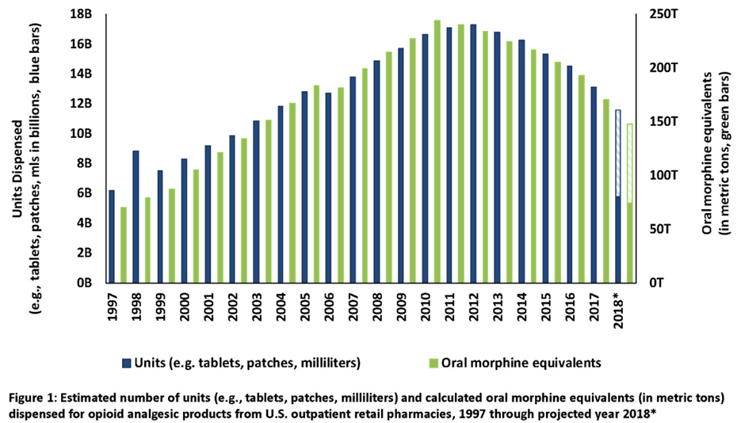
Opioid Prescribing Trends
Since 2011 MME decline by 43%
2018 largest MME decline at 17%
www.fda.gov, ONDCP 2019

Slide 8
Safer Opioid Prescribing for Chronic Pain

Slide 9
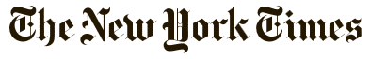
“The pain medication conundrum”
Opinion
Undertreating pain, we are admonished…it violates the basic ethical principles of medicine. On the other hand, we are lambasted for overprescribing pain medications… creating an epidemic of overdose deaths.
For patients with chronic pain, especially those with syndromes that don’t fit into neat clinical boxes, being judged by doctors to see if they “merit” medication is humiliating and dispiriting. This type of judgment, with its moral overtones and suspicions, is at odds with the doctor-patient relationship we work to develop.
“As Mr. W. and I sat there sizing each other up, I could feel our reserves of trust beginning to ebb. I was debating whether his pain was real or if he was trying to snooker me. He was most likely wondering whether I would believe him…”
Danielle Ofri, MD
Associate Professor at NYU and a physician at Bellevue Hospital, August 2015

Slide 10
Opioid Efficacy for Chronic Pain
Meta-analyses (3-6 m f/u)
  Opioids vs placebo (high quality studies) Opioids with statistically significant, but small, improvements in pain^{1,2} and physical functioning.²
  Opioids vs nonopioids (low-mod quality studies) Similar benefits²
RCT³ found opioids not superior to nonopioids for improving musculoskeletal pain-related function over 12 months
Study limitations: ⁴
Excluded patients already on long-term opioids
89% of eligible patients declined to be enrolled
Two longer term follow-up studies found 44.3% on chronic opioids for chronic pain had at least 50% pain relief ⁵
1. Meske DS, et al. J Pain Res. 2018
2. Busse JW, et al. JAMA. 2018
3. Krebs EE, et al. JAMA. 2018
4. Webster L. Pain Med. 2019
5. Noble M, et al. Cochrane Syst Rev. 2010
Notes:
Opioid Efficacy for Chronic Pain
How good are opioids for chronic pain? What is the efficacy for chronic pain? Now, this is different than acute pain, and I would argue that the efficacy for acute pain is probably 100 percent effective. For someone who comes in with a femur fracture, we would never withhold an opioid, because we assume that they’ll be some efficacy. There may be variability in terms of how much relief somebody gets, but we wouldn’t withhold it from someone with severe pain like that.
For chronic pain, it’s completely different. We’ve already talked about it as being more like a chronic disease. Well, lately, in the past year, we’ve had a couple of meta-analyses that have looked at opioids versus placebo for chronic pain. Unfortunately, these studies only evaluate for up to three to six months, and follow-up. So, we don’t have long-term studies, but in these short-term studies for chronic pain, they show that opioids were statistically significantly better, but with a small improvement in pain, and function, versus placebo. And when they compared opioids versus non-opioids, unfortunately, these studies were low to moderate quality, they showed that both were similar in terms of benefits.
There was a study that looked comparatively between opioids, and non-opioids. It was a randomized clinical trial that found that opioids were not superior to non-opioids for improving musculoskeletal pain-related function over 12 months, so a long-term outcome. However, an important limitation is that only 5 percent of those that were randomized actually entered into the study. So, what that tells me is that someone who’s willing to enter into a study where they could be randomized to an opioid or non-opioid that they seem to do equally well on either one. What happens to that 95 percent who said, “I don’t want to be entered into the study?” It’s unclear. Two longer-term follow-up studies, up to about a year, found that 44.3 percent of individuals on chronic opioids for chronic pain had at least 50 percent pain relief. So, it’s not zero percent; it’s not 100 percent. So, it’s around 50 percent of individuals on opioids for chronic pain will get adequate pain relief.

Slide 11
Multidimensional Care for Chronic Pain
Restore Function
Studies on all pharmacologic and nonpharmacologic treatments for chronic pain are < 12 m, vast majority are < 12 w
Tayeb BO, et al. Pain Med. 2016
  Exercise
  Manual therapies
  Orthotics
  TENS
  Other modalities
  (heat, cold, stretch)
  CBT/ACT
  Tx mood/trauma issues
  Address substances
  Meditation
Physical
Psycho-behavioral
Cultivate
Well-being
SELF
CARE
Reduce Pain
Multimodal approaches are more cost-effective than single modality options
Flor H, et al. Pain 1992
Roberts AH, et al. Clin J Pain. 1993
Patrick LE, et al. Spine. 2004
Kamper SJ, et al. Cochrane Review. 2014
Medication
Procedural
  NSAIDs
  Anticonvulsants
  Antidepressants
  Topical agents
  Opioids
  Others
  Acupuncture
  Nerve blocks
  Steroid injections
  Trigger point injections
  Stimulators
  Pumps
Improve
Quality of Life
Notes:
Multidimensional Care for Chronic Pain
I think it’s important to take a multidimensional care approach. And as you can see on this slide, it really starts in the middle with self-care, teaching patients to pace themselves, and care for themselves. And there are lots of apps, and online programs that patients can interact with to learn about self-care, and that our goals include restoring function, reducing pain, improving quality of life, and cultivate well-being.
And how do we do that? Well, we can use physical modalities: Exercise, manual therapies, certainly cycle behavior therapies, CBT, cognitive behavioral therapy, meditation, and so forth; procedures like acupuncture, and nerve blocks, steroid injections, and then medications. And there are lots of medications we can choose from, including NSAIDs, anticonvulsants, topical agents, and opioids. And we’re going to talk more about those in a while.
It’s important to note, however, that studies on all pharmacologic, and non-pharmacological treatments for chronic pain, are generally assessed for less than 12 months, and the vast majority are less than 12 weeks. So, we really don’t have any long-term studies on any treatment for chronic pain. We do know from systematic reviews that multimodal approaches are more cost-effective than single modality options.

Slide 12
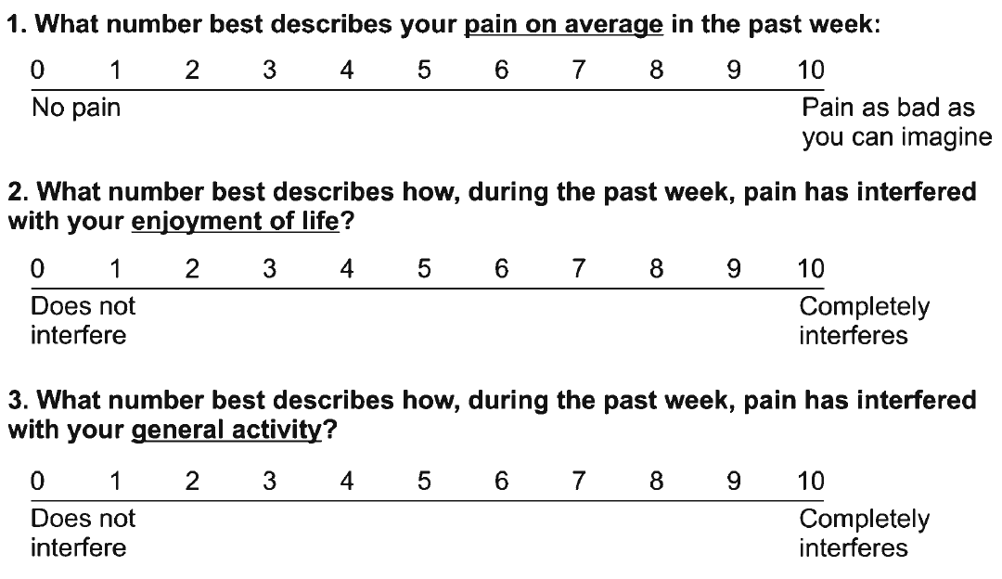
Assessing Benefit – PEG scale
Krebs EE, et al. J Gen Intern Med. 2009

Slide 13
Problematic Opioid Use
Systematic review from 38 studies (26% primary care, 53% pain clinics)
  Misuse rates: 21% - 29%
  Misuse: Opioid use contrary to the directed or prescribed pattern of use, regardless of the presence or absence of harm or adverse effects.
  Addiction rates: 8% - 12%
  Addiction: Pattern of continued use with experience of, or demonstrated potential for, harm (eg, “impaired control over drug use, compulsive use, continued use despite harm, and craving”).
Vowles KE et al. Pain. 2015
Notes:
So what is the opioid addiction risk? So when a patient comes to you and you prescribe opioids, what is the risk of them developing an addiction? And unfortunately, the true incidence and prevalence of addiction in chronic pain populations prescribed opioids is unknown. And a lot of it has to do with different criteria used to define addiction in different studies, and so it’s really all over the place.
And the range, if you look at all studies, is anywhere between zero and 50%, so that’s not particularly helpful other than to say it’s not 100%, and it’s probably not 0% either. And it’s probably more like 15 to 20%, when you look at the majority of studies.

Slide 14
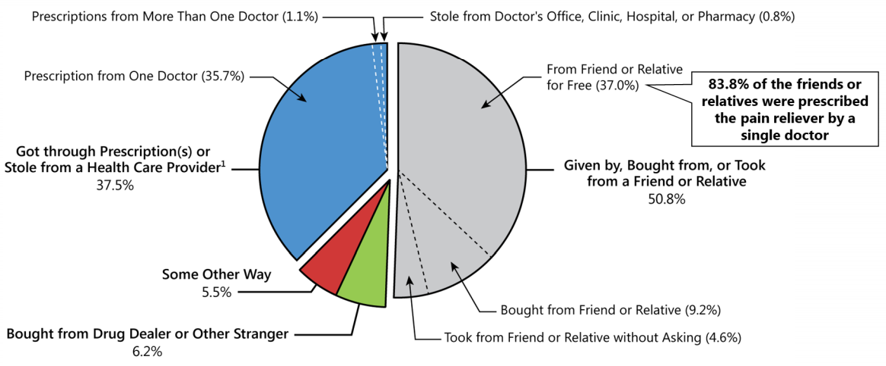
Source of Prescription Opioid Misused
SAMHSA. (2020). 2019 National Survey on Drug Use and Health

Slide 15
Risk Factors: Overdose & Addiction
Medication-related Factors |  | Risk
 | Daily dose >100 MME | overdose | addiction
 | Long-term opioid use (>3 mo) | overdose | addiction
 | ER/LA opioid formulation | overdose
 | <2 weeks after starting ER/LA opioid | overdose
 | Combination opioids + benzodiazepines | overdose
Volkow ND et al. N Engl J Med 2016

Slide 16
Risk Factors: Overdose, Addiction & Misuse
Patient-related Factors |  | Risk
 | Mental health disorder (e.g. depression, anxiety) | overdose | addiction
 | Substance use disorder (e.g., alcohol, nicotine, illicit & prescription drug) | overdose | addiction
 | Family history of substance use disorder |  | misuse
 | Adolescent |  | addiction
 | Age >65 | overdose
 | Sleep-disordered breathing | overdose
 | Legal history (e.g., DUI, incarceration) |  | misuse
 | History of sexual trauma |  | misuse
 | History of overdose | overdose
Akbik H, et al. J Pain Symptom Manage. 2006
Ives J, et al. BMC Health Serv Res. 2006
Liebschutz JM, et al. J Pain. 2010
Michna E, et al. J Pain Symptom Manage. 2004
Reid MC, et al. J Gen Intern Med. 2002
Volkow ND et al. N Engl J Med 2016

Slide 17
Does my patient have an OUD?
  *Tolerance
  *Withdrawal
  Use in larger amounts or duration than intended
  Persistent desire to cut down
  Giving up interests to use opioids
  Great deal of time spent obtaining, using, or recovering from opioids
  Craving or strong desire to use opioids
Recurrent use resulting in failure to fulfill major role obligations
Recurrent use in hazardous situations
Continued use despite social or interpersonal problems caused or exacerbated by opioids
Continued use despite physical or psychological problems
*This criterion is not considered to be met for those individuals taking opioids solely under appropriate medical supervision
Mild OUD: 2-3 Criteria
Moderate OUD: 4-5 Criteria
Severe OUD: >6 Criteria
American Psychiatric Association. (2013). Diagnostic and statistical manual of mental disorders (5th ed.)
Notes:
The diagnosis of addiction really is based upon the four C’s: loss of control, compulsive use, continued use despite harm, and craving.
The disease of addiction is fairly easy to detect when it’s really apparent. And it always becomes very apparent because people can’t hide from the disease of addiction. Within six months, usually, of exposing somebody to an opioid, those who have clear addiction will surface.
That doesn’t mean that people who are abusing fall into the same category. They can have still very problematic behaviors that look like the disease of addiction, and maybe just as problematic, but may not be quite as egregious in their behaviors as those with the disease of addiction.
Addiction, you know, is not the same as physical dependency, and I think this is an important point that needs to be restated several times because too often physicians think that if you become physically dependent and you have some withdrawal that that means you have the disease of addiction. We see withdrawal symptoms from people who are physically dependent to anticonvulsants, anti-depressants, and a lot of cardiovascular medicines as well, and when we suddenly stop those medications and people go into withdrawal, they’re not addicted to those medicines any more than we would be with an opioid. However, people who are addicted to opioids will have withdrawal if they suddenly stop the use of their medicines as well.

Slide 18
Is my patient addicted to the prescription opioid?
A clinical syndrome presenting as…
  Loss of Control
  Compulsive use
  Continued use despite harm
Aberrant
Medication
Taking
Behaviors
Savage SR et al. J Pain Symptom Manage 2003
Addiction is a behavioral maladaptation
Physical Dependence is a physiologic adaptation
Notes:
Behaviors suggestive of addiction may include: inability to take medications according to an agreed
upon schedule, taking multiple doses together, frequent reports of lost or stolen prescriptions, doctor
shopping, isolation from family and friends, and/or use of non-prescribed psychoactive drugs in addition
to prescribed medications. Other behaviors which may raise concern are the use of analgesic medications
for other than analgesic effects, such as sedation, an increase in energy, a decrease in anxiety, or
intoxication; non-compliance with recommended non-opioid treatments or evaluations; insistence on
rapid-onset formulations/routes of administration; or reports of no relief whatsoever by any non-opioid
treatments. Loss of Control over use “Every time I try to limit my use to only once a week, I end up using every day.”“I try to limit myself to one drink per day but once I start, I can’t seem to stop until I pass out.”Continued use despite knowledge of harmful Consequences “I know my drug use caused my HIV but I can’t stop using.”“I have to stop using because my life is out of control, but using is the only option for me.”Compulsion to use “All I do is think about how I am going to score.”“No matter what I do, I can’t get drugs out of my mind and I feel I have to use and use a lot. Once I want to use, it is like I am on autopilot and I just have to use. I’ll do anything to get drugs.” Craving “It’s like a physical drive or urge to use. I want it from the pit of my stomach; I get sweaty just thinking about it. At times, these urges come out of nowhere, or I get them when I meet my using buddies, pass the corner where my dealer hangs out or am feeling down.”

Slide 19
Using “Universal Precautions”
when Prescribing Opioids
(not evidence-based but has become “standard” of care)
Misuse risk assessment
  ORT - Opioid Risk Tool
  SOAPP - Screener and Opioid Assessment for Patients with Pain
  DIRE - Diagnosis, Intractability, Risk, Efficacy
Patient Provider Agreements (PPA)
  Informed consent (risks and benefits)
  Plan of care including medication management
Frequent face-to-face visits
  Assess and document risks and benefits
Monitor for adherence, addiction and diversion
  Urine drug monitoring and pill counts
  Prescription Drug Monitoring Program (PDMP) data
Gourlay DL et al. Pain Med 2005

Slide 20
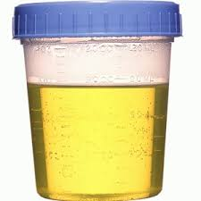
Urine Drug Testing
Objective information that can provide:
  Evidence of therapeutic adherence
  Evidence of use or non-use of illicit drugs
Discuss urine drug testing openly with patient
One medical data point to integrate with others
Urine drug screens are usually immunoassays (Risk of false negatives and false positives)
Unexpected findings can be verified with Gas Chromatography (GC) or Liquid Chromatography (LC) and Mass Spectroscopy (MS) (need to know expected metabolites)
Identify a toxicologist for questions regarding unexpected results
  Argoff CE, Alford DP, Fudin J et al. Pain Med. 2018, Nagpal G et al. JAMA. 2017, Christo PJ, et al. Pain Physician. 2011
Notes:
I would use the color urine image

Slide 21
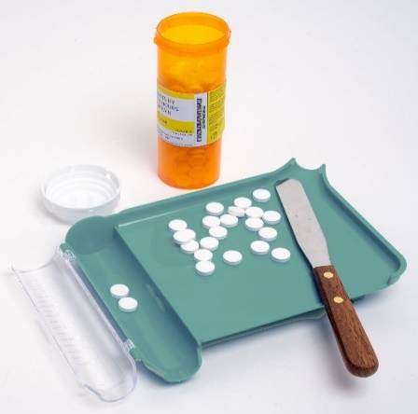
Monitoring: Pill Counts
Objective data that can provide:
  Information on medication adherence
  Information concerning for diversion
Strategy
28 day supply (rather than 30 days) prevents running out on weekends
Prescribe so that patient should have residual medication at appointments
Ask patient to bring in medications at each visit
Notes:
Pill Counts
Now, a word about pill counts. Pill counts can be used to confirm medication adherence, to minimize diversion and there are a couple of strategies that can be effective. First and foremost, it’s a good idea to prescribe a 28-day supply of medication and that’s rather than a 30-day supply. What that does is that ensures that patients never run out of medication on a weekend day, on a day when you may not be available to provide a refill.
It’s recommended to prescribe so that patients actually have leftover medication, have not run out of their prescription on the day of their appointment so that you can do a pill count. I think very commonly we’re writing prescriptions until the next clinic visit, but it can be a good idea to write for beyond the clinic visit so that you can then do a pill count when you see the patient. You can ask patients to bring medications to each of their visits and if you have concerns a higher level of monitoring is random pill counts where patients are called and asked to return with their pill bottles for an immediate count.

Slide 22

Monitoring: Prescription Drug Monitoring Programs
Objective data that can provide:
  Information on harmful polypharmacy
  Information on multiple provider use
Prescription data available to prescribers (delegates in some states) and pharmacists
Over 60% of states mandate use before prescribing controlled substances
PDMP use can change prescriber behaviors (e.g., decreased opioid prescribing)
Systematic review* insufficient evidence that PDMP implementation either increases or decreases nonfatal or fatal overdoses
Haffajee RL. N Eng J Med. 2019
Haffajee RL, et al. JAMA. 2015
Haegerich TM, et al. Drug Alcohol Depend. 2014
Patrick SW, et al. Health Affairs. 2016
*Fink DS, et al. Ann Intern Med. 2018
Notes:
Prescription Drug Monitoring Programs (PDMP)
Now, throughout our presentation we’ve mentioned prescription drug monitoring programs. These are pharmacy data that are available to prescribers and occasionally to other team members, and a majority of states now do require the use of PDMP programs before prescribing controlled substances. There’s been some research on the impact of PDMP programs and we know that they can change prescriber behavior. We’re still not quite sure whether prescription drug monitoring program implementation has an impact on overdoses. I think that remains to be seen. But it is something that is recommending and, depending on the state where you practice, may be required.

Slide 23
CDC Guideline
Dowell D et al. MMWR 2016
When to initiate/ continue opioids | Opioid management | Assess risks/ address harms
1. Do not use opioids as 1st-line therapy. If used, combine w/ other therapies | 4. When starting use immediate-release opioids | 8. Use strategies to mitigate risk (eg, naloxone)
2. Before starting opioids establish realistic goals. Continue opioids only if meaningful improvements outweighs risks | 5. Prescribe the lowest effective opioid dose. Use caution with any dose, if possible avoid doses >90 mg morphine mg equivalents | 9. Review PDMP data
3. Before starting and then periodically discuss risks and benefits of opioids | 6. Prescribe short durations for acute pain. <3 days often sufficient; >7 days rarely needed | 10. Use urine drug testing
 | 7. Evaluate benefits and harms within 4 weeks of starting and at least every 3 months thereafter | 11. Avoid concurrent benzodiazepines
 |  | 12. Offer/arrange treatment for patients with an OUD

Slide 24

Opioids for Chronic Pain
What is the clinician’s role?
VS.
Use a risk-benefit framework
Judge the opioid treatment, not the patient
Nicolaidis C. Pain Medicine 2011
24

Slide 25
Continuation of Opioids
Before writing the next opioid prescription…you should be convinced that there is…
  …benefit (pain, function, QOL) and…
  …absence of harm
Despite subjective assessments (benefits/harms), it should be documented at each visit

Slide 26
Discontinuing Opioids
Do not have to prove addiction or diversion - only assess and reassess the risk-benefit ratio
If patient is unable to take opioids safely or is nonadherent with monitoring then discontinuing opioids is appropriate even in setting of benefits
Need to determine how urgent the discontinuation should be based on the severity of the risks and harms
Document rationale for discontinuing opioids
You are NOT abandoning the patient.
You are abandoning the opioid therapy.
Notes:
You don’t have to prove that they are addicted, nor do you have to prove that they’re diverting. You only have to believe that that’s a likely occurrence and you’ve analyzed the situation, you’ve assessed it, you’ve done your risk/benefit analysis and you just are ready to move forward with what you think is the safest for that patient and that is to discontinue the use of the opioids.
Again, this doesn’t mean you discontinue treating the person for their pain, but it means that you won’t prescribe them an opioid.
So, there are just some people who cannot safely take their medications, and they’re not going to adhere, they’re not going to follow the monitoring, and it is the safest and the only real option for some of those patients.
You’ll need to determine though whether this is an urgent situation, that is whether or not you need to discontinue rapidly or whether this is something that occur over a period of time. And that depends largely upon what drives you to the decision to discontinue the opioids.

Slide 27
Tapering Opioids
No validated protocols in patients on opioids for chronic pain
Systematic review found very low quality evidence suggests that several types of opioid tapers may be effective and that pain, function, and quality of life may improve for some patients with opioid dose reduction
Study found 62% of patients in a pain clinic remained in a voluntary, patient-centered opioid taper over 4 m with median decreases in morphine equivalent daily dose from 288 mg to 150 mg
  Likelihood of >50% opioid dose reduction was not predicted by starting dose, baseline pain intensity, years prescribed opioids, or any psychosocial variable
  Neither pain intensity nor pain interference increased with opioid reduction
Darnall BD et al. JAMA Intern Med. 2018
Frank JW et al. Ann Intern Med. 2017

Slide 28
Thanks!
Questions?
If you want more education go to: www.scopeofpain.org

