Slide 1
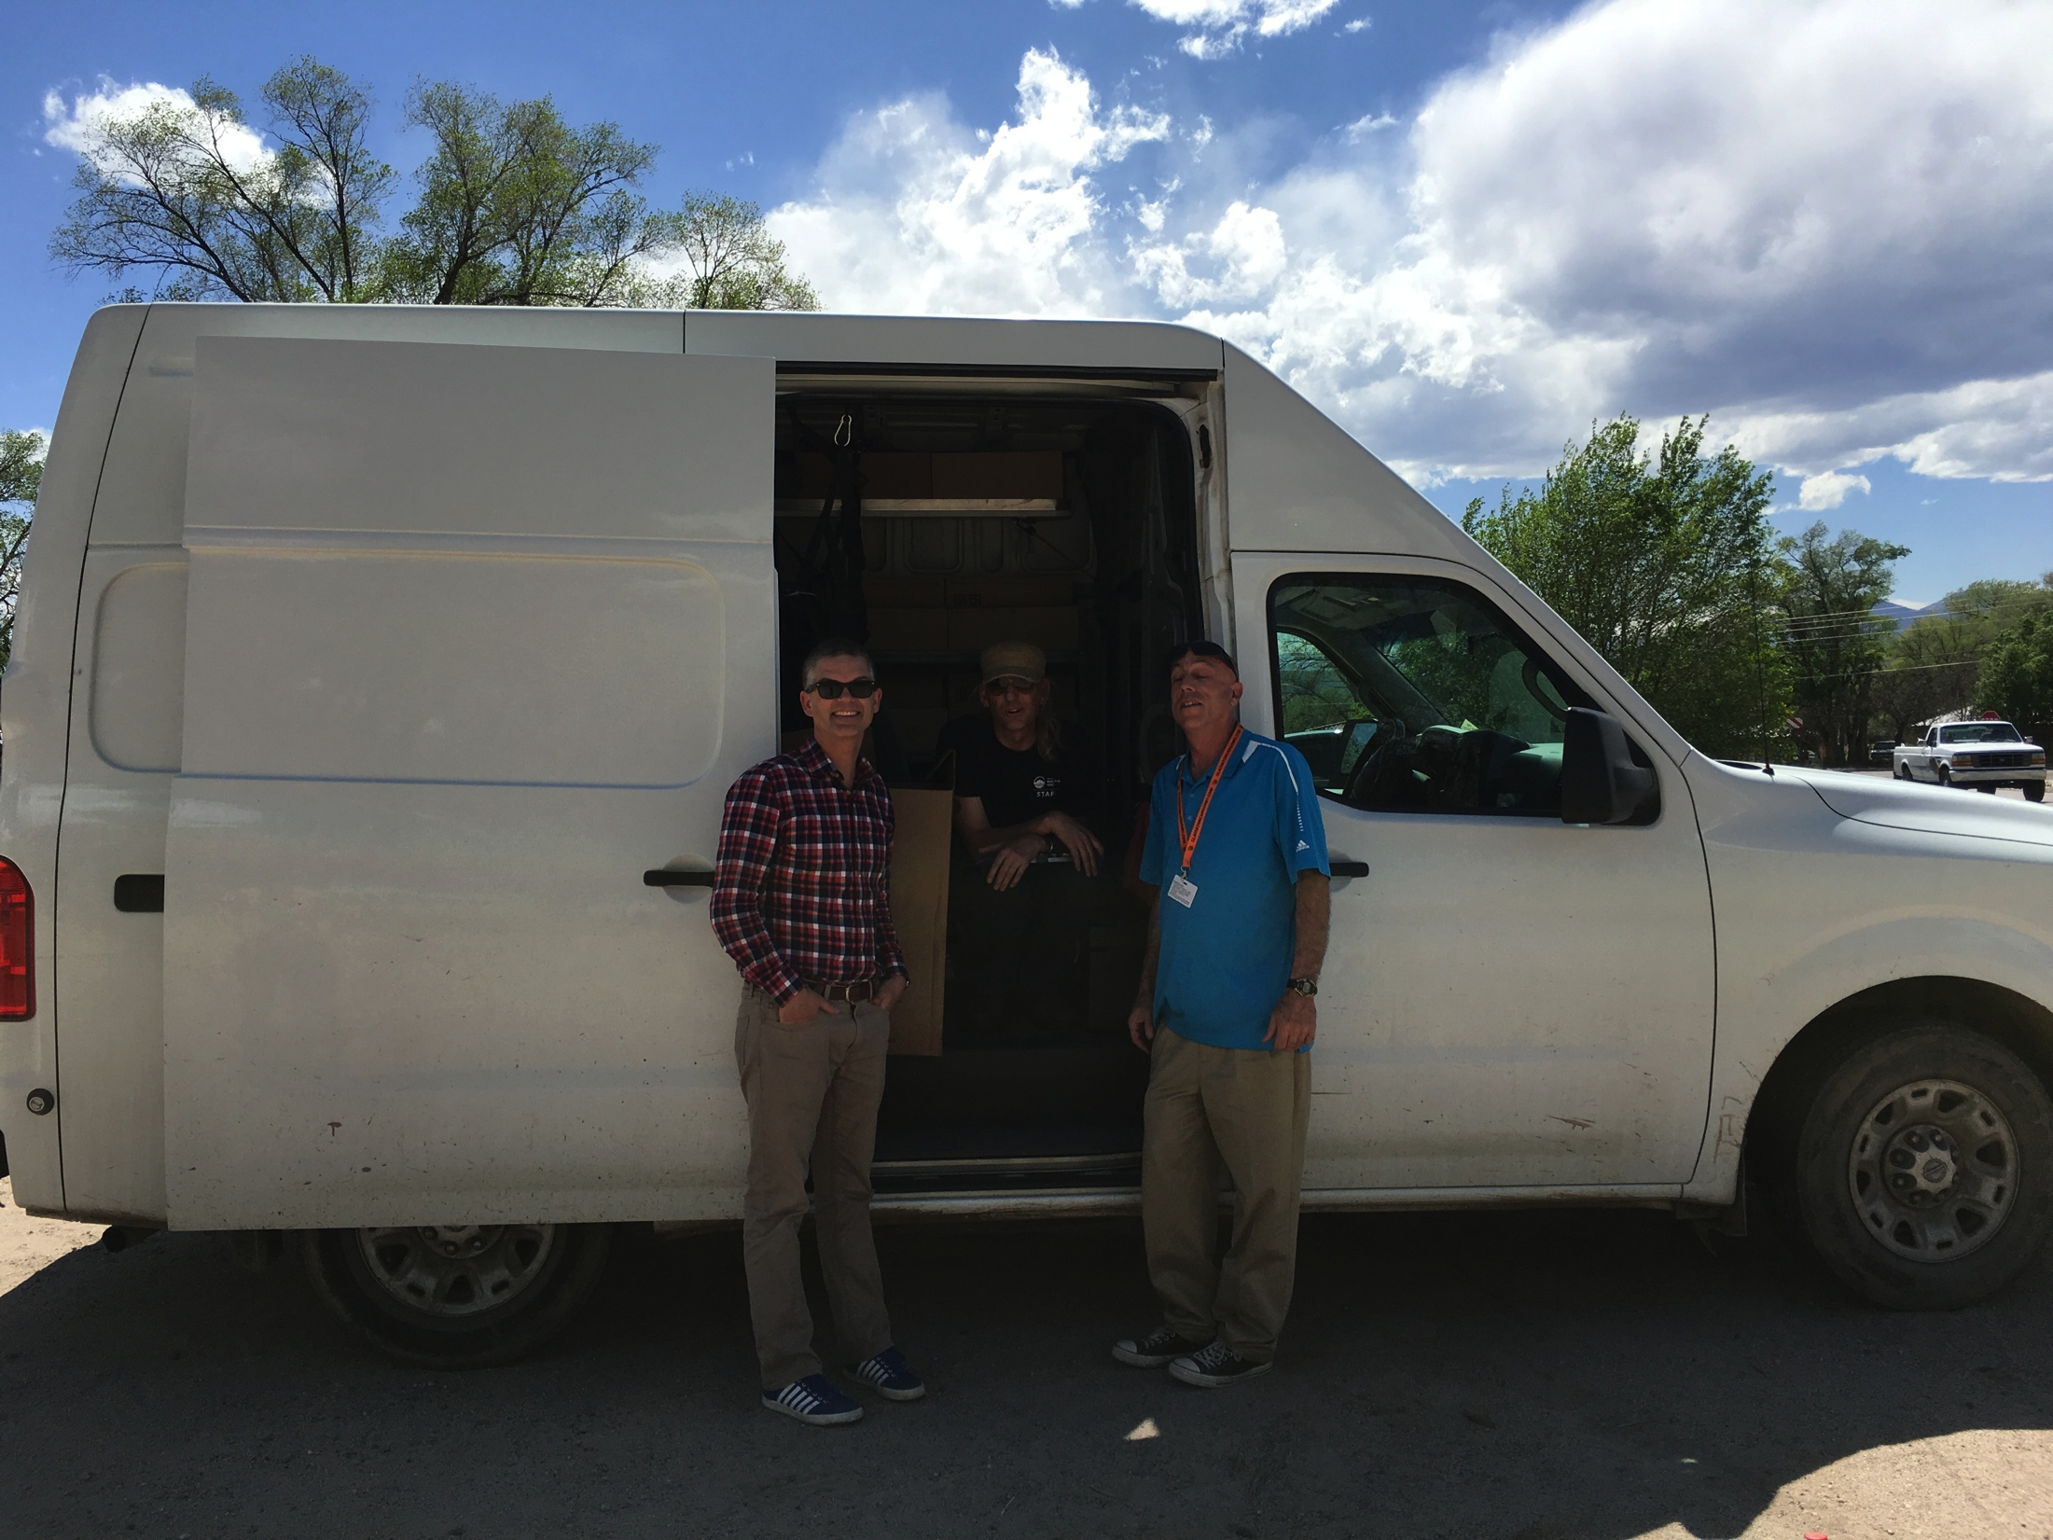
Optimizing Safety in People who use Substances
Alex Walley
CRIT/FIT/JFIT/AFIT – April 2019

Slide 2
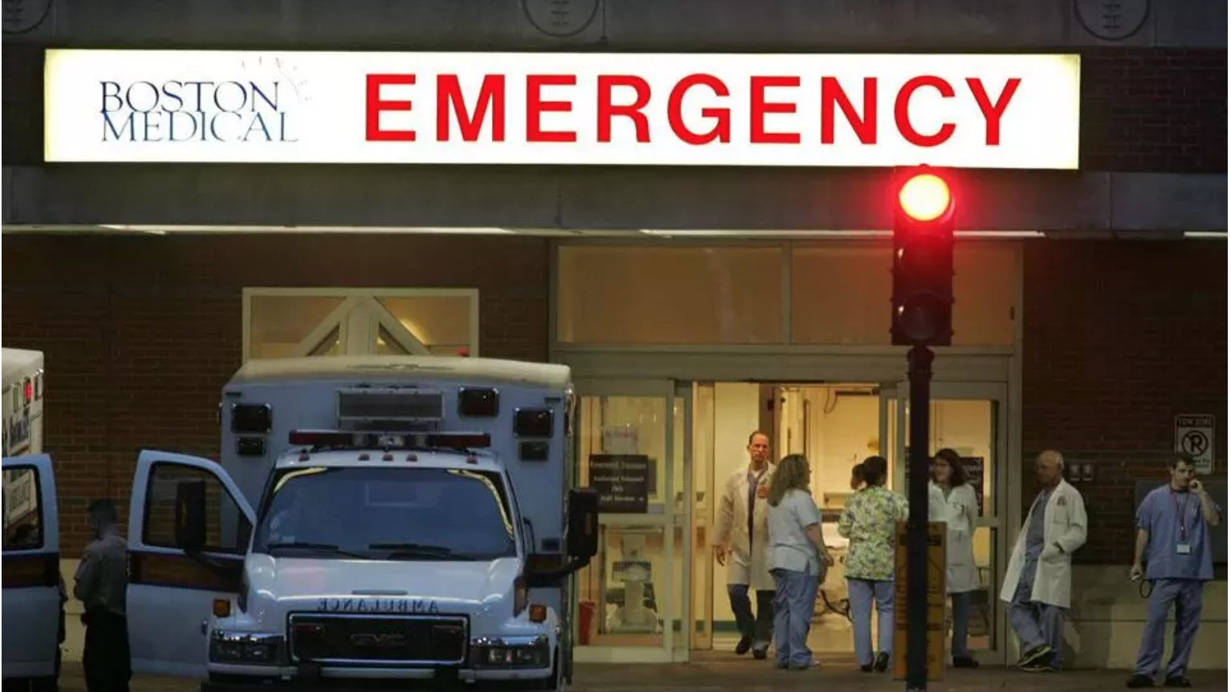
Learning Objectives
Define harm reduction and apply it to public health
Explain the rationale and evidence for:
  needle syringe access
  supervised injection facilities and
  naloxone rescue kits for overdose prevention
Notes:
Alex

Slide 3
Morning Report Case
– She doesn’t want anything
A 29 yo woman with polydrug overdose, complicated by aspiration, and a left arm cellulitis. She was found unresponsive in the bathroom of a restaurant with a syringe, cooker and filters.
  Works as a waiter
  Injecting heroin daily since age 23.
  Uses cocaine on the weekends and drinks alcohol after work
  Trades sex for drugs, when money is short
  Prescribed clonazepam, clonidine and gabapentin for panic disorder and mood stabilization
  Treated with methadone and buprenorphine in the past when pregnant
  Intends to use again on discharge
  Despite your best brief intervention and motivational interviewing…
  She is not interested in treatment at this time.

Slide 4
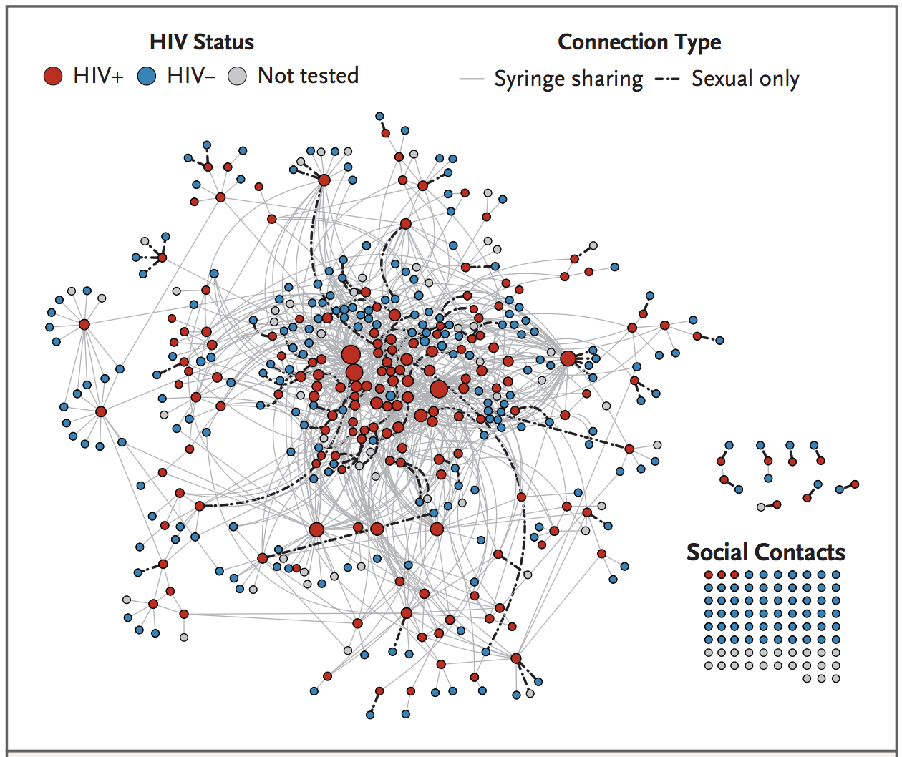
Scott County, IN HIV outbreak, 2014-2015
Peters et al. NEJM 2016
Notes:
This figure diagrams the network of 181 case patients in southeastern Indiana who received a new diagnosis of HIV infection between November 18, 2014, and November 1, 2015; the network is based on the syringe-sharing and sexual partners of the case patients at the time of their HIV diagnosis. The network comprises 536 unique persons and 1058 unique connections: 841 of the contacts in this network (79.5%) were syringe-sharing contacts, 81 (7.7%) were sexual contacts only, and 136 (12.8%) were syringe-sharing and sexual contacts. Reported contacts are represented by circles colored to reflect HIV status, and the sizes of the circles are proportional to the number of connections, with larger circles indicating more connections (range of number of connections, 1 to 56). Connections are represented by a solid gray line if the contact was a syringe-sharing contact only or a syringesharing and sexual contact and by a dashed black line if the contact was a sexual contact only. The 83 “social contacts” in the bottom right are persons with no reported syringe-sharing or sexual connections to other members of the network. These social contacts were named by case patients as persons the case patients knew who could benefit from an HIV test.

Slide 5
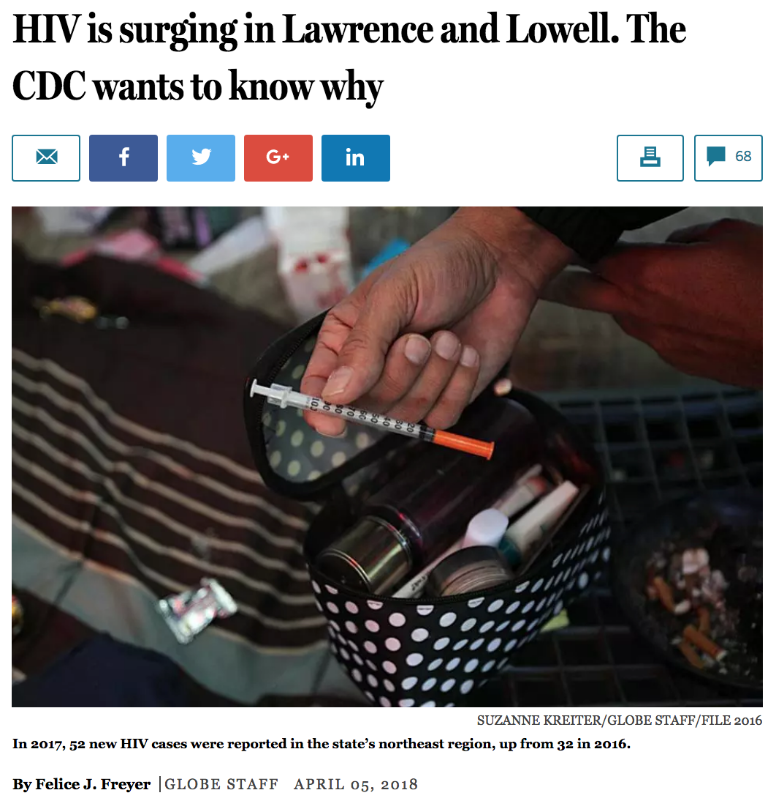
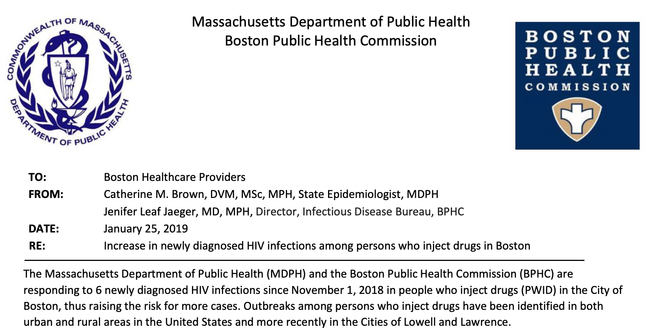
Lawrence and Lowell, MA
HIV outbreak, 2017
Boston Cluster 2018-19
Notes:
This figure diagrams the network of 181 case patients in southeastern Indiana who received a new diagnosis of HIV infection between November 18, 2014, and November 1, 2015; the network is based on the syringe-sharing and sexual partners of the case patients at the time of their HIV diagnosis. The network comprises 536 unique persons and 1058 unique connections: 841 of the contacts in this network (79.5%) were syringe-sharing contacts, 81 (7.7%) were sexual contacts only, and 136 (12.8%) were syringe-sharing and sexual contacts. Reported contacts are represented by circles colored to reflect HIV status, and the sizes of the circles are proportional to the number of connections, with larger circles indicating more connections (range of number of connections, 1 to 56). Connections are represented by a solid gray line if the contact was a syringe-sharing contact only or a syringesharing and sexual contact and by a dashed black line if the contact was a sexual contact only. The 83 “social contacts” in the bottom right are persons with no reported syringe-sharing or sexual connections to other members of the network. These social contacts were named by case patients as persons the case patients knew who could benefit from an HIV test.

Slide 6
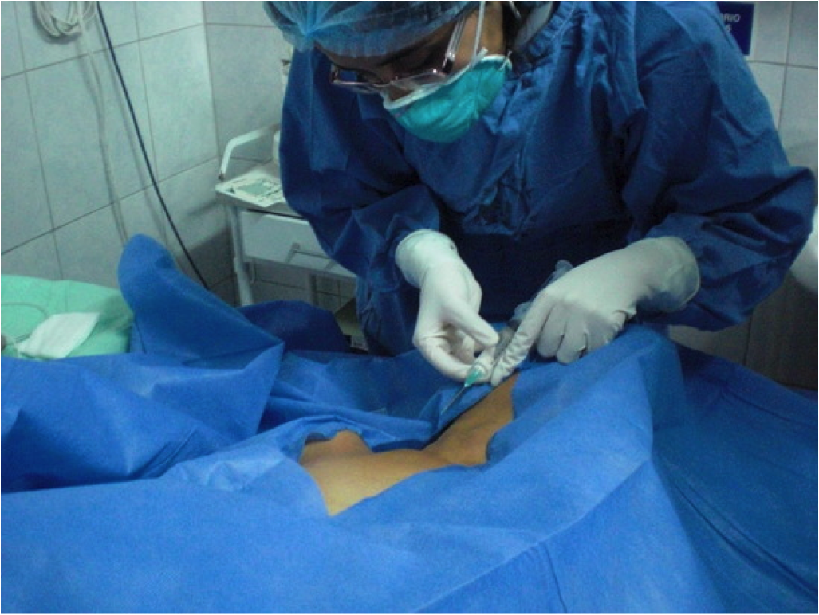
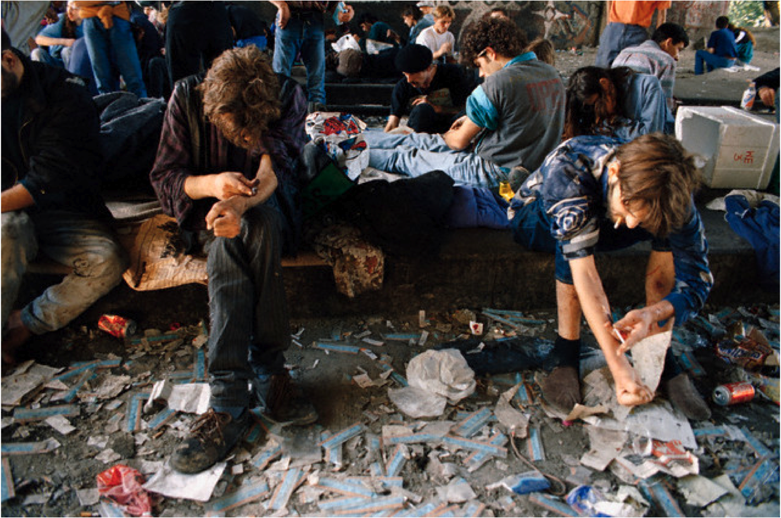
HIV decreases with and increases without needle-syringe programs
 | Cities with NSPs | Cities without NSPs
All cities | -5.8% per year | +5.9% per year
Cities with seroprevalence <10% | -1.1% per year | +16.2% per year
Hurley et al. Lancet 1997:349; 1797-1800.
www.unodc.org/documents/hiv-aids/EFA%20effectiveness%20sterile%20needle.pdf

Slide 7
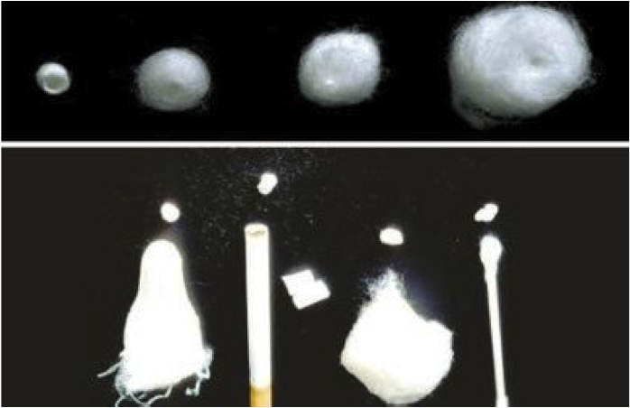
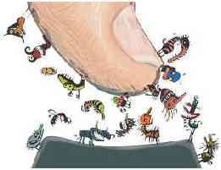
Filters
Used to trap particulate matter
Cotton balls, Q tip, tampon, cigarette filter
Require manipulation with fingers
Contamination with skin flora
Ideal filter small, preformed (dental pellet)
Slide from Sarah Wakeman

Slide 8
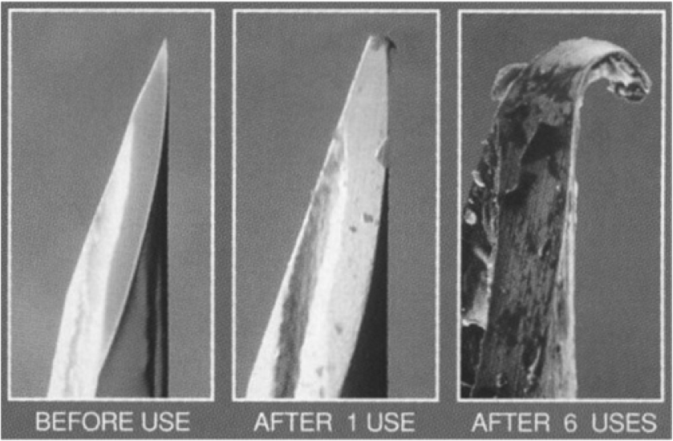
Syringes and needles
New needle and syringe each injection
Needle dulls with each use
Bleach is option
Don’t use syringe to divide dose or mix heroin
Slide from Sarah Wakeman

Slide 9
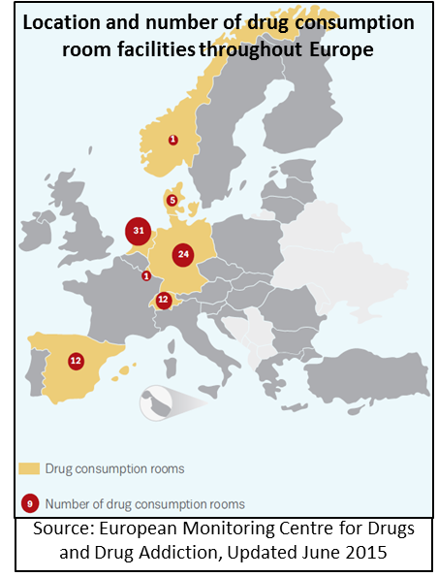

Supervised Injection Facilities
Legal facilities where people can inject pre-obtained drugs under supervision
Objectives: Public Health + Public Safety
  Reduce overdose
  Reduce injection-related infections
  Improve access to substance use disorder treatment
  Reduce public drug use
  Improve neighborhood security
Existing Facilities
  86 facilities throughout Europe
  Canada
  Sydney, Australia
Slide(s) courtesy of Jessie Gaeta

Slide 10
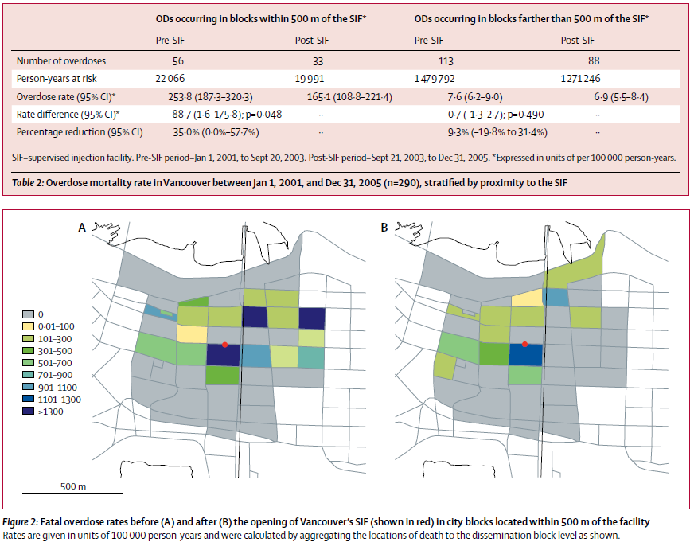
SIFs: Redcued Overdose Mortality
Methods: Population-based overdose mortality rates were examined in the 500m surrounding the SIF before and after its opening and compared with before and after rates in the rest of the city of Vancouver.
Results: In the area around the SIF overdose mortality decreased 35%, compared with a 9.3% reduction in the rest of the city.
Slide courtesy of Jessie Gaeta
Marshall, B. et al. (2011). Reduction in overdose mortality after the opening of
North America’s first medically supervised safer injecting facility: a retrospective
population-based study. Lancet, 377(9775):1429-37.

Slide 11
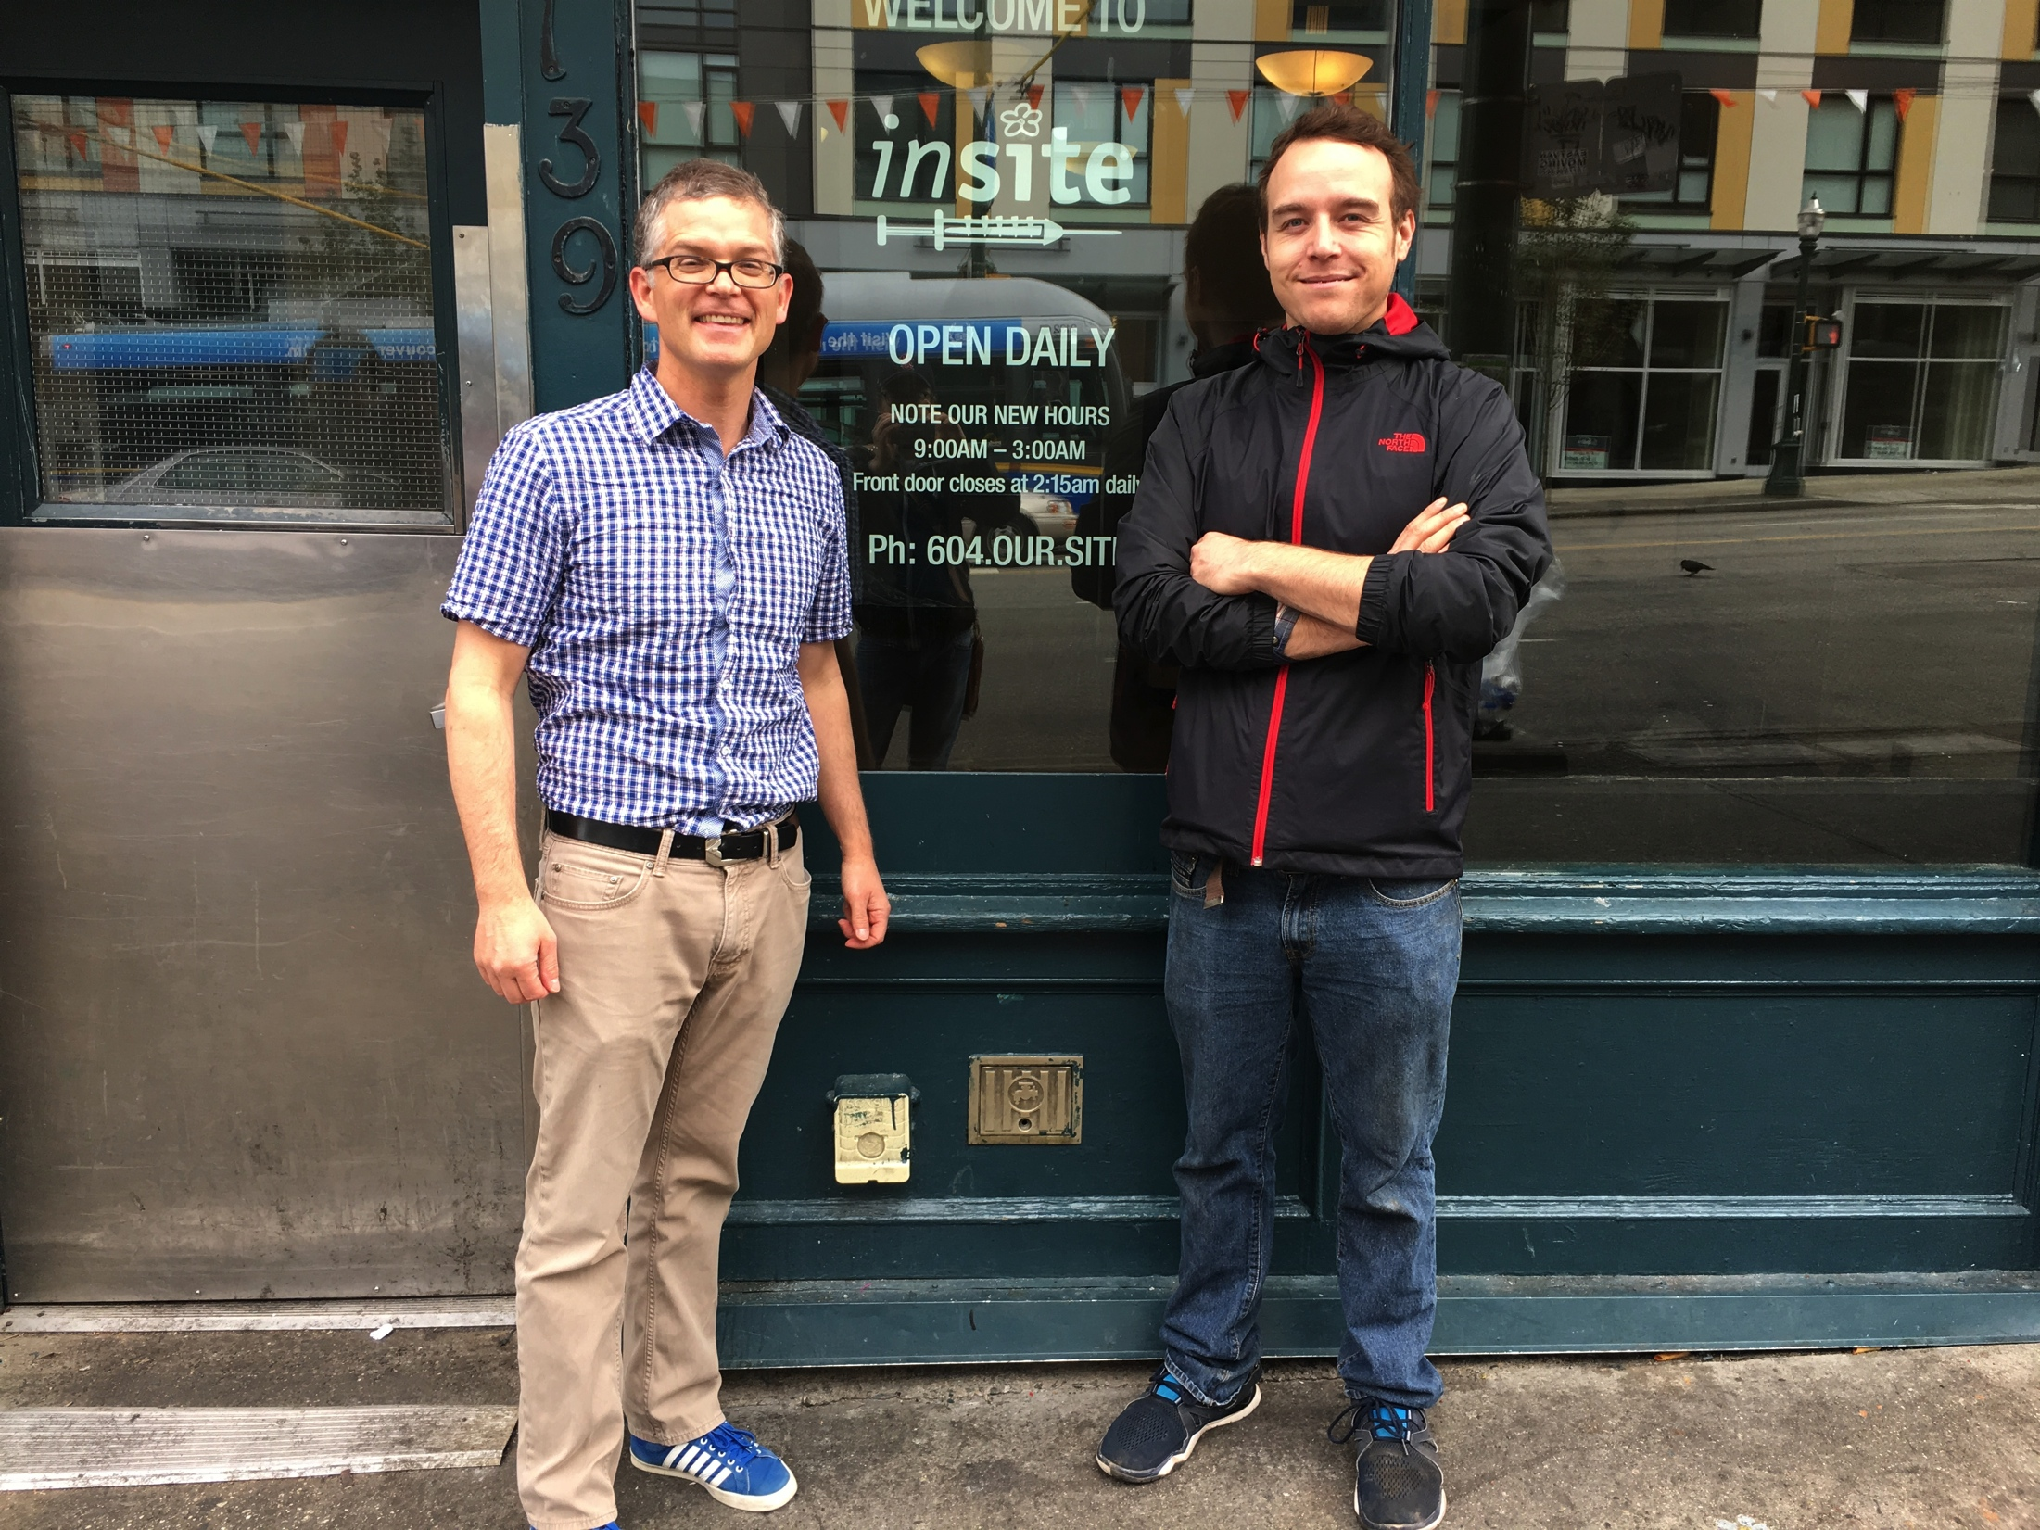
Legal and Logistical Barriers to SIF
Federal crack house statutes make it a crime to maintain a facility for the purpose of using substances
State laws would have to shield programs from local and state law enforcement
Local law enforcement, neighborhoods, and business community would need to support it
Adequate funding is needed to ensure the program is implemented correctly
An empowered group of people who use drugs is needed to ensure this works

Slide 12
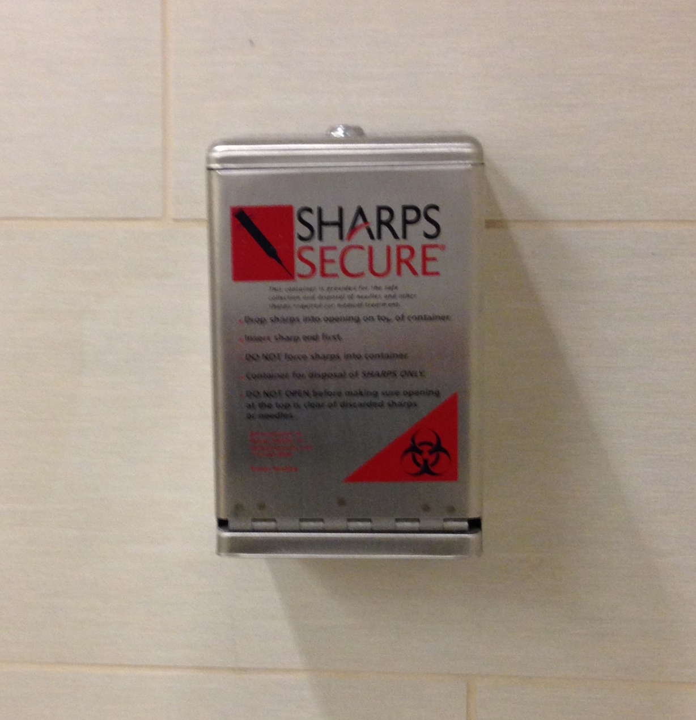
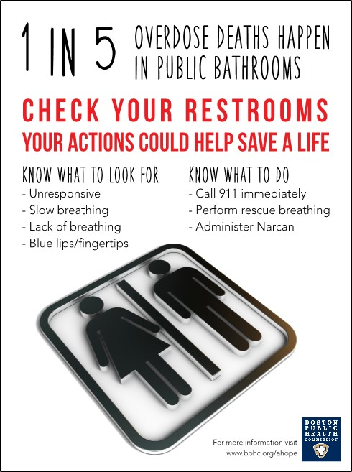
Bathrooms are injection facilities: How to make them safer?
Make your bathrooms safer - outfit bathrooms with:
Secure biohazard boxes
Good lighting and Mirrors
Doors that open out
Call button - Intercomm system
Reverse motion detector with timer
  10min? 5min? 2min?
Safer injection equipment
Naloxone rescue kits
Wolfson-Stofko B, Bennett AS, Elliott L, Curtis R. Drug use in business bathrooms: An exploratory study of manager encounters in New York City. International Journal of Drug Policy. 2017 Jan 31;39:69-77.

Slide 13
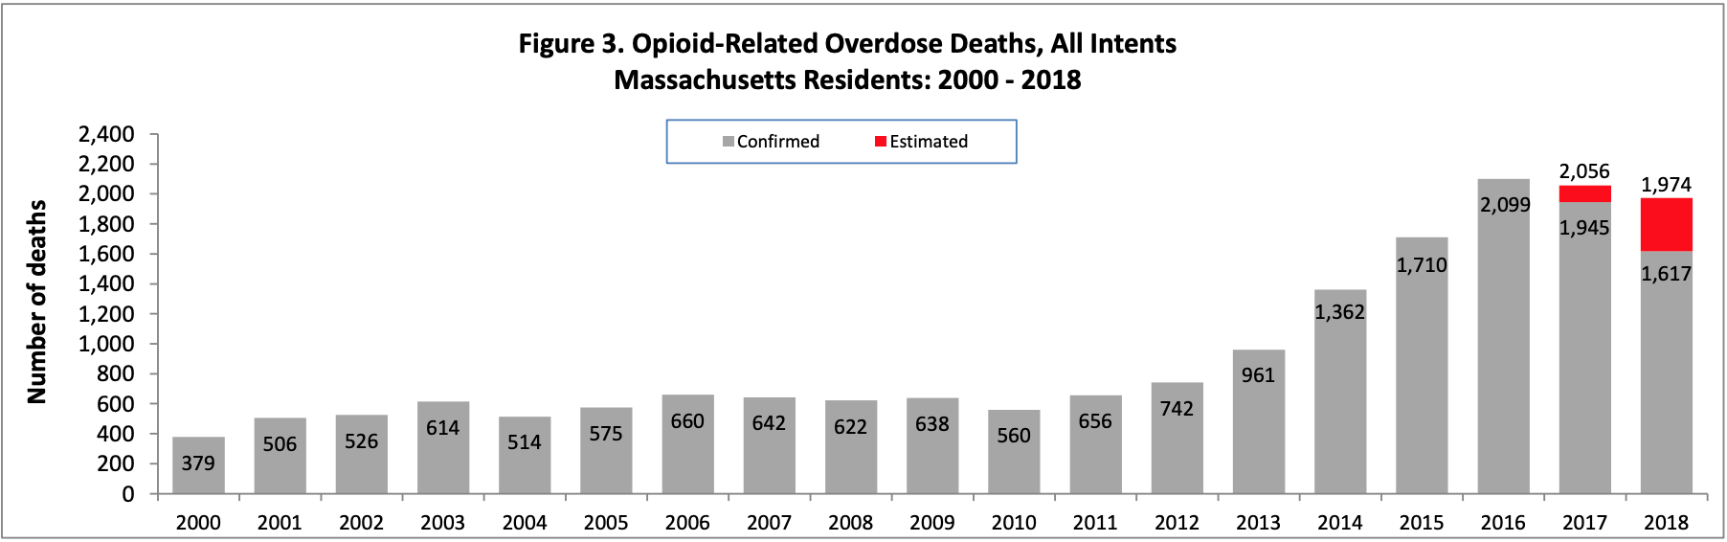
Opioid deaths in Massachusetts
Romney Care
Naloxone via public health programs
Expansion of buprenorphine treatment
Police/Fire naloxone
Safe opioid education mandated
www.mass.gov/files/documents/2017/11/13/sec1-od%20deaths%20mass%20residents%20Nov-17.pdf
Pharmacy SO
Notes:
Romney Care started 4/1/2006
Naloxone program started in Boston and Cambridge in 2006, then statewide in 12/2007
Buprenorphine expanded statewide in 2007 to 14 CHCs
Police and Fire: Quincy Police and Revere Fire started carrying naloxone in 2010
Legislature and BORIM required SafeOpioid Prescribing for re-licensure 2010
Gov Patrick declared state emergency 3/27/2014 → pharmacy standing order, all police and fire able to carry naloxone, PMP becomes mandatory
Gov Baker commission requires checking PMP with every opioid prescription, limits first time prescription to no more than 7 day supply

Slide 14
Opioid deaths in Massachusetts
Romney Care
Naloxone via public health programs
Expansion of buprenorphine treatment
Police/Fire naloxone
Safe opioid education mandated
www.mass.gov/files/documents/2017/11/13/sec1-od%20deaths%20mass%20residents%20Nov-17.pdf
Pharmacy SO
Notes:
Romney Care started 4/1/2006
Naloxone program started in Boston and Cambridge in 2006, then statewide in 12/2007
Buprenorphine expanded statewide in 2007 to 14 CHCs
Police and Fire: Quincy Police and Revere Fire started carrying naloxone in 2010
Legislature and BORIM required SafeOpioid Prescribing for re-licensure 2010
Gov Patrick declared state emergency 3/27/2014 → pharmacy standing order, all police and fire able to carry naloxone, PMP becomes mandatory
Gov Baker commission requires checking PMP with every opioid prescription, limits first time prescription to no more than 7 day supply

Slide 15
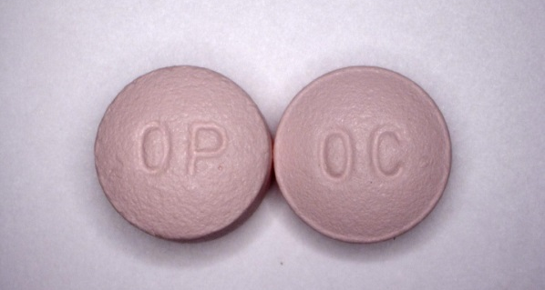
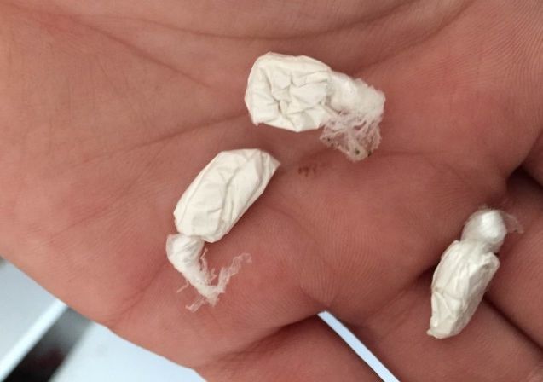
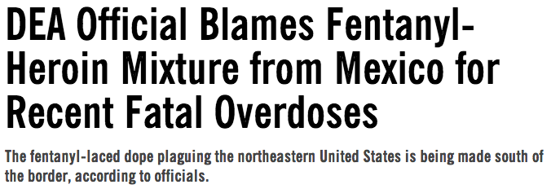
Why a Surge in Overdoses?
Prescription opioids for pain
Transitioning to heroin and illicitly-made fentanyl
Erratic and more deadly heroin and fentanyl supply
  Overdose response window has shrunk from minutes to hours to seconds to minutes
Polysubstance use (including polypharmacy)
Notes:
Alex

Slide 16
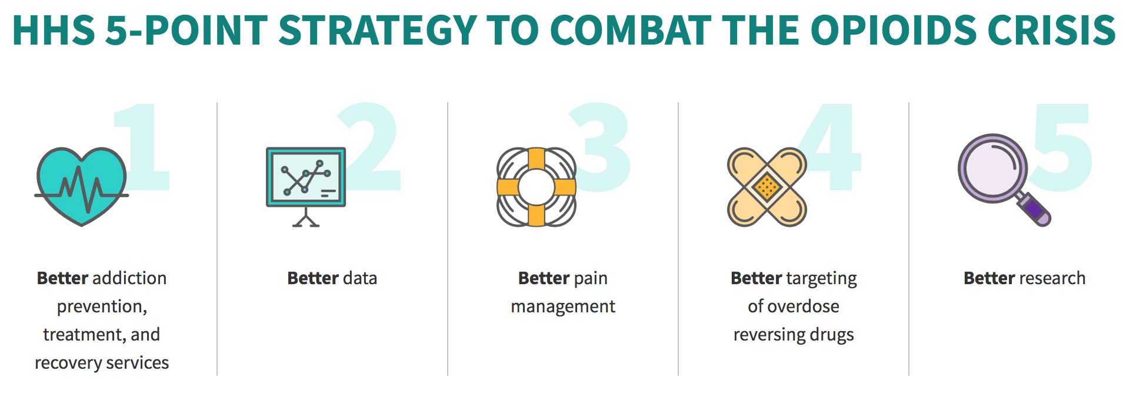
www.hhs.gov/opioids/about-the-epidemic/hhs-response/index.html

Slide 17
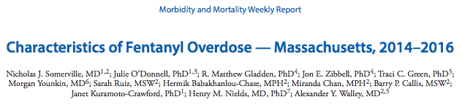
Addressing fentanyl overdose deaths
A comprehensive public health response to address overdoses related to IMF
Fentanyl should be included on standard toxicology screens
Adapt existing harm reduction strategies, such as direct observation of anyone using illicit opioids, and ensuring bystanders are equipped with naloxone
Enhanced access and linkage to medication for opioid use disorders
“So, now what they [people selling illicit drugs] are doing is they’re cutting the heroin with the fentanyl to make it stronger. And the dope [heroin] is so strong with the fentanyl in it, that you get the whole dose of the fentanyl at once rather than being time-released [like the patch]. And that’s why people are dying—plain and simple. You know, they [people using illicit drugs] are doing the whole bag [of heroin mixed with fentanyl] and they don’t realize that they can’t handle it; their body can't handle it.” -- Overdose bystander

Slide 18
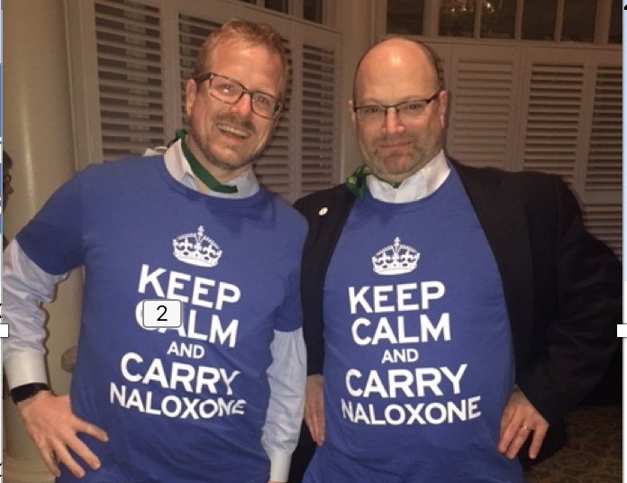

Case for overdose education and naloxone distribution (OEND)
Most opioid users do not use alone
Known risk factors:
  Mixing substances, abstinence, using alone, unknown source
Opportunity window:
  Opioid overdoses take minutes to hours and is reversible with naloxone
  For fentanyl, the window is seconds to minutes
Bystanders are trainable to recognize and respond to overdoses
Fear of public safety
Patient education videos and materials at prescribetoprevent.org
Notes:
Alex

Slide 19
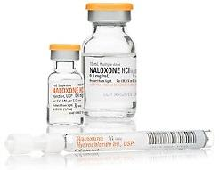
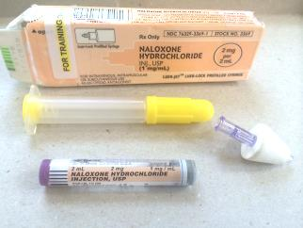
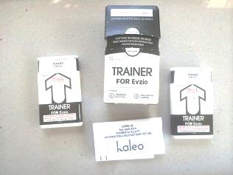
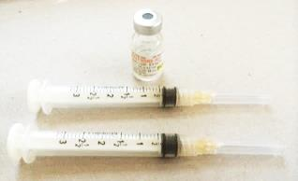
Evaluations of Overdose Education and Naloxone Distribution Programs
Feasibility
  Piper et al. Subst Use Misuse 2008: 43; 858-70.
  Doe-Simkins et al. Am J Public Health 2009: 99: 788-791.
  Enteen et al. J Urban Health 2010:87: 931-41.
  Bennett et al. J Urban Health. 2011: 88; 1020-30.
  Walley et al. JSAT 2013; 44:241-7. (Methadone and detox programs)
Increased knowledge and skills
  Green et al. Addiction 2008: 103;979-89.
  Tobin et al. Int J Drug Policy 2009: 20; 131-6.
  Wagner et al. Int J Drug Policy 2010: 21: 186-93.
No increase in use, increase in drug treatment
  Seal et al. J Urban Health 2005:82:303-11.
  Doe-Simkins et al. BMC Public Health 2014 14:297.
  Jones et al. Addictive Behaviors 2017:71:104-6
Reduction in overdose in communities
  Maxwell et al. J Addict Dis 2006:25; 89-96.
  Evans et al. Am J Epidemiol 2012; 174: 302-8.
  Walley et al. BMJ 2013; 346: f174.
  Coffin et al. Ann Intern Med 2016; 1-8.
Cost-effective
$438 (best)
$14,000 (worst ) per quality-adjusted life year gained
  Coffin and Sullivan. Ann Intern Med. 2013 Jan 1;158(1):1-9.
Notes:
15. Doe-Simkins M, Walley AY, Epstein A, Moyer P. Bystander-administered intranasal naloxone for opioid overdose. American Journal of Public Health 2008;Accepted
16. Sherman SG, Gann DS, Scott G, Carlberg S, Bigg D, Heimer R. A qualitative study of overdose responses among Chicago IDUs. Harm Reduct J 2008;5:2.
Sherman SG, Gann DS, Tobin KE, Latkin CA, Welsh C, Bielenson P. "The life they save may be mine": Diffusion of overdose prevention information from a city sponsored programme. Int J Drug Policy 2008;:[Epub ahead of print].
19. Strang J, Manning V, Mayet S, Best D, Titherington E, Santana L et al. Overdose training and take-home naloxone for opiate users: prospective cohort study of impact on knowledge and attitudes and subsequent management of overdoses. Addiction 2008;103(10):1648-57.
24. Dettmer K, Saunders B, Strang J. Take home naloxone and the prevention of deaths from opiate overdose: two pilot schemes. BMJ 2001;322(7291):895-6.
25. Galea S, Worthington N, Piper TM, Nandi VV, Curtis M, Rosenthal DM. Provision of naloxone to injection drug users as an overdose prevention strategy: early evidence from a pilot study in New York City. Addict Behav 2006;31(5):907-12.
26. Lagu T, Anderson BJ, Stein M. Overdoses among friends: drug users are willing to administer naloxone to others. J Subst Abuse Treat 2006;30(2):129-33.
Maxwell S, Bigg D, Stanczykiewicz K, Carlberg-Racich S. Prescribing naloxone to actively injecting heroin users: a program to reduce heroin overdose deaths. J Addict Dis 2006;25(3):89-96.
28. Piper TM, Rudenstine S, Stancliff S, Sherman S, Nandi V, Clear A et al. Overdose prevention for injection drug users: lessons learned from naloxone training and distribution programs in New York City. Harm Reduct J 2007;4:3.
Piper TM, Stancliff S, Rudenstine S, Sherman S, Nandi V, Clear A et al. Evaluation of a naloxone distribution and administration program in New York City. Subst Use Misuse 2008;43(7):858-70.
84. Loimer N, Hofmann P, Chaudhry HR. Nasal administration of naloxone is as effective as the intravenous route in opiate addicts. Int J Addict 1994;29(6):819-27.
85. Seal KH, Downing M, Kral AH, Singleton-Banks S, Hammond JP, Lorvick J et al. Attitudes about prescribing take-home naloxone to injection drug users for the management of heroin overdose: a survey of street-recruited injectors in the San Francisco Bay Area. J Urban Health 2003;80(2):291-301.
86. Seal KH, Thawley R, Gee L, Bamberger J, Kral AH, Ciccarone D et al. Naloxone distribution and cardiopulmonary resuscitation training for injection drug users to prevent heroin overdose death: a pilot intervention study. J Urban Health 2005;82(2):303-11.
87. Tobin KE, Sherman SG, Beilenson P, Welsh C, Latkin CA. Evaluation of the Staying Alive programme: Training injection drug users to properly administer naloxone and save lives. Int J Drug Policy 2008;
88. Green TC, Heimer R, Grau LE. Distinguishing signs of opioid overdose and indication for naloxone: an evaluation of six overdose training and naloxone distribution programs in the United States. Addiction 2008;103(6):979-89.

Slide 20
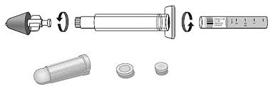
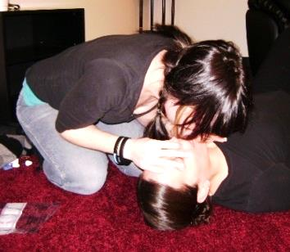


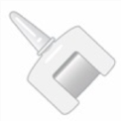
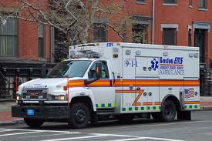
How to Respond in an Overdose
Steps to teach patients, family, friends, caregivers
Recognize overdose
1
Call 911 for help
2
3
4
Rescue breathe/
chest compressions
per rescuer’s level of training
Administer naloxone
as soon as it is available
Multi-step nasal spray
Intramuscular injection
Auto-injector (EVZIO®)
5
Stay until help arrives
Place in recovery position if breathing
Single-step nasal spray (NARCAN®)
Notes:
SLIDE 57 How to Respond in an Overdose
2:47
Now we are going to talk more in detail about the essential steps, 5 steps, to teach your patients and/or caregivers abut opioid overdose response: Recognizing the overdose, calling 911 for help, rescue breathing/CPR, administering Naloxone, and staying until help arrives.

Slide 21
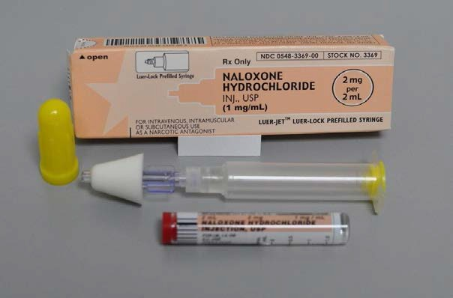
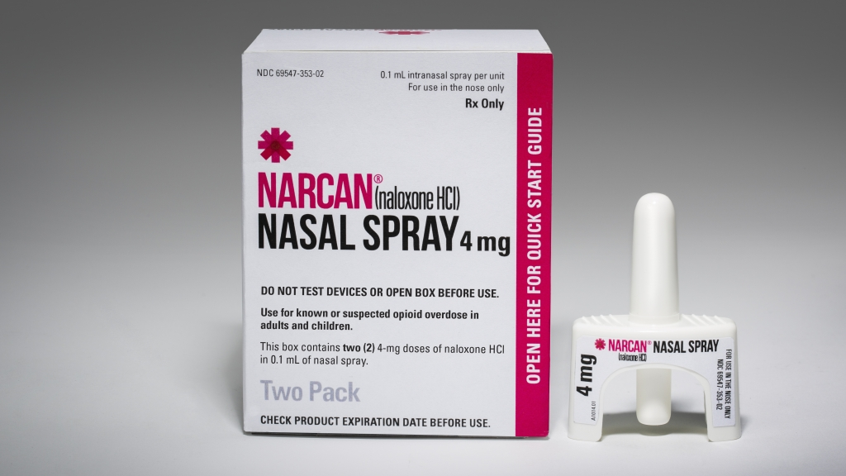
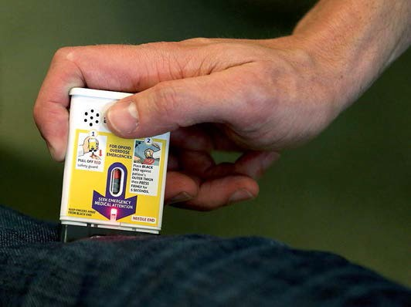
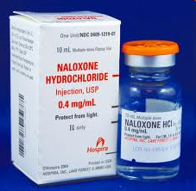
Naloxone formulations
Nasal with atomizer
“Multi-step”*
1 dose = 2mg/2ml
IN
$$
  NEW: Nasal Spray
  “Single-Step”
  1 dose = 4mg/0.1ml IN
  $$
Auto-injector*
1 dose = 0.4mg/1ml IM
$$$$
Intramuscular Injection
1 dose = 0.4mg/1ml IM
$

Slide 22
Making a risk reduction plan with your patients
Ask your patients:
  How do you protect yourself against overdose?
  How do you keep your medications safe at home?
And their loved ones:
  What is your plan if you witness an overdose in the future?
  Have you received training to prevent, recognize, or respond to an overdose?

Slide 23
Safer use behaviors that are particularly important for people using fentanyl include:
Use with other people present
Start with a small amount and give slowly to gauge potency
Take turns to prevent simultaneous overdose
Have naloxone ready and an immediate way to call for help
If using alone, connect with someone by phone or video to monitor while and immediately after using,

Slide 24

Risk Compensation and Moral Hazard
->> Narcan Party Urban Legend = Fake News
'Drug dealers are throwing Narcan parties'
Aug. 2016 previous assertions by two legislators in PA:
  http://www.upgruv.com/lawmakers-hesitant-to-expand-narcan-access-1957206979.html
The TV story March 2017 in PA:
  http://www.wgal.com/article/police-raising-concerns-about-narcan-parties-offering-drugs-and-antidote-to-users/9165193
Naloxone distribution does not increase drug use
  Maxwell et al.,Journal of Addictive Diseases, 2006;
  Seal et al., Journal of Urban Health, 2005;
  Wagner et al., 2010 International Journal of Drug Policy;
  Doe-Simkins et al, BMC Public Health, 2014
  Jones et al. Addictive Behaviors 2017:71:104-6
Similar examples:
Seat belts do not cause more motor vehicle deaths, but reduce them
Syringe distribution does not increase HIV transmission, but reduces
Vaccinations & condoms do not increase sexually transmitted infections
Fire extinguishers do not cause fires, but reduce their consequences

Slide 25
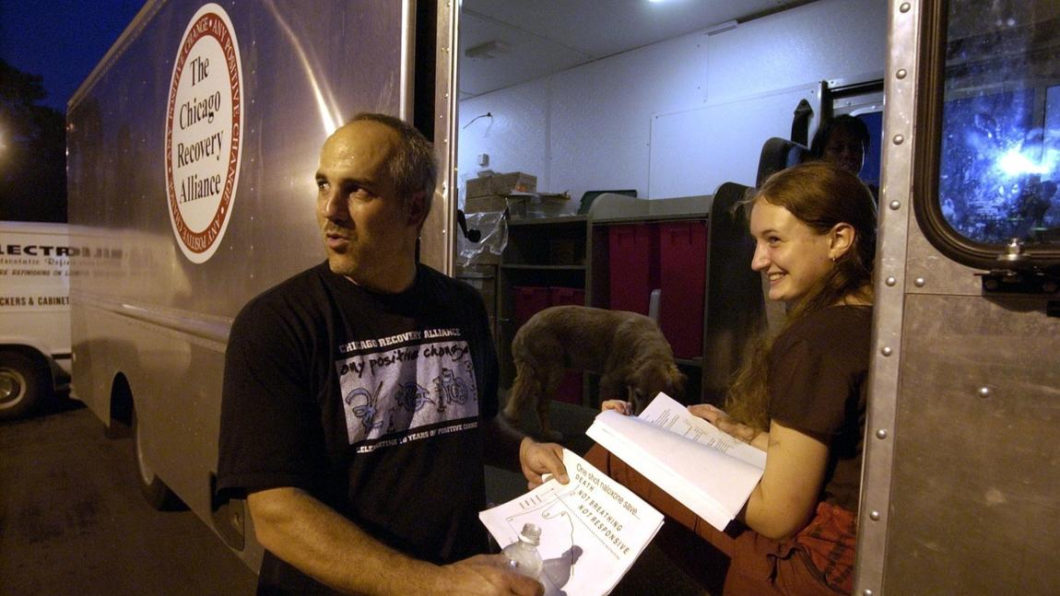
Notes:
Dan Bigg, left, and Petra Hranova of the Chicago Recovery Alliance chat with an addict outside the organization's van. The van is loaded with clean syringes and other drug supplies that addicts can get in exchange for used syringes. (Phil Velasquez/Chicago Tribune 2002)

Slide 26

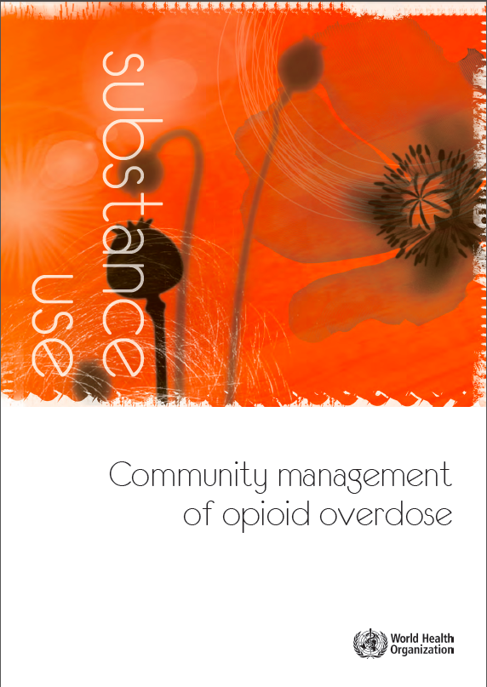
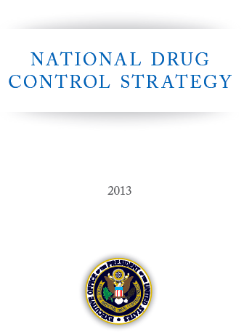
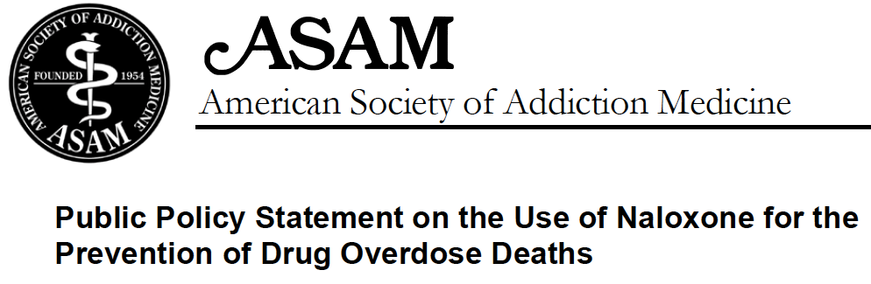

“The AMA has been a longtime supporter of increasing the availability of Naloxone for patients, first responders and bystanders who can help save lives and has provided resources to bolster legislative efforts to increase access to this medication in several states.”
www.ama-assn.org/ama/pub/news/news/2014/2014-04-07-naxolene-product-approval.page
ASAM Board of Directors
April 2010
“Naloxone has been proven to be an effective, fast-acting, inexpensive and non-addictive opioid antagonist with minimal side effects... Naloxone can be administered quickly and effectively by trained professional and lay individuals who observe the initial signs of an opioid overdose reaction.”
“APhA supports the pharmacist’s role in selecting appropriate therapy and dosing and initiating and providing education about the proper use of opioid reversal agents to prevent opioid-related deaths due to overdose”
www.pharmacist.com/policy/controlled-substances-and-other-medications-potential-abuse-and-use-opioid-reversal-agents-2
www.asam.org/docs/publicy-policy-statements/1naloxone-1-10.pdf
Notes:
Dan Bigg, left, and Petra Hranova of the Chicago Recovery Alliance chat with an addict outside the organization's van. The van is loaded with clean syringes and other drug supplies that addicts can get in exchange for used syringes. (Phil Velasquez/Chicago Tribune 2002)

Slide 27
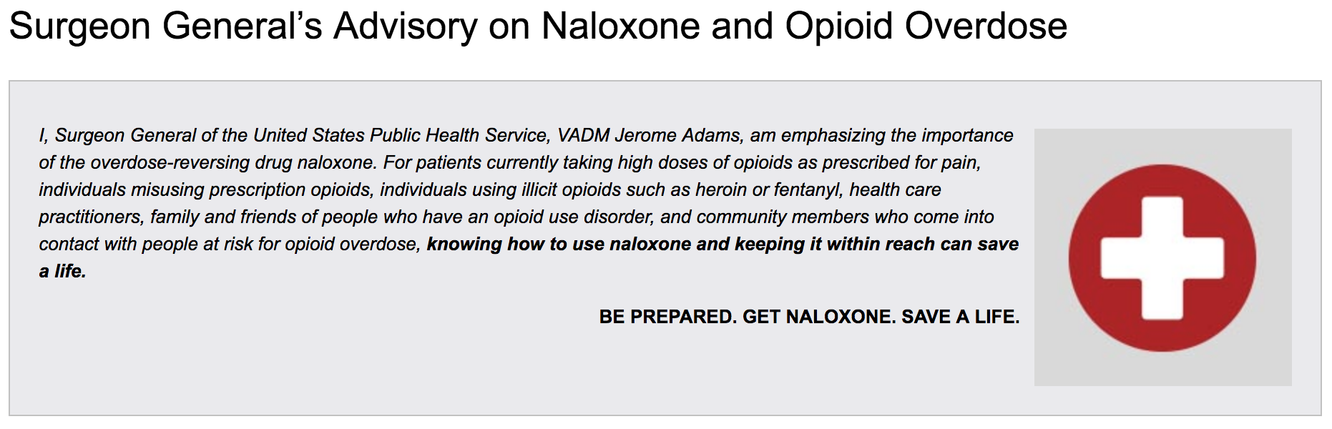
“The AMA has been a longtime supporter of increasing the availability of Naloxone for patients, first responders and bystanders who can help save lives and has provided resources to bolster legislative efforts to increase access to this medication in several states.”
April 5, 2018
www.ama-assn.org/ama/pub/news/news/2014/2014-04-07-naxolene-product-approval.page
ASAM Board of Directors
April 2010
“Naloxone has been proven to be an effective, fast-acting, inexpensive and non-addictive opioid antagonist with minimal side effects... Naloxone can be administered quickly and effectively by trained professional and lay individuals who observe the initial signs of an opioid overdose reaction.”
“APhA supports the pharmacist’s role in selecting appropriate therapy and dosing and initiating and providing education about the proper use of opioid reversal agents to prevent opioid-related deaths due to overdose”
www.pharmacist.com/policy/controlled-substances-and-other-medications-potential-abuse-and-use-opioid-reversal-agents-2
www.asam.org/docs/publicy-policy-statements/1naloxone-1-10.pdf
Notes:
Dan Bigg, left, and Petra Hranova of the Chicago Recovery Alliance chat with an addict outside the organization's van. The van is loaded with clean syringes and other drug supplies that addicts can get in exchange for used syringes. (Phil Velasquez/Chicago Tribune 2002)

Slide 28
Recommendations for when to prescribe and/or co-prescribe naloxone
US Dept of Health and Human Services - December 19, 2018
Naloxone is highly effective and has saved lives from opioid overdoses, but can only do so if it is in the right hands, at the right time. Healthcare providers have a critical role in assuring this occurs across all populations at risk. In order to reduce the risk of overdose deaths, clinicians should strongly consider prescribing or co-prescribing naloxone, and providing education about its use for the following patients who are at risk of opioid overdose.
Patients prescribed opioids who:
Prescribed opioids at 50 MME per day or more
Respiratory conditions such as chronic obstructive pulmonary disease or obstructive sleep apnea
Prescribed benzodiazepines
Have a non-opioid SUD, report excessive alcohol use, or have a mental health disorder
Patients at high risk for experiencing or responding:
Using heroin, illicit fentanyl or misusing Rx opioids
Using methamphetamine and cocaine, potentially contaminated with fentanyl
Receiving treatment for opioid use disorder, including methadone, buprenorphine, or naltrexone
History of opioid misuse and recent controlled settings where tolerance to opioids has been lost
www.hhs.gov/opioids/sites/default/files/2018-12/naloxone-coprescribing-guidance.pdf
Notes:
https://www.hhs.gov/opioids/sites/default/files/2018-12/naloxone-coprescribing-guidance.pdf

Slide 29
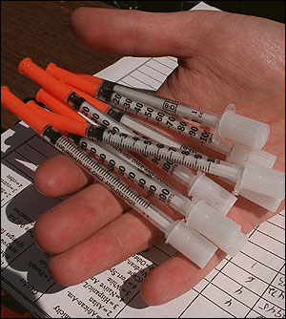
What is Harm Reduction?
Practical strategies and ideas to reduce substance use consequences
  A movement for social justice built on a belief in, and respect for, the rights of people who use substances
    Harmreduction.org
Interventions guided by risk-benefit analysis
  Abstinence is not a prerequisite to care

Slide 30
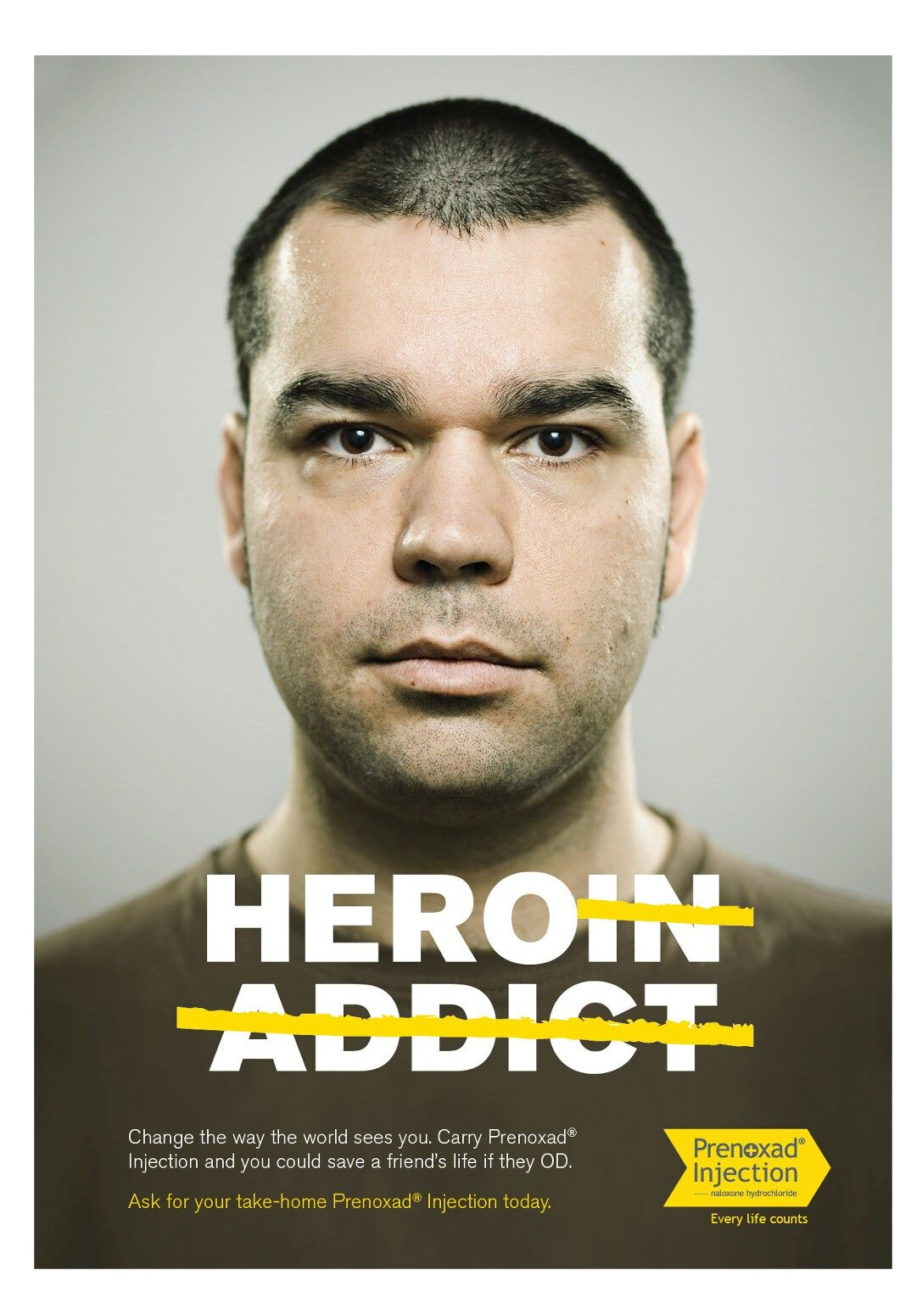
Harm Reduction Interventions
Opioid agonist treatment to reduce HIV and mortality
  Treatment continuity post-incarceration
  Injectable opoid treatments (diacetylmorphine and hydromorphone)
Needle and syringe programs to reduce HIV and injection risk
  Pharmacy access needles and syringes
Drug consumption rooms for injection risk and overdose mortality
Naloxone rescue kits for opioid overdose mortality
Pre and Post exposure prophylaxis
Housing first programs
Shelter-based alcohol administration
Bad date sheets
http://www.emcdda.europa.eu/best-practice/harm-reduction
Notes:
Timothy Poore

Slide 31
Morning Report Case
– She doesn’t want anything
A 29 yo woman with polydrug overdose, complicated by aspiration, and a left arm cellulitis. She was found unresponsive in the bathroom of a restaurant with a syringe, cooker and filters.
  Works as a waiter
  Injecting heroin daily since age 23.
  Uses cocaine on the weekends and drinks alcohol after work
  Trades sex for drugs, when money is short
  Prescribed clonazepam, clonidine and gabapentin for panic disorder and mood stabilization
  Treated with methadone and buprenorphine in the past when pregnant
  Intends to use again on discharge
  Despite your best brief intervention and motivational interviewing…
  She is not interested in treatment at this time.

Slide 32
Case
Discuss her addiction treatment options – conduct a brief intervention
  Residential treatment, intensive outpatient, pharmacotherapy, 12-step groups
Review her injection and other drug use routine for knowledge and readiness
  Educate/ re-enforce safer use strategies
    NSP, keeping substances safe from others, not using alone, tester shots, PrEP
Ask her about her overdose experience
  Make a plan with her to reduce her own overdose risk and how to respond to others
  Prescribe naloxone rescue kit if available
Work to reduce sexual risk
  Condoms
  PEP and PrEP
Screen her for interpersonal violence.
  Offer IPV and sex worker services info
Express concern about her polypharmacy and discuss strategies to reduce
  Speak her prescribers (with her permission) about whether they are aware of the overdose
  Encourage closer monitoring and a risk-benefit analysis for safety

Slide 33
Learning Objectives
Define harm reduction and apply it to public health
Explain the rationale and evidence for:
  needle syringe access
  supervised injection facilities and
  naloxone rescue kits for overdose prevention
Notes:
Alex

Slide 34


Slide 35
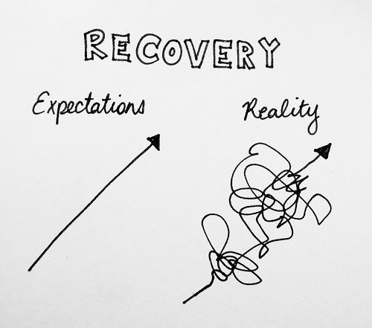
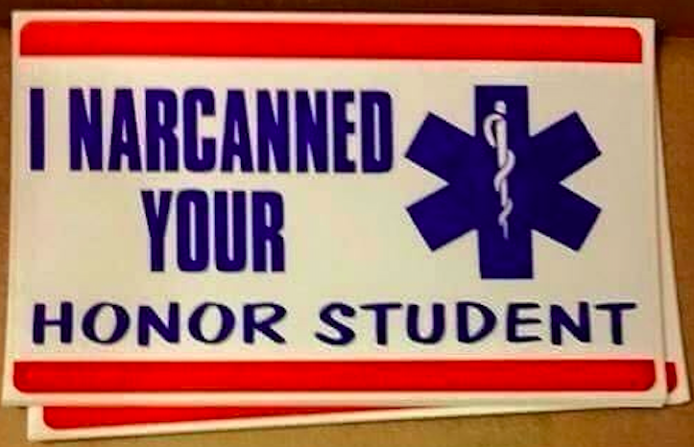
Realistic Expectations!
Addiction is a chronic relapsing condition
Over time treatment works
People get better, if the stay alive
Engage people before, at, and after health system touchpoints awalley@bu.edu

Slide 36
Successful strategies for HIV/AIDS and parallel opportunities for overdose reduction
Treatment <---------> Prevention | Successful strategies for HIV/AIDS | Parallel opportunities for overdose reduction
 | HIV testing and risk reduction counseling | Overdose risk assessment and reduction counseling
 | Needle-syringe distribution | Naloxone rescue kit distribution
 | Targeted outreach /peer-driven interventions | Targeted outreach /peer-driven interventions
 | Supervised injection facilities | Supervised injection facilities
 | Anti-retroviral therapy and opioid agonist treatment | Medication for opioid use disorders
 | Comprehensive, collaborative, longitudinal care for individuals with HIV infection | Comprehensive, collaborative, longitudinal care for individuals with addictions
 | Coordinated prevention and treatment strategy across public health and the healthcare system | Coordinated prevention and treatment strategy across criminal justice, law enforcement, public health and healthcare systems
 | Major funding across public health and the healthcare system of evidence-based interventions | Major funding across criminal justice, law enforcement, public health and healthcare systems of evidence-based interventions
Walley AY. Preventive Medicine 2015.

Slide 37
Successful strategies for HIV/AIDS and parallel opportunities for overdose reduction
Treatment <---------> Prevention | Successful strategies for HIV/AIDS | Parallel opportunities for overdose reduction
 | HIV testing and risk reduction counseling | Overdose risk assessment and reduction counseling
 | Needle-syringe distribution | Naloxone rescue kit distribution
 | Targeted outreach /peer-driven interventions | Targeted outreach /peer-driven interventions
 | Supervised injection facilities | Supervised injection facilities
 | Anti-retroviral therapy and opioid agonist treatment | Medication for opioid use disorders
 | Comprehensive, collaborative, longitudinal care for individuals with HIV infection | Comprehensive, collaborative, longitudinal care for individuals with addictions
 | Coordinated prevention and treatment strategy across public health and the healthcare system | Coordinated prevention and treatment strategy across criminal justice, law enforcement, public health and healthcare systems
 | Major funding across public health and the healthcare system of evidence-based interventions | Major funding across criminal justice, law enforcement, public health and healthcare systems of evidence-based interventions
Walley AY. Preventive Medicine 2015.

Slide 38
SIFs Reduce Overdose Mortality
Methods: Population-based overdose mortality rates were examined in the 500m surrounding the SIF before and after its opening and compared with before and after rates in the rest of the city of Vancouver.
Results: In the area around the SIF overdose mortality decreased 35%, compared with a 9.3% reduction in the rest of the city.
Slide courtesy of Jessie Gaeta
Marshall, B. et al. (2011). Reduction in overdose mortality after the opening of
North America’s first medically supervised safer injecting facility: a retrospective
population-based study. Lancet, 377(9775):1429-37.

Slide 39
Active overdose prevention advocacy efforts
Pharmacy access to naloxone rescue kit
Insurance coverage for naloxone rescue kits regardless of opioid using status
Integrating naloxone training into Basic Life Support education
Integration of addiction treatment and harm reduction education into the curriculum
Safe spaces, drug consumption rooms, supervised infection facilities, heroin maintenance

Slide 40
Law that limits liability and promotes help-seeking, third party prescribing
Massachusetts - August 2012:
Good Samaritan provision:
Protects people who overdose or seek help for someone overdosing from being charged or prosecuted for drug possession
  Protection does not extend to trafficking or distribution charges
Patient protection:
A person acting in good faith may receive a naloxone prescription, possess naloxone and administer naloxone to an individual appearing to experience an opiate-related overdose.
Prescriber protection:
Naloxone or other opioid antagonist may lawfully be prescribed and dispensed to a person at risk of experiencing an opiate-related overdose or a family member, friend or other person in a position to assist a person at risk of experiencing an opiate-related overdose. For purposes of this chapter and chapter 112, any such prescription shall be regarded as being issued for a legitimate medical purpose in the usual course of professional practice.

Slide 41
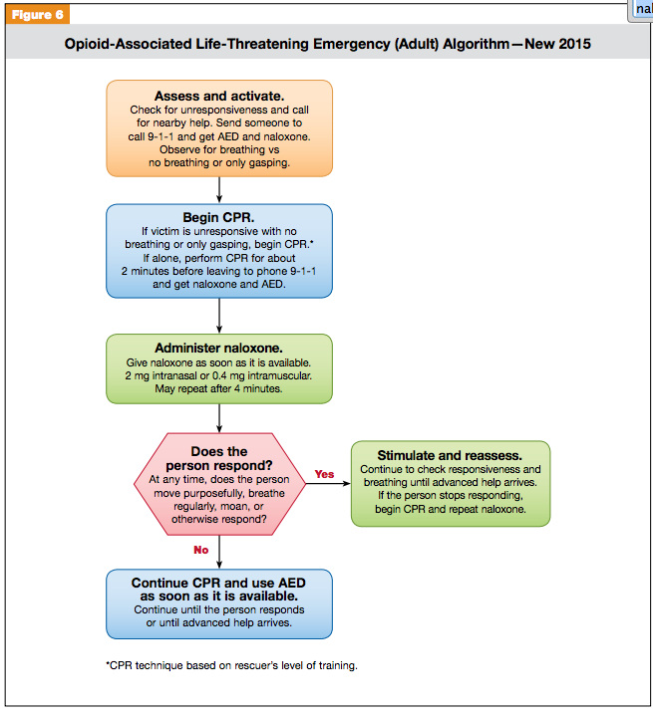
Updated Opioid-Associated Life Threatening Emergency (ADULT) Algorithm
American Heart Association Guidelines October 2015
https://eccguidelines.heart.org/wp-content/uploads/2015/10/2015-AHA-Guidelines-Highlights-English.pdf

Slide 42
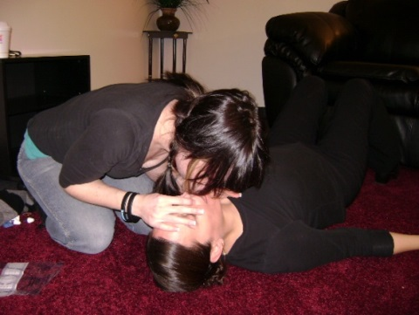
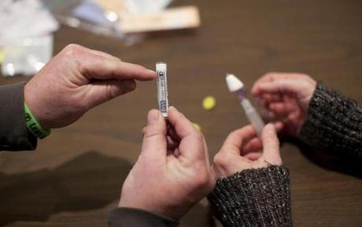
Overdose Education and Naloxone Rescue
What people need to know:
Prevention - the risks:
  Mixing substances
  Abstinence- low tolerance
  Using alone
  Unknown source
  Chronic medical disease
  Long acting opioids last longer
Recognition
  Unresponsive to sternal rub with slowed breathing
  Blue lips, pinpoint pupils
Response - What to do
  Call for help
  Rescue breathe
  Administer naloxone, continue breathing
  Recovery position
  Stay until help arrives
Patient education videos and materials at prescribetoprevent.org
Notes:
Alex

Slide 43
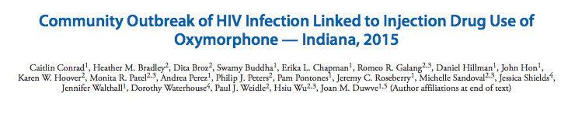
-> March 26, 2015 – Gov. Pence issued emergency order permitting needle-syringe distribution
-> May 2015 – Indiana law passed allowing needle-syringe distribution in communities with an HIV epidemic
-> Jan 2016 federal funding ban ended
MMWR / May 1, 2015 / Vol. 64 / No. 16
135 (129 confirmed, 6 prelim) infections in community of 4200 – Jan-April 2015
55% male, age range 18-57
80% acknowledge IDU, 3% deny IDU
  All PWIDs report oxymorphone tablets as drug of choice
  Other injection drugs include methamphetamine and heroin
84% co-infected with HCV
Up to three generations injecting together
Crushing and cooking 40mg tablets with frequent sharing of injection equipment
Number of injections per day range from 4-15
Injection partners range from 1 to 6

Slide 44
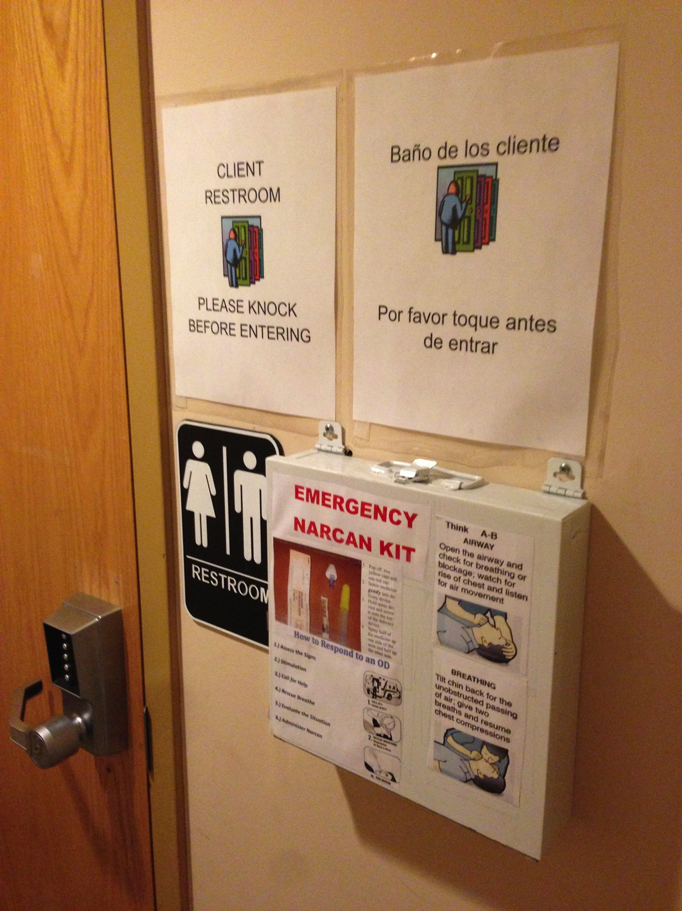
Bathrooms are injection facilities: How to make them safer?
Outfit bathrooms with:
Secure biohazard boxes
Good lighting
Mirrors
Doors that open out
Call button
Intercomm system
Timer with monitor
  10min? 5min? 2min?
Safer injection equipment
Naloxone rescue kit
Wolfson-Stofko B, Bennett AS, Elliott L, Curtis R. Drug use in business bathrooms: An exploratory study of manager encounters in New York City. International Journal of Drug Policy. 2017 Jan 31;39:69-77.

Slide 45
Evidence
SIFs DON’T….
Slide courtesy of Jessie Gaeta
Encourage people to initiate injection drug use | Kerr 2007 examined length of injecting career and circumstances surrounding initiation into injection drug use among 1065 SIF users and found that the median years of injection drug use was 15.9 years, and that only 1 individual reported performing a first injection at the SIF. These findings indicate that the SIF’s benefits have not been offset by a rise in initiation into injection drug use. Am J Public Health. 2007 Jul;97(7):1228-30.
Attract drug dealers to the area | Wood 2006 used Vancouver Police Department data to examine the effect of a SIF on crime rates before and after opening and no increases were seen with respect to drug trafficking (124 vs. 116) or assaults/robbery(174 vs. 180), although a decline in vehicle break-ins/vehicle theft was observed (302 vs. 227). The SIF was not associated with increased drug trafficking or crimes commonly linked to drug use. Subst Abuse Treat Prev Policy. 2006 May 8;1:13.
Increase relapse rates or decrease rate of stopping injection drug use | Kerr 2006 performed an analysis of periods before and after the facility’s opening that showed no substantial increase in the rate of relapse into injected drug use (17% v 20%) and no substantial decrease in the rate of stopping injected drug use (17% v 15%). BMJ. 2006 Jan 28;332(7535):220-2.
Increase the likelihood of overdose | Milloy 2009 surveyed injection drug users and found at baseline, 638 (58.53%) reported a history of non-fatal overdose and 97 (8.90%) reported at least one non-fatal overdose in the last six months. In the analysis, factors associated with recent non-fatal overdose included: sex-trade involvement and public drug use. Using the SIF for ≥75% of injections was not associated with recent non-fatal overdose in univariate or multivariate analyses. J Public Health (Oxf). 2010 Sep;32(3):342-9.

Slide 46
State laws nationwide have drastically increased patients' ease of access to naloxone through pharmacies
The great majority of states permit pharmacies…
Naloxone distributed without a prescription via standing orders, collaborative practice agreements or pharmacist prescribing authority
People not at risk themselves for overdose may receive naloxone via 3rd party distribution
Pharmacist immunity from liability for furnishing naloxone
Mandated insurance coverage (RI)
Check out PDAPS.org – Prescription Drug Abuse Policy System for the latest state overdose and naloxone laws
Davis and Carr. JAPhA. 2017
Notes:
Davis, C, Carr, D, 2017. State legal innovations to encourage naloxone dispensing. J Am Pharm Assoc 57, S180–184.

Slide 47
Accessing naloxone at pharmacies
Perspectives of people with chronic pain, substance use disorders, caregivers, and pharmacists in 2015 – MA and RI
Some fear about consequences from obtaining pharmacy naloxone
  “I think that if you go to the pharmacist and…bring it up that you are interested in getting Narcan…automatically red flags go up in that pharmacist’s mind. Why do you want Narcan? Do you think you are going to overdose? Then all of a sudden there you are the criminal again.”
Some pharmacists were concerned about offending patients
  “I think it, for me, I think it might ruin a relationship even knowing the background of somebody, but you don’t want to step over those boundaries where you would ruin a relationship, then they will go and talk to their friends, “Oh, she thinks I’m an addict.”
Green et al. JAPhA 2017
Notes:
Green TC, Case p, Fiske H, Baird J, Cabral S, Burstein D, Schwartz V, Potter N, Walley Y, Bratberg J. Perpetuating stigma or reducing risk? Perspectives from naloxone consumers and pharmacists on pharmacy-based naloxone in 2 states. JAPhA. 2017; 57(2): S19-S27.e4

Slide 48
Accessing naloxone at pharmacies
“…[You can take] the stigma away [from naloxone] by making it…as common as…'Do you want fries with that?” – Caregiver, MA
Others have had a good experience
  “He asked me if I knew how to use it and I said yeah and that was it. So I mean I think it should be that easy, because there are, there are some people who will give you a hard time, you know.”
Opt-out offer of naloxone considered promising strategy by all groups
  “If it was up to me, every single opiate prescription that was being filled would also be dispensed with Narcan. Even if the patients aren’t using them or the families aren’t using it, it would help, I think, to over time kind of reduce the stigma and that Narcan is only for heroin.”
Green et al. JAPhA 2017
Notes:
Green TC, Case p, Fiske H, Baird J, Cabral S, Burstein D, Schwartz V, Potter N, Walley Y, Bratberg J. Perpetuating stigma or reducing risk? Perspectives from naloxone consumers and pharmacists on pharmacy-based naloxone in 2 states. JAPhA. 2017; 57(2): S19-S27.e4

Slide 49
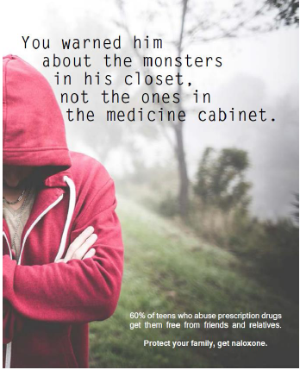
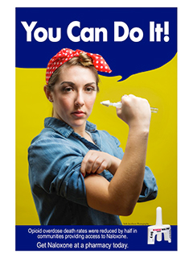


Innovations: Models for Pharmacy Naloxone
Prescriber writes prescription
Patient fills at pharmacy
Pharmacy provides naloxone directly to customer
Pharmacy provides naloxone to patients in treatment center/clinic
Pharmacy provides naloxone to patients in mobile setting
Setting: clinic with insured patients
Without prescriber contact under a standing order
Without prescriber or pharmacy contact under a standing order, distribution model
Without prescriber contact under a standing order
Event or venue-based, rapid deployment
Pharmacies alerted to prescribing plans
Training needed
Passive or active models:
Naloxone co-prescription
Universal offer, may require clear policy direction
Patient training done on-site at clinic, facilitates facility-level compliance and sustainability
Training needed, technology for mobile labeling/billing
Patient training done in-field by pharmacy
Informational brochure, patient fills
Prescriber-pharmacy communications key

Slide 50
Benzodiazepines and Opioids
Jointly contribute to overdose deaths
Benzodiazepines are present in 31% of opioid-related overdose deaths
Opioids are present in 75% of benzodiazepine-related overdose deaths¹
Among people prescribed opioids, the risk of overdose deaths is 3.8 times higher for people prescribed benzos also²
8/31/16– FDA announced black box warning for opioid pain and cough meds and benzodiazepines regarding risk of the combined use of opioids and benzos
Opioid-related Deaths
Benzodiazepine-related
Deaths
  Jones CM and McAninch JK. Am J Prev Med. 2015 Oct;49(4):493-501.
  Park TW, et al. BMJ. 2015 Jun 10;350:h2698.
  http://www.fda.gov/NewsEvents/Newsroom/PressAnnouncements/ucm518697.htm
Notes:
NEW SLIDE : Benzodiazepines and opioids jointly contribute to overdose deaths
Benzodiazepines are present in 31% of opioid-related overdose deaths
Opioids are present in 75% of benzodiazepine-related overdose deaths
Among people prescribed opioids, the risk of overdose deaths is 3.8 times higher for people prescribed benzos also.
****For this slide I think it would be good to have an image with a Venn diagram with an opioid and benzo circle that overlap representing this.

Slide 51
“Street pills”
Benzodiazepines
  Clonazepam (Klonopin)
  Alprazolam (Xanax)
  Diazepam (Valium)
  Also Z drugs –ambien and lunesta
Clonidine (Catapress)
Promethazine (Phenergan)
Quetiapine (Seroquel)
Gabapentin (Neurontin)
  Pregabalin (Lyrica)
Buproprion (Wellbutrin)
Notes:
Alex

Slide 52

Opioid Overdose Related Deaths: Massachusetts 2004 - 2006
OEND programs
2006-07
2007-08
2009
Towns without
Number of Deaths
No Deaths
1 - 5
6 - 15
16 - 30
30+

Slide 53
Fatal opioid OD rates by OEND implementation
Naloxone coverage per 100K
Opioid overdose death rate
27% reduction
46% reduction
Walley et al. BMJ 2013; 346: f174.

Slide 54

Objective: To evaluate the feasibility and effect of implementing naloxone prescription to patients prescribed opioids for chronic pain at 6 safety-net primary care clinics
Results
  38% of 1985 patients receiving long term opioids co-prescribed naloxone rescue kits
    Patients with higher opioid doses and previous opioid-related ED visits were more likely to be prescribed naloxone kits
  Opioid-related ED visits were reduced by 47% at 6 months and 63% at 12 months among those who were co-prescribed naloxone, compared with those who were not
  No change was detected in the net prescribed opioid doses for patients who were co-prescribed naloxone
Coffin PO, et al. Nonrandomized intervention study of naloxone coprescription for primary care patient receiving long-term opioid therapy for pain. Ann Intern Med 2016; 1-8.

Slide 55


Slide 56


Slide 57
MMWR / May 1, 2015 / Vol. 64 / No. 16
-> March 26, 2015 – Gov. Pence issued emergency order permitting needle-syringe distribution
-> May 2015 – Indiana law passed allowing needle-syringe distribution in communities with an HIV epidemic
-> Jan 2016 federal funding ban ended
181 (129 confirmed, 6 prelim) infections in community of 4200 – Jan-April 2015
55% male, age range 18-57
80% acknowledge IDU, 3% deny IDU
  All PWIDs report oxymorphone tablets as drug of choice
  Other injection drugs include methamphetamine and heroin
84% co-infected with HCV
Up to three generations injecting together
Crushing and cooking 40mg tablets with frequent sharing of injection equipment
Number of injections per day range from 4-15
Injection partners range from 1 to 6
Notes:
NEJM article results:
From November 18, 2014, to November 1, 2015, HIV infection was diagnosed in 181 case patients. Most of these patients (87.8%) reported having injected the extended-release formulation of the prescription opioid oxymorphone, and 92.3% were coinfected with hepatitis C virus. Among 159 case patients who had an HIV type 1 pol gene sequence, 157 (98.7%) had sequences that were highly related, as determined by phylogenetic analyses. Contact tracing investigations led to the identification of 536 persons who were named as contacts of case patients; 468 of these contacts (87.3%) were located, assessed for risk, tested for HIV, and, if infected, linked to care. The number of times a contact was named as a syringesharing partner by a case patient was significantly associated with the risk of HIV infection (adjusted risk ratio for each time named, 1.9; P

