Slide 1
Clearing the Smoke on Cannabis
Jeanette M. Tetrault, MD FACP FASAM
Associate Professor of Medicine
Program Director, Addiction Medicine Fellowship
Associate Director for Education and Training, Program in Addiction Medicine
Yale School of Medicine
<?xml version="1.0"?><AllQuestions><Question><slideID>353</slideID><slideType>Q&amp;A_QSlide</slideType><questionText>Marijuana use is increasing…..</questionText><teamScoringFlag></teamScoringFlag><correctValue></correctValue><incorrectValue></incorrectValue></Question><Question><slideID>361</slideID><slideType>Q&amp;A_QSlide</slideType><questionText>&#xB;&#xB;Fact or Fiction?&#xB;Withdrawal symptoms occur with marijuana cessation……</questionText><teamScoringFlag></teamScoringFlag><correctValue></correctValue><incorrectValue></incorrectValue></Question><Question><slideID>363</slideID><slideType>Q&amp;A_QSlide</slideType><questionText>&#xB;&#xB;Fact or Fiction?&#xB;No adverse health effects occur with marijuana use…….</questionText><teamScoringFlag></teamScoringFlag><correctValue></correctValue><incorrectValue></incorrectValue></Question><Question><slideID>364</slideID><slideType>Q&amp;A_QSlide</slideType><questionText>&#xB;&#xB;Fact or Fiction?&#xB;You can’t overdose on marijuana……..</questionText><teamScoringFlag></teamScoringFlag><correctValue></correctValue><incorrectValue></incorrectValue></Question><Question><slideID>365</slideID><slideType>Q&amp;A_QSlide</slideType><questionText>&#xB;&#xB;Fact of Fiction?&#xB;Marijuana use disorders are treatable…….</questionText><teamScoringFlag></teamScoringFlag><correctValue></correctValue><incorrectValue></incorrectValue></Question><Question><slideID>366</slideID><slideType>Q&amp;A_QSlide</slideType><questionText>&#xB;&#xB;Fact or Fiction?&#xB;Medical marijuana is approved for use nationwide……</questionText><teamScoringFlag></teamScoringFlag><correctValue></correctValue><incorrectValue></incorrectValue></Question><Question><slideID>367</slideID><slideType>Q&amp;A_QSlide</slideType><questionText>&#xB;&#xB;&#xB;&#xB;Fact or Fiction?&#xB;There is an association between a state’s legalization of recreational marijuana use and advancement of that state’s football team to the super bowl.…….</questionText><teamScoringFlag></teamScoringFlag><correctValue></correctValue><incorrectValue></incorrectValue></Question></AllQuestions>
<?xml version="1.0"?><Settings><answerBulletFormat>Numeric</answerBulletFormat><answerNowAutoInsert>No</answerNowAutoInsert><answerNowStyle>Explosion</answerNowStyle><answerNowText>Answer Now</answerNowText><chartColors>Use PowerPoint Color Scheme</chartColors><chartType>Horizontal</chartType><correctAnswerIndicator>Checkmark</correctAnswerIndicator><countdownAutoInsert>No</countdownAutoInsert><countdownSeconds>10</countdownSeconds><countdownSound>TicToc.wav</countdownSound><countdownStyle>Box</countdownStyle><gridAutoInsert>No</gridAutoInsert><gridFillStyle>Answered</gridFillStyle><gridFillColor>0,0,0</gridFillColor><gridOpacity>100%</gridOpacity><gridTextStyle>Keypad #</gridTextStyle><inputSource>Response Devices</inputSource><multipleResponseDivisor># of Responses</multipleResponseDivisor><participantsLeaderBoard>5</participantsLeaderBoard><percentageDecimalPlaces>0</percentageDecimalPlaces><responseCounterAutoInsert>No</responseCounterAutoInsert><responseCounterStyle>Oval</responseCounterStyle><responseCounterDisplayValue># of Votes Received</responseCounterDisplayValue><insertObjectUsingColor>Blue</insertObjectUsingColor><showResults>Yes</showResults><teamColors>User Defined</teamColors><teamIdentificationType>None</teamIdentificationType><teamScoringType>Voting pads only</teamScoringType><teamScoringDecimalPlaces>1</teamScoringDecimalPlaces><teamIdentificationItem></teamIdentificationItem><teamsLeaderBoard>5</teamsLeaderBoard><teamName1></teamName1><teamName2></teamName2><teamName3></teamName3><teamName4></teamName4><teamName5></teamName5><teamName6></teamName6><teamName7></teamName7><teamName8></teamName8><teamName9></teamName9><teamName10></teamName10><showControlBar>Slides with Get Feedback Objects</showControlBar><defaultCorrectPointValue>100</defaultCorrectPointValue><defaultIncorrectPointValue>0</defaultIncorrectPointValue><chartColor1>187,224,227</chartColor1><chartColor2>51,51,153</chartColor2><chartColor3>0,153,153</chartColor3><chartColor4>153,204,0</chartColor4><chartColor5>128,128,128</chartColor5><chartColor6>0,0,0</chartColor6><chartColor7>0,102,204</chartColor7><chartColor8>204,204,255</chartColor8><chartColor9>255,0,0</chartColor9><chartColor10>255,255,0</chartColor10><teamColor1>187,224,227</teamColor1><teamColor2>51,51,153</teamColor2><teamColor3>0,153,153</teamColor3><teamColor4>153,204,0</teamColor4><teamColor5>128,128,128</teamColor5><teamColor6>0,0,0</teamColor6><teamColor7>0,102,204</teamColor7><teamColor8>204,204,255</teamColor8><teamColor9>255,0,0</teamColor9><teamColor10>255,255,0</teamColor10><displayAnswerImagesDuringVote>Yes</displayAnswerImagesDuringVote><displayAnswerImagesWithResponses>Yes</displayAnswerImagesWithResponses><displayAnswerTextDuringVote>Yes</displayAnswerTextDuringVote><displayAnswerTextWithResponses>Yes</displayAnswerTextWithResponses><questionSlideID></questionSlideID><controlBarState>Expanded</controlBarState><isGridColorKnownColor>True</isGridColorKnownColor><gridColorName>Yellow</gridColorName><AutoRec></AutoRec><AutoRecTimeIntrvl></AutoRecTimeIntrvl><chartVotesView>Percentage</chartVotesView><chartLabelsColor>0,0,0</chartLabelsColor><isChartLabelColorKnownColor>True</isChartLabelColorKnownColor><chartLabelColorName>Black</chartLabelColorName><chartXAxisLabelType>Full Text</chartXAxisLabelType></Settings>
<?xml version="1.0"?><SlideMaster><tagSlideID>353</tagSlideID><slideID>353</slideID><tagSlideID>361</tagSlideID><slideID>361</slideID><tagSlideID>363</tagSlideID><slideID>363</slideID><tagSlideID>364</tagSlideID><slideID>364</slideID><tagSlideID>365</tagSlideID><slideID>365</slideID><tagSlideID>366</tagSlideID><slideID>366</slideID><tagSlideID>367</tagSlideID><slideID>367</slideID></SlideMaster>
<?xml version="1.0"?><AllAnswers><Answers><slideID>353</slideID><answerID>0</answerID><answerText>Fact</answerText><isCorrect>None</isCorrect><pointValue>0</pointValue></Answers><Answers><slideID>353</slideID><answerID>1</answerID><answerText>Fiction</answerText><isCorrect>None</isCorrect><pointValue>0</pointValue></Answers><Answers><slideID>361</slideID><answerID>0</answerID><answerText>Fact</answerText><isCorrect>None</isCorrect><pointValue>0</pointValue></Answers><Answers><slideID>361</slideID><answerID>1</answerID><answerText>Fiction</answerText><isCorrect>None</isCorrect><pointValue>0</pointValue></Answers><Answers><slideID>363</slideID><answerID>0</answerID><answerText>Fact</answerText><isCorrect>None</isCorrect><pointValue>0</pointValue></Answers><Answers><slideID>363</slideID><answerID>1</answerID><answerText>Fiction</answerText><isCorrect>None</isCorrect><pointValue>0</pointValue></Answers><Answers><slideID>364</slideID><answerID>0</answerID><answerText>Fact</answerText><isCorrect>None</isCorrect><pointValue>0</pointValue></Answers><Answers><slideID>364</slideID><answerID>1</answerID><answerText>Fiction</answerText><isCorrect>None</isCorrect><pointValue>0</pointValue></Answers><Answers><slideID>365</slideID><answerID>0</answerID><answerText>Fact</answerText><isCorrect>None</isCorrect><pointValue>0</pointValue></Answers><Answers><slideID>365</slideID><answerID>1</answerID><answerText>Fiction</answerText><isCorrect>None</isCorrect><pointValue>0</pointValue></Answers><Answers><slideID>366</slideID><answerID>0</answerID><answerText>Fact</answerText><isCorrect>None</isCorrect><pointValue>0</pointValue></Answers><Answers><slideID>366</slideID><answerID>1</answerID><answerText>Fiction</answerText><isCorrect>None</isCorrect><pointValue>0</pointValue></Answers><Answers><slideID>367</slideID><answerID>0</answerID><answerText>Fact</answerText><isCorrect>None</isCorrect><pointValue>0</pointValue></Answers><Answers><slideID>367</slideID><answerID>1</answerID><answerText>Fiction</answerText><isCorrect>None</isCorrect><pointValue>0</pointValue></Answers></AllAnswers>

Slide 2
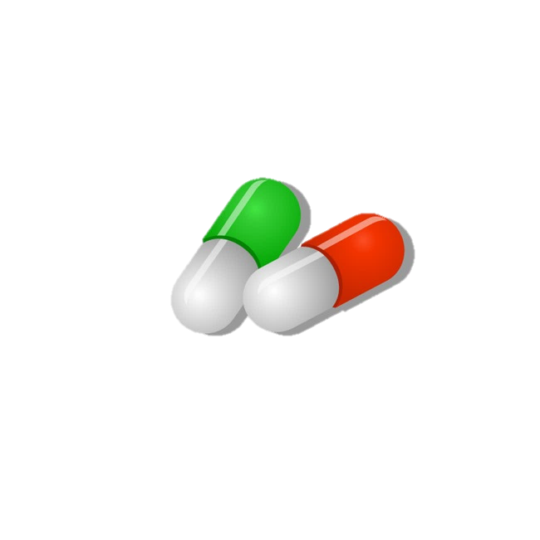
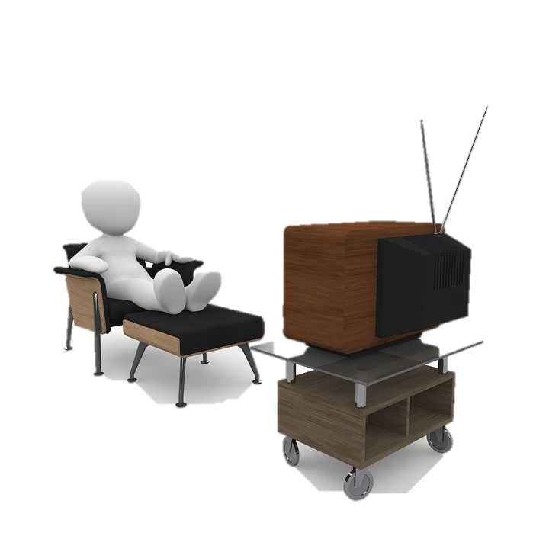
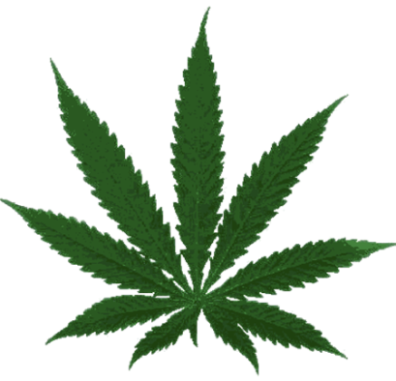
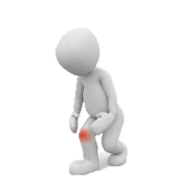


Clinical conundrum
Notes:
48 yo father of two living in CT with obesity and chronic OA of the knee presents for follow up
Initially followed by pain specialist, maintained on MS Contin 30 mg tid and one-two oxycodone 5mg tabs q6 hours for breakthrough pain, not to exceed 6 tabs/day
No longer seeing pain specialist after losing his insurance
In primary care, continued on regimen and followed treatment agreement
Became increasingly sedentary
Diagnosed with other chronic conditions including OSA, COPD and cardiac disease
BMI increased from 28-32 in two years; in a rut can’t exercise due to pain, can’t lose weight because can’t
exercise, weight gain has made the pain worse
History of binge drinking in college BUT NOW drinks 12 beers/week; has not drank more than 5 drinks per occasion in the last year; has not used an illicit substance in the past year.
After discussion with the patient, you both agree, his opioids are no longer optimizing his pain, he understands the risk profile and asks, “maybe you should just prescribe cannabis?”
States he tried it once in college but made him “giggly and a little paranoid” but has heard it has helped, including athletes, with pain. Asks if you will consider giving it to him since you are taking away his opioids

Slide 3
Learning objectives
Define the key components of cannabis and review relevant epidemiology and terminology
Briefly explore US policy regarding cannabis
Summarize potential adverse health effects
Examine the tension between health risks of cannabis vs. cannabis as medicine

Slide 4
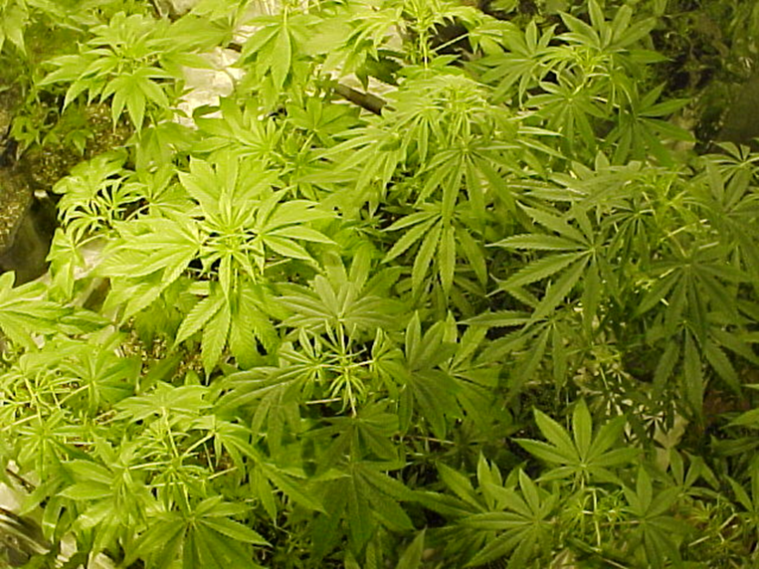
What is cannabis?
Dried flowers, leaves, stems and seeds of Cannabis sativa
Different species:
  Sativa
  Indica
Two main components:
  Terpenes
  Cannabinoids
    Cannabidiol (CBD)
    Δ9-tetrahydrocannabinol (THC)
Potency related to concentration of THC and route of administration

Slide 5
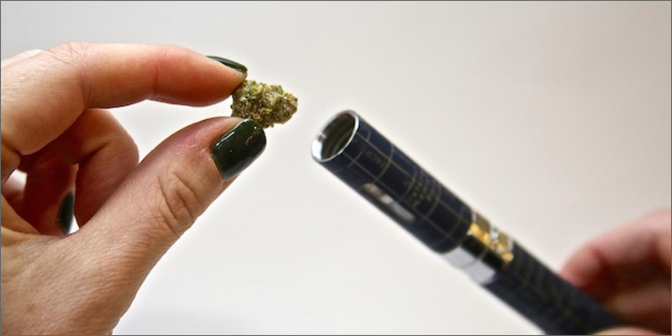
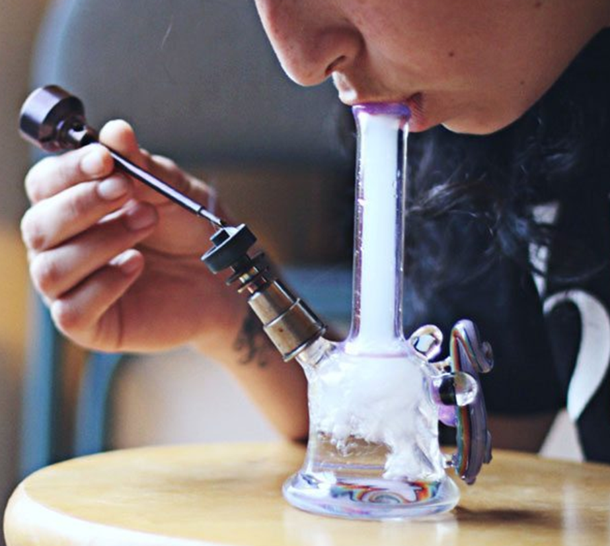
Routes of administration
Smoking
Edibles
Tinctures
Transdermal patch
Suppository
Topical cream
Beverage
Vaping – activating raw plant matter without combustion
  ~40% of individuals with medical cannabis user vape as a route of administration
Dabbing – inhale cannabis vapor from concentrates, oils or extracts through a “dab rig”
  Delivers a high dose of THC in a short period of time

Slide 6
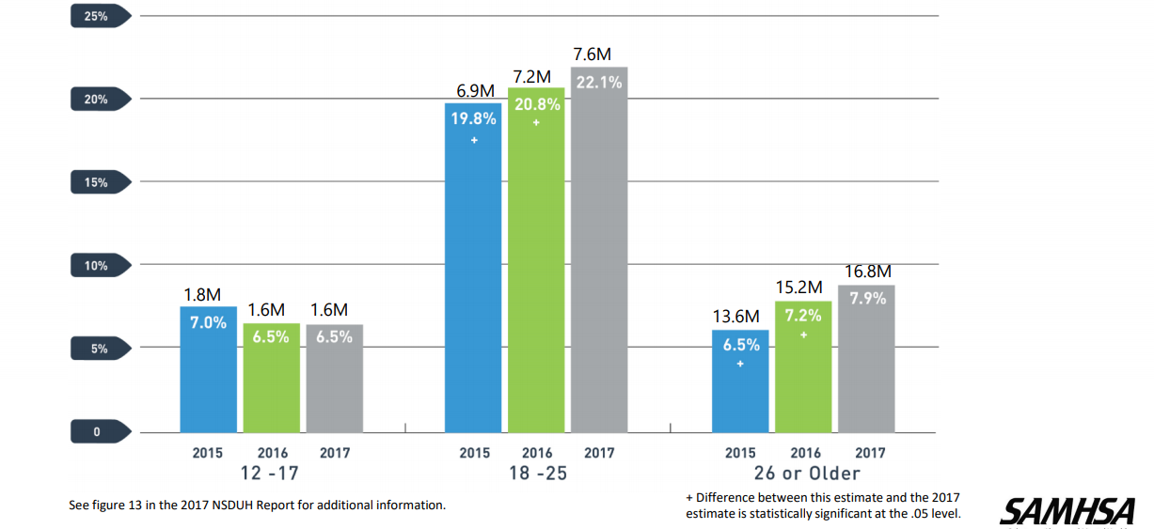
Past-month cannabis use 2015-2017
Notes:
In 2013, almost 6 million daily users of MJ which represents almost 17% of total users, 8 million monthly users representing almost 40% of total.

Slide 7
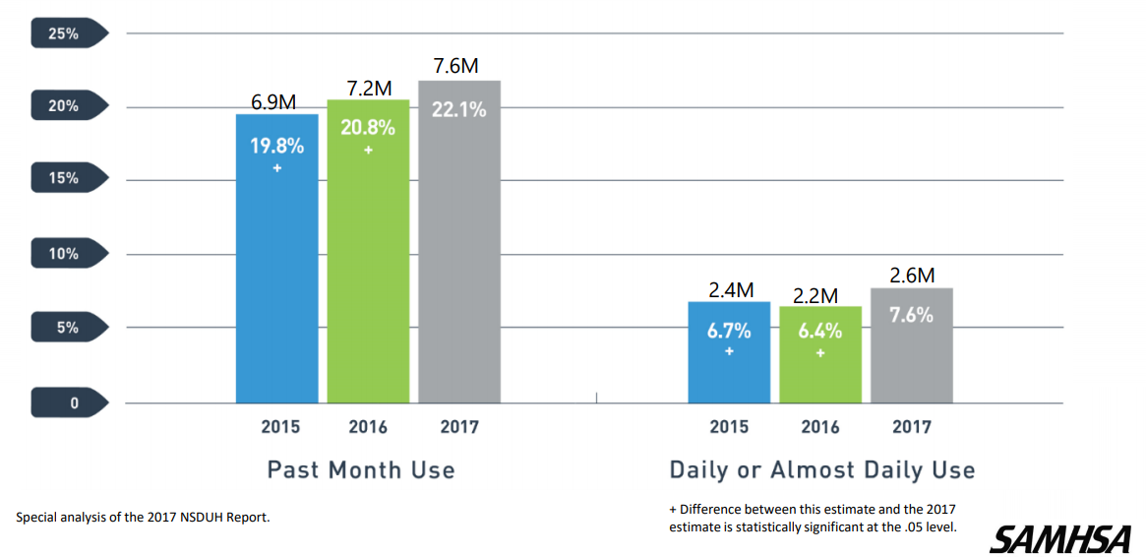
Cannabis use among young adults

Slide 8
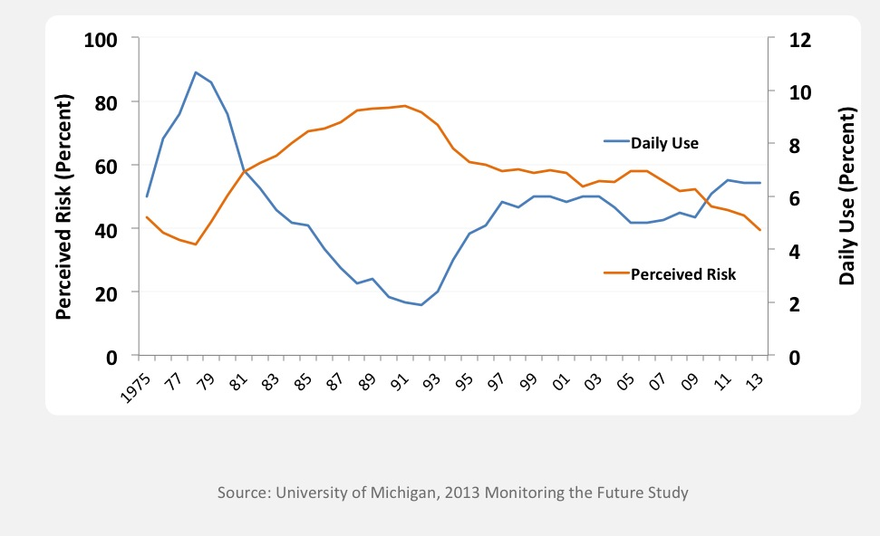
Why the increase?
Daily Cannabis Use vs. Perceived Risk of Regular
Cannabis Use among 12th Graders, 1975-2013
Notes:
Additionally, we know that Education is key, because when risk awareness goes up drug use goes down. Data from the MTF study suggests that there is inverse relationship between perceived risk and marijuana use. As perceived risk goes up (red line), marijuana use (blue line) goes down and vice versa. In recent years perceived risk has been decreasing, while use has been ticking up—even daily use among 12th graders is at about 6% (not shown), which is the highest its been in the history of the Monitoring the Future survey .
As perceived risk decreases, epidemiology increases.

Slide 9
Policy timeline
1970: Controlled Substances Act passed by Congress, cannabis listed as schedule I drug
1996-2018: 11 states with recreational + medical, 36 states with medical only, 4 states illegal
2005: Supreme Court decision (Gonzales v. Raich)
  Federal law enforcement has the authority to arrest and prosecute MDs or patients
2009, 2014: Department of Justice Memorandum
  Federal resources should not be used to prosecute those who comply with states laws
2008-2010: IOM, ACP, AMA
  Petitioned DEA/FDA to reschedule to schedule II …it remains schedule I to this day
Notes:
I think it is important to review the policy time line with regard to marijuana legislation in this country.
1970: Controlled Substances Act passed by Congress, marijuana listed as schedule I drug (i.e. no currently accepted medical use, high potential for abuse, and a lack of accepted safety even under medical supervision)
1985: dronabinol or Marinol (synthetic THC) approved in the US for treatment of intractable nausea
Between 1996-2017: 29 states legalize medical marijuana (AK, AZ, CA CO, CT, DE, HI, IL, ME, MD, MA, MI, MT, NV, NH, NJ, NM, NY, OR, RI, VT, WA) AND 4 states and DC legalized recreational use (AK, CO, OR, WA)
On the federal level:
In 2005: Supreme Court decision (Gonzales v. Raich)
Regardless of state laws, federal law enforcement has the authority under the CSA to arrest and prosecute physicians who prescribe or dispense marijuana and patients who possess or cultivate it.
In 2009: Department of Justice
Issued a memorandum to U.S. Attorneys stating that federal resources should not be used to prosecute providers and patients whose actions comply with their states’ laws permitting medical use of marijuana.
Between 2008-2010: several medical organizations including the IOM, ACP, AMA individually
Petitioned DEA/FDA to reschedule marijuana to schedule II …it remains schedule I to this day
Jan 2018: Sessions rescinds Obama era memorandum which in turn gives federal prosecutors around the country more discretion about enforcing federal law in marijuana cases, even in the states where it is legal.—this move has received deep criticism from both sides of the aisle.
Schumer's legislation would remove marijuana from the list of scheduled substances under a 1970 law that classifies marijuana as dangerous as heroin for legal and regulatory purposes.
It would establish funding for women- and minority-owned marijuana businesses, require more research on the drug's public health impact, and maintain federal authority to regulate commercial advertising, similar to existing regulations for tobacco and alcohol.

Slide 10
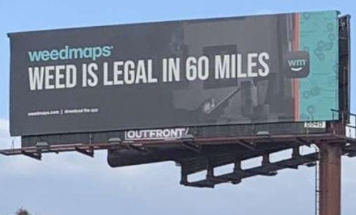
State-to-state variation

Slide 11
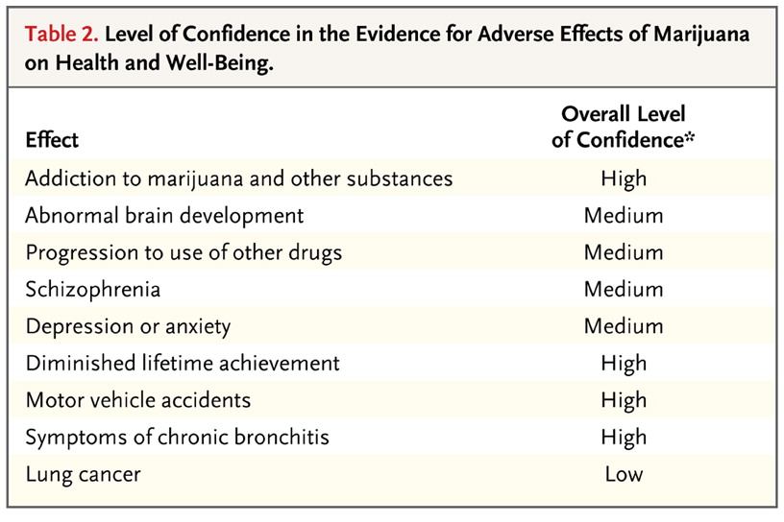

Adverse effects of cannabis use
Volkow ND et al. NEJM 2014;370:2219-2227.
Notes:
As physicians, it is imperative that we weigh known risks against possible benefits with patients when discussing any therapeutic option with patients. But outlining risks is just as important when discussing substance use with patients.
A recent study published in the New England Journal of Medicine in 2014 by the head of the National Institute on Drug Abuse reviewed the health consequences of marijuana use and graded the overall level of confidence in the existing literature with regard to various health consequences.
I will highlight over the next few slides some of these adverse effects.
The indicated overall level of confidence in the association between marijuana
use and the listed effects represents an attempt to rank the strength of the
current evidence, especially with regard to heavy or long-term use and use
that starts in adolescence.

Slide 12
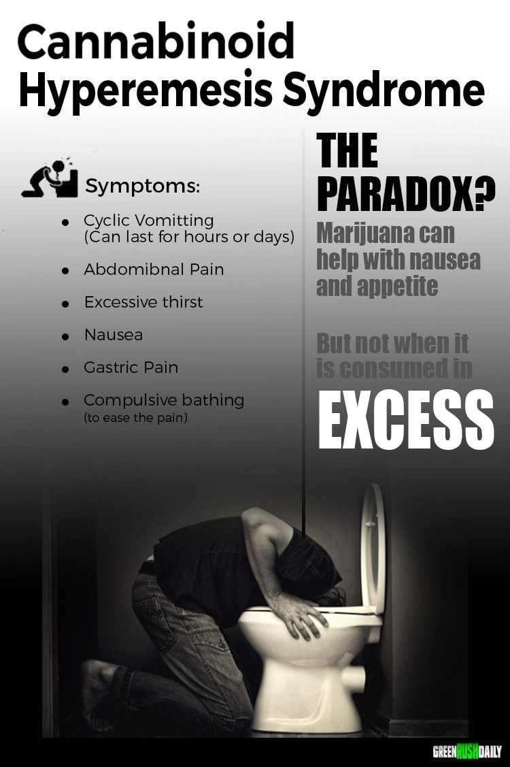
Moderate acute effects
Acute cannabis intoxication
  agitation, psychosis, and anxiety
  tachycardia and hypertension
Cannabinoid Hyperemesis Syndrome
Pediatric Exposures
Kim &Monte Annals of Em Med 2016
https://www.greenrushdaily.com/2016/08/17/cannabinoid-hyperemesis-syndrome-cannabis/
Notes:
We observed a doubling in ED visits for cyclic vomiting after the legalization of medical marijuana in Colorado in 2009 (41 per 113,262 visits prelegalization versus 87 per 129,095 visits postlegalization), although the absolute number of visits remained modest.¹⁸
Public service annoucement add about cannibis hyperemsis syndrome from https://www.greenrushdaily.com/Green Rush Daily is the voice of the cannabis revolution. Providing unbiased, uncensored marijuana news and information.

Slide 13
Cannabis Use Disorder DSM 5
A problematic pattern of cannabis use leading to clinically significant impairment or distress, as manifested by two or more of the following within a 12-month period:
Cannabis is often taken in larger amounts or over a longer period than was intended
There is a persistent desire or unsuccessful efforts to cut down or control cannabis use
A great deal of time is spent in activities necessary to obtain cannabis, use cannabis, or recover from its effects
Craving, or a strong desire or urge to use cannabis
Notes:
DSM 5 combines abuse and dependence into a single construct called substance use disorder with certain modifiers for mild, moderate or server.
Mild: Two to three symptoms
Moderate: Four to five symptoms
Severe: Six or more symptoms

Slide 14
Cannabis Use Disorder, Cont’d
Recurrent cannabis use resulting in a failure to fulfill major role obligations at work, school, or home
Continued cannabis use despite having persistent or recurrent social or interpersonal problems caused or exacerbated by the effects of cannabis
Important social, occupational, or recreational activities are given up or reduced because of cannabis use
Recurrent cannabis use in situations in which it is physically hazardous
Continued cannabis use despite knowledge of having a persistent or recurrent physical or psychological problem that is likely to have been caused or exacerbated by use
Tolerance
Withdrawal

Slide 15
Cannabis withdrawal: New to DSM 5
Cessation of cannabis use that has been heavy and prolonged
Three or more of the following signs and symptoms develop within approximately one week after the cannabis cessation:
  Irritability, anger, or aggression
  Nervousness or anxiety
  Sleep difficulty (eg, insomnia, disturbing dreams)
  Decreased appetite or weight loss
  Restlessness
  Depressed mood
  At least one of the following physical symptoms causing significant discomfort: abdominal pain, shakiness/tremors, sweating, fever, chills, or headache
Cause distress or impairment
No other explanation for symptoms
Of note, symptoms generally resolve in 7-14 days but may persist for weeks
Notes:
TIMELY: Just added to DSM IV
NEED TO INCLUDE:
The signs or symptoms cause clinically significant distress or impairment in social, occupational, or other important areas of functioning
The signs or symptoms are not attributable to another medical condition and are not better explained by another mental disorder, including intoxication or withdrawal from another substance
Symptoms generally resolve in 7-14 days but may persist for weeks.

Slide 16
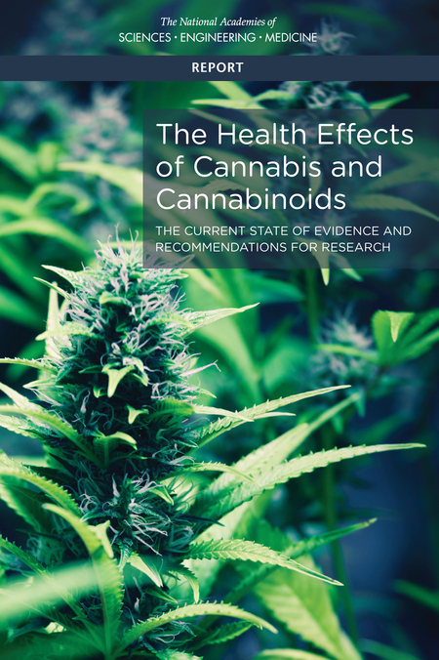
16 person committee reviewed > 10,000 abstracts published since 1999
Focused on recently published systematic reviews and high quality primary research for 11 groups of health effects including both harms and therapeutic effects
Report of National Academies of Science, Engineering and Medicine.
Health Effects of Cannabis and Cannabinoids. 2017
Notes:
Over the remainder of the talk, I will review *some* key articles relating to adverse effects in the field and cite this report “the health effects of cannabis and cannabinoids” published by the national academy of science. I will only mention those effects that substantial or moderate evidence exists for. This is an important but dense reference on the topic and worth having at your fingertips

Slide 17
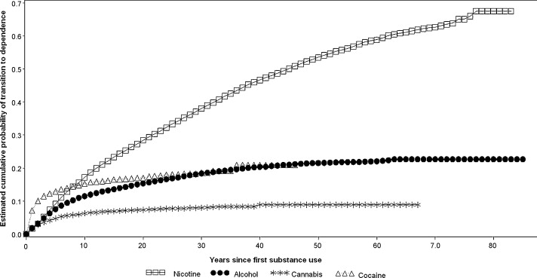
Cumulative Probability of Transitioning to Substance Use Disorder for Nicotine, Alcohol, Cannabis and Cocaine
Develop CUD:
9% of overall,
17% if begin during adolescence,
25-50% if daily use
Lopez-Quintero, C. et al. Drug & Alcohol Dependence 2011
17
Notes:
One of the most feared complications of any substance use is the development of addiction or a substance use disorder.
With a high level of confidence, the available evidence confirms that regular marijuana use can lead to addiction.
After the ﬁrst year of substance use the probability of
transition to addiction was almost 2.0% for nicotine, alcohol, and marijuana and 7% for cocaine.
Lifetime cumulative probability estimates, however, indicate that about 70% of individuals who use nicotine, roughly 20%
of individuals who use alcohol or cocaine, and 9% of individuals who use marijuana become addicted to these substances at some point in their lifetime.
For MJ, that number increases to 17% probability of developing into addiction if use begins during adolescence and ranges from 25-50% if daily use begins in adolescence and persists into adulthood.

Slide 18
Health effects of cannabis and cannabinoids: SUD
There is substantial evidence that:
Initiating cannabis use at an earlier age is a risk factor for the development of problem cannabis use
There is moderate evidence of a statistical association between cannabis use and:
The development of substance use disorder for substances, including alcohol, tobacco, and other illicit drugs
Report of National Academies of Science, Engineering and Medicine.
Health Effects of Cannabis and Cannabinoids. 2017

Slide 19
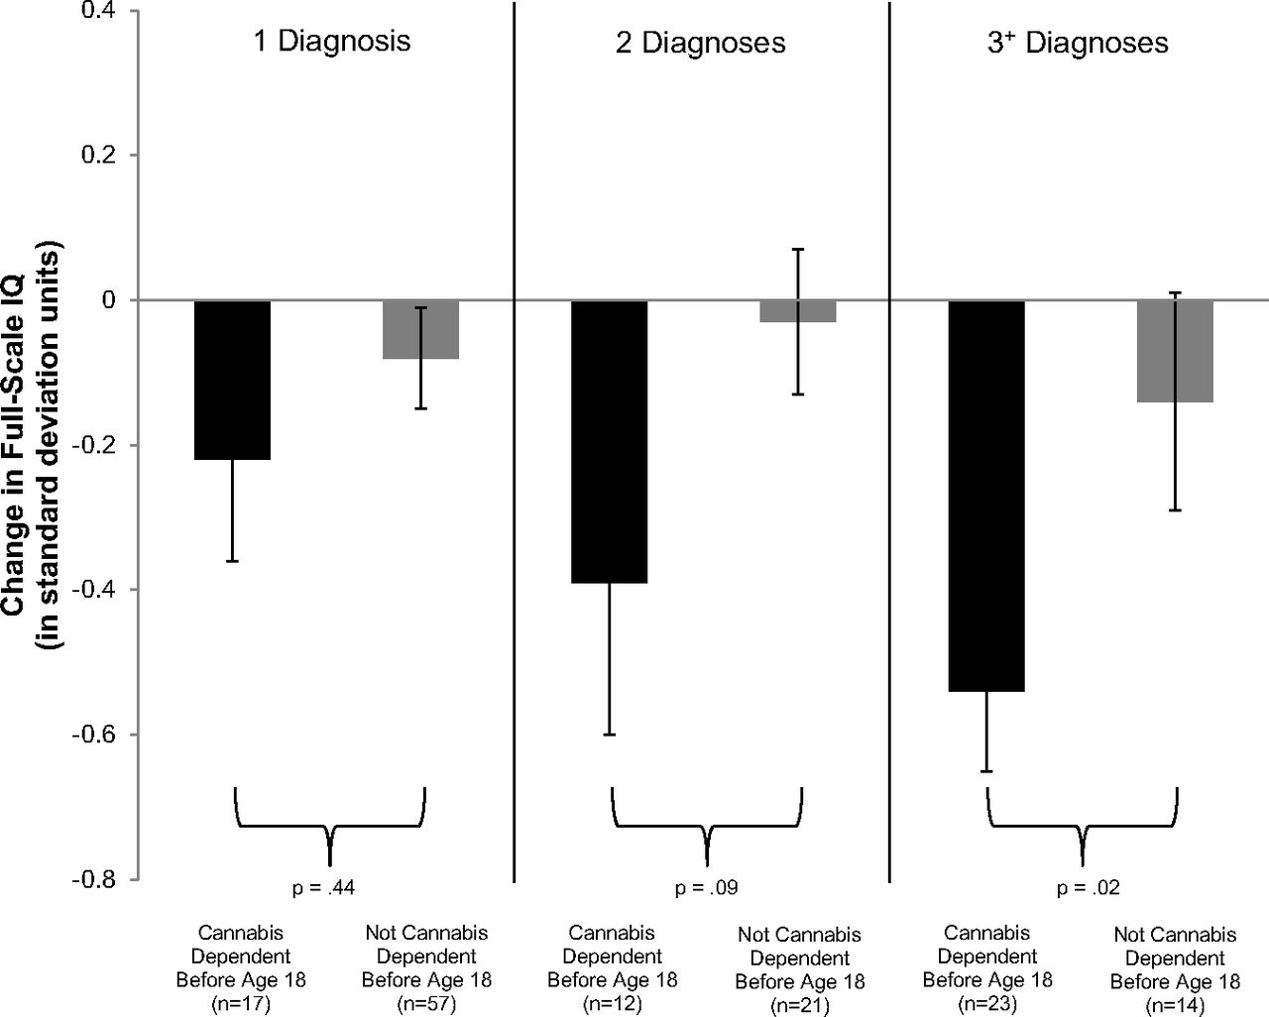
Adolescent vulnerability in IQ decline
Meier M H et al. PNAS 2012
Notes:
Though addiction is concerning especially among individuals who start using in adolescence, so too are concerns about brain development. Here we show data from a
Prospective birth cohort- which followed over 1000 individuals followed from birth to age 38, with multiple testing waves throughout this times period.
This Figure shows Adolescent vulnerability in IQ decline.. Individuals with adolescent-onset marijuana use disorder, shown in black bars, experienced greater IQ decline than individuals with adult-onset marijuana use disorder, shown in gray bars. The IQ decline of individuals with marijuana use beginning in adolescence and persisting into adulthood corresponds to a loss of roughly 8 IQ points.
Follow up data not shown here suggest that those who used marijuana heavily as teenagers and quit using as adults do not recover the lost IQ points. Although the numbers of individuals who met criteria for MJ use disorder were relatively small over multiple testing waves, this trend has been replicated in other studies.

Slide 20
Health effects of cannabis and cannabinoids: Psychosocial domains
There is moderate evidence of a statistical association between cannabis use and:
The impairment in the cognitive domains of learning, memory, and attention
Report of National Academies of Science, Engineering and Medicine.
Health Effects of Cannabis and Cannabinoids. 2017

Slide 21
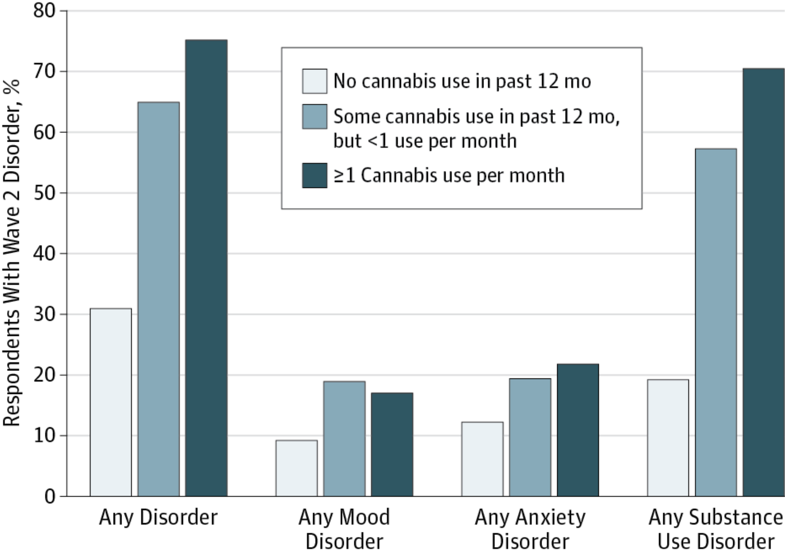
Association between mental health conditions and cannabis use
Blanco et al JAMA Psychiatry, 2016
Notes:
To examine prospective associations between cannabis use and risk of mental health and substance use disorders in the general adult population.
Within the general population, cannabis use is associated with an increased risk for several substance use disorders.
Carlos Blanco, Head of NIDA’s Division of Epidemiology, Services, and Prevention Research at NIH recently published a study using the NESARC data
Nationally representative sample of US adults aged 18 years or older was interviewed 3 years apart in the National Epidemiologic Survey on Alcohol and Related Conditions (wave 1, 2001-2002; wave 2, 2004-2005). In both analyses, the same set of wave 1 confounders was used, including sociodemographic characteristics, family history of substance use disorder, disturbed family environment, childhood parental loss, low self-esteem, social deviance, education, recent trauma, past and present psychiatric disorders, and respondent’s history of divorce.
Cannabis use in wave 1 (2001-2002) was significantly associated with substance use disorders in wave 2 (2004-2005) (any substance use disorder: odds ratio [OR], 6.2; 95% CI, 4.1-9.4; any alcohol use disorder: OR, 2.7; 95% CI, 1.9-3.8; any cannabis use disorder: OR, 9.5; 95% CI, 6.4-14.1; any other drug use disorder: OR, 2.6; 95% CI, 1.6-4.4; and nicotine dependence: OR, 1.7; 95% CI, 1.2-2.4),
but not any mood disorder (OR, 1.1; 95% CI, 0.8-1.4) or anxiety disorder (OR, 0.9; 95% CI, 0.7-1.1).
mood disorders (major depressive disorder, dysthymia, and bipolar disorder), and anxiety disorders (panic disorder, social anxiety disorder, specific phobia, and generalized anxiety disorder).
**WE DO KNOW ABOUT GENETIC PREDISPOSITIONS** MOVED SLIDE TO END BECAUSE WAS PART OF DAN’S OPENING PLENARY

Slide 22
Health effects of cannabis and cannabinoids: Mental Health
There is substantial evidence of a statistical association between cannabis use and:
The development of schizophrenia or other psychoses, with the highest risk among the most frequent users
There is moderate evidence of a statistical association between cannabis use and:
Increased symptoms of mania and hypomania in individuals diagnosed with bipolar disorders (regular cannabis use)
A small increased risk for the development of depressive disorders
Increased incidence of suicidal ideation and suicide attempts with a higher incidence among heavier users
Increased incidence of suicide completion
Increased incidence of social anxiety disorder (regular cannabis use)
Major depressive disorder is a risk factor for the development of problem cannabis use
Report of National Academies of Science, Engineering and Medicine.
Health Effects of Cannabis and Cannabinoids. 2017

Slide 23
Pulmonary effects of smoked cannabis
Acute → bronchodilation (FEV₁ increase ~ 0.15-0.25L)
Long-term → cough (OR 2.0, 95% CI 1.32-3.01), phlegm, wheeze; however data were inconclusive regarding an association between long-term cannabis smoking and airflow obstruction(1)
At low levels of exposure, FEV₁ increased by 13 mL/joint-year and FVC by 20 mL/joint-year, but at higher levels of exposure, airflow obstruction was observed(2)
Tetrault JM et al. Archives IM 2007
Pletcher MJ et al. JAMA 2012
Notes:
Most data on the pulmonary effects of MJ show an acute bronchodilatory effect of smoked MJ.
In a systematic review, 34 studies included. Chronic mj smoking was clearly associated with increased likelihood of cough, sputum production and wheeze.
In a 20 year cohort study of MJ smoking

Slide 24
Health effects of cannabis and cannabinoids: Respiratory disease
There is substantial evidence of a statistical association between cannabis smoking and:
Worse respiratory symptoms and more frequent chronic bronchitis episodes (long-term cannabis smoking)
There is moderate evidence of a statistical association between cannabis smoking and:
Improved airway dynamics with acute use, but not with chronic use
Higher forced vital capacity (FVC)
There is moderate evidence of a statistical association between the cessation of cannabis smoking and:
Improvements in respiratory symptoms
Report of National Academies of Science, Engineering and Medicine.
Health Effects of Cannabis and Cannabinoids. 2017

Slide 25
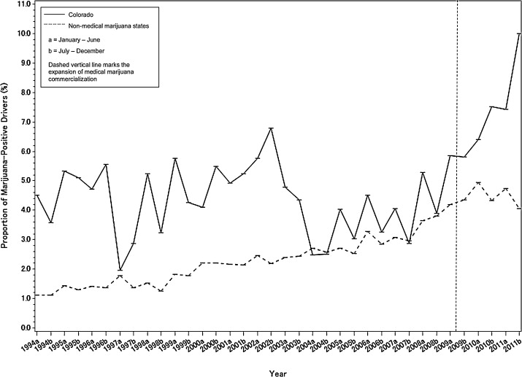
Trends in fatal motor vehicle crashes before and after cannabis commercialization in CO
Salomonsen-Sautel, S. Drug & Alcohol Dependence, 2014
Notes:
Both immediate exposure and long-term exposure
to marijuana have been shown to impair driving ability; marijuana
is the illicit drug most frequently reported
in connection with impaired driving and accidents,
including fatal accidents and According to a recent meta-analysis, the overall
risk of involvement in an accident increases by a
factor of about 2 when a person drives soon after
using marijuana.
Here we show the trends in FATAL motor vehicle crashes before and after MJ commercialization in CO.
In Colorado, since mid-2009 when medical marijuana became commercially available and prevalent, the trend became positive in the proportion of drivers in a fatal motor vehicle crash who were marijuana-positive (change in trend, 2.16 (0.45), p<0.0001); in contrast, NO significant changes were seen in Non Medical Marijuana States. The data are not shown here but for both Colorado and NMMS, NO significant changes were seen in the proportion of drivers in a fatal motor vehicle crash who were alcohol-impaired

Slide 26
Health effects of cannabis and cannabinoids: Injury and death
There is substantial evidence of a statistical association between cannabis use and:
Increased risk of motor vehicle crashes
There is moderate evidence of a statistical association between cannabis use and:
Increased risk of overdose injuries, including respiratory distress, among pediatric populations in U.S. states where cannabis is legal (9-4b)
Report of National Academies of Science, Engineering and Medicine.
Health Effects of Cannabis and Cannabinoids. 2017

Slide 27
Treatment Options for cannabis use disorder
Pharmacotherapy
  No currently approved medication
    cannabinoid antagonist
    oral THC for withdrawal, maintenance or short-term treatment?
      cannabinoid agonist—Levin FR DAD 2011
    N-Acetylcysteine
Behavioral
  Substance use treatment setting
    cognitive-behavioral therapy, contingency management, motivational enhancement, therapeutic living
  General medical settings
    Brief interventions
Notes:
Widespread screening for adolescent substance use is controversial, there is some emerging evidence for BI for mj use

Slide 28
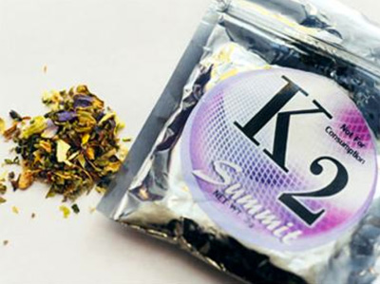
Synthetic cannabis: K2, Spice, etc.
General Information:
  Marketed as safe legal alternative to cannabis; generally smoked; very common among adolescents
Effects:
  Mild euphoria and relaxation
  The ‘giggles’
  Increased sensitivity to external stimuli
  Frank, vivid hallucinations
Adverse effects:
  Dry mouth, palpitations, rapid HR, vomiting, agitation
  Not detected in urine
  May be adulterated with heavy metal residues or other fillers including rat poison-→ severe bleeding
Notes:
What is K2 or Spice ? It is a synthetic marijuana that is Marketed as safe legal alternative to marijuana; it is easily accessible and available under multiple names is is generally smoked; very common among adolescents
In terms of its effects it can cause mild euphoria and relaxation and increased sensitivity to external stimuli and may cause frank vivid hallucinations.
It causes these effects through its activity at the cannabinoid receptors
Adverse effects include rapid heart rate, vomiting, agitation and confusion. It is important to note that it is evolving chemically and may be difficult to test for in the urine. Additionally it may be adulterated by heavy metal residues
Note: Spice users report experiences similar to those produced by marijuana—elevated mood, relaxation, and altered perception—and in some cases the effects are even stronger than those of marijuana. Some users report psychotic effects like extreme anxiety, paranoia, and hallucinations.
So far, there have been no scientific studies of Spice’s effects on the human brain, but we do know that the cannabinoid compounds found in Spice products act on the same cell receptors as THC, the primary psychoactive component of marijuana. Some of the compounds found in Spice, however, bind more strongly to those receptors, which could lead to a much more powerful and unpredictable effect. Because the chemical composition of many products sold as Spice is unknown, it is likely that some varieties also contain substances that could cause dramatically different effects than the user might expect.
Some new compounds have recently emerged that are sending many users to the hospital in cities around the country. They include:
AB-PINACA, AB-FUBINACA (sold as “Cloud 9,” “Relax,” or “Crown”) is sold as a liquid in eyedropper bottles and often used with vaporizing devices—e-cigarettes or “hookah pens.” Numerous hospitalizations in Michigan prompted the Macomb County Health Department to issue an emergency warning and ban on the sale of these drugs, which are reported to cause hallucinations, aggressive behavior, racing heartbeat, drowsiness, and vomiting.
MAB-CHMINACA, ADB-CHMINACA (sold as “Mojo,” “Spice,” “K2,” and “Scooby Snax”) resulted in over 150 hospital visits in Baton Rouge and Lafayette, LA in October, prompting the governor to ban the drug in that state. It is reported to cause severe agitation, anxiety, and paranoia; raised heartbeat and blood pressure; nausea and vomiting; muscle spasms, seizures, and tremors; intense hallucinations and psychotic episodes, including suicidal fixations and other harmful thoughts.

Slide 29
Fundamental tension
Intoxication and withdrawal of cannabis are not fatal
Overdose is unlikely
Long-term, moderate use seems to be relatively frequent (compared to other drugs)
Risk of end-organ damage appears to be lower than several other legal and illegal substances
Ratio of medical benefit to harm may be equal or better than some controlled substances
Notes:
Alcohol 10% past-year abuse dependence
I would say at the very least this argues for a rescheduling to II, which would at least provide a better opportunity to explore the last issue here

Slide 30
Health effects of cannabis and cannabinoids: Therapeutic effects
There is conclusive or substantial evidence that cannabis or cannabinoids are effective:
For the treatment of chronic pain in adults (cannabis)
As antiemetics in the treatment of chemotherapy-induced nausea and vomiting (oral cannabinoids)
For improving patient-reported multiple sclerosis spasticity symptoms (oral cannabinoids)
Report of National Academies of Science, Engineering and Medicine.
Health Effects of Cannabis and Cannabinoids. 2017

Slide 31
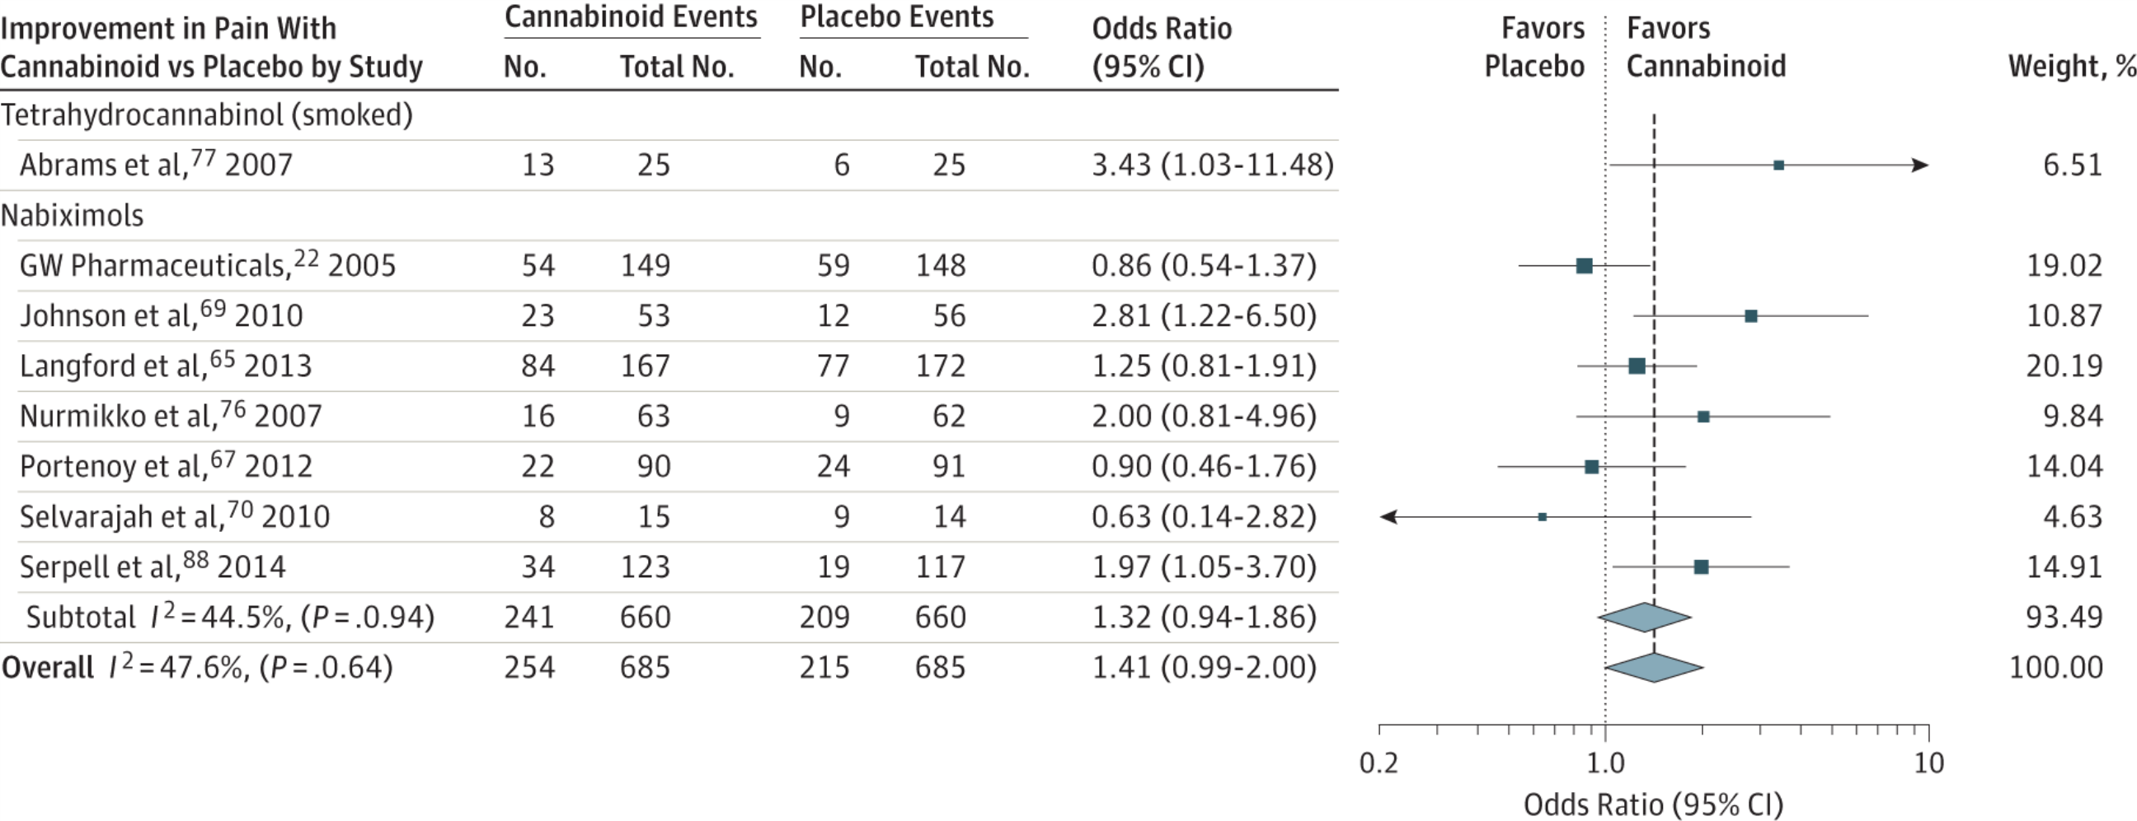
Cannbinoids for medical use: Pain
30% decrease in pain w cannabinoid vs placebo:
OR 1.41 (95% CI, 0.99-2.00)
Whiting PF et al. JAMA.2015;313(24):2456-2473
Notes:
ONE EXAMPLE
There was moderate-quality evidence to support the use of
cannabinoids for the treatment of chronic pain and spasticity. There was low-quality evidence
suggesting that cannabinoids were associated with improvements in nausea and vomiting
due to chemotherapy, weight gain in HIV infection, sleep disorders, and Tourette syndrome.
Cannabinoids were associated with an increased risk of short-term AEs.
Improvement in PainOdds indicate 30% or greater improvement in pain with cannabinoid compared with placebo, stratified according to cannabinoid. The square data markers indicate odds ratios (ORs) from primary studies, with sizes reflecting the statistical weight of the study using random-effects meta-analysis. The horizontal lines indicate 95% CIs. The blue diamond data markers represent the subtotal and overall OR and 95% CI. The vertical dashed line shows the summary effect estimate, the dotted shows the line of no effect (OR = 1).
Change in Ashworth Score for Cannabinoid Compared With Placebo, Stratified According to CannabinoidThe square data markers indicate mean differences from primary studies, with sizes reflecting the statistical weight of the study using random-effects meta-analysis. The horizontal line indicate, 95% CIs. The blue diamond data markers represent the subtotal and overall weighted mean difference and 95% CI. The vertical dashed line shows the summary effect estimate, the solid vertical line shows the line of no effect (mean difference = 0).
NOT Included in the spacticity was the following study:
The Cannabinoid Use in Progressive Inflammatory brain Disease (CUPID) trial: a randomised double-blind placebo-controlled parallel-group multicentre trial and economic evaluation of cannabinoids to slow progression in multiple sclerosis
Health Technology Assessment, No. 19.12; Feb 2015
Susan Ball, Jane Vickery, Jeremy Hobart, Dave Wright, Colin Green, James Shearer, Andrew Nunn, Mayam Gomez Cano, David MacManus, David Miller,Shahrukh Mallik, and John Zajicek.
Headline
The study found that oral dronabinol did not slow down the progression of progressive multiple sclerosis. No major safety concerns were identified in the use of dronabinol

Slide 32
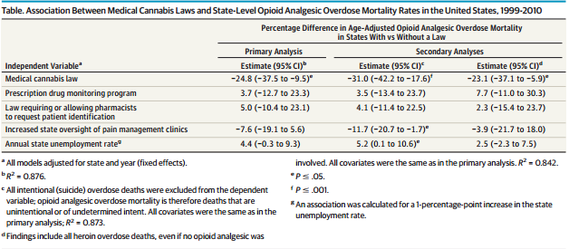
Medical Cannabis and OD risk
Bachhuber MA et al. JAMA 2014
Notes:
Ecological Study:
-not adjusted for SES, race/ethnicity, medical/psychiatric comorbidities
Heterogeneity Between States
-temporal relationship between passage of law
Fixed-Effects Models
-important time- and state-varying confounders not included in models
Death Certificate Data
-misclassification of type of opioid analgesic (and illicit) overdose death (bias)
Large Confidence Intervals
No information provided on the health history of the patients with or without valid prescriptions, (i.e. multiple providers, comorbid polypharmacy, and poor health) which are associated with overdose mortality

Slide 33
Cannabis legislation and prescription opioids
Between 2011-2016, among Medicaid enrollees, medical cannabis laws associated with 5.88% lower opioid prescribing rates
Between 2010-2015, among Medicare part D recipients, prescriptions filled for all opioids decreased by 2 million daily doses per year when a state instituted any medical cannabis law.
  Prescriptions for all opioids decreased by 3.742 million daily doses per year when medical cannabis dispensaries opened.
Cannabis use associated with increase in nonmedical use of prescription opioids (OR 5.78, 95% CI 4.23-7.9)
  Cannabis use associated with OUD (OR 7.76, 95% CI 4.95-12.2)
Wen, H et al, JAMA Internal Medicine Apr 2018
Bradford AC et al. JAMA Internal Medicine Apr 2018
Hill KP et al, JAMA Internal Medicine Apr 2018
Olfson M et al. Am J Psychiatry 2018
Notes:
Population-based, cross-sectional study using the all-capture Medicaid prescription data for 2011 to 2016, medical marijuana laws and adult-use marijuana laws were associated with lower opioid prescribing rates (5.88% and 6.38% lower, respectively).

Slide 34
Challenges in conducting research on adverse health effects or therapeutic effects of cannabis
Regulatory barriers, including the classification of cannabis as a Schedule I substance, impede the advancement of cannabis research
Difficult for researchers to gain access to the quantity, quality, and type of product necessary to address research questions on health effects
A diverse network of funders is needed to support cannabis research
To develop conclusive evidence for the effects of cannabis use on short- and long-term health outcomes, improvements and standardization in research methodology (including those used in controlled trials and observational studies) are needed
Report of National Academies of Science, Engineering and Medicine.
Health Effects of Cannabis and Cannabinoids. 2017

Slide 35
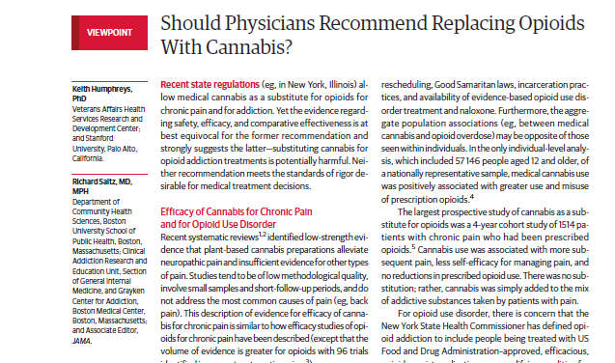
JAMA. 2019;321(7):639-640. doi:10.1001/jama.2019.0077

Slide 36
“For the opioid addiction crisis, clearly efficacious medications such as methadone and buprenorphine are under-prescribed. Without convincing evidence of efficacy of cannabis for this indication, it would be irresponsible for medicine to exacerbate this problem by encouraging patients with opioid addiction to stop taking these medications and to rely instead on unproven cannabis treatment.”
JAMA. 2019;321(7):639-640. doi:10.1001/jama.2019.0077

Slide 37
Reducing potential harm from cannabis use
Caution with edibles
  Describe long onset of action/labelling concerns
Safe storage
Caution with high THC products
  58 mg THC in a joint – don’t smoke the whole joint
Certain routes of administration i.e., dabbing carry particular risk
Consider use of products with lower THC, higher CBD
Cut back—employ brief intervention

Slide 38
Back to the case…What would you do?
Notes:
48 yo father of two living in CT with obesity and chronic OA of the knee presents for follow up
Initially followed by pain specialist, maintained on MS Contin 30 mg tid and one-two oxycodone 5mg tabs q6 hours for breakthrough pain, not to exceed 6 tabs/day
No longer seeing pain specialist after losing his insurance
In primary care, continued on regimen and followed treatment agreement
Became increasingly sedentary
Diagnosed with other chronic conditions including OSA, COPD and cardiac disease
BMI increased from 28-32 in two years; in a rut can’t exercise due to pain, can’t lose weight because can’t
exercise, weight gain has made the pain worse
History of binge drinking in college BUT NOW drinks 12 beers/week; has not drank more than 5 drinks per occasion in the last year; has not used an illicit substance in the past year.
After discussion with the patient, you both agree, his opioids are no longer optimizing his pain, he understands the risk profile and asks, “maybe you should just prescribe cannabis?”
States he tried it once in college but made him “giggly and a little paranoid” but has heard it has helped, including athletes, with pain. Asks if you will consider giving it to him since you are taking away his opioids

Slide 39
Interactive teaching scenario: Morning report/role play
Set up a “spicy,” public health debate regarding legalization of recreational marijuana using the following citation as a spring board for discussion:
Kilmer B. Recreational Cannabis — Minimizing the Health Risks
from Legalization. Perspective. NEJM. February 23, 2017
Assign report participants to one of two groups:
  Recreational marijuana SHOULD be legalized in all states nationwide
    Citing adverse effects of criminalization and potential for increasing state budgets through taxation, potential impact on opioid epidemic
  Recreational marijuana SHOULD NOT be legalized in all states nationwide
    Citing current research on adverse health effects and natural experiment data from states that have already legalized recreational marijuana
All arguments need to be evidence-based and factual

Slide 40
Thank you
Questions?
Acknowledgements: several slides adapted from Dr. William Becker (Yale), Dr. Devan Kansagara (OHSU)
Dr. Hilary Kunins (NY DPH), Dr. Jeffrety Hunt (Brown), Dr. Zoe Weinstein (BU)

