Slide 1
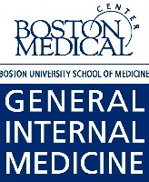
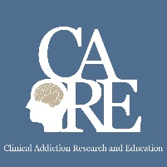
Adolescents, Young Adults, and Pregnancy
Sarah M. Bagley, MD, MSc
Assistant Professor of Medicine and Pediatrics
Medical Director, CATALYST Program
Grayken Center for Addiction
Boston University School of Medicine/Boston Medical Center
May 1, 2019

Slide 2
Disclosure Information
Sarah M. Bagley, M.D., MSc.
Nothing to disclose

Slide 3
Why are we talking about this?
Addiction is a disease of pediatric onset
What happens in childhood/adolescence affects how our adult patients present in primary care
I have been effective in lobbying these 2 points

Slide 4
Learning Objectives
Describe the current trends in adolescent and young adult substance use and treatment
Identify 2 barriers to evidence-based addiction care for adolescents and young adults
Discuss the epidemiology of alcohol and other drug use in pregnancy

Slide 5
Case 1
17 yo male with mother with history of HIV and substance use, referred from mother’s primary care provider
Referred to CATALYST program as a way to prevent development of problematic substance use
Meets with social worker for therapy and adolescent provider primary care and prevention

Slide 6
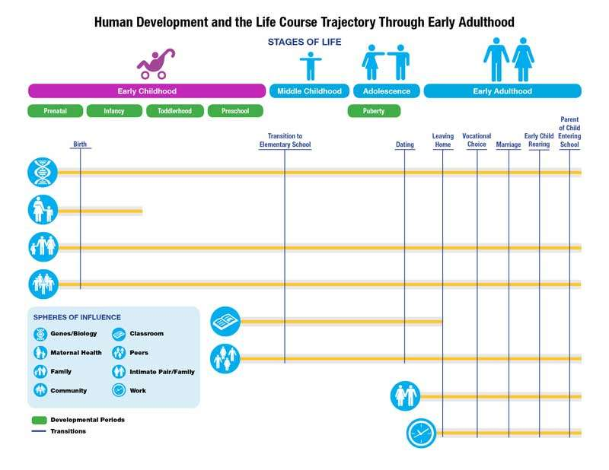
Adolescence and young adulthood is a key developmental period
Transitional
Decision making
Identity exploration, search for self
Increased autonomy
Image credit: Kellam & Rebok, 1992

Slide 7
Increased risk-taking
However – this is also the time that adolescents are taking more risks, are impulsive…
Significant opportunity to avoid effects of substance use if we can help teens abstain or decrease use
Steinberg Dev Rev 2008

Slide 8
Why do we care?

Slide 9
Early Onset Matters!
Both for development of substance use disorders AND
Because youth who use alcohol and other drugs engage in other risky behaviors

Slide 10
Long term consequences
Early onset matters:
Likelihood of lifetime substance use disorder was reduced by 4% and 5% with each year drug use onset was delayed
Grant, Dawson J Subst Abuse (1998)

Slide 11
Long term consequences
Early onset matters:
2 in 3 individuals in opioid treatment report first use before age 25
1 in 3 report first use before age 18
Treatment Episode Data Set (TEDS): 2011
SAMHSA, 2015

Slide 12
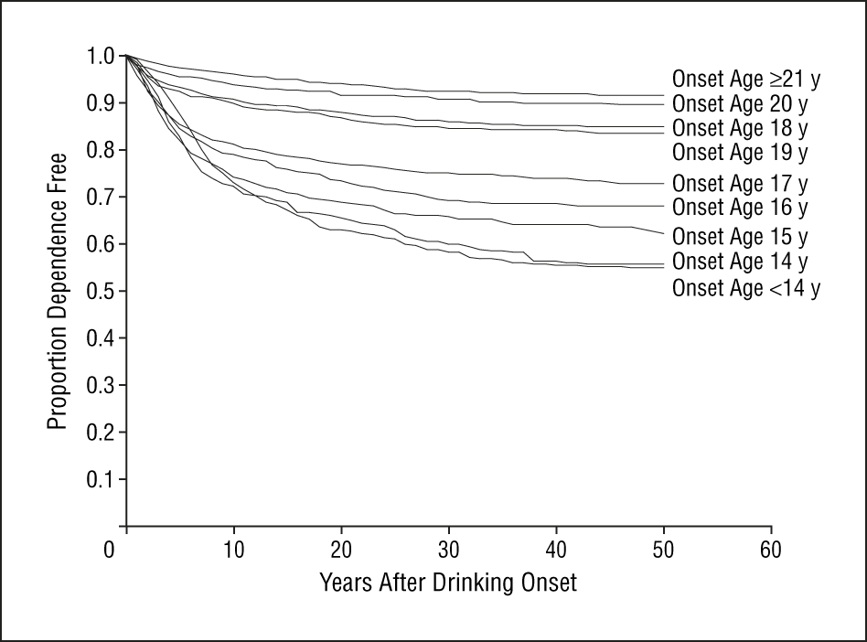
Long term consequences
Early onset matters:
Young adults who began drinking before age 14 exhibited a lifetime dependence prevalence of 47% compared to 9% of youth who began drinking at/after 21
Hingson, Heeren, Winter, 2006

Slide 13
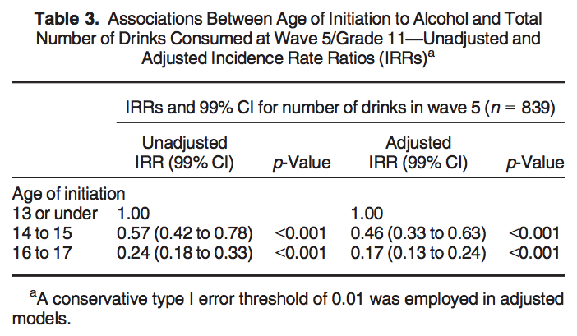
Long-term consequences
Early onset matters:
Earlier alcohol use associated with increased risk of binge drinking and higher quantity of consumption in late secondary school
Aiken, 2018

Slide 14
Long term consequences
Early onset matters:
Prior history of nonmedical use of prescription opioids strongly associated with heroin initiation
Cerda, 2015

Slide 15
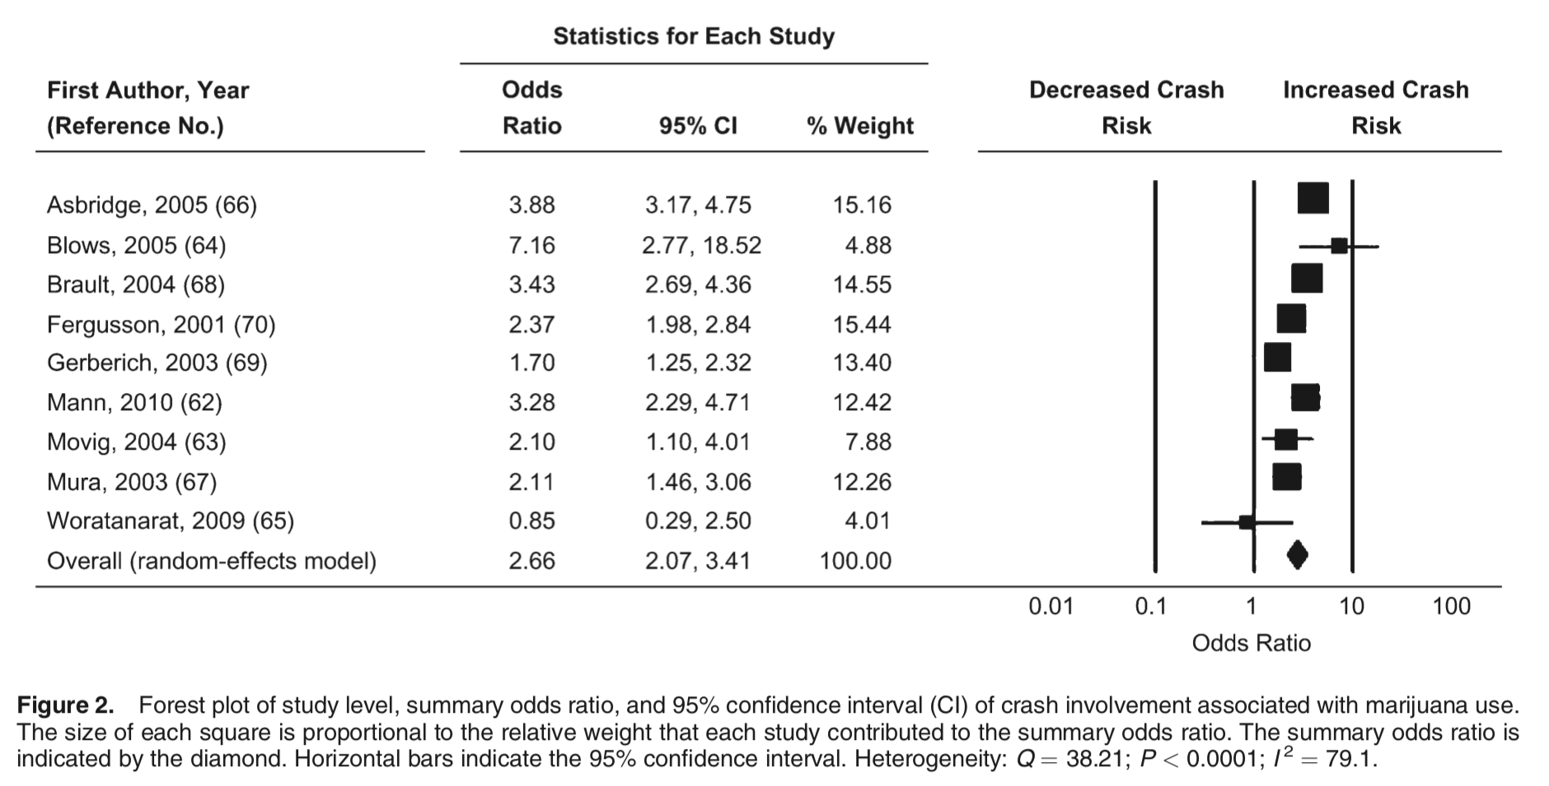
Short term consequences
Early onset matters:
Marijuana use associated with significantly increased crash risk in a dose and frequency dependent relationship
Li et al. Epidemiol Rev (2012)

Slide 16
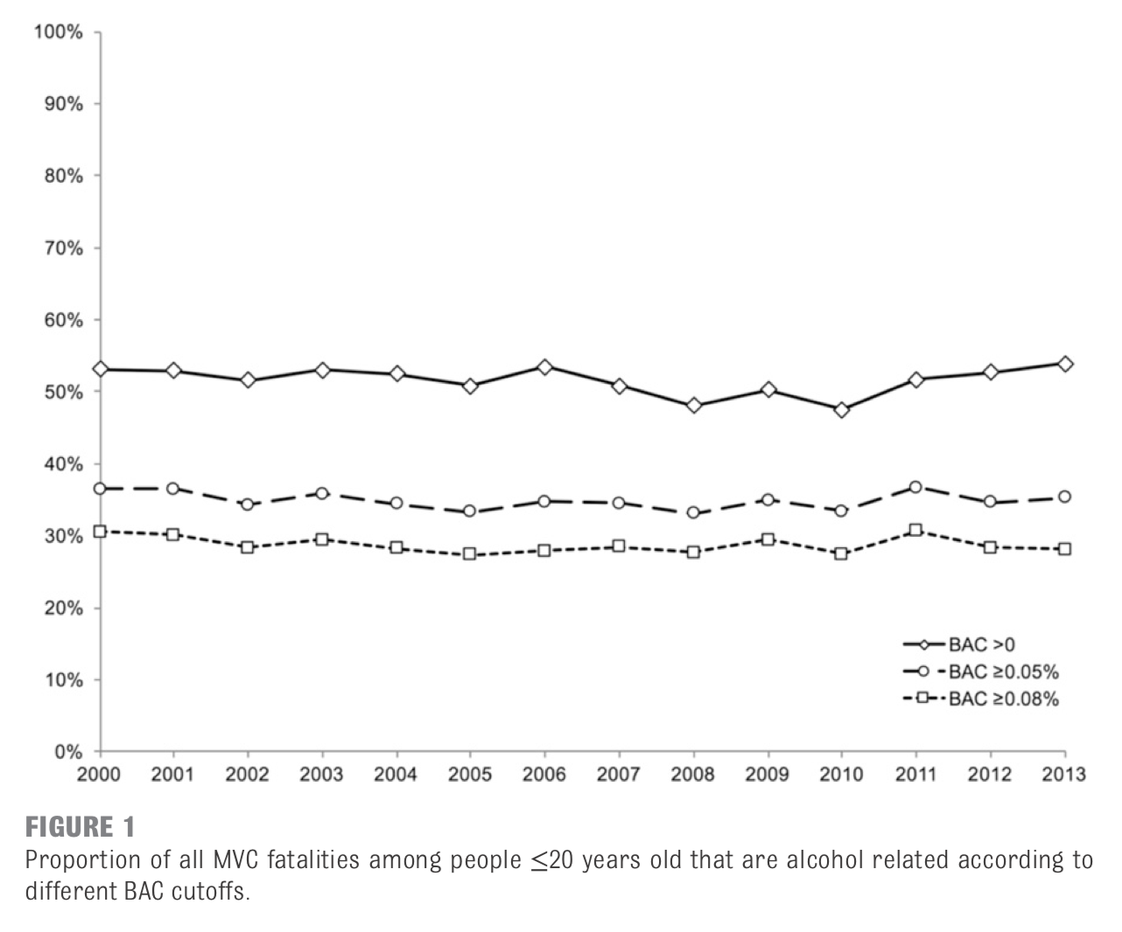
Short term consequences
Early onset matters:
28% of MVC fatalities with individuals ≤20 years old involved alcohol
Hadland et al. Pediatrics (2017)

Slide 17
Short term consequences
Early onset matters:
Compared to community-matched sample, youth in clinical treatment reported: earlier age of onset to sexual activity, more sexual partners, less consistent use of condoms, more STDs, more pregnancies
Tapert et al. Journal of Adolescent Health (2001)

Slide 18
Prevalence of Hep C rising

Slide 19
Increasing prevalence of infective endocarditis
From 2008 to 2013 there was an increase in IE related to injection drug use from 28% to 42% (P <0.001)
Wurcel AG et al. 2016

Slide 20
Overall drug use among teens and young adults
Past Month Illicit Drug Use among People Aged 12 or Older, by Age Group: 2017
NSDUH, 2017

Slide 21
Trends in alcohol use
Past Month Alcohol Use among People Aged 12 or Older, by Age Group: Percentages, 2002-2017
NSDUH, 2017
NSDUH, 2017

Slide 22
Trends in marijuana use
Past Month Marijuana Use among People Aged 12 or Older, by Age Group: Percentages, 2002-2017
NSDUH, 2017

Slide 23
Trends in other substance use
Past Month Cocaine Use among People Aged 12 or Older, by Age Group: Percentages, 2002-2017
NSDUH, 2017

Slide 24
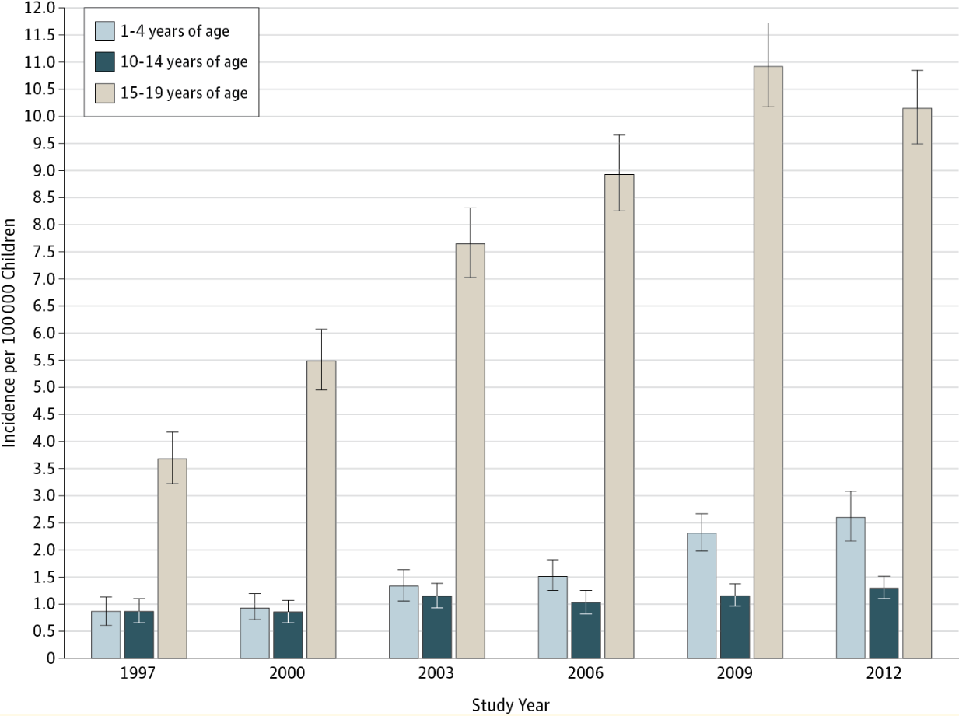
Opioid poisonings
Hospitalizations for Prescription Opioid Poisonings Stratified by Age Category
Pediatric hospitalizations for opioid poisonings increased nearly 2-fold from 1997 to 2012
Gaither (2016) JAMA Pediatr. 2016;170(12):1195-1201

Slide 25
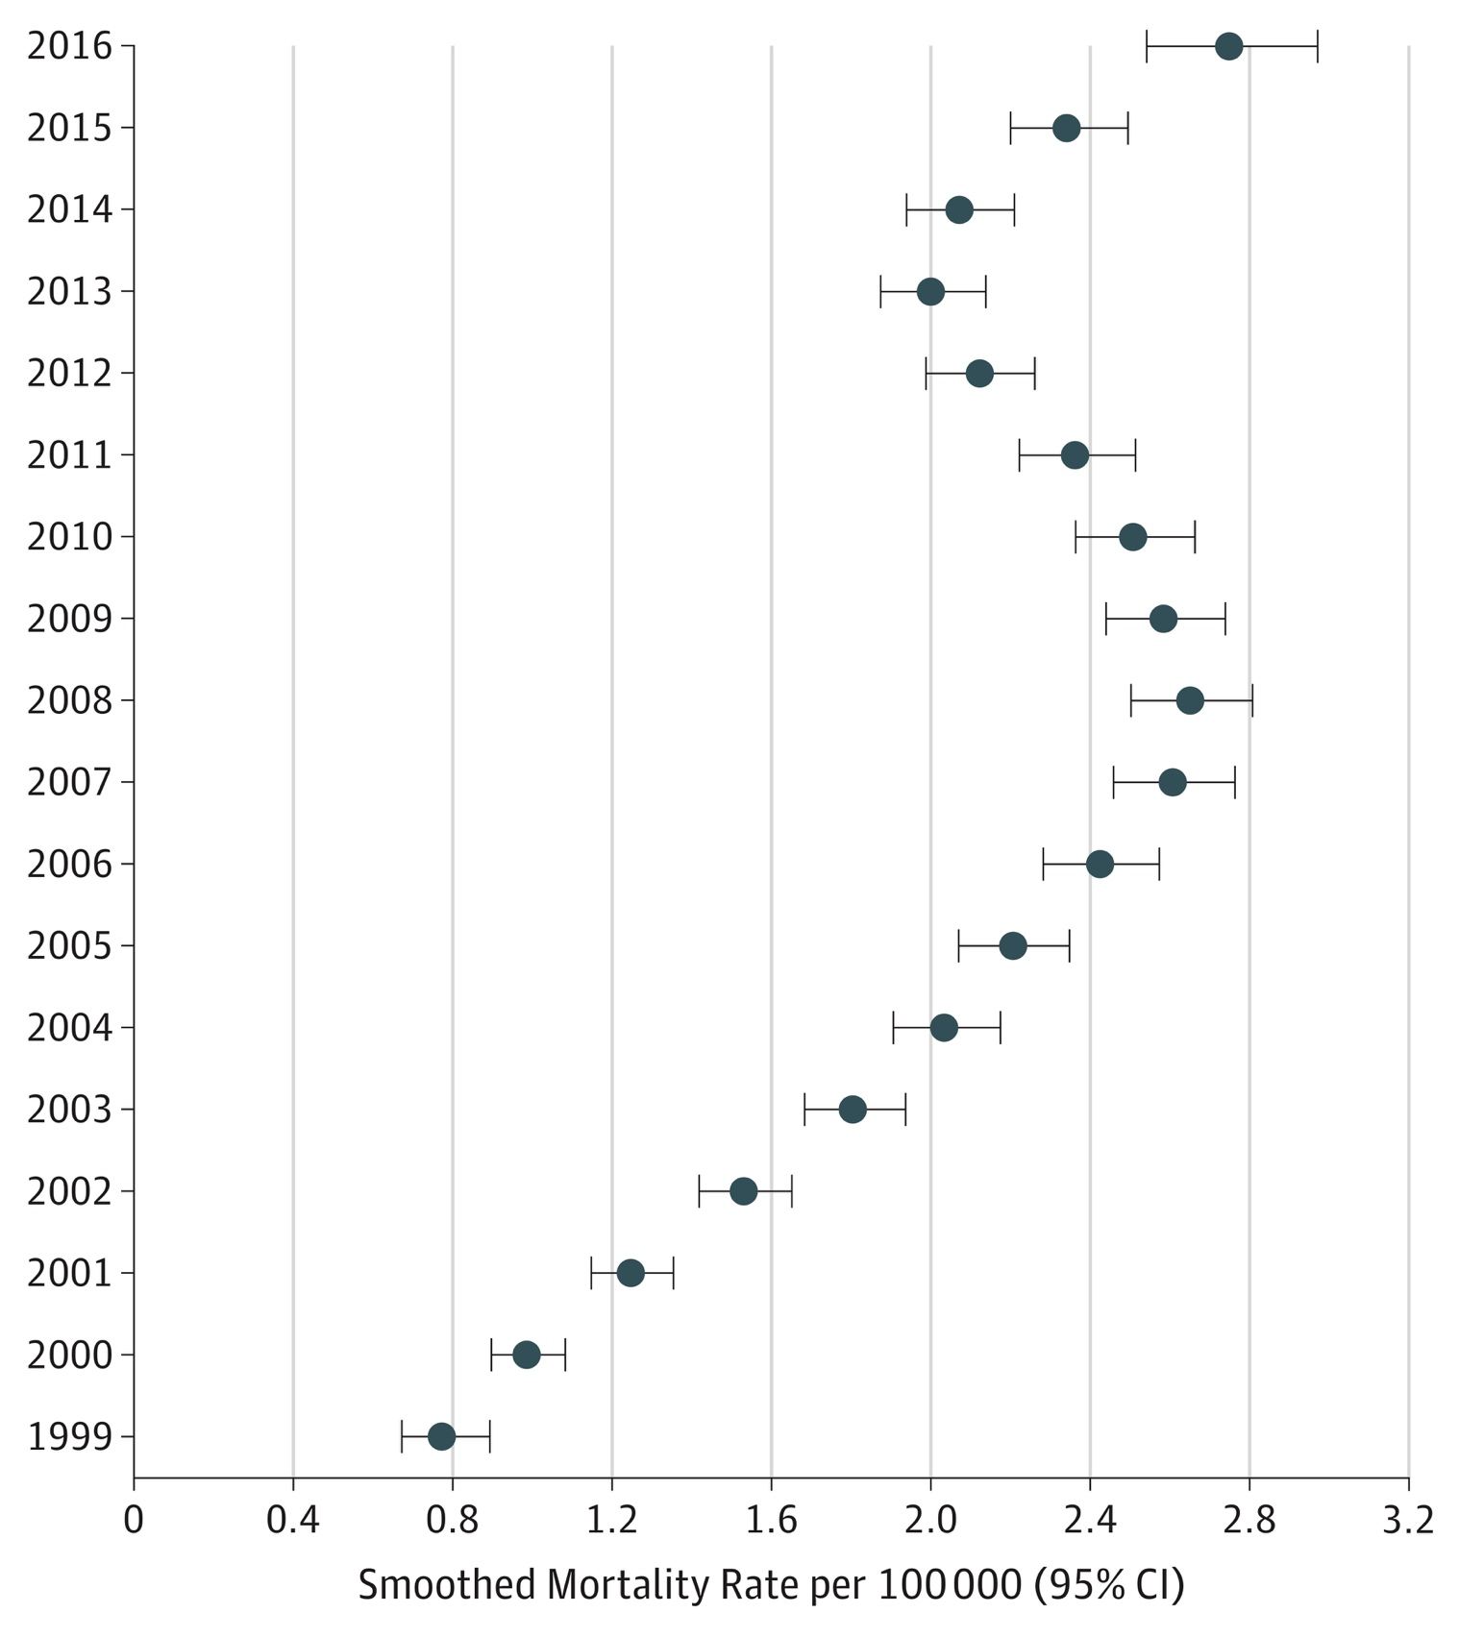
Opioid deaths
US National Trends in Pediatric Deaths From Prescription and Illicit Opioids, 1999-2016
Between 1999 and 2016, overdose deaths rose among 15- to 19-year-olds:
95% for prescription opioids
405% for heroin
2925% for synthetic opioids (i.e., fentanyl)
Gaither JR, et al. JAMA Netw Open. 2018;1(8):e186558.
Notes:
So I have now told you that overall opioid use has been decreasing but that hospitalization for opioid poisoning might be increasing- until really last week there was question about what was happening with overdose deaths in this age group- but then this data brief was released by the CDC and the NCHS- showing that there has been an increase in the last couple of years in overdose deaths (from any substance)

Slide 26
Overdose deaths involving opioids
Drug Overdose Death Rates for 15-24 year olds by type of opioid drug involved: United States, 1999-2017
Data Source: Centers for Disease Control and Prevention, National Center for Health Statistics. Multiple Cause of Death 1999-2017 on CDC WONDER Online Database, released December, 2018

Slide 27
Take home points
Adolescence and young adulthood is a unique and exciting time for development
Counseling should focus on the short and long term consequences
Overall teen drug use trends are encouraging but young adults continue to have the highest prevalence of use

Slide 28
Case 2
20 year old female referred to us from the adolescent/emerging adult crisis stabilization program
Has had multiple admissions related to opioid use and never offered medication treatment until this last admission
Started on buprenorphine at program and we then see her for regular follow-up
Despite relapse, she explicitly says that medication treatment has made a huge impact on recovery

Slide 29
Adolescents and young adults have poor access to addiction care
Received Specialty Substance Use Treatment in the Past Year among People Aged 12 or Older Who Needed Substance Use Treatment in the Past Year, by Age Group: 2017
NSDUH, 2017

Slide 30
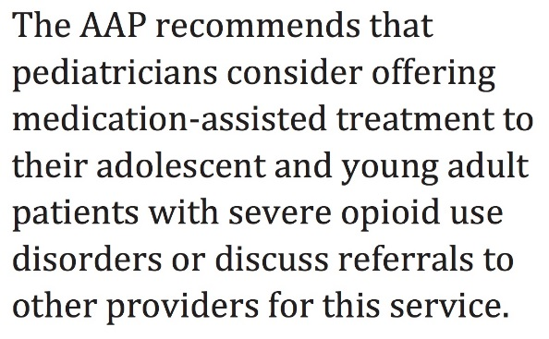
Should Youth Receive Meds…?
AAP Committee on Substance Use and Prevention, August 2016

Slide 31
Disparities in Access Based on Age
Availability of services for adolescents is limited: fewer than 1 in 3 specialty drug treatment programs in the United States offers care to adolescents
From 2000 to 2014 only 1 in 4 youth diagnosed with OUD received medication (buprenorphine or naltrexone) within 6 months of diagnosis
Hadland SE, et al. JAMA Pediatr, 2017;171(8):747-755.

Slide 32
Barriers and opportunities for care
Stigma: significant misinformation about what medication treatment is and it’s benefits
Lack of training: only 1% of waivered providers identify as pediatricians
Coordination of care: these cases are complicated - involve state agencies, families, children→ can be hard to ensure that a consistent plan is being offered and implemented

Slide 33
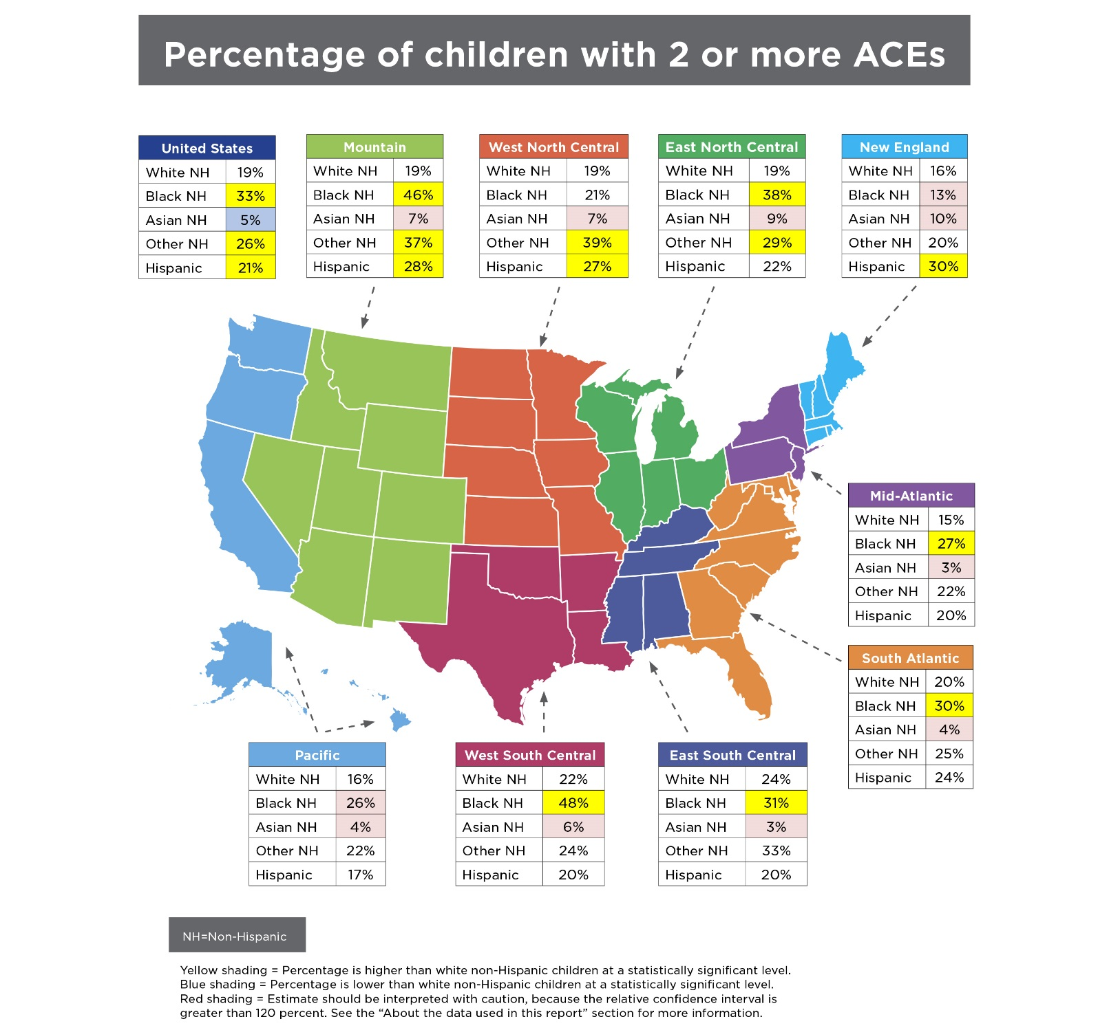
Prevalence of adverse childhood experiences
Adverse Childhood Event (ACE)
NH = Non-Hispanic
https://www.childtrends.org/publications/prevalence-adverse-childhood-experiences-nationally-state-race-ethnicity

Slide 34
https://www-cdc-gov.ezproxy.bu.edu/violenceprevention/childabuseandneglect/acestudy/about.html

Slide 35
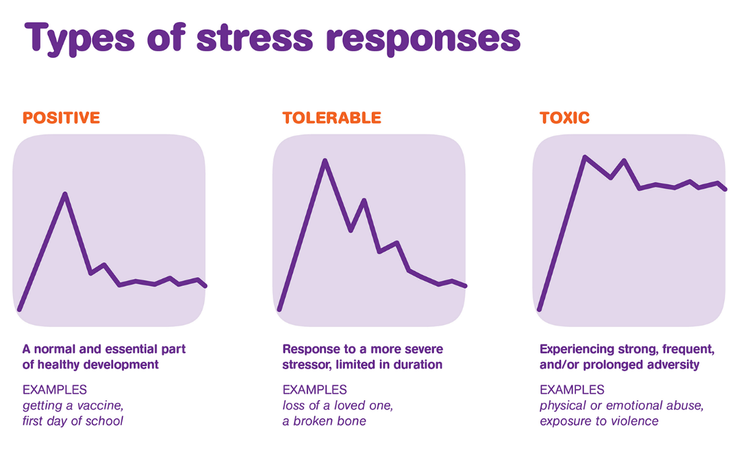
What does history of adverse experiences mean for our treatment plans?
In clinic: consistent behavior and treatment plans, ensure that entire clinic staff understands the challenges and responses
Compassion is key - behavior not intentionally “manipulative”
Life skills and training that might need more tailored support
help with resumes, looking for jobs, taxes, finding housing
May need to find classes that can specifically address these concerns and can help with skill development
Image credit: https://kaboom.org/resources/play_research/toxic_stress_and_caring_adults

Slide 36
Take home points
Barriers to treatment are significant for youth
Early childhood experiences may play a role in how youth present in clinical settings
By adapting our models of care, we will be able to better suit needs of youth

Slide 37
Drug use and pregnancy
https://www.tennessean.com/opinion/

Slide 38
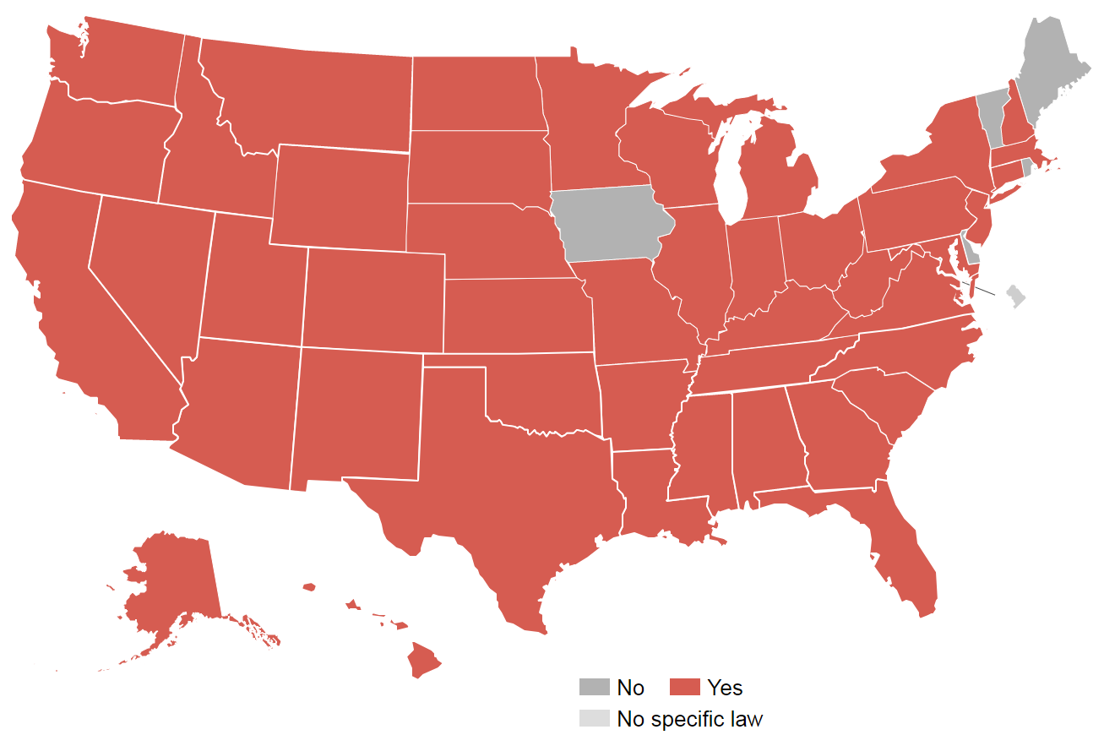
Criminalization of pregnancy and drug use
States where women have been prosecuted for drug use during pregnancy
Projects.propublica.org

Slide 39
Slide courtesy of SAMHSA presentation of 2017 NSDUH data

Slide 40
OUD during pregnancy has quadrupled
Haight SC, MMWR, 2018

Slide 41
Overdose risk dependent on treatment status
Schiff DA et al, Obstet Gynecol, 2018

Slide 42
Slide courtesy of SAMHSA presentation of 2017 NSDUH data

Slide 43
Slide courtesy of SAMHSA presentation of 2017 NSDUH data

Slide 44
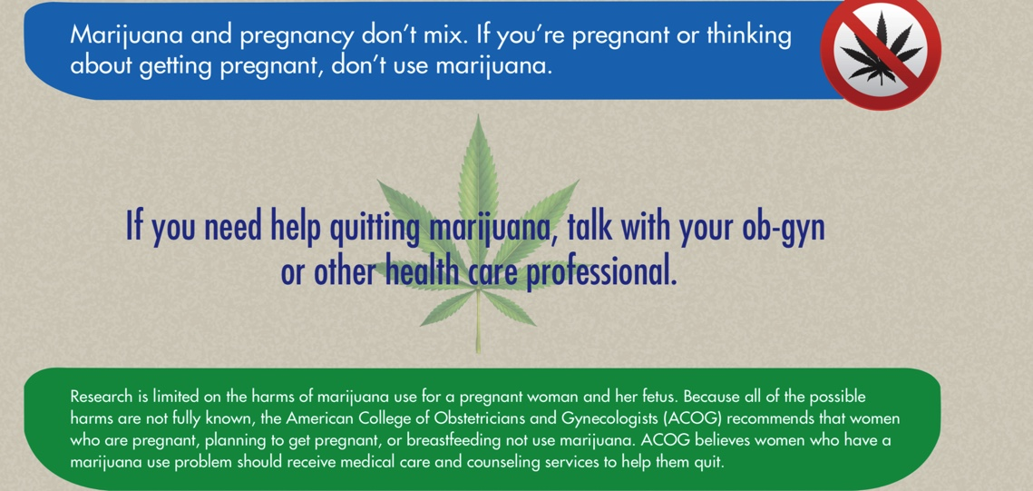
What should I tell my patients?

Slide 45
Models of care for pregnant women
https://safehealthcareforeverywoman.org/
https://store.samhsa.gov/system/files/sma16-4978.pdf
https://www.addictionpolicy.org/blog/coordinating-care-for-pregnant-and-postpartum-oud-patients

Slide 46
Acknowledgments
Samanthan Schoenberger- my stellar RA
Scott Hadland- partner in crime thinking through these issues

Slide 47
NAS incidence by payer
Tyler N.A. Winkelman et al. Pediatrics 2018

Slide 48
Treatment options for NAS
Disher T et al. JAMA Peds, 2019

Slide 49
What is toxic stress?
We often talk about how our patients development seems as though it was arrested
Can be two reasons for this- (1) substance use (2) effects of toxic stress that many of our patients have experienced
This has a direct impact on our interactions with our patients- even when caring for adults

