Slide 1
Introduction to Mutual Support Organizations and Recovery Support Services
We encourage you to use these slides when teaching. If you do, please cite this source and note any changes made.
- The Immersion Training in Addiction Medicine Programs
Sarah Bagley, MD
Director, CATALYST Clinic
Boston Medical Center
Assistant Professor of Medicine and Pediatrics
Boston University School of Medicine

Slide 2
Learning Objectives
At the end of the session, learners will be able to:
Explain the value of offering mutual support organizations as part of a “menu of options”.
Understand the differences between the various types of 12-step meetings.
List at least 4 guidelines for visitors attending a meeting of a mutual support organization.

Slide 3
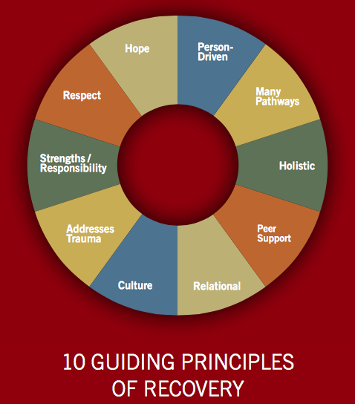
What is Recovery?
SAMHSA, 2012
Notes:
What is recovery- we have been talking about different substances while we have been here- medically focused- and that’s good because that is what we are trained to do- however, addiction is a complicated disease and really requires a holistic approach- that means that there are other supports that patients and families will see out that are outside the traditional treatment system- A process of change through which individuals improve their health and wellness, live a self-directed life, and strive to reach their full potential.

Slide 4
I have attended an Alcoholics Anonymous or Narcotics Anonymous meeting in the past.
Never
Once
2-5 times
6-10 times
11-25 times
26+ times

Slide 5
Offering Mutual Support Organizations as Part of “Menu of Options”
Addiction treatment should be individualized
Not possible to predict which combination of treatment will be effective on patient level
MSOs are the umbrella term referring to when >2 people meet and provide support to each other and are not formal treatment
Notes:
This slide is easy to go through- this is simply setting up the talk-
What is important is to be clear that AA, MHG are not treatment- they are support services-
Can be a helpful teaching tool though because many patients do access them
Today we have two goals, one is to help you understand this topic but then also prepare you for going to a meeting

Slide 6
What is Alcoholics Anonymous?
Anonymous fellowship of members with a desire to stop drinking
Founded in 1939 by Bill W. and Dr. Bob: reaching out to others to help stay sober
No central governing body
Similar groups: Narcotics Anonymous, Overeaters Anonymous, and Al-Anon
Notes:
Alcoholic Anonymous is probably the best known group- so we will spend some time talking about what it is

Slide 7
Therapeutic Elements
12 Steps: spiritual basis/necessary actions (principles)
12 Traditions: guidelines for meetings
Sponsorship
Sober environment of meetings
Forum for telling story with no judgment
Anniversaries
Slogans
Potential for social network outside of meetings
Notes:
Although this is not treatment, there are identifiable therapeutic elements

Slide 8
Process
Admitting lack over control over addiction
Recognition that higher power can give strength to achieve sobriety
Examining past mistakes
Making amends
Learning to live new life with new code
Helping others

Slide 9
Kinds of Meetings
Open, closed
Mixed, men-only, women-only, young peoples’
Speakers, Big Book, Step Study, Discussion
Smoking, non-smoking
Notes:
Note what as a visitor you can go to and what we will be going to as a group
Describe how you can find this out
For this grou- we are having you go to XX kind of meetings, we would recommend that if you were trying to organize this for a group of your chiefs that you would do the same-

Slide 10
Research has shown that:
AA attendance can reduce health care costs
Longer and more intensive AA involvement leads to better outcomes
Mechanism of effectiveness varies by gender, age and addiction severity
All of the above

Slide 11
Effectiveness of AA
Challenging to study- usually prospective, longitudinal studies occurring in treatment settings
Healthcare professionals can impact level of affiliation (Humphreys et al, 2004)
Cost-effective: attendance at MHG may lead to increased cost savings because of lower treatment costs (Kelly et al, 2009)

Slide 12
Mechanisms of Effectiveness
Self-efficacy, increased coping skills, maintain motivation for recovery over time, and adaptive changes in social networks (Kelly et al, 2009)
Increased spirituality shown to also have benefit especially for people with severe disease (Kelly, 2016)
Individuals benefit in different ways based on gender, age, and addiction severity (Kelly, 2016)

Slide 13
I have referred a patient to Alcoholics Anonymous or Narcotics Anonymous.
Never
Once
2-5 times
6-10 times
11-25 times
26+ times

Slide 14
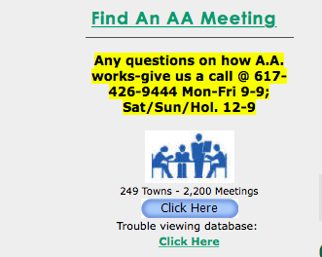
Referring a Patient
Provide access to list of local meetings, download app to find local meetings (for NA)
Encourage attending with a friend/family member and trying multiple meetings
Help choose among different types and locations of meetings (speaker, discussion, beginners’)
Talk about possible conflicts
Religion
Medications
Powerlessness
Notes:
Describe specifically how you can do this

Slide 15
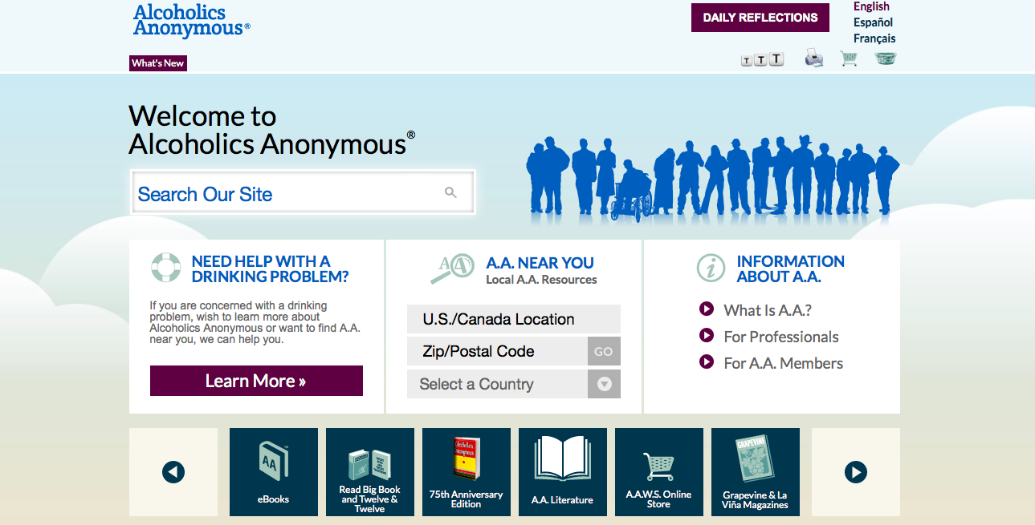

Slide 16
Role of Provider
Individuals who have sponsors and work the steps tend to do better in their recovery.
Important to ask patients if they have a sponsor and if they are working the steps.
Possible to find a temporary sponsor in the beginning if not ready to commit.

Slide 17
My primary concern about referring patients to Alcoholics Anonymous and Narcotics Anonymous is:
I don’t know much about the programs
The programs are too religious
The programs emphasize that members are powerless
I am not concerned about referring patients

Slide 18
Attending a Meeting
Contact: look up local AA website, call central service for more information
Attend only “open” meetings
Be honest and direct, introduce yourself to greeter if at door
Notes:
Add more to what Marlene and Melissa by coming down a couple of weeks ago to make sure that everything else was done has done in setting this up

Slide 19
Attending a meeting
Respect confidentiality
Feel free to join in prayer or closing ceremony
Give a few dollars if you feel comfortable
No note taking

Slide 20
Suggested script
“Hi, my name is X. We are group of physicians who are taking a course to learn about addiction so we can do a better job taking care of our patients. We understand that since this is an open meeting, it’s ok for us to attend. We really appreciate the chance to be here.”

Slide 21
Learning Objectives
At the end of the session, learners will be able to:
Explain the value of offering mutual support organizations as part of a “menu of options”.
Understand the differences between the various types of 12-step meetings.
List at least 4 guidelines for visitors attending a meeting of a mutual support organization.

Slide 22
Recovery Support Services
Recovery Support Services delivered by peers through formal structures, special roles, in various and settings (coaches, centers, schools, drop-in centers)
Notes:
Now to switch gears for the last few minutes and talk about recovery support services- this is

Slide 23
Evidence for Peer Recovery Support Services
Recent systematic review identified 9 studies and found that overall, peer support appears to have positive effect on substance use outcomes
Limited, weak data – varying definitions of peer support, lack of RCTs and comparison groups
More evidence needed to determine training, dose, context and effectiveness among target populations
Bassuk EL et al. JSAT 2016; 63:1-9

