Slide 1
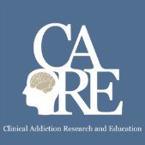


Opioids and
Chronic Pain
Immersion Training in Addiction Medicine Programs 2019
April 2019
Daniel P. Alford, MD, MPH
Professor of Medicine
Associate Dean, Continuing Medical Education
Director, Clinical Addiction Research and Education (CARE) Unit

Slide 2
Opioid Analgesics
Analgesia
  Turn on descending inhibitory systems
  Prevent ascending transmission of pain signal
  Inhibit terminals of C-fibers in the spinal cord
  Inhibit activation of peripheral nociceptors
  Variable response (not all patients respond to the same opioid in the same way)
    >3,000 polymorphisms in the human MOR gene
    Differences in pharmacokinetics (opioid metabolism)
Active the reward pathway
McCleane G, Smith HS. Med Clin N Am. 2007
Smith HS. Pain Physician. 2008

Slide 3
Opioid Risks
Allergies are rare
Side effects are common
    Nausea, sedation, constipation, urinary retention, sweating
    Respiratory depression – sleep apnea
Organ toxicities are rare
    Suppression of hypothalamic-pituitary-gonadal axis
Immunosuppression
  Increased risk of invasive pneumococcal dz and community acquired pneumonia
Worsening pain (hyperalgesia in some patients)
Addiction (Opioid Use Disorder)
Overdose
    when combined w/ other sedatives and at higher doses
Dunn KM et al. Ann Intern Med 2010
Li X et al. Brain Res 2001
Doverty M et al. Pain 2001
Angst MS, Clark JD. Anesthesiology 2006
Wiese AD, et al. Ann Intern Med. 2018

Slide 4

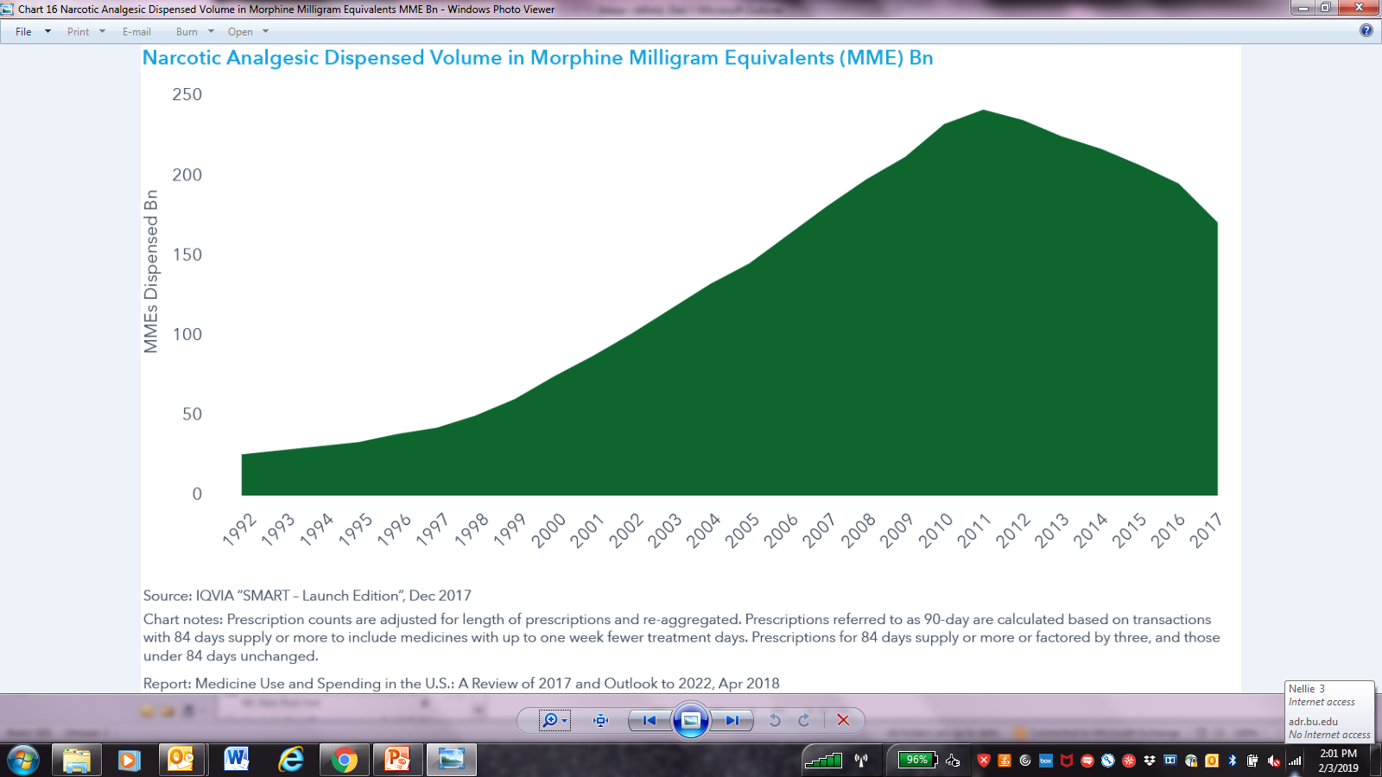
Opioid Prescribing Trends
Opioid Prescriptions Filled (in Millions)
MMEs Dispensed (in Billions)
MMEs Dispensed (in Billions)
Pezella EJ, et al. J Pain Res. 2017
2. Graph: IQVIA “Smart Launch Edition” – Dec 2017; Report: Medicine Use and Spending in the U.S.
Notes:
Opioid Prescribing Declining Since 2010
What’s interesting to note is looking at opioid prescribing over time, and really starting in the 1990s, we saw a dramatic increase in opioid prescribing. And there’s a lot of reasons for this. However, you can see that around 2010-2011, we saw a leveling off, and those are the green bars, to the point now where we’re seeing a gradual decrease, both in opioid prescribing, as well as the red line, which shows a decrease in morphine milligram equivalents. That is, we’re prescribing less opioids, and we’re prescribing less high-dose opioids. Now, the reason for this is, is it more judicious prescribing, or is it more fearful prescribing? It’s unclear. The bottom line is we are prescribing less opioids. However, you can notice that we’re still not even close to where we were in the 1990s.

Slide 5
Safer Opioid Prescribing for Chronic Pain

Slide 6
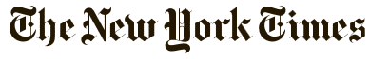
“The pain medication conundrum”
Opinion
Undertreating pain, we are admonished…it violates the basic ethical principles of medicine. On the other hand, we are lambasted for overprescribing pain medications… creating an epidemic of overdose deaths.
For patients with chronic pain, especially those with syndromes that don’t fit into neat clinical boxes, being judged by doctors to see if they “merit” medication is humiliating and dispiriting. This type of judgment, with its moral overtones and suspicions, is at odds with the doctor-patient relationship we work to develop.
“As Mr. W. and I sat there sizing each other up, I could feel our reserves of trust beginning to ebb. I was debating whether his pain was real or if he was trying to snooker me. He was most likely wondering whether I would believe him…”
Danielle Ofri, MD
Associate Professor at NYU and a physician at Bellevue Hospital, August 2015

Slide 7
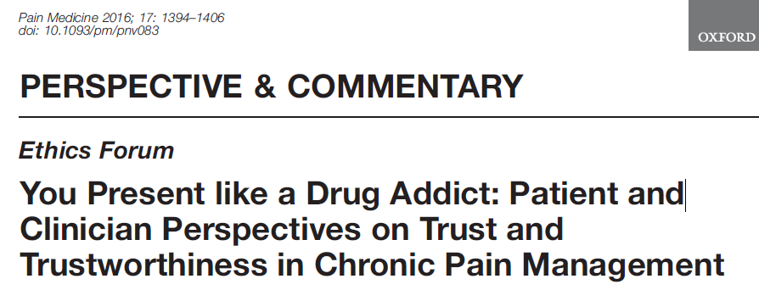
Qualitative study of adults with low back pain and their providers
Buchman DZ et al. Pain Med. 2016

Slide 8
Patient Theme 1:
Threats to Trustworthiness and Iatrogenic Suffering
Perceptions that their clinicians have demonstrated a lack of care, empathy, and respect…affecting patients’ assessments of clinician trustworthiness…negative interactions with clinicians caused them further suffering.
SUSAN: “You could just tell that he just didn’t believe me that I was in as much pain as I was. He was just very unsympathetic. He would literally walk away while I was in the middle of a sentence.”
Buchman DZ et al. Pain Med. 2016

Slide 9
Patient Theme 2:
Motive, Honesty, and Testimony
Patients’ doubts that their clinicians believed that they were being honest about their motives for seeking treatment (e.g., drug misuse or drug diversion). Patients described being perceived as untrustworthy by clinicians
LUDWIG: “When I was in [hospital] just a couple of weeks ago…the ambulance drivers just took one look at me and it was, like—the look in their eyes was like, ‘Oh, he’s just a junkie looking to get stoned.’ They didn’t believe that I was actually suffering and in pain. They thought I was faking it completely…”
Buchman DZ et al. Pain Med. 2016

Slide 10
Clinician Theme 1:
Challenges of the Practice Context
Physicians highlighted the challenging context in which chronic pain management is delivered. They recalled several difficult interactions and the impact these interactions had on their approach to care
DR. JOHN: “The things that we remember are the times that we got burned, right . . . You may get burned one in 100, but that one in 100 is enough to burn an impression in your mind that makes you wary of all patients potentially.”
Buchman DZ et al. Pain Med. 2016

Slide 11
Clinician Theme 2:
Complicated Clinical Relationships
Chronic pain management involving opioid analgesics can prohibit or destabilize the development of trusting clinical relationships. Physicians…did not necessarily see their role as a collaborative partner…[they] saw themselves in a defensive role of interrogator
DR. HENRY: “In most doctor–patient relationships we learn to listen to the patient and accept their testimony…in some instances, to be quite honest, we are interviewing the patient as if we are a police officer or a lawyer and we’re trying to find flaws in their story…So there is a different relationship here.”
Buchman DZ et al. Pain Med. 2016

Slide 12
Chronic Pain in Perspective
Chronic pain is common
Pain is subjective to the patient and the clinician
Pain can’t always be visualized
Psychiatric co-morbidities are common
Significant barriers to adequate pain care
  Negative attitudes and disparities in pain care
  Lack of decision support for chronic pain management
  Financial misalignment favoring use of medications
  Poor support for team-based care and specialty clinics
  Many competing priorities in primary care
Institute of Medicine. 2011 Relieving Pain in America. Washington DC

Slide 13

Opioids and Chronic Pain
“The problem is, there’s no evidence that opioids work for chronic pain, according to guidelines released in 2016 by the CDC”
Julia Lurie – reporter, Mother Jones,
April 27, 2018

Slide 14
Opioid Efficacy for Chronic Pain
Meta-analyses
(3-6m follow-up)
  Opioids vs Placebo (high quality studies)
  Opioids with statistically significant but small improvements in pain^{1,2} and physical functioning²
  Opioids vs nonopioids (low-mod quality studies)
  Both with similar benefits²
RCT found opioids not superior to nonopioids for improving musculoskeletal pain-related function over 12 months
[limitation: only 5% of potential patients enrolled and randomized (240/4485)]³
Two longer term follow-up studies found 44.3% on chronic opioids for chronic pain had at least 50% pain relief ⁴
1. Meske DS, et al. J Pain Res. 2018
2. Busse JW, et al. JAMA. 2018
3. Krebs EE, et al. JAMA. 2018
4. Noble M, et al. Coch Rev. 2010
Notes:
Opioid Efficacy for Chronic Pain
How good are opioids for chronic pain? What is the efficacy for chronic pain? Now, this is different than acute pain, and I would argue that the efficacy for acute pain is probably 100 percent effective. For someone who comes in with a femur fracture, we would never withhold an opioid, because we assume that they’ll be some efficacy. There may be variability in terms of how much relief somebody gets, but we wouldn’t withhold it from someone with severe pain like that.
For chronic pain, it’s completely different. We’ve already talked about it as being more like a chronic disease. Well, lately, in the past year, we’ve had a couple of meta-analyses that have looked at opioids versus placebo for chronic pain. Unfortunately, these studies only evaluate for up to three to six months, and follow-up. So, we don’t have long-term studies, but in these short-term studies for chronic pain, they show that opioids were statistically significantly better, but with a small improvement in pain, and function, versus placebo. And when they compared opioids versus non-opioids, unfortunately, these studies were low to moderate quality, they showed that both were similar in terms of benefits.
There was a study that looked comparatively between opioids, and non-opioids. It was a randomized clinical trial that found that opioids were not superior to non-opioids for improving musculoskeletal pain-related function over 12 months, so a long-term outcome. However, an important limitation is that only 5 percent of those that were randomized actually entered into the study. So, what that tells me is that someone who’s willing to enter into a study where they could be randomized to an opioid or non-opioid that they seem to do equally well on either one. What happens to that 95 percent who said, “I don’t want to be entered into the study?” It’s unclear. Two longer-term follow-up studies, up to about a year, found that 44.3 percent of individuals on chronic opioids for chronic pain had at least 50 percent pain relief. So, it’s not zero percent; it’s not 100 percent. So, it’s around 50 percent of individuals on opioids for chronic pain will get adequate pain relief.

Slide 15
Multidimensional Care for Chronic Pain
Restore Function
Studies on all pharmacologic and nonpharmacologic treatments for chronic pain are < 12 m, vast majority are < 12 w
Tayeb BO, et al. Pain Med. 2016
  Exercise
  Manual therapies
  Orthotics
  TENS
  Other modalities
  (heat, cold, stretch)
  CBT/ACT
  Tx mood/trauma issues
  Address substances
  Meditation
Physical
Psycho-behavioral
Cultivate
Well-being
SELF
CARE
Reduce Pain
Multimodal approaches are more cost-effective than single modality options
Flor H, et al. Pain 1992
Roberts AH, et al. Clin J Pain. 1993
Patrick LE, et al. Spine. 2004
Kamper SJ, et al. Cochrane Review. 2014
Medication
Procedural
  NSAIDs
  Anticonvulsants
  Antidepressants
  Topical agents
  Opioids
  Others
  Acupuncture
  Nerve blocks
  Steroid injections
  Trigger point injections
  Stimulators
  Pumps
Improve
Quality of Life
Notes:
Multidimensional Care for Chronic Pain
I think it’s important to take a multidimensional care approach. And as you can see on this slide, it really starts in the middle with self-care, teaching patients to pace themselves, and care for themselves. And there are lots of apps, and online programs that patients can interact with to learn about self-care, and that our goals include restoring function, reducing pain, improving quality of life, and cultivate well-being.
And how do we do that? Well, we can use physical modalities: Exercise, manual therapies, certainly cycle behavior therapies, CBT, cognitive behavioral therapy, meditation, and so forth; procedures like acupuncture, and nerve blocks, steroid injections, and then medications. And there are lots of medications we can choose from, including NSAIDs, anticonvulsants, topical agents, and opioids. And we’re going to talk more about those in a while.
It’s important to note, however, that studies on all pharmacologic, and non-pharmacological treatments for chronic pain, are generally assessed for less than 12 months, and the vast majority are less than 12 weeks. So, we really don’t have any long-term studies on any treatment for chronic pain. We do know from systematic reviews that multimodal approaches are more cost-effective than single modality options.

Slide 16
Benefit is Difficult to Measure
How does one measure pain, function, and quality of life?
How much improvement in pain, function and quality of life is enough?
  Is a decrease in pain from an 9-7 on a 10 point scale enough?
  Is walking 2 blocks to the store once per week enough?

Slide 17
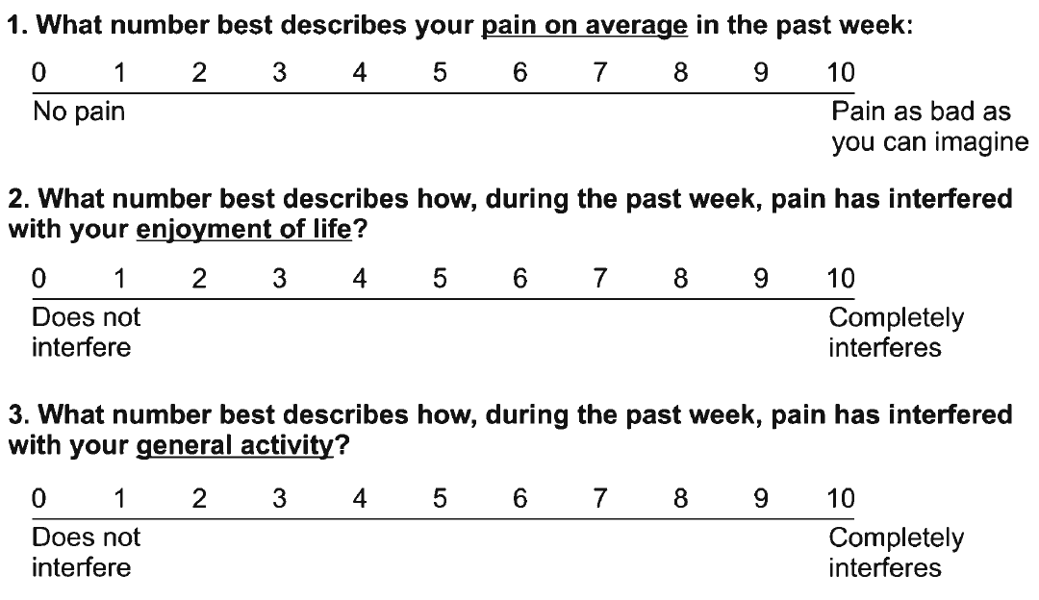
Assessing Benefit in Primary Care – PEG scale
Krebs EE, et al. J Gen Intern Med. 2009

Slide 18
Problematic Opioid Use
Systematic review from 38 studies (26% primary care settings, 53% pain clinics)
  Misuse rates: 21% - 29%
  Misuse: Opioid use contrary to the directed or prescribed pattern of use, regardless of the presence or absence of harm or adverse effects.
  Addiction rates: 8% - 12%
  Addiction: Pattern of continued use with experience of, or demonstrated potential for, harm (eg, “impaired control over drug use, compulsive use, continued use despite harm, and craving”).
Vowles KE et al. Pain. 2015
Notes:
So what is the opioid addiction risk? So when a patient comes to you and you prescribe opioids, what is the risk of them developing an addiction? And unfortunately, the true incidence and prevalence of addiction in chronic pain populations prescribed opioids is unknown. And a lot of it has to do with different criteria used to define addiction in different studies, and so it’s really all over the place.
And the range, if you look at all studies, is anywhere between zero and 50%, so that’s not particularly helpful other than to say it’s not 100%, and it’s probably not 0% either. And it’s probably more like 15 to 20%, when you look at the majority of studies.

Slide 19
Risk Factors: Overdose & Addiction
Medication-related Factors |  | Risk
 | Daily dose >100 MME | overdose | addiction
 | Long-term opioid use (>3 mo) | overdose | addiction
 | ER/LA opioid formulation | overdose
 | <2 weeks after starting ER/LA opioid | overdose
 | Combination opioids + benzodiazepines | overdose
Volkow ND et al. N Engl J Med 2016

Slide 20
Risk Factors: Overdose, Addiction & Misuse
Patient-related Factors |  | Risk
 | Mental health disorder (e.g. depression, anxiety) | overdose | addiction
 | Substance use disorder (e.g., alcohol, nicotine, illicit & prescription drug) | overdose | addiction
 | Family history of substance use disorder |  | misuse
 | Adolescent |  | addiction
 | Age <45 |  | misuse
 | Age >65 | overdose
 | Sleep-disordered breathing | overdose
 | Legal history (e.g., DUI, incarceration) |  | misuse
 | History of sexual abuse |  | misuse
 | History of overdose | overdose
Akbik H, et al. J Pain Symptom Manage. 2006
Ives J, et al. BMC Health Serv Res. 2006
Liebschutz JM, et al. J Pain. 2010
Michna E, et al. J Pain Symptom Manage. 2004
Reid MC, et al. J Gen Intern Med. 2002
Volkow ND et al. N Engl J Med 2016

Slide 21
Does my patient have an OUD?
  *Tolerance
  *Withdrawal
  Use in larger amounts or duration than intended
  Persistent desire to cut down
  Giving up interests to use opioids
  Great deal of time spent obtaining, using, or recovering from opioids
  Craving or strong desire to use opioids
Recurrent use resulting in failure to fulfill major role obligations
Recurrent use in hazardous situations
Continued use despite social or interpersonal problems caused or exacerbated by opioids
Continued use despite physical or psychological problems
*This criterion is not considered to be met for those individuals taking opioids solely under appropriate medical supervision
Mild OUD: 2-3 Criteria
Moderate OUD: 4-5 Criteria
Severe OUD: >6 Criteria
American Psychiatric Association. (2013). Diagnostic and statistical manual of mental disorders (5th ed.)
Notes:
The diagnosis of addiction really is based upon the four C’s: loss of control, compulsive use, continued use despite harm, and craving.
The disease of addiction is fairly easy to detect when it’s really apparent. And it always becomes very apparent because people can’t hide from the disease of addiction. Within six months, usually, of exposing somebody to an opioid, those who have clear addiction will surface.
That doesn’t mean that people who are abusing fall into the same category. They can have still very problematic behaviors that look like the disease of addiction, and maybe just as problematic, but may not be quite as egregious in their behaviors as those with the disease of addiction.
Addiction, you know, is not the same as physical dependency, and I think this is an important point that needs to be restated several times because too often physicians think that if you become physically dependent and you have some withdrawal that that means you have the disease of addiction. We see withdrawal symptoms from people who are physically dependent to anticonvulsants, anti-depressants, and a lot of cardiovascular medicines as well, and when we suddenly stop those medications and people go into withdrawal, they’re not addicted to those medicines any more than we would be with an opioid. However, people who are addicted to opioids will have withdrawal if they suddenly stop the use of their medicines as well.

Slide 22
Is my patient addicted to the prescription opioid?
A clinical syndrome presenting as…
  Loss of Control
  Compulsive use
  Continued use despite harm
Aberrant
Medication
Taking
Behaviors
Savage SR et al. J Pain Symptom Manage 2003
Addiction is a behavioral maladaptation
Physical Dependence is a physiologic adaptation
Notes:
Behaviors suggestive of addiction may include: inability to take medications according to an agreed
upon schedule, taking multiple doses together, frequent reports of lost or stolen prescriptions, doctor
shopping, isolation from family and friends, and/or use of non-prescribed psychoactive drugs in addition
to prescribed medications. Other behaviors which may raise concern are the use of analgesic medications
for other than analgesic effects, such as sedation, an increase in energy, a decrease in anxiety, or
intoxication; non-compliance with recommended non-opioid treatments or evaluations; insistence on
rapid-onset formulations/routes of administration; or reports of no relief whatsoever by any non-opioid
treatments. Loss of Control over use “Every time I try to limit my use to only once a week, I end up using every day.”“I try to limit myself to one drink per day but once I start, I can’t seem to stop until I pass out.”Continued use despite knowledge of harmful Consequences “I know my drug use caused my HIV but I can’t stop using.”“I have to stop using because my life is out of control, but using is the only option for me.”Compulsion to use “All I do is think about how I am going to score.”“No matter what I do, I can’t get drugs out of my mind and I feel I have to use and use a lot. Once I want to use, it is like I am on autopilot and I just have to use. I’ll do anything to get drugs.” Craving “It’s like a physical drive or urge to use. I want it from the pit of my stomach; I get sweaty just thinking about it. At times, these urges come out of nowhere, or I get them when I meet my using buddies, pass the corner where my dealer hangs out or am feeling down.”

Slide 23
Aberrant Medication Taking Behaviors
The Spectrum of Severity
  Requests for increase opioid dose
  Requests for specific opioid by name, “brand name only”
  Non-adherence w/ other recommended therapies (e.g., PT)
  Running out early (i.e., unsanctioned dose escalation)
  Resistance to change therapy despite AE (e.g. over-sedation)
  Deterioration in function at home and work
  Non-adherence w/ monitoring (e.g. pill counts, urine drug tests)
  Multiple “lost” or “stolen” opioid prescriptions
  Illegal activities – forging scripts, selling opioid prescription

Slide 24
Using “Universal Precautions”
when Prescribing Opioids
(not evidence-based but has become “standard” of care)
Misuse risk assessment
  ORT - Opioid Risk Tool
  SOAPP - Screener and Opioid Assessment for Patients with Pain
  DIRE - Diagnosis, Intractability, Risk, Efficacy
Patient Provider Agreements (PPA)
  Informed consent (risks and benefits)
  Plan of care including medication management
Frequent face-to-face visits
  Assess and document risks and benefits
Monitor for adherence, addiction and diversion
  Urine drug monitoring and pill counts
  Prescription Drug Monitoring Program (PDMP) data
Gourlay DL et al. Pain Med 2005

Slide 25
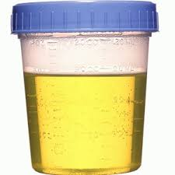
Urine Drug Testing
Objective information that can provide:
  Evidence of therapeutic adherence
  Evidence of use or non-use of illicit drugs
Discuss urine drug testing openly with patient
  “If I send your urine right now, what will I find in it?”
Document time of last medication use
One medical data point to integrate with others
  Cannot discriminate elective use, addictive use and diversion
Small risk for mislabeling, other lab error
Dedicated deceivers can beat the system
  Argoff CE, Alford DP, Fudin J et al. Pain Med. 2018
  Nagpal G et al. JAMA. 2017
  Christo PJ, et al. Pain Physician. 2011
Notes:
I would use the color urine image

Slide 26
Urine Drug Testing
Urine drug screens are usually immunoassays
  Can be done at point of care or in a lab
  Risk of false negatives due to cut offs
  Risk of false positives due to cross reactions
Unexpected findings can be verified with definitive testing using Gas Chromatography (GC) or Liquid Chromatography (LC) and Mass Spectroscopy (MS)
Identify a toxicologist/clinical pathologist for questions regarding unexpected results
Argoff CE, Alford DP, Fudin J et al. Pain Med. 2018
Reisfield GM, et al. Bioanalysis. 2009

Slide 27
Urine Drug Testing
GC-MS or LC-MS definitive/confirmation testing
  Identifies specific molecules
    Sensitive and specific but more expensive
  Measurement of urine drug levels is not a valid method of determining the amount of opioid ingested
Know opioid metabolism to interpret GC-MS or LC-MS results
  Examples:
    Hydrocodone → hydromorphone
    Oxycodone → oxymorphone
    Morphine → hydromorphone

Slide 28

Prescription Drug Monitoring Programs (PDMP)
Prescription data available to prescribers (and delegates in some states) and pharmacists
>60% states mandate use before prescribing controlled substances
PDMP use can change prescriber behaviors
Systematic review* insufficient evidence that PDMP implementation decreases nonfatal or fatal overdoses
Haffajee RL, et al. JAMA. 2015
Haegerich TM, et al. Drug Alcohol Depend. 2014
Patrick SW, et al. Health Affairs. 2016
*Fink DS, et al. Ann Intern Med. 2018
www.pdmpexcellence.org/sites/all/pdfs/Brandeis_PDMP_Report.pdf
Notes:
Prefer less busy image

Slide 29
CDC Guideline
Dowell D et al. MMWR 2016
When to initiate/ continue opioids | Opioid management | Assess risks/ address harms
1. Do not use opioids as 1st-line therapy. If used, combine w/ other therapies | 4. When starting use immediate-release opioids | 8. Use strategies to mitigate risk (eg, naloxone)
2. Before starting opioids establish realistic goals. Continue opioids only if meaningful improvements outweighs risks | 5. Prescribe the lowest effective opioid dose. Use caution with any dose, if possible avoid doses >90 mg morphine mg equivalents | 9. Review PDMP data
3. Before starting and then periodically discuss risks and benefits of opioids | 6. Prescribe short durations for acute pain. <3 days often sufficient; >7 days rarely needed | 10. Use urine drug testing
 | 7. Evaluate benefits and harms within 4 weeks of starting and at least every 3 months thereafter | 11. Avoid concurrent benzodiazepines
 |  | 12. Offer/arrange treatment for patients with an OUD

Slide 30
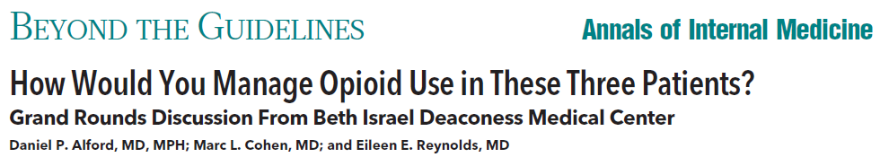
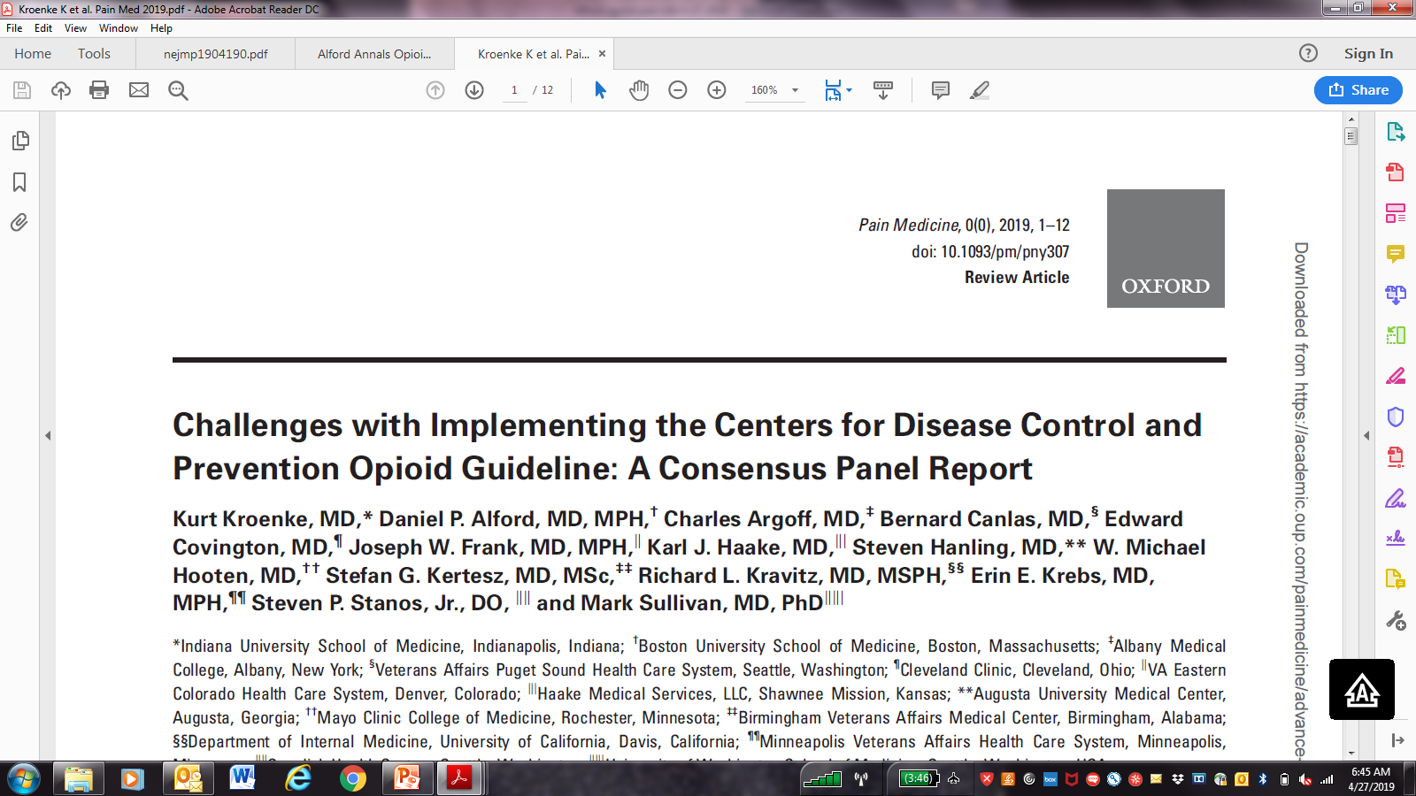

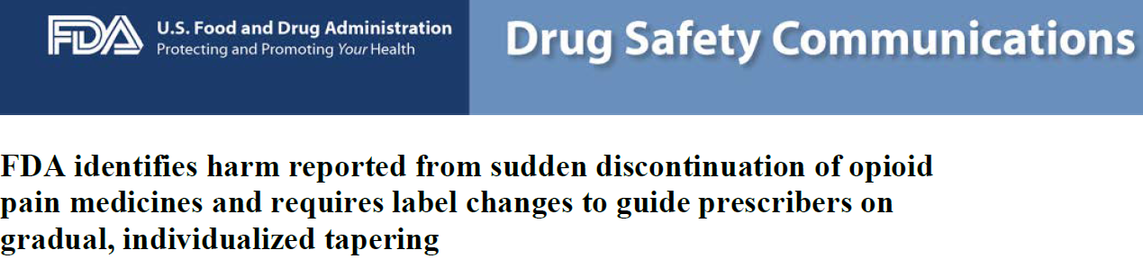
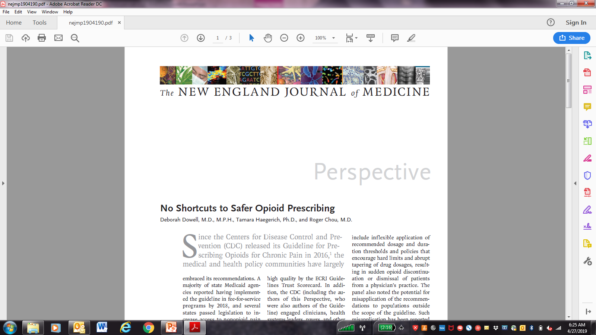
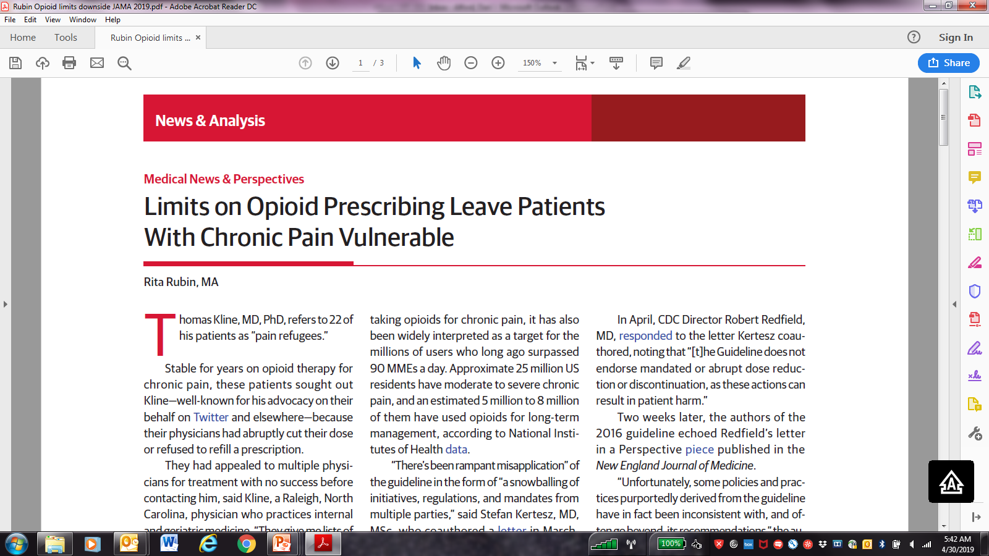
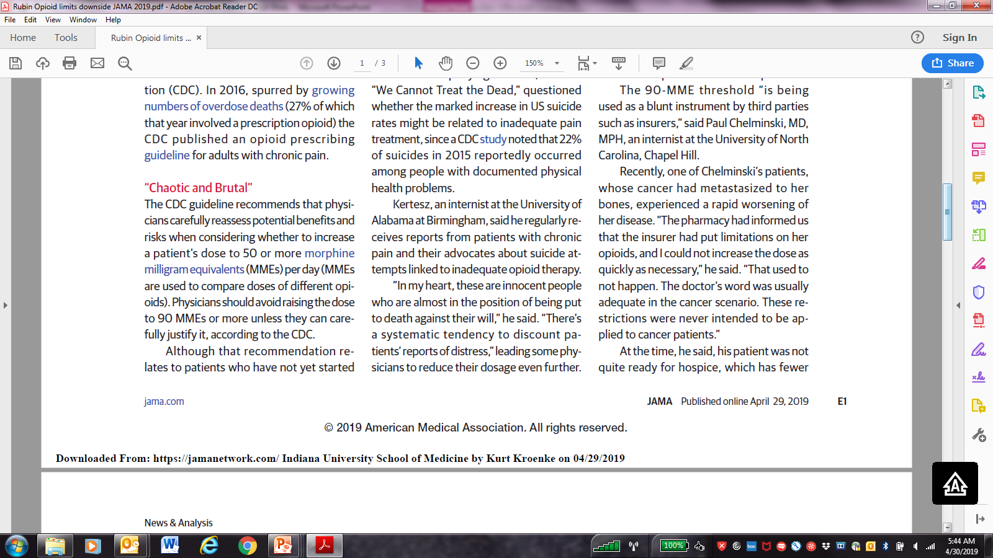

Slide 31

Opioids for Chronic Pain
What is the clinician’s role?
VS.
Use a risk-benefit framework
Judge the opioid treatment, not the patient
Nicolaidis C. Pain Medicine 2011
31

Slide 32
Continuation of Opioids
Before writing the next opioid prescription…you should be convinced that there is…
  …benefit (pain, function, QOL) and…
  …absence of harm
Despite subjective assessments (benefits/harms), it should be documented at each visit

Slide 33
Discontinuing Opioids
Do not have to prove addiction or diversion - only assess and reassess the risk-benefit ratio
If patient is unable to take opioids safely or is nonadherent with monitoring then discontinuing opioids is appropriate even in setting of benefits
Need to determine how urgent the discontinuation should be based on the severity of the risks and harms
Document rationale for discontinuing opioids
You are NOT abandoning the patient.
You are abandoning the opioid therapy.
Notes:
You don’t have to prove that they are addicted, nor do you have to prove that they’re diverting. You only have to believe that that’s a likely occurrence and you’ve analyzed the situation, you’ve assessed it, you’ve done your risk/benefit analysis and you just are ready to move forward with what you think is the safest for that patient and that is to discontinue the use of the opioids.
Again, this doesn’t mean you discontinue treating the person for their pain, but it means that you won’t prescribe them an opioid.
So, there are just some people who cannot safely take their medications, and they’re not going to adhere, they’re not going to follow the monitoring, and it is the safest and the only real option for some of those patients.
You’ll need to determine though whether this is an urgent situation, that is whether or not you need to discontinue rapidly or whether this is something that occur over a period of time. And that depends largely upon what drives you to the decision to discontinue the opioids.

Slide 34
Tapering Opioids
No validated protocols in patients on opioids for chronic pain
Systematic review found very low quality evidence suggests that several types of opioid tapers may be effective and that pain, function, and quality of life may improve for some patients with opioid dose reduction
Recent study found 62% of patients in a pain clinic remained in a voluntary, patient-centered opioid taper over 4 m with median decreases in morphine equivalent daily dose from 288 mg to 150 mg
  Likelihood of >50% opioid dose reduction was not predicted by starting dose, baseline pain intensity, years prescribed opioids, or any psychosocial variable
  Neither pain intensity nor pain interference increased with opioid reduction
Darnall BD et al. JAMA Intern Med. 2018
Frank JW et al. Ann Intern Med. 2017

Slide 35
Communication Exercise
Established Patient with an Unexpected Urine Drug Test Result

Slide 36
Patient
Established follow up
Chronic posttraumatic knee and ankle pain s/p infected compound fractures after a motorcycle accident 5 years ago
Pain medications
  Hydrocodone/Acetaminophen 1 tablet 3x/day
  Ibuprofen 800 mg 3x/day
PEG (Pain, Enjoyment of Life, General Activity) scores are always 4-5 out of 10
Works fulltime as a cashier in a hardware store
Denies current illicit drug use
Urine drug testing positive for hydrocodone and cocaine

Slide 37
Physician Tasks
In 2 minutes and 53 seconds…
  Discuss patient’s cocaine-positive urine drug test
  Discuss change in treatment plan based on this unexpected urine drug test result
Patient Task
In response to the physician telling you about your urine test results…state “The test must be wrong…I am not using drugs”
Then respond appropriately based on how the physician responds…
Notes:
Through the next three clinical presentations, will elucidate how to determine when opioid analgesics are indicated, how to assess for opioid misuse risk, how to talk to patients about opioid risks and benefits, and how to monitor and manage patients on long-term opioid therapy.

Slide 38
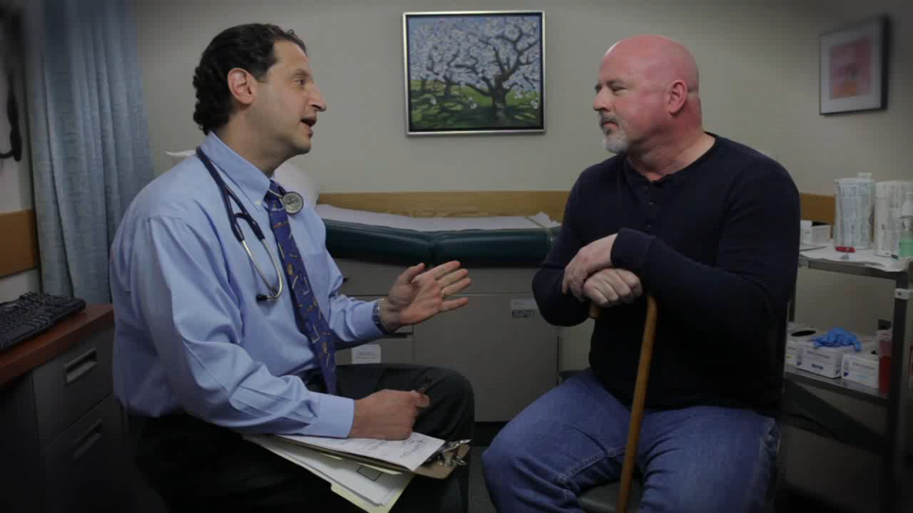
Demonstration Video
Notes:
Through the next three clinical presentations, will elucidate how to determine when opioid analgesics are indicated, how to assess for opioid misuse risk, how to talk to patients about opioid risks and benefits, and how to monitor and manage patients on long-term opioid therapy.

Slide 39
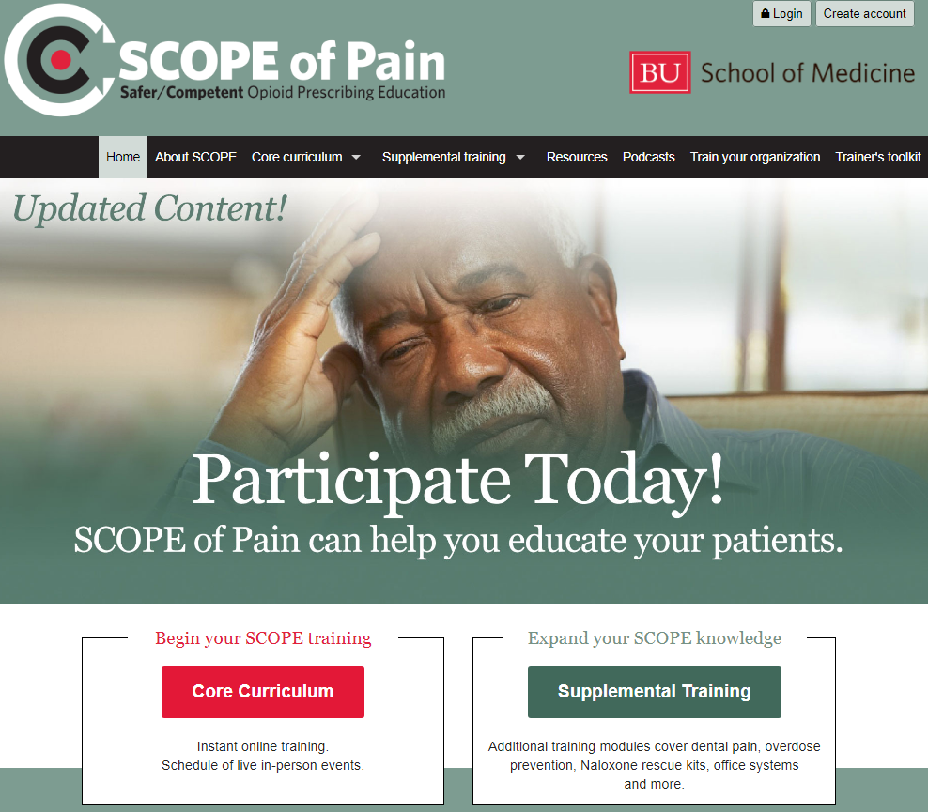
www.scopeofpain.org

Slide 40
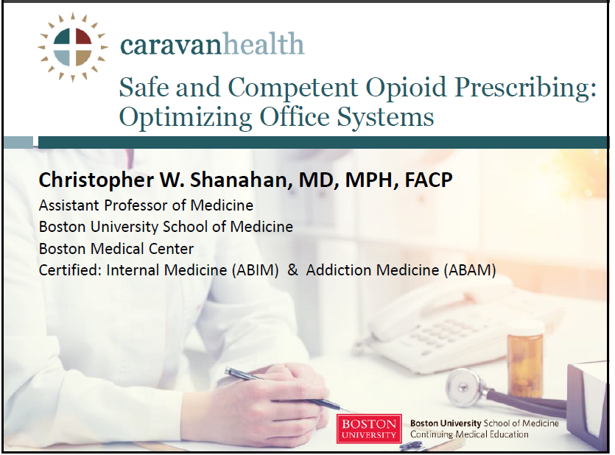
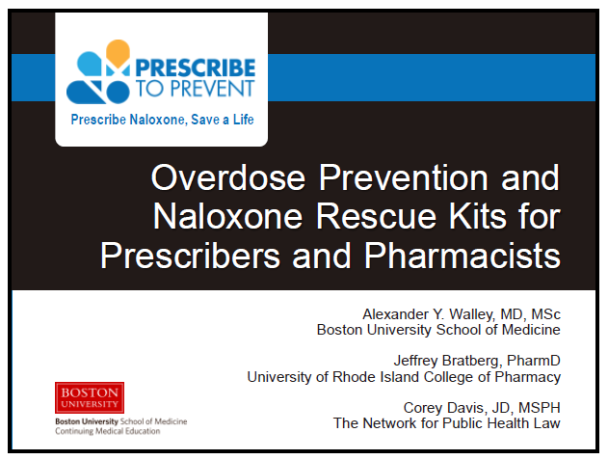
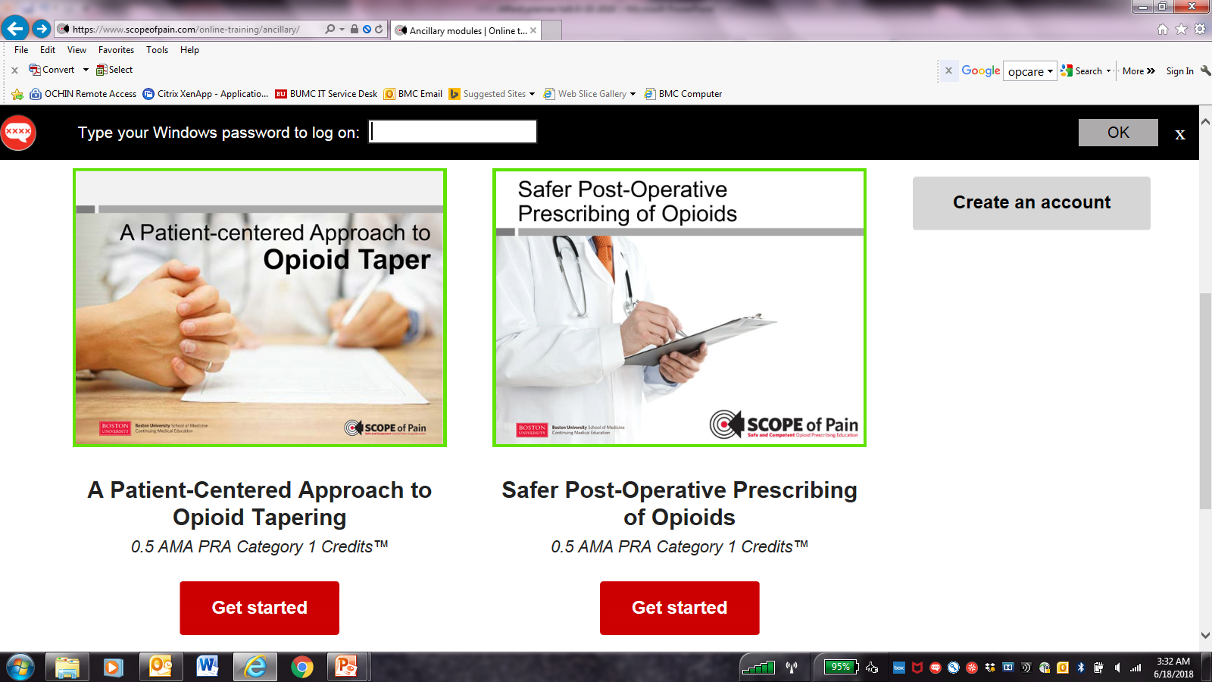
www.scopeofpain.org

Slide 41
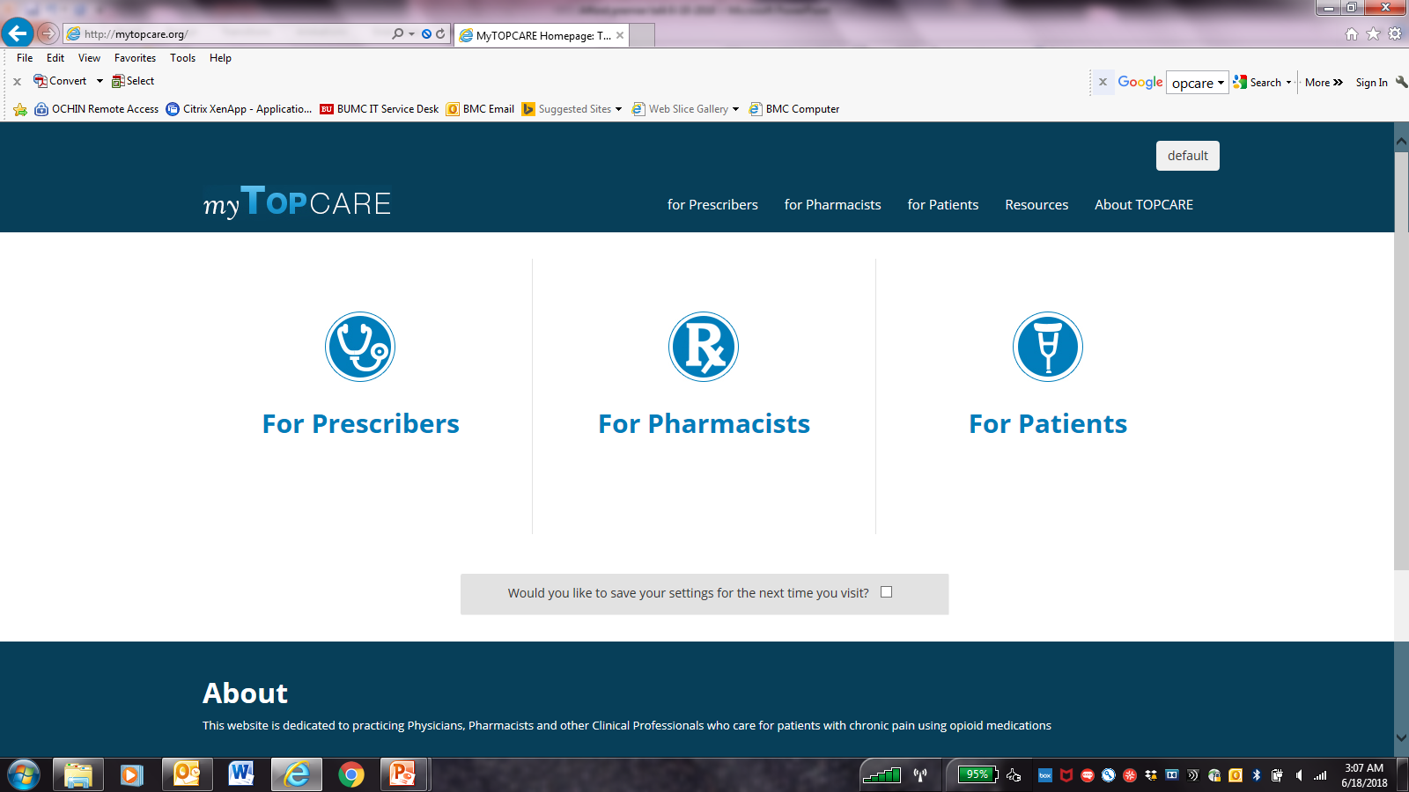
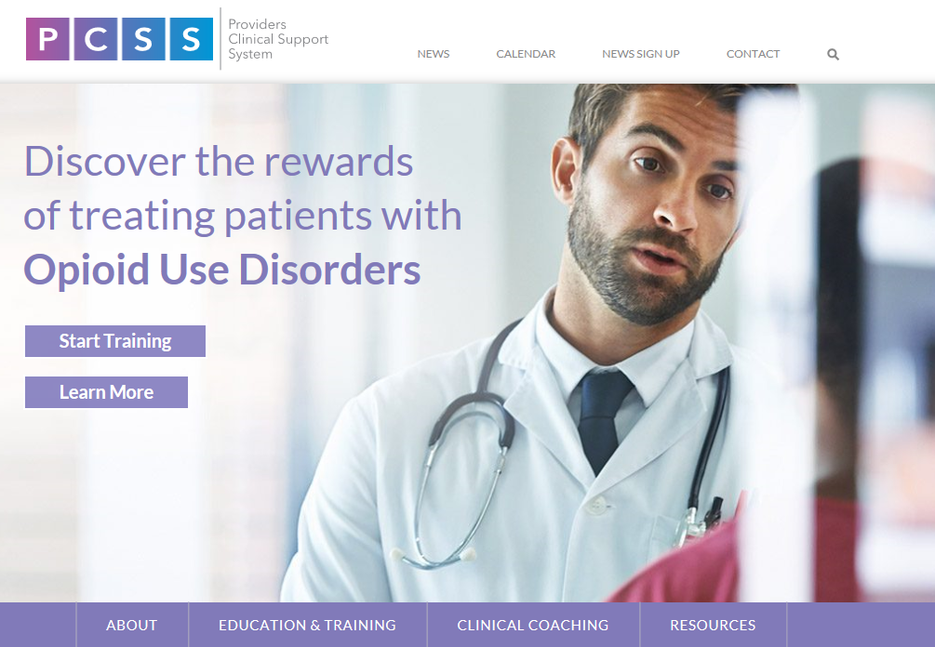
Resources
http://mytopcare.org/
Transforming Opioid Prescribing in Primary Care system change in delivery of primary care services to decrease prescription opioid misuse for patients with chronic pain
https://pcssnow.org/
PCSS is funded by SAMHSA to train primary care providers in the evidence-based prevention and treatment of opioid use disorders and treatment of chronic pain

