Slide 1
Immersion Training in Addiction Medicine Programs CRIT, FIT, JFIT
funded by the National Institute on Drug Abuse (NIDA R25DA013582)

Slide 2
Introductions
Name
Are you a…
Incoming Chief Resident
Faculty Mentor
Junior Faculty
Fellow
Specialty
Institution/State

Slide 3
Samples of CRITter Accomplishments
Alex Walley, MD CRIT 2003
University of California, San Francisco
Adam Rose, MD CRIT 2004
Montefiore Medical Center, NY
Notes:
Participant introductions

Slide 4
Samples of CRITter Accomplishments
Aaron D. Fox, MD, MS CRIT 2007
Montefiore Medical Center, NY
Andrew Chang, MD CRIT 2011
NYU Medical Center
Notes:
Participant introductions

Slide 5
Samples of CRITter Accomplishments
Angel Brown, MD CRIT 2011
University of Tennessee
Allison Ruff, MD CRIT 2014
Cleveland Clinic
Notes:
Participant introductions

Slide 6
Samples of CRITter Accomplishments
Rosita Frazier, MD CRIT 2011
University of Texas
Patricia Ng, MD CRIT 2015
Brown University

Slide 7
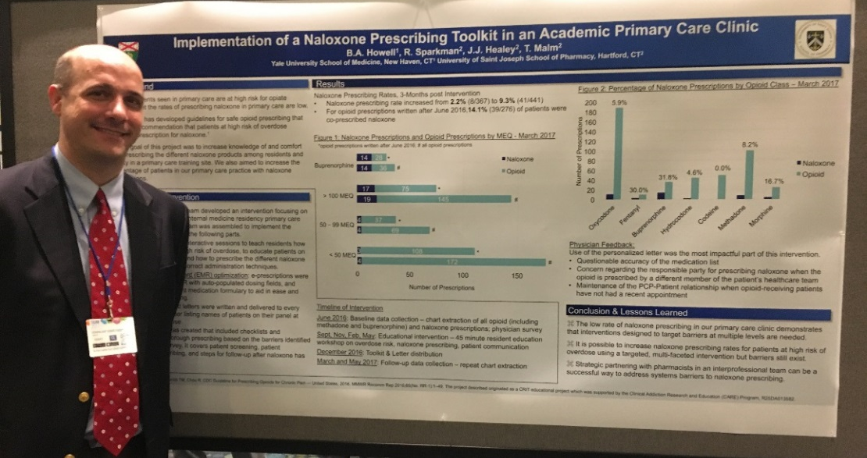
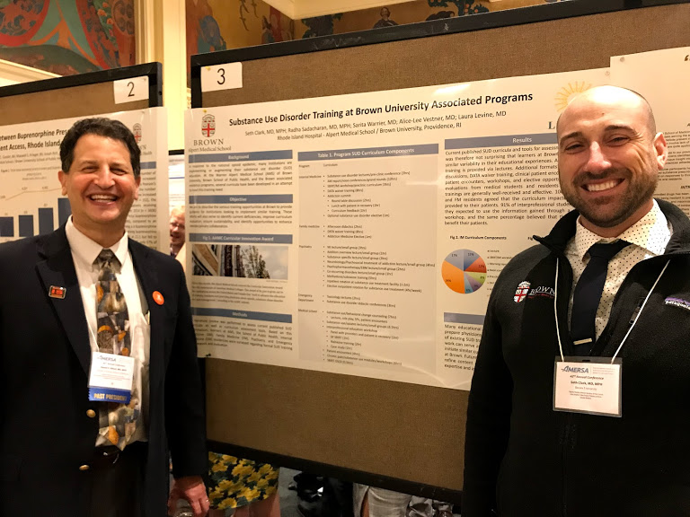
Samples of CRITter and CRIT-FM Accomplishments
Benjamin Howell, MD CRIT 2016
Yale University
Seth Clark, MD CRIT 2017
Brown University

Slide 8
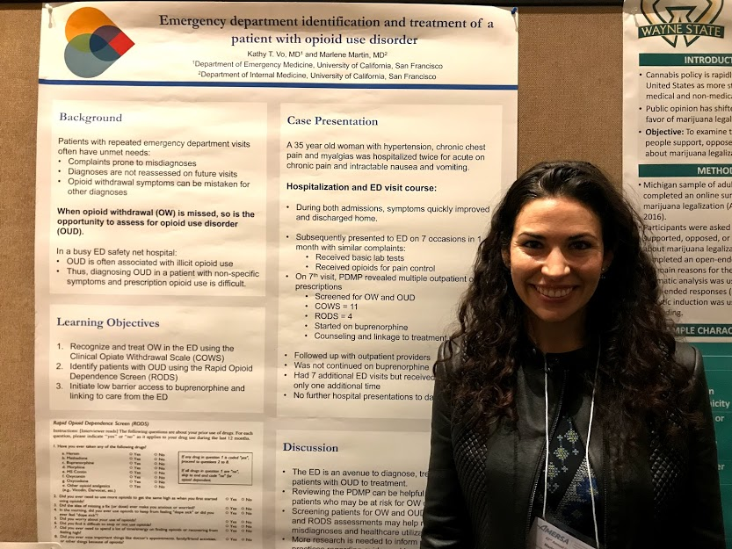
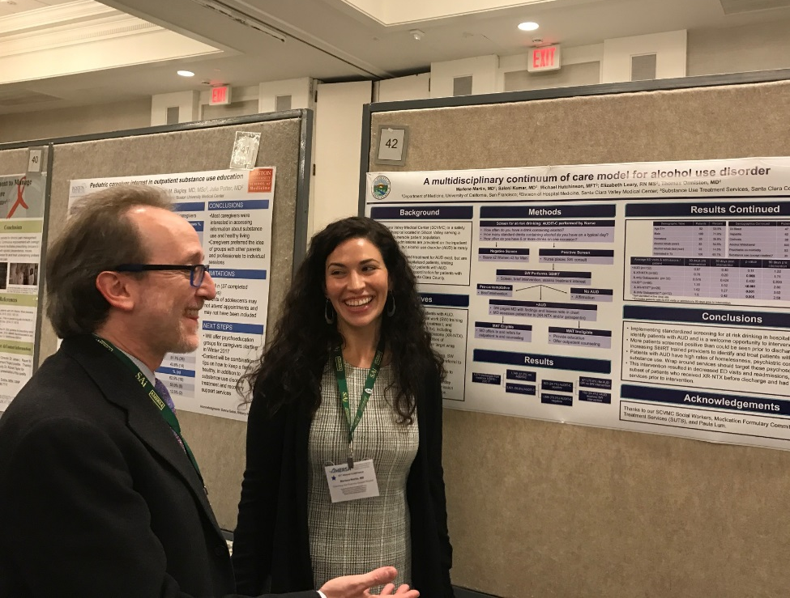
Samples of CRITter and CRIT-FM Accomplishments
Marlene Martin, MD CRIT-FM 2017
Stanford University
AMERSA 2018
Marlene Martin, MD CRIT-FM 2017
Stanford University
AMERSA 2017

Slide 9
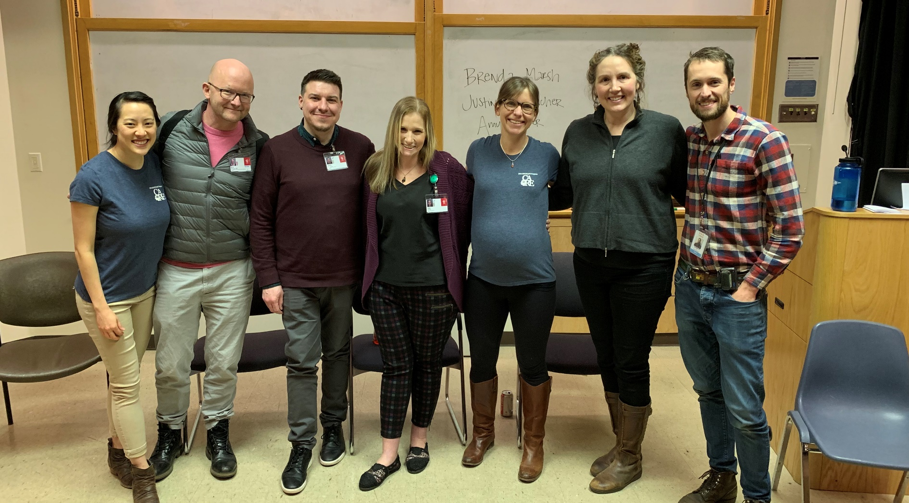
Samples of CRITter and CRIT-FM Accomplishments
“Faces of Recovery” Addiction Medicine Panel
Suvi Neukam (CR), Kristy Duggan (CR), Andy Seaman (FM), 2018
Oregon Health Sciences University

Slide 10
CRITter and FITter Accomplishments
Alison Rapoport, MD FIT 2015
Beth Israel Deaconess Boston, MA
Jessica Taylor, MD CRIT 2015
Beth Israel Deaconess Boston, MA
Alison Rapoport, MD FIT 2015
Beth Israel Deaconess Boston, MA

Slide 11
Samples of FITter Accomplishments
Kinna Thakarar, MD FIT 2013
Boston Medical Center
Josh Barocas, MD FIT 2016
Massachusetts General Hospital

Slide 12
Samples of FITter Accomplishments
Alysse Wurcel, MD FIT 2013
Tufts Medical Center
Elana Rosenthal, MD FIT 2014
Beth Israel Deaconess Medical Center

Slide 13
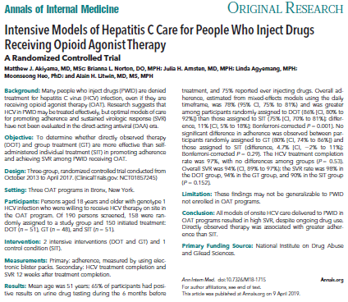
Samples of FITter Accomplishments
Matthew Akiyama, MD, MSc FIT 2015
NYU Langone Medical Center/Bellevue Hospital Center

Slide 14
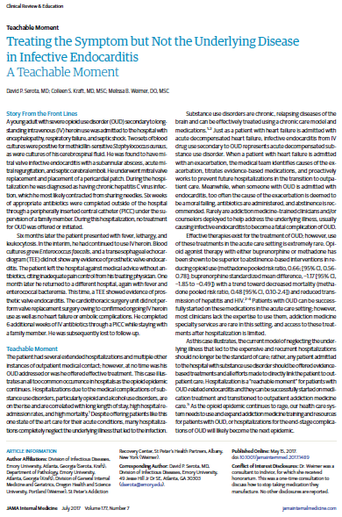
Samples of FITter Accomplishments
Amanda Noska, MD FIT 2014
Brown University/Lifespan Hospitals
David Serota, MD FIT 2017
Emory University

Slide 15
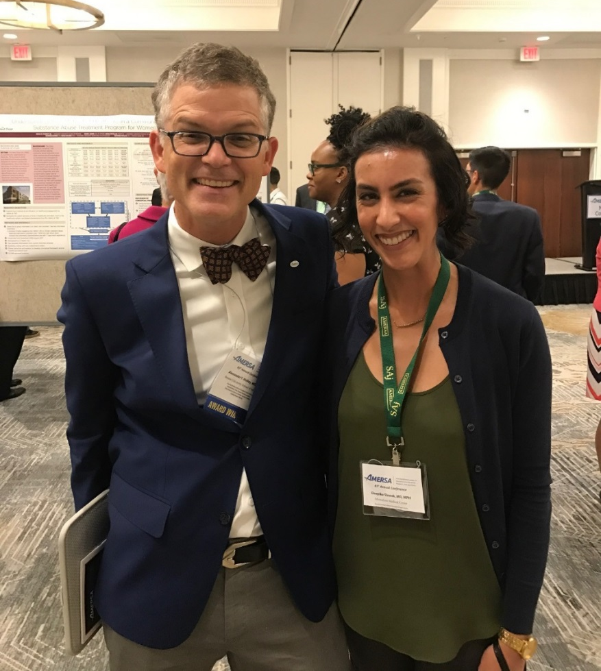
Samples of FITter Accomplishments
Lamia Haque, MD FIT 2017
Yale University
Deepika Slawek, MD FIT 2016
Albert Einstein School of Medicine, Montefiore

Slide 16
Audience Response Sample
What is your role at the 2018 Immersion Training in Addiction Medicine Programs?
Chief resident
Faculty mentor
Junior faculty
Subspecialty fellow (FIT)
Addiction fellow
Program faculty
Staff
Text MARLENELIRA890 to 22333 once to join, then A, B, C…
Click Here For Results

Slide 17
Announcements…

