Slide 1
GME URiM Recruitment Report for AY25
September 2024
Shawnda Walker
GME URiM Program Manager

Slide 2
02 | Overall URiM Trainee Data AY25
03 | Incoming PGY1 Trainee Data AY25
04 | BMC GME Recruitment Efforts
05 | BMC GME Trainee Support

Slide 3
Overall (Resident and Fellow Combined) URiM Trainee Data AY25
As a result of our recruitment efforts, we continue to perform above the ACGME national active URiM trainee average of 16%
Source: New Innovations data AY25 and ACGME Data Resource Book AY24

Slide 4
Percent of Incoming PGY1 URiM Trainee Data AY25
Our recent incoming URiM PGY1 recruitment results have remained consistently higher than in past academic years.
* New Innovations data AY25

Slide 5
BMC GME Recruitment Efforts
BMC GME is represented at URiM Medical Student conferences across the country throughout each academic year.
BMC's GME program hosts virtual events for underrepresented in medicine (URiM) students throughout the academic year.
Event | Date
BMC GME Virtual Faculty Showcase - An opportunity for medical students and others interested in learning more about BMC Faculty and our GME programs. | 10/3/2024 12-2 PM EST 1/17/2025 12-2 PM EST Virtual
BMC GME Fellowship URiM Virtual 2nd Look -An opportunity for URiM Trainees who have interviewed with Boston Medical Center (BMC) and are considering BMC for Fellowship to speak to current URiM Fellows and Faculty at BMC. | 10/10/2024 5:00-6:00 PM EST Virtual
BMC GME Residency URiM Virtual 2nd Look - An opportunity for Underrepresented in Medicine (URiM) medical students who have interviewed with Boston Medical Center (BMC) and are considering BMC for residency to speak to current URiM trainees at BMC. | 1/22/2025 5 – 6:30 PM EST 2/5/2025 5:00-6:30 PM EST Virtual

Slide 6
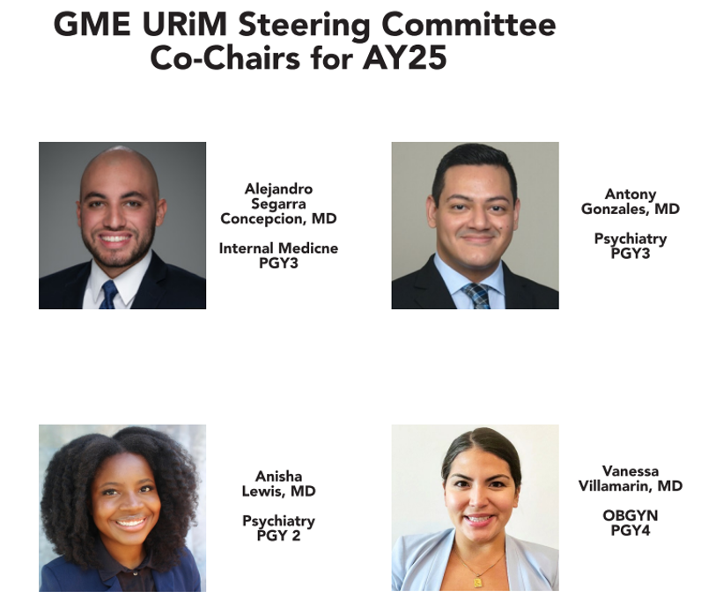
BMC GME URiM Trainee Support
BMC GME and the URiM Steering Committee host in-person and virtual events throughout the year to encourage cross-program relationship building and mentorship.
URiM Steering Committee Events and Programs
Celebrating Our History Black History Month (February)
Celebrating Our History Asian and Other Pacific Islander Heritage Month (MAY)
Welcome to BMC GME URiM Intern Social (July)
GME URiM Martha’s Vineyard Retreat (Aug)
Celebrating Our History Hispanic Heritage Month (Sep 15 – Oct 15)
Celebrating Our History American Indian Heritage Month (November)

Slide 7
BMC GME URiM Trainee Support
GME Diversity Equity and Inclusion Council
BMC and GME are dedicated to building an inclusive workplace where everyone is valued for their differences, whether visible or not. The DEI Council's goal is to tackle and reduce micro- and macro-aggressions in the workplace by identifying patterns of discriminatory behavior and addressing them.
GME DEI Fellows
GME DEI Fellows participate in the DEI Council and play a key role in addressing concerns. They provide support and guidance in reporting and resolving issues, emphasizing trust, support, and understanding.
GME URiM Intern Cohort Mentorship Program
The goal of this program is to create a supportive community for our new interns who self-identify as URiM. We aim to achieve this by organizing events that help you build strong relationships with mentors who can relate to your experiences as interns, fostering connections with other URiM trainees across different programs, and promoting mental and physical wellness through both in-person and virtual events.

Slide 8
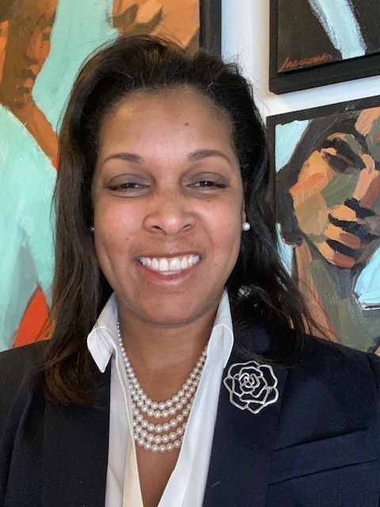
BMC GME URiM Trainee Support
GME URiM Program Manager
Shawnda Walker, who has 7 years of experience at BMC in various management roles, currently holds the position of GME URiM Program Manager. In this capacity, she skillfully manages GME URiM recruitment and support initiatives, and serves as a trusted advisor for new trainees adjusting to life in Boston and at BMC.
For questions and for further information regarding our recruitment events, please contact Shawnda.Walker@bmc.org.

