Slide 1
Advanced Practice Provider Council Town Hall 10/21/2021

Slide 2
Advanced Practice Provider Council Town Hall Agenda
Announcements: Mary Ellen Killion, NP
Speakers introductions: Rosha Foreman, CNM and Jenna Meade, NP
Skills and Thrills: Additional clinical skills training opportunities for APPs at BMC
Office based Substance Use Disorder Treatment, OBAT, Kristin Wason
Office based Hep C treatment, Marielle Baldwin
Long Acting Reversible Contraception (LARC) placement and International Board Certified Lactation Consultant (IBCLC), Emily Swisher-Rosa

Slide 3
APP Celebration Weeks!
Certified Nurse Midwife Week: October 3 – October 9
Physician Assistant Week: October 6 – October 12
Nurse Practitioner Week: November 7– November 12
Help us celebrate through BMC’s Social Media!
Contact Abigail Brann (Abigail.brann@bmc.org) or Mary Ellen Killion

Slide 4
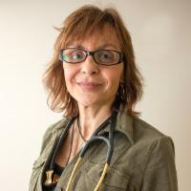
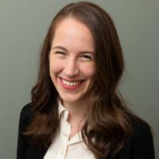
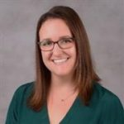
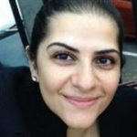
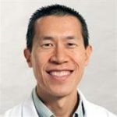
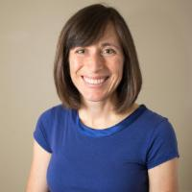
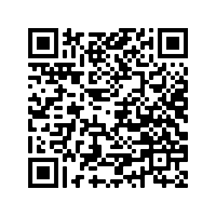
BUMG Virtual Clinical Excellence Awards Wednesday, October 27th, 12-1:00 PM
 | Charlene M. Sylvestre, MSN Hematology APP Excellence | Alice Cruikshank, MS Pediatrics APP Excellence
 | Cynthia A. Rupp, MD Anesthesiology New Faculty Excellence | Aala Jaberi, MD Nephrology New Faculty Excellence
 | Henri Lee, MD General Internal Medicine Excellence in Leadership | Sara N. Stulac, MD Pediatrics ﻿Excellence in Care
BUMG Clinical Excellence Society Inductees
Antonieta Camara, MSN, Internal Medicine
Kirsten Austad, MD, MPH, Family Medicine
Vincent Lau, MD, Neurology
Ilse Castro-Aragon, MD, Radiology
Vaishali Sanchorawala, MD, Amyloidosis
Lauren Cipriani, PA-C, Orthopedics
Register
Here!

Slide 5
APP Open Call
BMC and BUMG Committees have openings for Advanced Practice Providers
Be on the lookout for an announcement in early November
Application process involves submitting a short statement of interest and an updated CV

Slide 6
Advanced Practice Provider Council October, 2021 Roster
Mary Ellen Killion, NP, Chair | Kettie Louis, NP
Frances Blevins, PA | Rosha Forman, CNM
Lauren Cipriani, PA | Douglas Grunseich, CRNA
Lauren Hartnett, PA | Hee-Young Park, PhD Assistant Dean of Faculty Affairs
Cherisse Carlo, NP | Angela Reffel, PA Physician Assistant Program Director
Melissa Jacobs, NP | Jordan Spector, MD DIO ACGME Designee
Denise Eckstrom, NP | Chris Manesseh, MD Chief Medical Officer Designee
Kerin Flanagan, NP | Nicole Lincoln, NP Associate Chief Nursing Officer
Jenna Meade, NP

Slide 7
Emily Swisher-Rosa, NP, OBGYN LARC, IBCLC Emily.SwisherRosa@bmc.org

Slide 8
Nexplanon trainer for Organon (previously Merck)
Contact sales representative
Complete paperwork
Complete clinical trainer training
Await invitations to provide trainings
Excellent avenue for learning and becoming familiar with public speaking, teaching, and networking with other area providers and programs
Well paid

Slide 9
IBCLC as a provider
IBCLC= International Board Certified Lactation Consultant
Different pathways
Lay person
RN
Provider
Take week long CLC (Certified Lactation Consultant) course OR take coursework online (highly recommend in person for this)
Log clinical hours (think initial prenatal visits, postpartum visits, or can volunteer at Baby Cafes or other similar drop in groups as CLC—requires 1000 clinical hours)
Take 90 hours of coursework (online modules work well)
Sit for exam (maintenance every 3 years, every 6 requires reexamination)

Slide 10
WHNP--> CNM
Requires post master's certificate through accredited program
Duration of program and exemption from ambulatory clinical hourse dependent on program and nature of current practice
For non- WHNP or WHNP without prenatal experience, still able to complete program as advanced placement (i.e. no pharm, does not require additional Master's)
Expands practice scope and career growth

Slide 11
Office-Based Hepatitis C (HCV) Treatment
Marielle Baldwin, MD, MPH
Assistant Professor, Department of Family Medicine
Boston University School of Medicine
Medical Director, START (Stimulant Treatment & Recovery Team)
Director, FM Residency Addiction Pathway
marielle.baldwin@bmc.org
Notes:
I’m core faculty for the BU family medicine categorical residency and the family medicine-psychiatry dual residency program.
I’m a family medicine physician, and I practice full-spectrum outpatient primary care including women’s health and outpatient addiction medicine at BMC (Melnea Cass Clinic with Jenna Meade).
I also teach and precept for the residency program, round on our inpatient family medicine service with residents, and direct the addiction track for the residency out of south boston CHC and Greater Roslindale Medical & Dental Center.
I do some addiction focused and health equity focused research within our department, and administratively, I’m the medical director for START (Stimulant treatment and recovery team), a clinic for patients who use stimulants like methamphetamine and cocaine. It’s based in FM and is a collaboration between OBAT, psychiatry, project trust. As the former director of our outpatient FM HCV program, now led by Dr. Laura Adam, I am here to talk with you about te value of outpatient HCV work in the primary care or non-specialty setting.

Slide 12
HCV Management: A Life-Saving Skill
Global estimates of significant M&M from HCV:
71M people living with chronic HCV worldwide (3.9M in US)
>400K deaths from HCV-related liver disease worldwide (in 2013)
National Academies of Sciences, Engineering, & Medicine recommends:
removing restrictions to offering DAAs
AASLD partnering w/PCPs to build capacity for treatment
ASCEND trial (600 patients w/HCV to PCP vs NP vs specialists)
No statistically sig difference in achieving SVR for PCP/NPs vs specialists (Tran, 2018).
Notes:
References:
Tran, T. “HepC: Who should treat the HepC Virus? Role of the primary care provider”. Clinical Liver Disease, 11:3, 66-68, 3/2018.
DAAs (direct acting anti-hepatitis agents)
Why is this skill important for your practice? Maybe an example of positive patient experience at BMC? Does it expand the medical home? keep care local and improve care coordination? decrease stigma? etc?
High prevalence of infection with sig assoc M&M (show data for BMC)
Highly effective DAAs
Evidence that NPs as effective in achieving SVR in patients (without decomp cirrhosis) as specialists
Any initial hesitancy or management/operations push back to acquire the skill? Not at BMC, yes to residents at SBCHC
If so, how you broke the barrier and now is skill second nature to you and others in practice site?
Made the case for prevalence of HCV
PCPs/NPs – integration into primary care data
340B
https://340binformed.org/2019/05/340b-helps-achieve-hepatitis-c-gold-standard-at-boston-medical-center/
https://cherishresearch.org/2019/04/340b-hcv-primary-care/
Not reinventing the wheel (Proposal with workflow)
What other benchmarks are achieved- decreased ED admits, shorten LOS during admission, care coordination/consult when inpatient, etc?
Could this model or has this model been replicated throughout BMC? Where do you hope to this this skill used at BMC? Could be used – OB

Slide 13
Models of Outpatient HCV
BMC Family Medicine
Providers (NP, PA, MD providers trained)
Maggie Beiger, NP (Director of HCV Services, BHCHP)
Team: case manager, pharmacy liaison, pharmacist, public health infrastructure
Numbers to date (since 2019): 85 referrals, 42 treatment starts, 23 SVR
Operational support (scheduling flexibility/assistance, provider manual)
Anecdotal benefits: medical home model (fewer access/transportation/campus navigation barriers), improved engagement (trusted PCP)
Other BMC HCV Clinics
GIM, GI, ID, Catalyst, Faster Paths; ED linkage to care through FOCUS
South Boston Community Health Center
Notes:
To date there have been 85 referrals, 42 treatment starts, and 23 patients achieved SVR.
(only 1 patient did not achieve SVR after completing treatment, 1 never completed treatment, 10 are still actively on treatment and 7 are just waiting to complete their SVR labs).

Slide 14
Learning Resources
University of Washington National Hepatitis Center (free online modules/content): https://www.hepatitisc.uw.edu/
National AIDS Education & Training Center Program (HIV-HCV Co-infection Curriculum): https://aidsetc.org/hivhcv
Practice Guidelines – American Association for Study of Liver Diseases (AASLD): https://aasldpubs.onlinelibrary.wiley.com/doi/full/10.1002/hep.31060
SYNChronicity National Conference, Fall (HIV, HCV, STI, LGBTQIA Health; clinicians, RNs, CMs): https://healthhcv.org/
International Network on Health & Hepatitis in Substance Users (INHSU), Fall Conference (public health focused): https://inhsu.org/2021-conference/
Notes:
American Association for the Study of Liver Diseases (AASLD)
What is involved in the advance skills training?
- Go through the UWA course
We can share provider manual and workflow (GIM or FM)
If at BMC, would want to work with pharmacy team to embed into your practice
How APP can sign up for the skill/who should they contact?
If clinic or department interested in developing a HCV program -> Glory Ruiz, MD – Director of Public Health Programs at BMC

Slide 15
Skills and Thrills: Additional clinical skills training opportunities for APP at BMC
Kristin Wason, MSN, AGPCNP, CARN
Office Based Addiction Treatment Training and Technical Assistance Program (OBAT TTA+)

Slide 16
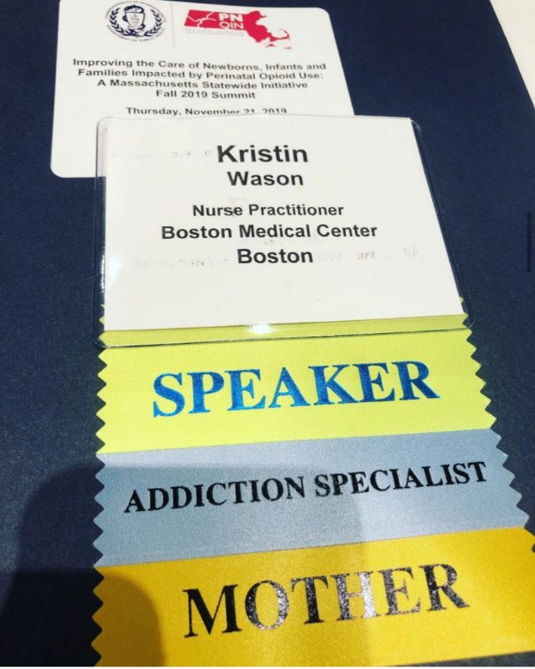
About Me
Primary Care Provider within Women’s Health suite of General Internal Medicine
Addiction Clinical Educator with OBAT TTA +
Associate Director of Grayken Addiction Nurse Fellowship
Clinical Expert for Provider Clinical Support System and SAMHSA
Focused on advancing care of persons who use substances and nursing practice

Slide 17
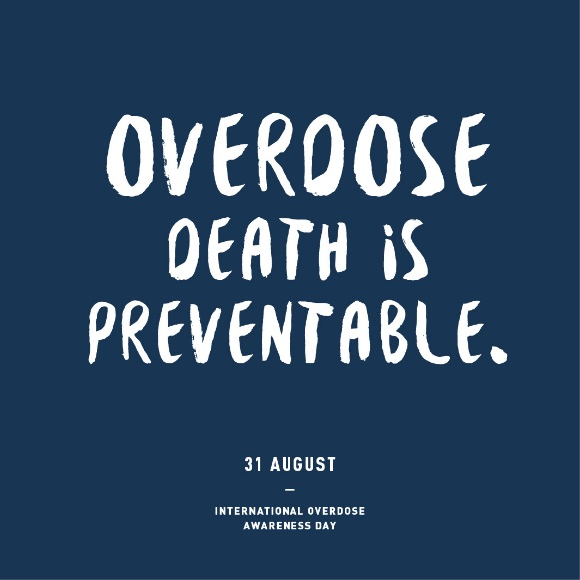
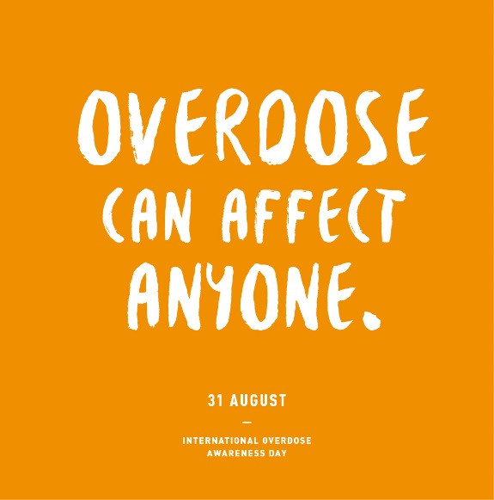
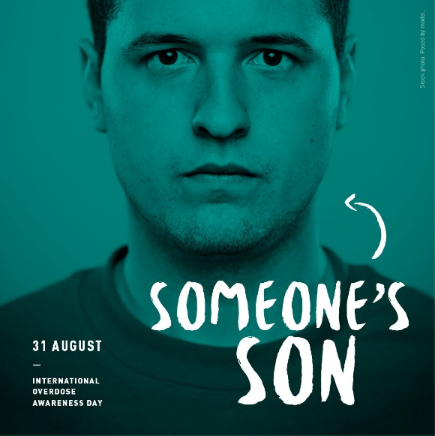
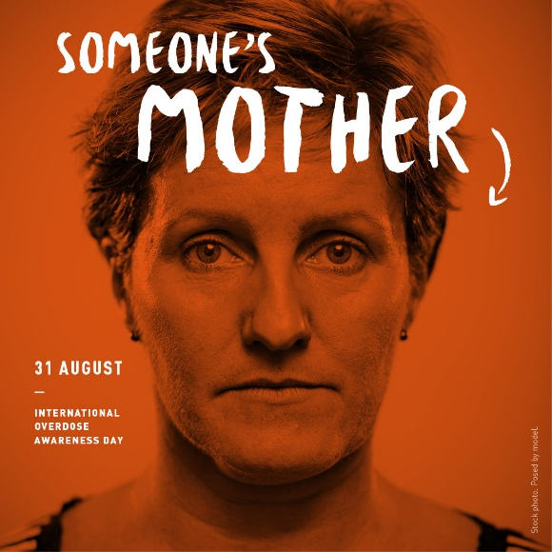
222 people die in our country each day from a drug overdose.

Slide 18
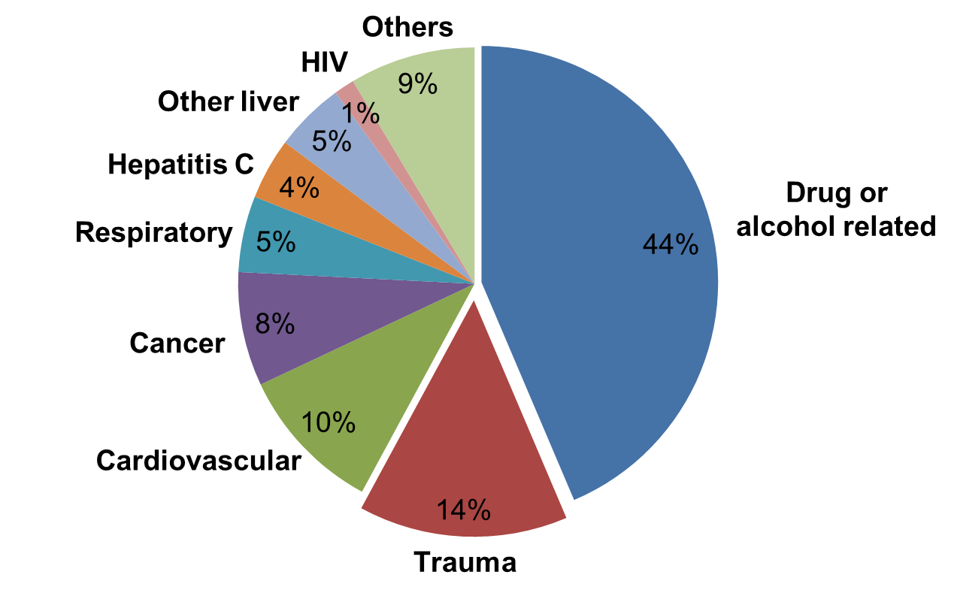
OPIOID USE DISORDER: CAUSES OF DEATH
Although nearly half of deaths among people with opioid use disorder are due to direct effects of the substance, more than 40% are due to common health problems, highlighting the importance of comprehensive medical care.
Evans et al., 2015
Notes:
Substance use is associated with numerous medical conditions that adversely effect a persons quality of life and lead to increased morbidity and mortality

Slide 19
Addiction Treatment is Chronic Disease Management
Medication Treatment
Immunizations
Acute Care
Skin and Soft Tissue Infections
Lifestyle Modifications
Ongoing Education & Support
Harm Reduction
PrEP and nPEP
Medication for OUD
Overdose Response
Trauma
Prevention
Managing Chronic Conditions
Screening and Assessment
SBIRT/AUDIT
History Collection
DSM-5
Diagnostics
Naloxone

Slide 20
Medications to Treat Opioid Use Disorder (MOUD)
The Pew Charitable Trusts, 2016.
Notes:
3 medications that we use for treatment.
How they work and how they differ.
MMT: full agonist, binds completely to the Mu opioid receptor. That is what gives us this dopamine release.
Bupe: partial agonist, binds very tightly to the mu receptor but doesn’t quite fill the entire receptor. this is why they still my have cravings or urges to use.
Naltrexone: antagonist or blocker - have to be off all opioids for 7-10 days b/c you want to avoid precipitated WD.

Slide 21
Buprenorphine Prescribing
Licensed provider with DEA Registration
Must apply by submitting Notice of Intent to SAMHSA
Register with SAMHSA and DEA
Adhere to patient panel size limits
Training:
Physician: subspecialty in addictions or completion 8hrs DEA training
*Waiver capability since Oct 2003
APP: completion of 24hrs DEA approved training
*Waiver capability since Feb 2017
Affirm the capacity to refer patients for appropriate counseling and ancillary services
As of April 2021, Education and Counseling requirements are exempt under updated HHS practice guidelines if treating <30 patients.

Slide 22
APPs are vital for Evidence-Based Treatment Access
In 2019: 70,020 waivered providers in US¹ of which 28,010 were APPs²
In rural areas from 2016 to 2019, APPs accounted for more than half of new waivers and were the first waivered providers in 285 counties with 5.7 million residents³.
NPs in states with full practice authority (FPA) are more likely to have a waivers than those in restricted practice states⁴.
12 states with the highest percentage of NPs with waivers are FPA states. Conversely, 11 out of the 12 states with the lowest percentage are non-FPA states.
1 (Abraham, Andrews, Harris, Freidmann, 2020)
2 (Auty, Stein, Walley, Drainoni, 2020).
3 (Barnett, Lee and Frank, Health Affairs, 2019)
4 (Dieperink, DePaepe, 2019)
Notes:
https://www.npjournal.org/article/S1555-4155(19)30892-X/fulltext
Greater practice restrictions were associated with a lower percentage of NPs, but not PAs, with waivers. The difference in NPs with waivers was modest in terms of percentage points, but was more than 75% larger in less restrictive states compared with more restrictive states. Differences in characteristics between NP and PA scope of practice restrictions, such as PA regulations in all states requiring collaboration with a physician, unlike NPs, may explain the result. https://jamanetwork.com/journals/jama/fullarticle/2730102
From 2016 to 2019 the number of waivered clinicians per 100,000 population in rural areas increased by 111 percent. NPs and PAs accounted for more than half of this increase and were the first waivered clinicians in 285 rural counties with 5.7 million residents.
(Barnett, Lee and Frank, Health Affairs, 2019) https://doi.org/10.1377/hlthaff.2019.00859
https://www.samhsa.gov/medication-assisted-treatment/practitioner-resources/DATA-program-data
October 2021 108,984
July 2019 70,020
As of December 2018, APPs accounted for 28,010 waivered providers.
Auty SG, Stein MD, Walley AY, Drainoni ML. Buprenorphine waiver uptake among nurse practitioners and physician assistants: The role of existing waivered prescriber supply. J Subst Abuse Treat. 2020 Aug;115:108032. doi: 10.1016/j.jsat.2020.108032. Epub 2020 May 13. PMID: 32600629.

Slide 23
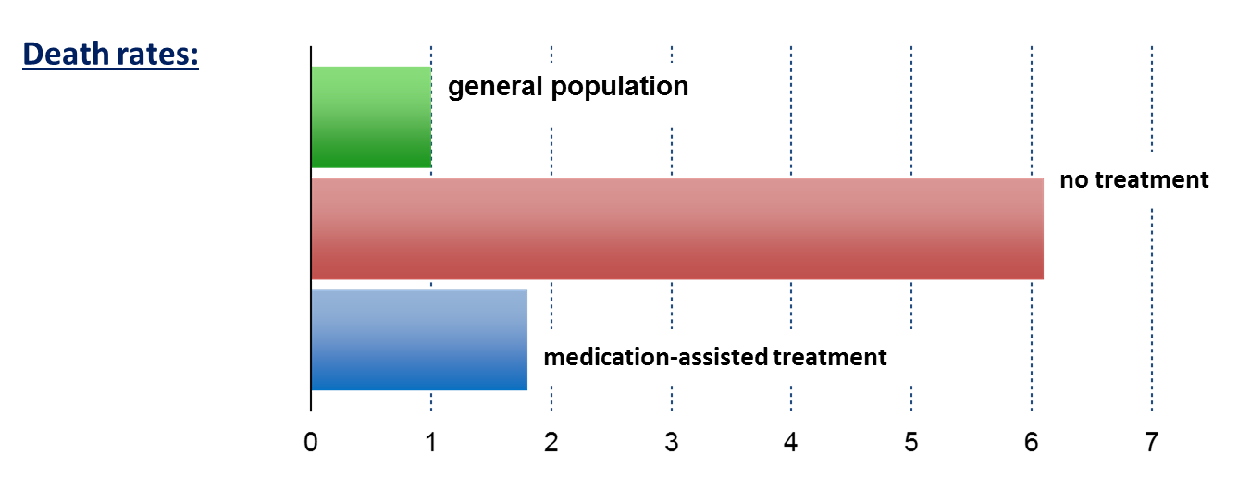
MOUD Decrease Mortality
medication treatment
Standardized Mortality Ratio
Sordo et al., 2017
Notes:
Speaker Notes:
Key Point #1: Patients out of treatment died at about 6 times the rate of people in the general population, while medication-assisted treatment with methadone brought this to less than 2 times.
Key Point #2: Retention in methadone and buprenorphine treatment is associated with substantial reductions in the risk for all cause and overdose mortality in people dependent on opioids.
When people have SUD and not on medicine, they are 6x more likely to die than the feneral pop.

Slide 24
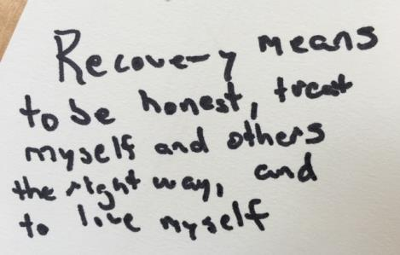
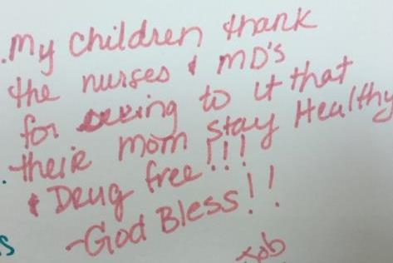
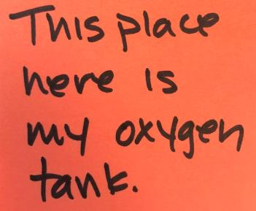
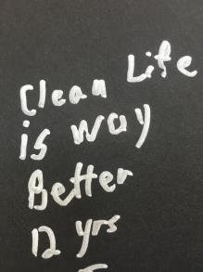
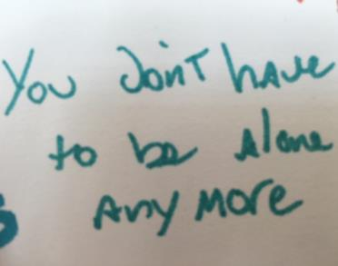
Voices of BMC Patients in Recovery
Notes:
This is my “About Me” slide.
I treat addiction and I love my patients.

Slide 25
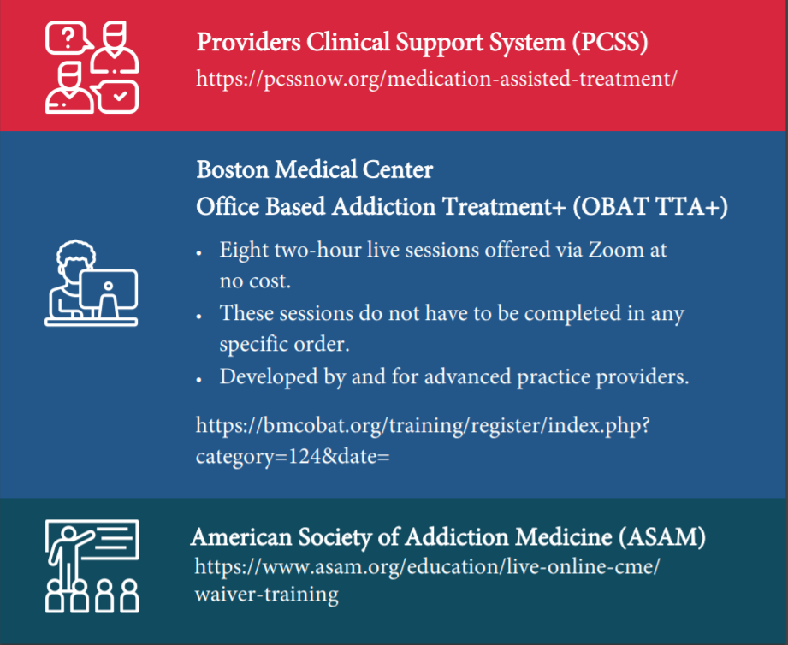
Free
Pre-Recorded Modules. CME and Pharm credits
No-cost
Live Training
Developed by and for APPs!
Most current data and practical tips.
CME and *Pharm credits.
Free
Pre-Recorded Modules. CME and Pharm credits.

Slide 26
BMC-PCSS APP Training Curriculum Thursdays from 3-5pm, ongoing now! Join Anytime!
Week 1: Overview of SUDs; Screening and Treatment Initiation
Week 2: Stigma and Harm Reduction; Motivational Interviewing
Week 3: Medications for OUD; Managing Polypharmacy
Week 4: Implementing Addiction Treatment Into Practice
Week 5: Managing OUD in Pregnancy; Managing Pain
Week 6: Care of Adolescents, Older Adults, Brain Injury
Week 7: Medical Considerations (SSTI, HIV, HCV); Overdose Education and Response
Week 8: Lab Testing and Regulatory Issues

Slide 27
The Nuts and Bolts of Addiction Treatment Pre-Recorded Training
Waiver-Trained: Now What? The Nuts and Bolts of Addiction Treatment training is available as an on-demand pre-recorded video on the BMC OBAT TTA+ website.
Watch this 2-hour FREE video training here: https://bmcobat.org/training/pre-recorded/
2 CME and Pharm credits will be provided to eligible providers
Watch on-demand at your convenience

Slide 28
OBAT TTA+ Short Educational Videos
Watch videos that discuss a variety of essential topics related to substance use disorders
Written by experts
Available on the BMC OBAT TTA+ website and YouTube channel.

Slide 29
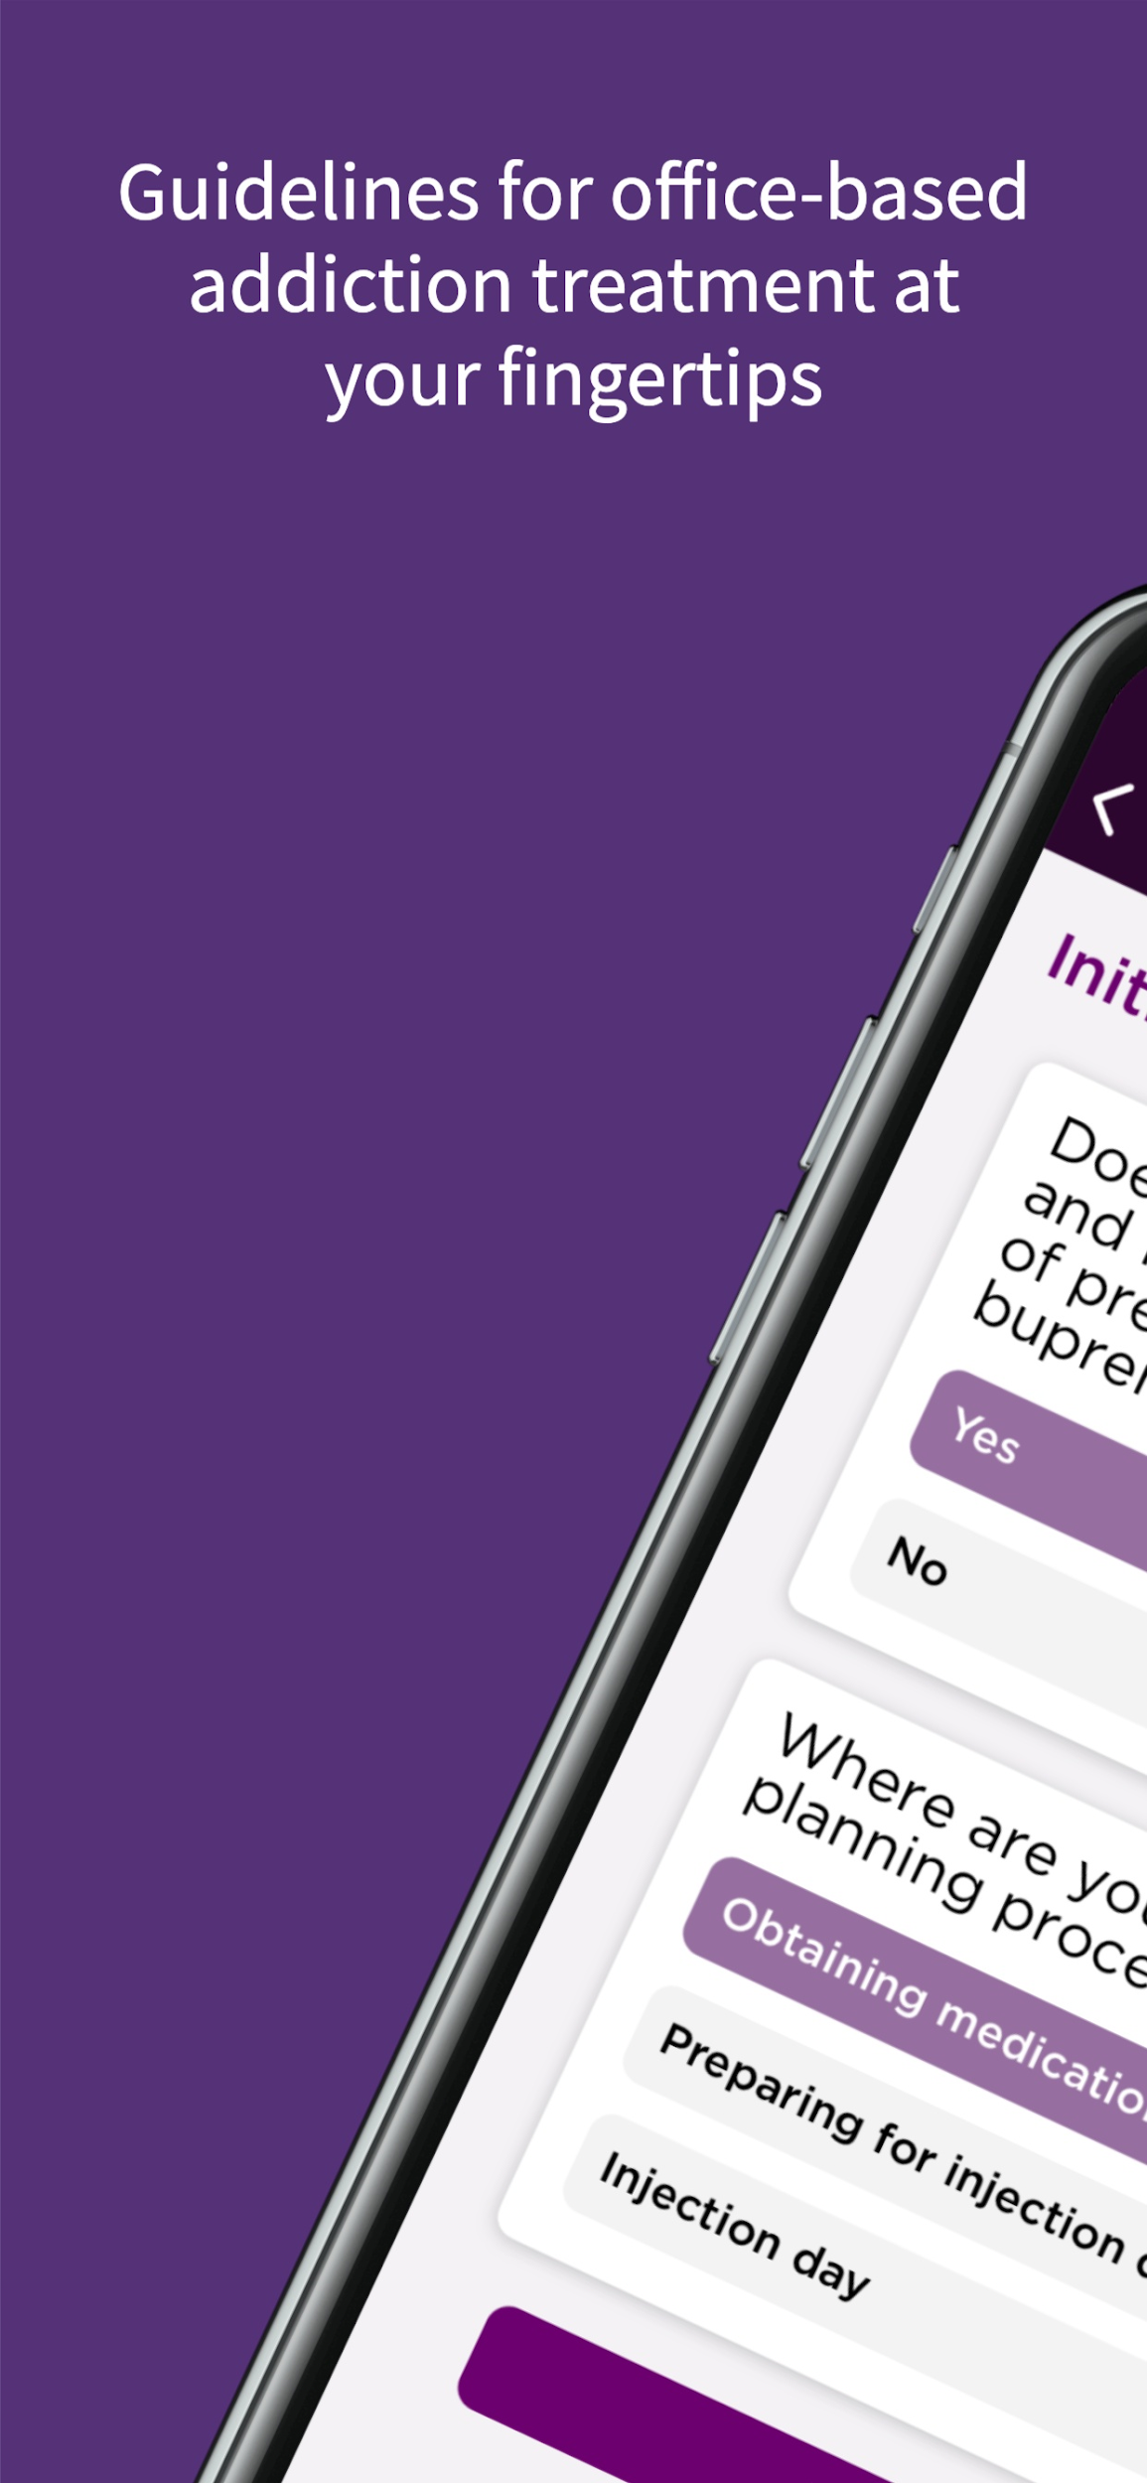
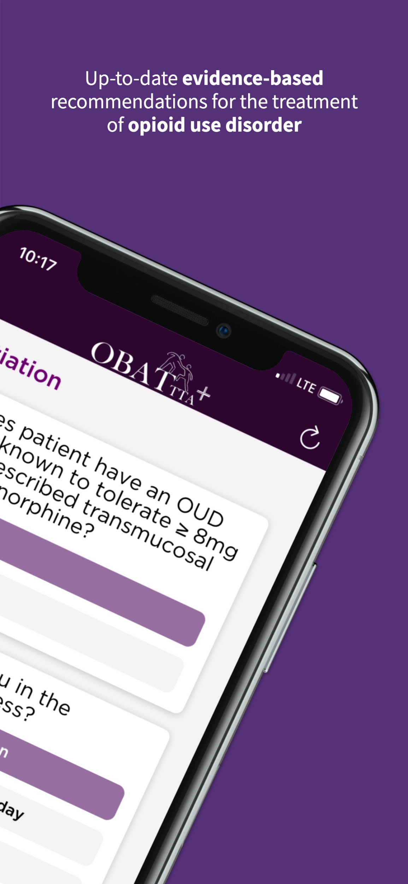
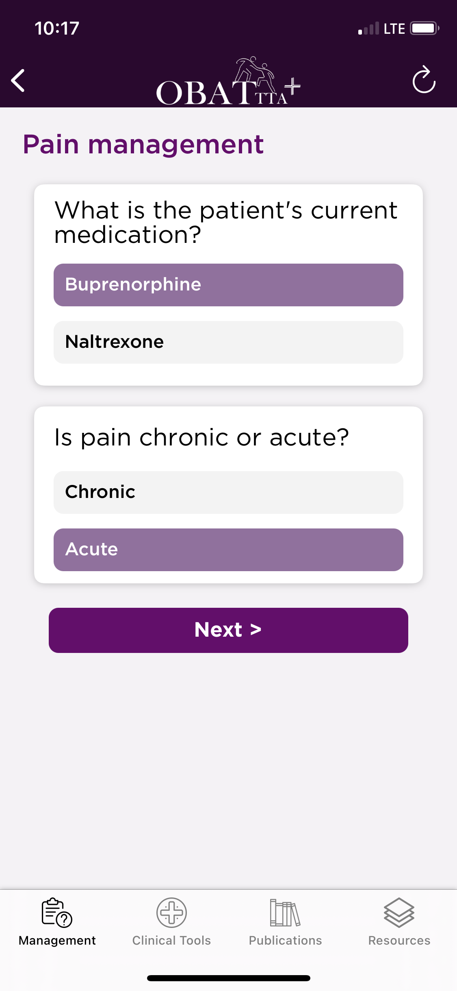
BMC MAT QUICK START APP
NOW AVAILABLE!
Provides real-time access to:
Algorithms for the initiation of buprenorphine and naltrexone
Links to guidelines and resources covered in this training and on our website
Available on iOS and Android; web version available on our website
Available for download, free of charge!
This initiative was made possible with funding from the SAMHSA Opioid Response Network and the Massachusetts Department of Public Health.

Slide 30
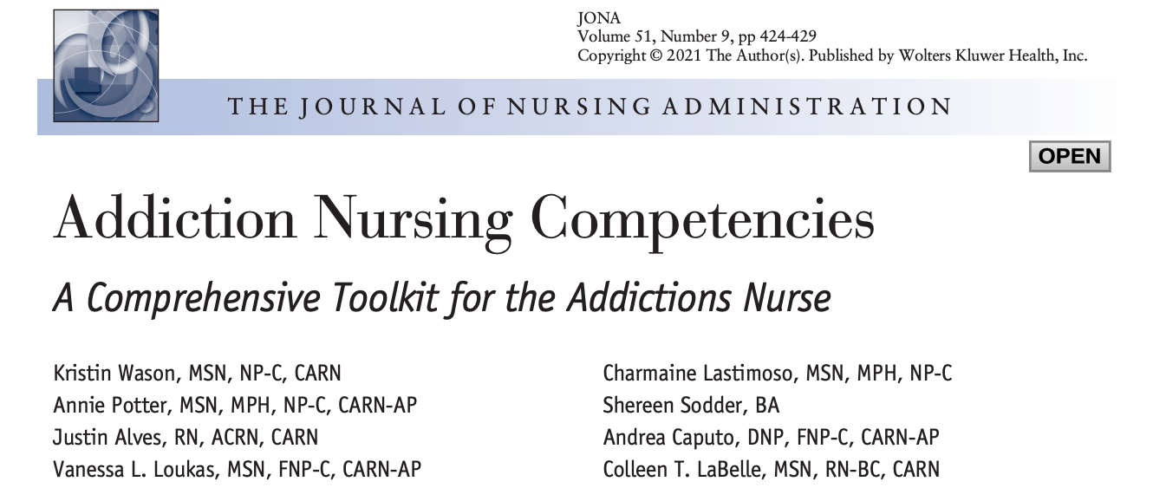

Slide 31
RESOURCES
Free education and support for providers in Massachusetts provided by:
Register for (free!) trainings
Access clinical guidelines, tools, and forms
Access Addiction Nursing Competencies
View recorded trainings and short topical videos
Request technical assistance
https://www.bmcobat.org

