Slide 1
Advanced Practice Provider Council Town Hall

Slide 2
Agenda
Topic | Presenter
APP Council Purpose & Membership | Melissa Jacobs, NP
APP Academic Appointments & Promotions | Dr. Hee-Young Park, Associate Dean for Faculty Affairs at BUSM
Questions | Open discussion
Notes:
Encourage use of chat feature

Slide 3
Advanced Practice Provider Council
Purpose: The Advanced Practice Provider Council will promote, develop and support the roles of APPs for the purposes of advising Boston University Medical Group and Boston Medical Center senior leaders on matters pertaining to
Systems of care
Scope of practice
Campus wide resources and programs
Reporting Structure: The APP Council will report to the BUMG Chief Executive Officer, BMC Chief Medical Officer, and BMC Chief Nursing Officer.

Slide 4
Advanced Practice Provider Council
Chair: Mary Ellen Killion, NP (Pediatrics)
Members:
Rosha Forman, CNM (OBGYN) | Douglas Grunseich, CRNA (Anesthesia)
Antonieta Camara, NP (GIM) | Cherisse Carlo, NP (Hospitalist)
Denise Eckstrom, NP (Cardiology) | Kerin Flanagan, NP (Neurology)
Melissa Jacobs, NP (GIM) | Jenna Meade, NP (Family Medicine)
Danielle Walker, NP (Psych) | Frances Blevins, PA-C (Hem Onc)
Lauren Cipriani, PA-C (Ortho) | Lauren Hartnett, PA-C (Surgery)
Diane Hanley (BMC) | Chris Manasseh, MD (BMC)
Jeff Schneider, MD (BMC) | Angela Reffel, PA-C (BU)
Hee-Young Park, MD (BU) | Mary Beth Molloy (BUMG)
Notes:
Bold ex-officios

Slide 5
Council Background
Proposed to Professional Development Committee
Jan 19
Workgroup Formed
July 19
First Meeting
Jan 20
Town Halls & Call for Membership
Oct/Nov 19
Approved by Leadership
May 19
Charter Approved
Aug 19
Council Formed
Dec 19

Slide 6
Call for Applications for APP Board Trustee
BUMG Advanced Practice Providers are invited to apply for a seat on the BUMG Board of Trustees
BUMG APPs are eligible, including: Physician Assistants, Nurse Practitioners, Certified Nurse Midwives, Certified Registered Nurse Anesthetists and Psychiatric Clinical Nurse Specialists
The deadline is August 14, 2020
To apply, submit a CV and statement of interest at:
http://www.bumc.bu.edu/bumg/apply-for-the-bumg-board-of-trustees/
For questions, contact John.Wood@bmc.org

Slide 7
Faculty Titles
Council Scope
Support academic promotion, professional development and advancement in order to sustain and improve provider retention
Council Goal
Increase the number of APPs with faculty titles & improve understanding on APP promotions process
Council Action
Collaboration with Dr. Hee-Young Park, Associate Dean for Faculty Affairs at Boston University School of Medicine
Town Hall for APP population
Notes:
Dr. Park oversees the Office of Faculty Affairs, whose mission is to support the recruitment, retention and academic advancement and career satisfaction of faculty.
Park received both her BS and PhD from MIT and joined the BUSM Department of Dermatology faculty in 1990. She was the PI of an active federally funded biomedical research laboratory that earned national and international recognition in cutaneous biology. She trained and mentored numerous graduate and medical students, residents, fellows and junior faculty.
She became an Assistant Dean for GMS in 2010 and Chair of the Department of Medical Sciences and Education in 2014. She has worked with faculty across schools and colleges at BU by serving as a member of the University Council, Faculty Council, and Executive Committee. Collaborating with clinicians and basic science educators, Park implemented a Master of Science in Health Sciences Education. In addition, she has served in a variety of roles at BUSM, including as a member of the Committee on Faculty Affairs, chairing the McCahan Education Day and leading the Boston Area Health Education Center partnership, an initiative to engage and expand the diversity and outreach efforts.
Through these administrative responsibilities, Park has developed a deep commitment and attained a wide range of experiences to support the recruitment, retention and academic advancement, and career satisfaction of our diverse faculty.

Slide 8
Faculty Appointments
&
Academic Advancements at BU/BUSM
Hee-Young Park, PhD
Associate Dean, Faculty Affairs
Professor & Chair of Medical Sciences & Education
School of Medicine | Faculty Affairs

Slide 9
Outline of Presentation
Institutional relationships:
Boston University/Boston University School of Medicine
Boston University Medical Group
Boston Medical Center/Affiliated Institutions
Structure of Boston University School of Medicine
Faculty Appointments & Promotions
Faculty Types
Faculty Titles
Criteria
School of Medicine | Faculty Affairs

Slide 10
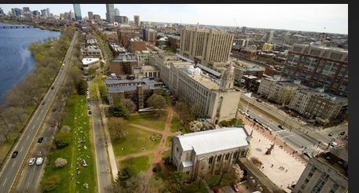
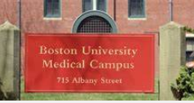
Boston University
One BU
CRC & Medical Campus
Charles River Campus (CRC)
Medical Campus (BUMC)
BUSM
School of Medicine
School of Public Health
School of Dental Medicine
Policies and Procedures apply across both campuses
School of Medicine | Faculty Affairs

Slide 11
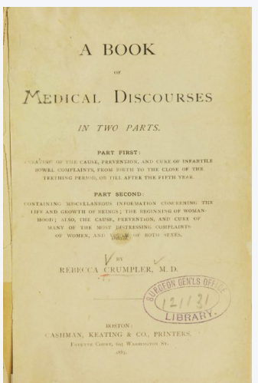
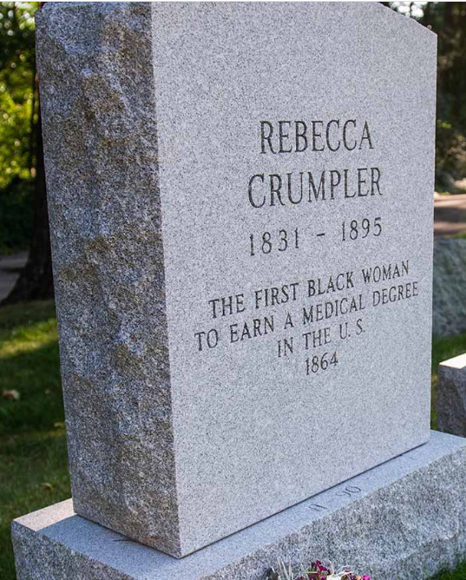
Boston University School of Medicine (BUSM)
Founded in 1848: New England Female Medical College
Renamed BUSM 1873
Awarded first MD degree to an African-American woman (Rebecca Crumpler)
Fairview Cemetery in Hyde Park, Mass
School of Medicine | Faculty Affairs

Slide 12
Boston University School of Medicine (BUSM)
Research Institution
Education Institution
MD students (~640 students)
Graduate Medical Sciences (GMS)
~ 300 PhD students
~ 40 MD/PhD students
~ 60 PA students
~ 600 Master’s students
School of Medicine | Faculty Affairs

Slide 13
Department | Count of Faculty | Percent Female | Percent Male
Basic Science Departments
Anatomy & Neurobiology | 32 | 46.88% | 53.13%
Biochemistry | 32 | 40.63% | 59.38%
Microbiology | 17 | 35.29% | 64.71%
Pharmacology & Experimental Therapeutics | 20 | 45.00% | 55.00%
Physiology & Biophysics | 19 | 15.79% | 84.21%
Clinical Departments
Medicine | 449 | 55.68% | 44.32%
Pediatrics | 101 | 80.20% | 19.80%
Family Medicine | 83 | 78.31% | 21.69%
Anesthesiology | 65 | 49.23% | 50.77%
Obstetrics & Gynecology | 56 | 83.93% | 16.07%
Emergency Medicine | 55 | 60.00% | 40.00%
Neurology | 52 | 57.69% | 42.31%
Psychiatry | 50 | 68.00% | 32.00%
Surgery | 39 | 30.77% | 69.23%
Pathology & Laboratory Medicine | 38 | 50.00% | 50.00%
Radiology | 37 | 35.14% | 64.86%
Ophthalmology | 25 | 64.00% | 36.00%
Dermatology | 17 | 70.59% | 29.41%
Orthopaedic Surgery | 14 | 21.43% | 78.57%
Otolaryngology-Head & Neck Surgery | 13 | 69.23% | 30.77%
Medical Sciences & Education | 9 | 88.89% | 11.11%
Urology | 9 | 22.22% | 77.78%
Neurosurgery | 7 | 28.57% | 71.43%
Radiation Oncology | 6 | 50.00% | 50.00%
School of Medicine | Faculty Affairs

Slide 14
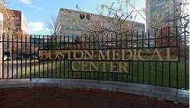
Boston University Medical Group (BUMG)
Boston Medical Center
BUSM Affiliated Institution
(BUSM)
Academic Home
Practice site
School of Medicine | Faculty Affairs

Slide 15
BUMG Employees
BU serves as Paymaster
BU provides academic appointments at the time of hire
School of Medicine | Faculty Affairs

Slide 16
BMC Employees
BMC is the major BUSM affiliated medical institution
Faculty appointment at BUSM is not automatic
Faculty appointment (Voluntary) is available if involved in teaching BUSM students
School of Medicine | Faculty Affairs

Slide 17
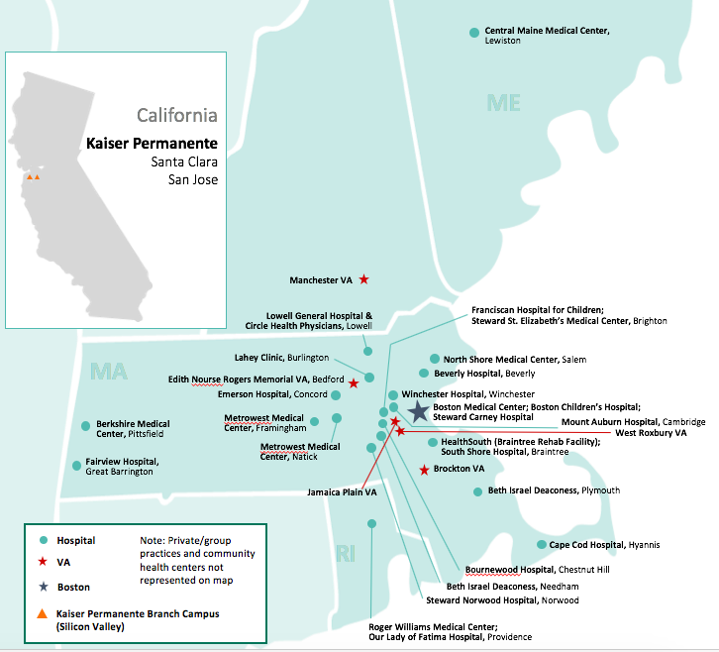
BUSM Affiliates

Slide 18
Practice Providers at the Affiliated Sites
BUSM Offers Voluntary Faculty Appointment
LCME requires that anyone teaching or precepting BUSM medical students must have faculty appointment
Teaching or education of BUSM students at least 40 hrs/year
Receive BU/BUSM announcements, BU email account and access to BUSM Alumni Library
Opportunity to collaborate with other BUSM faculty
School of Medicine | Faculty Affairs

Slide 19
Why Faculty Appointment?
Opportunity to get involved with innovative, thought provoking scholarly activities
Interact/net-work with other faculty across the disciplines
Potential broad impact
Intellectual curiosity
Be part of shaping of future healthcare providers
School of Medicine | Faculty Affairs

Slide 20
BUSM Faculty Affairs
Hee-Young Park, PhD: Associate Dean (hypark@bu.edu)
Danielle White: Manager (dawhite@bu.edu)
Daniella Adrien: Administrative Coordinator (dadrien@bu.edu)
School of Medicine | Faculty Affairs

Slide 21
Faculty Affairs Website
https://www.bumc.bu.edu/busm/faculty
School of Medicine | Faculty Affairs

Slide 22
Faculty Types Faculty titles Criteria Procedures
School of Medicine | Faculty Affairs

Slide 23
Faculty Type
Full time
Part time
Affiliate (Voluntary)
Adjunct (has faculty appointment at another academic institution)
School of Medicine | Faculty Affairs

Slide 24
Current Faculty
 | Full-Time |  | Part-Time |  | AFF & Voluntary Faculty
Calendar Year | Basic Science | Clinical | Basic Science | Clinical | Basic Science | Clinical | TOTALS
2015 | 112 | 1,533 | 13 | 106 | 38 | 383 | 2,185
2016 | 119 | 1,599 | 11 | 116 | 29 | 340 | 2,214
2017 | 123 | 1,823 | 9 | 114 | 32 | 341 | 2,442
2018 | 120 | 1040 | 10 | 110 | 16 | 1075 | 2,371
2019 | 120 | 1088 | 12 | 112 | 14 | 1021 | 2,367
2020 | 120 | 1128 | 10 | 122 | 15 | 1101 | 2,496
School of Medicine | Faculty Affairs

Slide 25
Faculty Titles
(dictated by BU Faculty Handbook)
Available at BU | BUSM (No Tenure)
I: Unmodified Instructor Assistant Professor Associate Professor Professor | I: Unmodified Instructor Assistant Professor Associate Professor Professor
II: Modified Clinical or Research | II: Modified Clinical or Research
III: – of – Practice | III: Not in use
School of Medicine | Faculty Affairs

Slide 26
Key Metrics for Evaluation of Promotion
Unmodified Faculty Titles
Modified Faculty Titles
-Scholarship
-Teaching/Education
-Research/Patient Care
-Service
-Mentorship
-Scholarship
-Teaching/Education
-Research/Patient Care
-Service
-Mentorship
School of Medicine | Faculty Affairs

Slide 27
Criteria
Identical for all Faculty Types, degrees and specialties
School of Medicine | Faculty Affairs

Slide 28
Instructor (unmodified)
Entry level
Completed their post doctoral training, residency, fellowship or equivalent training
School of Medicine | Faculty Affairs

Slide 29
Assistant Professor (unmodified)
Completion of all formal training
One peer-reviewed original empirical publication (excludes case reports, book chapters, reviewed articles (including peer-reviewed), editorials, etc.)
3 non-arm’s length letters for PhD
1 non-arm’s length letter for MD
School of Medicine | Faculty Affairs

Slide 30
Associate Professor (unmodified)
3-6 years as an assistant professor
Scholarly achievements, and recognition of these achievements at regional and national level
Requires 6 arm’s length evaluation letters
School of Medicine | Faculty Affairs

Slide 31
Professor (unmodified)
5 years as an associate professor
Distinguished record of scholarship and professional accomplishment recognized at regional, national, and international level
Requires 6 arm’s length evaluation letters
School of Medicine | Faculty Affairs

Slide 32
Evaluation Letters (Arm’s Length Letters-Unmodified Faculty Title)
The expectation is that there is “no personal or formal professional relationship to the candidate, although simply ‘knowing’ the candidate is not a problem because we expect our senior faculty to be well-known in the discipline.”
Following lists why letters are usually considered NOT arm’s length:
-Co-author (unless incidental in a very long list)
-Formal collaborator, co-instructor
-Co-investigator on a grant or contract
-Mentor or advisor
-Co-working, apart from short-term visiting appointments
-Former student or former supervisor
-Familial relationships or close personal ties beyond professional collegiality
School of Medicine | Faculty Affairs

Slide 33
National or International Recognition (Unmodified Faculty Title Promotions)
Member of National or International Society Committees
Invited speakers
Invited panelist
Invited presentations
Grant reviewer
Editorial Boards
School of Medicine | Faculty Affairs

Slide 34
Modified Faculty Titles
Prefixes (arm’s length letters NOT required)
Clinical: Predominantly responsible for clinical activities with few scholarly activities
Research: Scientists whose responsibilities include assigned projects under the aegis of a senior scientist
Ad hoc BUSM Promotion Criteria Committee has recommended to consider faculty title with a suffix
(i.e. Associate Professor of XXX at BMC or BUMC or BUSM, Associate Professor of Clinical XXX, etc.)
School of Medicine | Faculty Affairs

Slide 35
Appointments and Promotions Procedures
Instructor, Assistant Professor, Modified Associate Professor & Professor
Unmodified Associate Professor & Professor
Department FAP Committee
BUSM FAP Committee
BUSM Executive Committee
Final
CRC
School of Medicine | Faculty Affairs

Slide 36
BUSM Faculty Appointments and Promotions Committee
Faculty | Role on FAP Committee | Title
Kenneth M. Grundfast, MD | Chair | Professor of Otolaryngology - Head and Neck Surgery
Stephen Wilson, MD | Member | Professor & Chair of Family Medicine
Ali Guermazi, MD, PhD | Member | Professor of Radiology - Musculoskeletal Radiology
Jennifer Luebke, PhD | Member | Professor of Anatomy & Neurobiology
Tsuneya Ikezu, MD, PhD | Member | Professor of Pharmacology & Experimental Therapeutics
Jorge A. Soto, MD | Member | Professor and Chair of Radiology
Marie-Helene Saint-Hilaire, MD | Member | Professor of Neurology
Thomas T. Perls, MD, MPH, FACP | Member | Professor of Medicine in Geriatrics
Virginia R. Litle, MD | Member | Professor of Cardiothoracic Surgery
Jennifer J. Vasterling, PhD | Member | Professor of Psychiatry – General Psychiatry
Elizabeth D. Barnett, MD | Alternate Member | Professor of Pediatrics – Infectious Diseases
Mieke H. Verfaellie, PhD | Alternative Member | Professor of Psychiatry
Ravin Davidoff, MBBCH | Alternate Member | Professor of Medicine in Cardiovascular Medicine
Karen H. Antman, MD | Member Ex Officio | Provost of Medical Campus, Dean, School of Medicine
Hee-Young Park, PhD | Member Ex Officio | Associate Dean, Faculty Affairs

Slide 37
Actions
Have Faculty Appointment
Put your CV into BU CV format
Be familiar with the promotions criteria and process
Identify mentor(s)
Review your CV with mentor or a senior faculty
Plan a strategy for promotion (Annual Review)
Attend events/resources offered by BU/BUSM that relates to promotions
Net-work: opportunities for scholarly activities
School of Medicine | Faculty Affairs

Slide 38
Actions
Do Not Have Faculty Appointment
Meet with your chair/supervisor (identify the department)
Work with the department administrator to put together the dossier
Put your CV into BU CV format
School of Medicine | Faculty Affairs

Slide 39
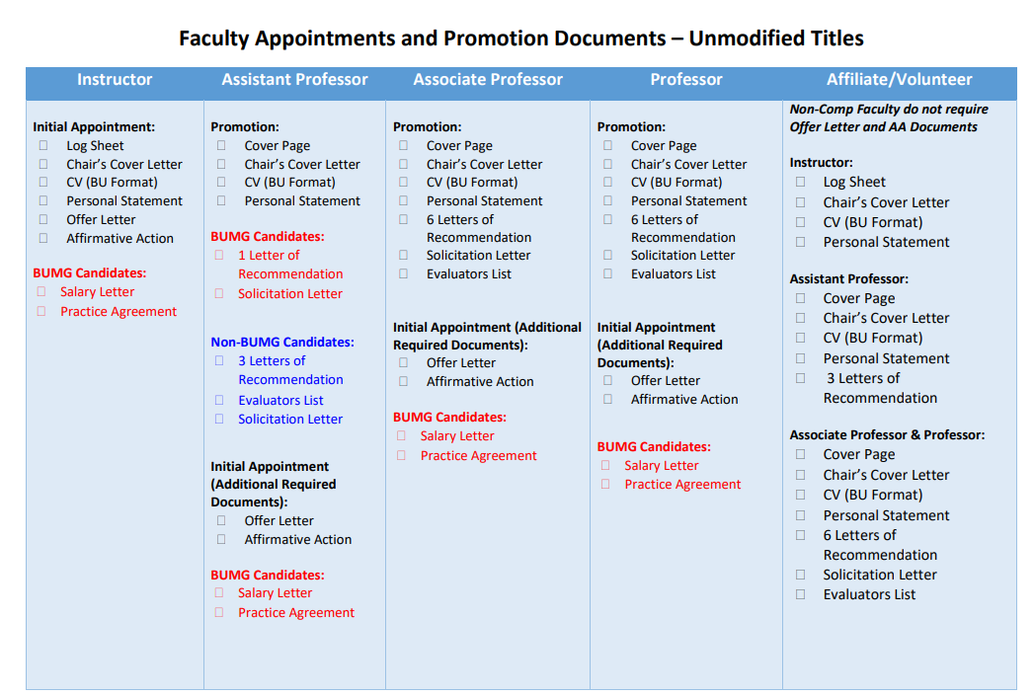
School of Medicine | Faculty Affairs

Slide 40
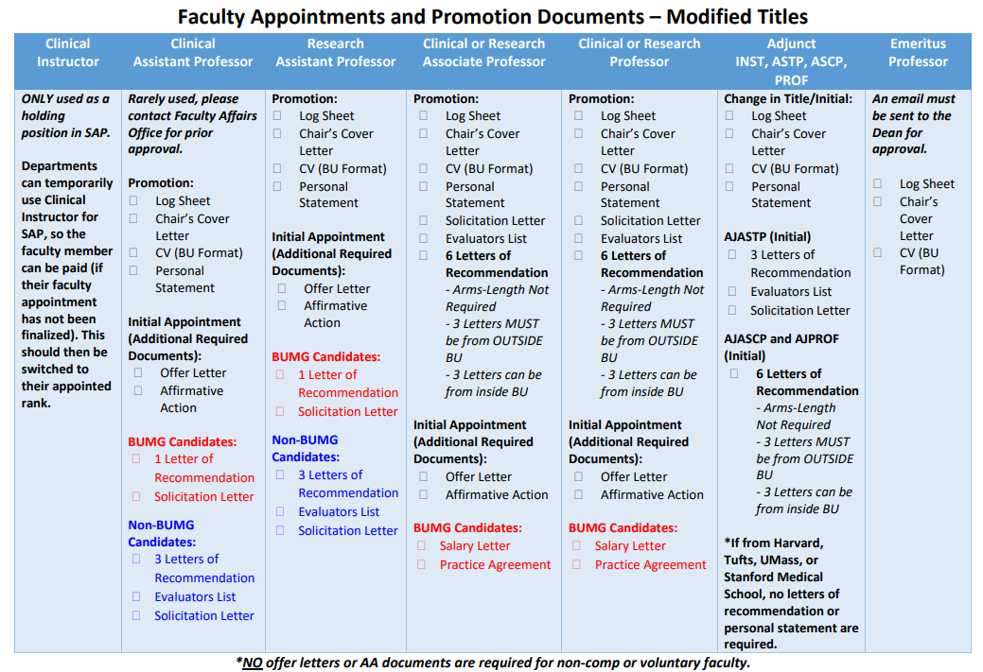
School of Medicine | Faculty Affairs

Slide 41
-How to Get Promoted Workshops: four times/year -CV reviews offered by BUSM FAP Committees (FA Office: Danielle White) -Annual Review—Come up with a plan with your chair/section chief/supervisor -Career Consultations offered by Faculty Development Office -Educator’s Collaborative Lunch & other relevant seminar series
Activities/Resources
School of Medicine | Faculty Affairs

Slide 42
Visit Faculty Affairs Website
https://www.bumc.bu.edu/busm/faculty
BU CV format template
Check list
Dates of BUSM FAP meetings
School of Medicine | Faculty Affairs

Slide 43
Questions?
School of Medicine | Faculty Affairs

Slide 44
Resources
BU School of Medicine Appointments and Promotions Website
https://www.bumc.bu.edu/busm/faculty/appointments-and-promotions/
BUMC Professional Development Programs (including Career Planning and CV Review)
https://www.bumc.bu.edu/facdev-medicine/all-bumc/
https://www.bumc.bu.edu/facdev-medicine/all-bumc/consultancies/
APP Council BUMG Internal Website
http://www.bumc.bu.edu/bumg/committees/advanced-practice-provider-council/

