Slide 1


Research Accelerator
Ground Rules & Guiding Principles
September 2025

Slide 2
Goals
Improve the quality and rigor of scientific works that our participants develop, present and publish
Foster collaborations among participants who have common or complementary academic/research interests
Support the development of trainees in research

Slide 3
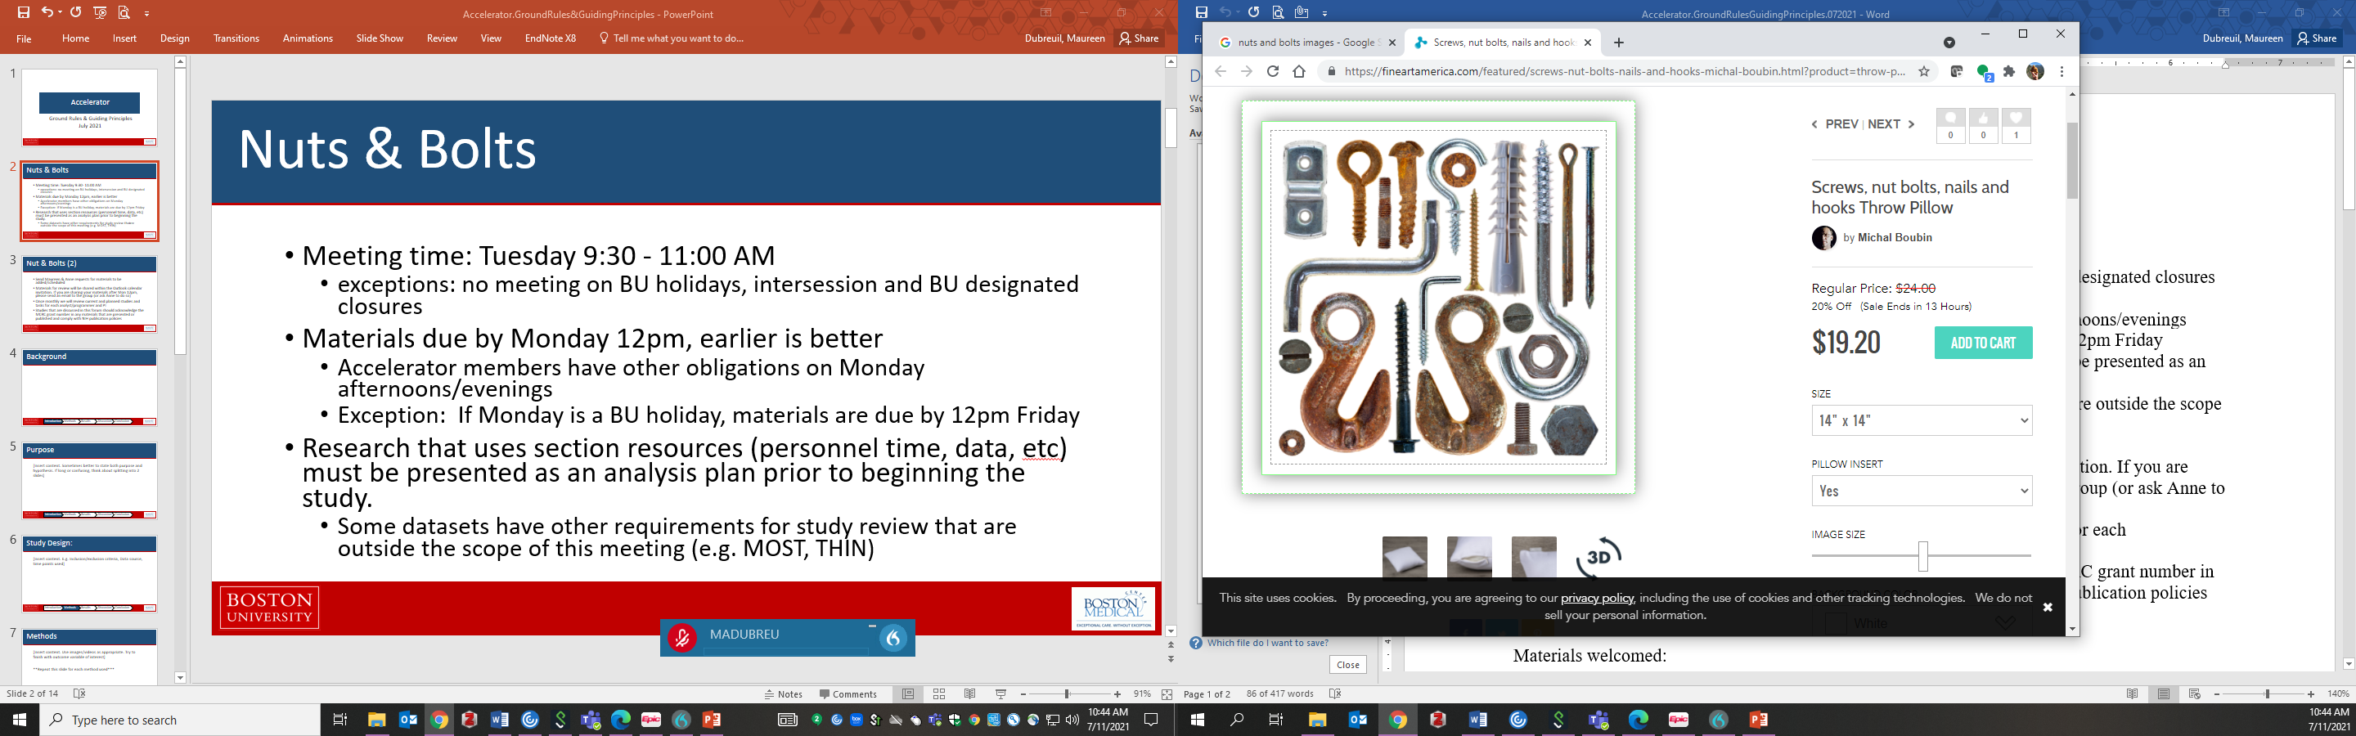
Nuts & Bolts
Meeting time: Tuesday 9:30 - 11:00 AM
  No meeting on BU holidays & closures
  Possible 2-hour meeting during abstract season
Materials due by Monday 12pm, earlier is better
  Accelerator members have other obligations on Monday afternoons/evenings
  If you are sharing your materials after Mon 12pm, please send an email to the group (or ask MCRC@bu.edu to do so if before 5pm)
  Exception: If Monday is a BU holiday, materials are due by 12pm Friday
Send Maureen & MCRC@bu.edu requests for materials to be added/scheduled
Notes:
Outlook invitation has participation info and materials

Slide 4
Nut & Bolts (2)
Research that uses section resources (personnel time, data, etc.) must be presented as an analysis plan before work begins
  Submission Form required for all studies
  The review of MOST APs requires sign off by the MOST Review committee (including Reza and Mike)
  Some other datasets have other requirements for study review that are outside the scope of this meeting (e.g. THIN, MarketScan)
Work discussed in Accelerator must acknowledge the P30 grant (AR072571) in presentations & publications
  Must comply with NIH publication policies (including PMCID)

Slide 5
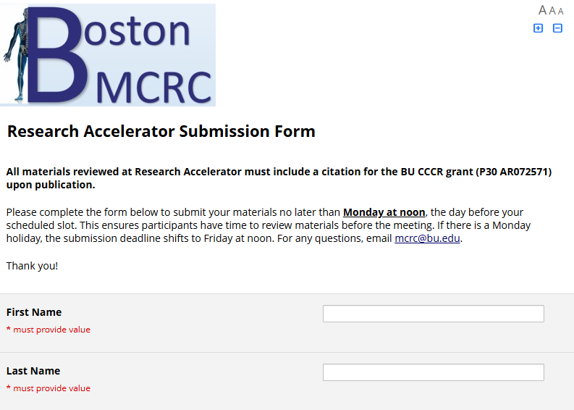

Slide 6



Material Types
Yes please | Maybe | No, thank you
Original research Grants & resubs Abstracts Posters & Orals Manuscripts & major revisions Discussion: study design, stat methods, ethics, equity | Invited talks Reviews Commentaries Opinions Editorials | Clinical case reports or series Grant progress reports Detailed budgets Recruitment materials

Slide 7
Participants
Members of the Rheumatology section and their collaborators and trainees/mentees from any section or institution
Diverse backgrounds: demographics, life and professional experiences, training, and research foci

Slide 8
Ground Rules
Discussions and materials from Accelerator meetings are confidential unless/until presented or published
Members should provide constructive, specific and actionable comments aimed to improve the impact, scientific rigor and quality of the applications, research, publications and presentations we discuss
Participants should serve as resources for each other in conducting and disseminating research, training researchers, and providing mentorship for trainees who plan to pursue research

Slide 9
Guiding Principles
You belong here
We value each participant’s input and contributions
There is no hierarchy to the value of one’s input – every member, regardless of role or stage of career, provides a useful perspective to help ensure the materials speak to and are understandable to a broad audience
We hope you will feel comfortable speaking during the group meeting- if not, you may email or speak with the presenter directly
THANK YOU for being part of this group and making it successful

Slide 10
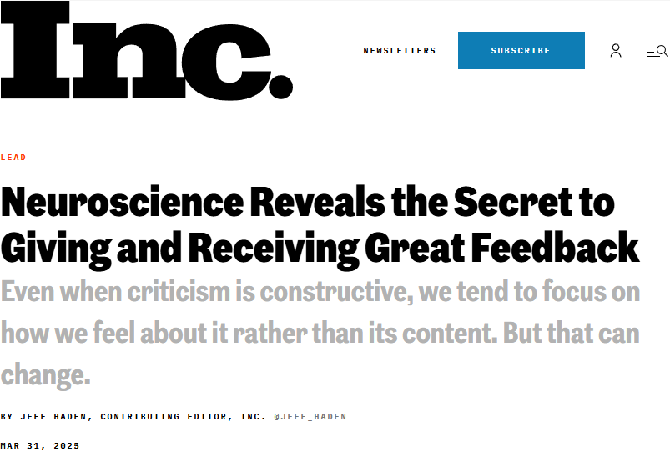
The Secret to Giving & Receiving Great Feedback

Slide 11
The Secret to Giving & Receiving Great Feedback
Well-intended. The goal isn’t to tear me down; the goal is to help me improve.
Considerate and respectful. How you say it matters.
Practical. What I really need to know is how I can improve. Tips. Strategies. Processes. Tell me what I can do better and show me how.
Relevant. Describe the specific reason for the feedback; the more individualized, the better.

Slide 12
More tips on reviewing materials:
Point out the strengths
Address the larger issues first
Make specific and actionable suggestions for improvement
Be tactful but be candid and direct
Don't be afraid to disagree with another reviewer
Remember peer review is not an editing service

Slide 13
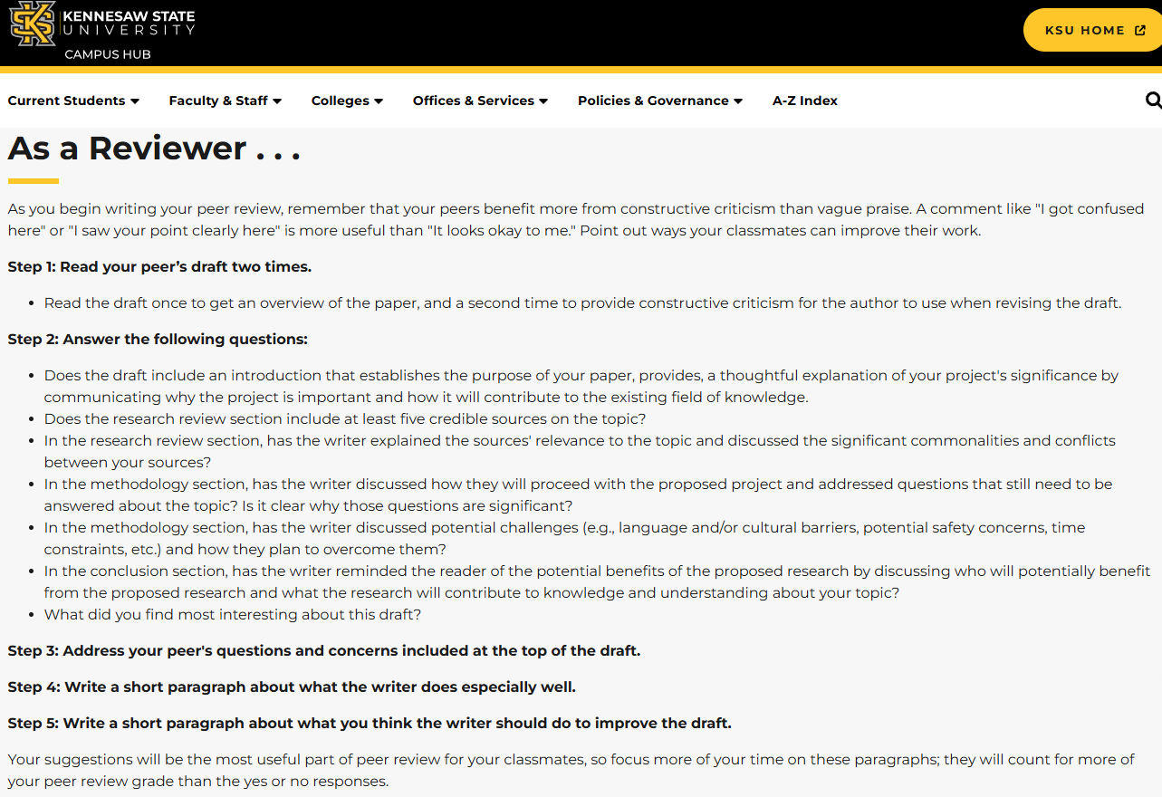

Slide 14
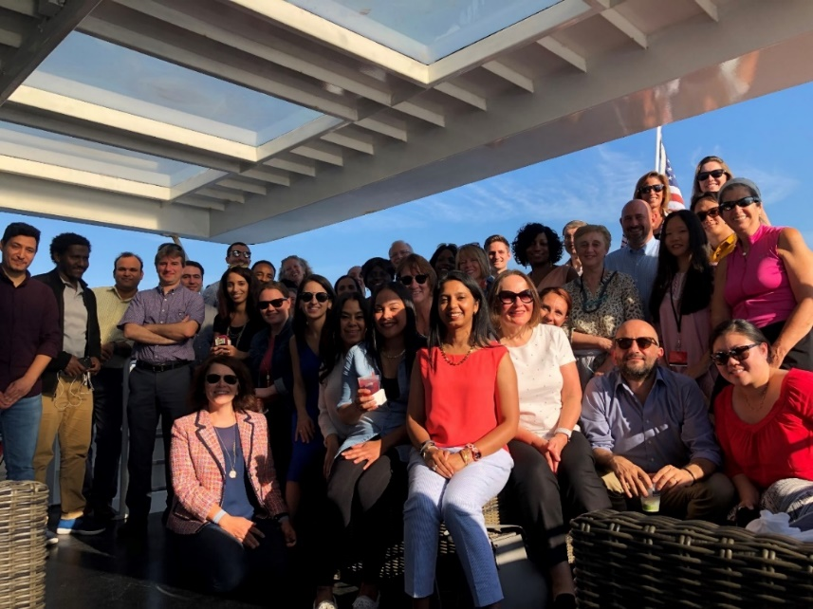
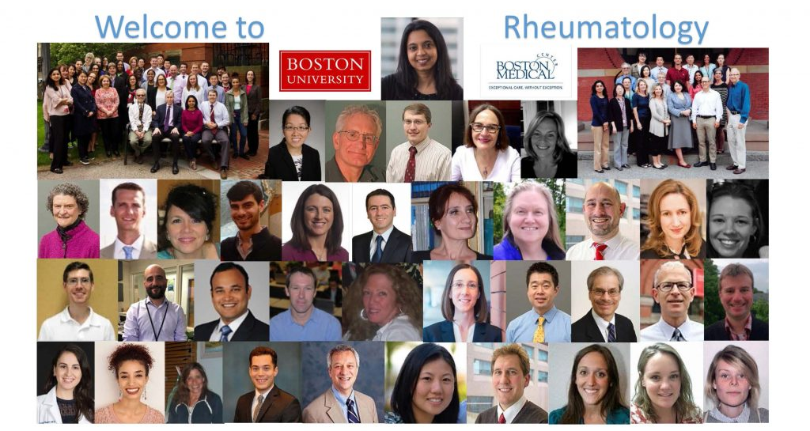
Thank you!
ACKNOWLEDGEMENT: P30 AR072571

Slide 15
Draft Ground Rules
Listen actively and seek to understand. Trying to understand someone's idea does not require you to agree with it. We commit to being self-reflective and curious rather than defensive or judgmental.
Create an inclusive, respectful environment. We maintain a welcoming, psychologically safe culture for all participants regardless of race, age, gender, physical ability, neurodiversity, etc. We will not demean, devalue, or minimize others or their ideas.
Challenge ideas, not people. Dissent and different opinions are encouraged when expressed with respect and civility. Focus on critiquing ideas or practices, not the individuals sharing them.
Speak from personal experience using "I" statements. Share thoughts, ideas, and questions authentically. You have permission to "speak in rough draft" - express ideas even if they're not fully formed.
Ask honest, open-ended questions. Engage in genuine inquiry rather than trying to persuade, lead, or pressure. Avoid blaming, accusing, or assuming bad intentions.
Assume others’ best intentions and take responsibility for your impact. Trust that everyone is doing their best, while acknowledging that good intentions don't negate negative impact. Be quick to apologize and remain open to learning.
Share discomfort and practice transparency. If something troubles you, speak up rather than texting privately or grumbling later. Address issues directly to build trust.
Be fully present and monitor participation. Our time is precious - participate fully including in pre-meeting preparation. Be mindful of your own airtime. Speak up when others dominate conversation.
Maintain confidentiality. What is said here stays here. What is learned here can leave here.
Commit to learning from each other. Listen to each other rather than talking at or over each other. Acknowledge our differences in backgrounds, skills, interests, and values as strengths.

