Slide 1
J1 Visas
From A to Z
Sandra Ordonez • Boston University Medical Center
Notes:
.

Slide 2
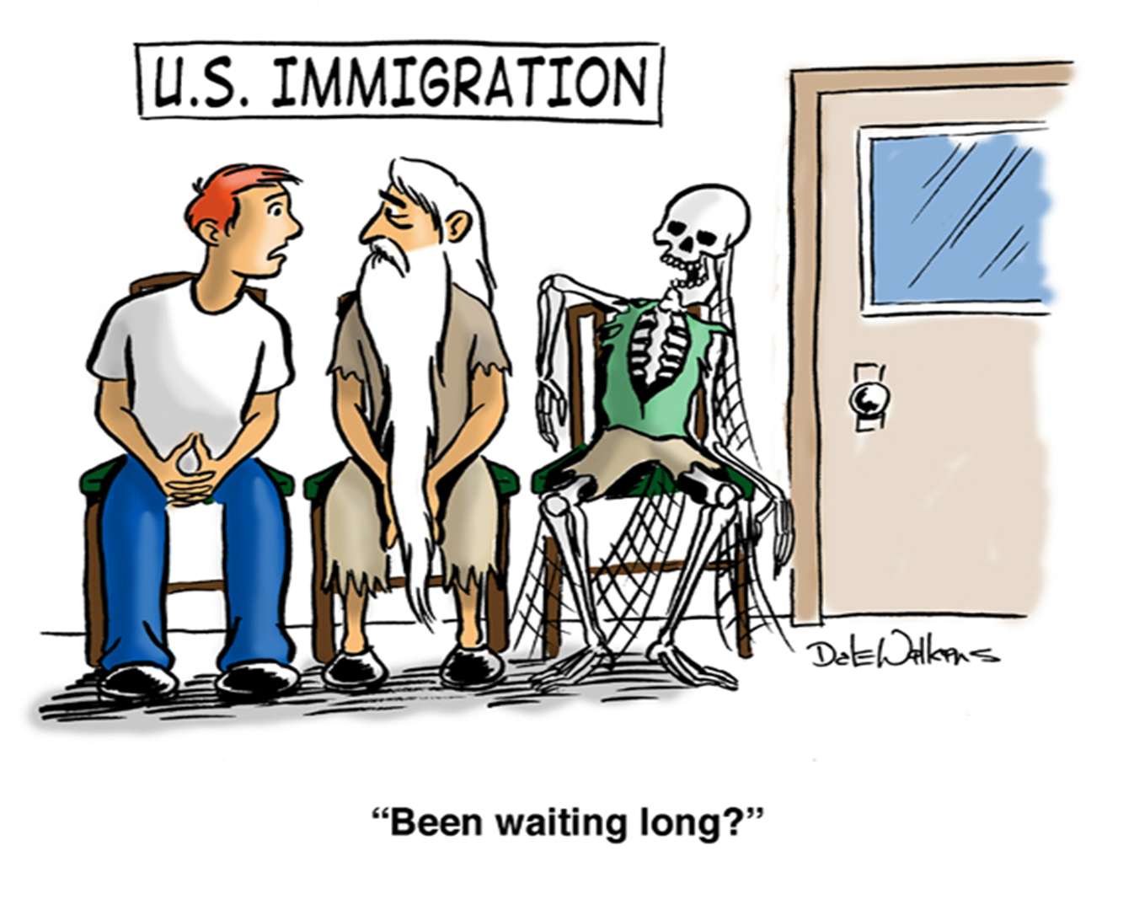
Trainee Visa Types
Notes:
The perfect time of the year to do a brief overview of what type of visas are available for Foreign national physicians who seek entry into U.S. programs of graduate medical education or training that permits clinical training activities.

Slide 3
Immigration Options for Residents
  F-1 Optional Practical Training (OPT)
  H1-B
  J2 or H2-B
  Employment Authorization Document (EAD)
  J-1
Notes:
The most common visa types are:
The F-1 with OPT,
The H-1B,
The J2 or H2-B
The EAD and
The J-1

Slide 4
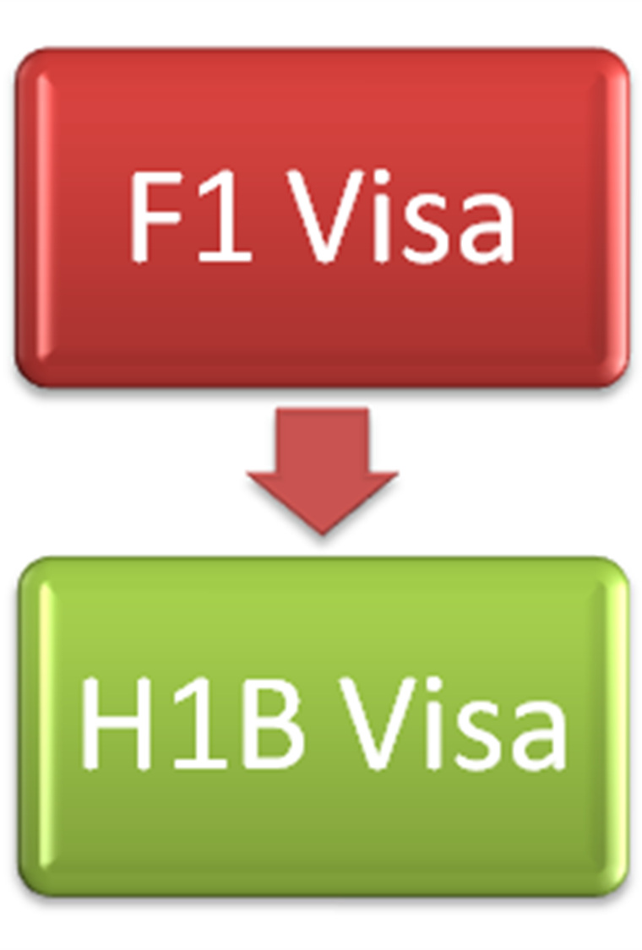
F-1 Optional Practical Training (OPT)
  F-1 Visa is for undergraduate or graduate students
  OPT permits additional 12 months of work to complement education
  Traditionally OPT is converted to H1B if used in residency
Notes:
Let’s talk briefly about F-1 (OPT) Who is elegible for this visa?
This status is commonly seen with an IMG who completed medical school in the USA. So basically any medical international students who are attending an academic programs in the US can apply for this visa
How long this visa works for medical trainees?
After completion of medical school the IMG is entitled to one year of optional practical training (OPT) and begins the residency program with an employment authorizations document (EAD) that allows employment for one year.
When they should apply for?
The UIMG should applied when they found their match before they graduate from medical school. The F-1 "designated school official" (DSO) at the US medical school can usually provide information necessary to make employment eligibility determinations for these graduates.
This OPT authorization is appropriate for the first or matched year
Can they apply for other visas?
A resident on F-1 status must change to either a J-1 or H-1B status to continue residency training past PGY-1, is a common knowledge that the F-1 is a bridge to H-1B or Other Visas.

Slide 5
H1-B
  Designed to allow U.S. employers to recruit & employ foreign professionals in specialty occupations within the USA for a specified period of time.
  No home residency requirement
  More liability, paperwork & cost for employer
Notes:
The H-1B is the most common temporary work visa option for medical residents and fellows they are considered employees, Their status is regulated by the Department of Homeland Security and the Department of Labor..
What are the requirements for H1-B visa:
Having a Fellowship or Medical Residency offer, because H-1B employment authorization is employer specific. The GME program must file an H-1B petition on behalf of the IMG; the law does not permit prospective trainees to file for themselves;
Physician must be paid prevailing;
ECFMG certification;
Passage of USMLE Steps I,II,III or FLEX Parts 1 and 2; and
State Medical License or other authorization to practice medicine in the State of intended employment (if such license/authorization is required by the State) **
** Most States require medical residents to have State Medical Licenses to practice medicine. However, some States such as New York do not require medical residents/fellows to hold State licenses. Other States, such as Connecticut, require that the employer obtain permits to practice for medical residents for at least the first two years of medical training
The documents are:
Copy of medical school diploma and course list/transcript;
Copy of ECFMG certificate;
Copy of USMLE Steps I,II,III pass results letters
Copy of valid passport (all pages);
Copy of residency/fellowship offer letter or contract;
Evidence of State Medical License/permit (when required) - if you do not yet have a State Medical License/permit, be sure to take the necessary steps to apply for the necessary license/permit, and advise us once such permit will be ready;
Costs for H1B visa processing are the responsibility of the employer. Most residency/fellowship programs agree to H-1B sponsorship but they prefer J-1 visa that not required to pay for it. Is recommend that all medical residents/fellows utilize premium processing for H1B visa applications, which guarantees a response from the US Immigration Service within 15 business days.
H-1B visas are granted initially for up to three years, and are renewable for another three-years. With some exceptions, H-1B visas are limited to six-years in duration, for residents in longer programs they may need to moved to J-1 or permanent residency. Every IMG that qualifies for H-1B status can also get a J-1, but not all qualified for H-1B
H1-B Cap- is nothing but the total number of petitions or maximum limit on the same allowed, This is loosely referred as general quota/cap or regular quota or non-advanced degree quota/cap. The annual cap is set as 65,000. Application opens in April 1st, the demand substantially exceeds supply. Exempt fromit are J-1 waivered physicians, universities, non-profit, university affiliated entities, etc

Slide 6
J-2 or H2-B
  Dependents of J-1 or H1-B visa holders
  Eligibility to work directly dependent on spouse
  Maintaining work eligibility is resident responsibility
  An Employment Authorization Document (EAD) is required in addition to the visa
Notes:
J-2 Visa (Family member of J-1 visa holder):
The spouse and minor children of the J-1 visa holder may accompany or follow to join the exchange visitor to the United States. J-2 dependents are eligible for employment authorization. A J-2 dependent will be subject to the two-year home country physical presence requirement if accompanying an exchange visitor on a program subjecting the J-1 visa holder to the requirement.
The H-2B program allows U.S. employers or U.S. agents who meet specific regulatory requirements to bring foreign nationals to the United States to fill temporary nonagricultural jobs.
To qualify for H-2B nonimmigrant classification, the petitioner must establish that:
There are not enough U.S. workers who are able, willing, qualified, and available to do the temporary work.
Employing H-2B workers will not adversely affect the wages and working conditions of similarly employed U.S. workers.
Its need for the prospective worker’s services or labor is temporary, regardless of whether the underlying job can be described as temporary.

Slide 7
Employment Authorization Document (EAD)
  Used in conjunction with J-2, H2-B and other forms of legal immigration.
  Typically issued for periods of 1 year and must be renewed.
  Typically followed up on by HR as part of I9 Verification
Notes:
An Employment Authorization Document (EAD) is a document issued by the USCIS to authorize an alien to work in the U.S. for a period of time, usually one year. It is also called a work permit. It takes the form of a card with the alien's name, photo, and work eligibility expiration date.

Slide 8

J-1 Exchange Visitor Sponsorship Program (EVSP)

Slide 9

J-1 Visa
  Department of State
  AAMC
  NRMP
  ECFMG
Notes:
There are 3 organizations and one federal agency involved in the J-1 Visa process for IMG’s
DoS- Department of State-administers the Exchange Visitor Program, which includes the J-1 medical training program
AAMC- Association of American Colleges-monitors and sets standards for medical education and administers the Electronic Residency Application Service (ERAS)
NRMP- National Residency Matching Program –administers the MATCH
ECFMG- Educational Commission for Foreign Medical Graduates- as we already mentioned the serve as the Responsible Office (RO) for the EV program and provides the academic credentialing services and issues the DS-2019. They are also responsible for authorizing travel for the J-1 IMG and issuing the ECFMG certification

Slide 10
Educational Commission for Foreign Medical Graduates (ECFMG)
  Private, non-profit organization
  Established in 1956
  Administers Exchange Visitor Sponsorship Program (EVSP)
      Designated visa sponsor for all J-1 physicians participating in clinical US GME
  Utilizes Institutional or Program Training Program Liaison (TPL) to process visa applications
Notes:
The Department of State has designated the Educational Commission for Foreign Medical Graduates (ECFMG) as the only sponsor for all alien physicians who wish to pursue a program of graduate medical education or training.
The objectives of the J-1 Visa program are:
Enhance international educational and cultural exchange
Promote mutual understanding between the USA and other countries through the interchange of persons, knowledge, and skills.
provides foreign nationals this opportunities with the expectation that on completion of their exchange program, they will return home to share their experiences.
TPL is responsible to coordinate the sponsorship application process with prospective and current J-1 physicians in training at the institution and to be knowledgeable of the J-1 regulations.

Slide 11
2014-2015 J-1 Physician Facts
  J-1 Physicians in US GME Programs in 2014-2015
    130 Countries Represented
    61% Men, 39% Women
    Training in 49 out of 50 states + Puerto Rico
    Over 30% training in Internal Medicine
Notes:
The J-1 Exchange Visitor Program provides opportunities for around 300,000 foreign visitors from 200 countries and territories per year to experience U.S. society and culture and engage with America

Slide 12
Top 10 Nations of Origin for J-1 Physicians, 2014-15
Country | No. of J-1 Physicians
India | 2,369
Canada* | 1,855
Pakistan | 567
Lebanon | 401
Saudi Arabia | 309
Jordan | 264
Egypt | 173
Philippines | 168
Syria | 165
Peru | 164
Source ECFMG database. Data current as of January 29, 2016.
Notes:
As you can see the statistics for the 2014-2015 academic year were high considering that the number of US applicants keeps growing every year.
Applicants from India are almost 5 times more than other countries with the exception of Canada, but the quantity will change because Canada put a cap to the number of applicants that can leave the country starting in 2017

Slide 13
States With Highest Number of J-1 Physicians, 2014-15
Country | No. of J-1 Physicians
New York | 1,595
Michigan | 692
Texas | 605
Ohio | 569
Massachusetts | 521
Illinois | 513
Pennsylvania | 500
Florida | 460
Source ECFMG database. Data current as of January 29, 2016.
Notes:
At the same time with the exception of NY the states in this table have a very close average number of participants

Slide 14
Top Specialty Fields Pursued by J-1 Physicians, 2014-15
Country | No. of J-1 Physicians
Internal Medicine | 4,441
Pediatrics | 1,064
Family Medicine | 651
General Surgery | 622
Neurology | 557
Psychiatry | 429
Pathology | 227
Anesthesiology | 168
Diagnostic Radiology | 164
Obstetrics/ Gynecology | 146
Source ECFMG database. Data current as of January 29, 2016.
Notes:
And as expected the majority of participants are in the Internal Medicine Field that is of course because they all want to continue doing a Medicine sub-specialty fellowship, i.e., cardiology, gastroenterology, etc

Slide 15

Prior to Arrival
Notes:
.

Slide 16
Timeline for Processing
  Nov - Jan
  Recruiting
  Mid-March
  NRMP Match
  March/April
  Collect Required Documents
  April
  Submit J1 Application to EVNet
  June
  J1 Arrival

Slide 17
J-1 Visa
U.S. Teaching Hospital
Training Program Liaison
J-1 Physician
ECFMG
U.S. Department of State
SEVIS
Notes:
Each U.S. teaching hospital at which a J-1 physician trains designates an individual to serve as the institution’s TPL. The TPL is responsible to coordinate the sponsorship application process with prospective and current J-1 physicians in training at the institution and to be knowledgeable of the J-1 regulations. The TPL works with both ECFMG and J-1 physicians to ensure that the host training site and its J-1 trainees are in compliance with federal requirements for participation.
Immediately:
Provide contract or offer letter for signature and return
List of required documents
• Hold a Standard ECFMG Certificate without expired examination dates, if applicable.
• Hold a contract or an official letter of offer for a position in an approved graduate medical education or training program.
• Provide a Statement of Need from the Ministry of Health of the country of nationality or most recent legal permanent residence. This statement must provide written assurance that the country needs specialists in the area in which the Exchange Visitor will receive training and that he/she will return to the country upon completion. If permanent residence is in a country other than that of citizenship, the Statement of Need must come from the country of most recent legal permanent residence. Duration of Stay: ECFMG’s sponsorship for GME participation is limited to the time typically required to complete specialty/subspecialty training requirements as determined by the American Board of Medical Specialties (ABMS). The duration of sponsorship is further limited to a maximum of seven years

Slide 18
Initial Application Documents
  Contract/Letter of Offer
  Statement of Need
  CV
  Passport Name Page(s)
  Training Program Description (subspecialties only)

Slide 19
Initial Application Documents
  Contract/Letter of Offer
    Start and End Dates of Training
    Specialty
    Training Level
    Stipend
    Signed by Applicant & Appropriate Personnel
  Fully executed contract/offer letter required prior to applicant being submitted in EVNet

Slide 20
Initial Application Documents
  Statement of Need
    Issued by federal office of applicant’s most recent country of permanent residence
    Ministry of Health letterhead
    Addressed to ECFMG
    Align with specialty being pursued
    Contain stamp/seal of issuing government
    Dated signature of issuing official
    Issued in English
  Also known as the Ministry of Health (MOH) Letter

Slide 21
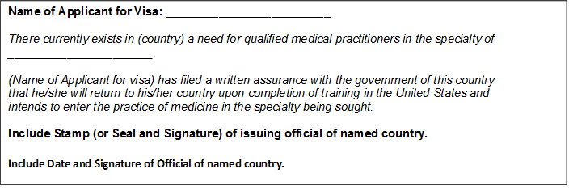
Initial Application Documents
  Statement of Need Sample
Exact wording that has been approved by the U.S. Secretary of Health and Human Services for the Statement of Need:
Notes:
Statement of Need Sample
Issued by federal office of applicant’s most recent country of permanent residence
Ministry of Health letterhead
Addressed to ECFMG
Align with specialty being pursued
Contain stamp/seal of issuing government
Dated signature of issuing official
Issued in English
Also known as the Ministry of Health (MOH) Letter

Slide 22
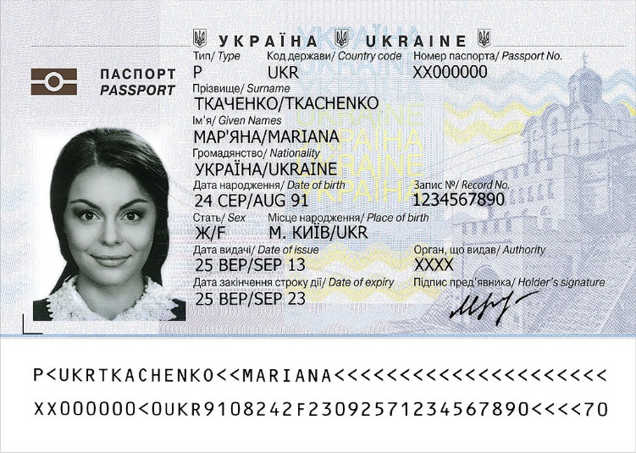
Initial Application Documents
CV
  Educational History
  Academic History
  Month/Year to Month/Year format
  All gaps after medical school should be accounted for.
Passport Name Page
    Applicant
    All dependents

Slide 23
Additional Initial Application Documents
  Previous IAP-66 and/or DS-2019 (previous J1s)
  I-94 Arrival/Departure Records (previous J-1s)
  Return Airbill for Expedited Delivery (Optional)
  Transfer Request Documentation (J1-reseach to J1-clinical)
  Medical School Diploma & Passport Photo (LCME Graduates Only)
Notes:
EVNet

Slide 24
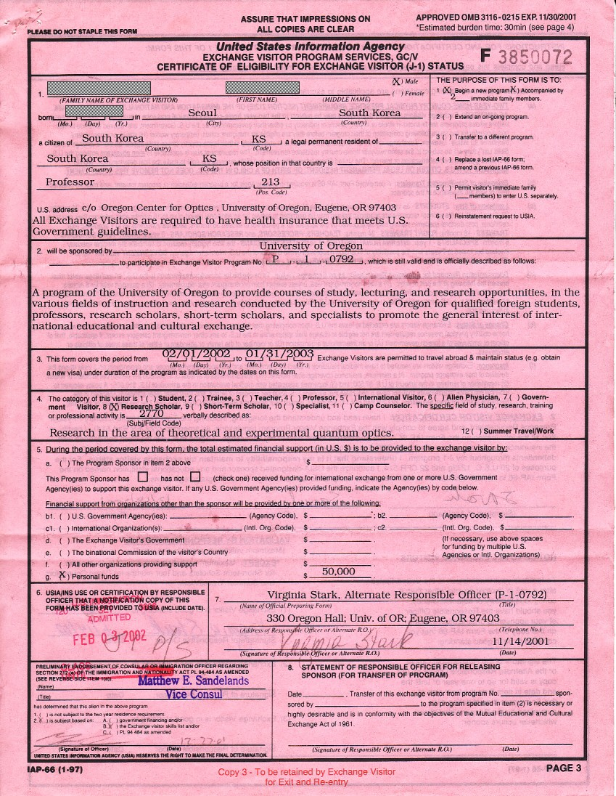
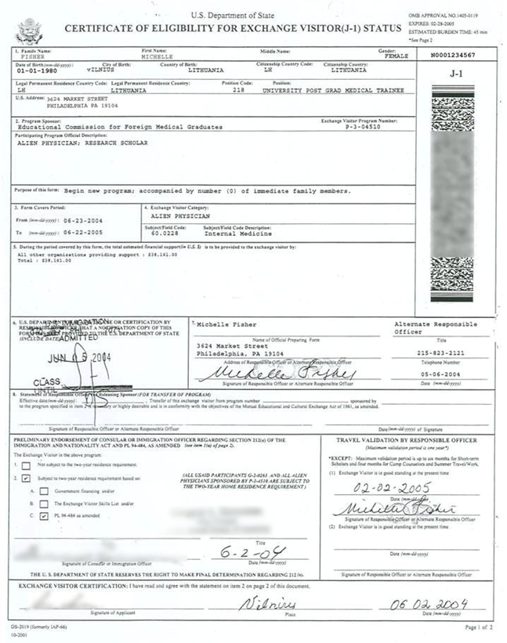
Additional Initial Application Documents
  Previous IAP-66 now a DS-2019
Sample IAP-66
Sample DS-2019
Notes:
About DS-2019
The Form DS-2019 or "Certificate of Eligibility for Exchange Visitor (J-1) Status" is the basic document used in the administration of the exchange visitor program.
This form permits a prospective exchange visitor to seek an interview at a U.S. embassy or consulatein order to obtain a J visa to enter the United States.
The Form DS-2019 identifies the exchange visitor and their designated sponsor and provides a brief description of the exchange visitor’s program, including the start and end date, category of exchange, and an estimate of the cost of the exchange program. Read the detailed description of the Form DS-2019.
How can I obtain a Form DS-2019?
Designated sponsors are authorized to issue this form to prospective exchange visitors they have screened and selected for participation in the exchange visitor program (see How To Apply). The information in this form is completed by the sponsor prior to being given to the participant, who once given the DS-2019, can apply at a U.S. embassy or consulate for the J-1 visa.
Issuance of the J-1 visa, like all non-immigrant visas, is at the discretion of Consular Officers viewing visa applications at U.S. embassies and consulates. This means that even if you are accepted to an exchange visitor program and have received your DS-2019, the Consular Officers decide if you receive the J-1 visa.
The Form DS-2019:
Identifies the participant (block 1);
Identifies the sponsor (block 2 and block 7, which contain the name, signature and telephone number/address of the sponsor’s responsible officer);
Provides a brief description of the program activity to be completed by the participant (block 2);
Identifies the beginning and end dates of the program (block 3) and the program category (block 4); and
Provides a breakout of the total estimated financial support to be provided to the participant during his or her program (block 5).

Slide 25

DS-2019
DS-2019 Mailed to TPL
Review all information for accuracy
Copy/Scan for program records
Mail to J-1 Holder via trackable courier
Notes:
The Form DS-2019:
Identifies the participant (block 1);
Identifies the sponsor (block 2 and block 7, which contain the name, signature and telephone number/address of the sponsor’s responsible officer);
Provides a brief description of the program activity to be completed by the participant (block 2);
Identifies the beginning and end dates of the program (block 3) and the program category (block 4); and
Provides a breakout of the total estimated financial support to be provided to the participant during his or her program (block 5).

Slide 26
J1-Appointment Application
  Create Appointment Profile in EVNet
  Initiate Individual Appointment
  Upload All Required Documents
Resident Completes OASIS Application & Pays Fee
4-6 Weeks
  DS-2019 Mailed to TPL

Slide 27
Initial Arrival

Slide 28
J1-Appointment Application
Maximum 30 days prior to start date
  Visa Holder Enters Country
Within 72 Hours
  Initial Arrival Verification With TPL
3-10 days
  Initial Arrival Validation
7-14 days
  Social Security Number Application

Slide 29
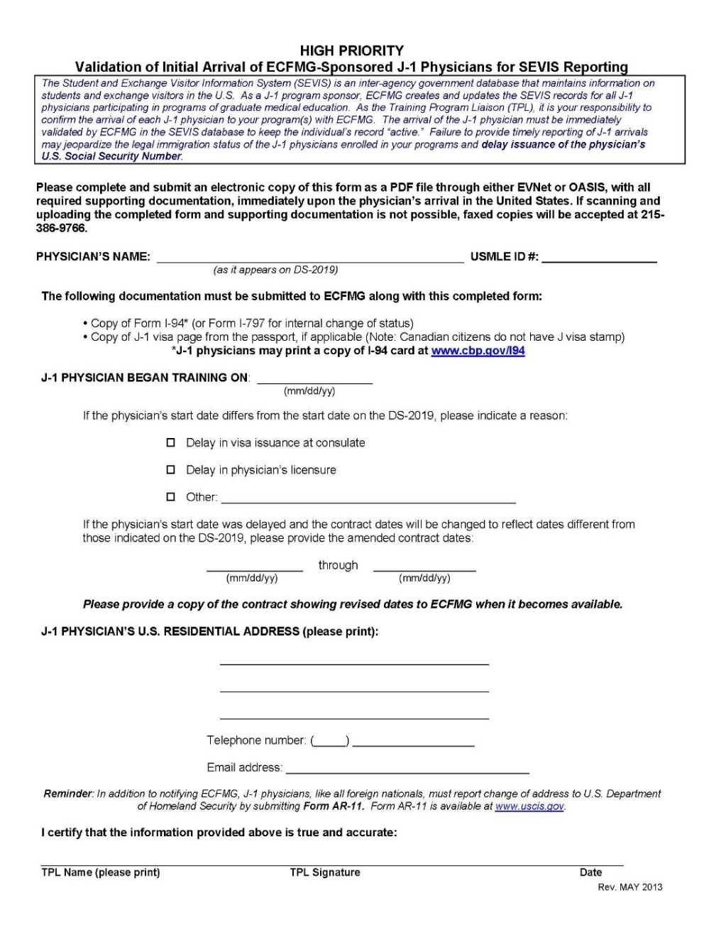
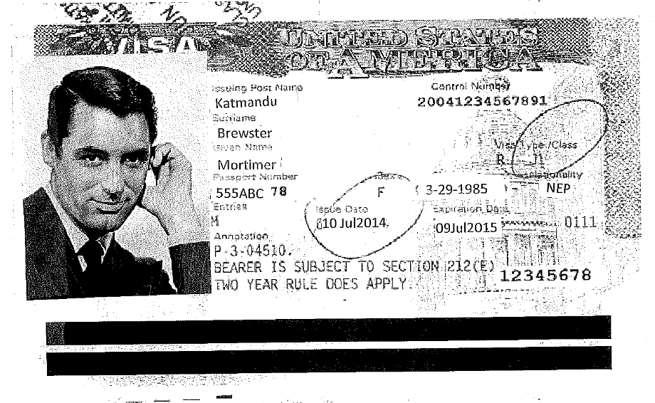
Initial Arrival Validation Form
Validation of ECFMG sponsored
Copy of visa
Notes:
*Entry Document Only* Confirms:
· Visa type/class
· Number of entries
 (single or multiple)
· Issue date  Expiration date for entry May expire while in the US in valid visa status

Slide 30
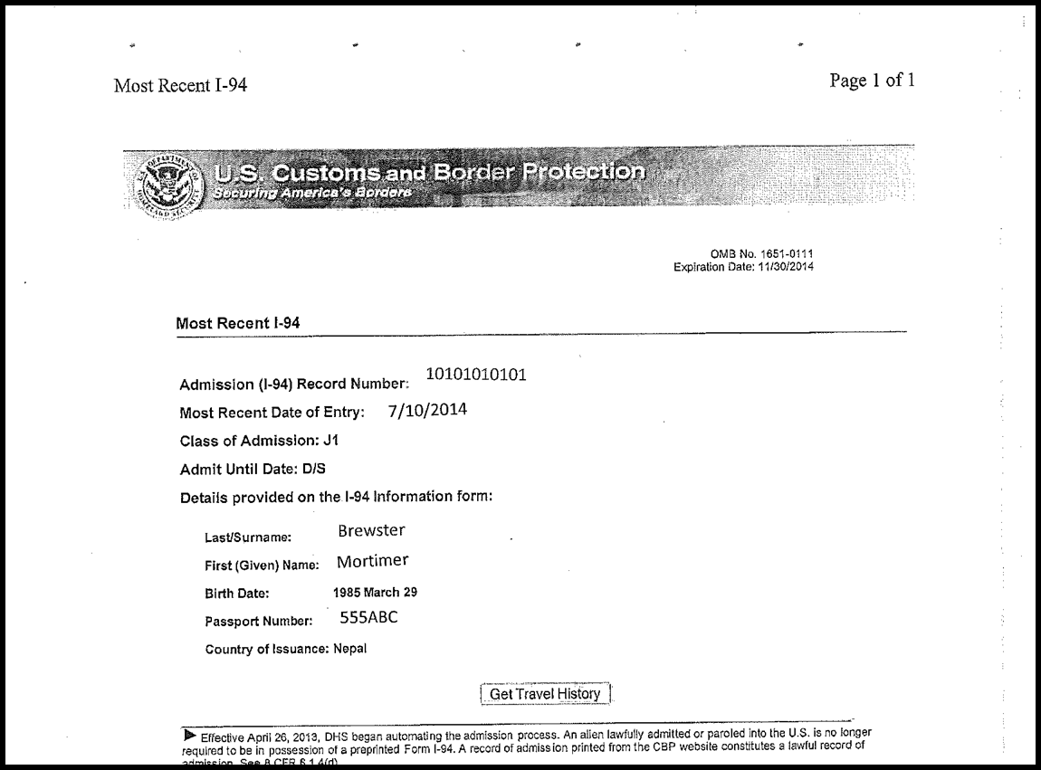
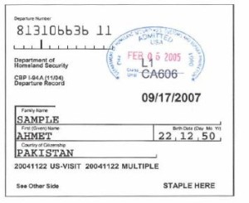
Additional Initial Application Documents
  I-94 Arrival/Departure Records
Electronic I-94
Paper I-94 (Land and Sea Crossings)
Notes:
J-1 Physician + TPL = Complete Application  Sponsorship Available for Participation in:  ACGME-accredited residency training  ACGME-accredited subspecialty training  Non-Standard programs (advanced cutting edge fellowships)  Extension for board examinations Sponsorship application instructions available

Slide 31
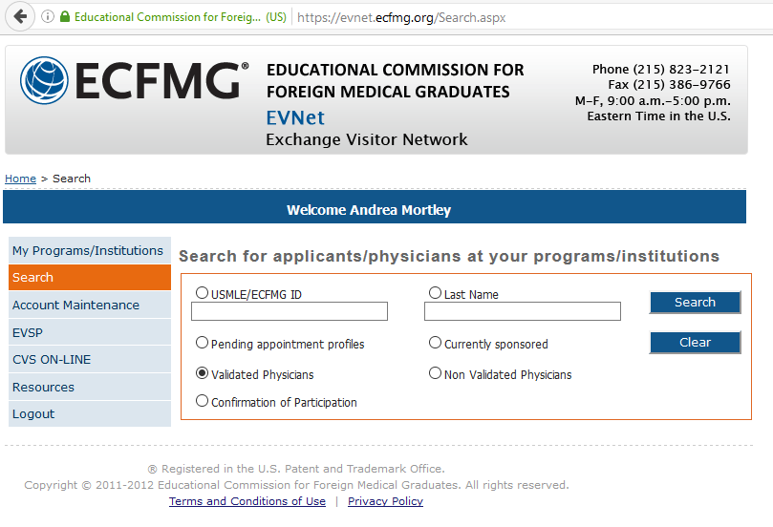
SEVIS Verification
Notes:
SEVIS Student and Exchange Visitor Information System  Data exchange between DHS / DOS  Immigration tracking of the activities of non-immigrant (J, F & M) visa holders and dependents  Accessed by consulates, embassies, ports-of-entry, and other DHS agencies  ECFMG creates and updates SEVIS records for all J-1 “alien physicians” and J-2 dependents

Slide 32
Social Security Number
  Apply as soon as SEVIS Verification is complete
        Social Security Number Application
        Original documents
        7-14 days
        Required for I9 Processing

Slide 33
During Residency
Notes:
ROLE OF THE J-1 EXCHANGE VISITOR
Each ECFMG-sponsored J-1 physician is responsible to know and understand the requirements for securing and maintaining J-1 visa status. J-1 physicians are also specifically responsible to:
• Maintain a valid passport
• Secure and maintain required health and accident insurance for themselves and their J-2 dependents, as detailed on the Mandatory Insurance page on the ECFMG website.
• Report any address changes within ten days to ECFMG through ECFMG’s On-line Applicant Status and Information System (OASIS) or the MyECFMG mobile app
• Engage in full-time training at the host institution identified on Form DS-2019
• Notify ECFMG of any proposed changes to his/her training plan (e.g., training levels, training dates, resignation, etc.)
• Adhere to all U.S. laws

Slide 34
Role of the J-1 Exchange Visitor
J-1 physicians are also specifically responsible to:
• Maintain a valid passport
• Secure and maintain required health and accident insurance for themselves and their J-2 dependents, as detailed on the Mandatory Insurance page on the ECFMG website.
• Report any address changes within ten days to ECFMG through ECFMG’s On-line Applicant Status and Information System (OASIS) or the MyECFMG mobile app
• Engage in full-time training at the host institution identified on Form DS-2019
• Notify ECFMG of any proposed changes to his/her training plan (e.g., training levels, training dates, resignation, etc.)
• Adhere to all U.S. laws

Slide 35
Insurance Requirement
Federally mandated requirement
Minimum continuous coverage
Trainee attests annually in OASIS

Slide 36
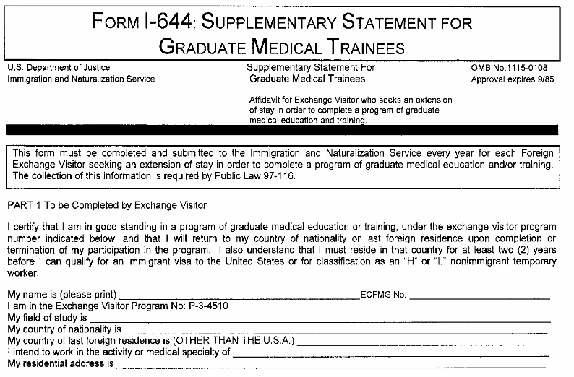
Form I-644
Completed annually for continuing trainees

Slide 37
Away Electives
Notification of Off Site Rotation Form
http://www.ecfmg.org/evsp/notification-off-site-rotation.pdf
Required 30 or more days in advance
New DS-2019 will be issued

Slide 38
Leave of Absence/Early Departure
Leave of Absence
Notification of Leave of Absence Form
http://www.ecfmg.org/evsp/notification-LOA.pdf
Requires updated contract if training dates impacted
New DS-2019 will be issued
Dismissal
http://www.ecfmg.org/evsp/early-dismissal-form.pdf
Resignation
http://www.ecfmg.org/evsp/notification-resignation.pdf
Notes:
■ Medical, FMLA, Educational, etc.  Host institution must seek ECFMG’s pre-approva

Slide 39
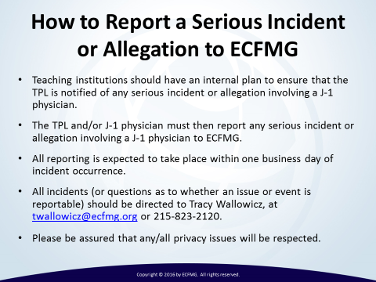
Reporting Serious Incidents

Slide 40
Cross Cultural Activities
  J1 program objective is educational AND cultural
  Trainees expected to have opportunities to learn about American culture
  Celebrating holidays
  Cultural activities (museums, festivals, etc)
  Social events (concerts, sporting events)
  Multicultural events (potlucks, festivals)
  Academic conferences
Notes:
As a J-1 Exchange Visitor Program Sponsor, the sponsors are required to comply with all Exchange Visitor regulations found in 22 C.F.R. § 62.15. These regulations require they submit an annual report to the Department of State which includes among other components, a narrative program evaluation which details: (c) Cross-cultural activities. A summary of the cross-cultural activities provided for its exchange visitors during the reporting year. Over the past few years the Department of State has tightened its review of this aspect of the program and all J-sponsors must ensure appropriate compliance or risk jeopardizing their ability to maintain their J program.
What is the Goal of the Cross-Cultural Component? The cross-cultural component of the exchange visitor program gives participants the opportunity to learn about U.S. society and culture outside of their placement; to share their own culture, traditions and views with Americans; to help see the world from another perspective; to be more tolerant and respectful of differences; and to appreciate similarities that bring people together.
What Types of Activities are Appropriate? Cross-cultural programs can be built around any number of general themes that participants might like to learn more about: civic responsibility; civil rights; community service and volunteerism; American history and exploration; youth leadership; science, technology, engineering and math in the local/global economy; personal or individual freedoms; American entrepreneurial spirit; democracy and governance; individual responsibility; holidays and food; the media; government; American film, culture and the arts; and ethnic, racial and religious diversity in the U.S.offered by your host teaching institution to share your culture, learn from others with different backgrounds, and explore your community.
Examples of cross‐cultural experiences might include:
Family picnics
Excursions to local amusement parks, sporting events, concerts, museums, or community events
Celebrations for U.S. holidays (i.e., Thanksgiving, Fourth of July)
Gatherings for physicians / families to share and compare their cultures
Outings to local restaurants or “pot luck” dinners featuring foods from different cultures
Departmental luncheons, happy hours, or other social events
Academic conferences

Slide 41
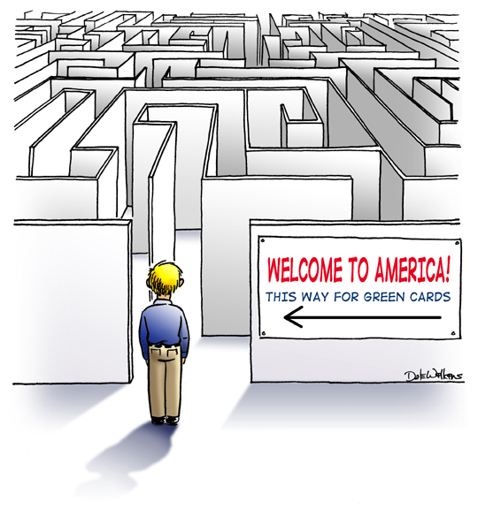

Notes:
When Travel is “REQUIRED”  Be sure to discuss contract conditions • Delayed return • Failure to return  Request travel documents from ECFMG • Travel endorsement on Form DS-2019 Refer to: www.ecfmg.org/evsp/tr

Slide 42
After Residency

Slide 43
Options After Residency
  Fellowship
  J-1 Waiver Job
  Return to Home Country (minimum 2 years)
Notes:
Transition to fellowship; Form I-644 is an attestation of the exchange visitor physician’s good standing in the Exchange Visitor Program as of his/her participation in his/her most recent host program. It must, therefore, be completed by the program director or the director of graduate medical education at the current, or most recent (not proposed) host institution.

Slide 44
J-1 Waiver Job
No required documents from training program
Items that may be requested:
Letters of recommendation
Board eligibility letter
Copies of visa documents
Notes:
J-1 Physicians are normally limited to seven years in training, but can also obtain an extension of J-1 status to take specialty board examinations.
Waivers: Program participants who are subject to the two-year home-country physical presence requirement, must apply for a waiver of that requirement if they seek to remain in the United States beyond the end date of their programs or if they seek to submit an application for a change in visa status. A waiver may be requested for five statutory bases:
a claim of Exceptional Hardship to a U.S. citizen or legal permanent resident spouse or child of an exchange visitor if the exchange visitor is required to return to the country of residence;
a claim that the participant will be persecuted due to race, religion, or political opinions if he/she returns to the country of residence;
a request from an interested U.S. Government Agency on the participant's behalf;
a No Objection Statement from your government; and
a request by a designated State Health Department or its equivalent.
Participants must file an application to receive a recommendation for a waiver with the Department of State. All J-1 waivers are awarded based on the fiscal year; from October 1 through September 30. As a physician can have only one interested government waiver pending at a time and can only have one waiver it is particularly important that a physician begin looking for a job as early as possible and to perform due diligence on the waiver job before signing the employment contract.

Slide 45
Returning to Home Country
No required documents from training program
Trainee has 30 days from end date to leave the country
Several extensions can be requested:
Board Exams (trainee initiated)
Personal/Medical (program initiated)
Notes:
Failure to depart the United States on time will result in you being out of status. Program Extension: The responsible officer has the discretion to extend a participant's program to its maximum regulatory duration, that is, to the limit imposed by the regulations specific to a program category or to a program sponsor's designation. A new Form DS-2019 reflecting the extension is issued to the participant. Extensions beyond the maximum program duration are allowed in some program categories for exceptional or unusual circumstances, with approval from the Department of State. To obtain approval for such extensions, the responsible officer must submit a written request that justifies the petition and provides supporting documentation to the Department of State on behalf of the participant.
Travel Grace Period: Following the completion of their program, the period defined on the Form DS-2019, the United States Citizenship and Immigration Services (USCIS) allows participants a 30-day travel period commonly referred to as the "Grace Period." During this 30-day grace period, participants are no longer in J-visa status, and are under the jurisdiction of the USCIS. The USCIS grants this period to allow participants to settle their affairs and to prepare to return to their home countries. Program participants may no longer continue and/or complete exchange activities, nor may they work. Although participants may travel in the United States, it is recommended that they do not travel beyond the borders of the United States as they may not be permitted reentry..

Slide 46
Best Practices
&
Resources
Notes:
Pre-Arrival Information
Sponsors are required to provide their participants with information about the program and related matters before they leave their home countries for the United States. Sponsors must also provide their participants with specific program information and any contractual obligations relevant to their program category. For details, please refer to the regulations. [22 CFR 62.10 (b)(1-8) and specific regulations for categories of interest]
Orientation
Sponsors must offer appropriate orientation for all participants, and are encouraged to offer orientation to the participant's family (J-2 spouses and dependents), especially those expected to remain in the United States for at least one year. For details, please refer to the regulations. [22 CFR 62.10 (c)(1-7) and specific regulations for categories of interest]. Orientation materials should include information about the region, state and locale.

Slide 47
Recommendations for Trainees
  Retain copies of all visa documents.
  Keep originals in a safe place and copies in separate location.
  Do not carry around documents unless absolutely necessary.
Notes:
The IMG Advisors Network (IAN) is a free service of the ECFMG Certificate Holders Office (ECHO). IAN allows qualifying IMGs who plan to come to the United States to connect with advisors who can answer questions about applying to U.S. GME and living and working in the United States. IAN advisors may also be a good source of advice and guidance on training and career issues beyond residency, such as pursuit of subspecialty fellowships. Beyond Entry into U.S. GME, there are daily living issues, these issues typically have included:
Where to find housing
Where to find ethnic restaurants and grocery stores
Where to find houses of worship
Setting up personal finances
Obtaining a Social Security Number
Buying/leasing an automobile; getting a driver’s license
Spouses and children - employment opportunities, child care, schools
Support groups - people from the same country or ethnic groups
Expectations for work and call schedules, time off, vacations
Recreational resources
U.S. culture - books, TV shows, movies, music, sports
Language - idioms, jargon, abbreviations (see also the “Medicalese” glossary)
Unique features or characteristics of the program or the area in which it is located

Slide 48
Resources
Pre-Arrival Information
http://www.ecfmg.org/evsp/pre-arrival-information.html
The Exchange Visitor Program Welcome Brochure
https://j1visa.state.gov/wp-content/uploads/2015/03/Brochure-The-Exchange-Visitor-Program.pdf
U.S. Embassies and Consulates
http://www.usembassy.gov/

Slide 49
Resources
Visa Appointment and Processing Wait Times
https://travel.state.gov/content/visas/en/general/wait-times.html
Wilberforce Pamphlet on the Rights and Protection of Temporary Workers
https://travel.state.gov/content/dam/visas/LegalRightsandProtections/English%20Online%20Reading%205-20-2013.Pdf

Slide 50

Questions

