Slide 1
Department of Medicine Faculty Meeting January 24, 2017
Announcements
Clinical Update
ACO Readiness, Context and Contributions to Success

Slide 2
Announcements
Update on Section Chief searches
Medical Data Science retreat on February 27 at 12:30 pm in EBRC 714/715
Suggestions for 2017 Evans Days Speakers sought
Faculty and trainee Dim Sum tentatively scheduled for Saturday February 18, 2017 (details to follow)
Update on Searches
ID
Heme Onc
Chair searches: Surgery, Neurology, Otolaryngology

Slide 3
BU Benefits
Final agreement near on reducing fringe rate on departmental (non-grant) portion of salaries to low 20% from high 20% range
Retroactive to July 1, 2016
Clearer definition of “full time” for purposes of benefits
No major changes in existing benefits
Improvements in HR and other administrative services sought
Depending on overall financial performance, seek to increase faculty compensation/incentive payments

Slide 4
Upcoming Grand Rounds
January 27, 2017-CLINICAL / RESEARCH
Activity Title: "Is Calorie a Calorie? The Redox Approach to Understanding Metabolism"
Speaker: Dr. Caroline Apovian & Dr. Nawfal Istfan
February 3, 2017
Activity Title: Philip Kramer Lecture
Speaker: Dr. Vijay Shah & Terri Johnson
February 10, 2017
Activity Title: TBD
Speaker: TBD
February 17, 2017- CLINICAL / RESEARCH
Activity Title: TBD
Speakers: Dr. Frederick Ruberg and Dr. Lawreen Connors
February 24, 2017
Activity Title: Joint Grand Rounds for Internal Medicine and Hematology-Oncology
Speakers: Dr. Linda Sprague-Martinez & Dr. Karen Winkfield

Slide 5
March Grand Rounds
March 3, 2017
Activity Title: Beldon Idelson VP
Speaker: TBD
March 10, 2017
Activity Title: TBD
Speaker: Elizabeth McGlynn
March 17, 2017
Activity Title: IM Residency Alumni Speaker
Speakers: TBD
March 24, 2017
Activity Title: TBD
Speakers: Dr. Nicholas Hill & Dr. Harrison Farber
March 31, 2017- CLINICAL / RESEARCH
Activity Title: TBD
Speakers: TBD

Slide 6
Faculty Development Seminars
Making Effective Use of BU Profiles for Graceful Self-Promotion
Christopher Shanahan
January 25th from 12-1pm in computer lab L1110
Giving Effective Presentations
Rob Lowe
February 2nd from 12-1pm in Evans 118

Slide 7
Faculty Development Seminars
How to Navigate BU/BUMC Resources for Finding Funding
Rick Ruberg
February 6th from 12-1pm in Evans 118
Effective Communication for Leading High Performing Teams
David Coleman & Mark Braun
February 6th from 5-6pm in Evans Seminar Room (112A)
How to Publish on MedEd Portal
Rachel Simmons, Jenny Siegel, and Gail March
February 6th from 12-1pm in Evans 118

Slide 8
DOM Networking Dinners
Educators’ Dinner
January 25th from 6:30 to 8:30
Enjoy good food and meaningful discussion with your DOM colleagues.
Emelia Benjamin’s home in Brookline
RSVP to Robina Bhasin at rbhasin@bu.edu

Slide 9
Application deadlines for longitudinal faculty development programs
Academy for Faculty Advancement: early career
February 1st – March 19th
Mid-Career Faculty Leadership
February 13th – March 26th
Women’s Leadership
March 20th – April 23rd
Under-Represented Minority Faculty Development
April 3rd – April 30th

Slide 10
Early Career: Academy for Faculty Advancement (AFA)
Target audience
BUMC Instructors & Assistant Professors
Number of Faculty
Up to 30 per year
Program Structure
9 months from September to May
Meets 2 ½ hours two Mondays each month
Applications accepted February 1 - March 19, 2017
Program Elements
Professional development experiential seminars
Individual academic project with content mentor
Peer mentorship across BUMC schools
Career mentorship provided by AFA core faculty

Slide 11
Mid-Career Faculty Leadership Program
Target audience
BUMC Late Assistant Professors & all Associate Professors
Number of Faculty
14 FPF faculty + up to 6 BUSM & SPH faculty
Program Structure
July – June
Meets off campus for six 2-day modules
Applications accepted February 13 – March 26, 2017
Program Elements
360 evaluation & coaching
Team leadership projects
Senior and peer mentorship
Meetings with inspirational leaders in health sciences
Experiential seminars focused on developing leadership skills

Slide 12
Women’s Leadership Program
Target audience
BUMC women faculty
Number of Faculty
Up to 20 per year
Program Structure
10 months from September to June
2 hours every three weeks
Applications accepted March 20 – April 23, 2017
Program Elements
Experiential seminars focused on effective leadership and fostering change from current role
Learning community to successfully negotiate challenges, foster resiliency, and achieve goals
Conversation Cafes with inspirational leaders

Slide 13
Minority Faculty Development Program
Target audience
BUMC under-represented minority in medicine faculty
Number of Faculty
Up to 20 per year
Program Structure
9-months from October to June
1.5 hours every three weeks
Applications accepted April 3 – April 30, 2017
Program Elements
Experiential seminars focused on career and leadership development skills, and the experiences of URM faculty
Individual career coaching to identify resources and mentors, successfully negotiate challenges, and achieve identified goals
Conversation Cafes with inspirational leaders

Slide 14
Goals of URM Post-Graduate & Faculty Development Program
Increase recruitment, retention & advancement of URM trainees & faculty in DOM
Enhance vitality and visibility of URM trainees & faculty
Foster sense of community among URM trainees & faculty
Create an inclusive environment in DOM

Slide 15
Activities (1 of 2)
Support recruitment of URM trainees & faculty
Support Residency Program interview season with morning presentation, interviewing, and URM resident and faculty support at end of interview day dessert.
Meet with prospective URM faculty candidates
Increase retention & advancement of URM trainees & faculty
Pilot unconscious bias talk at pre-clinic ambulatory conference for residents
Longitudinal leadership & faculty development program
Eleven URM faculty from BUSM
Program includes an individualized development plan (IDP) for each participant to support participants with mentoring and career planning
Stay interviews of all URM faculty in DOM are underway

Slide 16
Activities (2 of 2)
Increase vitality and foster community
URM & Allies Dinner at Emelia Benjamin’s home in November 2016
Attended by faculty, residents and fellows from BUMC
Next URM & Allies Dinner in May 2017
URM faculty and trainee networking event at local restaurant in December 2016
Quarterly networking events planned

Slide 17
Clinical Update
New Documentation Policy being unveiled by FPF, delinquent notes distributed in February
Clinician satisfaction Advisory Group have interviewed 20 clinicians from 10 clinical sections-data being analyzed
Physician coaching (Patient Experience initiative) starting in Endocrine section
Clinical Faculty Compensation Committee report due soon
wRVU’s up 6.9% compared to AY 16

Slide 18
Clinical Volume FY YTD
 | Relative to Budget | Relative to FY 16
Discharges | 1.5% increase | 7.0% increase
Clinic Visits | 8.0% decrease | 1.6% decrease

Slide 19
Recap: The Commonwealth is aiming to reduce spending off trend 2.5% over 5 years…
MassHealth approaching 40% of their budget
Commonwealth is looking to reduce spending off trend 2.5% over 5 years…
… and fundamentally alter the trajectory of healthcare cost growth in the longer term
Source: MassHealth communication January 2016

Slide 20
. . . By moving providers into MassHealth Accountable Care Organizations
ACO guiding principles
Local accountability
“ACO is an organization of healthcare providers that agrees to be jointly held accountable for achieving measured quality improvements, reductions in rate of spending growth, and overall care of patients who are assigned to it”
Standardized performance management
Payment reform

Slide 21
Despite uncertainty of transition in Federal government, MassHealth is still aggressively pursuing reform on the same timeline…
Waiver approved
2016
2017
Jan 16
9
10
11
12
1
2
3
4
5
6
7
8
9
10
11
12
Apr 17
Jul 17
Oct 17
ACO
ACO
selection
MassHealth ACO contracting and rates finalized
Member
selection
Auto-
assign
ACO RFR released (incl. Model Contract)
Databooks & pricing methodology released
ACO
responses due
ACO
launch
ACO readiness reviews
Apr 17
Jul 17
Pilot performance period begins
Pilot performance period ends
MCO
MCO RFR released (incl. Model Contract)
MCO
responses due
MCO
selection
MassHealth MCO contracting
MCO readiness reviews
BH & LTSS Community Partners (CPs)
CP RFI released
Draft design document released for public comment
Public comment due
CP RFR released
CP RFR responses due
CP selection
MassHealth CP contracting
CP readiness reviews

Slide 22
Initially, we provided a route for potential partners to join BACO as limited members to take part in the MassHealth ACO pilot
Expanded BACO MassHealth ACO Pilot:
Core BACO (10 groups)¹ – 22K
HealthFirst Family Health Center (Fall River) – 2K
Greater New Bedford CHC – 5K
Family Healthcare Center at SSTAR (Fall River) – 1K
Upham’s Corner Health Center – 3K
Boston Healthcare For The Homeless – 1K
Signature Healthcare (Brockton) – 6K
Sisters Of Providence Health System (Springfield) – 2K
We are gaining experience using MassHealth data and collaborating across a broader group of physicians
Core BACO: Health Centers: Codman Square, Dorchester House, Greater Roslindale, Mattapan, South Boston, Sound End Hospital: Multiple BMC primary care and pediatric practices

Slide 23
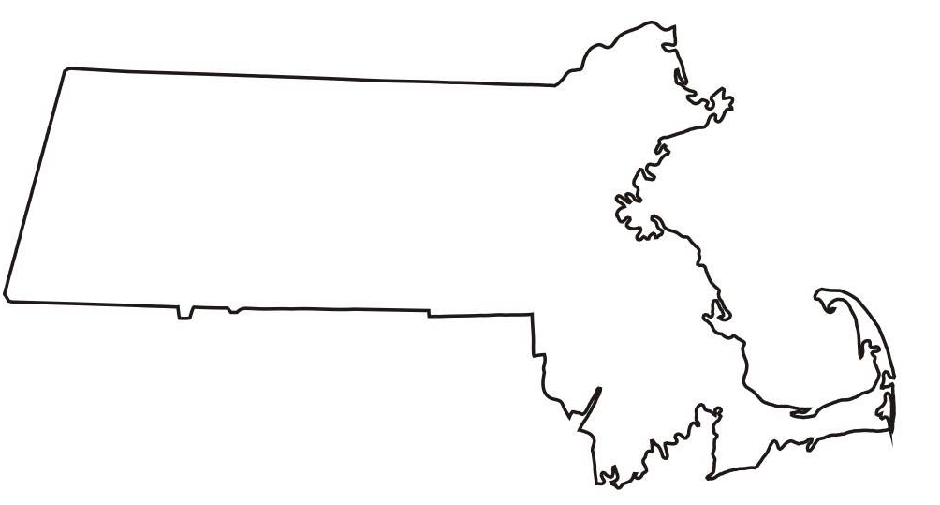
We are on track to form partnerships with a significant number of organizations across MA in Model A ACO/MCO arrangements…
High-potential partner organizations by region Number of lives in thousands
BACO
Existing BACO (42)
BHCHP (3)
South
Sturdy (10) Greater NB CHC (9)
HealthFirst (3)
SSTAR (2)
South Shore (1)
West
Holyoke Med Ctr. (8)
Cooley Dickinson (11)
Others still considering
Merrimack Valley ACO¹ (45)
Mercy/Riverbend (30)
Signature Brockton (31)
Southcoast (24)
Cape Cod (13) Outer Cape CHC (4) Duffy Health Ctr. (2)
We project that our current partnerships will result in ~200K lives statewide
1. Greater Lawrence Family Health Center and Lawrence General Hospital

