Slide 1
Managing Conflict and Difficult Conversations
Grand Rounds
Department of Medicine
28 April 2015

Slide 2
Francine Montemurro,
Boston University Ombuds
fmonte@bu.edu
www.bu.edu/ombuds

Slide 3
Learning Objectives
Think about the options we have and what we can influence regarding:
Our perspectives of conflict
Understanding and engaging some basic negotiation skills
Preparing for difficult conversations

Slide 4
“Conflict”

Slide 5
“A quarrel between friends, when made up, adds a new tie to friendship.”
Saint Francis de Sales

Slide 6
Perspectives of Conflict
One perspective:
Conflict is a social disease that needs a cure
Another perspective:
Conflict is normal whenever people get together
When managed appropriately conflict can help us move ahead

Slide 7
Takeaway #1
Effective conflict management calls for engaging conflict constructively, not avoiding or suppressing it

Slide 8
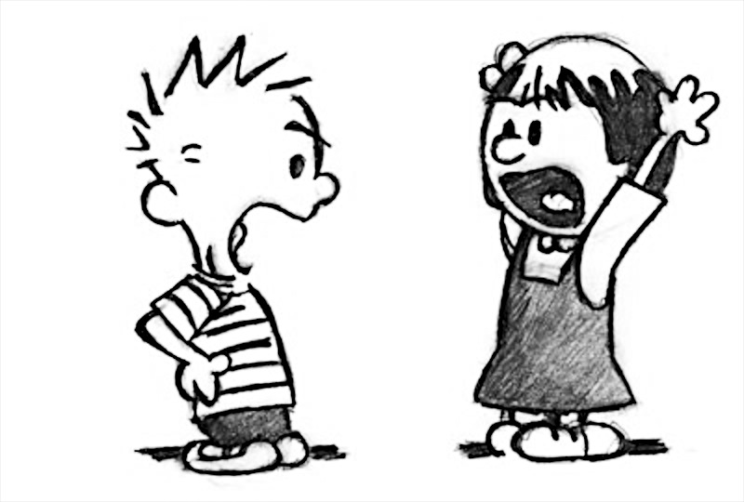
Case Study:
Octavia Jones and Prunella Winters

Slide 9
Takeaway #2
Managing conflict well is a combination of will and skill
Learn how to engage some basic conflict management and negotiation skills

Slide 10
A few Basic Skills
Active Listening (seek to understand)
Fundamental negotiation concepts*
Separate the people from the problem
Focus on interests, not positions
Use objective criteria
Understand your BATNA (“away from the table”)
Create “elegant” (win-win) solutions
*Adapted from Getting to Yes, Roger Fisher and William Ury, Penguin Books

Slide 11
Understanding Interests
Positions answers the question “what?”
Interests answers the question “why?

Slide 12
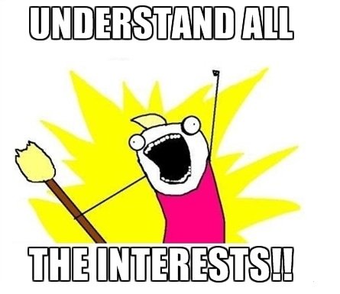
Positions and Interests
(understanding what’s really at stake)
 | Definition | Example
Position Your demand; what you say you want. | A specific outcome or action perceived as meeting immediate needs. | I need a $10,000 raise or I’ll have to find a new job.
Interest What really matters to you. | The desires, beliefs, and needs underlying your position. | Shelter, safety, financial security, fairness, respect social status, self-esteem, etc.

Slide 13
Takeaway #3
Conflict happens
With thoughtful preparation, difficult conversations are more likely to yield constructive outcomes

Slide 14
Preparing for a Difficult Conversation
First: Work on You
“The majority of the work in any conflict conversation is work you do on yourself.”
“No matter how well the conversation begins, you’ll need to stay in charge of yourself, your purpose and your emotional energy.”
Judy Ringer, Portland, NH
www.JudyRinger.com

Slide 15
What can we Influence in
a Difficult Conversation?
Find the right time and place for your conversation
Be in the right frame of mind
Think about your best approach and how to carry it out
Invite the conversation
Help set the tone
*Developed by Melissa Brodrick, Ombudsperson, Harvard Medical School

Slide 16
What can we Influence in
a Difficult Conversation?*
Listen Actively
Commit to your plan and . . .
. . . show some flexibility as warranted
Summarize your understandings at the end of the conversation
Seek help when you need it
*Developed by Melissa Brodrick, Ombudsperson, Harvard Medical School

Slide 17
Preparing for a Difficult Conversation

Slide 18
Takeaway #4
Don’t go it alone
Know when to ask for help
Be willing to ask for help
Know where to ask for help

Slide 19
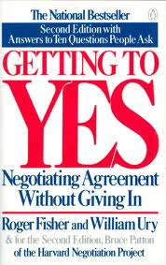
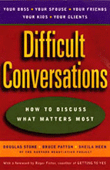
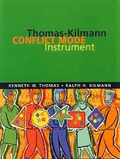
A Few Good Resources

Slide 20
Francine Montemurro,
Boston University Ombuds
fmonte@bu.edu
www.bu.edu/ombuds

