Slide 1

Clinical Trials:
Budgeting, Billing & Financial Management
Financial and Administrative Management of Research
Education and Training Program
Selvin Ohene
Director, Clinical Trial Office
October 21, 2014

Slide 2
Goals of the presentation
What will I get out of this training?
An understanding of Medicare Coverage Analysis
An overview of the Financial Lifecycle of a clinical trial as well as Roles & Responsibilities
An understanding of the Budget Development process at BMC
An understanding of the Financial Management of a Clinical Trial (Charge Capture) and Account Reconciliation
An understanding of what is required to properly Closeout a clinical trial.
What is a Qualifying Clinical Trial?
Drug/Biologic study qualification (IND) & Device study qualification (IDE)
Routine Costs vs. Research-only costs
Billing Grids
Medicare Coverage Analysis workflow

Slide 3
Clinical Trial Finance Lifecycle
RESEARCH
vs. SOC
CHARGE
CAPTURE
BILLING
&
CODING
CTO
CLAIMS
EDITING
PATIENT
VISIT
PATIENT
REGISTRATION
INVOICING
Patient Enrollment and Interaction
Financial Management
PATIENT
CONSENT
COLLECTIONS
POST TO
CORRECT
RESEARCH
ACCT.
COVERAGE
ANALYSIS
Account Reconciliation and Closeout
Study Initiation
RECONCILIATION
Others involved
BUDGETS
REPORTING
PI
Study Team
Department Administrator
CONTRACT
MGMT
ACCOUNT CLOSEOUT
IRB APPROVAL

Slide 4
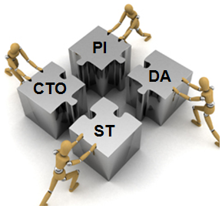
Roles & Responsibilities
Principal Investigator (PI)
Department Administrator (DA)
Financial Management
Medicare Coverage Analysis Approval & Attestation
Budget Review and Approval
Provide Administrative Support to PI
Regulatory Submissions
Medicare Coverage Analysis
Budget Development & Negotiation
Terms and Conditions
Financial Administration
Study Team (ST)
Provide study support to PI
Study Training
Responsible for Study Conduct
Account Reconciliation
& Closeout
Budget Development
Attestation at Closeout
Patient Interaction
Data Management
Clinical Trial Office (CTO)
Account Reconciliation
Account Reconciliation
Notes:
Compliance should be at the forefront of everyone's mind when thinking about clinical trials. Compliance is important for human subjects protection and compliance with

Slide 5
An Introduction to Medicare Coverage Analysis

Slide 6
What is a Coverage Analysis?
Medicare Coverage Analysis
Determines if patient care costs are the financial responsibility of the sponsor, other funding source, or qualify for reimbursement by third party payers
Comprehensive analysis of clinical trial related documents to determine the billing status of items and services administered as part of a clinical trial.
Basis of the research billing compliance process
Source: Huron Consulting Group and PharmaSeek Financial Services

Slide 7
Why Should an MCA be performed?
Assures compliance with the CMS National Coverage Decision 310.1 that states, “Effective for items and services furnished on or after July 9, 2007, Medicare covers the routine costs of qualifying clinical trials…as well as reasonable and necessary items and services used to diagnose and treat complications arising from participation in all clinical trials. All other Medicare rules apply.”
Medicare “double billing” has been the subject of numerous OIG and Department of Justice (“DOJ”) investigations/settlements
From a research and business perspective, it is important to track routine care vs. “research only” procedures
It is the “right” thing to do
And for all of the reasons above, the Board requires that an MCA is performed on all Clinical Trials using BMC clinical infrastructure.

Slide 8
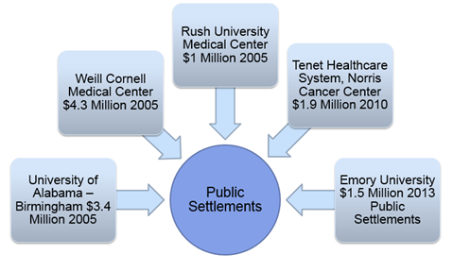
Risks and Consequences of Not Performing a Coverage Analysis
Major Risks if You Do Not Perform an MCA
Billing third-party payors for the following services rendered on clinical trials:
Services that are already paid by the sponsor (double-billing).
Services promised free in the informed consent.
Services that are for research‐purposes only.
Services that are part of a non‐qualifying clinical trial
These services should never be billed to a
patient’s insurance!!!
Consequences
Costs Associated With Investigation
Civil Fines
Criminal Penalties
Increased Governmental Scrutiny
Loss of Govern-mental Funding
Costs to Implement Corrective Action Plan
Loss of Trust by Sponsors and Participants
Under Billing
Source: Huron Consulting Group and PharmaSeek Financial Services

Slide 9
Why Coverage Analysis is important to you
Principal Investigators (PIs) carry the ultimate responsibility for the conduct of the research study including compliance with billing regulations.
The MCA addresses the two conditions identified in the Center for Medicare and Medicaid Services (CMS) Clinical Trial Policy (CTP)
Determining if a clinical trial qualifies for coverage by CMS
and if so,
Which items/services are considered routine care and billable to Medicare.
All clinical trials and clinical research utilizing BMC clinical infrastructure will require a Coverage Analysis prior to budget development and negotiation and Clinical Trial Agreement Execution.

Slide 10
Step 1– Does the Clinical Trial Qualify?
On September 19, 2000, CMS issued the National Coverage Decision (NCD) on clinical trials, known as the Clinical Trials Policy.
Any clinical trial receiving Medicare coverage of routine costs must meet the following three requirements:
The subject or purpose of the trial must be the evaluation of an item or service that falls within a Medicare benefit category (e.g., physicians' service, durable medical equipment, diagnostic test) and is not statutorily excluded from coverage (e.g., cosmetic surgery, hearing aids).
The trial must not be designed exclusively to test toxicity or disease pathophysiology. It must have therapeutic intent.
Trials of therapeutic interventions must enroll patients with diagnosed disease rather than healthy volunteers. Trials of diagnostic interventions may enroll healthy patients in order to have a proper control group.
DOES THE TRIAL ALSO HAVE THE DESIRED CHARACTERISTICS WHICH HELP AUTOMATE QUALIFICATION???
SOURCE: National Coverage Determination (NCD) for Routine Costs in Clinical Trials (310.1)

Slide 11
What is a “Qualifying Clinical Trial?”
Drug/Biologic Study Qualification
Evaluates a Medicare benefit
Has therapeutic intent
Enrolls diagnosed beneficiaries
Qualifying Trial
Has desirable characteristics
Item /service falls within a Medicare Benefit category and
is not statutorily excluded from coverage (e.g. cosmetic surgery, hearing aids)
i.e. not designed exclusively to test toxicity/pathology; and
Enroll patients with diagnosed disease rather than only
healthy volunteers (but may also enroll a healthy control group)
Deemed Trials (Presumed to meet the desirable characteristics criteria automatically qualified)
 Funded by NIH, CDC, AHRQ, CMS, DOD and VA; or
 Trials supported by centers or cooperative groups funded by same (above); or
 Trials conducted under an IND reviewed by the FDA; or
 IND exempt under 21 CFR 312.2(b)(1)

Slide 12
Step 2– What are considered “Routine Costs”?
Routine Costs – Billable to insurer
Items or services that are typically provided absent a clinical trial (e.g., conventional care);
Items or services required solely for the provision of the investigational item or service (e.g., administration of a noncovered chemotherapeutic agent), the clinically appropriate monitoring of the effects of the item or service, or the prevention of complications; and
Items or services needed for reasonable and necessary care arising from the provision of an investigational item or service--in particular, for the diagnosis or treatment of complications.
Research-only Costs – Not Routine Care/Not Billable to insurer
The investigational item or service, itself
Items and services provided solely to satisfy data collection and analysis needs and that are not used in the direct clinical management of the patient (e.g., monthly CT scans for a condition usually requiring only a single scan)
Items and services customarily provided by the research sponsors free of charge for any enrollee in the trial.
SOURCE: National Coverage Determination (NCD) for Routine Costs in Clinical Trials (310.1)

Slide 13
MCA of Studies Using Investigational Devices
Prior to beginning a clinical trial involving an investigational device, approval for reimbursement must be obtained from the local Medicare Contractor for costs related to the device.
http://cms.gov/Regulations-and-Guidance/Guidance/Manuals/downloads/bp102c14.pdf
It is the responsibility of the provider participating in the clinical trial to furnish all necessary information concerning the device and the clinical trial that the Medicare Contractor deems necessary for a coverage determination and claims processing.
SOURCE: Medicare Benefit Policy Manual Chapter 14 - Medical Devices

Slide 14
MCA of Studies Using Investigational Devices
Per Chapter 14 of the Medicare Benefit Policy Manual, the following device categories require Medicare contractor approval:
Category A Devices –
Experimental –
Innovative devices believed to be in class III
Absolute risk of the device type has not been established (i.e., initial questions of safety and effectiveness have not been resolved and the FDA is unsure whether the device type is safe and effective).
CMS normally does not cover Category A devices under Medicare because they do not satisfy the statutory requirement that Medicare pay for devices determined to be reasonable and necessary.
Category B Devices –
Nonexperimental –
    and/or investigational devices believed to be in classes I or II
    or devices believed to be in Class III where the incremental risk is the primary risk in question (i.e., underlying questions of safety and effectiveness of that device type have been resolved),
    or it is known that the device type can be safe and effective because, for example, other manufacturers have obtained FDA approval for that device type.
CMS may cover Category B devices
if they are considered reasonable and necessary
and if all other applicable Medicare coverage requirements are met.

Slide 15

MCA of Studies Using Investigational Devices
The Medicare Contractor must review the use of the device to make a final determination regarding reimbursement before the clinical trial begins.
The CTO will work with the Medicare Contractor to obtain the determination.
A copy of the Medicare Contractor determination and supporting documentation must be maintained with the study budget files for research billing purposes.

Slide 16
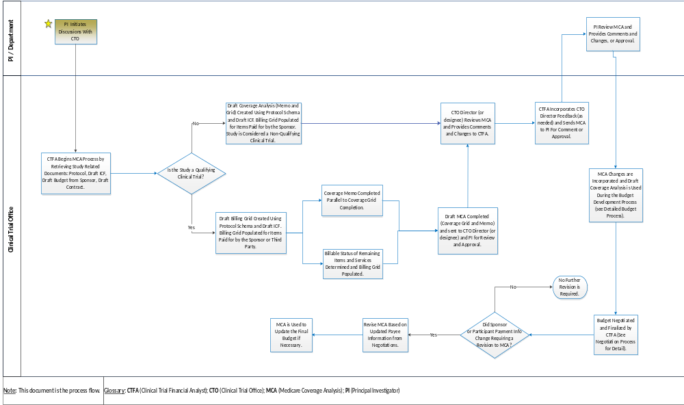
Medicare Coverage Analysis workflow

Slide 17
Documents Required to prepare an MCA
Clinical Trial Office Intake Form
DRAFT Consent Form from Sponsor
DRAFT Budget Template from Sponsor
Draft Clinical Trial Agreement (CTA) or Notice of Grant Award (NOGA)
Protocol
FDA-related documentation
      Approval letter(s) or IND/IDE source documentation
Other pertinent documentation related to the Coverage Analysis

Slide 18
Documents Received From the Clinical Trial Office
Medicare Coverage Analysis Memo
Medicare Coverage Analysis Worksheet
Billing Grid
Details all study events including patient procedures performed during each subject visit
Drives where the service should be billed, who is financially responsible for the charge
Each charge clearly identified as Third-Party (SOC) or Research (Sponsor Paid- SP)
Billing grid should be used for each study participant as a roadmap to guide patient care charges
Vital tool when reconciling study charges

Slide 19
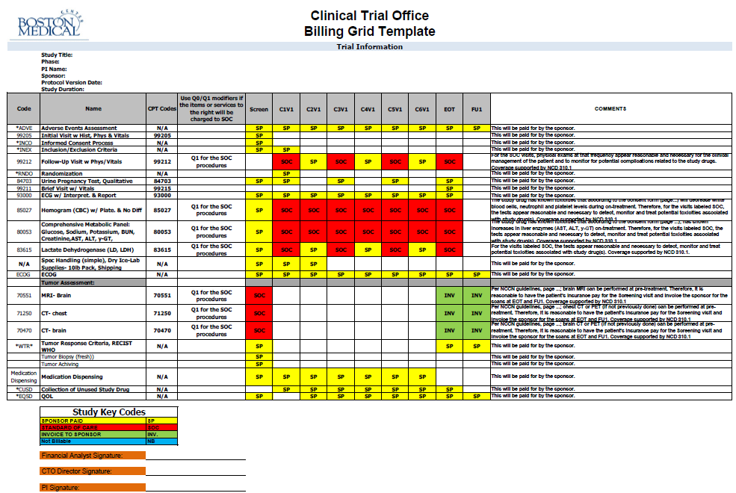

Slide 20


Budget Development

Slide 21
Budget Responsibilities
Principal Investigator (PI)
Receive budget template and agreement from sponsor
Study Team
(ST)
Assist with calculating time associated with events
Department
Administrator
(DA)
Clinical Trial Office
(CTO)
Provide salary information for budget;
Prepare and finalize MCA and billing grid with PI input;
Develops internal budget and sponsor budget;
Negotiates budget with sponsor
Work with CTO to finalize MCA and billing grid;
Review protocol to determine events to be budgeted;
Provide costs for non-clinical budget items (e.g., travel)
Review and approve final budget
Attestation that all study charges will be administered in good faith based on Billing Grid;
Notes:
Please refer to the handout in you package for a full list of

Slide 22

Does the budget support the work to be performed?
This question cannot be answered by looking at the sponsor budget alone.
    An internal budget must be prepared.
    Your CTFA will work with you to answer this question.
It is important to understand the complete cost and have an accurate budget for every clinical trial.
There are many reasons to go ahead with a study knowing the cost is not fully covered, however you should discuss this with your Chair, as departmental or discretionary funds are required to cover the projected deficit.

Slide 23


Capturing all Costs
  Start-Up Costs
  PI and Team Effort - Investigator meeting, Site selection visit, Site Initiation, etc.…
  Administrative Fees
  Study training
  Regulatory Document Preparation
  IRB preparation & review
  Cost should be calculated and included for:
  Screen failure rate
  Drop out rate
  Review of Medications
  Processing of Pharmacokinetics (PKs)
Other fixed costs:
  Pharmacy
    Study Initiation
    Study Maintenance
    Study Close-Out Fees
  Storage fees
  Other fixed costs?
Event Based (Invoiceable) Fees –
As Applicable
Annual IRB Preparation and Review
IRB Amendment Preparation and Review
Safety Report Preparation and Review
Adverse Event Reports submissions
Advertising Fees
Monitoring/Audit Visit Fees

Slide 24

Capturing all Costs (cont’d)
  Patient Care
  Procedures
  Tests
  Labs
  Professional Fees (Budgeted at 100%)
  Subject Costs
  Participant Compensation
    Travel reimbursement
    Lodging reimbursement
Personnel Costs (Time and Effort/Hourly)
  Physician
  Study Coordinator/Data Coordinator
  Research Nurse
  Other Specialists?

Slide 25

Personnel Costs: Professional Fees
Physical Exams
    Complete
    Limited
    Follow- up
Procedural Charges
Per Patient based on CPT
For Industry and Foundation Trials:
PI may budget Professional Fees for clinical procedures, however time allocated to these procedures must not be included in calculation of PI effort.
For NIH Trials:
No professional fees should be budgeted. All PI and other clinical personnel time and effort is expected to be included in budget as % effort.

Slide 26

Personnel Costs: PI Effort
PI’s time is calculated as a % of effort
for all research activities not related to clinical procedures
On-line training
Regulatory review and sign-off
Site initiation meeting
Informed consent process
Review of case report forms
Other document review
Data analysis
Close-out meeting
For NIH Trials, effort for clinical procedures should be included in total effort.
No professional fees should be charged if effort is budgeted.

Slide 27


What To Look For In The Protocol:
CPT Codes Needed
FIRST - Determine Location of the Research
Pharmacy
  Tracking
  Randomization
  Preparation
  Drug Dispensing
  Specific requirements for monitoring
  Drug return or destruction at conclusion of trial
  Pathology
  Reading Fees
  Additional Slides or Blocks
Laboratory
Central lab vs local lab
Who’s drawing the blood?
Who will process the samples?
Radiology
Copies of Films
Who will read the Films
RECIST Reads
Cardiology
ECHO (EKG) – Will sponsor provide EKG?
Reading fees
Pulmonary
PFTs
Notes:
Check with Selvin to see if we want to add or eliminate from this slide

Slide 28
Building an Internal Budget – CTO function
    Salary Expense - Time spent on study outside of clinical procedure
Clinical Charges
        MCA can identify which charges are billable to Sponsor at a research rate
    Travel Charges – Is the PI and/or study required to attend meetings at other sites?
Consultants – Are services required that are not available from BMC workforce?
Subcontracts – Are there other sites for which you will be responsible?
Supplies – Will you be sending out excessive mailings for follow up?
Equipment – Is there a specific piece of equipment required for the trial that must be purchased?
Participant Compensation – How much will each participant be compensated for each visit?
Indirect Costs –
Industry 30% of Total Direct Costs (TDC)
Foundations Published rate TDC
Federal DHHS negotiated rate (74%) of Modified Total Direct Costs (MTDC)

Slide 29
Evaluating the Sponsor Budget – CTO function
Questions to ask:
    Is the per patient amount comparable to the internal budget per patient amount?
    Is the indirect cost correct? (30% for Industry Clinical Trials)
    Are start up and fixed costs covered?
    Are hidden costs covered such as screen failure compensation, etc.?
    What is the initial payment?
    What are the payment terms?
    Will the study break even?
      PI must be notified, and asked to provide a departmental or discretionary account to offset any potential deficit.

Slide 30


Financial Management
(including Charge Capture),
Account Reconciliation &
Closeout

Slide 31
Financial Management & Administrative Responsibilities
Principal Investigator (PI)
Monthly review of expenditures;
Department Administrator
(DA)
Process salary and expense transactions;
Provide administrative/financial support to PI
Update projections;
Clinical Trial Office (CTO)
Monthly reconciliation of patient care charges with Study Team;
Billing to sponsor;
Enrollment Log(s);
Data collection
Study Team
(ST)
Allocation of effort
Monthly review of salary & expenditures (Lawson);
Account setup;
Approve and process journal entries;
Accounts Receivable
Make adjustments/corrections based on Lawson reports;
Maintain Study Binder;
Approve expenses;
Prepare and log participant compensation payments;
Reconcile patient care billing to patient enrollment in collaboration with CTO;
Notes:
Compliance should be at the forefront of everyone's mind when thinking about clinical trials. Compliance is important for human subjects protection and compliance with

Slide 32
Reconciling the study visits
The CTO will reach out on a monthly basis to review and reconcile all charges that have been allocated to a Research Plan in SDK. When you receive the report, a few things to consider…
Are all patients charged to the study truly part of the study?
Are there any patients that you do not see on your list that you know participated?
Are there any charges missing?
Are some of these charges not related to the study?

Slide 33
Closeout Responsibilities
Principal Investigator (PI)
Final reconciliation of all expenses
Department Administrator
(DA)
Reconcile expenses
Clinical Trial Office (CTO)
Ensure all patient data has been submitted to sponsor
Study Team
(ST)
Prepare residual balance transfer form
Final bill to sponsor
Reconcile A/R
Obtain PI certification that all expenses are allocable and appropriate for the trial
Resolution of any deficit
Attestation that all expenses are allocable and appropriate for the trial
Resolution of any deficit
Transfer / correction of any inappropriate expenses
Ensure all anticipated costs have hit account
Review contract and deliverables and confirm that all milestones have been met
Closeout memo(s) to PI/DA
Work with CTO to ensure sponsor has been billed for everything related to the clinical trial
Notes:
Compliance should be at the forefront of everyone's mind when thinking about clinical trials. Compliance is important for human subjects protection and compliance with

Slide 34
Review of Key Points
PI is responsible for all aspects of a clinical trial throughout the lifecycle, with assistance from CTO, Study Team and Department Administrator
All clinical trials and clinical research utilizing BMC clinical infrastructure must have an MCA and must include appropriate hospital service charges (Professional and Technical)
Internal budget development is necessary to determine if sponsor budget will support the trial
CTO staff will assist with MCA, budget development and negotiation
CTO negotiates Terms and Conditions (Clinical Trial Agreement) and final Budget
PI and their Team (DA/SC) are responsible for the post-award monitoring of expenses posted to the clinical trial activity number (Financial Management)
PI is responsible for attesting upfront that charges will be administered in good faith prior to account setup
PI is responsible for attesting that all charges are appropriate prior to account closeout

Slide 35
Who do I Contact if I Have a Clinical Trial?
Clinical Trial Financial Analysts:
Allisson Duggan Dean Robinson
Allisson.Dugan@bmc.org Dean.Robinson@bmc.org
617-414-2867 617-414-2871
CTO@bmc.org

Slide 36
Questions
?
All BMC Research Policies and Procedures can be found at:
http://internal.bmc.org/grants/post_policies.htm

