Slide 1
Department of Medicine
Faculty Meeting
January 23, 2018
Announcements
Center for Regenerative Medicine (A. Wilson)
Smoking Cessation Program (H. Kathuria)

Slide 2
Announcements
Update on Searches for Chief, Section of Infectious Diseases and Chief, Section of Nephrology
Search beginning for Director, Whitaker Cardiovascular Institute
DoM to participate in NIH funded study based at University of Wisconsin on Bias Reduction in Internal Medicine
Considering addition to the DoM’s faculty offer letters that includes mentor options
David Salant, M.D. starting as Vice Chair for Research, March 1, 2018
Budgeting process for AY 19 beginning this month – “A” and “E” support in CARE+ under review
Coding Audit for clinical charges to start soon

Slide 3
Faculty Development Seminars
Using Mobile Technology to Enhance Patient Outcomes
  Christopher Shanahan, Rebecca Mishuris, Jeffrey Kalish
  January 30th from 12-1pm in Wilkins
Incorporating Active Learning Strategies into Your Teaching
  Molly Cohen-Osher
  February 6th from 12-1pm in Wilkins

Slide 4
Faculty Development Seminars
Smashing the Silo: Tips for effective collaborations between clinical & basic scientists
  Avrum Spira & Jessica Fetterman
  Feb 22nd 12-1pm in FGH Carter Conference Room
Working with Trainees to Turn QI into scholarship
  James Moses
  February 27th from 5-6pm in Wilkins Board Room

Slide 5
Application deadlines for longitudinal faculty development programs
Academy for Faculty Advancement: early career
  February 5th – March 12th
Mid-Career Faculty Leadership
  February 5th – March 9th
Women’s Leadership
  March 19th – April 16th
Under-Represented Minority Faculty Development
  April 2nd – April 30th

Slide 6
Academy for Faculty Advancement: Early Career
Program Objective
Develop skills to effectively navigate a successful career in academic medicine
Target Audience
BUMC Instructors & Assistant Professors
Number of Faculty
Up to 30 per year
Program Structure
Meets 2 ½ hours for 14 sessions from September to May
Program Elements
Professional advancement experiential seminars
Individual academic project with content mentor
Peer mentorship across BUMC schools
Career mentorship provided by program core faculty
Applications accepted February 5th - March 12th, 2018

Slide 7
Mid-Career Faculty Leadership Program
Program Objective
Develop strategic leadership skills to foster innovations in education, clinical care, research & public health
Target Audience
Late Assistant Professors (7+ yrs.) & all Associate Professors, selected through a competitive admissions process
Number of Faculty
Up to 14 BUMG + 6 non-clinical BUSM, BUSPH & BUGSDM
  Program Structure
July – June; Meets off campus for 6 two-day modules
RVU support provided for BUMG faculty
Program Elements
360 evaluation & coaching; Senior and peer mentorship
Team leadership projects to address institutional needs
Meetings with inspirational leaders in health sciences
Experiential seminars focused on developing leadership skills
Applications accepted February 5th – March 9th, 2018

Slide 8
Women’s Leadership Program
Target Audience
BUMC women faculty in leadership roles
Number of Faculty
Up to 20 per year
Program Structure
Meets for 15 two-hour sessions from September to June
Program Elements
Experiential seminars on leadership skills and fostering change as a woman leader
Peer mentoring & coaching to successfully negotiate challenges, foster resiliency, and achieve goals
Conversation Cafes with inspirational leaders
Applications accepted March 19th – April 16th, 2018

Slide 9
URM Faculty Development Program
Target Audience
BUMC under-represented minority in medicine* faculty
Number of Faculty
Up to 20 per year
Program Structure
Meetings monthly for 1.5 hours from October - June
Program Elements
Experiential seminars focused on career and leadership development skills, and the experiences of URM faculty
Participant-led forums on navigating a career in academic medicine as a URM faculty member
Individual career coaching to identify resources and mentors, successfully negotiate challenges, and achieve identified goals
Applications accepted April 2nd – 30th, 2018
*NIH defines URM: Blacks or African Americans, Hispanics or Latinos,
American Indians/Alaska Natives, Native Hawaiians and other Pacific Islanders

Slide 11
Grand Rounds Speakers
Date | Topic | Speaker
January 26th | Immigration Status as Important Social Determinant of Health | Dr. Sarah Kimball
February 2nd | Palliative Care at Boston Medical Center: the Myth, the Legend, the Future | Dr. Sandhya Rao
February 9th | Biologics for severe asthma: A turning point? | Dr. George O’Connor
February 16th | CLINICAL / RESEARCH Topic: Renal Autoimmunity | Drs. Ian Rifkin and Ramon Bonegio
Notes:
Gopal Yadavalli

Slide 12
Grand Rounds Speakers
Date | Topic | Speaker
February 23rd | Ethics Panel | Michael Ieong and Jolion McGreevy
March 2nd | Topic: TBD | TBD
March 9th | Neuroprognostication after Cardiac Arrest | Dr. David Greer
March 16th | CLINICAL / RESEARCH Topic: HIV Related Topic | Drs. Manish Sagar and Ioana Bica
March 23rd | Mark Moskowitz Visiting Professor Lecture | Joann G. Elmore M.D., M.P.H. Professor of Medicine, Adjunct Professor of Epidemiology, University of Washington School of Medicine Harborview Medical Center
Notes:
Gopal Yadavalli

Slide 13
Wilson Lab Research Program Overview
DOM Faculty meeting
1/23/18

Slide 14
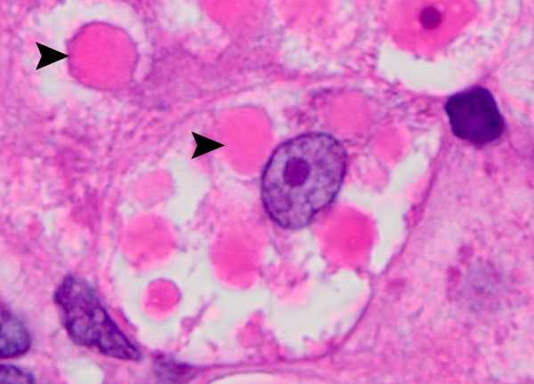
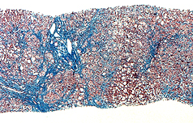
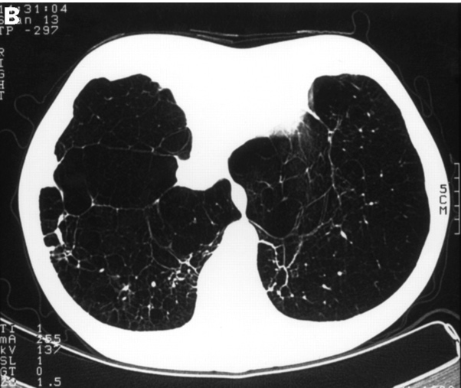


PiZZ AATD phenotypes:
Gain of Function:
Intracellular accumulation of misfolded zAAT
Aberrant gene expression
Liver disease (≈12%)
Loss of Function:
Low level circulating AAT protein
Protease/antiprotease imbalance in the lung
Lung disease
Notes:
Numerous open questions in the field that both the Wilson and Kotton labs are interested in addressing. NOTE: need image of liver fibrosis. In general, have mainly focused on the gain of function effects in our studies over the past several years and what I am going to tell you about today is the variety of ways that we are going about addressing this question. Not only going to be describing the basic research that we have been doing in the lab but also the clinical-epidemiological research we have gotten involved with in addressing AATD-associated liver disease, the tools we have been assembling to address these questions, and the ways in which we are trying to take advantage of our clinical portfolio to advance studies in the lab.

Slide 15
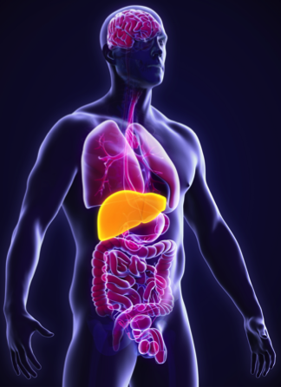


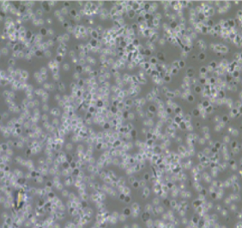
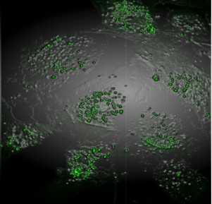
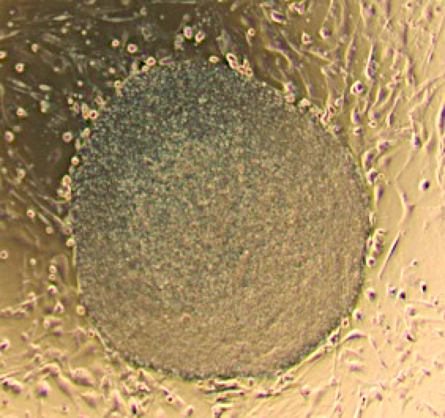
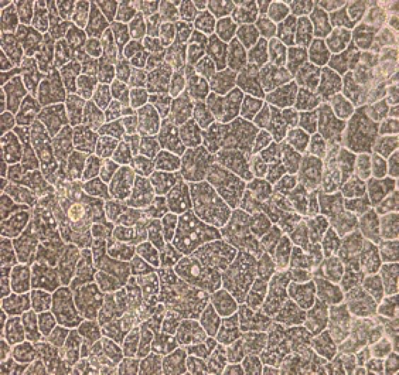
iPSC applications:
Reprogramming factors
Klf4
Oct4
Sox2
cMyc
Cell-based
therapy
100
Survival (%)
50
Model drug toxicity
0
0
15
20
50
100
Patient sample
Drug concentration (nM)
Test drug efficacy
LC3-GFP
Model disease
100
Patient iPSCs
50
Labelled AAT (%)
0
Time (hours)
Differentiated cell type of interest
Notes:
Figure 2: Potential future iPSC applications for AATD: A sample of patient cells, such as skin fibroblasts or peripheral blood, undergoes reprogramming via the transient expression of the transcription factors Oct4, Klf4, Sox2, and cMyc. Colonies that emerge in culture are functionally similar to embryonic stem cells but are instead termed “induced” pluripotent stem cells, or “iPSCs”. iPSCs can be differentiated into cell types affected by genetic diseases such as AATD and in some cases a disease phenotype is then observed in vitro. Future applications of iPSCs relevant to AATD will potentially include predictions of future risk of liver disease (based on the secretion kinetic of radiolabeled AAT protein), in vitro testing of drug efficacy (in this case represented by induction of LC3+ autophagosome formation), testing for potential drug toxicity, and the production of cells that can undergo transplantation back into the patient after genome editing to repair the SERPINA1 Glu342Lys mutation that causes AATD. Engrafted iPSC-hepatocytes could represent a potential future treatment for AATD-associated liver disease.

Slide 16

CReM AATD patient- iPSC repository:

Slide 17


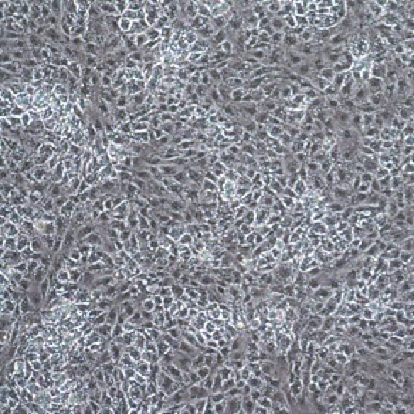
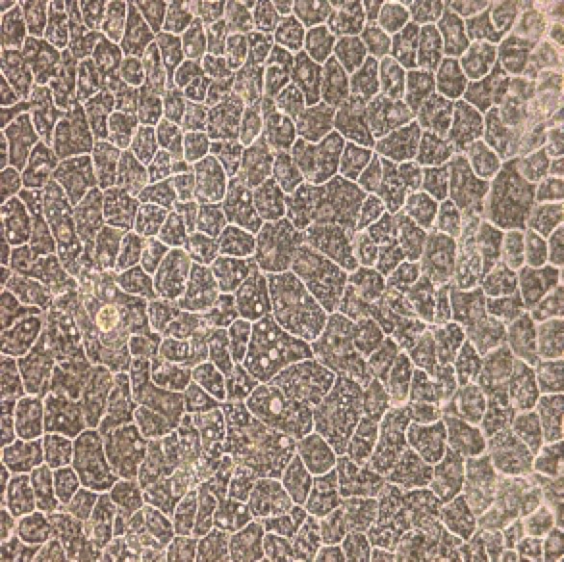
Turning undifferentiated cells into liver cells:
A
B
Undifferentiated
hiPSCs
Hepatic
progenitors
AAT
SOX17
Endoderm
iPSC-heps
ALB
1000000
HNF4A
100000
AFP
Relative gene expression
10000
1000
100
10
1
Day 0
Day 5
Day 12
Day 25
0.1
0
5
15
25
Human Fetal Hepatocyte
Days of differentiation

Slide 18

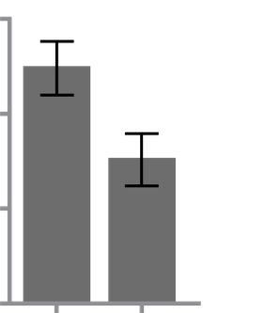


Patient iPSC-hepatic cells model disease:
A
Intracellular AAT
B
Secreted AAT
C
Endoderm
ESC
iPSC Normal
iPSC PiZZ
*
**
15000
10000
*
PC2
Hepatic
ng/ml
5000
ESC-hep
ZZ iPSC-hep
0
Undiff
MM iPSC-hep
ZZ iPSC-hep
PiZZ
MM iPSC-hep
PC1

Slide 19

How do we “edit” a gene?
1-3
Ex4
Exon 5
sgRNA target site
PAM
5’GCCGTGCA
Z mutant SERPINA1
TAAGGCTGTGCTGACCATCGACAAGAAAGGGACTGAAGCTGCTGGG3’
3’CGGCACGT
ATTCCGACACGACTGGTAGCTGT TCT TTCCCT GAC TTCGACGACCC5’
ssODN template
5’GCCGTGCATAAGGCTGTGCTGACCATCGATGAAAAAGGTACTGAAGCTGCTGGG3’

Slide 20

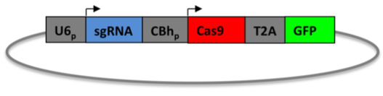
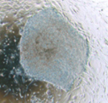
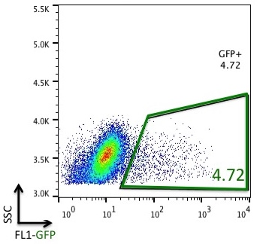
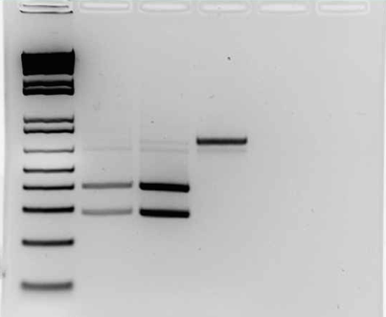
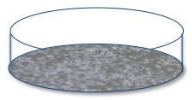
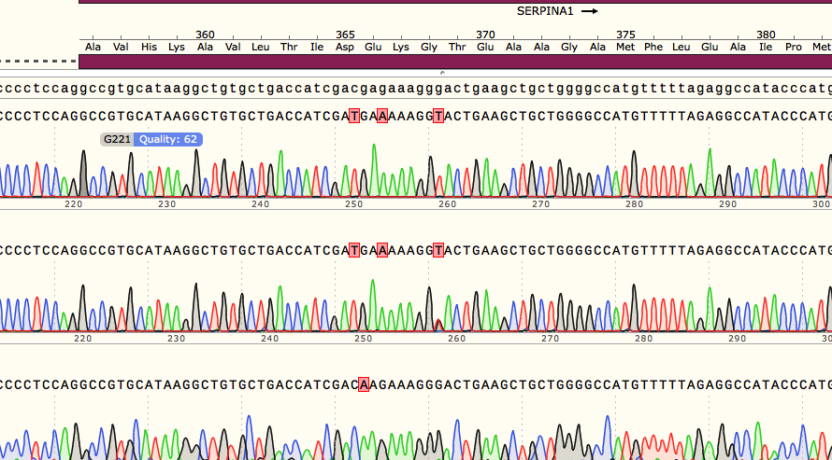
CRISPR/Cas-based editing of the SERPINA1 locus:
ClaI digest:
1
2
3
48 hrs
PiZZ iPSCs
WT sequence
Clone 1
Clone 2
Clone 3
Notes:
gRNA-Cas9-GFP plasmid = Zhang lab from Addgene “pSpCas9-2A-GFP” (“PX458”)

Slide 21
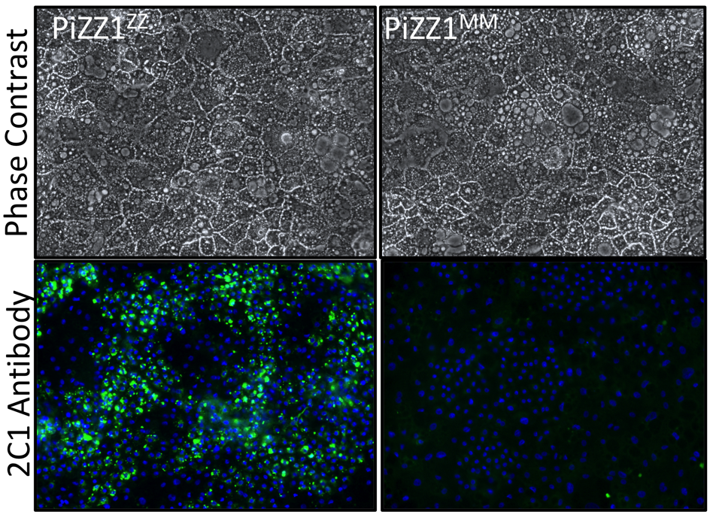
What happens when you correct the Z mutation in patient liver cells?
Parental ZZ line:
Corrected MM line:
D
100-3^{ZZ}
100-3^{MM}

Slide 22
Wilson lab interests:
AATD lung disease
Does Z AAT protein cause GOF toxicity in lung cells?
What genetic co-factors contribute to liver disease risk in ZZ homozygotes?
Can we model CS-injury in patient iPSCs?
AATD liver disease
COPD genetics
Patients
Do COPD GWAS genes contribute to disease pathogenesis?
Are MZ patients (1% of entire US pop) at intermediate risk?
Tool development
Knockouts/ins
Lineage reporters
iPSC repositories
Gene editing
Edit SNPs
Notes:
Tool development: iPSC repositories, differentiation protocols, CRISPR-based genome editing

Slide 23
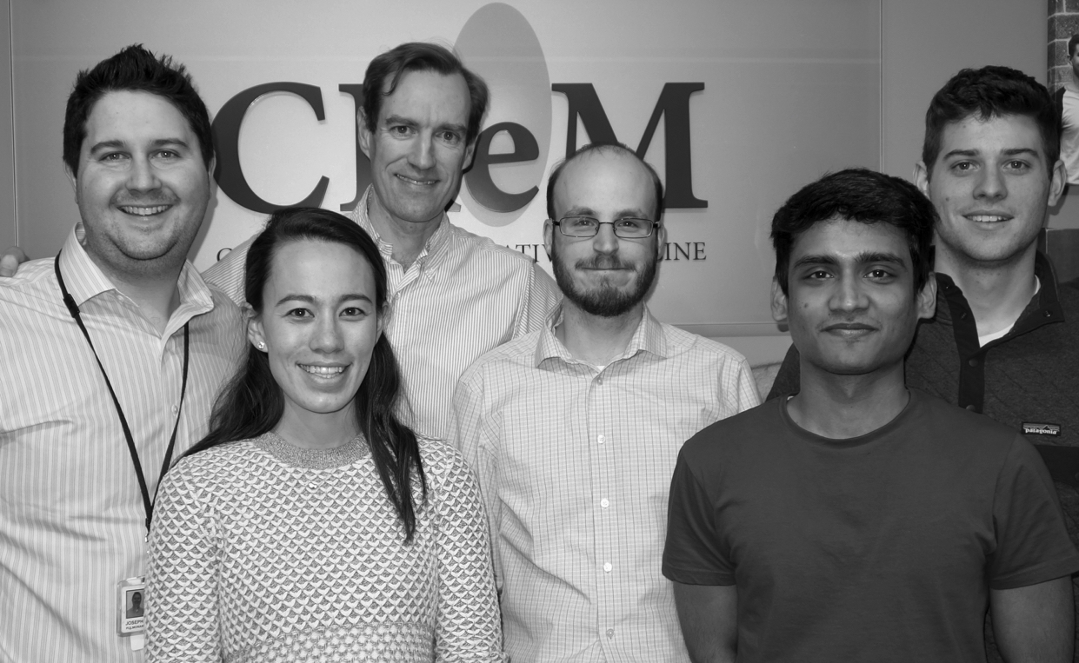
Thanks!
www.wilsonlaboratory.com
www.bu.edu/alpha-1
Subliminal message: don’t forget to test ALL COPD PATIENTS for AATD as recommended by ATS, ERS, GOLD, and others!

Slide 24

Hasmeena Kathuria, MD
Assistant Professor of Medicine, Pulmonary Center
Boston University School of Medicine
Capitalizing on Hospitalization to Improve Smoking Cessation
In the setting of hospitalization, does an intervention that initiates tobacco treatment by proactive outreach to hospitalized smokers improve smoking quit rates and compliance with Tobacco Reporting Metrics?
Notes:
10-12 min max presentation by Hasmeena

Slide 25
Hospitalization: A Teachable Moment
Hospitalization is an opportunity to engage smokers who may not otherwise seek tobacco treatment
It serves as a “teachable moment” of cognitive focus & emotional arousal, when smokers may be acutely aware of the consequences of smoking & thus, more receptive to cessation interventions
Intensive counseling that began during the hospital stay & continues with supportive contacts for at least 1 month post-discharge increases smoking cessation rates post-hospitalization by 40%
Inpatient smoking cessation treatments are associated with:
  Decreased post-discharge mortality, overall
  Decreased post-discharge mortality & hospital readmission rates for patients admitted with CVD
  Decreased rate of re-hospitalization in acute CVD & psychiatric patients
  Increased survival & decreased re-hospitalization in COPD patients
Rigotti NA, Clair C, Munafò MR, Stead LF. Interventions for smoking cessation in hospitalised patients. Cochrane Database of Systematic Reviews 2012, Issue 5. NCD001837.; Colivicchi F, Mocini D, Tubaro M, Aiello A, Clavario P, Santini M: Effect of smoking relapse on outcome after acute coronary syndromes. Am Jn Cardio 2011, 108:804–808.

Slide 26
Tobacco Cessation Metrics at BMC
Several public reporting programs require submission of Inpatient Tobacco Cessation Metrics (DSTI waiver program, MassHealth Pay for Performance program, Joint Commission ORYX)
Inpatient Tobacco Cessation metrics include:
  Tob-1: Tobacco Use Screening
  Tob-2: Tobacco Use Treatment, Counseling & Medication During Hospitalization
  Tob 3: Tobacco Use Treatment Management at Discharge
  Tob 4: 1-Month Follow-Up Assessing Treatment Use/Cessation
Between April 2015 – March 2016 (randomly selected MassHealth BMC hospitalized smokers):
  19.7% (15/76) received tobacco use treatment during hospitalization (Tob-2)
  0% (0/57) patients received tobacco use treatment management at discharge (Tob-3)
Fiore MC, Goplerud E, Schroeder SA. The Joint Commission's New Tobacco-Cessation Measures — Will Hospitals Do the Right Thing? N Engl J Med 2012;366:1172-1174.

Slide 27
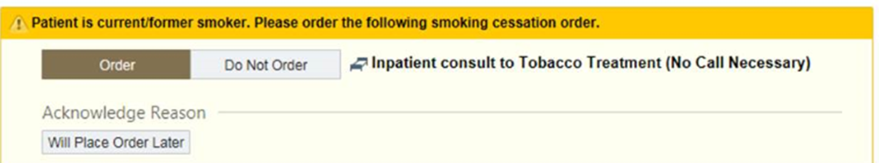
Intervention
We created an Inpatient Tobacco Treatment Consult (TTC) service and a new smoking Cessation Best Practice Alert (BPA)+order set to help hospitalized patients quit smoking
Inpatient smoking cessation consult service
  Provides counseling
  Makes recommendations for nicotine replacement while hospitalized
  Establishes outpatient treatment following discharge
BPA+ order set has been designed to fire for all current smokers admitted to the hospital & display orders for an Inpatient Consult to Tobacco Treatment

Slide 28
Outcome Goals
  Increase the number of hospitalized smokers who receive effective and timely stop smoking advice, counseling, and medications at the bedside and discharge
  Increase the support available to smokers after hospitalization
  Improve compliance with reporting programs: Delivery System Transformation Initiatives (DSTI) waiver program, MassHealth Pay for Performance, and Joint Commission ORYX requirement
  Improve patient outcomes by increasing smoking quit rates

Slide 29
Percent of Smokers & Consults Ordered by Service (30-day)
US Smoking Prevalence
(15% overall)
GED vs. high school | Below vs. above poverty level | Medicaid vs. private
34.1% vs. 19.8% | 26.1% vs. 13.9% | 27.1% vs. 11.1%
US smoking prevalence (%)
Nicole Herbst, Eric Helm,, Carmel Fitzgerald, Charlie O'Donnell, Carolina Wong, Renda S Wiener, Hasmeena Kathuria Capitalizing on the Teachable Moment: Implementation of an inpatient smoking cessation consult service. (abstract). Am J Respir Crit Care Med.; Centers for Disease Control and Prevention, MMWR, 2016; 65(44), 1205-11.

Slide 30
Number of Smokers Who Had Consult Ordered
Percent of smokers whose clinicians signed off on the order set
Adoption: Explore barriers
65% smokers get consult ordered
Nicole Herbst, Eric Helm,, Carmel Fitzgerald, Charlie O'Donnell, Carolina Wong, Renda S Wiener, Hasmeena Kathuria Capitalizing on the Teachable Moment: Implementation of an inpatient smoking cessation consult service. 2017 (abstract). Am J Respir Crit Care Med

Slide 31
Patient Acceptance of Counseling, Nicotine Replacement Therapy, & Outpatient Referrals (Aug 2016 – Jan 2017)
Research: Nursing & IT >implement patient education on meds; initiation of Chantix while hospitalized;
exploring barriers
Research:
meds to bed; Nursing, pharmacy involvement
Research: Longitudinal treatment in methadone and ambulatory clinics; discharge recs; IVR
Nicole Herbst, Eric Helm,, Carmel Fitzgerald, Charlie O'Donnell, Carolina Wong, Renda S Wiener, Hasmeena Kathuria Capitalizing on the Teachable Moment: Implementation of an inpatient smoking cessation consult service. 2017 (abstract). Am J Respir Crit Care Med

Slide 32
Barriers | Representative Quotes
Physicians perceptions of smoker’s motivation Patients with low health literacy, acute illness, and psychiatric disease have little motivation to quit. | “I think that they see smoking as sort of the least of their problems or a crutch that helps make them tolerate their other problems..”
Clinician Factors: In the inpatient setting, smoking cessation is not a priority | “I will say it has been a fault of mine to not always follow up on those recommendations, especially at times of discharge.”
BPA Annoyance | “I don’t like that it (BPA) prevents you from getting to the chart when you need to do something”
Smoking cessation counseling is more of an outpatient issue | “...I feel really comfortable doing outpatient counseling … but I almost never do that inpatient”
System Issues Clinicians are unaware of smoking metrics | “I can’t say that I am actually (knowledgeable) in terms of the actual performance measures.”
Poor communication with smoking cessation team | “I’ve seen the tobacco treatment consult service talking to patients, but I haven’t actually had them then come back to me and say “We spoke with them and this is what they’re thinking.’”
B. Seth, N. Herbst, K Clark E. Helm, C. Wong, C. O'Donnell, C. Fitzgerald, R. Wiener, H. Kathuria Provider-level barriers to adoption of a large-scale inpatient tobacco treatment service , Chest (abstract) 2017

Slide 33
Clinician Suggestions for Improving the Intervention to Hospitalized smokers
Improving communication with the Tobacco Treatment Service
“If you’re actually having a consultant take the time to see a patient and make recommendations and then have them report in person, I think there’s going to be better follow through just because of the person to person contact.” “…anytime a recommendation comes in from a consult team, I think it’s nice to get a text page, because it makes you more aware that that note has gone in.”
Improving transition of care to the outpatient setting
“In an ideal world, they would be able to get it (smoking cessation medications) right at discharge.” “You could do a meds to bed for a month supply of the patch and the gum… so they’re leaving the hospital with it in hand” “Then the other part of that is …making this (tobacco dependence) an outstanding issue on the discharge summary…I think it’s very important to have them (PCPs) on board so that they continue what was started in the hospital.”
B. Seth, N. Herbst, K Clark, E. Helm, C. Wong, C. O'Donnell, C. Fitzgerald, R. Wiener, H. Kathuria Provider-level barriers to adoption of a large-scale inpatient tobacco treatment service , Chest (abstract) 2017

Slide 34
BMC Tobacco Consults: Aug 2016 – Jan 2017
Research Limited Resources:
? target specific populations
? avatar vs in-person counseling
? Engage other personnel
Nicole Herbst, Eric Helm,, Carmel Fitzgerald, Charlie O'Donnell, Carolina Wong, Renda S Wiener, Hasmeena Kathuria Capitalizing on the Teachable Moment: Implementation of an inpatient smoking cessation consult service. 2017 (abstract). Am J Respir Crit Care Med

Slide 35
MassHealth v Non-MassHeath Tobacco Consults
Research Limited Resources:
? target specific populations
? avatar vs in-person counseling
? Engage other personnel such as community health workers
Nicole Herbst, Eric Helm,, Carmel Fitzgerald, Charlie O'Donnell, Carolina Wong, Renda S Wiener, Hasmeena Kathuria Capitalizing on the Teachable Moment: Implementation of an inpatient smoking cessation consult service. 2017 (abstract). Am J Respir Crit Care Med

Slide 36
Effectiveness: Improvement in Performance Measures
MassHealth Patients (2015 vs 2016)
Measure | 2015 | 2016 (January through October)
TOB-1 | 96% | 70.2%
TOB-2 | 2.7% | 39.6%
TOB-3 | 0% | 10.9%
MassHealth Patients (July 2016-January 2017)
 | Seen by TTC Team | Not seen by TTC team
Number of patients | 673 | 702
Inpatient NRT Prescribed | 48.7% | 31.2%
Outpatient NRT Prescribed | 22.9% | 10.1%
6-Month quit rates | 11.2% | 8.8%
 | Medicaid |  | Non-Medicaid
 | Seen by TTC team | Not Seen by TTC team | Seen by TTC team | Not Seen by TTC team
6-Month quit rates | 11.2% | 8.8% | 27% | 9.8%

Slide 37
Conclusions
Greater understanding of who the smokers are at BMC
  Data on demographics, education, race, ethnicity, income, insurance, comorbidities, comorbid substance use
  Data on patient’s motivation to quit, level of dependency, etc.
BPA+ order set is adapted by many inpatient services, but not all (65% adapters)
Increased the number of hospitalized smokers who receive effective & timely stop smoking advice, counseling & medications at the bedside & discharge, but
  Unable to meet demand of consults ordered (quality vs quantity)
  Did not improve quit rates in MassHealth patients
  Low follow-up after discharge
Met compliance with reporting programs, but with unintended consequences [MassHealth v. motivated & high-risk smokers (lung, cardiac, vascular, cancer)]
Need for further research in smoking cessation interventions that target Medicaid patients (community health workers, initiation of Chantix while an inpatient)

Slide 38
Thank-you!
Boston Medical Center
CTSI
Research Partners
Nicole Herbst
Eric Helm (Epic/Data Analyst)
Renda Wiener
Bhavna Seth
Zoe Weinstein
Minda Gowarty
Ryan Seibert
Vinson Cobb
Tobacco Treatment Team
Charles O’Donnell (RRT)
Carmel Fitzgerald (NP)
Carolina Wong (Patient Navigator)
Erin Wilcox (RRT)
Evans Center for Implementation and Improvement Sciences (CIIS)
Allan Walkey
Mari-Lyn Drainoni

