Slide 1
Department of Medicine
Faculty Meeting
May 22, 2018
Announcements
Medical Education Resources for Faculty and Trainees: Lindsay Demers, Ph.D.
Highlights of the Amyloid Center: Vaishali Sanchorawalla, M.D.

Slide 2
Announcements
Medical Student Clerkship leadership changes – Dr. Sonia Ananthakrishnan to become Clerkship Director June 1, 2018, Dr. Hershman to focus on faculty development interests.
ID Section Chief Search update
Renal Section Chief Search update
Rheumatology Section- Clinical Epidemiology Section merger (update)
Bias Reduction in Medicine (BRIM) update
Epic (RevUp) billing go-live update
Leadership training track for residents

Slide 3
Grand Rounds / Chief’s Report
Date | Topic | Speaker
May 25th (Last Grand Rounds) | Emotional Intelligence – Communication Skills for all Career Levels | Dominick Tammaro, MD, FACP Director, Internal Medicine Residency Program Associate Professor of Medicine Alpert Medical School, Brown University Rhode Island Hospital Providence, RI
June 15th | Chief’s Report 2018 | Chief Residents
Notes:
Gopal Yadavalli

Slide 4
K Grant Writing Workshop
Open to Faculty and accomplished Post-Doctoral Students/Fellows who anticipate remaining at BUMC.
Course Directors: Megan Bair-Merritt, MD, MSCE BU-Profile and Richard Wainford, PhD BU-Profile
Key Dates:
  Application Opens May 1st, 2018
  Application Closes June 1th, 2018

Slide 5
Faculty Development Seminars
How to Design a Curriculum
  Priya Garg
  May 24th from 5-6pm in Wilkins
How to Get Your Education Project Published: Part 2
  Bob Vinci
  May 29th from 12-1pm in Wilkins

Slide 6
DOM Networking Dinners
Investigators’ Dinner
  June 19th from 6:30 to 8:30
Enjoy good food and meaningful discussion with your DOM colleagues.
  Emelia Benjamin’s home in Brookline
  RSVP to Robina Bhasin at rbhasin@bu.edu

Slide 7
Faculty Grants
Faculty Development & Diversity Grants
  Open to ALL DOM FACULTY at all levels seeking to further their professional development in research, education, clinical skills, and/or leadership
  Next deadline is July 15th
  http://www.bumc.bu.edu/facdev-medicine/grants/

Slide 8
Epic Billing and Scheduling Update

Slide 9
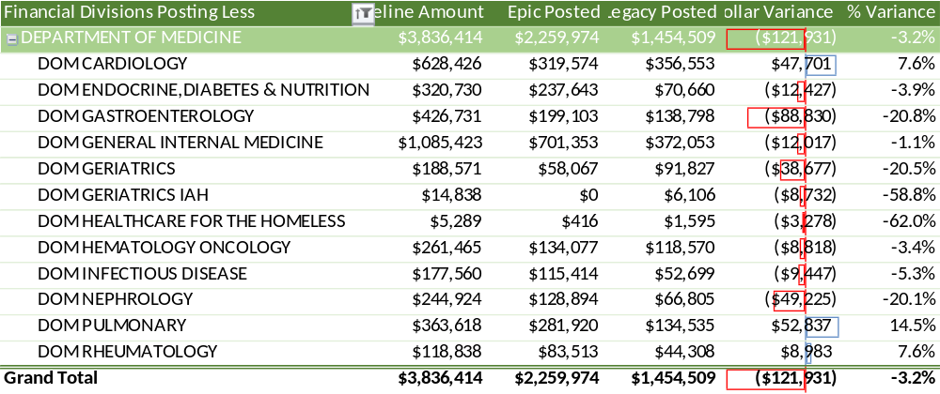
3.2% drop in charges since EPIC
As of 5/17/2018

Slide 10
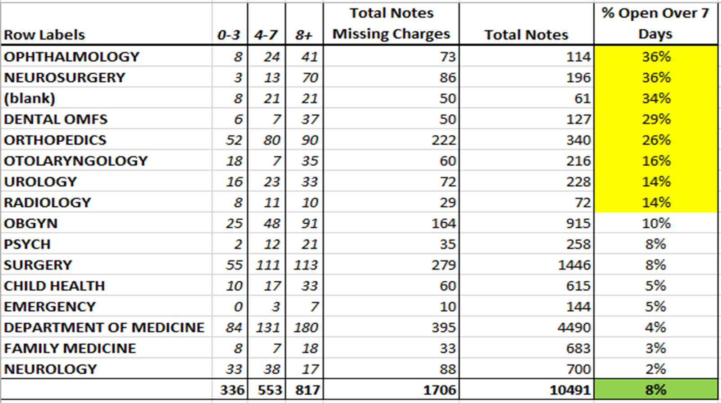
395 Inp Notes Missing Charges
As of 5/17/2018

Slide 11
Next steps
Update Providers, Billing Areas and Accounting Units, if needed
Review all edits and accuracy of Work Queue’s
Controlled sampling of insurance claims
Dashboards and Reports are underway

Slide 12
Budget Update AY 18 and AY 19

Slide 13
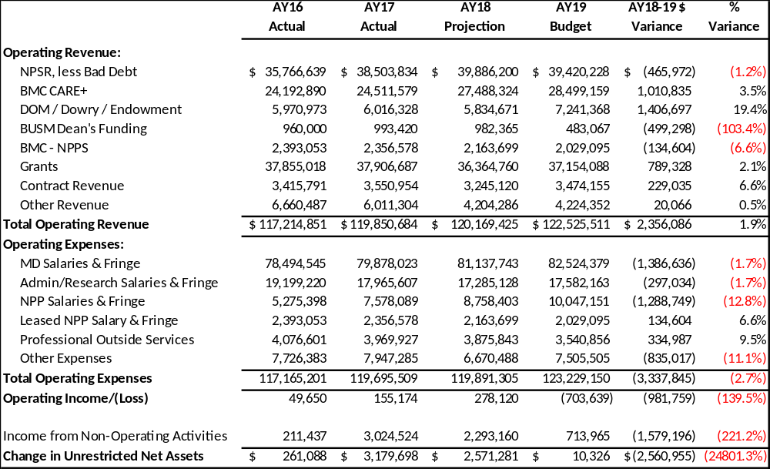
DOM Consolidated P&L
*AY19 Budgeted Non-Ops does not include unrealized gains

Slide 14
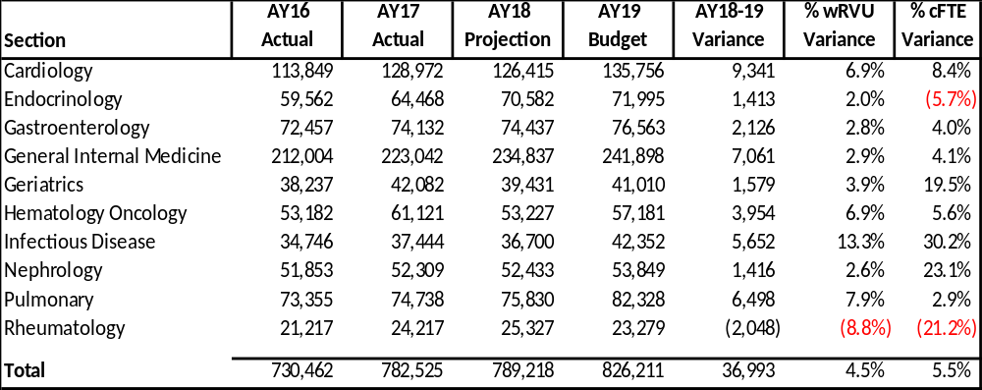
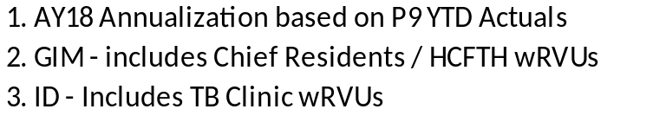
wRVU by Section

Slide 15
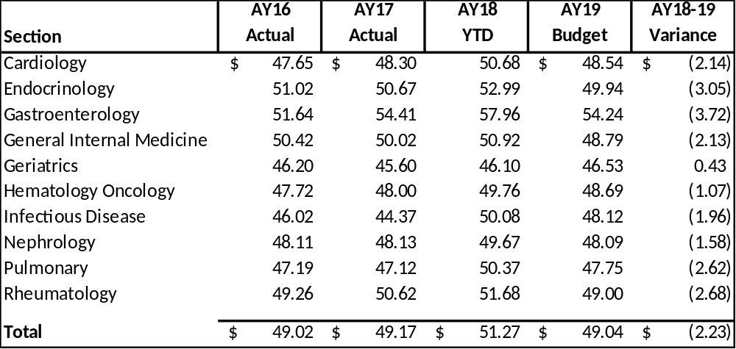
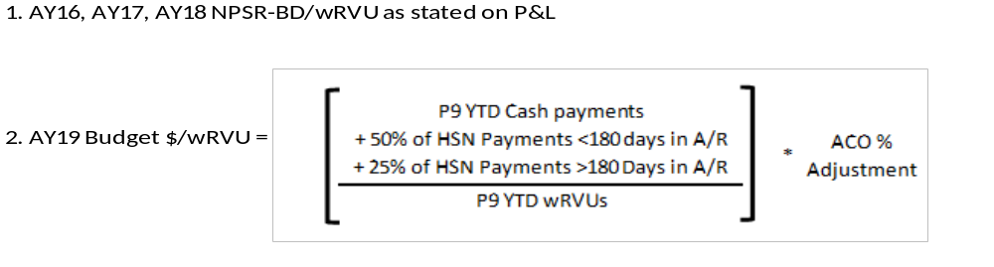
$ per wRVU

Slide 16
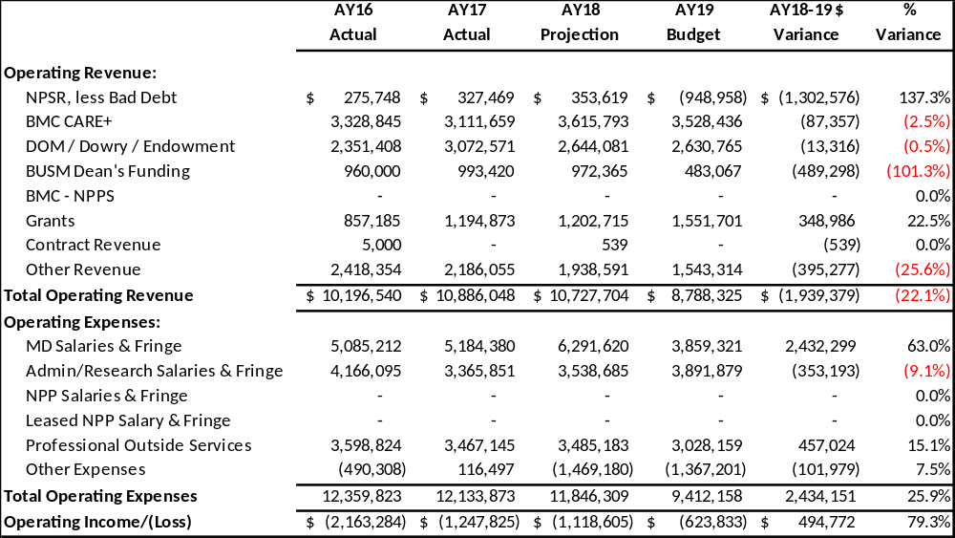
Appendix C: DOM Central P&L
Includes: Central DOM, Central Administration, HCFTH, Pass Thru, VC Education, GPMTM, BVAMC, Faculty D&D, VC Research, Cores, ECIBR, TEC, TB Clinic, Vacancy

Slide 17
DOM Annual Departmental Awards- Due
June 8, 2018
Robert Dawson Evans Faculty Special Recognition Teaching Award
Research Mentoring Award
Excellence in Educational Scholarship Mentoring. New!
Junior Faculty Mentoring Award
Outstanding Citizenship Award
Award for Clinical Quality Improvement
DOM Clinical Excellence Award
DOM Clinical Innovations Award

Slide 18
DOM Education Evaluation Core (EEC)
Lindsay Demers, Director
5/22/2018

Slide 19
Medical Educators Face Unique Challenges
Trying to conduct and publish rigorous education/social science research with little to no formal training or support​
Lack of research lab structure commonly found in social and basic science research​
​
Limited funding opportunities for education research

Slide 20
What is the EEC?
Provides support to clinician- and scientist-educators
  Designing and carrying out research projects
  Evaluating the effectiveness of education interventions/programs
  Assisting with scholarly dissemination
  Creating opportunities for networking/collaboration

Slide 21
One-on-One Consultations
Fill out the intake form on our website
Email me at ldemers@bu.edu

Slide 22
Faculty Development
Have experimented with different modes of faculty development
Open to suggestions for trainings – both content and format

Slide 23
Group Trainings
Upcoming:
  “I Ain’t ‘Fraid of No Stats!”
  Monday June 18th 9-11am
  Tuesday July 17th 3-5pm
Previous Topics (that will be offered again in the future):
  Qualitative coding
  Research methods
  Designing an education evaluation

Slide 24
Online Writing Course
Run through Blackboard
Takes the “Bird by Bird” approach to manuscript writing

Slide 25
Networking
Education Evaluation Core Journal Club
  Third Tuesday of each month from noon-1pm
Educators’ Happy Hour
  First Wed or Thurs of each month at Estragon

Slide 26
BUSM/DOM Resources
IRB office hours
Health Sciences Education courses
EEC Website (URL on next slide)
Medical librarians

Slide 27
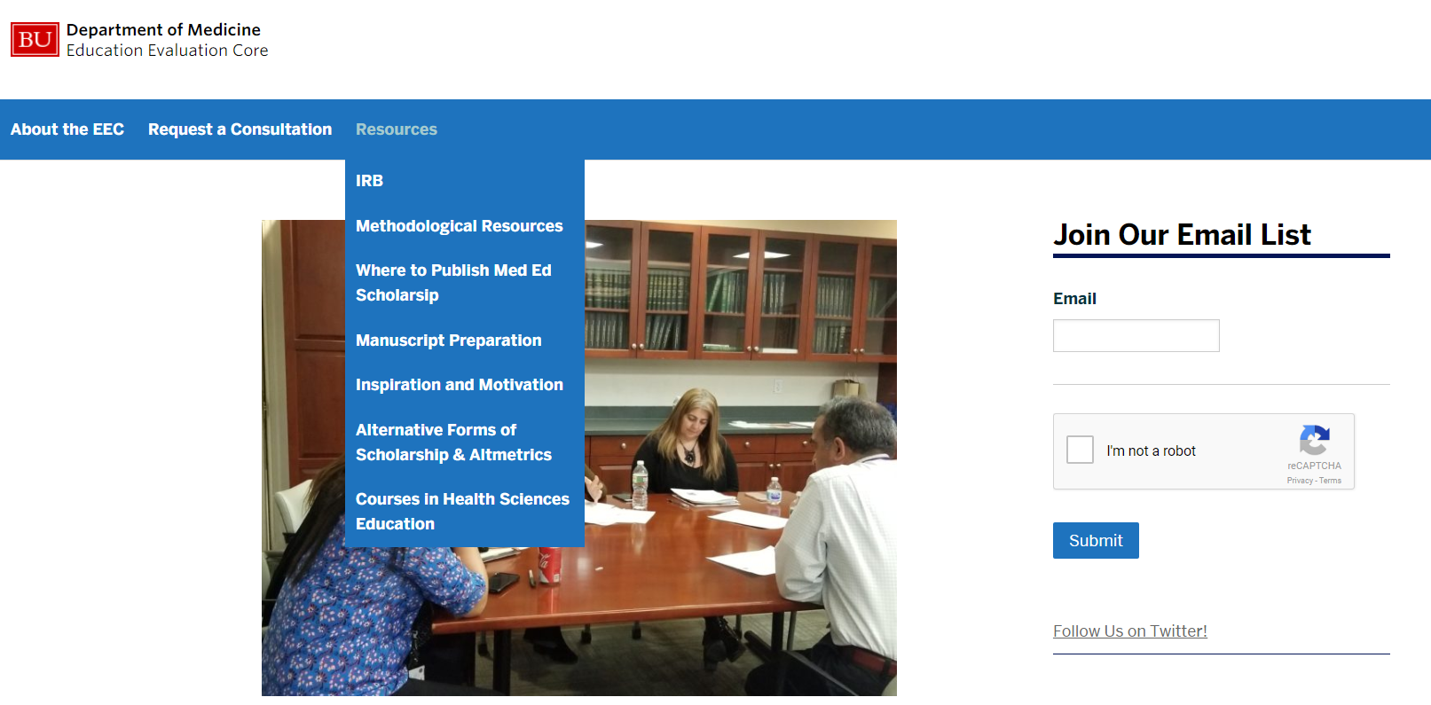
EEC Website
http://sites.bu.edu/eec/

Slide 28
BU Resources
Qualtrics, Redcap
NVIVO
SPSS
Center for Teaching and Learning (CTL)
Kilachand Honors College Thesis Students

Slide 29
Questions?

Slide 30
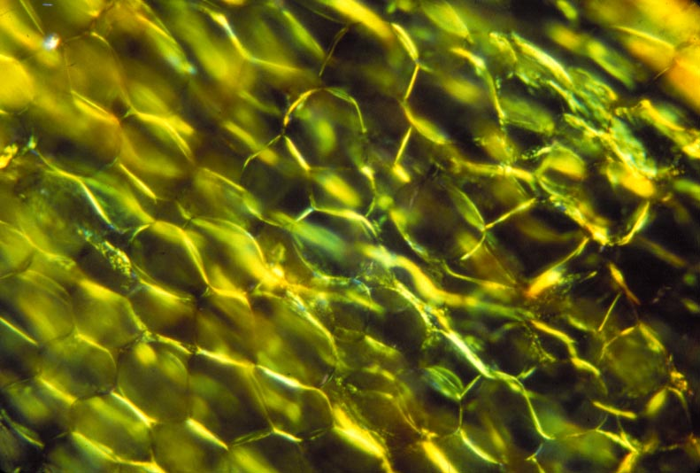
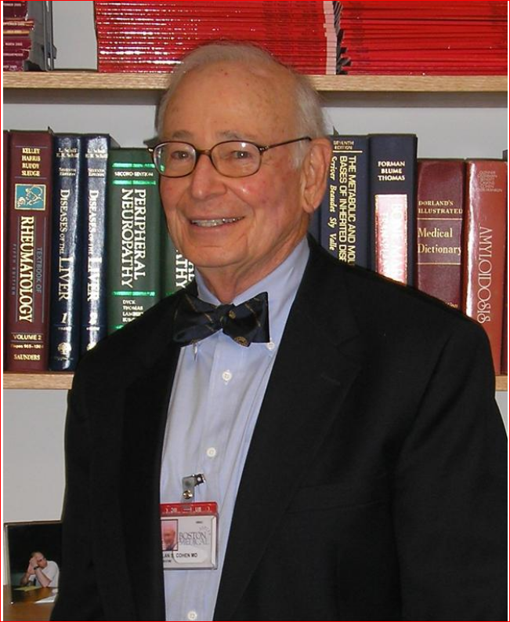
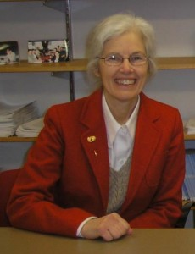
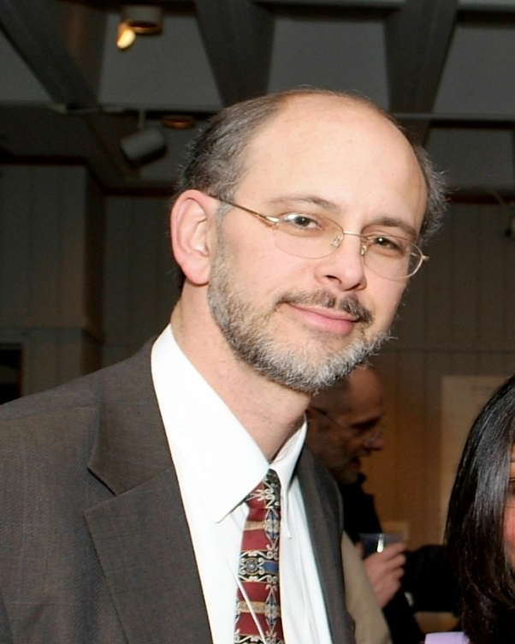
AMYLOIDOSIS CENTER
Alan S. Cohen
1960 - 1990
Martha Skinner
1990 - 2007
David C. Seldin
2007 - 2015
http://www.bu.edu/amyloid

Slide 31
Mission and Vision
Our mission is to serve as a:
  Referral center for evaluation and treatment of patients with amyloid diseases
  Coordinating center for clinical trials and basic science research on systemic amyloidosis
  Reference laboratory for amyloid pathology and molecular diagnostics
  Resource for information on amyloidosis for patients and their families, physicians, and scientists
Vision
  To create a high performing future oriented center with better and continued international recognition.
  To be the engine behind innovation in amyloidosis research and treatment – collaborative, mission driven, strategic and results-oriented.

Slide 32
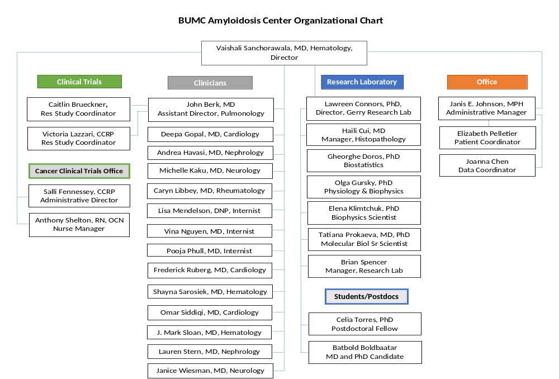

Slide 33
Highlights
Electron microscopic identification of fibrils as the hallmark of systemic amyloidosis in the 1960s, and identification of many of the proteins involved in other types of amyloidosis
First prospective randomized clinical trial of oral melphalan and prednisone, conducted in 1980s and published in 1996
The first large prospective studies of high-dose chemotherapy and stem cell transplantation for AL amyloidosis, beginning in 1994

Slide 34
Gerry Research Laboratory
Founded in 2002 as a basic science and clinical research center devoted exclusively to the study of systemic amyloid diseases.
Studies focused on:
  Basic research
  Genetics
    Biophysics
    Accessory molecules
    Biomarkers
    Cytotoxicity
    Animal models
    Clinical research
    Natural history
      Diagnostic indicators
      Outcome metrics - PROs
      Treatments targeting precursor proteins
      Treatments targeting fibrils and deposits

Slide 35
Gerry Research Laboratory
Research resources include:
  Amyloid patient specimens repository
    sera (>6000)
    bone marrow specimens (>1200)
    lyophilized urines (550)
    fat aspirates (980)
    autopsy/biopsy tissues (180 cases)
  Patient clinical database
    clinical data & lab results on ~4376 patients
  ALBase (immunoglobulin light chain database)
    http://albase.bumc.bu.edu
  protein & nucleotide sequences on >4026 LCs
  Purified amyloid proteins:
    patient-derived
    recombinant sources
collected with patient consent, under approval by the Institutional
Review Board of Boston University Medical Center

Slide 36
Amyloid Reference Laboratory
  Nationally and internationally utilized facility with CAP-accreditation and CLIA approval for amyloid diagnostics testing as of 2009
  Testing for diagnosis/confirmation of amyloidosis
    Histopathological analyses (light and electron microscopic techniques)
    Since 1998, >9000 samples evaluated
  Amyloid disease typing
    Isoelectric focusing and gene sequencing
    Immunohistochemistry and immuno-electron microscopy
    Biochemical and mass spectrometric analyses

Slide 37
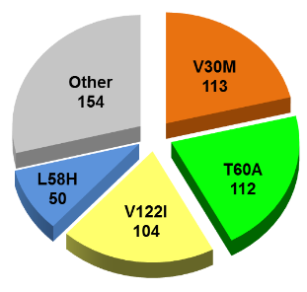
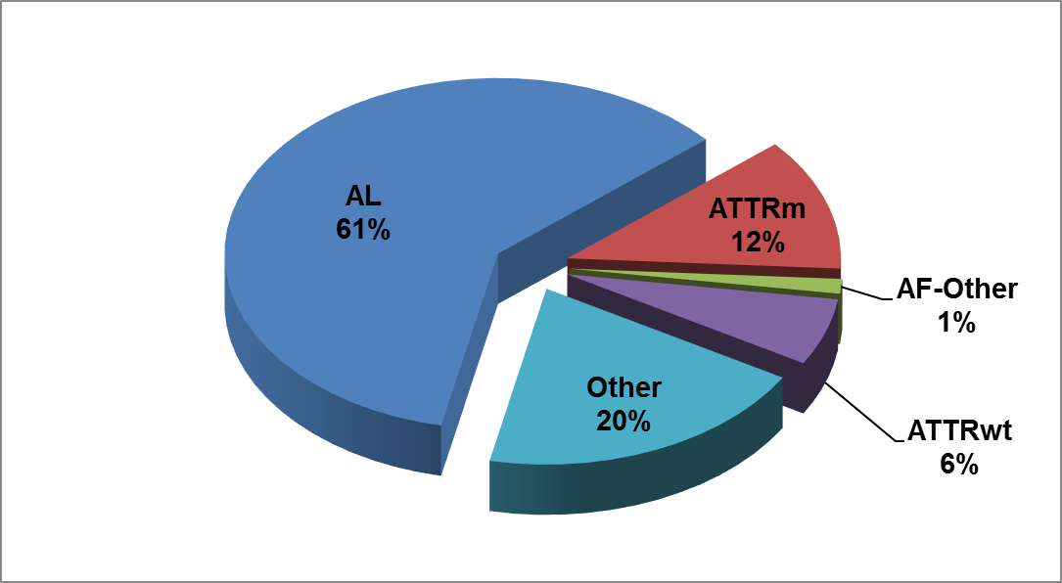
Amyloidosis Center
Clinical Program
Amyloidosis Clinical Program since 1972
In 2017, ~762 evaluations (227 new patients)
Total, 4372

Slide 38
Clinical Program Highlights
The first large prospective studies of high-dose chemotherapy and stem cell transplantation for AL amyloidosis, beginning in 1994
Clinical trials for chemotherapeutics and immunomodulatory agents
Establishment of a clinic for localized airway amyloidosis to offer specialized care to patients with this form of amyloidosis, under direction of John Berk
Establishment of protocols for combined heart/stem cell transplantation for selected patients with amyloid heart disease, in collaboration with MGH

Slide 39
Highlights
Development of the first transgenic mouse model of AL amyloidosis and its use for showing the efficacy of anti-fibril antibiotic compounds, leading to ongoing clinical trials
The repurposing of the anti-inflammatory drug Diflunisal for treatment of neurologic disease due to hereditary transthyretin (ATTR) amyloidosis, led by John Berk
Establishment of patient-specific induced pluripotent stem cell (iPSC) lines to allow study of amyloid pathophysiology in the test tube, in collaboration with George Murphy and CReM

Slide 40
Highlights
Publishing the long term outcome results of ~650 patients with AL amyloidosis undergoing stem cell transplantation over 20 years
Demonstration of improvement in quality of life after treatment in a large cohort of patients with AL amyloidosis

Slide 41
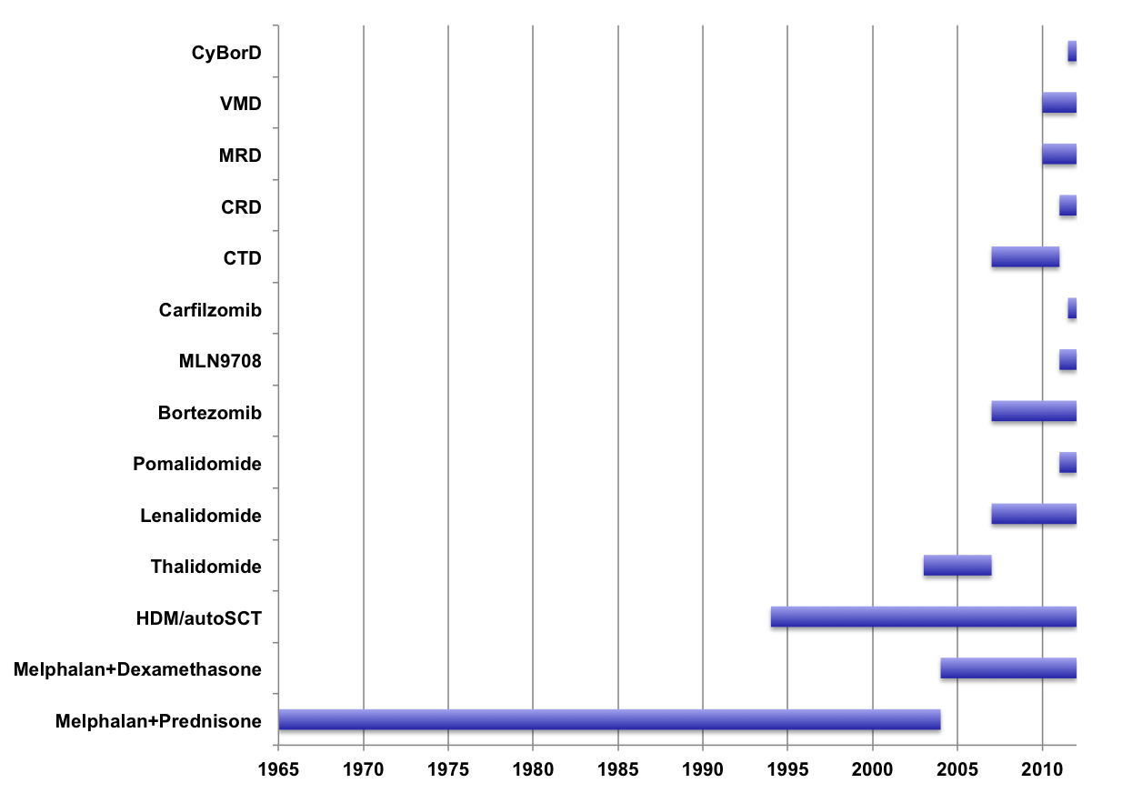
AL Amyloidosis Therapies
Time Line
Combination
Regimens
Proteasome
Inhibitors
Immunomodulators
(IMiDs)
Transplant
Oral
Alkylators

Slide 42
Multi-Disciplinary Program Components
Multidisciplinary Program
Nursing
Gastroenterology
Cancer Support
Program
Nutrition
Pulmonary
Clinical &
Basic Science
Research
Nephrology
Cardiology
Neurology
Hematology
Psychiatry
Internal Medicine
(Amyloid Program)
Integrative
Medicine
Insurance
Approvals & Appeals

Slide 43
Multi-Disciplinary Program Schedule
Monday | Amyloid Internist Initial Visit Blood and Urine test/EKG/CXR/Skeletal Survey (if indicated) Fat Pad Aspiration/Bone Marrow Biopsy Echocardiogram Hematology visit
Tuesday | Cardiology visit Research Nurse/SCT Coordinator Visit Nephrology visit Neurology Evaluation (if indicated) Pulmonary Function Tests Support group meeting Amyloid Internist Summary Visit
Wednesday | Cardiopulmonary ETT (if indicated)
Thursday | Hematopathology and chemistry SCT meeting
Friday | Amyloid Program Multidisciplinary Meeting Treatment recommendations relayed to patient by phone

Slide 44
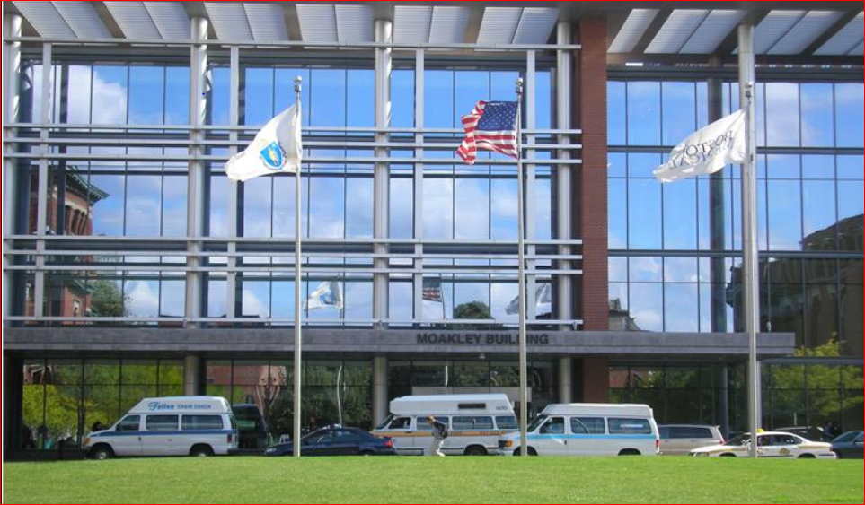
One Stop Multidisciplinary Clinic

Slide 45
Impact Report: 2017
Clinical trials enrollment
AL amyloidosis: (62 patients)
C16011 – 2
CIBMTR – 15
Daratumumab – 17
MICA – 5
VITAL - 1
MRD – 7 (specimen)
BH3 – 15 (specimen)
ATTR amyloidosis: (11 patients)
Patisiran (EAP) - 11
Publications
  34 peer-reviewed journal publications in 2017
Presentations
International Symposium on Amyloidosis
    14 abstracts presented, 5 oral and 9 poster
    2 Keynote addresses

Slide 46
Impact Report: 2017
Clinical program:
Total number of patients evaluations 2017 – 743 (683 in 2016, increase of 9%)
Grants/funded projects:
Wildflower Foundation grant to Lawreen Connors
Carpenter Foundation grant extension to Lawreen Connors
R56 to Lawreen Connors
Diagnostic laboratory expansion (CLIA certified)
Total number of histology evaluations 2017 – 544 (359 in 2016, increase of 50%)
Total number of molecular testing 2017 – IFE 125, Exons 291 (IEF 86, Exon 218 in 2016, 45% increase in IFE and 33% increase in exon sequencing)

Slide 47
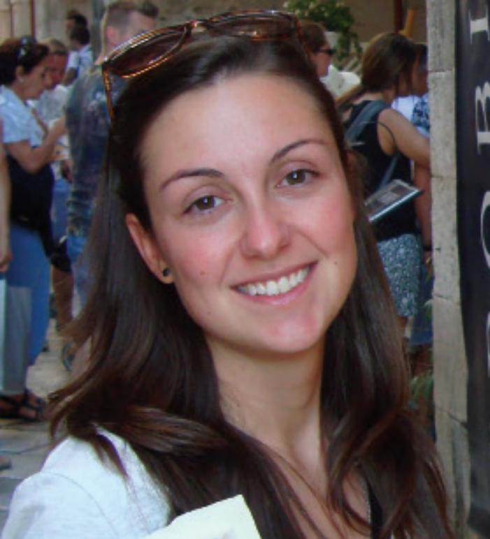
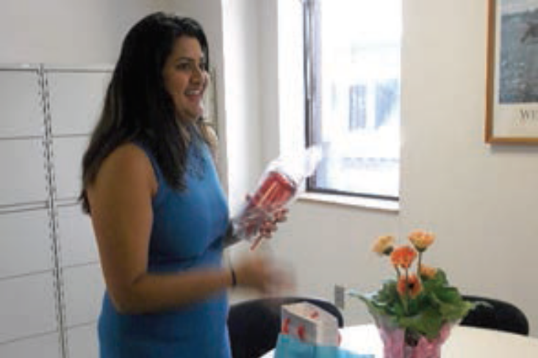
Visitors of 2017
The David C. Seldin, MD, PhD Amyloid Research Training Award
Roberta Mussinelli, MD (Cardiologist, Italy)
Summer internship in the Gerry Research Laboratory
Analiese Fernandes (Undergrad, UPenn and Wharton)
Christopher Mueller, MD (cardiologist, MCW, WI)

Slide 48
Clinical Trials at BMC
AL amyloidosis
IRB #H-22838: Data, Tissue, Blood, and Urine Repository for Amyloid Diseases
IRB #H-36533/ BH3: Assessment of apoptotic dependencies in AL amyloidosis in an effort to determine treatment response to anti-apoptotic therapies
IRB #H-34469/ MRD: Assessment of Minimal Residual Disease (MRD) After Treatment with High Dose Melphalan and Autologous Stem Cell Transplantation (HDM/SCT) in Patients with AL Amyloidosis: Feasibility and Prognostic Significance
HIRB #2017-61/ Janssen Daratumumab #3001 (Andromeda): A Randomized Phase 3 Study to Evaluate the Efficacy and Safety of Daratumumab in Combination with Cyclophosphamide, Bortezomib and Dexamethasone (CyBorD) Compared With CyBorD Alone in Newly Diagnosed Systemic AL Amyloidosis
IRB #H-35835/ Evomela: A Phase II Single-Center, Open-Label, Safety and Efficacy Study of Propylene Glycol-Free Melphalan Hydrochloride (Evomela) in AL Amyloidosis Patients Undergoing Autologous Stem Cell Transplantation
WIRB #2012-1122/ Millennium C16011: Phase 3, Rand’, Controlled, Open-label, Multicenter, Safety and Efficacy Study of Dexamethasone + Ixazomib or Physician’s Choice of Treatment Administered to Pts W/ Relapsed or Refractory AL Amyloidosis
IRB #H-35360/ Janssen Daratumumab #2002: A Phase I-II Trial of Daratumumab for the treatment of patients with AL amyloidosis
http://www.bumc.bu.edu/cancercenter/clinicaltrials

Slide 49

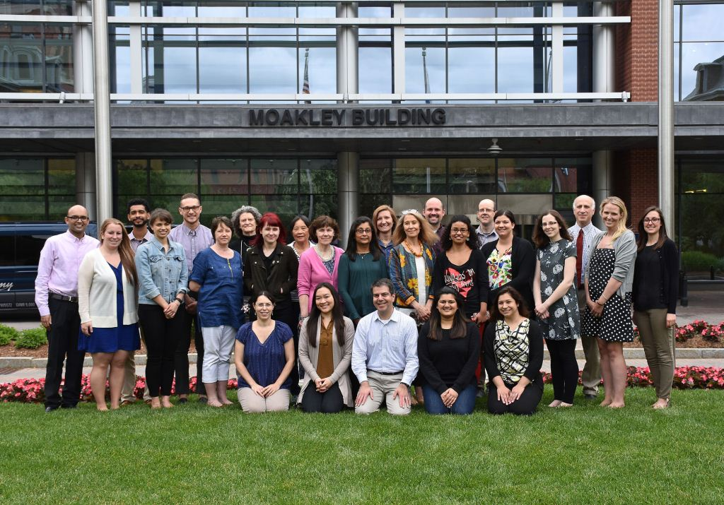
Patients
Clinical Trials Office
Colleagues & Collaborators
Transplant and Pheresis Programs
Boston University and Medical Center
Gruss, Wildflower, Brotherton Foundations
International Society for Amyloidosis
Amyloidosis Support Groups
Amyloidosis Foundation
NIH, AHA, FDA
www.bu.edu/amyloid vaishali.sanchorawala@bmc.org

Slide 50
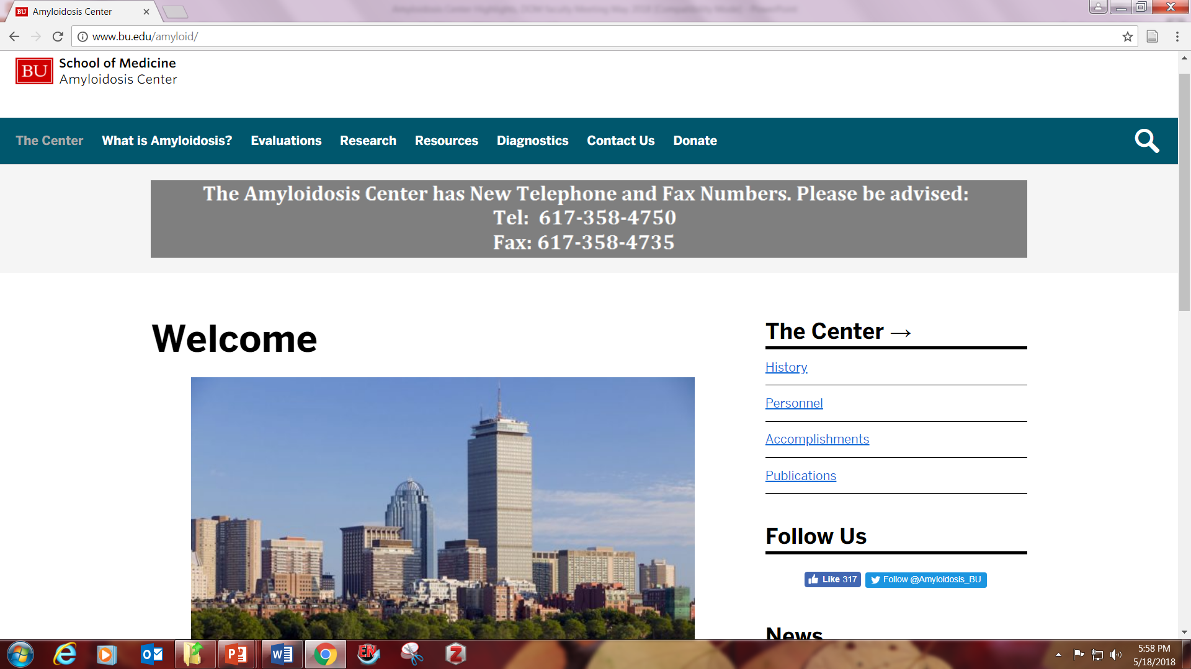

Slide 51
