Slide 1
Board Review: Anemia
Greg Radin
7/9/2013

Slide 2
Anemia
Definition: Insufficient erythrocytes to carry O2 to peripheral tissues
Symptoms: Tachycardia, DOE, decreased exercise tol, pallor→ depend on severity and acuity
Low O2 in kidney→EPO release→RBC production in bone marrow

Slide 3
Approach to Anemia
3 mechanisms:
Blood loss
Hemolysis
Underproduction
Retic count will be low in underproduction, high in blood loss or hemolysis
Be careful w/ low retic count in the elderly

Slide 4
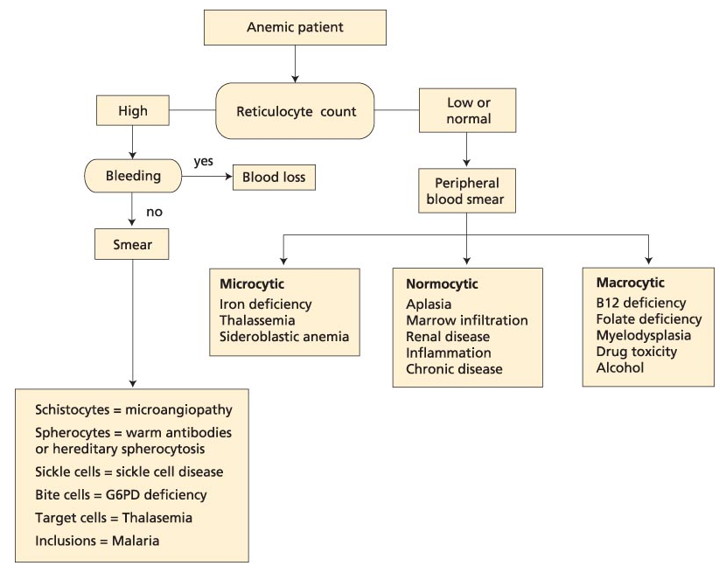
UNDERPRODUCTION
?elevated LDH, indirect bili
?Low haptoglobin
HEMOLYSIS
Review risk factors
Review Smear…

Slide 5
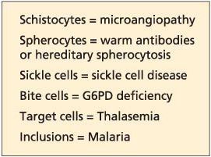
Hemolytic anemia
Membrane defects
Hereditary spherocytosis
Enzyme deficiencies
G6PD deficiency
Hemoglobinopathy
Sickle cell
Immune hemolysis
Cold, warm, drug induced
Mechanical:
Intravascular foreign body (ie mechanical valve)
Repeated trauma (“march hemolysis”)
Malaria/babesia
microangiopathy

Slide 6
UNDERPRODUCTION
?elevated LDH, indirect bili
?Low haptoglobin
MCV
Review Smear…
Review risk factors?
HEMOLYSIS
Review risk factors
Review Smear…

Slide 7
Hypoproliferative anemias
Bone marrow bx may be helpful

Slide 8
77M presents with 1 year fatigue & DOE, 8 weeks substernal exertional CP
Vitals: T36.7 137/78 HR 118, RR 17
Pale conjunctiva, summation gallop, bibasilar crackles
Hb 5.4, MCV 58 RDW 25
WBC 6.4, Plt 154
Smear…
Cause of anemia?
A) G6PD deficiency
B) Iron deficiency
C) Myelofibrosis
D) TTP

Slide 9
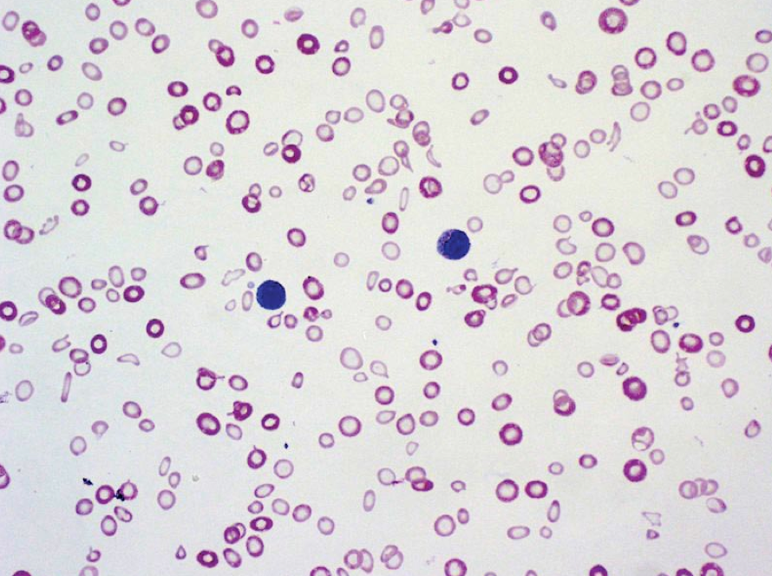

Slide 10
Most likely diagnosis is iron deficiency.
Ferritin <15 highest diagnostic accuracy
High RDW
May have thrombocytosis (benign)
BM bx for stainable iron is gold standard (rarely necessary)
Smear: variations in erythrocyte size and shape (anisopoikilocytosis) and increased central pallor.
Pt’s may have symptoms of iron-deficiency without anemia
Fatigue, irritability, headache, pica
Treatment: PO iron salts
Take on an empty stomach (absorbtion inhibited by antacids, abx, cereals dietary fibers
Expect reticulocytosis in 7-12 days, Hb increase in several weeks
Try stopping iron after 3-6 months
only use IV if unable to absorb, failure of treatment, or on HD
Must look for source of blood loss (menstrual, colon CA)

Slide 11
22F recently diagnosed with SLE manifesting as painful joints, malar photosensitive rash, oral aphthous ulcers, and a positive antinuclear antibody and anti-Smith abs. Normal menses
Meds: hydroxychloroquine and a multivitamin.
Vitals: 37.2 °C (99.0 °F), BP 126/78, HR 88/min, RR 17/min. BMI is 20.
malar rash and thinning hair, no joint abnormalities, oral lesions, pericardial or pleural rubs, or heart murmurs.
Hb 8.2 WBC 3.9
Iron 18, TIBC 180, Ferritin 556
Cr 1.0
Smear…
Cause of anemia?
A) inflammatory anemia
B) iron deficiency
C) MAHA
D) Warm ab-associated hemolysis

Slide 13
The patient has inflammatory anemia.
Initially normocytic and normochromic but can become hypochromic and microcytic over time.
Reticulocyte count: low
Iron: low or normal TIBC: low Ferritin: high
Smear: normal or may show microcytic hypochromic erythrocytes as in iron deficiency, not diagnostic
Pathophysiology: elevated hepcidin levels that develop in response to inflammatory cytokines, including interleukin-1, interleukin-6, and interferon decreases iron absorption from the gut and the release of iron from macrophages
Treatment: treat underlying process

Slide 14
87M seen for f/u of 8 months asymptomatic anemia
PMH: HTN, HL
Meds: lisinopril, atorvastatin, ASA 81
Vitals: T 98.0 BP 137/78, HR 88, RR 17 BMI 19
Exam: +S4, otherwise normal
Hb 11.4 WBC 6.2, Plt 225
MCV 90, Retic 0.8%
Iron 78, TIBC 356 Ferritin 187
Creatinine 1.5
Smear: normocytic, normochromic anemia
Most likely cause?
A) old age
B) inflammatory
C) iron deficiency
D) kidney disease

Slide 15
Anemia of kidney disease
Reduced EPO production due to renal cortical loss
Onset around GFR of 60
Dx: rule out other causes of anemia
Consider measuring EPO level if uncertain
Tx: EPO-stimulating agent if needed after correction of other factors
Anemia is always pathologic even if elderly

Slide 16
Primarily occurs in renal peritubular capillary endothelium
Liver takes over at a lower Hb setpoint in ESRD

Slide 17
29F college student at PCP to establish care
Full-time college student, runs 3 miles twice weekly, but complains of mild fatigue in the evening.
PMH: hereditary sperocytosis (onset at age 10)
Meds: folate
Vitals: T97.4, BP 133/62, HR 68, RR 18
Exam: scleral icterus, no adenopathy, normal heart/lungs. Spleen palpable below the costal margin
Hb: 11.2 (←11.5 3 yrs ago) WBC 5.9 Plt 172
MCV 103, Retic 3.4%
Abd US mild splenomegaly, no gallstones
Treatment?
A) Cholecystectomy
B) corticosteroids
C) splenectomy
D) supportive care

Slide 19
Hereditary spherocytosis
Pathophys: defect in structural RBCs proteins. Most common ankyrin, but also spectrin, band 3, band 4.2
RBCs trapped and destroyed by the spleen
DX:
Family hx (autosomal dominant, may be sporadic)
Osmotic fragility test: increased RBC fragility in hypotonic saline
Consider Coombs test—spherocytes seen in autoimmune hemolysis
Clinical course: varies from asymptomatic to severe anemia
Complications: leg ulcers, pigmented gallstones
If mild, no treatment necessary
Splenectomy: curative
Prophylactic cholecystectomy at time of splenectomy controversial in pts WITH gallstones

Slide 20
87F with CC: 6 months numbness and tingling in her feet
Eats a normal diet, no ETOH
T normal, BP 127/85 HR 98 RR 28 BMI 20
Exam: pale conjunctivae, +icterus, decreased vibratory sensation in her toes. Finger and toenails normal.
Hb: 6.9 WBC 3.9 Plt 49
T bili 4.9 LDH 520
MMA elevated, HC elevated
Vitamin B12: 224
Smear…
Treatment?
A) oral B12
B) oral folate
C) parenteral B12
D) parenteral folate

Slide 22
B12 deficiency
Dx: elevated HC, MMA (B12 level may be normal)
Contrast with folate def., only HC elevated, no neurotoxicity
Elevated LDH and indirect hyperbili due to ineffective erythropoesis, intravascular hemolysis
Testing for etiology no longer important as tx the same.
Smear: macrocytosis, hypersegmented neutrophils (>5 lobes)
Lack of vibratory sense and paresthesia→weakness, spasticity, paraplegia
Most common cause: malabsorbtion
Treatment: high dose PO B12 (1000-2000 mcg daily), equivalent to parenteral

Slide 23
17F here for f/u of microcytic anemia identified on routine CBC 3 weeks ago
Otherwise healthy, no significant PMH or FH
Med: OCP
Vitals: BP 117/78 HR 88 RR 17 BMI 19
Exam: Conjunctival pallor, otherwise normal
Hb 11.6 WBC 5.4 Plt 213
MCV 60, RDW 15, RBC count 5.5 x10^6
Retic Count: 2.3%
Dx?
A) hereditary spherocytosis
B) iron deficiency
C) sideroblastic anemia
D) B-thalassemia trait

Slide 24
Thalassemias
Due to abnormalities in the globin-producing genes.
May be difficult to distinguish from iron-deficiency, also consider lead poisoning
RBC indices: microcytic anemia, normal or increased RBC count.
Mentzer index: MCV/RBC count. If <13, usually assoc w/ B-thal (our pt = 11)
Target cells, microcytosis, hypochromia.
Hemoglobin electrophoresis:
Beta: decreased HbA, increased Hb A2 and F
Alpha: normal in adults (no alternative a-globin)
Severity of anemia depends on amt of synthesis of affected globin gene.
Tx: transfusions as needed, iron chelation, HSCT

Slide 25
15M seen in ED for subacute fatigue, SOB, lethargy.
2 weeks fever, arthralgia which improved this week.
Sick contact: cousin
PMH: Hb SS (infrequent pain crises, no CVA or acute chest).
Immunizations UTD
Meds: folate 2mg/d
VS: T 96.4, BP 96/55, HR 114, RR 22
Exam: pale, lethargic
No rash, normal heart and lungs, no adenopathy or splenomegaly
CXR normal
25

Slide 26
Diagnosis?
A) aplastic crisis
B) hyperhemolytic crisis
C) megaloblastic crisis
D) splenic sequestration crisis

Slide 27
Causes of acute worsening of chronic anemia
Aplastic crisis: Usually due to Parvovirus B19, which supresses RBC production.
can confirm dx by anti-parvovirus IgM or PCR for parvo
Low retic count
Hyperhemolytic crisis: high retic count (rare)
Megaloblastic crisis: folate deficiency in pts with high RBC turnover (pregnancy, rapid growth, hemolytic anemia)
Splenic sequestration crisis: splenic vasoocclusion and pooling of blood.
Rapid drop in Hb, high retic count
Rapidly enlarging spleen, LUQ pain

Slide 28
55M presents w/ 2 months L chest pain, SOB, diffuse joint pain, hematuria, LE swelling
Healthy, lifts weights and jogs 3x weekly
PMH: sickle cell trait, HTN, HL
Meds: HCTZ, simva
VS: normal, Exam normal
Hb 14.2, WBC 8.6 Plt 239
MCV 85, Retic 1.9%
Hb electrophoresis Hb A 59%, Hb S 39% Hb F 2%
Smear, ECG, CXR all normal
Which symptoms can be attributed to sickle cell trait?
A) hematuria
B) CP
C) diffuse joint pain
D) leg swelling
E) shortness of breath

Slide 29
Sickle cell trait
Benign condition with normal CBC
Complications: hematuria (common, probably due to renal papillary necrosis), renal medullary CA, VTE, splenic rupture
Seek alternative explanations for other symptoms in sickle cell trait

Slide 30
32M with fatigue, dyspnea, lethargy, yellow eyes x1 week
PMH: MRSA cellulitis successfully treated with 14 days TMP/SMX completed yesterday.
VS: T 98.4, BP 103/53, HR 112, RR 16
Exam: scleral icterus, tachycardia, otherwise normal
Hb 9.6, WBC 8.9 Plt 259
MCV 104 (← 85 3 years ago), retic 6.4%
Smear…
Diagnosis?
A) cold agglutinin disease
B) G6PD deficiency
C) hereditary spherocytosis
D) sickle cell disease
E) thalassemia

Slide 32
G6PD deficiency
Acute hemolytic episode after oxidant drug such as bactrim (dapsone, primaquine, nitrofurantoin)
Smear shows bite cells
Heinz body: denatured oxidized hemoglobin (special stain)
Tx: withdraw offending agent
Board trickery: Don’t check G6PD level during acute crisis (increased retic fraction, retics have more of the enzyme)
Check in a few months

Slide 33
43M p/w 2 days severe abd pain.
PMH: recent dx of pancytopenia
FH: negative
Med: multivitamin
VS: 97.2, BP 143/69, HR 86, RR 12
Exam: jaundice, no splenomegaly, otherwise normal
Hb 10.4, WBC 3.4, Plt 89
Haptoglobin: 0, LDH 775, T/D bili 2.8/0.4
Retic count 7%
CBC and LFTs 1 year ago were normal
CT A/P: mesenteric vein thrombosis, no adenopathy or splenomegaly.
Next diagnostic step?
A) Direct coombs test
B) Factor V Leiden assay
C) Flow cytometry for CD55 and CD59
D) lupus anticoagulant and anti cardiolipin antibody assay

Slide 34
Parosysmal nocturnal hemoglobinuria
Primary acquired stem cell disorder,
RBCs or WBCs lacking glycophosphatidalinosital-anchored surface proteins ie CD55 or CD 59
Protect cells against compliment mediated destruction
Signs/Symptoms: hemolytic anemia, thromboses at atypical locations, esophageal spasm, erectile dysfunction, pulmonary HTN
Thrombosis is a sign of more aggressive disease
Dx: flow for CD55/59
Tx: anticoagulate for thrombosis
?steroids
eclizumab (anti-C5) some benefit
Increased risk of meningococcal infection
Immunosupressives +/- HSCT if severe

Slide 35
56M seen in ED for 4 weeks progressive fatigue, DOE, CP with moderate exertion. Unable to work (construction worker)
FH/PMH/Meds: none significant
VS: T98.2, BP 123/69 HR 98 RR 16
Exam: scleral icterus, no adenopathy, +splenomegaly
Hb 8.1, WBC 4.9, Plt 159
Retic 5.4%
Coombs test: IgG strong positive, C3 weak positive
Smear…
Dx?
A) Cold agglutinin disease
B) G6PD deficiency
C) hereditary spherocytosis
D) TTP
E) Warm autoimmune hemolytic anemia

Slide 37
Autoimmune hemolytic anemia
Warm: IgG antibodies bind to Rh antigens, ab-coated RBCs removed by spleen.
optimum binding at T99.0,
Tx: steroids first-line (2/3 respond)
Splenectomy, rituximab, immunosupressives
Cold: IgM antibodies bind to RBC antigens I or i. Abs fix compliment leading to intravascular lysis
Maximal activity at 4 Celsius
Usually a clonal B-cell disorder
Tx: cold avoidance
-chlorabmucil or cyclophosphamide, rituximab
-plasmapheresis if acute/severe
-steroids and splenectomy unhelpful

Slide 38
Autoimmune hemolytic anemia
Most common drug in 2012: cephalosporins

