Slide 1
Federal & MA Taxes for 2012
Jim Briggs
The Tax Detective

Slide 2
Session Outline
What are the filing requirements
  Federal
  Massachusetts
Tax filing status rules
Sources of income:
  Wages/Stipends/Scholarships/Interest/Dividends
  Education Credits/Deductions/Student Loan Interest

Slide 3
IRS Publications
IRS Publication 17 – Your Federal Income Tax
IRS Publication 970 – Tax Benefits for Education
MA - http://www.mass.gov/dor/

Slide 4
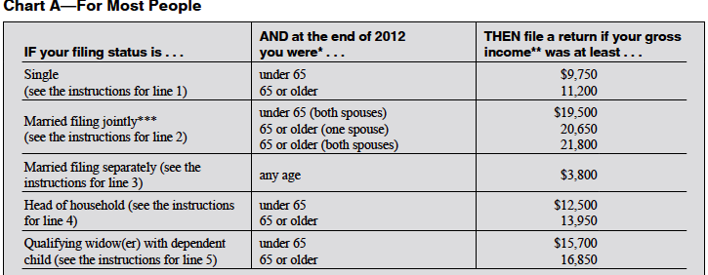
2012 Tax Filing Threshold - General

Slide 5
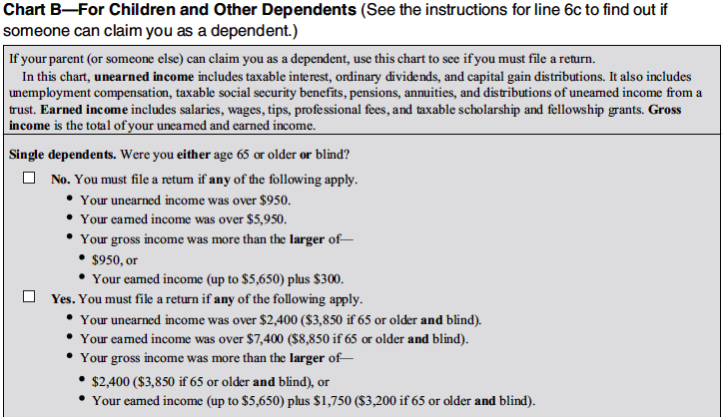
2012 Tax Filing Threshold - Dependents

Slide 6
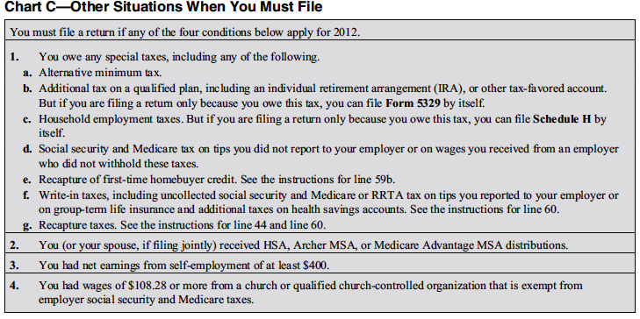
2012 Tax Filing Threshold - Other

Slide 7
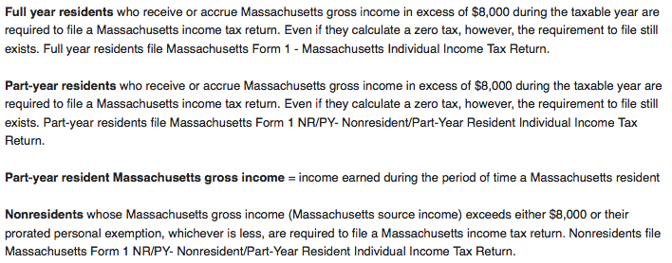
2012 MA Tax Filing Threshold

Slide 8
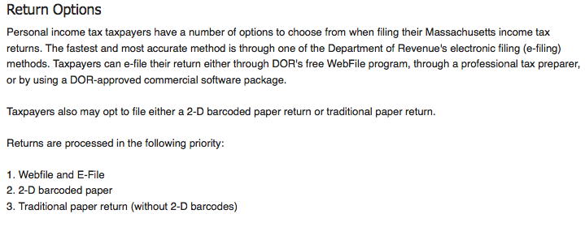
2012 MA Tax Filing Options

Slide 9

2012 MA Tax FREE Filing Option

Slide 10
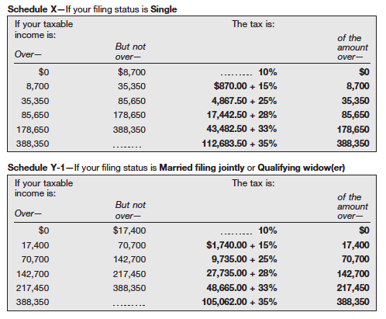
Federal Tax Rates

Slide 11
MA Tax Rate
5.25% of taxable MA income

Slide 12
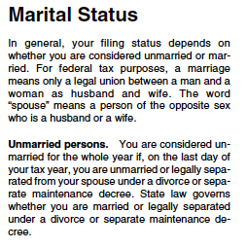
Tax Filing Status-1

Slide 13
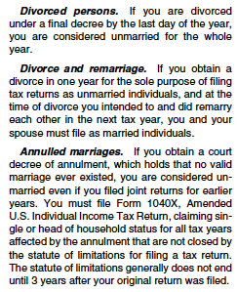
Tax Filing Status-2

Slide 14
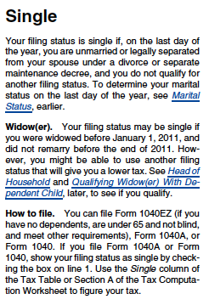
Tax Filing Status-4

Slide 15
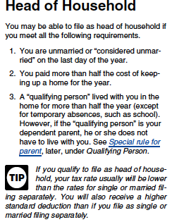
Tax Filing Status-5

Slide 16
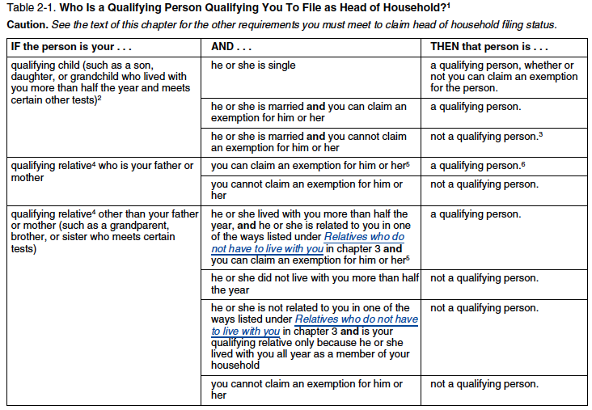
Tax Filing Status-6

Slide 17
Questions
Are there questions on:
  Tax filing thresholds?
  Tax filing status?

Slide 18
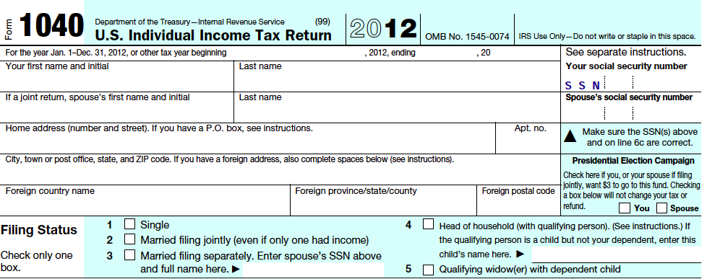
1040 – Lines 1-5

Slide 19
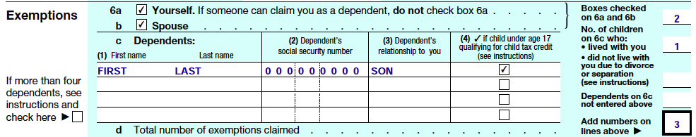
Dependents

Slide 20
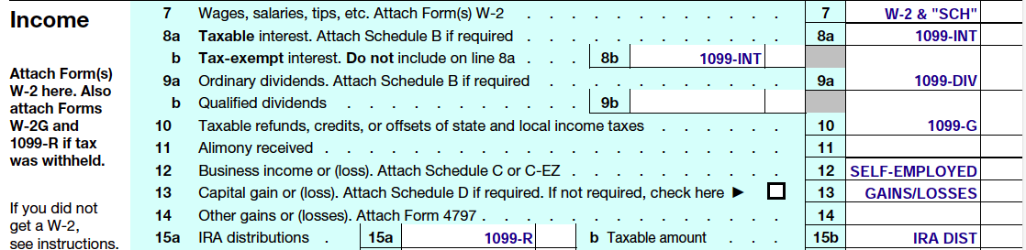
1040 Lines 7-15

Slide 21
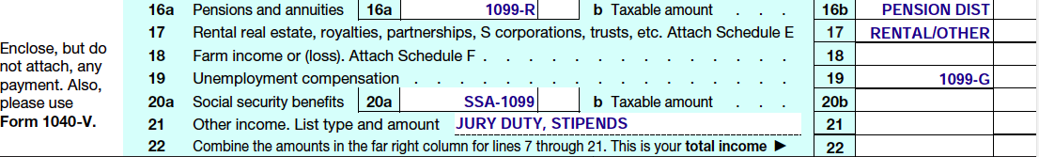
1040 Lines 16-21

Slide 22
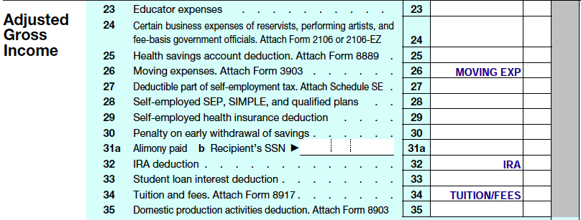
1040 Lines 23-35

Slide 23
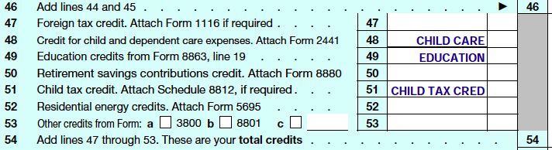
1040 Lines 47-53

Slide 24
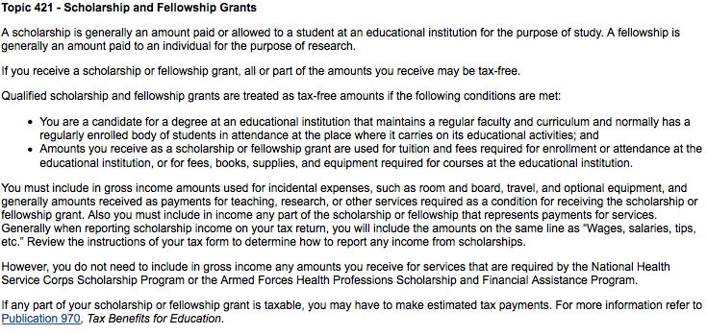
Scholarships/Fellowships

Slide 25
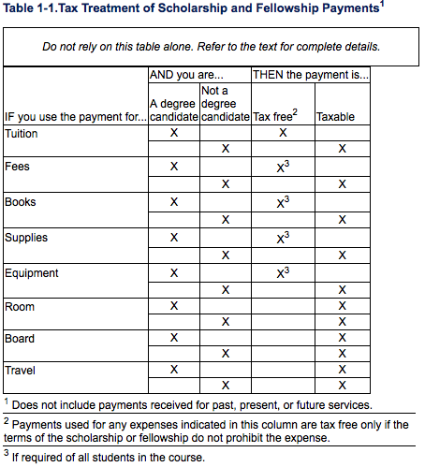
Scholarships/Fellowships

Slide 26
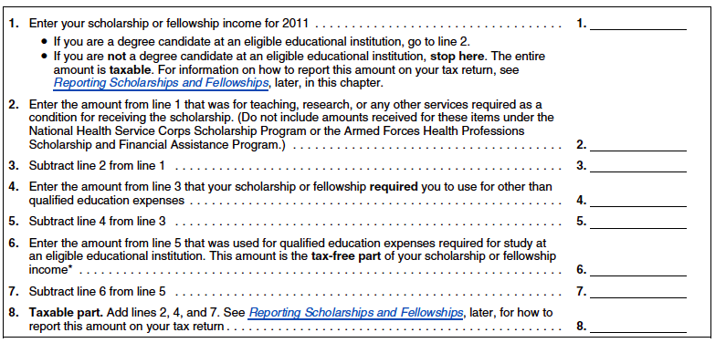
Is it taxable?

Slide 27
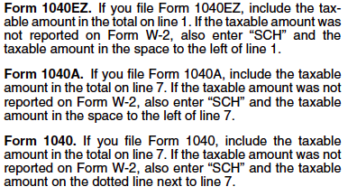
Where to report it?

Slide 28
Lifetime Learning Credit
Maximum of $2,000 per student
20% of first $10,000 of qualifying educational expenses (tuition, books and fees)
IRS form 8863
Reduces federal tax dollar for dollar

Slide 29
Extension of time to file
Federal
  File form 4868 by April 15, 2013
  Automatic 6 month extension until 10-15-13
MA
  File M-4868 by April 15, 2013
  6 month extension until 10-15-13
  Must have paid at least 80% of final tax by April 15, 2013 for extension to be valid

Slide 30
Suggestions
Find a good CPA to advise you on federal and state tax issues and to prepare required tax returns
Schedule an annual review in October/November with your CPA to obtain recommendations to ways to reduce your taxes.

Slide 31
Questions
Questions on the 1040 or 1040A?
Questions on your MA return?
Questions on filing for an extension?
Any other questions?

Slide 32
The End
The BU Medical School office and Jim Briggs thank you for your participation.

