Slide 1
Data Visualization

Slide 2
Objectives
Determine when data and statistical results are best displayed in text, tables and figures
Identify design features of effective tables and figures
Create tables and figures to summarize data statistical results
Improve data presentation for both scientific and lay audiences

Slide 3
Design principles – Big picture
Generate interest
Provoke thought
Motivate reader/consumer to want to know more
Know your audience

Slide 5
What is data visualization?
A way of visually conveying information – often quantitative in nature – in an accurate, compelling format
Usually makes relationships more apparent by clustering, color coding and putting items in scale
Can be static or interactive

Slide 6
Data visualization is not new

Slide 7
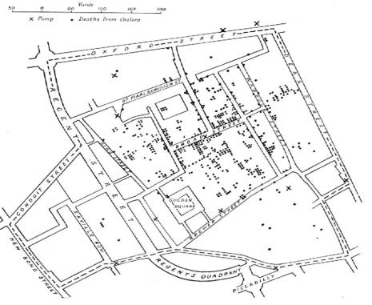
1854
John Snow
1854: Mapping deaths from a Cholera outbreak in central London
Notes:
1854 – In the earliest days of mapping as an epidemiological tool, John Snow mapped the deaths from a London cholera outbreak. This map showed that the cholera cases clustered around a well, where he famously removed the handle to the pump to prevent further spread of disease (though there’s some debate on if that’s more legend than reality).
This is a great example of the early use of data visualization as a way of debunking myths and focusing us in science and evidence. At the time, it was thought that cholera was spread through miasmas (airs) in the streets, rather than through water. Snow’s mapped and subsequent action provided evidence that cholera was a water borne disease.

Slide 8
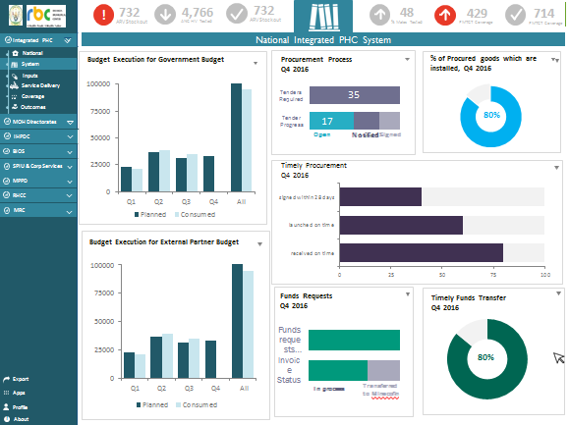
2018
Notes:
Fast forwarding to 2018, we now have a wealth of data visualization tools at our fingertips. Modern computing and software have made it possible for you to point and click your way to great visualizations, and are being used by Ministries of Health around the world (as in this example from Rwanda – dummy data only) to create decision support tools in the form of dashboards that put information at the fingertips of those who need it most.

Slide 9
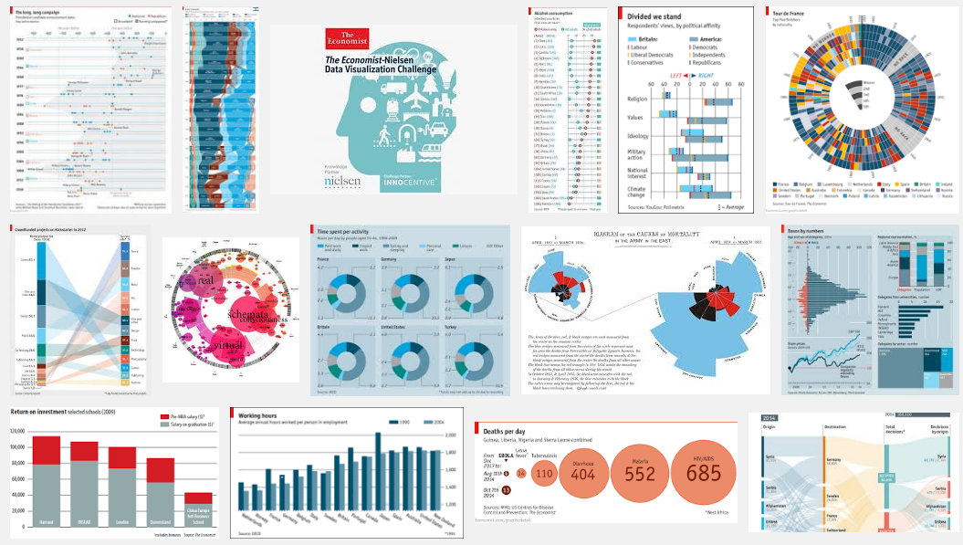

Slide 10
Understand your audience Create data story Design visualization Disseminate
Four Steps
Notes:
Simplified to four basic steps, data visualization design requires: 1. Understanding who your audience is and what they need to know.
2. Analyzing the data you have to find the interesting “stories” you want to tell to that audience.
3. Building a visualization that effectively communicates that story, using various visual best practices.
4. Thinking through how you will package, disseminate, and share that visualization – which may impact the kind of visuals you create (if they need to be interactive versus printable, or if they will be distributed in print media versus the web)

Slide 11
Understanding your audience
School of Public Health

Slide 12
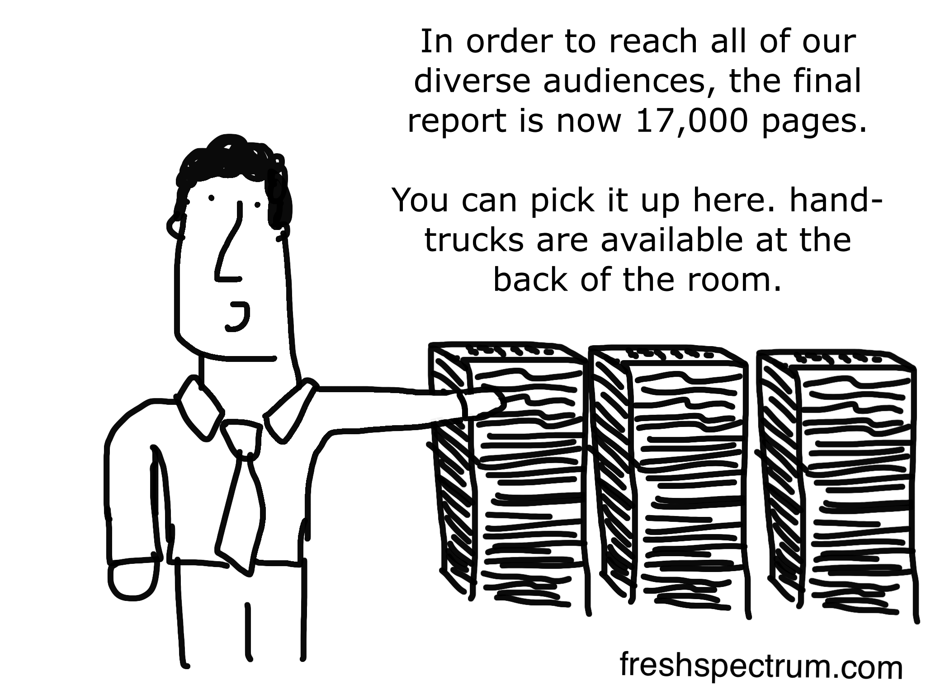
Notes:
Often, when planning for data visualization products and other ways of sharing our results, we write long reports that have all of the information possible included, rather than summarizing down to simpler, more targeted stories about our work.

Slide 13
Create data story - reporting results
Clear and accurate reporting of data and statistical results is essential
Match format (text, tables, figures) with what we are trying to convey and to whom

Slide 14
Typical paper/report summary –(data story)
How data were collected
(design/protocol)
Who was involved
(demographics, clinical history)
Extent of exposure(s), outcome(s) in sample
Associations, effects of exposure
Crude associations, effect
Adjusted for confounders
Homogeneity of effect in key subgroups
Other explanations
Interpretation, context, impact

Slide 15
Design - Properties of good visualizations
Interesting
Form
Integrity
Function
Design Principles
Function: you see trends and patterns clearly
Form: visually appealing and well structured to attract readers and hold their attention
Integrity: portray the data accurately and honestly
Interesting: relevant and meaningful, new information
David McCandless, 2012

Slide 16
Ensure clarity
titles, labels, axes
Minimize “chart-junk”
extraneous features that clutter tables and figures*
Make deliberate design decisions
including how text, color, and other features are used
*Tufte ER. The Visual Display of Quantitative Information, 2nd ed. Chesire, CT: Graphics Press; 2001.

Slide 17
Some examples

Slide 18
Clinic Performance
May –November 2016
Notes:
A graph should show clear patterns.
In this example, the number of lines makes it hard to see what’s happening in any one clinic, and there’s no clear trend to follow across clinics.

Slide 19
redesigned
A clear title gives the reader the takeaway
Clinic XYZ showed the greatest improvement in performance.
May –November 2016
Notes:
Here, by highlighting one clinic at a time, we can see the trend over time more clearly.

Slide 20
Label directly where possible (instead of a legend)
redesigned

Slide 21
Notes:
Here, color isn’t used purposefully and the three dimensional formatting make it difficult to compare the categories. The most significant message gets lost he

Slide 22
redesigned
Across facilities, at least 30% of clients were dissatisfied with the services they received.
Notes:
By flattening the graph (to be two dimensional), it’s easier to compare the relative size of the bars. In addition, we use color to call out the story we want to call attention to – in this case, that at least 30% of clients were dissatisfied with services across the clinics. (Note that this is not the only story in this data, but it’s the one we chose to emphasize here.)

Slide 23
Scale y-axis to zero
Integrity
to
If these are means – use a different format… More on this later

Slide 24
Exceptions to scaling to zero
Integrity

Slide 25
Integrity

Slide 26
When to use text, tables and figures
School of Public Health

Slide 27
Text
A few numbers
Data that are secondary or ancillary to main analysis

Slide 28
Tables
Many data points to present and exact values are important
Main findings (often readers turn to tables before reading text)

Slide 29
Figures
Distributions
Complex relationships among variables
Trends over time
Geographic variation
Main findings (often readers turn to figures before reading text)

Slide 30
Many figures, charts and graphs are iterations on a few basic types
Master these, and you’re on your way to mastering the art of data vizualization

Slide 31
Some bad examples

Slide 32
Chart-junk

Slide 33
Chart-junk

Slide 34
Pie charts are popular displays to represent component parts of whole But, they can be challenging for readers to interpret and should be use sparingly, if at all (other displays often more effective)

Slide 36
Pie chart or table?
Sometimes a pie chart that requires more than five categories is better as a table
Categories are sorted by % of total (descending) to make it easy to find the high and low caegories

Slide 37
Do not connect independent categories with lines

Slide 38
What figure to use when
Distributions
Comparing categories
Change over time
Relationships
Part-to-whole
Geography

Slide 39
What is extent of exposure, range of outcomes in study sample?
Continuous and ordinal exposures, outcomes
Distributions using box-whisker plots, histograms
Categorical, binary exposures, outcomes
Bar charts– % response in key comparison groups

Slide 40
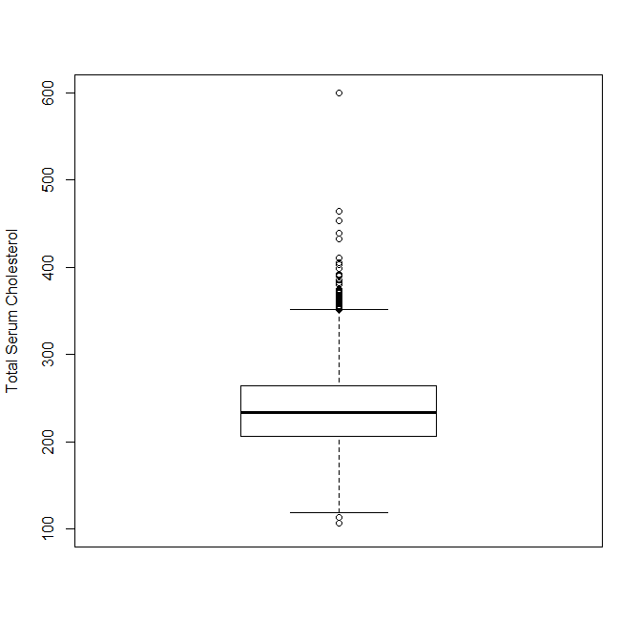
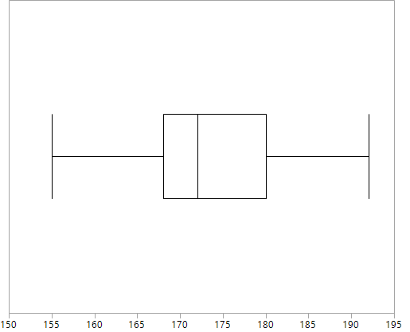
Box whisker plots
Maximum pulse rate on exertion Total serum cholesterol, mg/dL
Maximum pulse rate, beats per minute

Slide 41
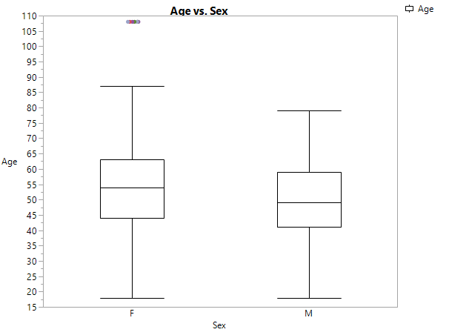
Box whisker plots
Age distributions in men and women

Slide 42
Histogram
Relative frequency histogram for ordinal variable
Clear title, axis labels

Slide 43
histograms versus bar charts
What’s the difference?

Slide 44
Comparing outcomes
Change in pain intensity over four weeks by treatment in men and women
Change in pain intensity over four weeks by sex with NSAIDs versus placebo

Slide 45
Means and 95% CI
Bars not necessary –
highlight data (means) and not design features

Slide 46
Which groups are statistically different?
Confidence intervals
Non-overlapping suggest a statistical difference between groups
Overlapping – can’t be sure there is no difference

Slide 47
Geographical variation
Using maps to display distributions of key health indicators
Must include clear titles, description of measures, and clarity of geographic subunit of interest (country, state, county, neighborhood)
Chloropleth maps use shading to reflect the magnitude of measures

Slide 48
Geographical variation

Slide 49
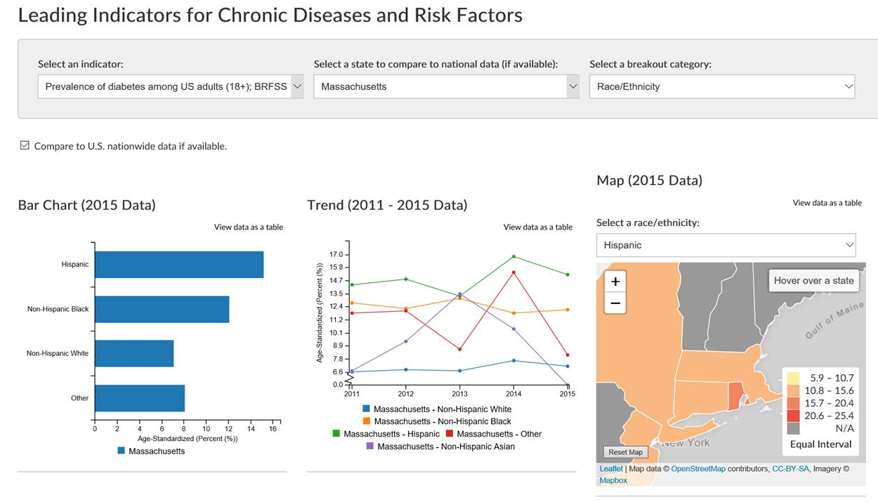

Slide 50
Data Viz critiques
Identify what attributes of the graphic make it easy to understand what the designer is trying to share,
and what attributes make it difficult to understand.

Slide 51
NEJM 2000; 342(1): 1-7

Slide 57
Summary
The right approach to present data and statistical results depends on the audience and the nature of the data and statistical results to be displayed
Effective communication requires clarity and accuracy
Must adhere to sound statistical practice and effective design principles

