Slide 1
Unconscious Bias
Identifying strategies to recognize and mitigate our biases

Slide 2
Learning Objectives
Recognize that bias is human and that it impacts all parts of all of our lives
Identify the negative consequences of bias are
Develop strategies to become more aware of and mitigate our biases
Identify tools to effectively recognize and acknowledge when we observe instances of unconscious bias with our learners and colleagues

Slide 3
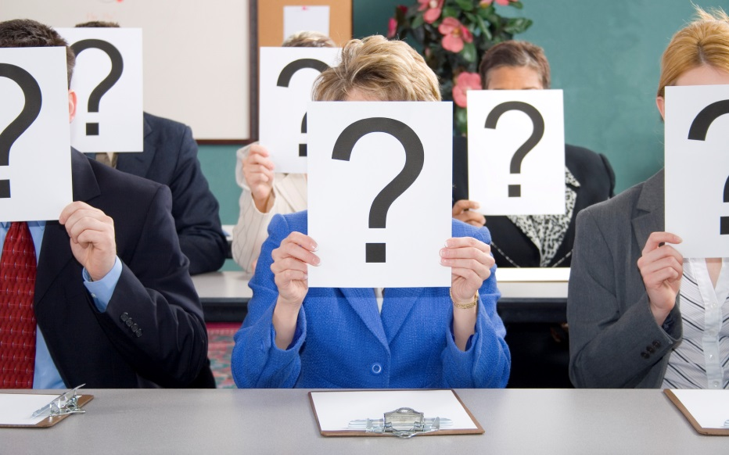
What are your associations with “bias” and “unconscious bias”?
Notes:
TIME: 3 min
ASK: So when you hear the terms “bias” or “unconscious bias”, what are your associations with them? (If needed, prompt participants with asking: Do you feel like it is positive or negative? Are you excited about this training topic, or maybe a little cautious? etc.)
DO: Solicit 2-3 responses and thank people for sharing.
SAY: During this training, we talk about unconscious bias not as necessarily good or bad, but as a natural function of the human mind that can potentially impact diversity and inclusion in our organizations. Recognizing unconscious bias helps us to get more insight into our interpretations and evaluations, and to make more conscious decisions.
DO: Share a personal example of a moment in which you had bias, were aware of it, mitigated it, and the positive impact this had.
SAY: I am sharing this with you to illustrate the universal nature of bias; we all have bias, and we’re not necessarily trying to get rid of it. The key is practicing conscious awareness, which is the overall purpose of this workshop.
TRANSITION: Now that we’ve begun to discuss the what, let’s discuss the why. What makes it important for us to explore unconscious bias and blind spots in the context of academic medicine and healthcare?
Cook Ross Inc. © 2015
May be used only with express permission.

Slide 4
Feelings, Judgments, and Reactions
Notes:
TIME: 10 min
SAY: I’m going to show you a series of pictures. As you view each slide, watch your own thinking and immediate assumptions about the individual pictured. What do you find yourself thinking about them? Two particular assessments you may wish to keep in mind are: 1) how warm you think they are and 2) how competent you think they are. Research from Amy Cuddy and colleagues at Harvard discovered that the these tend to be two of the key traits we evaluate people based upon.
DO: Advance the slides through the series of pictures, lingering for about 15 seconds on each one.
Cook Ross Inc. © 2015
May be used only with express permission.

Slide 5
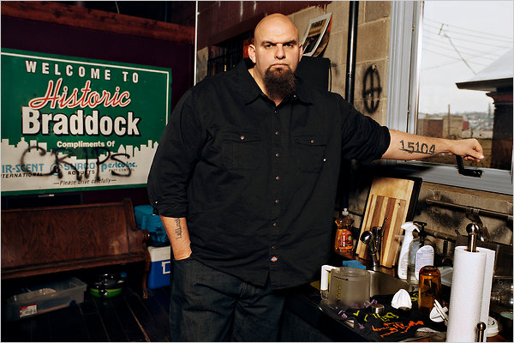
Notes:
<Picture>
Cook Ross Inc. © 2015
May be used only with express permission.

Slide 6
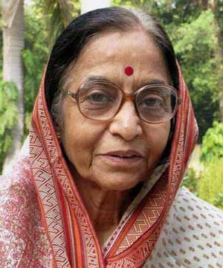
Notes:
<Picture>
Cook Ross Inc. © 2015
May be used only with express permission.

Slide 7
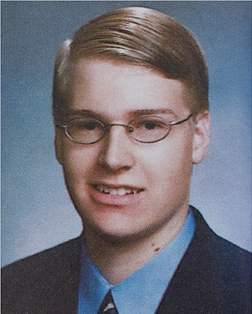
Notes:
<Picture>
Cook Ross Inc. © 2015
May be used only with express permission.

Slide 8
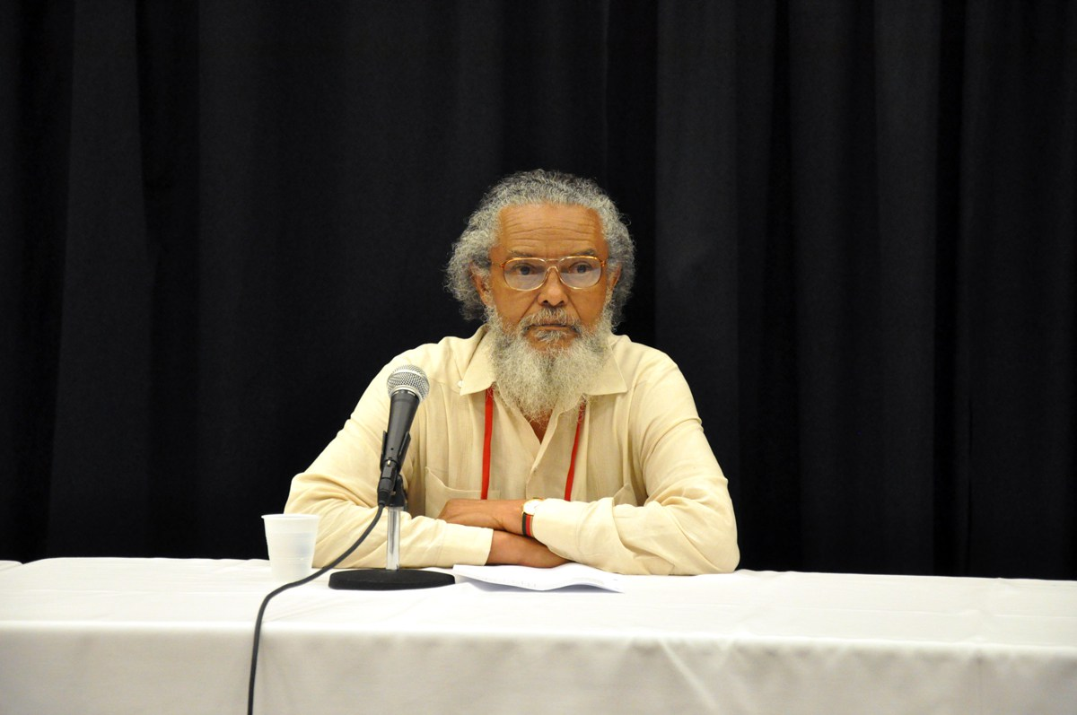
Notes:
<Picture>

Slide 9
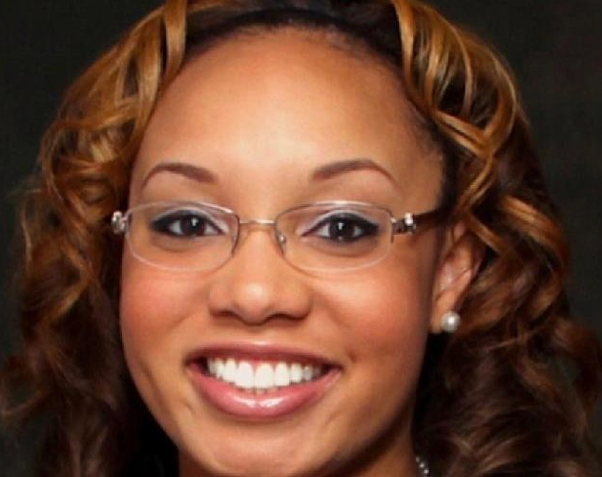
Notes:
<Picture>
Cook Ross Inc. © 2015
May be used only with express permission.

Slide 10
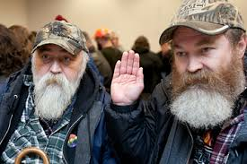
Notes:
<Picture>
10
Everyday Bias for the Health Professions
Facilitator Guide
Cook Ross Inc. © 2015
May be used only with express permission.

Slide 11
Gender
Ethnicity
Skin tone
Age
What patterns did you notice?
Setting
Facial expression
Body posture
Body type
Clothing
Notes:
TIME: 2 min
SAY: What patterns did you notice when you were watching your own perceptions?
SIMPLY GIVE YOUR REACTION – NOT ANYTHING ABOUT WHAT YOU MAY OR MAY NOT KNOW ABOUT THE FACES SHOWN, ETC.
DO: Ask 3-4 participants to share what they reacted to when they saw the pictures, and comment appropriately.
SAY: Now I’m going to share with you a little bit about who each of these individuals are.

Slide 12
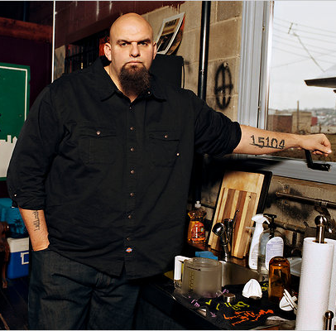
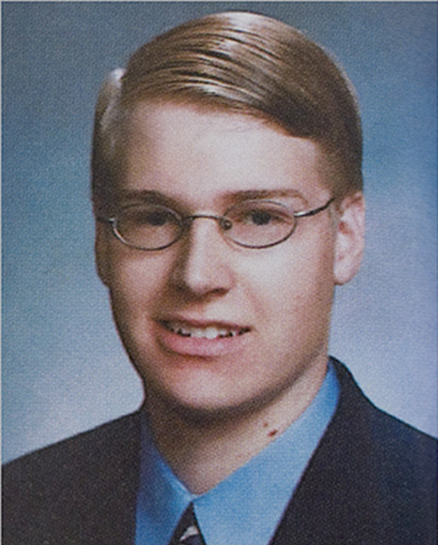
Notes:
SAY: Here is everyone together.

Slide 13
John Fetterman
Mayor of Braddock, PA (a suburb of Pittsburgh) – the tattoo on his arm is the zip code!
Has a Master’s degree in Public Policy from Harvard
Served in the AmeriCorps
Received international media attention for the economic revitalization programming he started in his community
Notes:
DO: Introduce each individual using the some of the key points about them on each slide. Know that some of them may provoke strong reactions from the audience!
ASK the group every now and then: did you perceive them to be warm, competent? Why or why not? What other feelings or assumptions did you have about them?
John Fetterman
Mayor of Braddock, PA (a suburb of Pittsburgh) – the tattoo on his arm is the zip code!
Has a Master’s degree in Public Policy from Harvard
Served in the Americorps
Received international media attention for the economic revitalization programming he started in his community
Cook Ross Inc. © 2015
May be used only with express permission.

Slide 14
Pratibha Patil
Economist
Attorney
First female president of India, 2007-2012
Notes:
Pratibha Patil
President of India from 2007-2012
First female president of India

Slide 15
Philip Markoff
Boston University medical student (2009)
'Craigslist Killer'
Notes:
<Picture>
Cook Ross Inc. © 2015
May be used only with express permission.

Slide 16
Byron Rushing
MA House of Representatives, 9th Suffolk district (South End), since 1982
Serves as the Majority Whip
Priorities include environmental justice and health care.
Notes:
<Picture>
Copyright Cook Ross Inc. - Unconscious Bias Learning Lab

Slide 17
Tamika Cross, MD
Chief OB/GYN Resident at the Harris Health Lyndon B. Johnson Hospital, University of Texas Health Science Center at Houston
Delta Air Lines staff didn't believe she was a doctor during an in-flight medical emergency
Notes:
<Picture>
Cook Ross Inc. © 2015
May be used only with express permission.

Slide 18
Notes:
<Picture>
18
Everyday Bias for the Health Professions
Facilitator Guide
Cook Ross Inc. © 2015
May be used only with express permission.

Slide 19
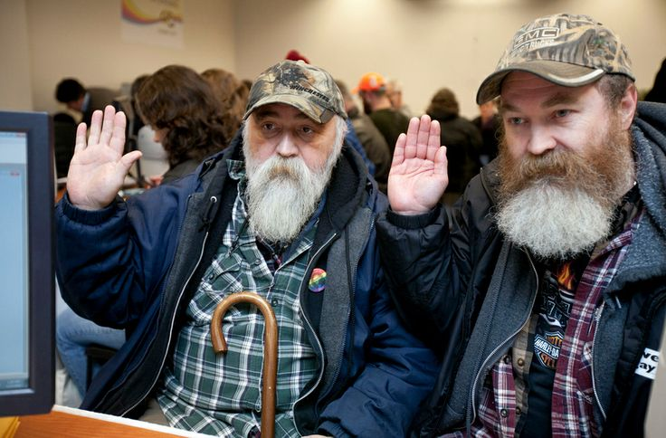
Notes:
<Picture>
19
Everyday Bias for the Health Professions
Facilitator Guide
Cook Ross Inc. © 2015
May be used only with express permission.

Slide 20
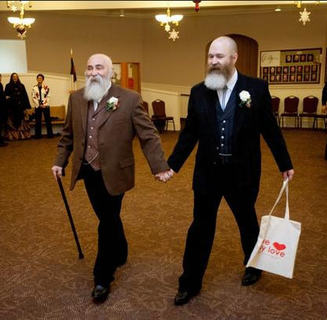
Couple applying for a marriage license in Seattle, WA.
Notes:
20
Everyday Bias for the Health Professions
Facilitator Guide
Cook Ross Inc. © 2015
May be used only with express permission.

Slide 21
Thoughts? Reactions?
What did you notice?
Have you observed or experienced examples your own life?
Notes:
TIME: 3 min
ASK: So when you hear the terms “bias” or “unconscious bias”, what are your associations with them? (If needed, prompt participants with asking: Do you feel like it is positive or negative? Are you excited about this training topic, or maybe a little cautious? etc.)
DO: Solicit 2-3 responses and thank people for sharing.
SAY: During this training, we talk about unconscious bias not as necessarily good or bad, but as a natural function of the human mind that can potentially impact diversity and inclusion in our organizations. Recognizing unconscious bias helps us to get more insight into our interpretations and evaluations, and to make more conscious decisions.
DO: Share a personal example of a moment in which you had bias, were aware of it, mitigated it, and the positive impact this had.
SAY: I am sharing this with you to illustrate the universal nature of bias; we all have bias, and we’re not necessarily trying to get rid of it. The key is practicing conscious awareness, which is the overall purpose of this workshop.
TRANSITION: Now that we’ve begun to discuss the what, let’s discuss the why. What makes it important for us to explore unconscious bias and blind spots in the context of academic medicine and healthcare?
Cook Ross Inc. © 2015
May be used only with express permission.

Slide 22
Reactions?
Have you seen examples of unconscious bias in:
  Your own life?
Work in groups of 2 or 3
Notes:
TIME: 3 min
ASK: So when you hear the terms “bias” or “unconscious bias”, what are your associations with them? (If needed, prompt participants with asking: Do you feel like it is positive or negative? Are you excited about this training topic, or maybe a little cautious? etc.)
DO: Solicit 2-3 responses and thank people for sharing.
SAY: During this training, we talk about unconscious bias not as necessarily good or bad, but as a natural function of the human mind that can potentially impact diversity and inclusion in our organizations. Recognizing unconscious bias helps us to get more insight into our interpretations and evaluations, and to make more conscious decisions.
DO: Share a personal example of a moment in which you had bias, were aware of it, mitigated it, and the positive impact this had.
SAY: I am sharing this with you to illustrate the universal nature of bias; we all have bias, and we’re not necessarily trying to get rid of it. The key is practicing conscious awareness, which is the overall purpose of this workshop.
TRANSITION: Now that we’ve begun to discuss the what, let’s discuss the why. What makes it important for us to explore unconscious bias and blind spots in the context of academic medicine and healthcare?
Cook Ross Inc. © 2015
May be used only with express permission.

Slide 23

What is bias?
A tendency or inclination that results in judgment without question
A shortcut to interact with our world
An automatic response
Notes:
TIME: 1 min
SAY: Bias refers quite simply to the mechanism of the brain that operates on associations; it is an automatic response. Our brain operates with short-cuts that allow us to quickly interpret and respond to the world around us. Bias is a decision we make so quickly that it simply occurs to us as data; we don’t know that we’ve actually taken in data points, interpreted them, and made meaning out of them. It all happens so fast that judgments such as ‘He’s stand-offish’ or ‘She’s charming’ in a first impression simply appear as though they were facts. However, we’re really just associating this new person with someone or something we’ve experienced before and creating a judgment based on that. This is a normal human function, but often it has consequences that are unintended.
TRANSITION: Some of our biases are conscious. For instance, you might be aware that you have a preference for working with people from your own culture or with people your age, rather than younger employees. Most of our biases, however, are unconscious to us.
Cook Ross Inc. © 2015
May be used only with express permission.

Slide 24
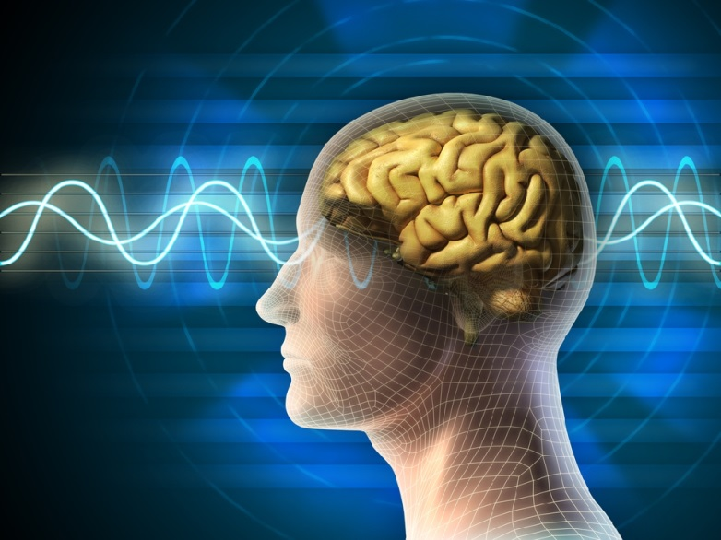

What is Unconscious Bias?
        Mental associations
        without:
          Awareness
          Intention
          Control
        These often conflict with our conscious
        attitudes, behaviors, and intentions.
Notes:
TIME: 2 min
SAY: So what is unconscious bias?
DO: Read what is on the slide.
SAY: My assumption from being with you is that everyone has an intention to be inclusive, and yet, when we look at our results we don’t always see the fruits of our labor. (Click to reveal “These often conflict with our conscious attitudes and intentions”). Unconscious bias often conflicts with our conscious attitudes, behaviors, and intentions. This explains the fact that even though we have consciously worked on increasing diversity and inclusion, we have not been as successful as we hoped we would be, like we discussed earlier.
NOTE: If you have time, ask people in large group popcorn style or in pairs, and see if they can identify some of these discrepancies between intention and outcome.
Cook Ross Inc. © 2015
May be used only with express permission.

Slide 25
There are many kinds of biases, and as humans, we all have them.
Race/ethnicity
Sex
Gender identity
National origin/geography/rurality
Disability status
Education
Physical appearance/height/weight
Personality
Age
Others?

Slide 26
Why is bias important to address in the academic health sciences environment?
Notes:
TIME: 3 min
ASK: So when you hear the terms “bias” or “unconscious bias”, what are your associations with them? (If needed, prompt participants with asking: Do you feel like it is positive or negative? Are you excited about this training topic, or maybe a little cautious? etc.)
DO: Solicit 2-3 responses and thank people for sharing.
SAY: During this training, we talk about unconscious bias not as necessarily good or bad, but as a natural function of the human mind that can potentially impact diversity and inclusion in our organizations. Recognizing unconscious bias helps us to get more insight into our interpretations and evaluations, and to make more conscious decisions.
DO: Share a personal example of a moment in which you had bias, were aware of it, mitigated it, and the positive impact this had.
SAY: I am sharing this with you to illustrate the universal nature of bias; we all have bias, and we’re not necessarily trying to get rid of it. The key is practicing conscious awareness, which is the overall purpose of this workshop.
TRANSITION: Now that we’ve begun to discuss the what, let’s discuss the why. What makes it important for us to explore unconscious bias and blind spots in the context of academic medicine and healthcare?
Cook Ross Inc. © 2015
May be used only with express permission.

Slide 27
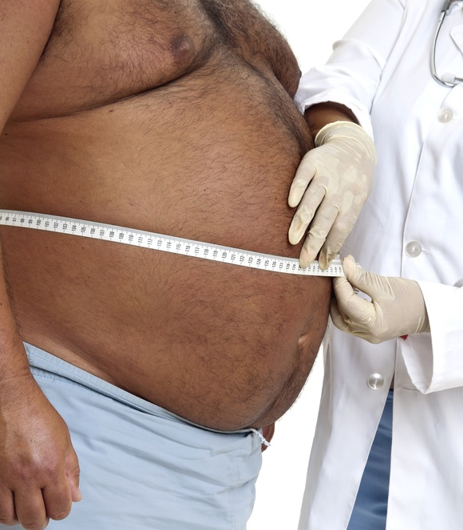
Weight
A study involving 2284 MDs found that doctors show a strong implicit bias against overweight people.
Men’s bias was stronger than women’s.
Bias was strongest among those MDs who were the thinnest.
Sabin JA, et al. PLoS One. 2012;7(11):e48448
Notes:
TIME: 1 min
SAY: Overweight patients report experiencing discrimination in health care settings. This often leads to avoidance of routine preventive health care. This 2012 study investigated the pervasiveness of negative attitudes about weight among health care professionals using the Implicit Association Test. The 2284 medical doctors who voluntarily took the test revealed a strong implicit anti-fat bias. This bias was stronger among men, and the thinnest test-takers.
NOTE: Reference study: Sabin, J.A., Marini, M., and B. Nosek (2012). “Implicit and Explicit Anti-Fat Bias among a Large Sample of Medical Doctors by BMI, Race/Ethnicity and Gender.” PLoS One, 7(11): e48448. Abstract available in Additional Resources section of this Facilitator Guide.
Cook Ross Inc. © 2015
May be used only with express permission.

Slide 28
The Effect of Race and Sex on Physicians' Recommendations for Cardiac Catheterization
“Men and whites were significantly more likely to be referred than women and blacks.”
Schulman K, et. al, N Engl J Med. 1999 Feb 25;340(8):618-26
Notes:
TIME: 1 min
SAY: Let’s examine one study more closely. In 1999, researchers explored how race and sex impact whether patients are recommended for cardiac catheterization. What they found in their experiment was that both men and whites were significantly more likely to be referred for the procedure than women and blacks. What might be causing the discrepancy? In recent years, a considerable amount of research has revealed that unconscious bias on the part of medical professionals may be actively contributing to health disparities.
NOTE: Reference study: Schulman KA, Berlinj A, Harless W, et al. (1999). “The effect of race and sex on physicians' recommendations for cardiac catheterization.” NEngFJ Med, 340:618-626. Abstract available in Additional Resources section of this Facilitator Guide.
Cook Ross Inc. © 2015
May be used only with express permission.

Slide 29
Survey of the general public (online, n=92), medical students (first through third year, n=194), and residents (n=28)
Believed that compared to whites, blacks:
Age more slowly
Have less sensitive nerve endings
Have smaller brains
Have thicker skin
Have stronger immune systems
Notes:
In two studies, we asked people to make judgments about another person’s pain. In study 1, we used a between-participants
design in which laypeople were randomly assigned to rate the pain of either a black or a white target. In study 2, we used a
within-participants design in which medical students and residents provided pain ratings and treatment recommendations for
both a black and a white target. In addition to pain ratings, we measured beliefs about biological differences between blacks and
whites using 15 items (e.g., black people’s skin is thicker than white people’s skin; see SI Text for the full list of items). We
predicted that these beliefs would be associated with racial bias in pain perception.

Slide 30
Notes:
Study 2
We collected data from a total of 418 medical students and residents. Two hundred twenty-two met the same a priori criteria
as in study 1 and completed the study (first years, n = 63; second years, n = 72; third years, n = 59; residents, n = 28).

Slide 31
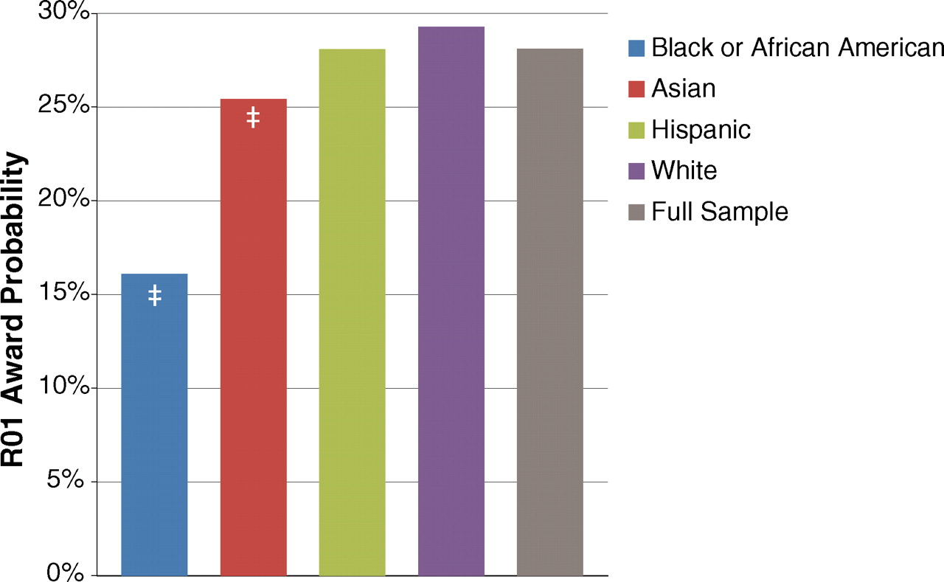
Black scientist applicants to NIH are 10% points less likely than whites to be awarded NIH research funding
Race, Ethnicity, and NIH Research Awards
‡, P < .001
Ginther, DK, Science, 2011:333;1015-1019

Slide 32
Are Emily and Greg More Employable than Lakisha and Jamal? A Field Experiment on Labor Market Discrimination
50% difference in call back rate for job interview based on names only
  “White” sounding name - 9.7%
  “Black” sounding name - 6.5%
Bertrand, M., & Mullainathan, S. American Economic Review 2004, v94(4,Sep), 991-1013

Slide 33
Scientific community. U.S. study shows unconscious gender bias in academic science
Yale University asked 127 professors to judge identical resumes from a female and male applicant
Significantly more likely to (p< 0.05)
    Hire the man
    Pay him higher salary
    See him as more worthy of mentoring
  Bias was equally strong among women & men
  Bias did not vary by age, race, or discipline
Mervis, J. Science 2012; 337(6102); 1592-1592.

Slide 34
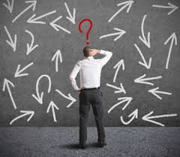
Thoughts?

Slide 35
6 Ways to Mitigate Your Biases
Recognize and accept that you have bias
Get feedback
Develop the capacity to use a flashlight on yourself
Engage with people you consider “others” and expose yourself to positive role models in that group
Practice “Constructive Uncertainty”
Explore awkwardness, and discomfort
Notes:
TIME: 30 sec
TRANSITION: Let’s transition from reviewing these strategies to creating an action plan for mitigating bias.
Cook Ross Inc. © 2015
May be used only with express permission.

Slide 36
The Unfinished Work
What is the role of the bystander?
How do we call our colleagues in with curiosity vs. calling them out?
How do we diversify the pool of speakers, students, candidates, faculty?
Explore awkwardness, and discomfort
“The elephant”
Engage with people you consider “others” and be an ally
Get feedback from colleagues in how we raise issues of race?
Notes:
TIME: 30 sec
TRANSITION: Let’s transition from reviewing these strategies to creating an action plan for mitigating bias.
Cook Ross Inc. © 2015
May be used only with express permission.

Slide 37
Freedom is the pause between stimulus and response.
- Rollo May
Notes:
TIME: 30 sec
SAY: As Rollo May said, freedom is the pause between stimulus and response. Let’s take a look at how we can effectively do this.
Cook Ross Inc. © 2015
May be used only with express permission.

Slide 38
Take a P.A.U.S.E.
A quick way to check your reaction.
P
Pay attention to what’s actually happening, beneath the judgments and assessments
A
Acknowledge your own reactions, interpretations and judgments
E
Execute your action plan
U
S
Understand the other possible reactions, interpretations and judgments that may be possible
Search for the most empowering, productive way to deal with the situation
Notes:
TIME: 3 min
SAY: The first important thing to do in any situation, is to quickly check your reaction by taking a pause.
DO: Click to reveal each step as you are reading what is on each section. Provide a personal example of when you did or could have applied this model, demonstrating how you would perform each step.
Cook Ross Inc. © 2015
May be used only with express permission.

Slide 39
Examples of unconscious bias from your own lives
In groups of 3, describe a situation in which you observed unconscious bias in the workplace at play.
  What are the challenges?
  What strategies can you employ to address it?
Suggested per person: 1-2 minutes to describe situation; 3 minutes to peer coach & provide feedback

Slide 40
Your Commitment
Based on what we have discussed today, identify concrete action-steps:
  How will you use this information to improve your relationship with a colleague?
  Identify an important decision-making point you have coming up, and strategize how you can mitigate the impact of bias in this decision.
  Come up with an idea for recognizing, navigating, and/or mitigating biases in your team, department or organization.
Journal for 5 minutes
Notes:
TIME: 10 min
SAY: (Click to reveal first sentence) Come up with concrete action-steps you are committed to taking within the next month.
DO: Read the three types of action steps outlined on the slide, and depending on time and group dynamics, choose from one of the assignment options below:
Option 1: Split up in small groups and ask participants to discuss all of the three questions in their group. Encourage them to give and receive constructive feedback. Walk around the room to hear some of their action steps, conversations, feedback, challenges and concerns, and provide coaching along the way. Report out in large group. Consider capturing ideas on wall chart
Option 2: Split up in small groups and divide the questions over the groups (for example, six groups, one question for each two groups). Encourage them to give and receive constructive feedback. Give them a few minutes for this. Walk around the room to hear some of their action steps, conversations, feedback, challenges and concerns, and provide coaching along the way. Report out in large group. Consider capturing ideas on wall chart.
Option 3: Individual exercise and paired sharing/feedback. Walk around the room to hear some of their action steps, conversations, feedback, challenges and concerns, and provide coaching along the way. Debrief in large group.
Option 4: Large group discussion of each of the questions
For large group report out for each of the options:
SAY: Who is willing to share one of their action steps with us?
DO: Invite 4-5 responses, and provide acknowledgement and/or coaching along the way. Especially encourage those who see challenges with their action steps, and invite peer coaching from other participants in addition to your own coaching. Suggest that they might want to come up with mini/sub-steps for each action step and continue to consult their participant guide and each other for ongoing support and coaching.
Commit to having honest internal dialogues about yourself and how your biases play out in your interactions with patients/clients/learners/colleagues
Commit to explore ways to create a more diverse and inclusive environment
Cook Ross Inc. © 2015
May be used only with express permission.

Slide 41
Thank you
Dr. Yvette Cozier, BU School of Public Health (yvettec@bu.edu)
Dr. Larry Dunham, BU Goldman School of Dental Medicine (lgdunham@bu.edu)

