Slide 1

Navigating organizational politics and change
Aviva Lee-Parritz, MD
Chief
Department of Obstetrics and Gynecology
Boston Medical Center
Chair and Associate Professor
Boston University School of Medicine

Slide 2
objectives
Self assessment
Understand underpinnings of political intelligence
Identify tips for negotiating change
Increase awareness of internal resources for successful leadership

Slide 3
Rules of Organizational Politics
1. You ignore organizational politics at your own peril.
2. You engage in the politics of your organization at your own peril.
3. All organizations are political.
4. You need to get over #3

Slide 4

WHY IS THIS SO IMPORTANT NOW?

Slide 5
“One of the penalties for refusing to participate in politics is that you end up being governed by your inferiors.“
Plato

Slide 6
Developing Political Intelligence
Behavior Helps
Personal Goals
Behavior Hurts
Personal Goals
Behavior Helps
Organization Goals
Winner | Martyr
Sociopath | ???
Behavior Hurts
Organization Goals
  Never advance your own interests by harming your organization or hurting other people.

Slide 7
THE 4 P’S OF POLITICAL SUCCESS
Power
assessment
Performance
Perception
Partnerships

Slide 8
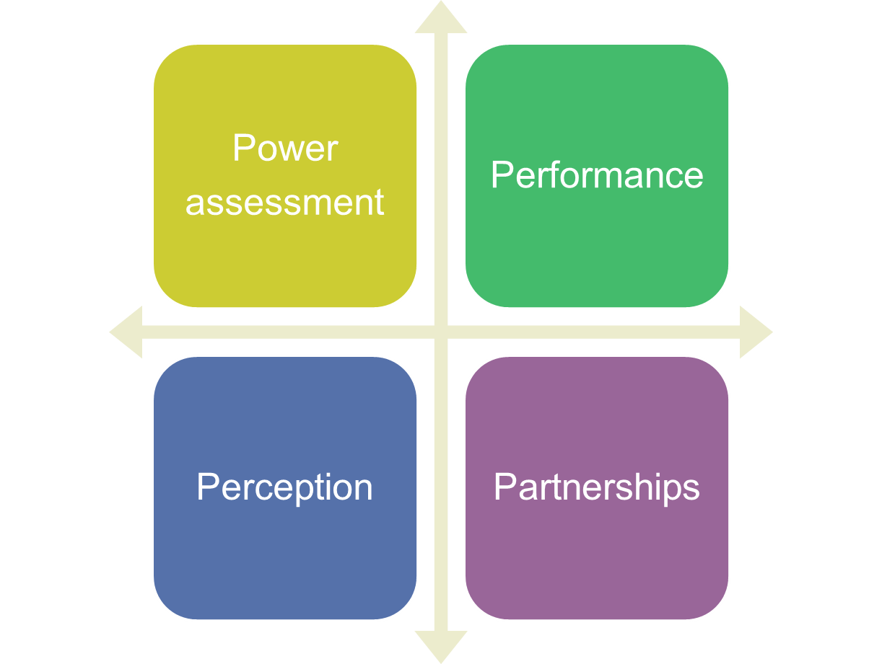
Power Assessment
Whose cooperation will be needed?
Whose compliance will be needed?
What differences exist that could create conflict or adversarial feelings?

Slide 9
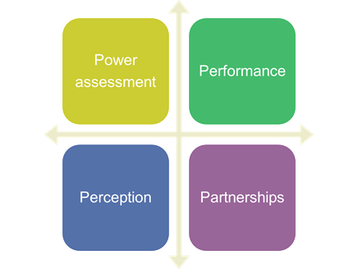
Performance
Say what you are going to do and then do it!
If you create a gap between what you say and what you actually do → Demotivation due to:
  Working harder as a result of someone’s actions
  Seeing the positive results of their work undone by someone else
  Putting their own interests ahead of that of the organization

Slide 10
Perception
Ability to get visibility
  There is no value in toiling in obscurity
    Creates resentment
    Everyone wants to be recognized for what they do
    You too!
Mange emotions
  Think before you speak
RESIST situations that encourage win-lose situations

Slide 11
Partnerships
Network, network, network
Fine tune emotional intelligence
Manage up, down and sideways

Slide 12
People are messy
We are creatures of emotions not logic
We are all driven by our own wants, ideas, insecurities and selfishness
Any time we work with others, we’re forced to negotiate and compromise (which is rarely easy).
Livelihoods tied to success → potential for conflict.
Driven by the need to get along, get ahead and have meaning

Slide 13
Negotiating Change
Expectations
  It is a process
  Do not expect to get it right at the start or all the time
  Strength comes from adaptation and handling set backs
Sure footing
  Be careful in unfamiliar territory
  Build your credibility (“money in the bank”)
  Recognize/respect other's negotiable and non-negotiable boundaries

Slide 14
Negotiating change
Know yourself
  Recognize your discomfort
    Decrease self sabotage,
    Avoid hot buttons
  Accept your own strengths→ leverage them
  Accept your “less strong” areas (aka weaknesses).
  Get help if needed (that is not a weakness!!)
Clarity of purpose for change
  Be able to contextualize
  Articulate rationale
  Keep mission/ needs in focus

Slide 15
New situation
Study and learn how decisions are really made in your organization | Follow the fast-trackers
Learn to be a network connector. | Give to get: Bring something of value to the relationship. And talk about it!
Notes:
1. Study and learn how decisions are really made in your organization. While you might assume that decisions flow from hierarchy, more often than not there’s an informal decision-making process that occurs somewhere other than at the highest points on the organizational chart. Top-level approval might be required somewhere along the way, but most projects, resource decisions and spending decisions occur elsewhere. In the case of my client, no one person typically holds Yea or Nay decision rights. While this ambiguity is at first a bit disconcerting, once you plug into the culture, you realize that the “Networking” and “Give to Get” approaches described below heavily influence decision-making.
2. Follow the fast-trackers. Assess what’s important to the most visible and aggressive climbers, and you gain valuable insight into the political environment.
Whether there’s a fast-track or not in your organization, some people are moving faster than others. Pay attention to how these people work and cultivate an understanding of what’s important to them in terms of support, visibility, involvement and information. Your knowledge of who these fast-trackers are and what’s important to them will help you engage in the political discourse from an informed perspective.
3. Learn to be a network connector. The importance of cultivating a strong internal network is a major issue in most organizations, and especially so in larger firms. In my client’s case, personal network strength equals power, and the pursuit of connecting is part of everyone’s daily routine. While my initial reaction was to be concerned over the massive investment in time that goes into this overt bridge building, I learned that the pursuit of being connected to the power-brokers and fast-trackers was a core part of the organization’s communication flows. The talk is typically laser focused on improving the business, although the individual motivation to gain sponsorship and support for an idea (thus potentially gaining resources, visibility and budget) is a visible driver for all to see. To the most persuasive go the spoils of responsibility. It might not be perfect, but it is perfectly clear.
4. Give to get: more lessons from my networking-obsessed client company above. The rules for connecting typically involve bringing something of value to the relationship. Talk is nice, but ideas are the coin of the realm, and actionable big ideas the gold. The most successful networkers are those bringing actionable ideas to solve big problems. To the firm’s credit, there’s a huge appetite for consuming big ideas and, those moving ahead and gaining more responsibility (and power) are the ones who are most successful in gaining sponsorship for their ideas.
The big ideas are golden, however, people actively trade in other denominations of political currency, including invitations for involvement, opportunities for visibility and the provision of resources, including budget and gray-matter.

Slide 16
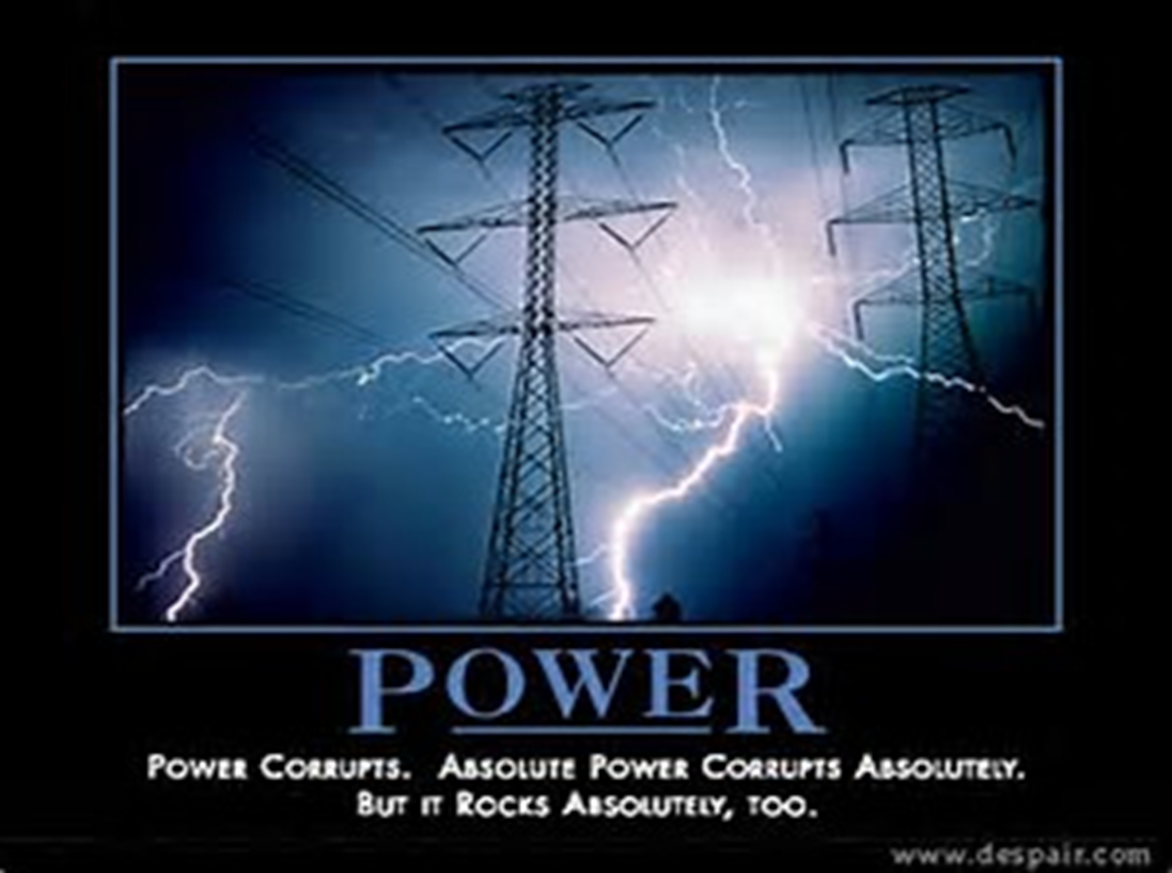
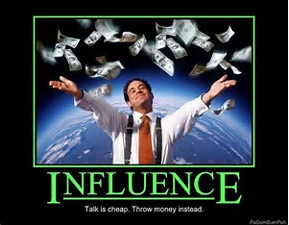

Slide 17
POWER
INFLUENCE
Independent of person
Depends on person
Wielded
Granted
Imposed by authority
Does not need formal position
Others might not do on own
Others act out of belief
Continues after person is gone
You can build a throne with bayonets, but you cannot sit on it for very long.
--Boris Yeltsin

Slide 18
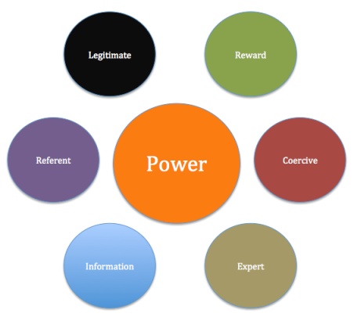

Slide 19
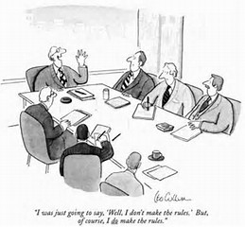

Slide 20
How do we go about influencing?
Become knowledgeable:
  Be clear on what you want to achieve
  Articulate what you are seeking to achieve
  Anticipate challenges
Informal support:
  Socialize with people you trust
  Consider your sources of support
  Who are the other potential winners
Campaign for broad support:
  Increase your sphere of influence, use your informal supports
  Take your idea to other people which is now supported
Gain formal approval and become accountable:
  Communicate context and support
  Take it to leaders and to get sign off
  Be accountable

Slide 21
THE FIVE LEVELS OF LEADERSHIP
5
PINNACLE
---Respect---
People follow because of who you are
and what you represent
4
PEOPLE DEVELOPMENT
---Reproduction---
People follow because of what you have done for them
3
Production
---Results---
People follow because of what you have done for the organization
PERMISSION
---Relationships---
People follow you because they want to
2
1
POSITION
---Rights---
People follow you because they have to
Excerpt from “The Five Levels Of Leadership”, by John C. Maxwell

Slide 22
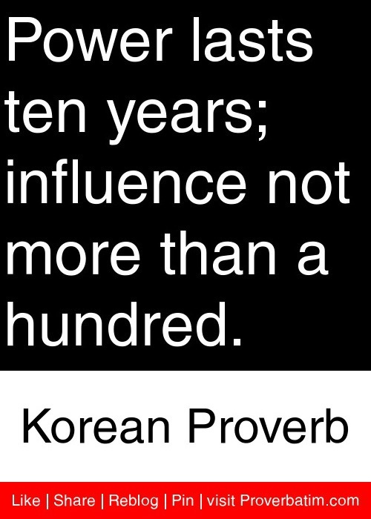
Believe in yourself
Be yourself
Be strategic

Slide 23
My ask of you
4 things I am going to do this year to increase my influence on others.
-Amplify something I already am/have
-Master something new
-Dream big
-Accept incremental progress

