Slide 1
The IDP – what it can do for you (and your trainees)
Linda Hyman
Lauren Celano
October 27, 2013

Slide 2
Individual Development Plan
Not new – used extensively in business and in government – for example (from the FDA):
A clear statement of an employee's career goals,
A map for attaining goals that specifies immediate and long-range developmental needs,
An individually-tailored action plan to develop specific competencies (knowledge and skills) needed to improve performance in present position or to prepare for new responsibilities,
A written plan for scheduling and managing an employee's development,
A tool for a supervisor to estimate resources needed for employee development training,
An agreement between the employee and supervisor based on funds available to meet the employee's and the organization's goals and

Slide 3
Why the focus on an IDP now?
July 23, 2013 –
NIH: NIH Encourages Institutions to Develop Individual Development Plans for Graduate Students and Postdoctoral Researchers
Notice Number: NOT-OD-13-093
The purpose of this Guide Notice is to announce that NIH encourages institutions to assist graduate students and postdoctoral researchers to achieve their career goals within the biomedical research workforce through the use of Individual Development Plans (IDPs). Institutions are encouraged to report on this in all progress reports submitted on/after October 1, 2014, using the Research Performance Progress Report (RPPR).

Slide 5
Why

Slide 6
Are we prepared?
1. Are you thinking…….
when I was in grad school I had to…….
my PI would never let me out of the lab……
your job is to make me famous……..
2. We operate in the apprentainship model and we’re very good at preparing trainees for jobs in academic research…but is that where they end up?

Slide 7
Where are they now?
Career Outcome | Number in Field | % in field
Academic - Research Institution | 78 | 25.57%
Academic - Teaching Institution | 22 | 7.21%
Clinical practice | 25 | 8.20%
Government Research/Policy | 8 | 2.62%
Industry - Research | 89 | 29.18%
Other | 8 | 2.62%
Research Support | 9 | 2.95%
Still in training | 66 | 21.64%
Grand Total | 305 | 100.00%
RESULTS. In 2011, GMS compiled data on position outcomes of trainees, drawing from a variety of local and university-wide resources (GMS data, Alumni Association data, Development Office data, T32 outcome data). : the distribution is similar to that reported by the NIH working group. Notably, our graduates seem to choose careers in industry
The data is 52% complete (of the 583 graduates we have data for 305).

Slide 8
Its taking too long!
Time to degree
Multiple post doc appointments
First R01 – age 42
Not enough jobs in academia (faculty don’t retire, adjuncts fulfill teaching positions etc)

Slide 9
Recommendations from taskforce:

Slide 11
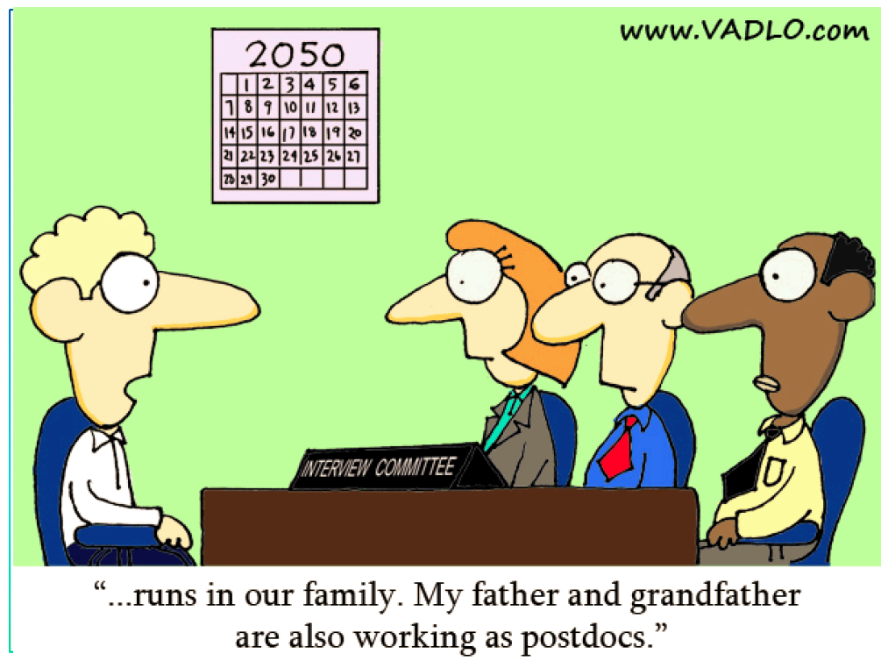

Slide 12
The IDP: what can it do for you?
Can ensure you are compliant with NIH regulations
Can make you a better mentor
Can assist your trainees in fulfilling their goals
Can assist you in ensuring trainees are accountable
Can help provide a positive working environment which makes for happy and productive trainees

