Slide 1
“It is not how much money we make that ultimately makes us happy…
…three things - autonomy, complexity and a connection between effort and reward -
are qualities that work has to have if it is to be satisfying." Malcom Gladwell in Outliers

Slide 2
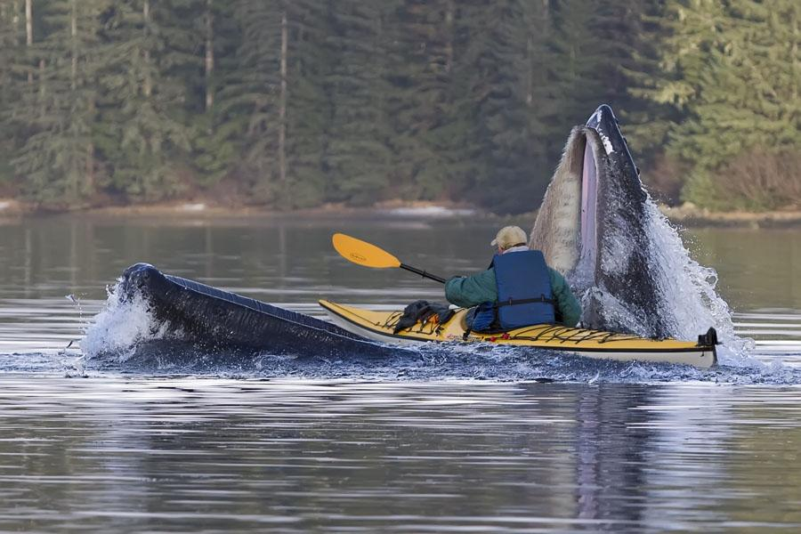

Slide 3
Reflections on balance:
A baker’s dozen
judjones@bu.edu

Slide 4
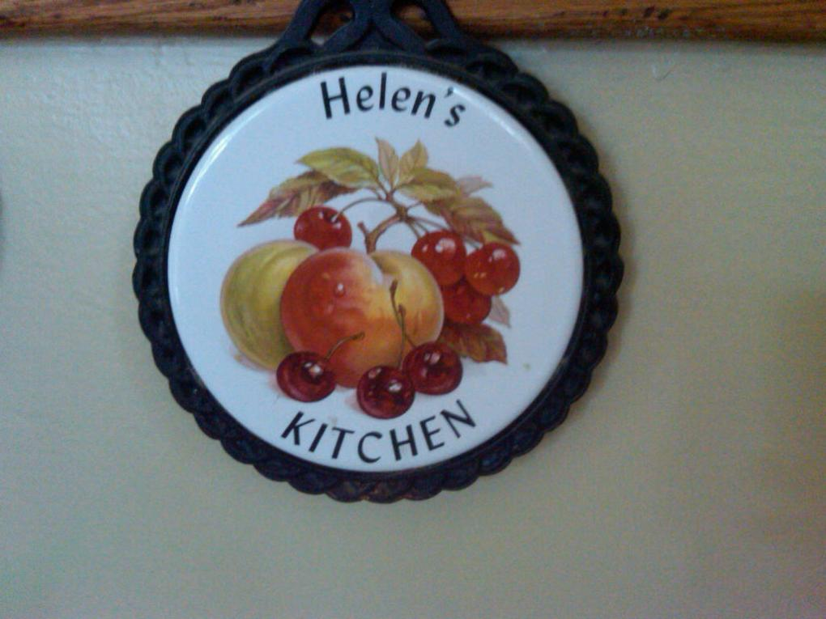
Almost everything I learned about balance I learned in Helen’s kitchen

Slide 5
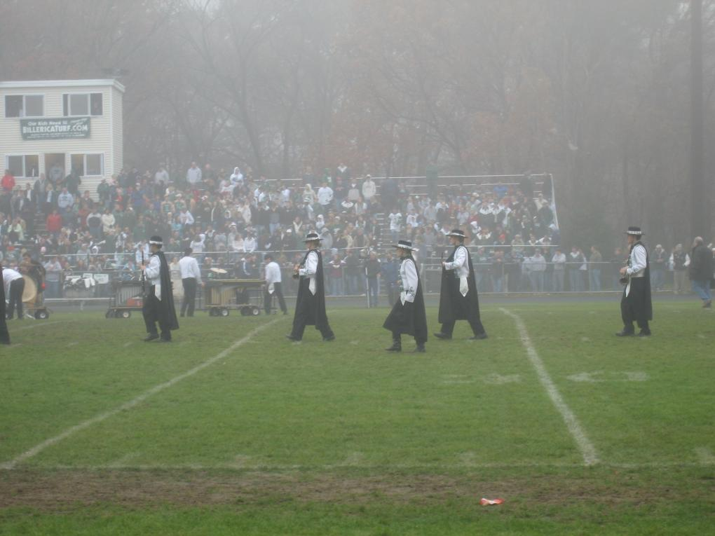
1. It’s different for everyone

Slide 6
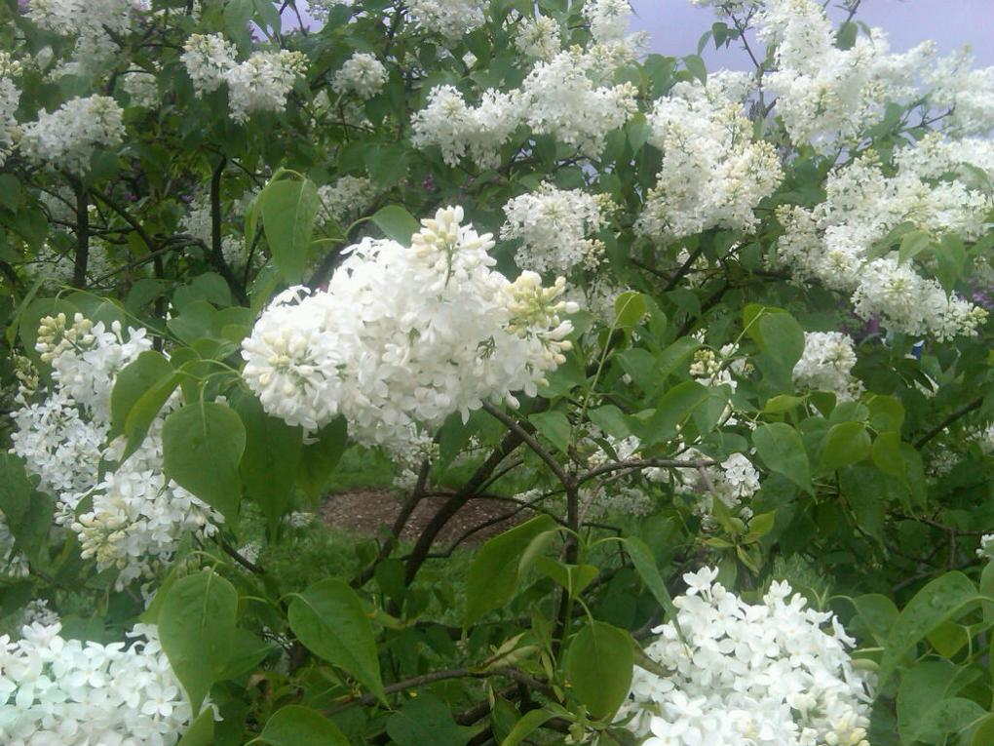
2. Bloom where you’re planted

Slide 8
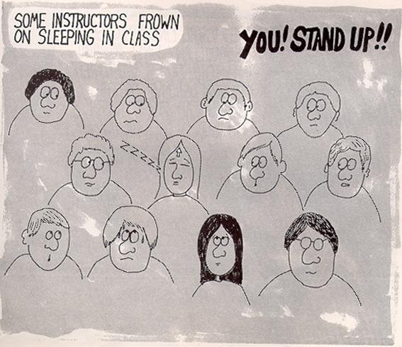
3. Get plenty of sleep

Slide 9
4. Get help!
“It's not the load that breaks you down, it's the way you carry it.”
Lena Horne
1917-2010

Slide 10
“It’s never 50:50” Bob Howell, c1979
Seek partners who are willing to work with you
If you love someone who is high maintenance, they will always be so
This is even more exaggerated as they grow older

Slide 11
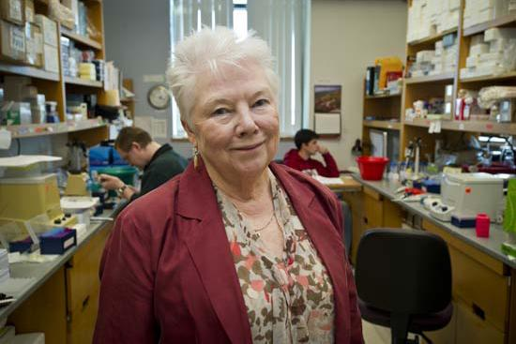
Why We Are Fat
MED biochemist says chemicals, not just calories could explain epidemic BU Today, 03.12.2012
By Barbara Moran.

Slide 12
Barbara Corkey
“It was almost impossible to live on my income,” says Corkey. “I couldn’t afford babysitters. I couldn’t afford anything.” Her daughter Valerie remembers her mother struggling to provide for the family, shuttling her around on the back of a bicycle because they didn’t own a car. “But I don’t remember wanting for anything”
…On the contrary, Valerie and her sister, Pamela, share happy memories of playing in their mother’s lab, spinning magnets on the centrifuge and snapping tiny plastic vials together into necklaces. “I wouldn’t trade her for any other parent,” …

Slide 13
Pot roast versus metabolic regulation
Barbara Corkey: “I realized that I am in charge of me, and I’m responsible for my life,” she says. “No one’s going to take care of me except me. And no one’s going to take care of my kids except me. So get over it.”
Pamela Corkey: “Having a bunch of kids and giving them home-cooked pot roast seven nights a week is one way to make a contribution to the world… But when your brain is capable of understanding and breaking down metabolic regulation, that’s what you should be doing. I can’t imagine how miserable she would have been if she hadn’t given wing to her intellect.”

Slide 14
5. Build in redundancy
In child care, this means having multiple babysitters, plus day care and an au pair or nanny
Incidentally – you know you’re in trouble when the kids make up a game called
“bad au pair”
For eldercare, this means home health care or personal care attendants, plus someone at night if you need it

Slide 15
“Take a two mile walk every morning before breakfast.”
6. Exercise
Harry S. Truman

Slide 16
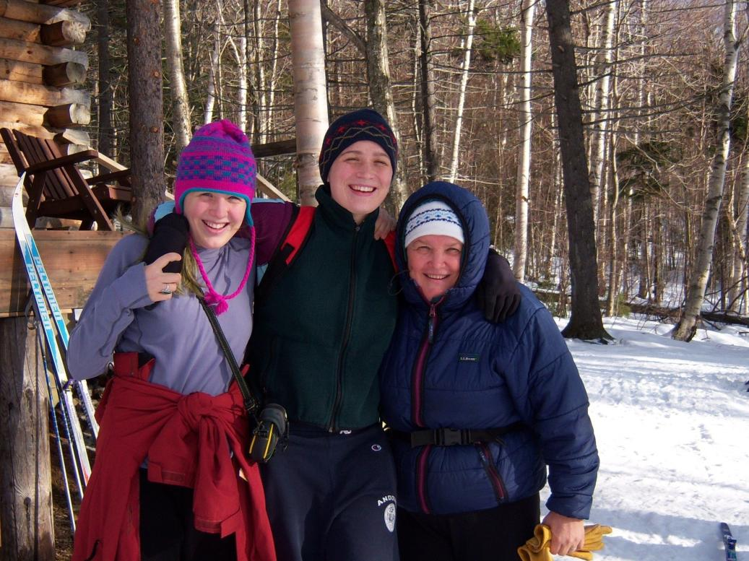

Slide 17
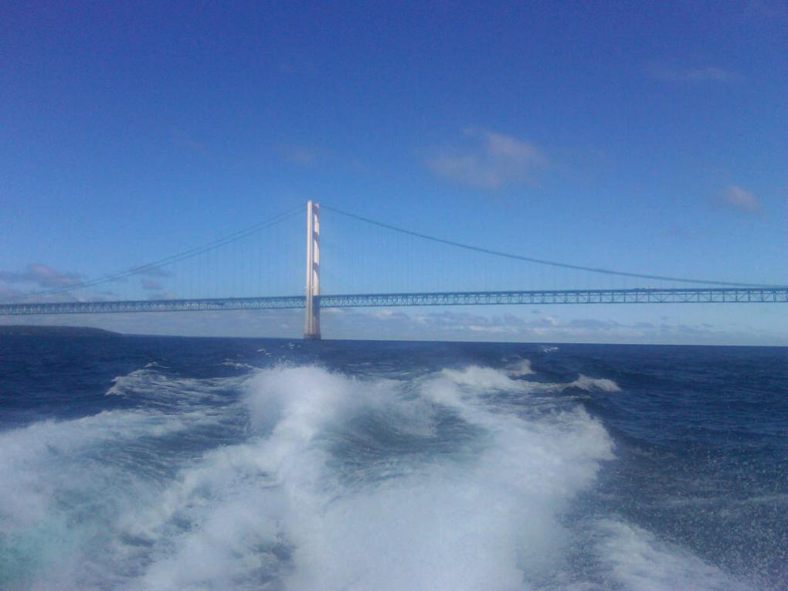
“What you don’t need is as important as what you do need.”
7. Mind the essentials
Romare Bearden

Slide 18
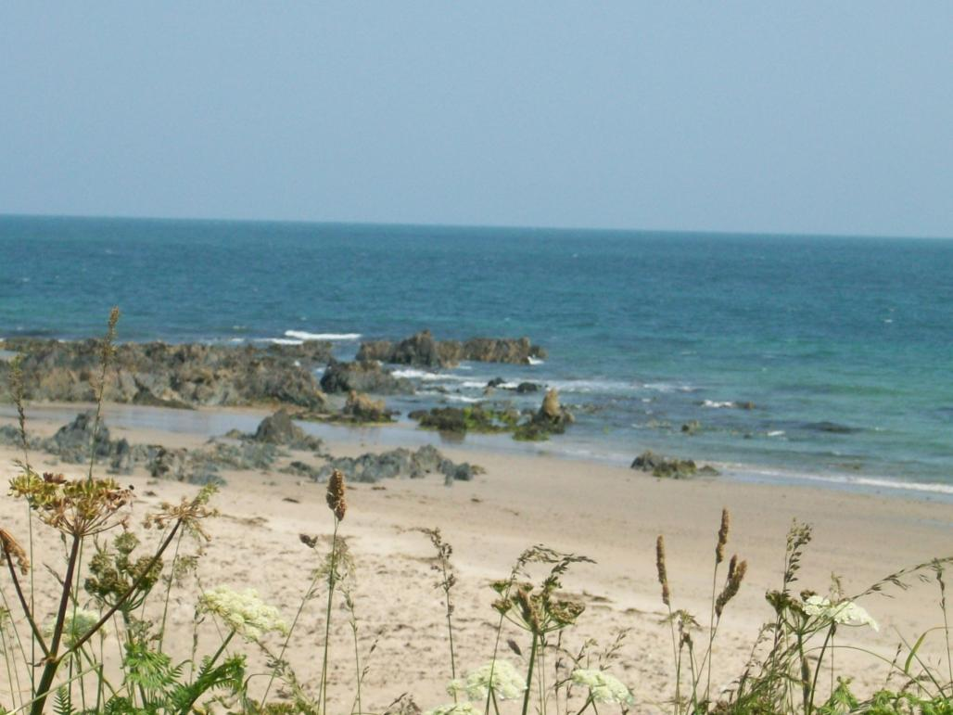
Big rocks: values, family Small rocks: career, work, obligations Sand: everything else
“No matter how full your life is there is always room for beer”

Slide 19
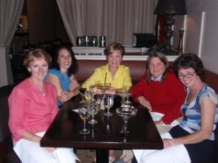
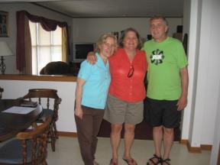
"Beer is proof that God loves us and wants us to be happy“ Ben Franklin
8. Refresh yourself with friends
Notes:
Top 5 quotes from Benjamin Franklin "Any society that would give up a little liberty to gain a little security will deserve neither and lose both."
"They that can give up essential liberty to obtain a little temporary safety deserve neither liberty nor safety."
"Be civil to all; sociable to many; familiar with few; friend to one; enemy to none."
"Where there's marriage without love, there will be love without marriage."
"Some are weather-wise, some are otherwise."
Top 5 quotes from Comedy "I believe that sex is one of the most beautiful, natural, wholesome things that money can buy."
"I'm very proud of my gold pocket watch. My grandfather, on his deathbed, sold me this watch."
"All I've ever wanted was an honest week's pay for an honest day's work."
"Beer is living proof that God loves us and wants us to be happy."
"The problem is not that we have too many fools, it's that the lightning isn't distributed right."

Slide 20
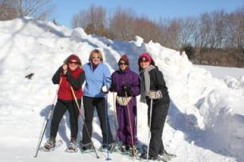
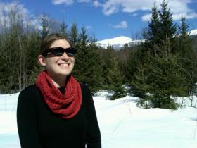
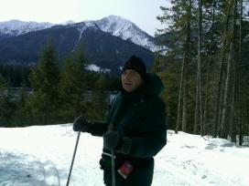
9. Find someone to talk with
“If you want a friend in the corporate world, get a dog”
Give em hell Harry Truman

Slide 21
“Live or die: mere consequences of what you have built. What matters is building well… What matters is what you are doing when you die, and… I want to be building.”
10. Build your own community
Paloma in Muriel Barbery's The Elegance of the Hedgehog.

Slide 22
profound thought #4 Care for plants for children
Paloma in Muriel Barbery's The Elegance of the Hedgehog.

Slide 23
Journal of the movement of the world No. 1: “Stay centered without losing your shorts”
11. Find your center
Paloma in Muriel Barbery's
The Elegance of the Hedgehog.

Slide 24
“Athletes, artists and other people in other fields refer to this sense of personal power as being centered. The centered person draws power from knowing his or her own competencies, being comfortable with those, and refusing to let others diminish them.”
Kathleen Reardon
“The Secret Handshake”, p.150

Slide 25
12. Get and stay organized
Covey’s Seven habits of highly effective people
Be proactive
Begin with the end in mind
Put first things first
Think win / win
Seek first to understand, then to be understood
Synergize
Sharpen the saw

Slide 26
13. Sex and spirtuality
Again, it’s different for everyone

Slide 27
“The secret of a good sermon is to have a good beginning and a good ending… then having the two as close together as possible.”
George Burns

Slide 28
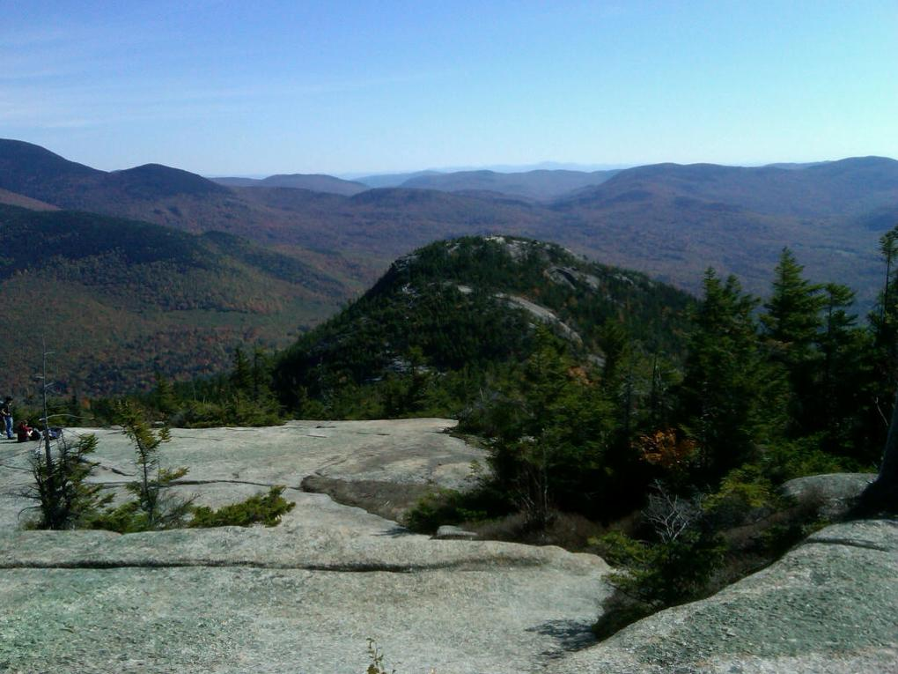
How will you be remembered?

Slide 29
“I always remember an epitaph which is in the cemetery at Tombstone, Arizona. It says: 'Here lies Jack Williams. He done his damnedest.' I think that is the greatest epitaph a man can have - When he gives everything that is in him to do the job he has before him. That is all you can ask of him and that is what I have tried to do.”
Harry S. Truman (1884-1972)
33rd President of the United States

Slide 30
Resting here until day breaks and shadows fall and darkness disappears is Quanah Parker, the last chief of the Comanches
1848-1911
Gwynne’s Empire of the Summer Moon, p.319

Slide 32
Last Will and Testament (To All My Friends and Family) to you I leave... A warm spring rain The lonely whistle of a passing train A sky of blue A love that's true Hot, lazy summer days The warm of an august sun's rays The cool, cool waters Near a sandy, warm beach The beautiful stars Some beyond your reach The chirp of crickets Or the croak of a frog A misty spooky evening The mystery of a fog
The smell of autumn The falling of leaves The rustling sounds Of a walk in the woods Diamonds in the snow Or icicles melting Hot cozy fireplaces And popcorn popping Warm spring rain The buds poking thru Soon green grass and leaves And flowers of every hue Love them For God gave them all to you --Helen Patricia Mazur Jones 2/21/1980

