Slide 1
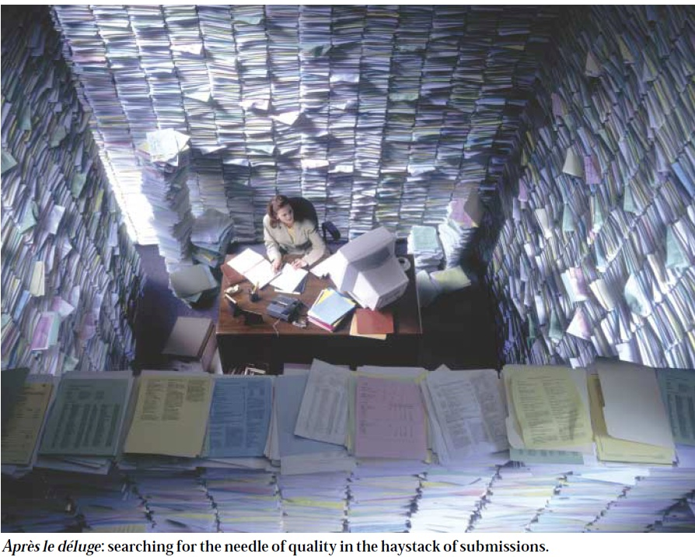
Getting Published ?! (*#~)
Vasan S. Ramachandran, MD
BUSM / Framingham Heart Study
Source screen shot: Lawrence P. Nature 2003

Slide 2
Sources
erm.wustl.edu/Dodson_ERM_3.27.08.pdf
dor.umc.edu/.../WritingandpublishingaresearcharticleAdair.pptx
www.pri.univie.ac.at/~derntl/papers/meth-se.pdf
DOI: 10.1126/science.caredit.a0700046
Google images.
Cartoonstock.com

Slide 3
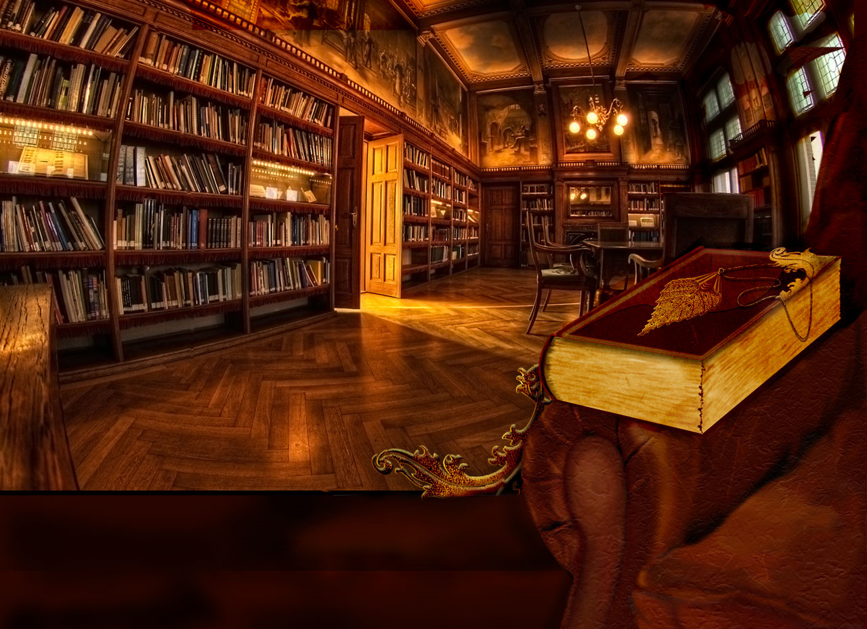
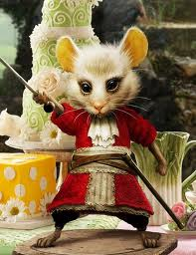
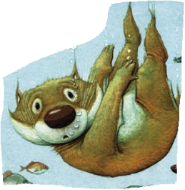
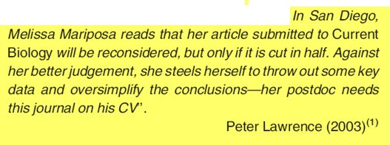
NATURE|VOL 422 |20 MARCH 2003 |

Slide 4
Questions
How many of you have felt ‘sore’ about an authorship position or about being ‘left out’ of a publication you thought you should be part of?
How many of you have been corresponding authors on manuscripts?
How many of you work with fellows on manuscripts?
How many of you have felt ‘shattered’ by a rejected manuscript?
How many of you have ‘given up’ on trying to publish a manuscript after repeated rejection?

Slide 5
Issues Discussed
Author responsibilities: an overview
Choosing a journal
Unmasking editorial processes: inside the board room
Processing editorial decisions & revising MS

Slide 6
Some Key Tips
Read many papers, and learn from good ones & bad ones
Write frequently: quality is everything
Review frequently
Learn to be objective about your work
Believe that editors/reviewers are likely trying to be objective about your work
Learn to expect and accept rejection
Modified from Bourne PE. Plos Comput Biol 2005

Slide 7
Some Key Tips
Ingredients of good science
Novelty of idea (timing)
Comprehensive review of literature
Strong data; strong analysis/stats input
Thought provoking discussion recognizing limitations of one’s work
Ingredients of good writing
Good organization
Appropriate use of tables & figures
Right length
Right audience
Modified from Bourne PE. Plos Comput Biol 2005

Slide 8
Why write and publish research papers?
Ideally –
to share research findings and discoveries with the hope of improving healthcare.
Practically –
to get funding
to get promoted
to get a job
to keep your job!
Source: dor.umc.edu/.../WritingandpublishingaresearcharticleAdair.ppt

Slide 9
“Scientists are rated by what they finish, not by what they attempt”
Source: dor.umc.edu/.../WritingandpublishingaresearcharticleAdair.ppt

Slide 10
Publishing begins with choosing a Good Research Question !!

Slide 11
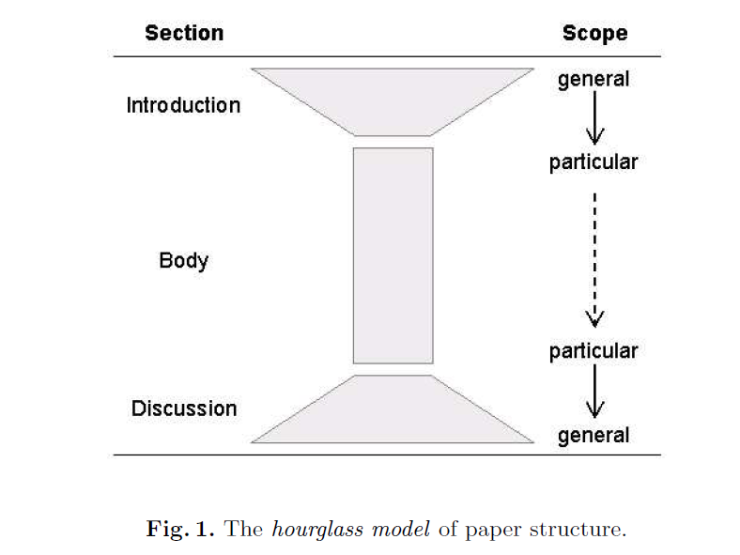
MS Structure
Source: www.pri.univie.ac.at/~derntl/papers/meth-se.pdf

Slide 12
First Impressions

Slide 13
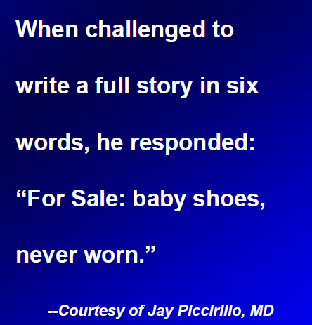
Writing Simply
“Those who have the most to say usually say it with the fewest words”
Source: erm.wustl.edu/Dodson_ERM_3.27.08.pdf

Slide 14
Source: erm.wustl.edu/Dodson_ERM_3.27.08.pdf

Slide 15
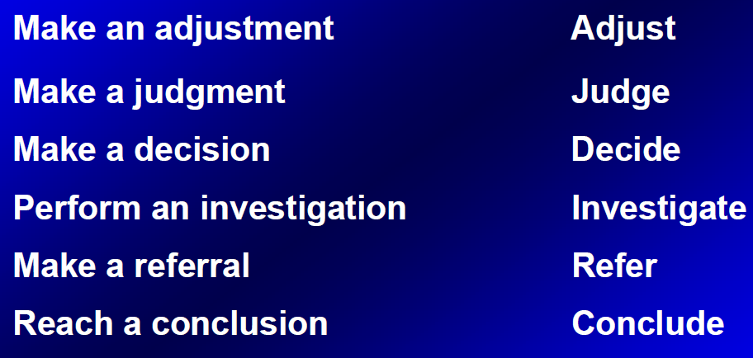
Writing simply & clearly
Source: erm.wustl.edu/Dodson_ERM_3.27.08.pdf

Slide 16
Avoid obtuse/obtruse language

Slide 17
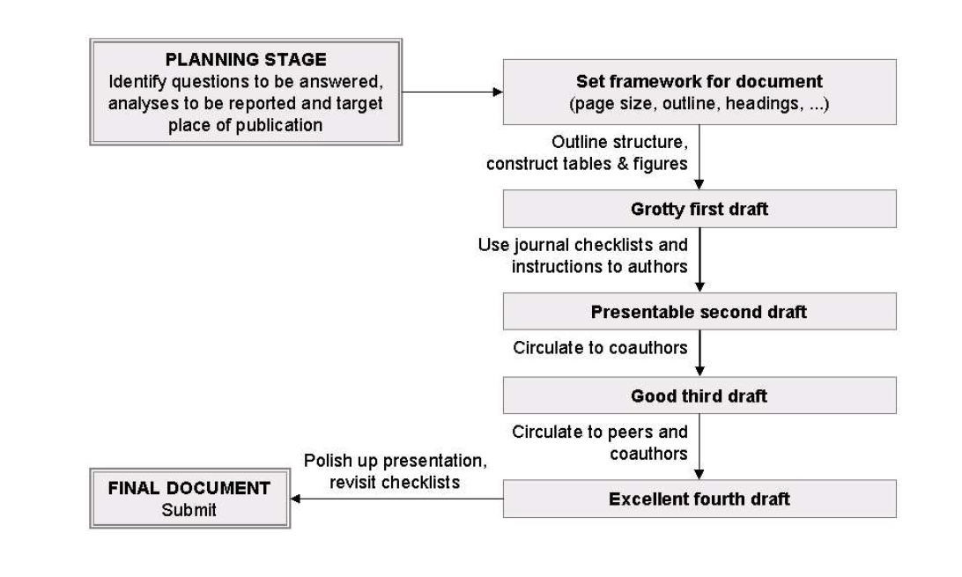
MS Preparation
Source: www.pri.univie.ac.at/~derntl/papers/meth-se.pdf

Slide 18
Process of Publication
Submission of manuscript
Assignment and review
Decision
Rejection
Revision
Resubmission
Re-review
Acceptance
Rejection
Publication
Source: dor.umc.edu/.../WritingandpublishingaresearcharticleAdair.ppt

Slide 19
Source: erm.wustl.edu/Dodson_ERM_3.27.08.pdf

Slide 20
Source: erm.wustl.edu/Dodson_ERM_3.27.08.pdf

Slide 21
Beware of autoplagiarism;
Cryptomnesia
Source: erm.wustl.edu/Dodson_ERM_3.27.08.pdf

Slide 22
Source: erm.wustl.edu/Dodson_ERM_3.27.08.pdf

Slide 23
Authorship principles
Fairness (ICJME 3 criteria)
‘Openness’/transparency
Communication
Team perspective:
Sensitivity towards varying views on contributorship
Enjoying the process
‘Feeling good’ about process
“Democracy is the worst form of government, except for all those other forms that have been tried from time to time." (Winston Churchill, from a House of Commons speech on Nov. 11, 1947)

Slide 24
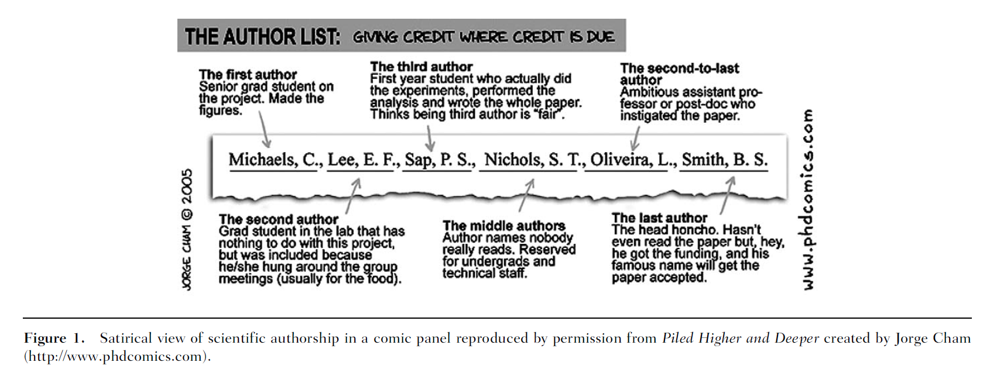
Appears in Brumback RA. J Child Neurol 2009;24:370-378

Slide 25
Authorship issues
Senior author’s primary responsibility
Some people are silent but resentful in their silence
Some people speak louder, hoping to gain in authorship
Avoid manipulation at any cost
Discuss, discuss, discuss
Several rounds of discussion
Tentative authorship proposal→then finalize with group consensus→ then circulate paper

Slide 26
Authorship Issues
First author vs. Senior author
‘Starred first’ and promotion implications
Corresponding author
Corresponds with journal editors/reviewers
Corresponds with press
Corresponds with queries/letters to editors
Gets invited to present findings at meetings
Takes overall responsibility for research

Slide 27
What constitutes redundant publication?
Data in conference abstract?
Same data, different journal?
Data on website?
Data included in review article?
Expansion of published data set?
No
Yes
Maybe
OK if later
Yes
Source: dor.umc.edu/.../WritingandpublishingaresearcharticleAdair.ppt

Slide 28
Choosing the Right Journal

Slide 29
What constitutes a good journal?
Impact factor –
average number of times published papers are cited up to two years after publication.
Immediacy Index –
average number of times published papers are cited during year of publication.
Source: dor.umc.edu/.../WritingandpublishingaresearcharticleAdair.ppt
Notes:
Immediacy Index – number of times articles published in 2003 (by a journal) that were cited in 2003 divided by number of articles that were published in 2003 (by the journal)

Slide 30
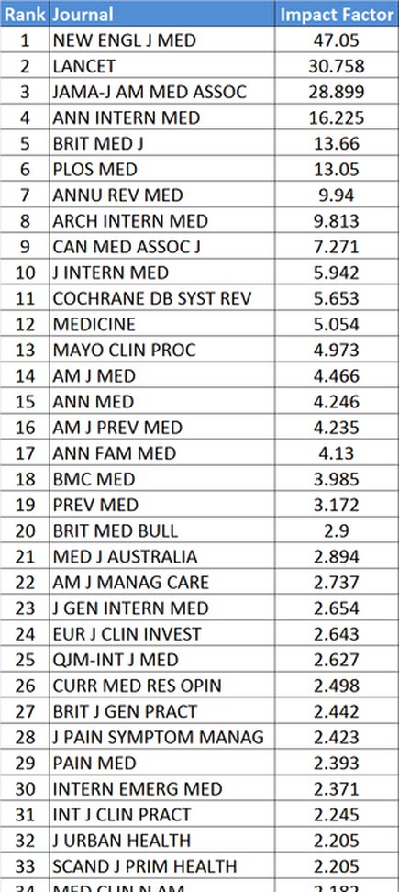
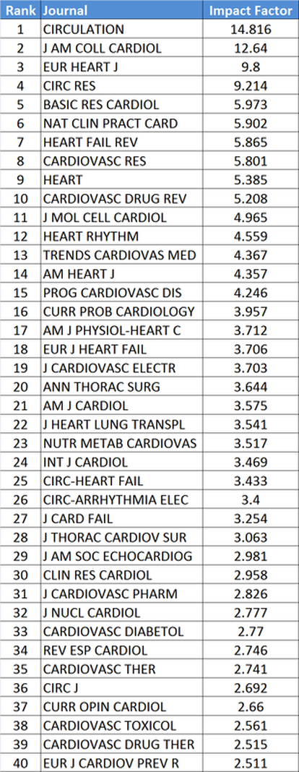
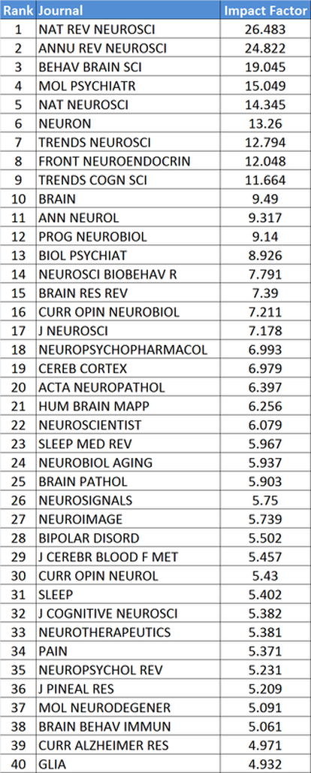
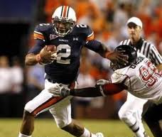
Impact factors

Slide 31
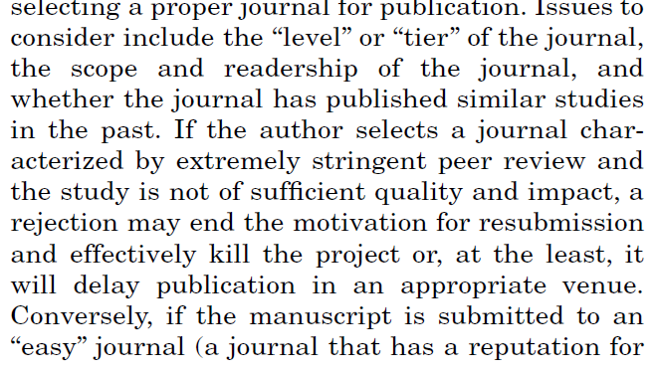
Choosing the right journal
Woolley K L , Barron J P Chest 2009;135:573-577

Slide 32
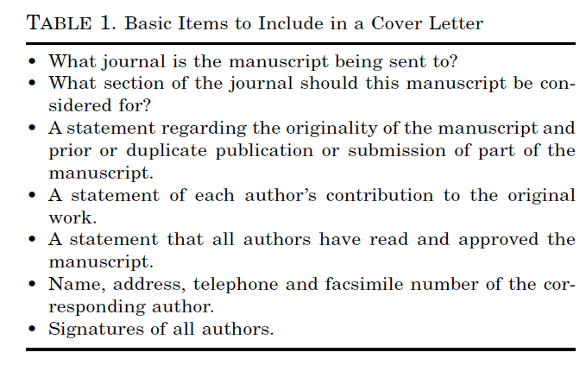
The Cover Letter
Suggested reviewers and excluded reviewers
DeBehnke DJ. Acad Emerg Med 2001; 8: 844–850
Kelner K. Science. DOI: 10.1126/science.caredit.a0700046

Slide 33
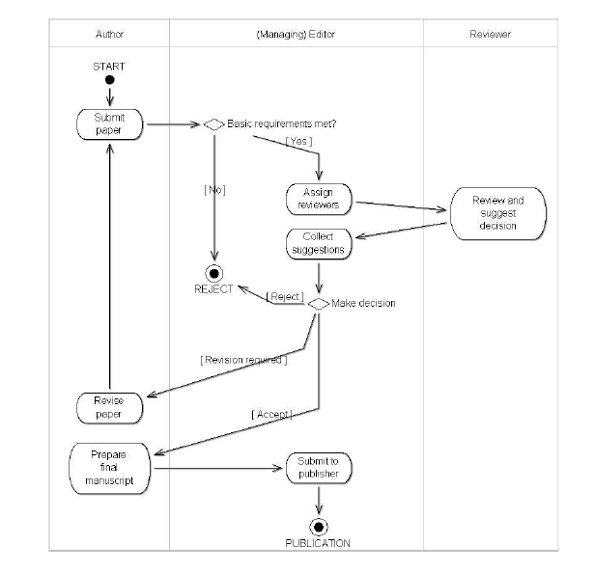
The Editorial Process
Source: www.pri.univie.ac.at/~derntl/papers/meth-se.pdf

Slide 34
What constitutes good science?
Novel – new and not resembling something formerly known or used (can be novel but not important)
Mechanistic – testing a hypothesis - determining the fundamental processes involved in or responsible for an action, reaction, or other natural phenomenon
Descriptive – describes how are things are but does not test how things work – hypotheses are not tested.
Source: dor.umc.edu/.../WritingandpublishingaresearcharticleAdair.ppt
Notes:
What is a descriptive study?

Slide 35
Novelty is most critical !

Slide 36
Erratic Editors

Slide 37
The Editor may be on your side !
Editors work hard & tend to be pro-authors
Editors respect the peer review system
Editors struggle with difficult decisions & are also ‘pained’ by decisions (as authors)
Editors have broader perspective
Editors don’t like involvement in authorship disputes
Editors don’t mind rebuttals

Slide 38
Quotes from Editors

Slide 40
A request for revision ?!
Source: erm.wustl.edu/Dodson_ERM_3.27.08.pdf

Slide 41
A request for revision ?!
Source: erm.wustl.edu/Dodson_ERM_3.27.08.pdf

Slide 42
Be responsive to reviewers
Make it easy for them to re-review the MS

Slide 43
Source: erm.wustl.edu/Dodson_ERM_3.27.08.pdf

Slide 44
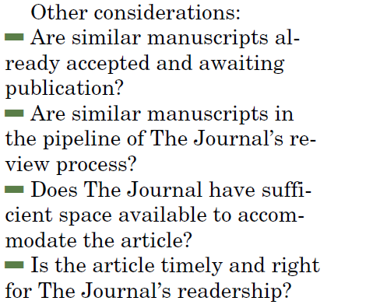
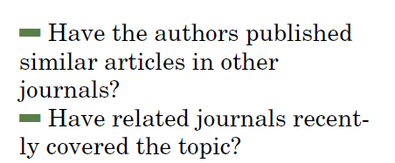
Miscellaneous Reasons for Rejection
Glick M. J Am Dent Assoc 2007;138;568-571

Slide 45
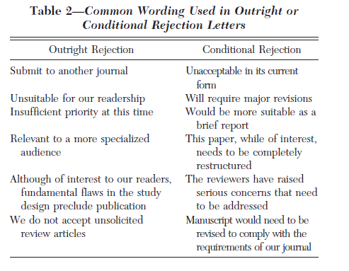
Interpreting Wording of Rejection
Rejection with referral to another journal in family

Slide 46
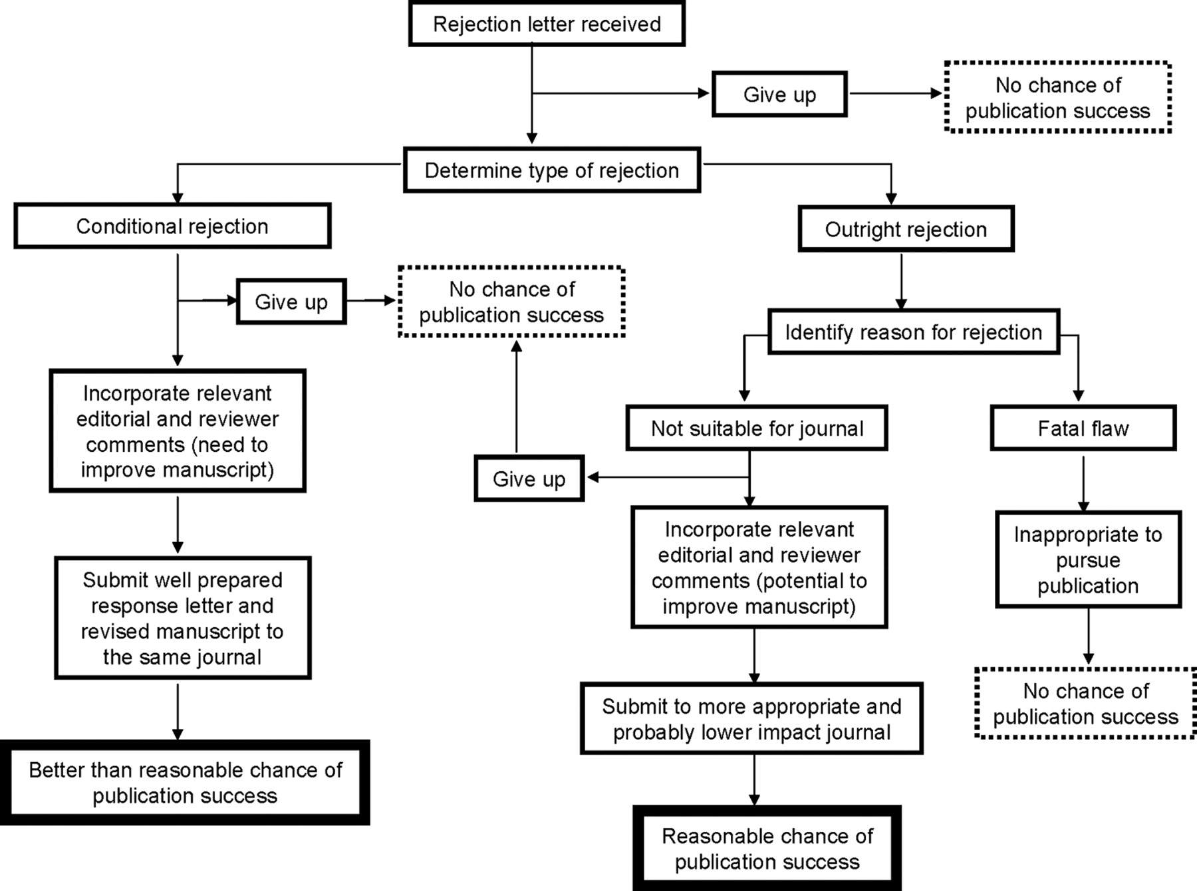
Flow diagram illustrating the choices authors can make after receiving a manuscript rejection letter from the editor of their first-choice journal.
Woolley K L , Barron J P Chest 2009;135:573-577
©2009 by American College of Chest Physicians
Notes:
Flow diagram illustrating the choices authors can make after receiving a manuscript rejection letter from the editor of their first-choice journal.

Slide 47
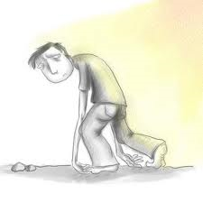
Dealing with Rejection
Kelner K. Science. DOI: 10.1126/science.caredit.a0700046

Slide 48
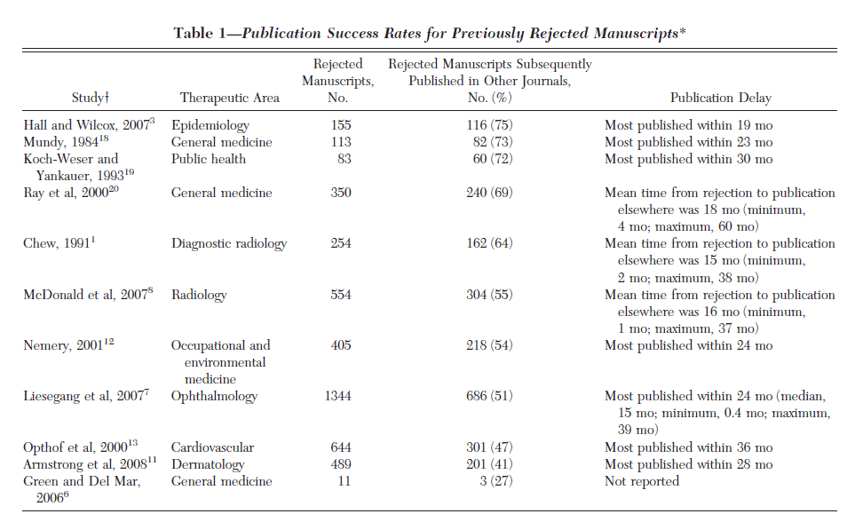
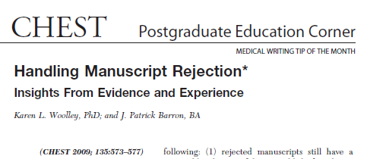
Rejection Fraction !

Slide 49
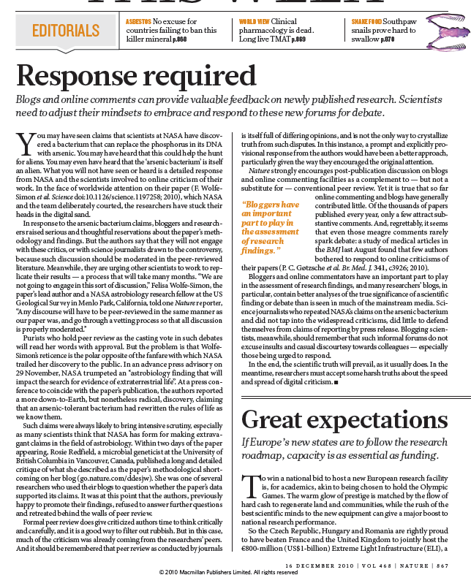
Some new challenges
Open Access journals
Social media & Open peer review
“joint’ online authorship

Slide 50
Some Key Tips
Read many papers, and learn from good ones & bad ones
Write frequently: quality is everything
Review frequently
Learn to be objective about your work
Believe that editors/reviewers are likely trying to be objective about your work
Learn to expect and accept rejection
Modified from Bourne PE. Plos Comput Biol 2005

Slide 51
Some Key Tips
Ingredients of good science
Novelty of idea (timing)
Comprehensive review of literature
Strong data; strong analysis/stats input
Thought provoking discussion recognizing limitations of one’s work
Ingredients of good writing
Good organization
Appropriate use of tables & figures
Right length
Right audience
Modified from Bourne PE. Plos Comput Biol 2005

Slide 52
“There is no way to get experience except through experience.”
Source: dor.umc.edu/.../WritingandpublishingaresearcharticleAdair.ppt

Slide 53
Getting published!
Thank you!

