Slide 1
Communicating with
Challenging Personalities
Bonnie Jean Teitleman, LICSW
March 21, 2012

Slide 2
Agenda
Description of challenging personality types
Coping strategies/communication
Opportunity to practice new strategies
Notes:
Disclaimer:These types are not pure. People can have pieces of each and there is wide range.
Also skills and strategies-should have a number of tools we will talk about later. Even if use them well, it may not work. Everyone is different.

Slide 3
What Makes a Person
Difficult to Work With?
Behaviors (Habits, Styles, Tone)
Attitudes
Differences
Cultural
Generational
Gender
Notes:
How many of you thought of a particular person?
How many thought of yourself?
Few of us see ourselves as difficult.
Generational differences:ask ages
Describe WW 2 veterans, baby boomers, Xers,
Have you thought of what it’s like w/Xers who assume technical expertise when older folks can’t/won’t
Cultural differences:Rules, relationships.
Ex:Japanese-little eye contact, confrontation avoided, prioritize group over individual, formal, do not reveal thoughts/feelings
American-prefer eye contact, more comfortable w/ confrontation, favor individual over group, informal,reveal thoughts/emotions, physical contact more comfortable
Example: Asian PI was insulted when a support person called him by his first name-disrespectful
People gravitate towards people like themselves; people not inclusive
Ask:Why do you think people do that? People are more comfortable w/similar than different
What do we lose by that?
Habits/style
Ex:lipsmacking, untidiness, too loud, style of dress, others?
Discussion
Tone emotionally, pay attention to

Slide 4
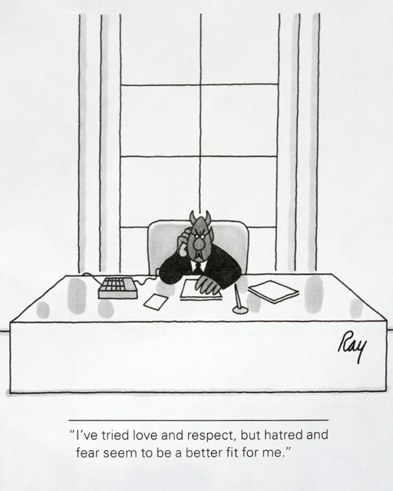
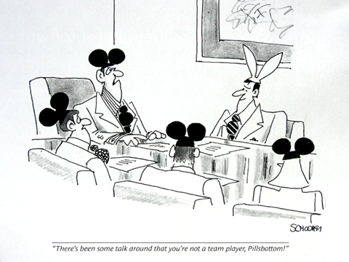

Slide 5
The Stressed Person
Changes in behavior, interactions
Looks nervous, jittery
Doesn’t seem to listen (anxious)
Disappointing work performance
Notes:
Life events, home stress
Stress exacerbates all the other personality types we will describe
For example, if you are compulsive by nature, under stress you will become more compulsive and people will experience you as controlling
Marriage,move,change in lifestyle, loss of income, death, illness
Work:conflict, poor communication, child care issue, new child,
Find out what is stressful for this person and help them find resources
Being stressed certainly exacerbates behaviors—lets talk about some of these behaviors
These types may be blend of several types

Slide 6
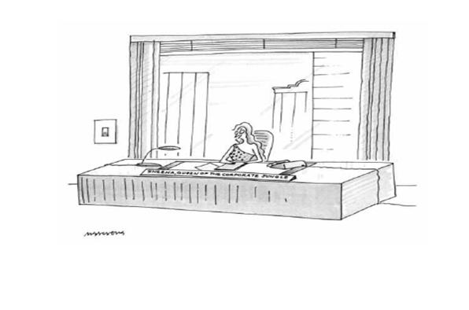

Slide 7
The Dramatic Person
Frequent ups and downs
Likes attention
Has difficulty not being noticed
Tires you out
Focuses on appearance
Notes:
How do you thiink Drama Queen will behave under stress? They take up a lot of space
Example:My lawyer-smart, attractive, dresses in bright colors. Collection of designer bags. Sings, acts, cries easily. Always has a story to engage, entertain.
Prob:People were tired of herr, stopped listening and responding. People were mad at her.
My strategy:I confronted her, hypothesized that she was wearing people out and offered ways to tone it down.
Good outcome.

Slide 8
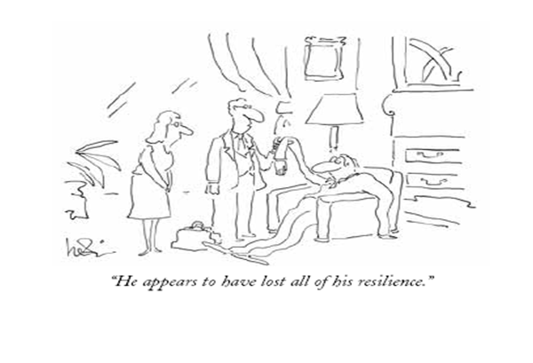

Slide 9
The Passive/Avoidant Person
Meek, mild mannered
Shy, withdrawn
Often gets marginalized by staff
Afraid you won’t like him
May or may not want attention
Notes:
What would a passive person do when they are upset? Perhaps internalize or use substances to squelch uncomfortable feelings. Can be cultural-Japanese who do not reveal their emotions.
Examples:An interesting project comes along and the boss asks for volunteers. The more outspoken person gets the best assignment and the passive person the worst. Can tell by body language.
Example: a 35 y.o. Chinese man I saw recently was terrified he was not doing well at his new job. He had a strong work history and ethic and described what he was doing, long hours he was working. He had said nothing to his boss. I coached him on how to ask the boss for feedback, something which wouldn’t be done in china. He eventually did and learned that the boss had no idea that he was worried and that he was doing a great job.
Another man I saw w/social difficulty. He was anxious, shy. I had him join a community safety group (task oriented so something to talk about) and get a dog. Modest success.

Slide 11
The Aggressive Person
Loud
Bossy, pushy
Intimidating
Knows it all
Emotional incontinence (temper tantrums)
Notes:
Example:
How successful are aggressive people? DO they always get their way? Why? Why not? If smart and aggressive…it all depends, context
Example: a director I saw who was large man, physically intimidating. Used his voice to yell, dominate, control a group, especially women who were frightened by him. They described a twitch he would get that would precede a melt down. People backed off but he lost their confidence. He didn’t realize how he was perceived until he got direct feedback from a 3rd party.
AT BU, hear a lot about temper tantrums at high levels.We can reinforce inadvertently.
Dynamics:Usually have a strong sense of how others should act
Like to win, hate to lose
these behaviors intensified w/stress
Strategies:Do your homework; know the facts or won’t talke you seriously
Don’t compete as counterexpert; listen and acknowledge their ideas
Usually doubt their superior ideas will be understood by you so paraphrase
Use questions as way to raise other points
Disagree tentatively by using their facts and logic

Slide 12
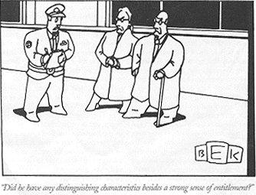

Slide 13
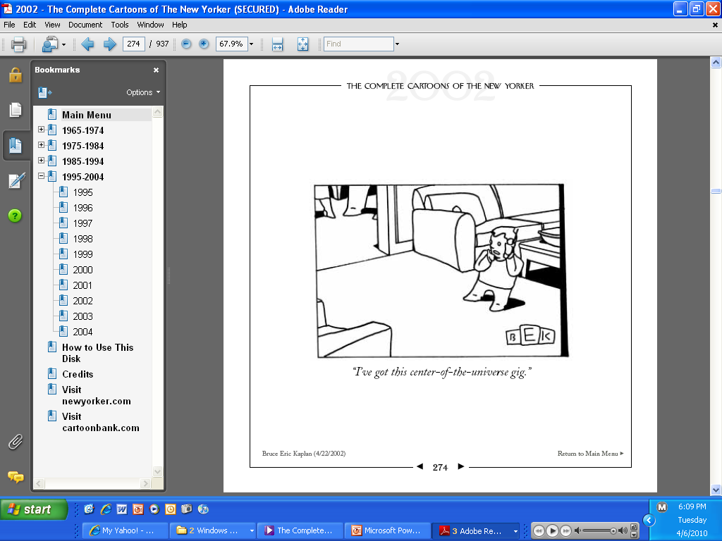

Slide 14
The Arrogant/Narcissistic Person
Entitled, demanding
Doesn’t care about what others think/need/feel
Feels superior or special
Condescending to patients, colleagues
Notes:
Bonnie:It’s never their fault. Never do anything wrong.
“That’s enough about me:Job, family now you can tell me how wonderful you think I’m managing.”
Example:Nikki’s case—nothing is ever this person’s fault, it is always his mate’s. Before they had a child she did everything for him. This is where without the stress he is able to cope. After child no longer the total focus of attention. Her fault dinner isn’t ready, can’t go out, etc, even though they both have equally high powered jobs. When the baby is crying it is her fault and can’t she shut her up. Never there for her. Really wasn’t before but she didn’t need the support. So when she decided it was time ti end the relationship, he had no clue as to why. Thought she was thoughtless, inattentive, etc. Projected all his behaviors onto her.
Narcissistic men can have difficulty w/birth of a child
Narcissists can be very successful, especially if they are smart enough to have wise advisors to help them w/their blind spots
Inability to empathize with others, indifferent/ don’t understand other people’s feelings, can’t tolerate criticism
Example:BU male separated, ask wife how she felt. Her complaint-all about him
Strategies:similar to aggessive
Believes in his rightness, superiority, but lacks understanding of what others think/feel so blind spot
“Emperor’s New Clothes” mirroring, make it in their best interests

Slide 15
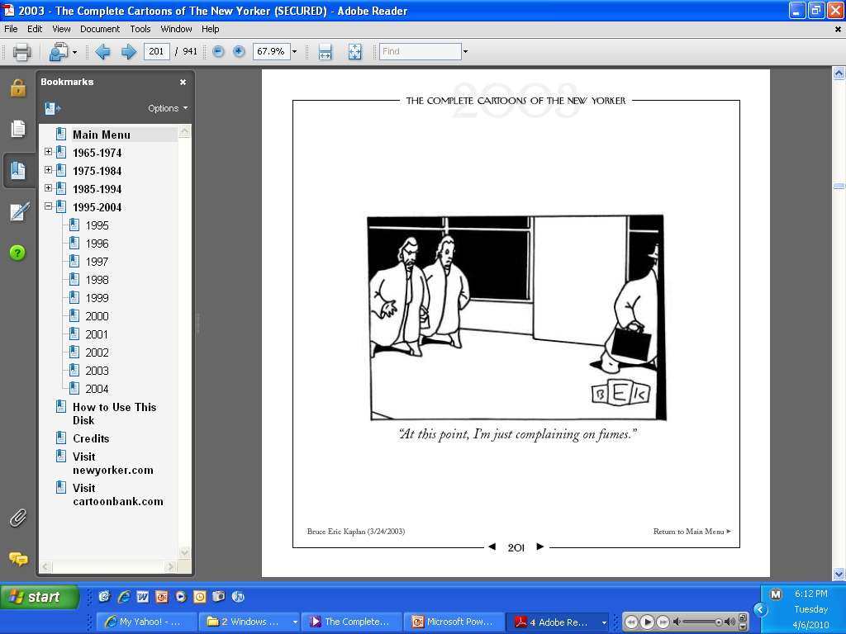

Slide 16
The Complainer
Fault finding
Blames others
May not really want solutions
    “The food is terrible and there isn’t enough”
Triangle complainers
Notes:
Ex:Young woman I saw some time ago about a personal/family problem complained about each member. I experienced her as whining. Saw herself as exploited by family members. Offered suggestions, she rejected them all but came 8-10 times until I asked her what her goal was and she decided to end. Two yrs. Later she returned, describing exactly the same dynamics re:work situation. She had applied and not gotten several jobs. Asked who her friends at work were, she has none.
How do we respond to constant complainers? Defensive, angry, avoid
-can have low self esteem, or be depressed need to see self as better than others.
Try to empower them:”What do you want to do about this?” Have them take ownership of their complaint.
Triangle complainers: complain about others to you; what do they say about you?
Dynamics:Feel powerless, helpless
Blaming others makes them feel “ good” as opposed to others who are “bad”
Attention getting
May have good points but message gets lost
Strategies:Listen, acknowledge, interrupt and take control
Don’t agree; don’t fall into accusation-redefense-reaccusation
Avoid defensiveness, move to problem solve
W/ Triangle complainers, ask if spoken to problem person
State that you’re not comfortable hearing this info

Slide 17
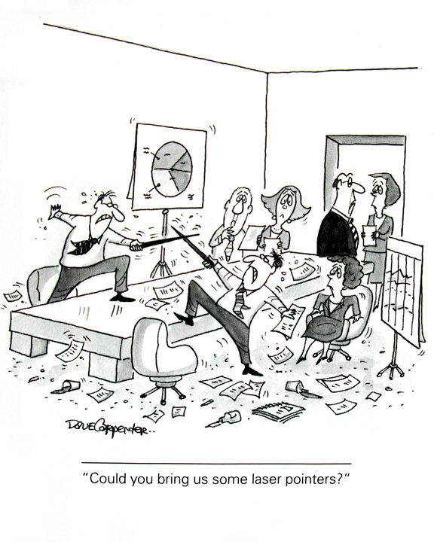

Slide 18
The Toxic Colleague
Lack of civility
Berates bosses or colleagues
Angry, hostile behavior
Argumentative
Spreads rumors
Negative talk behind one’s back
Notes:
Strong impact of incivility on perfomranc
People decrease work effort,decrease time at work, decrease work quality,
Performance declined
Lost time worrying
Avoiding the offender
Commitment to organization diminishes

Slide 19
The Bully
May use violence, threats, or profanity to get what they want
Steps on people
Intimidating, aggressive talk
Holds grudges
May make you feel angry, helpless
Notes:
Bullies are aggressive X10. The difference is intent to step on people while aggressives may be adaptive and useful, see a necessary purpose to their aggression. For example, many people who choose surgery, investment banking or sports are aggressive.
What has been your experience w/bullies?
There are verbal and non verbal signs of violence, aggression
Example: domestic abuse case
They act don’t think about consequences
Dynamics:Similar to Aggressive, but worse. Care less abiout injuring people, may want to eliminate targets
Don’t see selves as responsible
Strategies:Set limits, get help, often standing up to them gets them to back down
Restraining order, leave job, avoid person

Slide 20
The Passive/Aggressive Person
Indirect aggression
Passive, non-confrontational
Sabotages the efforts of others
Feels envious and resentful
Sarcastic and sly
Sulks, pouts, dawdles
Feels like the victim
Notes:
See themselves as victims, martyrs
Victim bullies or chronic victim Ex NS wife
Can be super agreeable on the surface
Have group do this :
List some forms of pass-aggressive behavior
Being late chronically, procrastinate
Undermining someone’s work or reputation to further your own
Try to elicit your guilt
Ex:my sister, Nikki’s example:man who avoided meeting time w/errands, lateness
Give impression of being hopeless, helpless
Example:Nikki’s case-Avoid things/responsibilities
I know a person who is smart, entertains well but when asked to do something simpler, she says”I don’t know what you mean, can you do that for me?”
How do you react to someone who is pass-aggressive? RAGE
Dynamics:they are uncomfortable expressing anger and aggression directly
Strategies:Gentle confrontation, “I” messages
Enlist them in problem solving

Slide 21
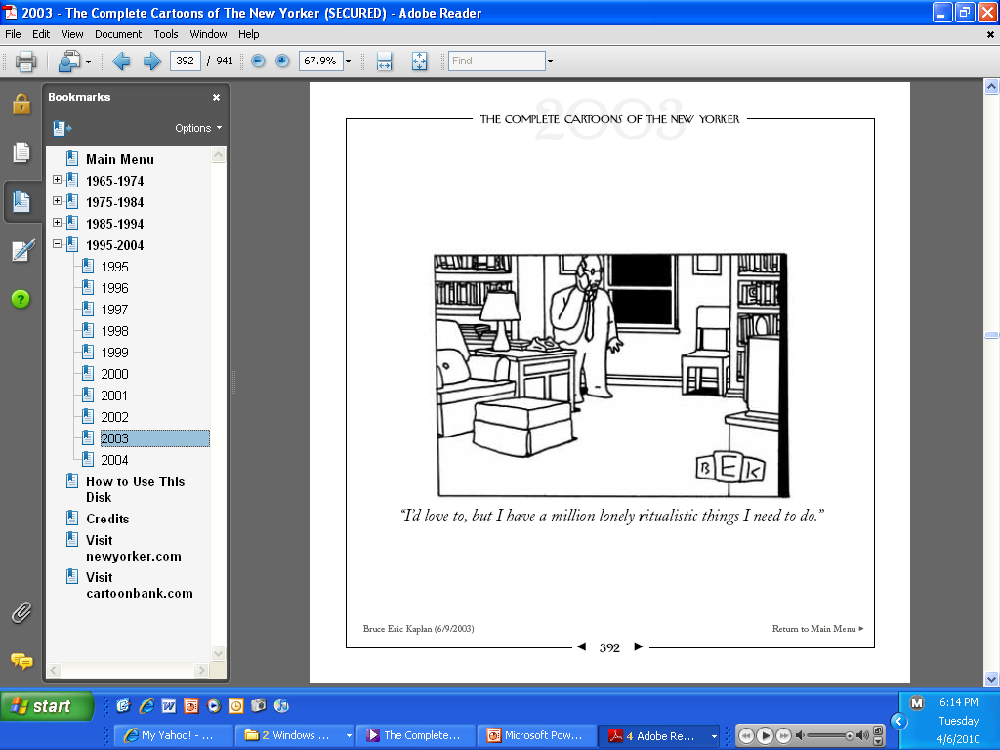

Slide 22
The Compulsive Person
Perfectionistic, detailed, precise
Micromanages
Can be driven
Rigid, inflexible
Difficult to “move on”
You may feel impatient
Notes:
Can, like aggressive, be a good thing to be compulsive. We all want obsessive compulsive physicians.
How are compulsives as bosses? (Generate list)
No room for creativity
Micromanage
Can’t delegate
Example:Physician
Trap of Parents - want to program their child’s liife, can’t deal w/deviation Want the child to be what they want, not what child wants
Have you ever completed a project and they find something else that has to be done
Dynamics:anxious, insecure, genetic
Strategies:Be precise, detailed, avoid mistakes
Have them prioritize, show them you can do the job
Ask:”What do we need to see to move to next level”
Don’t personalize

Slide 23
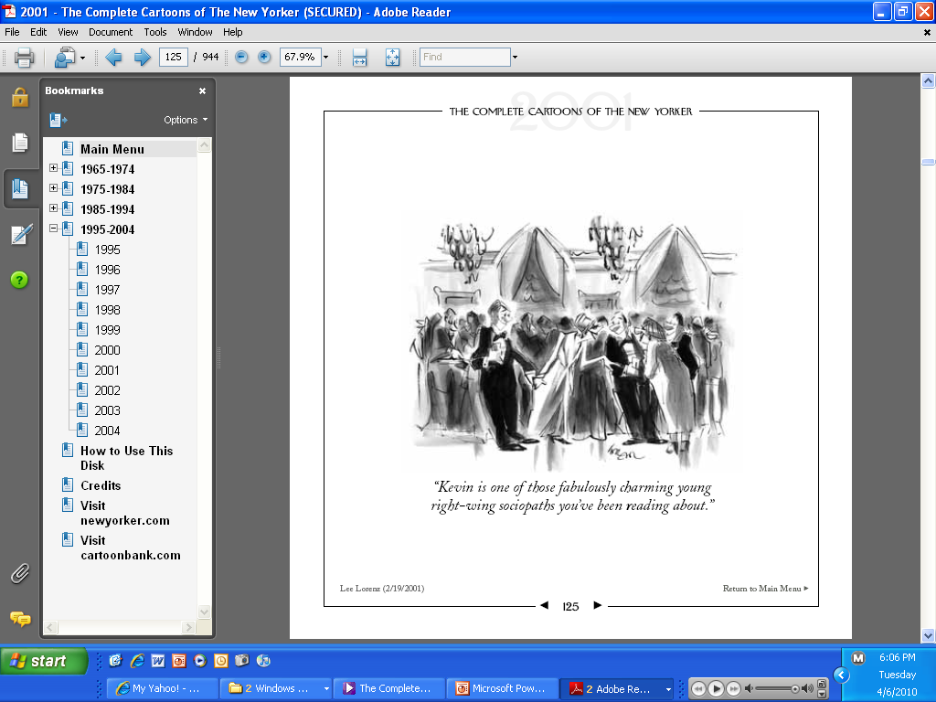

Slide 24
The Charming Person
Genuinely nice, friendly
Positive, optimistic
Outgoing, social
Humorous, agreeable, complimentary
Downside?
Notes:
What’s so difficult w/people like this> They are easy and pleasant,
Dynamics:Want to be liked/loved –universal need
Down side-avoid conflict, confrontation at all cost so honesty may be compromised
May be indecisive, esp if unpopular
May minimize negative, enhance positive, overcdommmit
Strategies:Listen to their humor, may be indirect hint of their true feelings
Make it easy for them to be honest/”I really need you to be candid about this”
Ex:Pleasant manager who never made decisions but was great schmoozer; people got mad
Husb. In long term marriage was considering leaving b;c of wife’ s drinking and accusing him of seeing other women while she was drinking. In couples work, it was clear she was clueless about how seriously he was thinking of leaving.

Slide 25
The Substance Using Person
Erratic performance, attendance
Mood swings
Signs: odor of alcohol, poor hygiene, etc.
Irritability
Cover-ups
Notes:
Sudden change in ms
Addictions
Example:
Internet pornography, gambling
Anything that interferes w /performance or relationship is a problem
Dynamic: dependence on substance or activity
Strategies:confrontation and consequences and help
Ex:Man w/family probs, wife leaving, job threat
EAP, tx and help on demand

Slide 26
The Dependent Person
Needy, clinging
Doesn’t like to be alone
May be helpless, wants to be told what to do
You may be annoyed by him
Notes:
Need constant direction
Example:MSW I hired who stuck to me like glue. Couldn’t imagine what to do/say w/out checking it out w/me + getgting a script
Tactful feedback: “I need you to take ownership of this” , “I’d really like to see you manage this on your own and I think you’ll do a great job”
Let’s take an example of a stressful situation that will bring out these traits in people.
Next slide

Slide 27
Overview of Personality Types
Which ones have you worked with?
Which ones make you nervous?
Which ones do you find most difficult to deal with?
Why?
Notes:
Thought we have an overall discussion of these types before we went into the communication part. Talk about a boss’s personality you liked, didn’t like
Now we’ll move to describing some techniques after the break.

Slide 28
Feelings
Why do feelings matter?
  They drive the interaction
  Too powerful to ignore
  Make it difficult to listen
Leak into conversation through body language and facial expression
    Others often read our feelings accurately
Notes:
How do you figure out how we feel, what's ok to say or not - doesn't always make sense to talk about feelings. Give example of when better to let sleeping dogs lie.

Slide 29
Identity
Three core identities:
  Am I competent?
  Am I good?
  Am I worthy of love/being liked?
Notes:
Identity is about self-esteem and our core image. It is who we are in the world.
Three core identities:
Am I competent? Example: When a colleague of mine applied for a job as Director of Training and did not get it she had a crisis about whether she was as competent, skilled as she thought.
Am I good? Ex: A young woman I was working with wanted to break up with a boyfriend. He began to cry. She felt so badly being cruel to him that she found herself telling him everything would work out between them.
Example: A secretary's work - station was set beneath a ceiling which had leaked several times, not while she was there. The supervisor said humorously: "We should get an umbrella to go over your chair." The secretary responded that she had felt devalued and uncared about b/c the supervisor had not immediately had the ceiling repaired. The supervisor felt she had missed the boat completely, although the secretary had not shared her feelings.
Am I worthy of love/like? Ex: After a husband left a wife of many years when he became involved with someone else, she questioned whether she was lovable at all.
Suddenly who we thought we were at the beginning of the conversation is called into question
Identity crisis knocks us off balance.
Physical reaction
Rush of anger
Anxiety
Wish to flee
When my colleague learned she did not get the training job she felt overwhelmed with anxiety and could not hear another word of why the decision was made. She left as soon as she could.
Vulnerable Identity=someone who is easily knocked off balance
Must ground your identity to have conversation
Becoming aware of your identity issues ahead of time so you can spot them when they come up in conversation. Note when you feel anxious, upset, etc as clue.
Complexify your identity (use AND stance) get clear picture of yourself, we have constellation of qualities, positive and negative.

Slide 30
Consider
Think of your own way of connecting w/people, what skills you have
What attitudes do you have that might get in the way?
How do people see you as a person?

Slide 31
Steps to Cope Effectively
Assess the situation
Ground yourself emotionally
Stop wishing the person was different
Formulate a plan
Implement your plan
Notes:
Plan, prepare, practice
Assess:look at the history, precipitants, contributing factors
Accept reality of who/how the person behaves
Take a break
Develop some ideas, strategies
Try them out

Slide 32
Strategies/Ways to Cope
Use of self: language, voice, body
Respect
Empathy/Emotional IQ
Setting a limit
Honest communication
Knowing when to compromise (pick your battles)
Notes:
Don’t expect a miracle change
Use of self:Pay attention to your volume, expressed emotion
In role play, used empathy at beginning, emotional IQ informed that Nikki was upset. I use limit setting, explanation and finally confrontation.
Exercise:Break into groups of 3-4.
You are the supervisor for Susan and Sally, who have been working together for 2 years. Susan is emotional, easily upset, fearful and has a hard time joining in laughing. Susan came to you last week and told you that she feels uncomfortable when she sees you chatting and laughing w/Sally, saying that she doesn’t know how to join such an interaction but she feels left out. She feels criticized and her work is suffering. Sally is confident, outgoing and successful w/people. She feels her reward for doing good work is getting more of it while Susan is getting off the hook. Susan’s performance, in fact, has deteriorated and your boss is noticing.
Discuss for 7-8 minutes, then we’ll see what people do.

Slide 33
More Strategies
Focus on positives
Promote partnership
Problem solving
Walk away
Reframe
Getting Help
Notes:
Example:Woman I worked with, felt she was competitive w/me. At first, I would get annoyed when she would exclude me from things I wanted to be involved with.I would keep suggesting that I could do this, that only to have her reject my offers. I watched her, talked to a friend and realized that she is terribly insecure. So I waited until I saw her do something and called and praised how she handled a situation skillfully. She was so grateful, noting that she rarely gets any feedback and when she does, it is often negative. She now believes I like her, think she does a good job and includes me more.
Who has example of walking away, problem solving?
Reframe-Common one I do
An employee comes in to complain that his supervisor is micromanaging, doesn’t trust him, watches over his shoulder. Sees supervisor as controlling, intrusive and rude. He is angry. I ask how long supervisor has been supervisor (usually not too long) and reframe that he hasn’t learned that skill set yet, that BU doesn’t offer training in supervisory skills. I’ll say:”Sounds like he’s insecure about his boss and he hasn’t learned to delegate yet. Maybe you could help him learn by….”

Slide 34
Resolving Conflicts
Conflict
  Describe the person, situation and what you would like to change
Resolution
  Your role/responsibility in making the change
Notes:
-talked about coping strategies now
Exercise 10 minutes Mark
Have them break off onto groups to do this activity and discuss together
Describe what a “better relationship” would be.
What is your commitment to doing it? If not, how come?

Slide 35
When to get help
  When it makes you nervous
  When you think it all the time
  When it affects your work
  When it changes your behavior in ways you regret
  When there is a high “business cost”
Notes:
Overview
Seen some difficult personalities, described some strategies, now let’s look at when to get help
Reasons: you feel frustrated, threatened, fed up, nervous, angry. You are short, irritable, uncooperative, unproductive, stressed. You complain a lot outside of work to your friends, family.
You think about it a lot, imagining what you could say to really put the person in their place.
It’s interfering w/ other things.
Business cost:lost motivation, less productivity, may be positive or negative costs, more risk for accident, injury

Slide 36
Where to Get Help
Faculty and Staff Assistance Office
Phone: (617) 353-5381
Email: fsao@bu.edu
Web: www.bu.edu/fsao
Office of the Ombuds
  Phone: (617)-638-7645
  Email: fmonte@bu.edu
  Web: www.bu.edu/ombuds/

