Slide 1

CBE and a Syllabus
"Education is not the filling of a vessel, but the kindling of a flame." - Socrates
Celeste V. Kong DMD, CAGS in Prosthodontics
Director of Restorative Dentistry
Department of General Dentistry

Slide 2
At the end of this presentation the participants:
Will be able to define Competency Based Education
Will be able to describe the different levels of learning in the cognitive domain.
Will be able to apply Bloom’s Taxonomy in a syllabus
Will be able to differentiate between formative and summative evaluation
Will be able to create a syllabus for a course/lecture
Will be able to design a rubric
Will be able to evaluate a colleague’s learning objectives.
Notes:
Curriculum is defined more broadly than a syllabus. I am not discussing how to write a curriculum for a medical or dental school. In Prideaux’s article he descirbes 2 different models for curriculum design: Prescriptive (what curriculum designers should do) and Decriptive ( what they actually do) Another prescriptive model : Outcomes based curriculum design…working backwards by desning curriculum based upon outcomes.

Slide 3

When designing a course keep in mind that Course Goals and Objectives always link back to a Competency

Slide 4
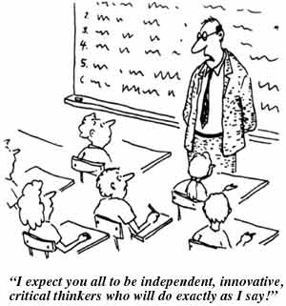
CBE: Competency Based Education
It was defined by the U.S. Office of Education as a “performance-based process leading to demonstrated mastery of basic and life skills necessary for the individual to function proficiently in society” (U.S. Office of Education, 1978).
Is based upon what the learner needs to be able to do upon completion of a program
Notes:
Our schools all developed Competency statements. The dental school has 20. You can think about them as though they are the broad statements of your goals in the syllabus. For each and every goal we define what the student is able to do when they graduate.
Instructors on Med campus for the last 10 years have had to learn how to deal with “Competency Based Education”. We have always focused on Cognitive and psychomotor skills in dentistry. Trying to learn how to develop/ instill attitudes in our students has been a more difficult process. Through the interview process, we hope to gather the type of individuals who will be care providers but we still have to able to demonstrate that upon graduation, these students have all the knowledge skills and attitudes necessary.

Slide 5
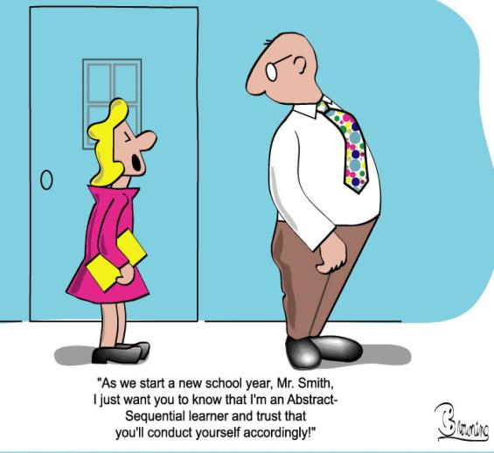
CBE: Competency Based Education
It focuses on the outcomes
Knowledge, attitudes and skills
It is adaptive to the learner, the teacher and the community
Notes:
Instructors on Med campus in the last 10 years have had to learn how to deal with “competency Based Education”. We have always focused on Cognitive and psychomotor skills in dentistry. Trying to learn how to develop/ instill attitudes in our students has been a more difficult process. Through the interview process, we hope to gather the type of individuals who will be care providers but we still have to able to demonstrate that upon graduation, these students have all the knowledge skills and attitudes necessary.

Slide 6
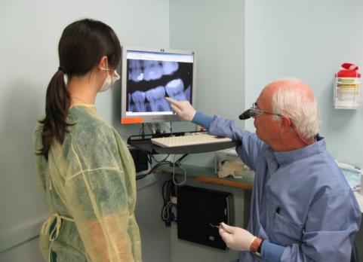
CBE
Provides learners with immediate feedback on assessment performance
Formative evaluation
Paces instruction to learner needs
Milestones
Summative evaluation = Learner demonstrates mastery of specified competency statements
Remediation
Enrichment
Notes:
Feedback always starts with the positive. There are those who suggest that taking the fear out of learning, makes if easier for the person to learn the necessary skills. I think that if the learner has the right attitude, there will always be the fear of causing harm if he/she is not prepared to treat their patient. Negative feedback is also required if appropriate. Without the negative feedback ot the “picky” feedback, there is less improvement. We have had some discussions about specialty trained faculty members involved in teaching. Do we need specialists to teach general practitioners?

Slide 7

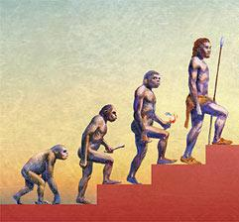
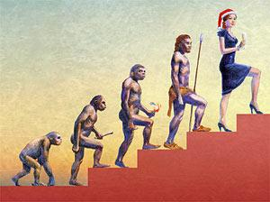

Dreyfus model of skill acquisition
The Story of Man
Novice
Beginner
Competent
Proficient
Expert/Mastery
The Economist : Dec 2005
Notes:
Novice is has some idea of what we do. Has a layman’s perspective. Is learning the language. 1st year student.
Beginner: has learned the skills necessary to function. 2nd and 3 year students. Performed simulations and gone on to observe others treating patients. Learning to recognize certain situations. Identifying problems. Making diagnoses.
Competent: Dreyfus suggests that at Competency level, the person is more emotionally involved in the outcomes. Not only making diagnoses, formulating treatment plans and caring out procedures and evaluating outcomes of treatment.
In the dental school curriculum we describe what a competent general practitioner should be able to do upon graduation. Part of that is recognizing what needs to be sent to a specialist = someone who has reach Mastery of their field of study.
Someone who has mastered the knowledge, skilsl and attitude of a profession, will make intuitive decisions.

Slide 8
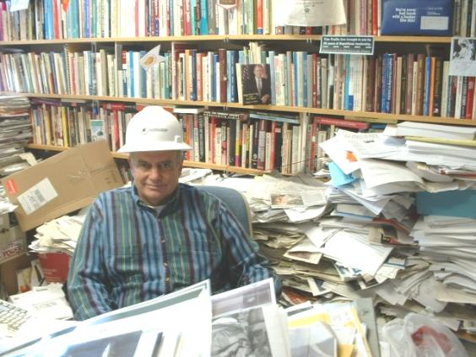
How do we write a syllabus?
Buried in literature
  http://www.bumc.bu.edu/fd/teaching/course-development/

Slide 9
12 Elements of a Syllabus
1. Title Page
2. Table of Contents
3. Contact Information
4. Course Description
  Importance (significance for patient)
  Link to Medical Competencies
  Format (lecture, seminar, online)
  Prerequisites
  Learning Objectives (outcomes)

Slide 10
12 Elements of a Syllabus
5. Roles and Responsibilities for Learning
6. Schedule
7. Course Content : Topics
8. Assignments
9. Tips for Learning
10. Assessment
11. Student Evaluations of the course
12. Learning Resources
Notes:
Office of Medical Education produced a document for Faculty development. You will find it online.

Slide 11
Elements of a Learning Objective: ABCD
Audience : students, residents, colleagues
Behavior : verb
Condition : in class, in seminar, online
Degree: to what degree do we expect them to retain information or perform a skill ….
http://www.bu.edu/cms/www.bumc.bu.edu/fd/files/PDF/WritingLearningObjectivesWebFD.pdf
Notes:
Learning Objectives are about the student. What do we expect them to be able to do at the end of the course.
It is NOT about our content. If we are looking for outcomes, we have to use words that describe something measurable.
Cannot use the words : appreciate, understand,

Slide 12
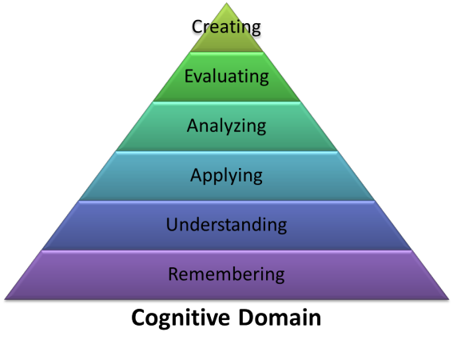
Blooms taxonomy revised by Anderson and Krathwohl 2001 :cognitive domain
See handout with list of suggested verbs.
Notes:
Psychomotor and Affective domains have similar pyramids.

Slide 13
Examples of Assessment Vocabulary Based on Bloom's Taxonomy
COGNITIVE DOMAIN | DESCRIPTIVE VERBS | ASSESSMENT WORDS/PHRASES
Knowledge | List, Describe, Catalog, Itemize, Define, Classify, Organize, Identify, Name, Show, Indicate, Explain, Read | Who, What, Where, When, Why, How, How much, Which one, Describe..., Select....
Comprehension | Change, Infer, Outline, Propose, Replace, Modify, Summarize, Alter, Vary, Condense, Explain | Which facts/opinions?; What does this mean?; Outline the information in...; Restate in your own words...; Explain what is happening...; Summarize...
Application | Solve, Predict, Explain, Diagnose, Estimate, Plan, Project, Judge | What would happen if...; Explain the effects of...; What and how much would change...
Analysis | Examine, Compare, Contrast, Identify, Equate, Rank, Deduce | What conclusions can be drawn from...; What is the theme or main idea?; What is the relationship...; Which are the most important ideas?; What is the motive of...
Synthesis | Create, Brainstorm, Predict, Plan, Design, Set up, Imagine | Make up, Choose, Create, Design, Plan
Evaluation | Judge, Rank, Determine, Critique, Defend, Conclude | Which is more important, moral, logical, appropriate, valid; Compare and contrast...; Critique...
http://www.warrenlocal.k12.oh.us/whs/literacy/BloomVocab.htm

Slide 14
At the end of this presentation the participants:
Will be able to define Competency Based Education
Will be able to describe the different levels of learning in the cognitive domain.
Will be able to apply Bloom’s Taxonomy in a syllabus
Will be able to differentiate between formative and summative evaluation
Will be able to write a syllabus for a lecture/course
Will be able to design a rubric
Will be able to evaluate a colleagues learning objectives.
Notes:
Building upon skill sets…

Slide 15

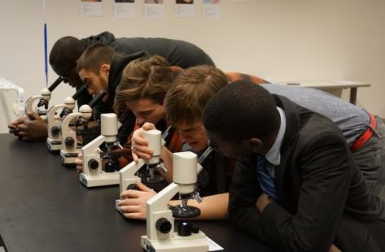
Assessment
What multiple measures will we be using to assess our students’ performance?

Slide 16
Formative Evaluation
Ongoing assessments or reviews of a student’s performance that take place in the classroom, the lab or the clinic
Some advocate for frequent short tests
It is immediate (we start with the positive)
Students can monitor their progress
We use it to improve instructional methods
It is often ungraded ( in the dental school)
Notes:
Cowie and Bell ^{[5]} define formative assessment as "the process used by teachers and students to recognize and respond to student learning in order to enhance that learning, during the learning".

Slide 17
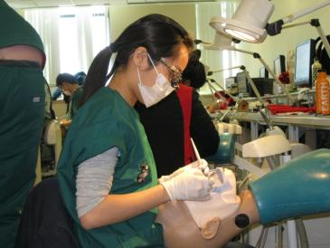
Skills Test
Evaluates a specific skill
e.g. evaluates a person’s ability to draw blood, prepare a tooth for a crown, perform an interview , give a presentation
They are not competency tests or summative evaluations when they stand alone.

Slide 18
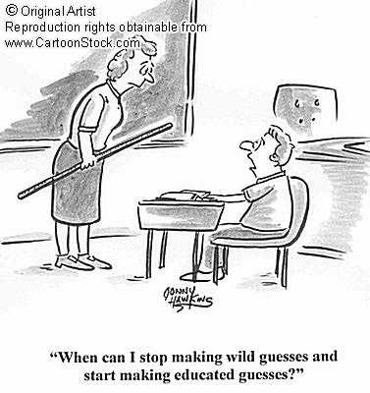
Summative Evaluation
Used to make a judgment of a student’s competency at the end of the course
A Final exam
Case based questions/papers
Portfolios
Licensing exams
Uses multiple measures.

Slide 19
Eportfolios to Make Learning Visible
Students of the Facebook and Twitter generation know what it means to share ideas and reflections
Multimedia
Access can be limited to the teacher, group mates, class or even go public to be used for job interviews
Submissions, comments, directions, evaluations can occur on the web site and made visible to the parties involved
Teaching portfolios make visible the reflection and teaching philosophies of the instructor along with the evidence of their work and their students progress towards competency

Slide 20
E-portfolios for Formative and Summative evaluation
Comprehensive
Available for all BU faculty and students with Kerberos
https://www.digication.com/
http://www.bu.edu/eportfolio
https://secure.aacu.org/PubExcerpts/VALEPORT.html (Excerpt from Electronic Portfolios and Student Success: Effectiveness, Efficiency, and Learning)
https://bu.digication.com/JamesWolff/Home//
IH 790: Leading Organizations to Achieve the MDG's: https://bu.digication.com/Wolff-MDG-May-2011/Welcome/published
IH 887: Planning and Managing MCH programs: https://bu.digication.com/IH887/Welcome/published

Slide 21
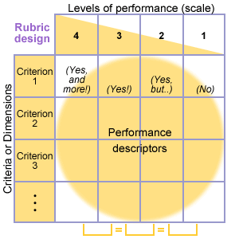
Rubrics
Establish clear guidelines for Evaluation and define the criteria that differentiate levels of performance

Slide 22
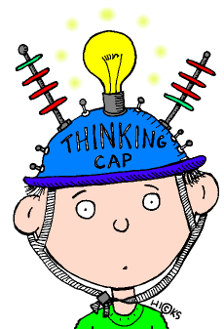

Rubric Development
First Step

Slide 23
Rubric contains 3 items*
A Scale of the levels of performance e.g. novice, developing, competent, excellent
The Dimensions or Evaluative Criteria or what are we evaluating. e.g. infection control, patient management
Quality descriptions of each of the criteria. e.g. differentiate between what is excellent and needs improvement

Slide 24
Tooth Prep Skills test
Scale
Criteria | 1 | 2 | 3
Patient Management | Patient was in pain, patient improperly positioned in chair, universal precautions not adhered to, needed help or direction. | Patient was comfortable, Patient well positioned in the chair, universal precautions were followed. Student may have needed some advice. | Patient was comfortable, universal precautions were followed. Treatment completed in timely manner No advice or correction needed.
Occlusal reduction | Occlusal reduction was under prepped or over prepped by more than 1 mm for the type of restoration being fabricated. | Occlusal reduction was correct for the type of restoration being fabricated but student needed some direction. Student may have needed some advice. | Occlusal reduction was correct for the type of restoration being fabricated.. No advice or correction needed.
1 = clinically unacceptable
2 = clinically acceptable
3 = clinically exceptional

Slide 25
Presentation Rubric: https://celop.bu.edu/groups/ccf10/wiki/bb35a/Presentation_Rubric.html
 | 1 | 2 | 3 | 4 | Total
Organization | Audience cannot understand presentation because there is no sequence of information. | Audience has difficulty following presentation because student jumps around. | Student presents information in logical sequence which audience can follow. | Student presents information in logical, interesting sequence which audience can follow.
Subject Knowledge | Student does not have grasp of information; student cannot answer questions about subject. | Student is uncomfortable with information and is able to answer only rudimentary questions, but fails to elaborate. | Student is at ease and answers most questions with explanations and some elaboration. | Student demonstrates full knowledge (more than required) by answering all class questions with explanations and elaboration.
Visual Aids | Student uses superfluous visual aids or no visual aids. | Student occasionally uses visual aids that rarely support the presentation. | Student's visual aids relate to the presentation. | Student's visual aids explain and reinforce the presentation.
Eye Contact | Student makes no eye contact and only reads from notes. | Student occasionally uses eye contact, but still reads mostly from notes. | Student maintains eye contact most of the time but frequently returns to notes. | Student maintains eye contact with audience, seldom returning to notes.
Verbal Techniques | Student mumbles, incorrectly pronounces terms, and speaks too quietly for audience in the back of class to hear. | Student's voice is low. Student incorrectly pronounces terms. Audience members have difficulty hearing presentation. | Student's voice is clear. Student pronounces most words correctly. Most audience members can hear presentation. | Student uses a clear voice and correct, precise pronunciation of terms so that all audience members can hear presentation.
 |  |  |  | Total Points:

Slide 26
Summary
Goals and Objectives link back to the competency statements
Goals and objectives must be measurable
Formative evaluation allows for the student to get immediate feedback and understand if they are at the correct milestone for developing their skill set.
Skills tests make up only a portion of the total evaluation
Rubrics must be outlined and included in the syllabus
Summative evaluation requires multiple measures
Eportfolios may be a comprehensive tool used for evaluation that is suited to the lifestyles of our students

Slide 27
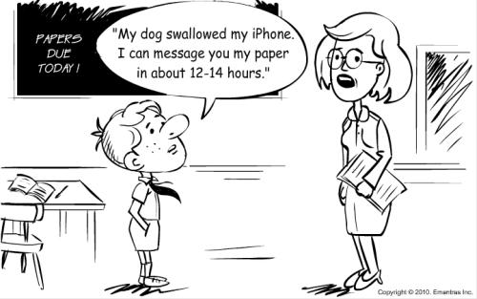
Use of social media
http://www.youtube.com/watch?v=QzZyUaQvpdc&feature=related

Slide 28
Other References
Prideaux D. ABC of Learning and Teaching in Medicine. Curriculum Design BMJ 2003 ; 326:268-270
Steven DD, Levi AJ. Introduction to Rubrics. Sterling, VA: Stylus Publishing, 2005
Boston University School of Medicine (instructions on how to write a syllabus)
  http://www.bumc.bu.edu/fd/teaching/course-development/
University of Minnesota ( Center for Teaching and Learning)
  http://www1.umn.edu/ohr/teachlearn/tutorials/syllabus/what/index.html

Slide 29
Faculty Resource
http://www.bumc.bu.edu/facdev-medicine/mentoring/
http://www.bumc.bu.edu/facdev-medicine/mentoring/ecfdp/
http://www.bumc.bu.edu/fd/teaching/course-development/
http://ww2.odu.edu/educ/roverbau/Bloom/blooms_taxonomy.htm

