Slide 1
ATM Committee BUSM
Robert J. Vinci, MD
Chair ATM Committee

Slide 2
BUSM Commitment to Students
Boston University School of Medicine (BUSM) is committed to providing a supportive and respectful learning environment that fosters mutual trust among all community members. Such an educational environment engenders optimal teaching, learning and professional development

Slide 3
ATM MISSION
Developed to support an environment conducive to learning by investigating and responding to reports of student mistreatment
Provides a process for prompt, non-adversarial and respectful responses to complaints of medical student mistreatment by conducting any investigations thoroughly, promptly, and impartially

Slide 4
ATM COMMITTEE CHARGE
Communicate mechanisms for reporting and procedures to address alleged mistreatment
Respond to reported complaints of mistreatment
Identify patterns of concern
Report to BUSM Dean, Executive Committee, and Medical Education Committee
Identify preventive strategies

Slide 5
WHAT TO REPORT
Humiliation or intimidation of students
Verbal attacks
Deliberate exclusion from reasonable learning opportunities
Being asked to perform personal services (e.g. errands)
Assignment of tasks or chores to punish or belittle students
Disregard for student safety
ATM Policy does not apply to complaints relating to:
Sexual misconduct, violence, or discrimination, (Equal Opportunity policy/Title IX)
Grading - addressed in BUSM Evaluation, Grading, and Promotion Policy

Slide 6
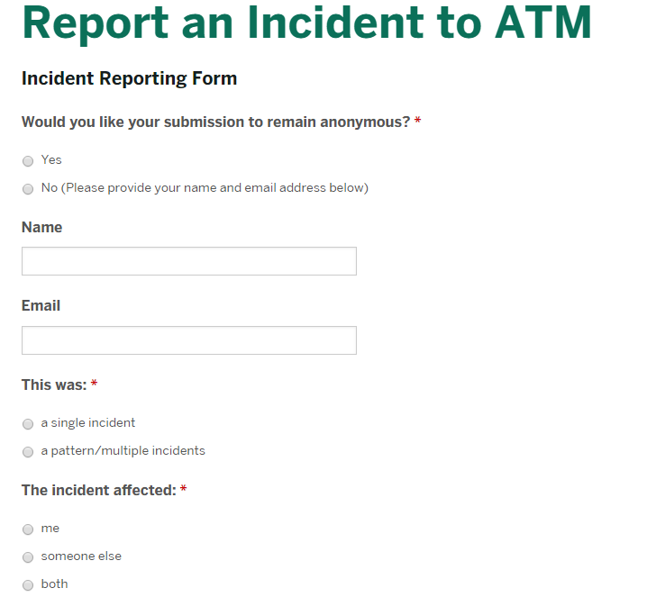
The Process
https://www.bumc.bu.edu/busm/student-life/student-life/atm/report-an-incident-to-atm/
Or
By contacting ATM Chair or any Committee member

Slide 7
Process
The student is contacted to confirm receipt of complaint (if not anonymous)
The appropriate time for an investigation will be determined (e.g. such as after grades are submitted)
ATM committee completes an investigation including meeting with involved parties (maintaining anonymity)
Communicates with all parties regarding the complaint
Reports findings and recommendations to the Dean
Closed loop communication with the student regarding outcomes as appropriate
Report to BUSM Community

Slide 8
ATM 2018
We received 14 ATM Reports
Actions taken to improve the learning environment
A clinical department underwent a comprehensive review of its learning environment
Faculty members were referred to professionalism training
Faculty were referred to sensitivity training and referred to a professional coach
Faculty were counseled regarding appropriate interactions with medical students

Slide 9
ATM 2019
We received 45 reports
We are seeing more reports where students are providing contact information, which is extremely helpful to our work
We reviewed
Unprofessional treatment of patients by staff but witnessed by students
Unprofessional interactions with faculty
Concerns regarding implicit and explicit bias in the learning environment

Slide 10
ATM 2020
13 reports received to date
We are currently reviewing
Concerns regarding professionalism in our resident trainees
Unprofessional behavior of faculty that has led to requiring professional development training
Concerns that faculty have not been respectful to our patients
Recently we have discussed the topic of race, structural racism and how BUSM needs to become an anti-racist organization, at all levels of our academic community

Slide 11
Our Commitment to BUSM
We work for you
You should expect open and regular communication
Individually and as a community
Uncertainty ATM role/What is appropriate, reach out to us
We will absolutely respect your privacy and anonymity
Website will be updated to ensure clarity of role/process
Each class has student representatives
Anyone can reach out to me

Slide 12
ATM committee Members
Faculty
Bob Vinci MD ATM Chair (bob.vinci@bmc.org)
Vonzella Bryant, MD
Ravin Davidoff, MD
Nancy Gaden, DNP, RN
Donald Hess, MD
Mikhail Higgins, MD
Angela H Jackson, MD ex officio
Patrick Mabray MD, PhD
Jeffrey Schneider, MD ex officio
Elisabeth Woodhams, MD
Staff
Amanda Kaufman OSA
BUSM Student Reps
Lauren Burdine BUSM 4th year
Yousif Kettoola BUSM 4th year
Aaron Afran BUSM 3rd year
Jake Barrett BUSM 3rd year
Gabriel Walt BUSM 2nd year
Nakul Vyas BUSM 2nd year
BUSM 1st year
BUSM 1st year
BMC Resident Reps
Shakeela Faulkner OB
Christina Ajewole OB (Alternate)
Student members are chosen by SCOMSA and serve for the duration of their BUSM tenure

