Slide 1
Enhancing the Second Year Experience
Academic Enhancement Office
Boston University School of Medicine

Slide 2
Overview
Principles of long-term success in the 2nd yr
Network of Support
Step 1 Prep Program
Upcoming Sessions
Appointments

Slide 3
Principles of Long-Term Success
SPF: Spacing, Pacing, and Frequency

Slide 4
Principles of Long-Term Success
SPF: Spacing, Pacing, and Frequency
SPACING → Interval of exposure
PACING → Sustainable effort
FREQUENCY → Early & Often

Slide 5
Strategy Application
STRATEGY | GOAL | HOW
Pre-exposure | What is the big picture? Where do I anticipate having difficulties? | Learning Objectives Skim Syllabus/Slides Look out for terminology
Active engagement in lecture | Fill in the layers of information to give you more context | Take notes on slides throughout the lecture Ask questions! Highlight areas of concern by changing the color of the slide Timing: flexible
Active review of lecture | Target gaps in knowledge first Integrate the concepts | Target the marked slides first Connect it to the learning objectives Timing: not to exceed length of lecture
Utilize Practice Problems | Which lectures to target to fill gaps Efficiently identifies weekend study structure | Chunk out problems to complete over the weekend Investigate why right answer is right, why other choices are wrong
Attend Exam Reviews | Close the loop on problem areas Course correct for the future Identify exam strategy vs lack of knowledge errors & develop plan to address errors. | Complete a Root cause analysis of errors: # incorrect by changing answers, read the question wrong, didn’t know it.

Slide 6
Weekly Schedule
SUN. | MON. | TUE. | WED. | THURS. | FRI. | SAT.
Review Mon-Fri | Lecture | Lecture | Lecture | Lecture | Lecture | Review Fri. material
 |  | Review Mon. material | Review Tues. material | Review Wed. material | Review Thurs. material
Pre-expose Mon. material | Pre-expose Tues. material | Pre-expose Wed. material | Pre-expose Thurs. material | Pre-expose Fri. material
1. Iron-out problem areas
2. Active Recall

Slide 7
I know there’s a forest in there somewhere

Slide 8
Principles of Long-Term Success
SPF: Spacing, Pacing, and Frequency
Self-management is key

Slide 9
2. Self Management
Perspective taking
Staying connecting to others
Finding your “1 thing”
Having a “take away” from challenges
Celebrate the small stuff

Slide 10
Principles of Long-Term Success
SPF: Spacing, Pacing, and Frequency
Self-management is key
Organize & integrate your resources
Good memory = Deep learning

Slide 11
3. Types of Resources
High Yield
Notes:
Citation - http://blog.cambridgecoaching.com/a-guide-to-the-best-step-1-study-resources
https://case.edu/medicine/sites/case.edu.medicine/files/2019-02/Student%20to%20Student%20Guide%20to%20Step%201.pdf

Slide 12
3. Types of Resources
High Yield Little Details
Notes:
Citation - http://blog.cambridgecoaching.com/a-guide-to-the-best-step-1-study-resources
https://case.edu/medicine/sites/case.edu.medicine/files/2019-02/Student%20to%20Student%20Guide%20to%20Step%201.pdf

Slide 13
3. Types of Resources
High Yield Little Details
LECTURES
UWorld Qbank
First Aid Paper & PDF
Pathoma
Notes:
Citation - http://blog.cambridgecoaching.com/a-guide-to-the-best-step-1-study-resources
https://case.edu/medicine/sites/case.edu.medicine/files/2019-02/Student%20to%20Student%20Guide%20to%20Step%201.pdf

Slide 14
Resources to Enhance DRx Material
UWORLD Qbank Questions: No need to purchase “practice tests” they offer bundled into qbank purchase. 365 day subscription only.
FIRST AID 2020:
Foundations & ID – Use as reference & become familiar with format.
Pulm & each module that follows – Use as reference & to annotate
FIRST AID 2020 PDF: for quick search find of where to annotate question.
PATHOMA Lectures: Night before new modules begins, or a few days into module watch correlated lecture (e.g., Pulm) NO NOTES, NO REWINDING. Enhances understanding of material to be presented.
Notes:
Citations - https://www.apa.org/monitor/2008/06/testing
HOW? Start small
When Pulm begins, 3-5 questions each day. How many? Pulm M-F 3 & Sat & Sun 5 – if you are able to consistently meet this goal, increase in next module. For example: Cardio M-F 5 & Sat & Sun 7
FA $50

Slide 16
3. Types of Resources
High Yield Little Details
LECTURES SketchyMicro
UWorld Qbank Goljan Audio
First Aid Paper & PDF Goljan Rapid Review Path
Pathoma
Notes:
Citation - http://blog.cambridgecoaching.com/a-guide-to-the-best-step-1-study-resources
https://case.edu/medicine/sites/case.edu.medicine/files/2019-02/Student%20to%20Student%20Guide%20to%20Step%201.pdf

Slide 17
Resources to Enhance DRx Material (make the details stick)
SketchyMicro: Night before new modules begins, or a few days into module watch correlated lecture (e.g., Pulm) NO NOTES, NO REWINDING. Enhances understanding of material to be presented.
GOLJAN Audio Lectures: Listen to module specific 4-5 days after start of module. How? Download lectures and listen on commutes, while cooking, cleaning. NO NOTES, NO REWIND & not at optimal learning times.
Notes:
Citations - https://www.apa.org/monitor/2008/06/testing
HOW? Start smallWhen Pulm begins, 3-5 questions each day. How many? Pulm M-F 3 & Sat & Sun 5 – if you are able to consistently meet this goal, increase in next module. For example: Cardio M-F 5 & Sat & Sun 7
FA $50

Slide 18
Stay way from resource FOMO

Slide 19
Principles of Long-Term Success
SPF: Spacing, Pacing, and Frequency
Self-management is key
Organize and integrate your resources
Seek support

Slide 20
Experiencing Difficulties?
Go to CLASS- Shorten the feedback loop
Consult Someone
SAO or MEO
Academic Enhancement
Peer Support
Peer Tutoring
Group Study
Advisors/Mentors
Course Director(s)
Skill Acquisition
Step 1 Prep Program
Enhancement Workshops

Slide 21
Experiencing Difficulties?
Go to CLASS- Shorten the feedback loop
Consult Someone
SAO or MEO
Academic Enhancement
Peer Support
Peer Tutoring
Group Study
Advisors/Mentors
Course Director(s)
Skill Acquisition
Step 1 Prep Program
Enhancement Workshops

Slide 23
Requesting a Tutor
Attend class
Come to the 1-1 tutoring session prepared to engage
Provide your tutor with objectives for the tutoring session within 24 hours
Adhere to the attendance policy listed on the Peer Tutoring Program Manual
(e.g. arriving 10 minutes after the start time is considered late)
Enter with a plan, leave with a plan
Complete 'Tutee Survey' 1x per module

Slide 24
Tips to Learning from Others
Be prepared (hone in on what you know and don’t know)
Have an objective for what you hope to get out of the session
Repeat back what you hear to solidify understanding
“What I’m hearing is…”
“If I understand correctly, what you’re saying is…”
Write down key TAKEAWAYS
Follow-Up

Slide 25
Experiencing Difficulties?
Go to CLASS- Shorten the feedback loop
Consult Someone
SAO or MEO
Academic Enhancement
Peer Support
Peer Tutoring
Group Study
Advisors/Mentors
Course Director(s)
Skill Acquisition
Step 1 Prep Program
Enhancement Workshops

Slide 26
Experiencing Difficulties?
Go to CLASS- Shorten the feedback loop
Consult Someone
SAO or MEO
Academic Enhancement
Peer Support
Peer Tutoring
Group Study
Advisors/Mentors
Course Director(s)
Skill Acquisition
Step 1 Prep Program
Enhancement Workshops

Slide 27
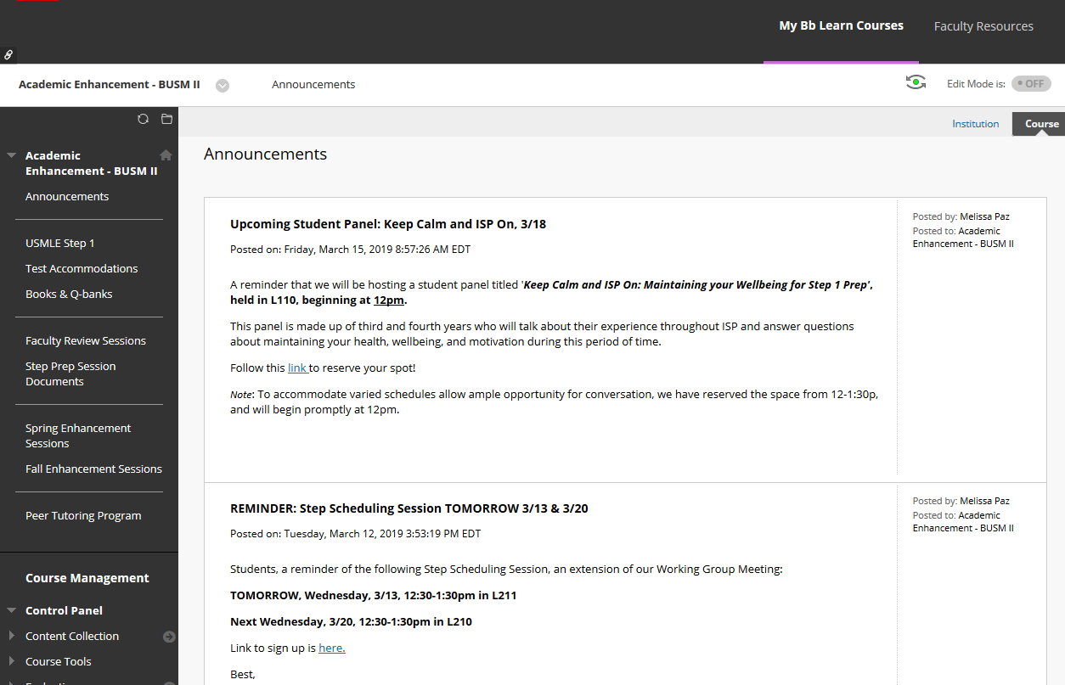

Slide 28
Upcoming Sessions

Slide 29
Fall 2020 Workshop Schedule
Panel for Success in DRx
TBD August
Integration Sessions
TBD August
Back to Basics: Embracing Errors for Active Learning
TBD September
The Long Haul: Attentional Endurance
TBD October
3rd Year Panel
TBD November
Lifting the Load: Stress Management Strategies
TBD December

Slide 30
Experiencing Difficulties?
Go to CLASS- Shorten the feedback loop
Consult Someone
SAO or MEO
Academic Enhancement
Peer Support
Peer Tutoring
Group Study
Advisors/Mentors
Course Director(s)
Skill Acquisition
Step 1 Prep Program
Enhancement Workshops

Slide 31
Meeting with AEO
Email Dean Curran directly
For appointment with Melissa, access this link
http://Calendly.com/melissapaz

Slide 32
Do not do this alone

Slide 33
Takeaways
Go to CLASS- the majority of people who struggle in DRx are not going to class. Get there.
Meet with faculty before/after class, email and utilize office hours, if available.
Request a tutor – must be attending class.
Use each other to discuss concepts and areas of concern.
Contact faculty again
Watch this video for a reminder of ways to approach material.
Reach out to the SAO or MEO to discuss obstacles in your learning.
Attend the Step 1 Prep Program and other related sessions

Slide 34
Milestones
July – September | Focus on mastering DRx course material Purchase and become familiar with First Aid (optional) Purchase and become familiar with QBANK Attend Integration Session to learn how to balance Step 1 Prep and DRx Attend Enhancement Sessions Attend Panel for Enhancing DRx Experience to learn from upperclassmen Class Meeting: What’s Next?
October – November | Focus on mastering DRx course material Integrate QBANK questions Annotate sections of First Aid that correlate with DRx modules Attend Enhancement Sessions Class Meeting: Professionalism
November – December | Attend Step 1 Panel to learn from upperclassmen Register for the exam via www.nbme.org Apply for exam accommodations if necessary

