Slide 1


Become an outcomes researcher
(or at least speak like one)
Allan Walkey, MD, MSc
Assistant professor of Medicine
Director, Center for Implementation and Improvement Sciences
Pulmonary, Critical Care

Slide 2
Overview
What is outcomes research, why is it important?
How do you evaluate a quality outcomes study?
What are resources here to embark on your own outcomes research?

Slide 3
Outcomes research: Definitions
Studies the end results of the “structure and processes” of the health care system on the health and well-being of patients and populations.
  Structure and processes can be technology, medications, health care system designs, etc
Identifying and maximizing ‘effectiveness’ of the health care system
REAL WORLD RESEARCH

Slide 4
Other names
Health services research
Comparative effectiveness research (CER)
‘Patient centered outcomes research’
“Efficacy” works in an experimental trial
“Effectiveness” works in the real world

Slide 5
Why Switch over to Outcomes?
Findings are directly and immediately relevant to clinical care (from real world to real world)
Data usually already collected for you (we’ll be talking about observational studies today)
Often is considered ‘not human subjects research’ by IRB even though you are studying human data (low risk)

Slide 6
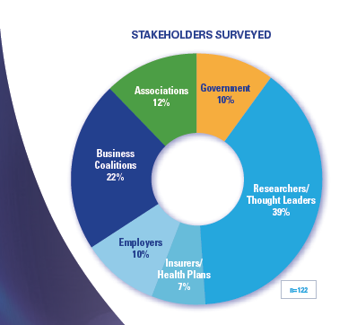

Why YOU?
Clinicians, the forgotten stakeholders
2015 CER Stakeholder Survey
Notes:
Well, it seems that clinicians are not being considered very much in the planning of future CER studies. Here the national Pharmaceutical Council surveyed key ‘stakeholders’ in CER but did not include clinicians.

Slide 7
Why isn’t everyone doing it?
Biases in observational research make it difficult to obtain valid results
  Misclassification
  Confounding
  Immortal person time
It’s not easy to design an observational study that minimizes bias and yields useful results

Slide 8


Hey, that outcomes research isn’t half bad!
Yeah, It’s all bad!
Notes:
Some will discount all obsrevational data awaiting RCTs

Slide 9
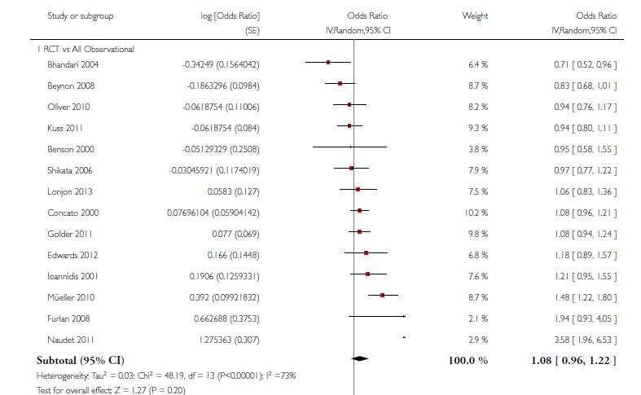

Observational CER is not all bad
Anglemeyer A et al. Outcomes in RCTs vs. Observational designs. Cochrane 2014
A meta-analysis of meta-analyses:
1583 studies, 283 conditions
Notes:
Anglemeyer looked at prior meta-analyses of RCT vs Observational studies looking at same question. Included 1500 studies and found no difference in treatment effects estimated from RCTs as compared to observational studies on the same topic. One prior Meta-analysis, Ioanidis et al, concluded that RCTs disagree with each other as much as observational studies disagree with RCTs. Thus, using traditional hierarchy of evidence, observational CER generally has comparable results to RCTs. This is reassuring.

Slide 10
Outcomes research 101
Even if you don’t do it, you need to understand it to read the literature
Growing exponentially

Slide 11
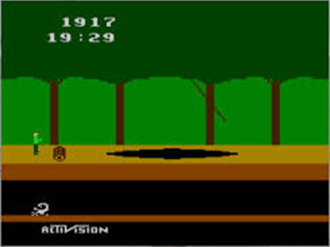
How do we recognize studies that do not avoid common Pitfalls of outcomes research?

Slide 12
Case study: Approach to Outcomes
“The most important people you will meet are those that show you what NOT to do”
  My Dad, to me, when I was 7…
One published study contained most pitfalls
  Causal language
  Misclassification bias
  Ignoring Confounding
  Immortal time bias
  No sensitivity analyses
Notes:
My father told me when I was 7 that the most important people I’d meet in life were the one’s who demonstrate how NOT to act. We will follow this Walkey family teaching tradition by systematically evaluating one particular study that contained many pitfalls…

Slide 13
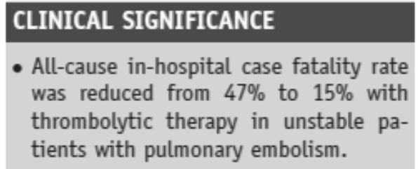
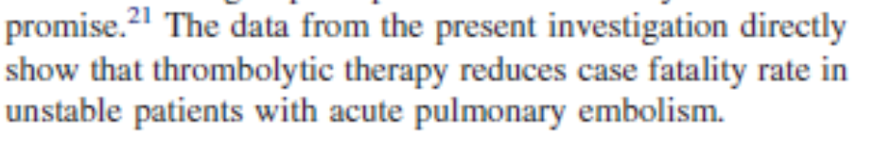
thrombolysis in unstable patients with pulmonary embolism
(names and titles have been changed)
Very little RCT data for lytics during massive PE
  8 patients: 4 lysed: lived, 4 not lysed: died¹
Nationwide Inpatient Sample
  Claims data
  ICD-9 codes
Unstable=shock or mechanical ventilation
1. Jerjes-Sanchez C. J Thromb Thrombolysis. 1995
Notes:
Names and titles have been changed so that I’m not a total jerk. Briefly orient to study: there is very little evidence for lytics among unstable patients with PE. In fact one trial, of 8 patients. The authors used used adminsitrative claims data to (ICD-9 codes) to compare outcomes between unstable patients with PE who did and did not receive thrombolytics. They conclude…

Slide 14
Watch your language!
Notes:
We should be cognizant of how language affects our interpretation of a study. Kohli and Cannon here make a nice chart about how observational studies should describe their results.

Slide 15
Language should match level of evidence/causal inference
Notes:
One first clue to a quality CER study is that the authors understand the strengths and limitation of the data and analyses. Using language appropriate to level of causal inference shows that the authors understand their methods.

Slide 16
Misclassification bias
Unstable PE?
Shock:
  “shock unspecified, cardiogenic, septic, hypovolemic”
  These are not all appropriate to PE
Mechanical Vent: ICD-9 “…Encounter for Respirator dependence during power failure, encounter for vent weaning,…”
  Not what we use to ID mechanical ventilation…
Thrombolytics: 1/3 used in line clearance dose
  Line-clearance patients are not as sick as massive PE
Notes:
In retrospective studies, this may not have been what they currently seem. Look for how authors defined their measures and outcomes. Look for some validation that what they measured is what they though it was.

Slide 17
Look for validation of important measurements

Slide 18

Immortal Person-Time Bias
In observational studies:
  You were ‘immortal’ until the Treatment was given
  If you did not get treated, you COULD HAVE DIED BEFORE TREATMENT could be given
Immortal person-time
Lytics given, Day 3
Lytic group
Died
No Lytics group
Always strong bias against NO TREATMENT GROUP having a good outcome
Notes:
My favorite bias
Always biases against control group.

Slide 19
There should be methods specified to deal with immortal person-time biases.
Corollary:
Treatment vs. No treatment studies are more likely to have biases than
treatment A vs. treatment B
Notes:
The methods should generally describe a way they dealt with immortal person-time or differences in time until a treatment was given between groups.
Also have a higher index of suspicion for observational studies of a treatment vs. nothing, as these types of studies are more likely to produce spurious results.

Slide 20
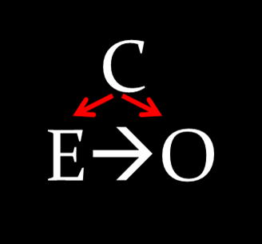
Watch for Confounding
DNR¹ status
lytic
death
lytic
death
Mixing of effects from extraneous factors with the effect of the exposure of interest
Produces a biased effect estimate
¹ Bradford…Walkey. DNR status and observational CER. Crit Care Med. 2014
Notes:
Confounding is the classic bias in observational studies. It occurs when an external factor associated with the outcome and exposure of interest causes a biased result.
For example, patients who are DNR are liekly less likely to be treated aggressively with lytics (or any other intervention) and more likely to die.

Slide 21
Confounding by Disease Severity
Notes:
Multiple types of confounding to look out for: Counfounding by disease severity is especially potent: if risk of death is correlated with risk of getting treatment, there is strong confounding. Here all comorbidities are higher in the no lytics group, signalling confounding by disease severity.

Slide 22
Address Measured Confounders
Restrict sample to similar patients
Match based on strong confounder
Multivariable adjusted regression
Propensity Scores
Quality studies will try to do most/all of these
Analyze data in multiple different ways = Sensitivity Analyses
Notes:
Multiple methods exist to attempt to address measured confounders. Athough multiple methods are available, our example performed no adjustment for confounding: measured or unmeasured. Generally you want to see >1 methods used yield same result = sensitivity analysis.

Slide 23

Address Unmeasured Confounders
Unmeasured Confounders
Randomization!
Observational research
Instrumental variables
  Create natural experiments based on factor associated with outcome only through exposure of interest
  Eg., distance from hospital
  Regression discontinuity, difference-in-difference
Estimate how strong a theoretical confounder would have to be to change your results
Notes:
Perhaps even more important than measured confounding is unmeasured confounding. The devil you know is less scary than the devil you don’t. Multiple methods also exist to attenuate unmeasured confounding. The promise of so called BIG DATA is the ability to measure lots of things and hopefully decrease the number of unmeasured confounders.

Slide 24
Look for methods to address both measured and unmeasured confounding

Slide 25
Why it matters: Re-analysis
Study X result, large mortality reduction with thrombolytic: RR 0.31 (95% CI 0.30-0.32)
  Reduce misclassification and Use Validated Measures: shock, MV, thrombolytics
  Account for Measured confounding: propensity match
  Account for immortal time and stratify by clinically different groups:
Re-analysis: shock 0.75 (0.39-1.30)
Mechanical vent: OR 1.16 (1.11-1.21)
  Change Language: We did not identify a significant association between thrombolysis and mortality for patients with ‘unstable PE’. Limitations include…
Bradford M & Walkey AJ.

Slide 26
Checklist: 5 Markers of Quality Observational CER/Outcomes
Representative patient samples
  But quantity ≠ quality
  Large, bad studies yield precise, spurious estimates
Use validated measures
Address confounding
  Deal with Measured + Unmeasured
  Sensitivity analyses
Account for immortal time
Match language to study design
Notes:
So, after going through this study demonstrating many pitfalls of observational CER, we can identify a checklist of 5 things to look out for to help assess the quality of an observational CER study. Large, poor quality studies only estimate spurious effects more precicely

Slide 27
Quality outcomes research exists… and can change practice

Slide 28
Right Heart Catheter for Critical illness
RHC: Standard of Care in ICUs prior to 1996
Was felt unethical to withhold RHC
Only observational research could be done

Slide 29
JAMA 1996
Patients: Critically ill patients enrolled in SUPPORT trial (end-of-life care in ICU)
  Functional status, labs, APACHE scores, DNR status!
Confounding:
  Measured: Multiple Propensity score-based analyses
  Unmeasured: effect of hypothetical confounder
Exposure: RHC use within 24hours
  Little immortal time bias
Outcome: 30day mortality
RHC: 67% vs No RHC 62.5% mortality RR 1.08
“RHC was associated with increased mortality and increased utilization of resources.”

Slide 30
Connors met Markers of Quality Observational CER
Representative patient samples
Used validated measures
Addressed confounding
  Deal with Measured + Unmeasured
  Sensitivity analyses
Accounted for immortal time
Matched language to study design
Notes:
Large, poor quality studies only estimate spurious effects more precicely

Slide 31
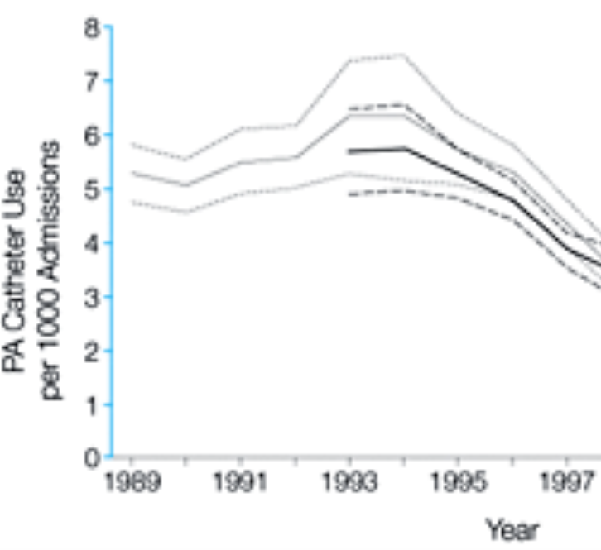
Fallout
Wiener RS et al. JAMA. 2007
Walkey et al. Crit Care Med. 2013

Slide 32
Randomized Trials Emerge
2005, Effectiveness RCT:
  Enrolled 1000 ICU patients who were about to get RHC, either to get it or not to get it.
RR 1.07 (0.92-1.24) w/ RHC
  Wow same as Connors!!!

Slide 33

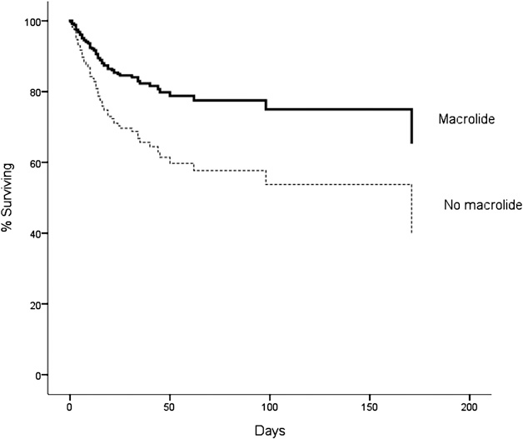
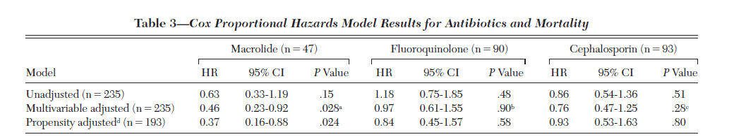
Outcomes research can also generate Novel Hypotheses
“Investigators at the University of Michigan have proposed two clinical trials…the second trial assessing the impact of macrolide administration (azithromycin) on outcome in patients with early onset ARDS.”

Slide 34
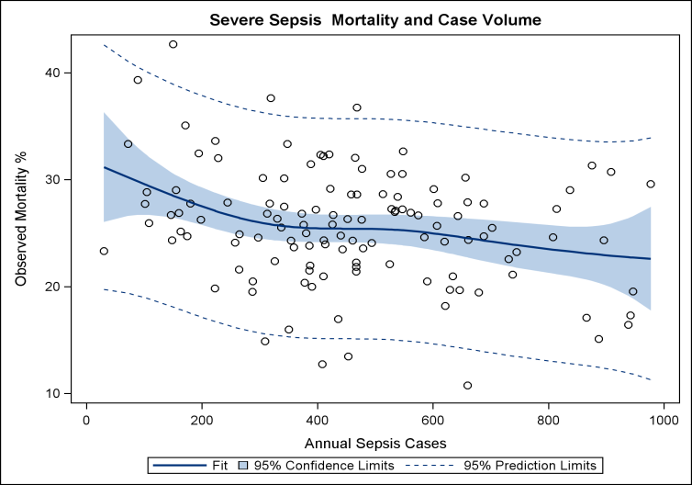
Can methods Compare Hospitals
R² =0.10, p=0.01
Walkey AJ and Wiener RS. Hospital Case Volume and Outcomes among Patients Hospitalized with Severe Sepsis. Am J Respir Crit Care Med 2014.
Notes:
CMS

Slide 35
Checklist: 5 Markers of Quality Observational CER/Outcomes
Representative patient samples
  But quantity ≠ quality
  Large, bad studies yield precise, spurious estimates
Use validated measures
Address confounding
  Deal with Measured + Unmeasured
  Sensitivity analyses
Account for immortal time
Match language to study design
Notes:
So, after going through this study demonstrating many pitfalls of observational CER, we can identify a checklist of 5 things to look out for to help assess the quality of an observational CER study. Large, poor quality studies only estimate spurious effects more precicely

Slide 36
How do I begin?
7 Steps to Outcomes Heaven
What is your clinical or policy question?
  Convert to research question
What data source can best address your question?
What are current practices?
  Is there real world variation?
Exploit variation
  natural experiments
  identify areas for improvement
What methods best address biases in observational research
Who can help with planning and executing analyses?
Publish findings!

Slide 37
“Sign me up” you say?
BUMC has a number of resources to take you through the 7 steps to Outcomes heaven
Center Translational Epidemiology/CER (TEC)
  Design, evaluate, report Big Data-based outcomes research
Center of Implementation and Improvement Sciences (CIIS)
  Design, evaluate, report QI projects

Slide 38
TEC
Bindu Kalesan
“To provide data infrastructure and methodological expertise and statistical support to clinicians and researchers committed to translational epidemiology and comparative effectiveness research.”

Slide 39
TEC
How to find the right data for their question?
How to access the correct variables?
How use the data available?

Slide 40

TEC: Infrastructure and Foundation
Secondary data sources
Downloadable and Requested
-NHANES
-AHRQ- NIS, SID, NEDS
-NLMS
-New Immigrant Survey
Based on hospital claims, cross-sectional, longitudinal data
Primary data sources
Framingham, OPTUM cohorts, i2b2 cohorts, trial and cohort data from internal and external collaborators
Based on longitudinal data: clinical and population-based.
Methodology
expertise
Study design,
content of datasets,
statistical analysis
Epidemiology and Biostatistical expertise
Center for Translational Epidemiology and Comparative Effectiveness Research

Slide 41
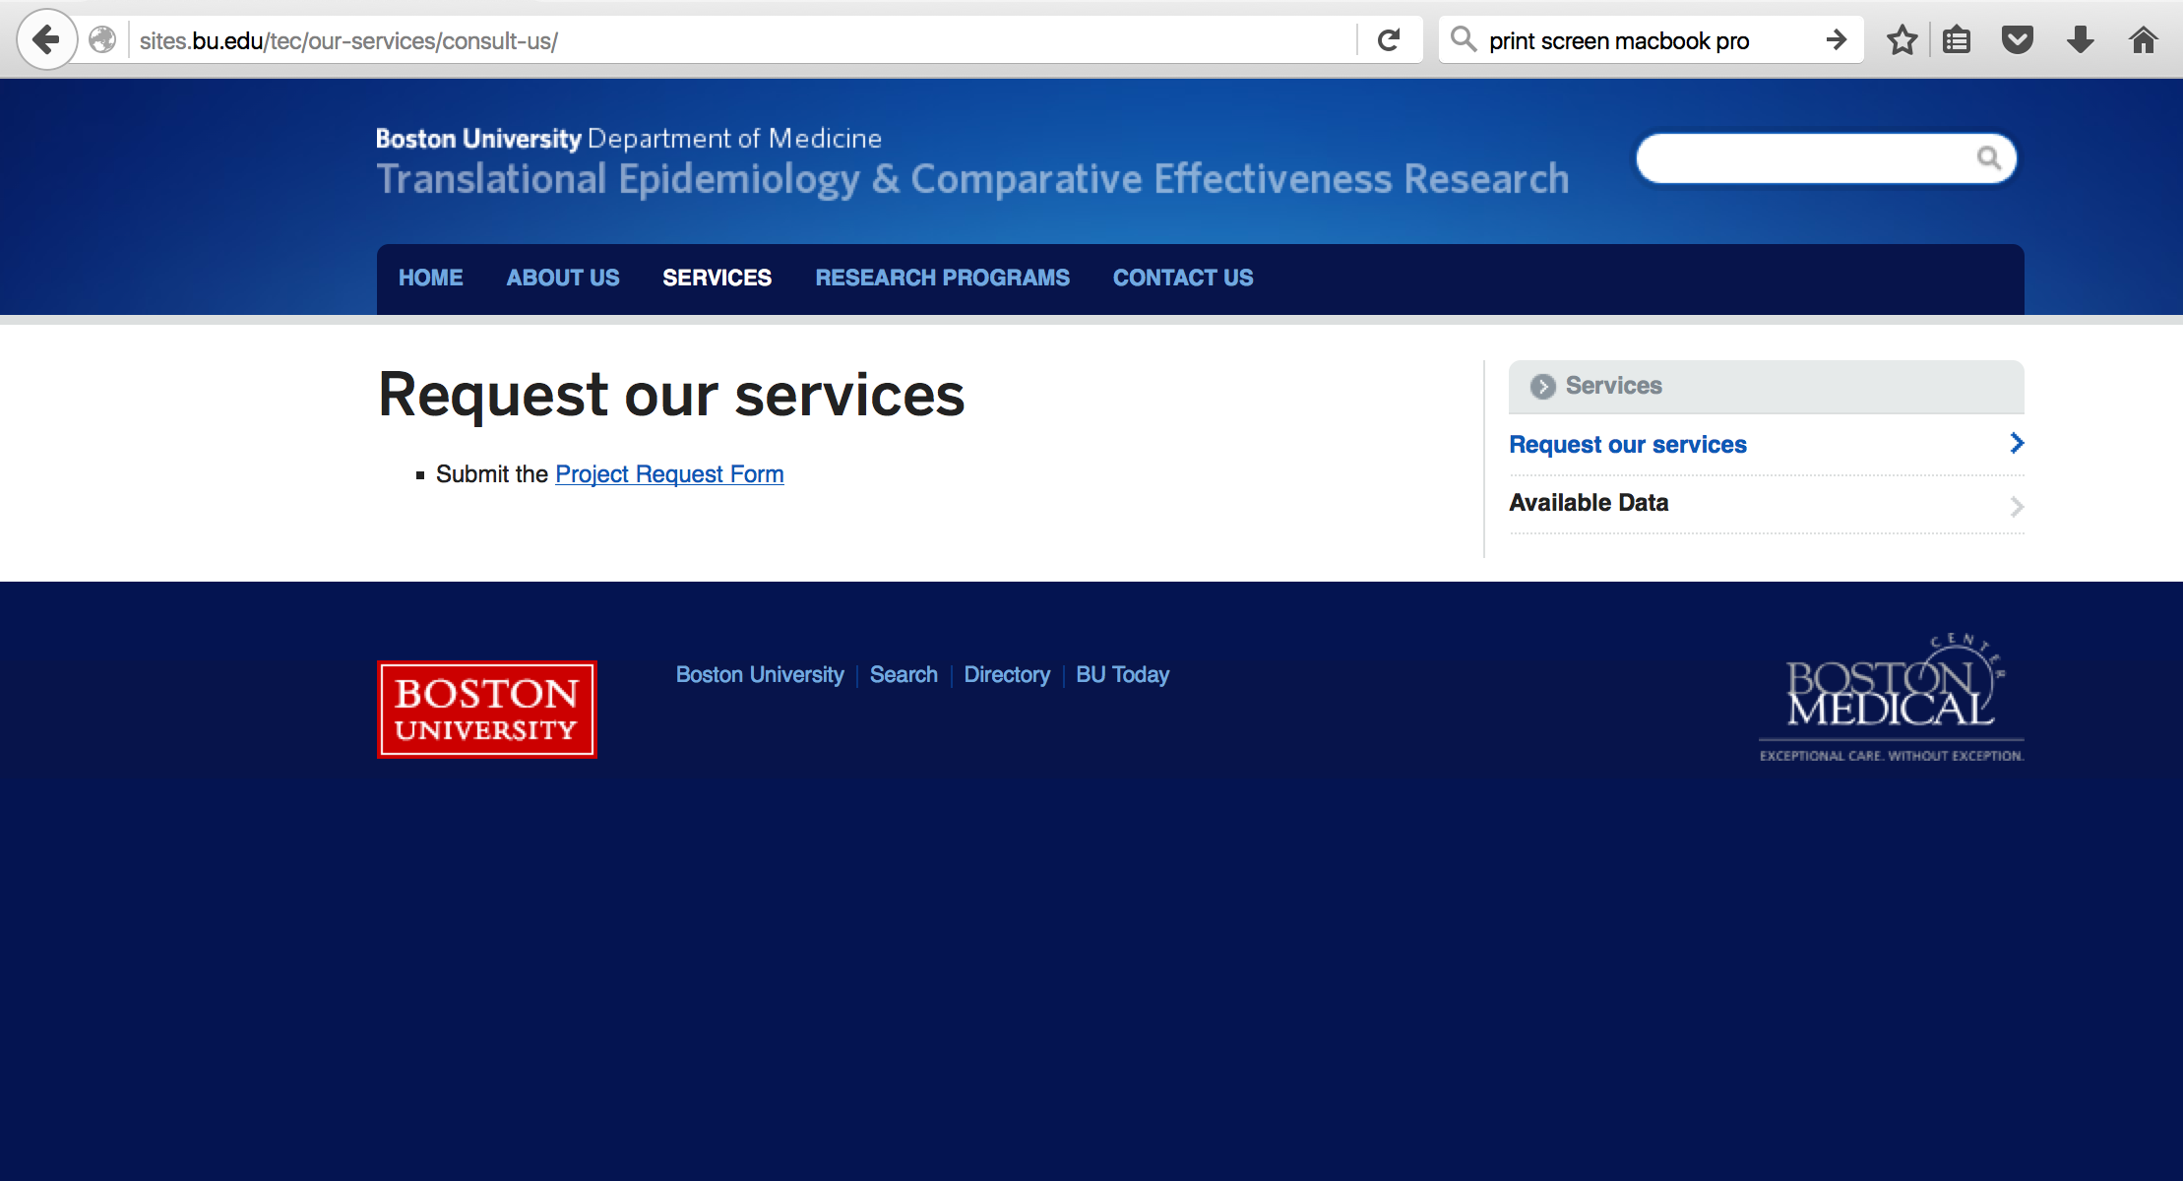
Find us @: http://sites.bu.edu/tec/

Slide 43
We often want to improve Quality
Effective
Patient-centered
Efficient
Equitable
Timely
Safe
Notes:
Tenuous balance

Slide 44

“Not every change is an improvement”
-Elliot Fisher
Patient-centered
QUALITY
Effective
Timely
Safe
Efficient
Equitable
Notes:
Trying to improve quality without framework to evaluate implementation and improvement may result in unintended consequences and paradoxically reduce quality

Slide 45
Implementation Science
What makes clinicians do or not do?
Field of HSR focused on moving from research to practice
“the investigation of methods, interventions (strategies) & variables to influence adoption of evidence-based healthcare practices…to improve clinical & operational decision making…”¹
Robust methods, quality data, publishable results, sustainability
¹Titler MG, Everett LQ, Adams S. Implications for implementation science. Nursing Research; 2007, 56(4s): S53-S59.

Slide 46
“Evidence-based medicine should be complemented by evidence-based implementation.”
- Richard Grohl
Grimshaw et al. Implementation Science 2012 7:50
Notes:
Implementation science studies the best strategies to get clinicians to do or not do something. Here is some data from a systematic review of Implementation strategies showing that, in general, educational meetings and enlisting local leaders are most successful strategies. But what about here?

Slide 47
Improvement Science
Rigorously measure outcomes of efforts to improve healthcare delivery
Questions of translation: does it work in the real world?
Robust methods, quality data, publishable results, sustainability

Slide 48
Improvement Science
confounding
Intervention
Outcome

Slide 49
Implementation & Improvement
Ideal World Lab
Efficacy

Slide 50
Implementation & Improvement
Ideal World Lab
Real World Lab
Efficacy
Improvement?
Implementation?

Slide 51
Implementation & Improvement
Ideal World Lab
Real World Lab
Better World
Efficacy
Improvement?
Implementation?
Quality

Slide 52
CIIS Objectives
Guide, support, and innovate design of projects that rigorously evaluate the effectiveness of efforts to implement healthcare system change.
Identify factors and strategies that accelerate the adoption and promote sustainability of effective healthcare interventions, especially in safety net systems.
Educate faculty and trainees in Implementation and Improvement Sciences.

Slide 53
What can CIIS do?
Offer input on evidence-based interventions & implementation strategies to test/use
Assist with theoretical framing, design, analysis, writing up QI studies
Convene: Provide linkage to additional expertise; promote collaborations
Provide seed grants, pilot data, writing assistance
Help us and others learn from our experience

Slide 54

Mixed Methods
Qualitative analytics (Dr. Drainoni)
  Conceptual frameworks for implementation
  Formative evaluations
Quantitative analytics (me)
  Observational
    Interrupted Time-series, Regression discontinuity, Propensity scores, Instrumental variables
  Interventional: Point of Care Platform-adaptive Trials

Slide 55

Center of Implementation and Improvement Sciences
Bringing Science to Quality
Discovery, Idea
Implement
Re-Evaluate processes and outcomes
Disseminate findings
Innovate methods
Evaluate processes and outcomes
BMC, BUMC, SPH, CRC

Slide 56
Checklist: 5 Markers of Quality Observational CER/Outcomes
Representative patient samples
  But quantity ≠ quality
  Large, bad studies yield precise, spurious estimates
Use validated measures
Address confounding
  Deal with Measured + Unmeasured
  Sensitivity analyses
Account for immortal time
Match language to study design
Notes:
So, after going through this study demonstrating many pitfalls of observational CER, we can identify a checklist of 5 things to look out for to help assess the quality of an observational CER study. Large, poor quality studies only estimate spurious effects more precicely

Slide 57
Summary
Assessing real world healthcare practice is important
Now you know how
With Help You can do it
TEC
CIIS
Other resources: VA MAVRIC, CHOIR

Slide 58
NHS was not wrong
WHI was not right
Things seem to be much more complicated….
CVD

